Slide 1






Title Page
UCS321 Introduction to AI for Engineers
Predicting Server CPU Temperature using Machine Learning
Proactive Cooling Management and Failure Prevention

Slide 2


Title Page
Introduction
UCS321 Introduction to AI for Engineers
Problem Statement
  Servers generate high heat during heavy workloads, which can lead to hardware damage and reduced performance.
  Overheating increases energy consumption and operational costs in data centers.
  Traditional cooling systems work reactively instead of predicting temperature changes in advance.
So, there is a need for a Machine Learning model to accurately predict server temperature and enable proactive cooling management.

Slide 3



Title Page
Introduction
Problem Statement
Existing Solutions
UCS321 Introduction to AI for Engineers
Existing Solutions
Rule-Based Monitoring Systems
Manual Monitoring & Alerts
Statistical Methods
Traditional systems trigger cooling only after temperature crosses a fixed threshold.
Administrators monitor server temperatures and take action when overheating occurs.
Basic statistical models (like average load estimation) are used to estimate temperature trends.
Threshold systems react to overheating—ML predicts it before it happens

Slide 4

Title Page
Introduction
Objectives
UCS321 Introduction to AI for Engineers
Objectives
• Develop a regression-based Machine Learning model to accurately predict CPU temperature using system performance parameters.
• Compare multiple regression models (Linear Regression, Decision Tree, Random Forest) to identify the best-performing model.
• Analyze feature importance to understand which system parameters most influence CPU temperature.
• Evaluate model performance using R² score, MAPE, MSE and RMSE to ensure reliability.
• Design a cooling decision system based on predicted temperature levels to enable proactive server management.

Slide 5
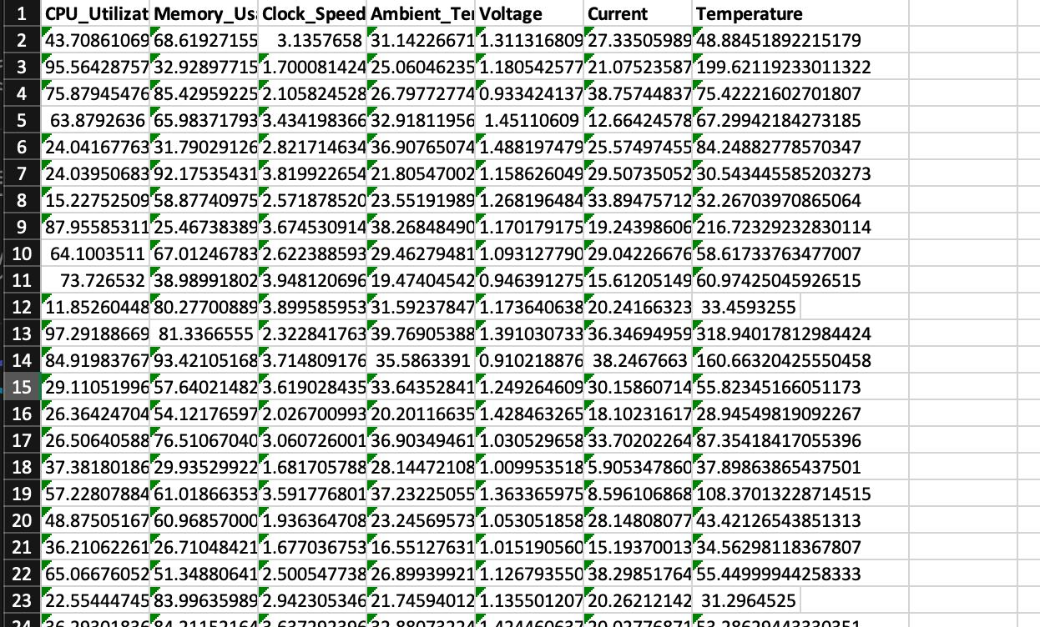
Title Page
Introduction
Dataset Info
UCS321 Introduction to AI for Engineers
Dataset Description
OUR DATASET WITH
14967 ROWS &
7 COLUMNS

Slide 6
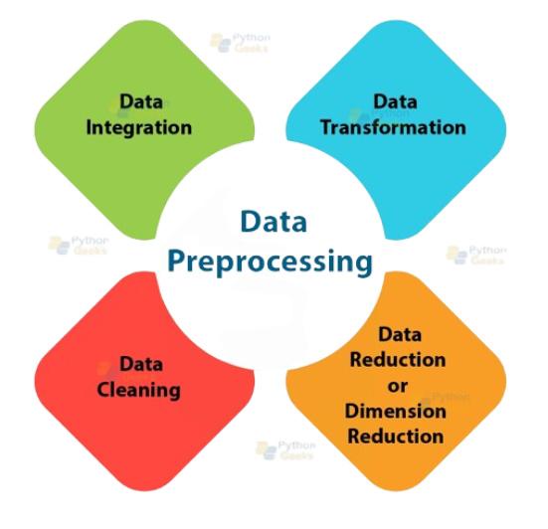
Title Page
Introduction
Problem Statement
Data Preprocessing
UCS321 Introduction to AI for Engineers
Data Preprocessing
  Loaded and inspected the dataset to understand its structure, features, and dimensions.
  Handled missing values by replacing them with the mean of numerical columns to maintain data consistency.
  Performed feature engineering by creating:
  Selected relevant input features and defined the target variable (Temperature).
  Removed outliers using the Interquartile Range (IQR) method to improve model robustness.
  Split the dataset into 70% training and 30% testing data for unbiased evaluation.
  Applied StandardScaler to normalize feature values and improve model performance, especially for Linear Regression.
Power_Load = Voltage × Current
Workload = CPU_Utilization × Memory_Usage

Slide 7
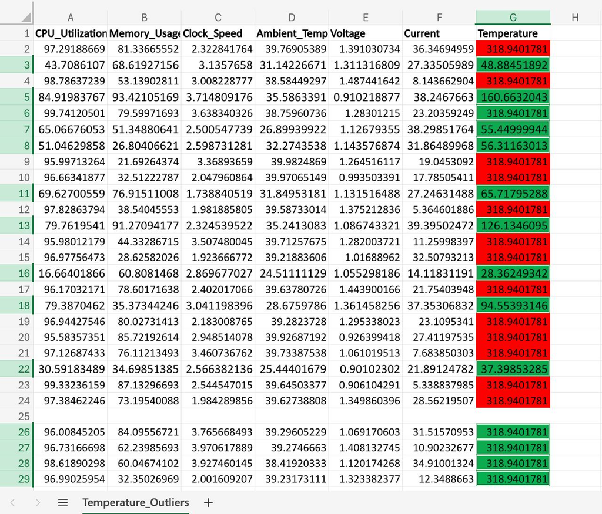
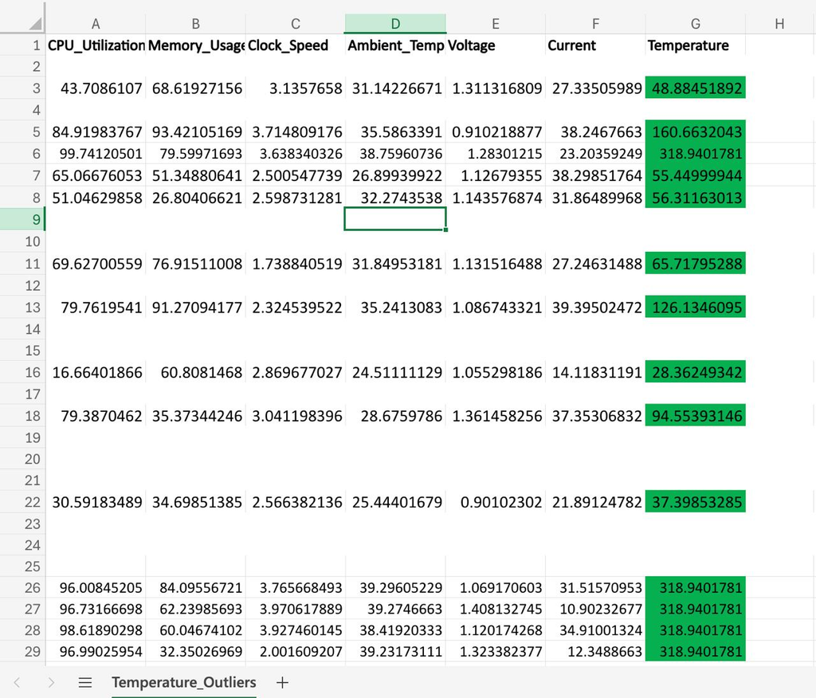
Title Page
Problem Statement
Data Cleaning
UCS321 Introduction to AI for Engineers
Data Cleaning
BEFORE
AFTER

Slide 8
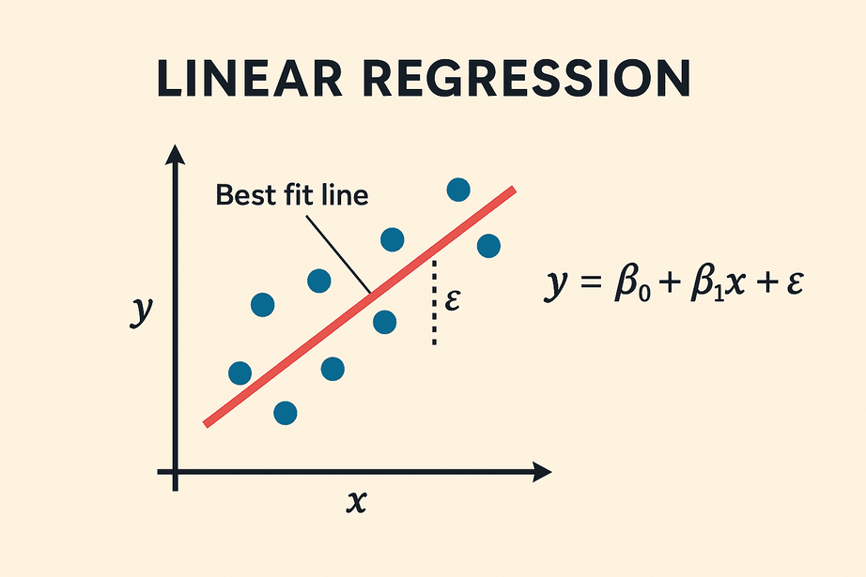
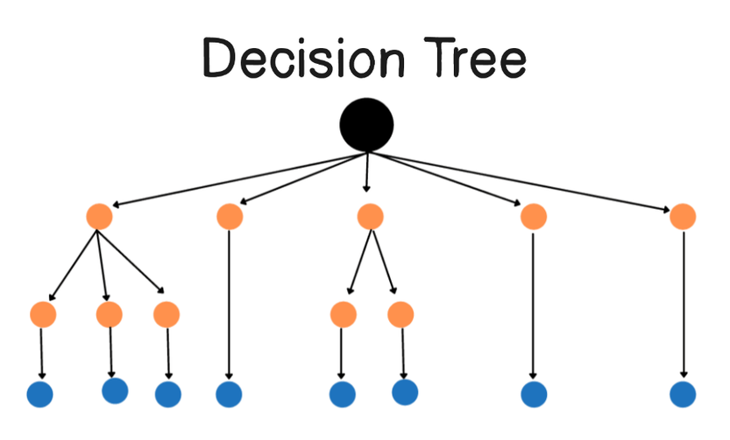
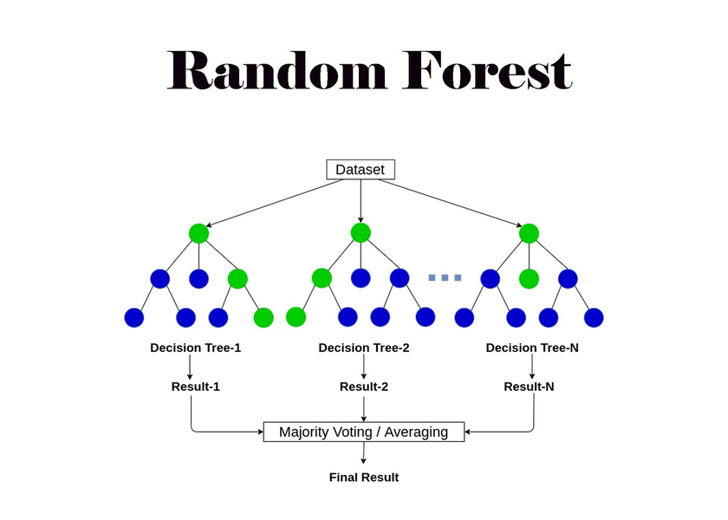
Title Page
Introduction
Problem Statement
ML Models
UCS321 Introduction to AI for Engineers
ML Models Used
LINEAR REGRESSION
DECISION TREE
RANDOM FOREST

Slide 9

Title Page
Introduction
Data Preprocessing
ML Models
Linear Regression
UCS321 Introduction to AI for Engineers
Linear Regression
• Baseline regression model.
• Assumes linear relationship between features and temperature.
• Applied feature scaling for better performance.
• Used for comparison with advanced models.

Slide 10
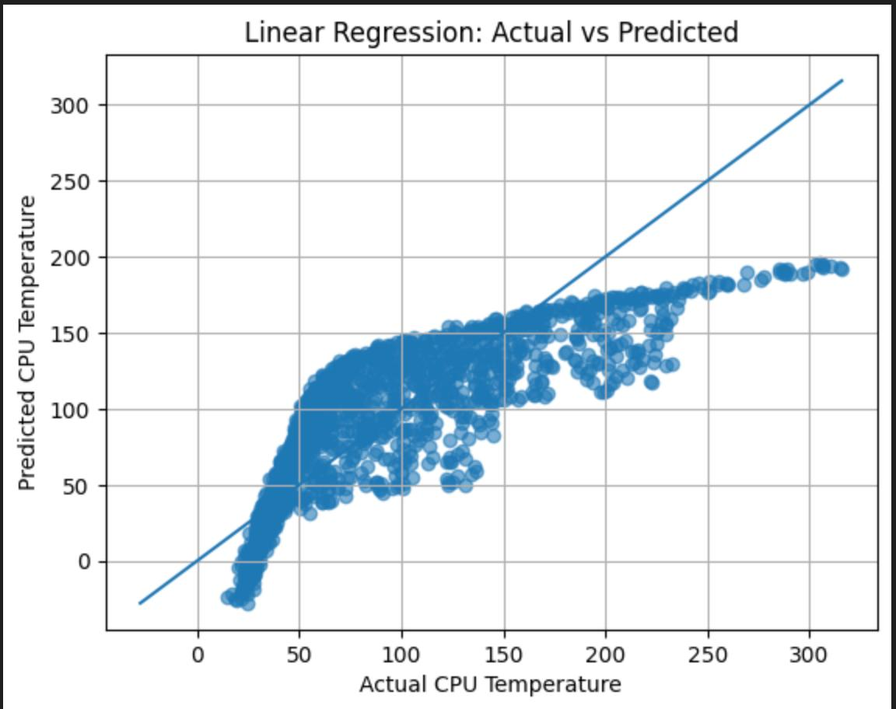
Title Page
Introduction
Data Preprocessing
ML Models
Linear Regression
UCS321 Introduction to AI for Engineers
R2 score: 0.6826136006692878
RMSE: 11.69814902583441

Slide 11
Title Page
Introduction
Data Preprocessing
ML Models
Decision Tree
UCS321 Introduction to AI for Engineers
Decision Tree
  Non-linear model that splits data into decision nodes.
  Captures complex patterns in server workload.
  Tuned using max_depth, min_samples_split, and min_samples_leaf.
  Moderate performance (~85% R²).

Slide 12
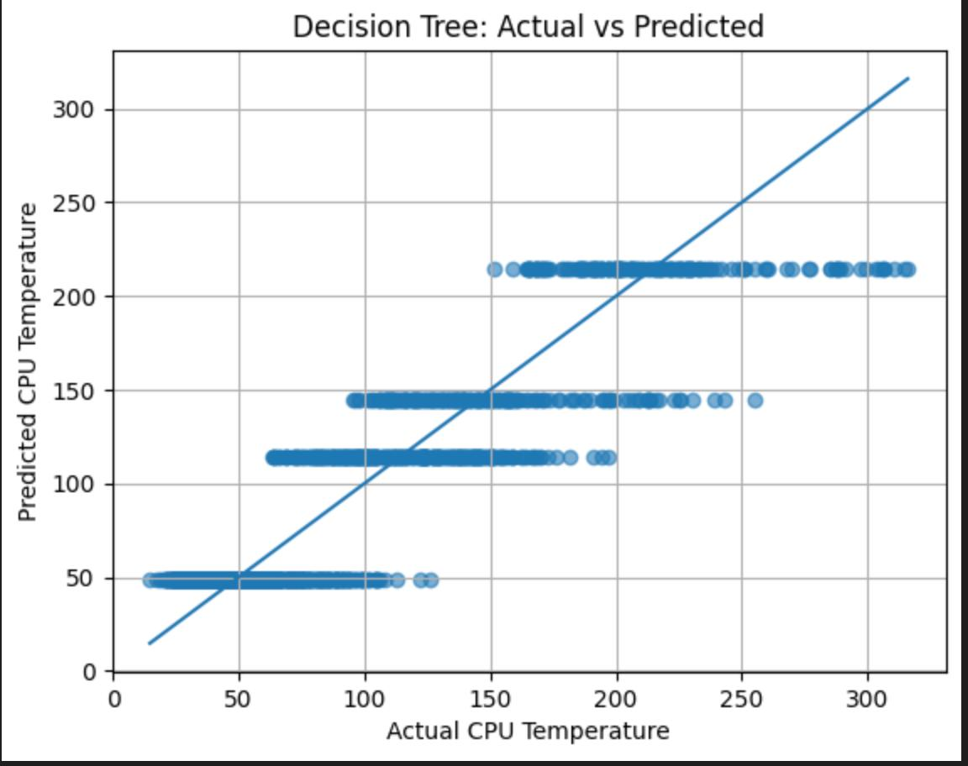
Title Page
Introduction
Data Preprocessing
ML Models
Decision Tree
UCS321 Introduction to AI for Engineers
R2: 0.8335370528110876
RMSE: 7.404543035873175

Slide 13
Title Page
Introduction
Data Preprocessing
ML Models
Random Forest
UCS321 Introduction to AI for Engineers
Random Forest
• Ensemble model combining multiple decision trees.
• Reduces overfitting and improves stability.
• Used 300 trees with optimized depth and splitting criteria.
• Achieved highest accuracy among all models.

Slide 14
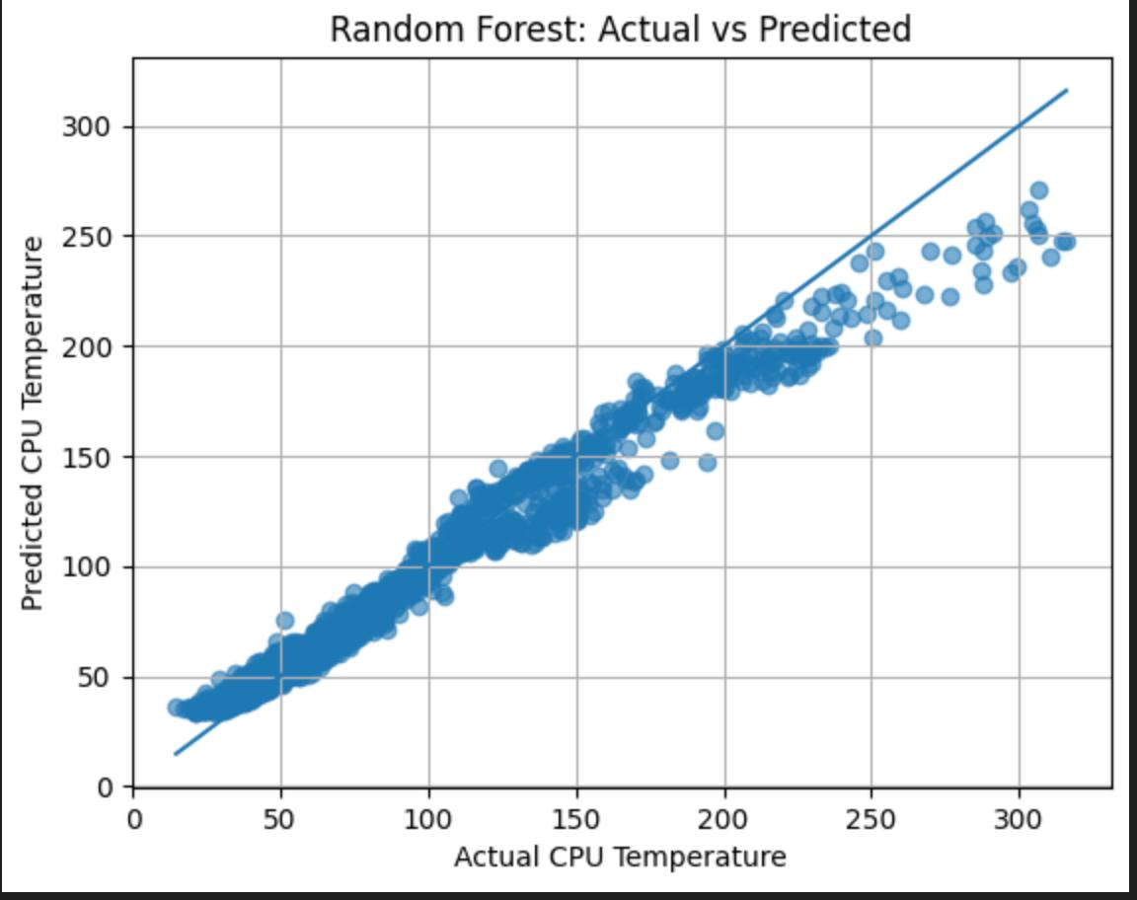
Title Page
Introduction
Data Preprocessing
ML Models
Random Forest
UCS321 Introduction to AI for Engineers
R2: 0.9633137016783759
RMSE: 3.456813329579411

Slide 15
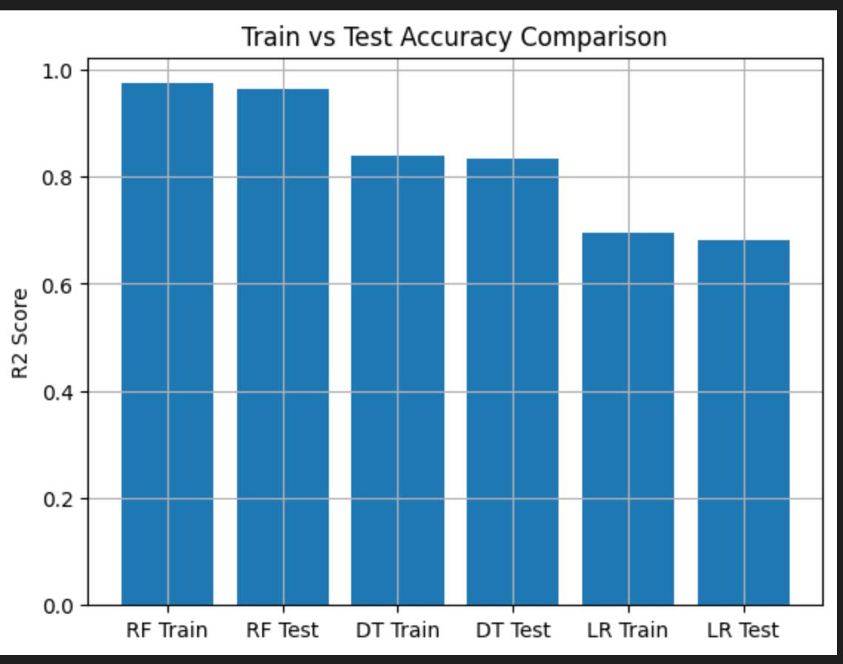
Title Page
Introduction
Data Preprocessing
ML Models
Comparison
UCS321 Introduction to AI for Engineers
Test vs Train Accuracy Comparison

Slide 16
Title Page
Introduction
Data Preprocessing
ML Models
Cross Validation
UCS321 Introduction to AI for Engineers
Cross Validation Results
• Applied 5-fold cross-validation to all three models.
• Used R² score as the evaluation metric.
• Ensured model stability across multiple data splits.
• Reduced dependency on a single train-test split.
Random Forest CV Score: 0.9608035716247445
Decision Tree CV Score: 0.8368193848632488
Linear Regression CV Score: 0.6918074878563079

Slide 17

Title Page
Introduction
Data Preprocessing
ML Models
Conclusion
UCS321 Introduction to AI for Engineers
Conclusion & Future Scope
Conclusion
• Successfully developed a Machine Learning model to predict server CPU temperature.
• Feature engineering (Power_Load, Workload) improved prediction capability.
• Random Forest achieved the highest R² score among all models.
• Cross-validation confirmed model stability and reliability.
• The model can support proactive cooling decisions and reduce overheating risks.
Future Scope
  Implement real-time temperature prediction using live server data.
  Integrate IoT sensors for automated cooling control.
  Apply advanced models like XGBoost or Deep Learning for further accuracy improvement.
  Deploy the model in cloud-based monitoring systems for scalable solution

Slide 18
Title Page
Introduction
Data Preprocessing
ML Models
Cross Validation
UCS321 Introduction to AI for Engineers
References
DATASET:
https://www.kaggle.com/datasets/mohammedarfathr/cpu-performance-metrics-system-monitoring-logs
CPU Performance Metrics (System Monitoring Logs)
ARTICLES:
https://dl.acm.org/doi/10.1145/2694344.2694378
CoolAir: Temperature- and Variation-Aware Management for Free-Cooled Datacenters
Moore, J., Chase, J., Ranganathan, P., & Sharma, R. (2005)
https://www.researchgate.net/publication/355483327_Study_on_the_Prediction_of_Indoor_Temperature_and_Thermal_Load_on_Different_Floors_in_a_Community
Study on the Prediction of Indoor Temperature and Thermal Load on Different Floors in a Community
Operating System Concepts By Galving 9th Edition

