Slide 1
RG
DEVSECOPS FINAL PROJECT
ReleaseGuard
Release decisions backed by visible evidence
From commit to tested image, GitOps deployment, and observable AWS EKS
React + TypeScript
FastAPI + PostgreSQL
Docker + Kubernetes
Terraform + AWS EKS
Nipun Patel
2026

Slide 2
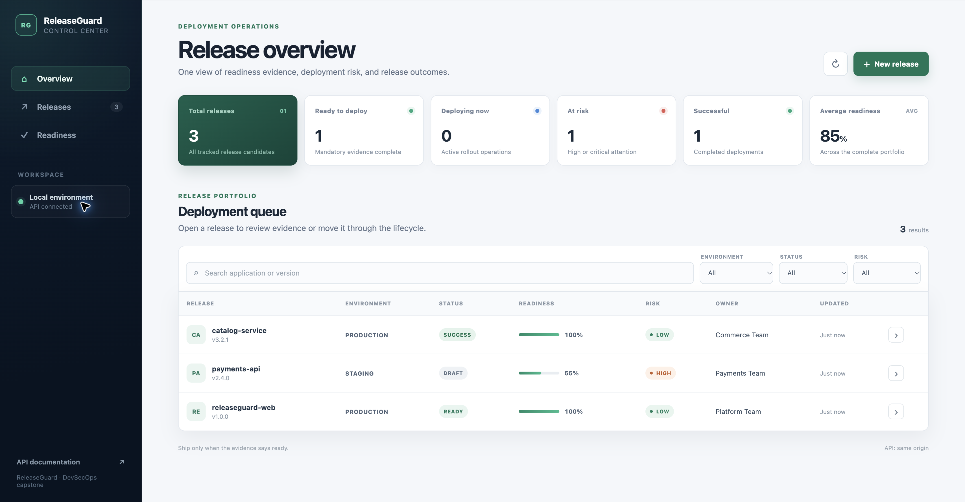
RELEASEGUARD
02
Release decisions with visible evidence
A single workspace replaces approval by chat, memory, and disconnected tools
The operational gap
Critical release evidence is easy to miss when teams approve deployments across separate tools
Tests and security results stay scattered
Production approvals lack a durable record
Risk decisions become difficult to explain
ReleaseGuard computes readiness, risk, blockers, and lifecycle status from the same evidence
100
5
4
maximum readiness score
required evidence checks
explicit lifecycle outcomes

Slide 3
RELEASEGUARD
03
Product workflow
Five explicit stages turn release evidence into a deployment decision
01
02
03
04
05
Register
Verify
Evaluate
Deploy
Record
Application, version, owner, and environment
Tests, security, approval, backup, and rollback
Readiness score, risk level, and blockers
Controlled status transitions
Success, failure, or rollback outcome
0–100
4
409
deterministic readiness score
environment-aware risk levels
invalid transition response

Slide 4
RELEASEGUARD
04
End-to-end DevSecOps architecture
Every layer is versioned, reproducible, and observable
SOURCE
VERIFY
PACKAGE
RECONCILE
GitHub
GitHub Actions
GHCR
Argo CD
Code and infrastructure
Tests, coverage, and Trivy
Immutable SHA-tagged images
Helm desired state
RUN
Terraform on AWS
Kubernetes + Helm
Prometheus + Grafana
VPC, IAM, EKS control plane, and managed worker
Frontend, backend, PostgreSQL, services, probes, and ingress
Application metrics and operational visibility
Developer commit
Observable deployment

Slide 5
RELEASEGUARD
05
Technology stack
A compact toolchain covers application delivery, infrastructure, GitOps, and observability
01
02
03
04
Application
Delivery
Platform
Operations
React + TypeScript
Git + GitHub
Terraform
Argo CD
FastAPI + Python
GitHub Actions
AWS VPC + EKS
Prometheus
PostgreSQL
Docker Compose
Kubernetes
Grafana
Alembic
Trivy + GHCR
Helm
Health probes
One Git history drives build, security scanning, deployment, reconciliation, and monitoring

Slide 6
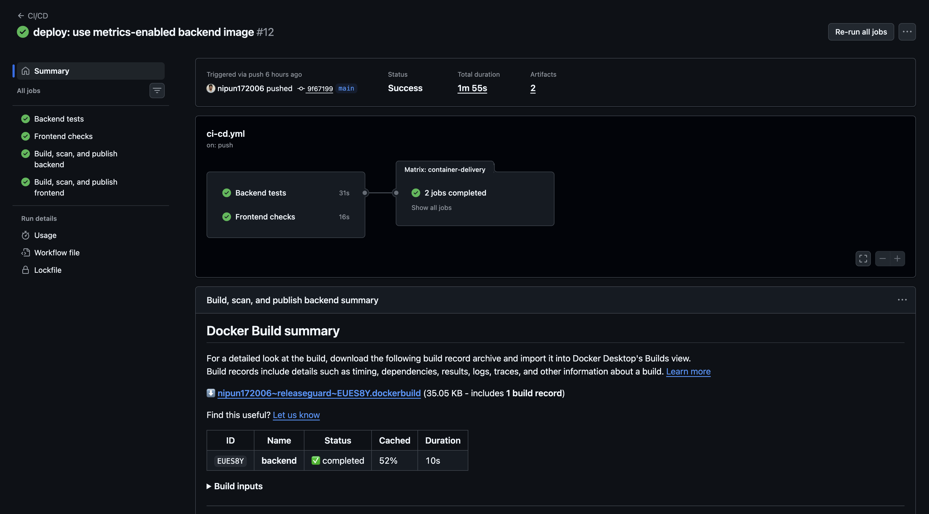
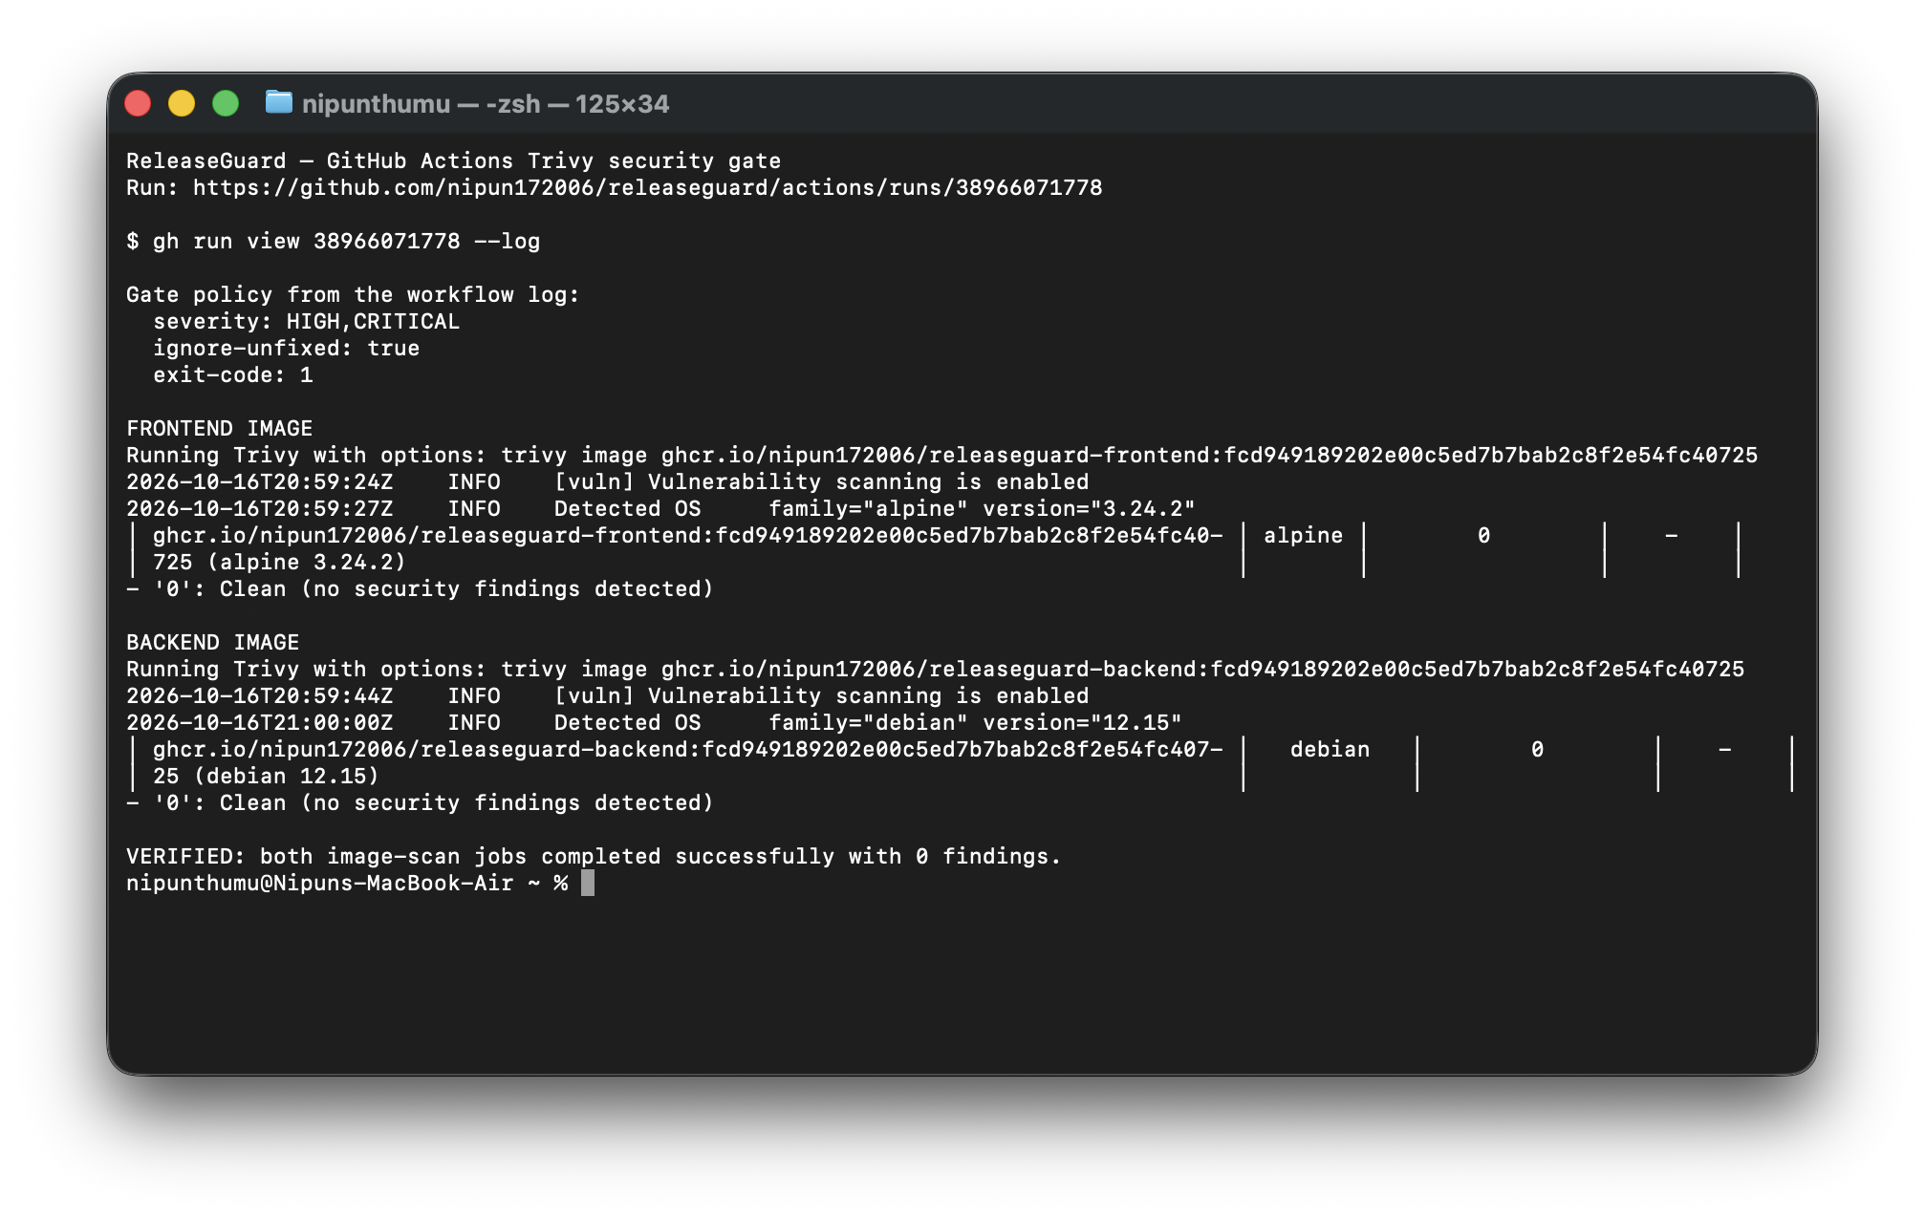
RELEASEGUARD
06
CI/CD and security gates
Only tested, scanned, immutable images reach the registry
VERIFIED PIPELINE
24
90%
backend tests
coverage gate
0 HIGH / CRITICAL FINDINGS

Slide 7
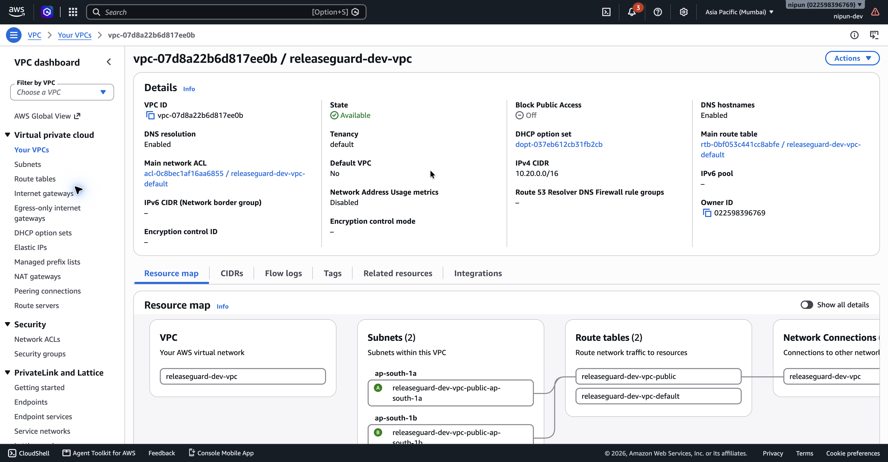
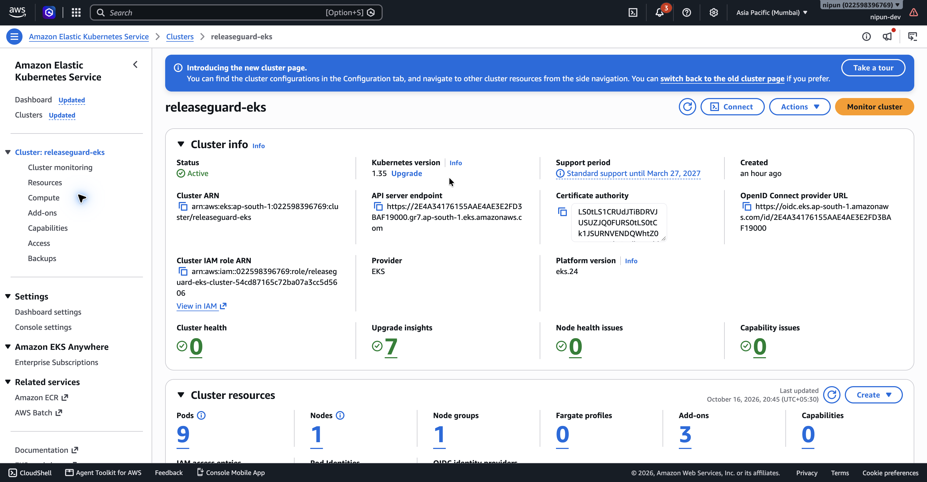
RELEASEGUARD
07
Infrastructure as code on AWS
Terraform created the environment, captured evidence, and removed every project resource
VPC foundation
EKS control plane
10.20.0.0/16
1.35
1
46
project VPC
Kubernetes version
managed worker
resources destroyed

Slide 8
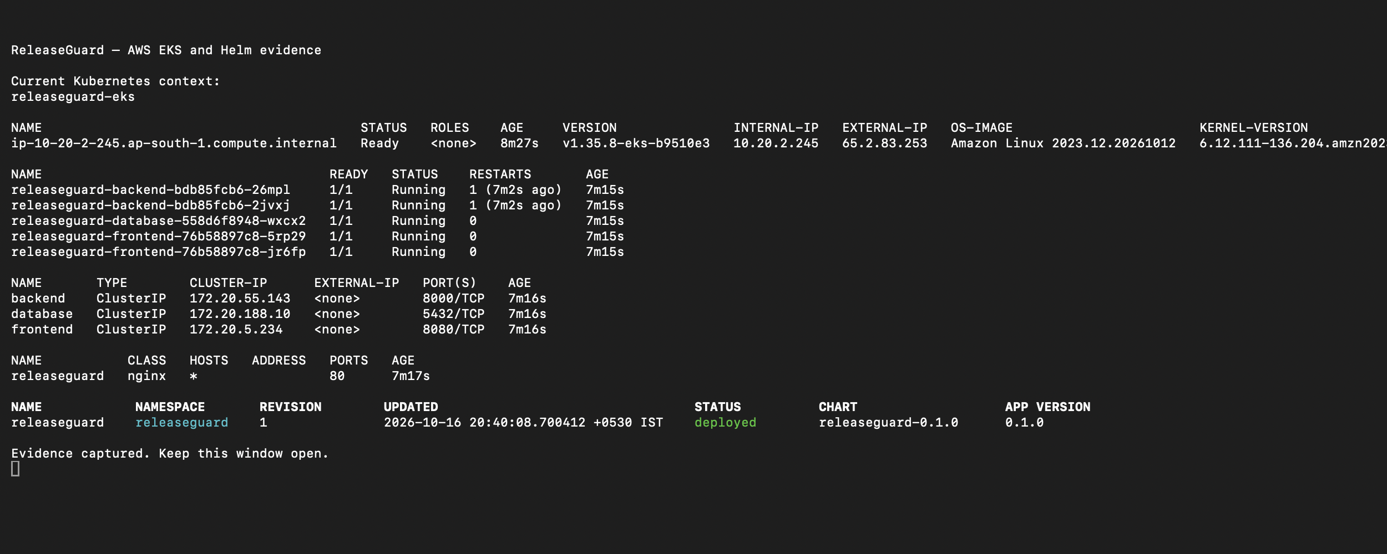
RELEASEGUARD
08
Kubernetes delivery with Helm and Argo CD
Desired state lives in Git, while Argo CD synchronizes and repairs the cluster
GITOPS CONTROL LOOP
01
Git
Helm chart and values
02
Argo CD
Sync, prune, and self-heal
03
EKS
Desired state reconciled
2 frontend 2 backend 1 database

Slide 9
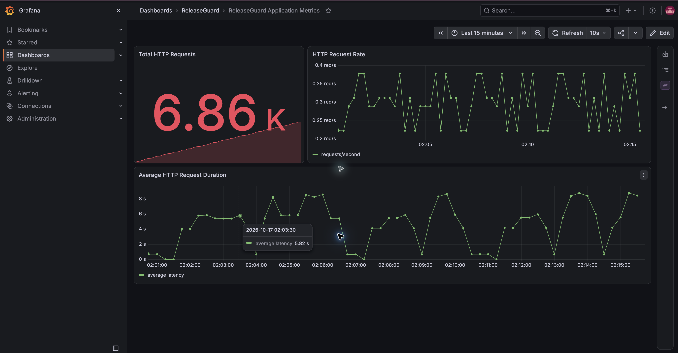
RELEASEGUARD
09
Observability closes the feedback loop
Prometheus scrapes application metrics and Grafana turns them into operational signals
LIVE APPLICATION METRICS
Every deployment remains measurable after release
1 / 1
3
Prometheus target UP
provisioned Grafana panels
/health /ready /metrics
Request count, throughput, and average latency

Slide 10
RELEASEGUARD
10
What I learned
The project connects application code to infrastructure, security, delivery, and operations
01
Delivery is a feedback system
02
Artifacts must be traceable
Tests, scans, reconciliation, and metrics continuously validate the release
Commit-SHA image tags connect source code to the deployed runtime
03
Operations start in the codebase
04
Cloud evidence needs teardown proof
Health endpoints and metrics belong beside application features
The final state matters as much as the successful deployment
DEMO ORDER
Architecture and codebase
GitHub Actions and images
AWS and GitOps evidence
Prometheus, Grafana, teardown

