Slide 1
DEVSECOPS CAPSTONE
ReleaseGuard
Deployment readiness and
release-risk control center
Ship only when the evidence says ready.
React • FastAPI • PostgreSQL • Docker • Kubernetes • AWS EKS
DevOps Final Project

Slide 2
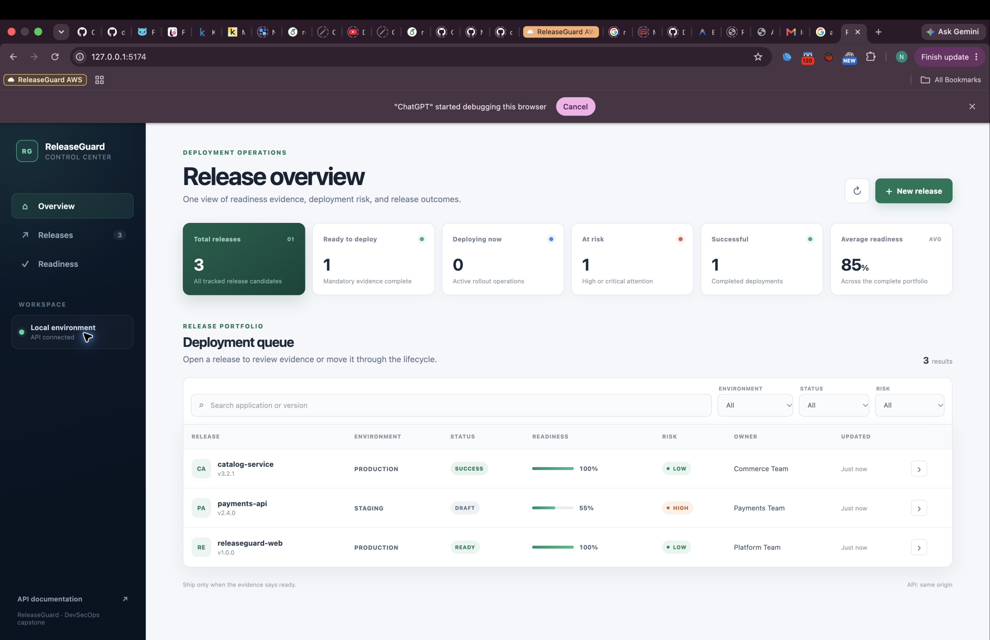
RELEASEGUARD / 02
From informal approval to explainable readiness
One shared view turns release evidence into a clear deployment decision.
THE PROBLEM
Teams approve releases through chat, memory, and disconnected tools.
Mandatory tests or security scans can be missed
Production approval and backup evidence stay invisible
Risk decisions are difficult to explain later
SOLUTION
A deterministic score, risk level, blockers, and lifecycle status for every release.
02

Slide 3
RELEASEGUARD / 03
Product workflow
ReleaseGuard is the decision layer around deployment, not the deployment engine itself.
1. Register
2. Verify
3. Evaluate
4. Deploy
5. Record
App, version, owner, environment
Tests, scan, approval, backup, rollback
Score, risk level, blockers
DRAFT → READY → DEPLOYING
SUCCESS, FAILED, or ROLLED_BACK
Readiness is transparent
100
Five weighted checks produce a score from 0 to 100
Environment-aware rules classify LOW, MEDIUM, HIGH, or CRITICAL risk
Invalid lifecycle transitions return a clear 409 response
maximum readiness score
5
explicit readiness checks
03

Slide 4
RELEASEGUARD / 04
End-to-end DevSecOps architecture
Every layer is versioned, reproducible, and observable.
✓
✓
✓
✓
Source
CI security gates
Artifact registry
GitOps source
GitHub repository + pull/push workflow
Tests → coverage → Docker → Trivy
Immutable Git-SHA images in GHCR
Helm values + Argo CD Application
↓
AWS CLOUD
Terraform
Kubernetes + Helm
Observe
VPC • subnets • IAM • EKS
2 frontend • 2 backend • PostgreSQL
Services • probes • Ingress
Prometheus scrapes /metrics
Grafana visualizes service health
Developer → GitHub Actions → GHCR → Argo CD → EKS → Prometheus / Grafana
04

Slide 5
RELEASEGUARD / 05
Technology stack
A compact stack selected to demonstrate the full delivery lifecycle.
APPLICATION
DELIVERY
PLATFORM
OPERATIONS
React + TypeScript
FastAPI + Python
PostgreSQL
Alembic migrations
Git + GitHub
GitHub Actions
Docker + Compose
Trivy + GHCR
Terraform
AWS VPC + EKS
Kubernetes
Helm
Argo CD
Prometheus
Grafana
Health + readiness probes
Design principle
Use the same Git history to build, scan, deploy, reconcile, and observe the application.
05

Slide 6
RELEASEGUARD / 06
CI/CD and security gates
Only verified, scanned, immutable images are published.
Commit
Test
Quality
Build
Scan
Publish
Push to main
23 tests + PostgreSQL
90% coverage gate
Backend + frontend
Trivy filesystem + images
Git-SHA tags to GHCR
Security is part of delivery
23
Pinned Python and JavaScript dependency trees improve repeatability
Non-root application containers reduce runtime privilege
High and critical vulnerabilities fail the pipeline before publishing
backend tests
90%
coverage gate
06

Slide 7
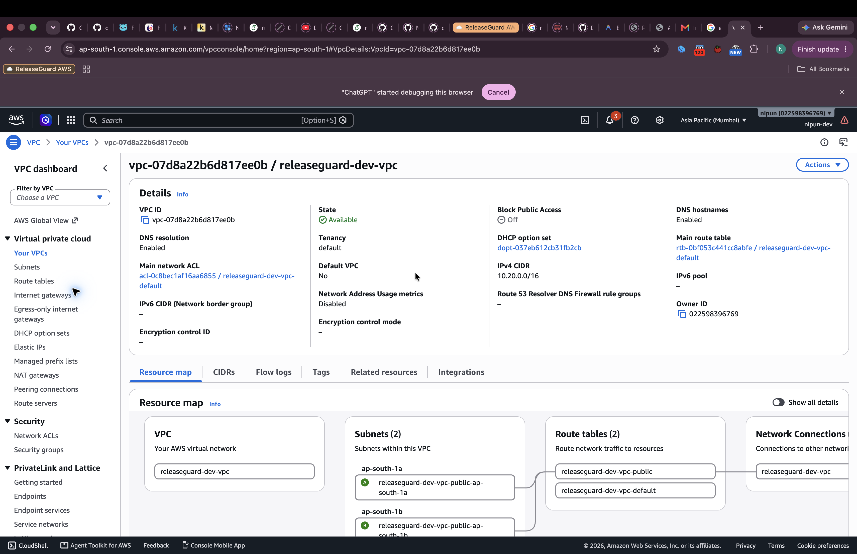
RELEASEGUARD / 07
Infrastructure as code on AWS
Terraform created a temporary, evidence-backed EKS environment and then removed it safely.
VERIFIED DEPLOYMENT
Reproducible AWS foundation
VPC with CIDR 10.20.0.0/16
Two public subnets across availability zones
EKS 1.35 control plane and managed node group
m7i-flex.large worker selected from account-eligible types
Plan applied, application verified, resources destroyed
46 RESOURCES DESTROYED
07

Slide 8
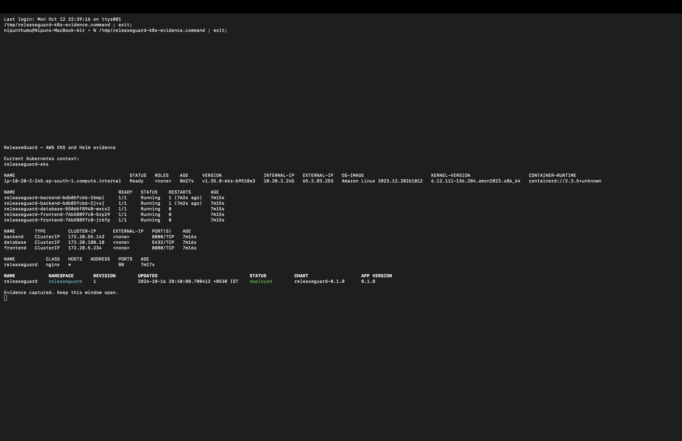
RELEASEGUARD / 08
Kubernetes delivery with Helm and Argo CD
Declarative configuration keeps desired state in Git and repairs drift automatically.
GITOPS CONTROL LOOP
Git
Helm chart + values
Argo CD
Sync, prune, self-heal
EKS
Desired state reconciled
2 frontend • 2 backend • 1 database • ClusterIP Services • Ingress
08

Slide 9
RELEASEGUARD / 09
Observability closes the feedback loop
Health endpoints support orchestration; metrics explain application behaviour.
FastAPI
Prometheus
Grafana
→
→
/health • /ready • /metrics
scrape target = UP
request count • rate • duration
What the platform can answer
TARGET UP
Is the process alive and is the database reachable?
Is Prometheus successfully scraping the application?
How many requests are arriving and how long do they take?
3
provisioned Grafana panels
09

Slide 10
RELEASEGUARD / 10
What I learned and how I will demo it
KEY LEARNINGS
LIVE DEMO ORDER
DevSecOps is a chain of feedback loops, not a single tool
Immutable artifacts and GitOps make deployments repeatable
Health probes and metrics are part of application design
Infrastructure evidence must end with a verified teardown
1 Architecture and codebase
5 Pods, Services, Ingress
2 Push and GitHub Actions
6 Prometheus target UP
3 Terraform and AWS evidence
7 Grafana live metrics
4 Argo CD Synced / Healthy
8 Safe teardown evidence
Result: a complete application moved from local development to a secure CI pipeline, GitOps-managed Kubernetes, and observable AWS EKS.
10

