Slide 1
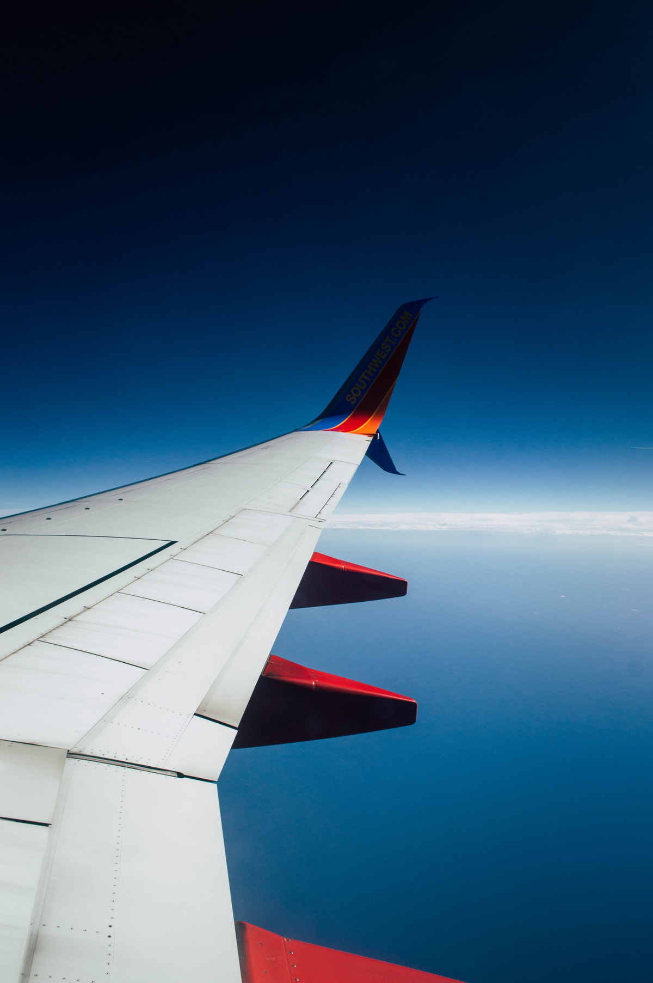
AeroCast-AI
Day-Ahead Flight Delay Prediction
Predicting delay risk before the next day's flights take off.
Our project focuses on predicting which flights are likely to arrive late, using information available the evening before departure. In Phase 1, we built and compared machine learning models for this task.
TEAM MEMBERS
T-049
Nipun Patlori
Mohan Kumar C R
Anushka Tyagi
Omkar Hadole
Krish Dabas
2401010323
2401010282
2401010090
2401010175
2401010233

Slide 2
Problem Statement & Our Approach
“Can we predict tomorrow's flight delays today?”
The Problem
Our Approach
Flight delays disrupt schedules and can affect many later flights. Airlines need an early warning to plan ahead.
Use historical flight records and machine learning to estimate the risk of a flight arriving 15 minutes or more late.
Our prediction deadline
8:00 PM · Previous day
(Only information available by this time can be used)
Delayed Flight
the one arriving 15 minutes* or more after its scheduled arrival time
Identify high-risk flights early and compare two machine learning approaches fairly.
Phase 1 Goal
*This 15-minute cutoff follows the US Bureau of Transportation Statistics' on-time arrival rule.

Slide 3

Understanding Dataset
336,776
2013
3
≥ 15 min
Original Flight Records
Year
Origin Airports
(EWR, JFK, LGA)
Delay Threshold
Binary Target Class Definition: Target variable → (is_delayed)
Class 0: NOT LATE
Class 1: LATE
Arrival delay < 15 minutes
Arrival delay ≥ 15 minutes
  Supervised Learning
  Binary Classfication
  Time-dependent prediction
Previous day, 8 PM → Model predicts → Next day's arrival
Chronological split (train on the past, test on the future; no shuffling)
TRAIN
8 Jan – 31 Aug 2013
211,684 flights · 26.5% late
CALIBRATION
Sep – Oct
55,628 · 15.7% late
TEST
Nov – Dec
53,991 · 25.8% late
Cancelled (8,255) and diverted (1,175) flights have no arrival delay, so they are left out of the target but still counted in schedule congestion. Overall, 24.5% of flights are late.

Slide 4
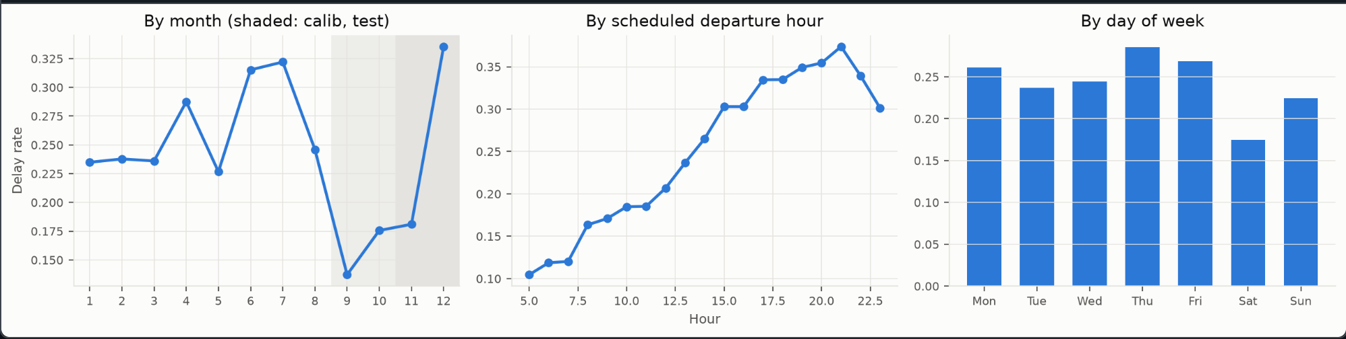
Key Delay Patterns (EDA)
Season
Hour of Day
Day of Week
Dec, Jul and Jun are worst (over 30%); Sep to Nov are calmest (under 20%)
About 10% of 5 am flights are late, rising to about 37% at 9 pm
Saturday is the best day (about 18% delayed)

Slide 5
Feature Engineering & Leakage Prevention
43 features engineered across 5 categories.
4.
ENTITY
HISTORY
5.
DAY-LEVEL
HISTORY
1.
CATEGORICAL
2.
SCHEDULE
3.
CONGESTION
Three automated leakage checks ran; one detected two same-day aircraft-rotation features that violated the cutoff constraint. They were removed.
45 → 43 features

Slide 6
Training & Model Selection
Models We Trained
Model Selection
CV PR-AUC Results
    Logistic Regression: L2-regularised (C = 0.1), missing values median-imputed with flags.
    XGBoost: shallow trees (depth 2, 108 trees), handles missing values natively.
    Baselines: base-rate prior and route-history delay rate.
    Chronological splits: train Jan–Aug, calibrate Sep–Oct, test Nov–Dec.
    Rolling-origin CV: 4 folds validate May, Jun, Jul and Aug, each trained only on earlier months.
    Rule fixed before test: pick the higher mean CV PR-AUC.
Base-rate prior
0.265
XGBoost
0.450
Logistic Regression ✓
0.471

Slide 7
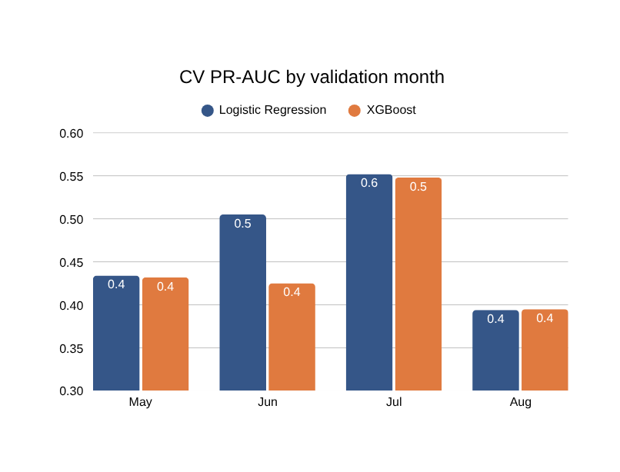
Why We Chose Logistic Regression
Our final model is Logistic Regression. Four simple reasons:
1
We fixed the rule before testing
Pick the model with the higher average CV PR-AUC. LogReg scored 0.471 vs 0.450 and won 3 of 4 months.
2
XGBoost's test lead is not real proof
It is ahead by only 0.014, and the 95% range [−0.010, +0.040] includes zero. That gap could be luck.
3
Switching now would be unfair
Changing the model after seeing test scores means choosing by the test set, which spoils the evaluation.
Axis starts at 0.3 · Mean: LogReg 0.471, XGBoost 0.450
4
Simpler and easier to explain
One coefficient per feature that we can read and defend. With equal performance, we keep the simpler model.
In one line
Both models perform about the same, so we keep the one our pre-planned rule picked: the simpler LogReg.

Slide 8
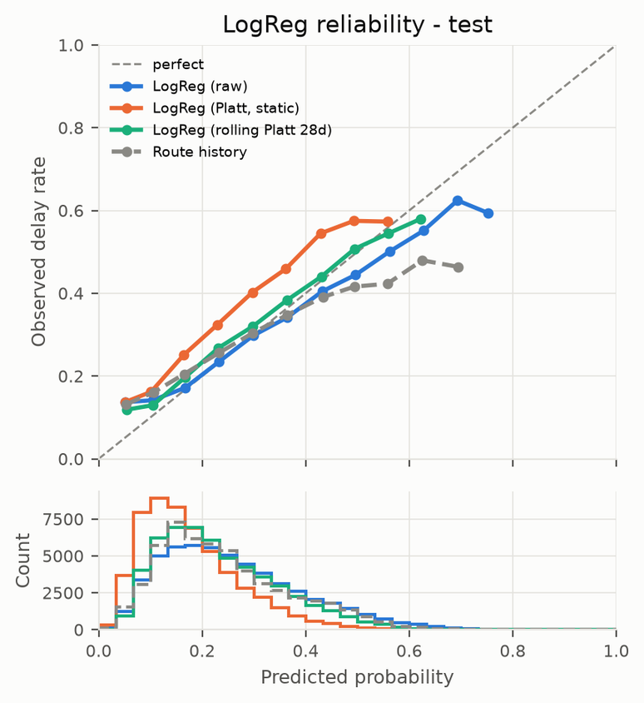
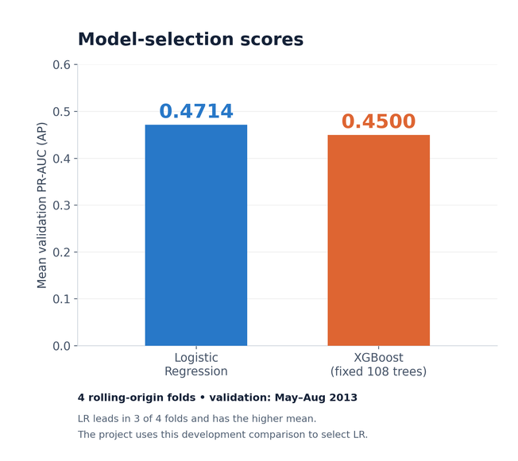
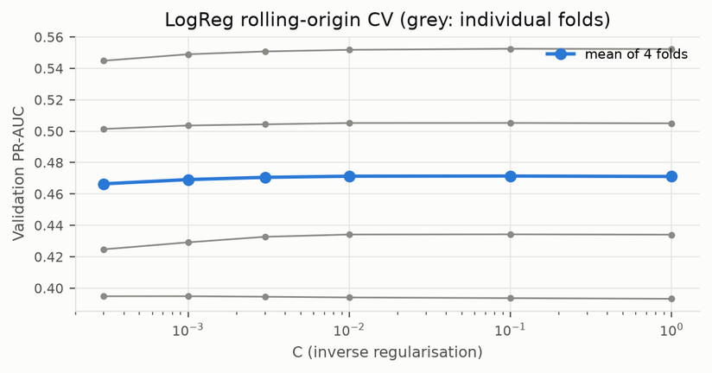
Calibration & Operating Policies
Platt calibration
Rolling Platt refits daily using the previous 28 days of known outcomes; the 0.508 decision threshold was selected on September–October data and frozen before November.
Test ECE: 0.027 (rolling) vs 0.019 (raw)
Frozen threshold
0.507908
Chosen on Sep–Oct labels to target precision ≥ 0.40, then locked before test.

Slide 9
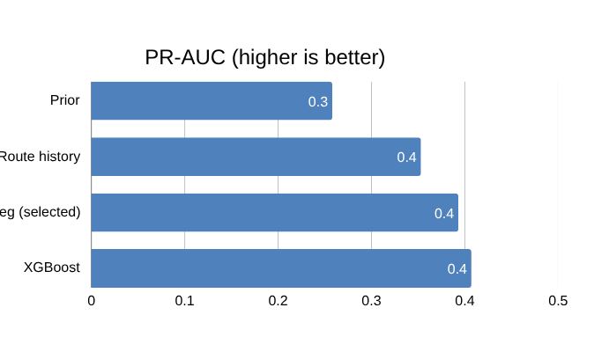
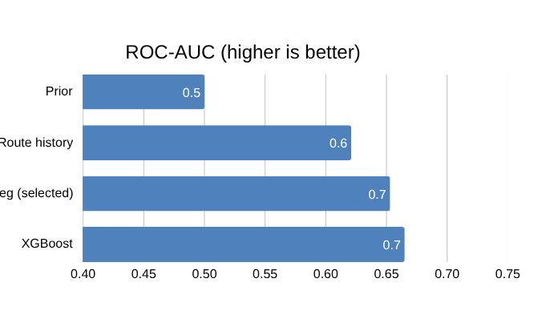
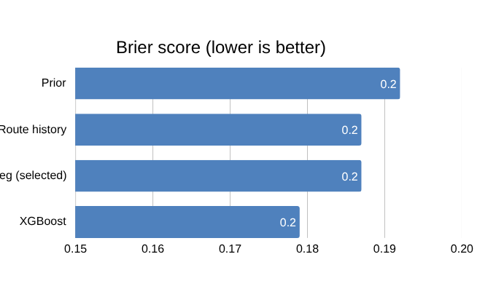
Test Results & Model Comparison
Test set: Nov–Dec 2013 · 53,991 flights · base rate 25.8%
Both models beat the baselines
The gap is too small to trust
No conclusive test winner
LogReg 0.393 and XGBoost 0.407 PR-AUC, both well above route history (0.353) and the base rate (0.258).
XGBoost is ahead by only 0.014.
The test set cannot tell the two models apart. We keep Logistic Regression (next slide).

Slide 10
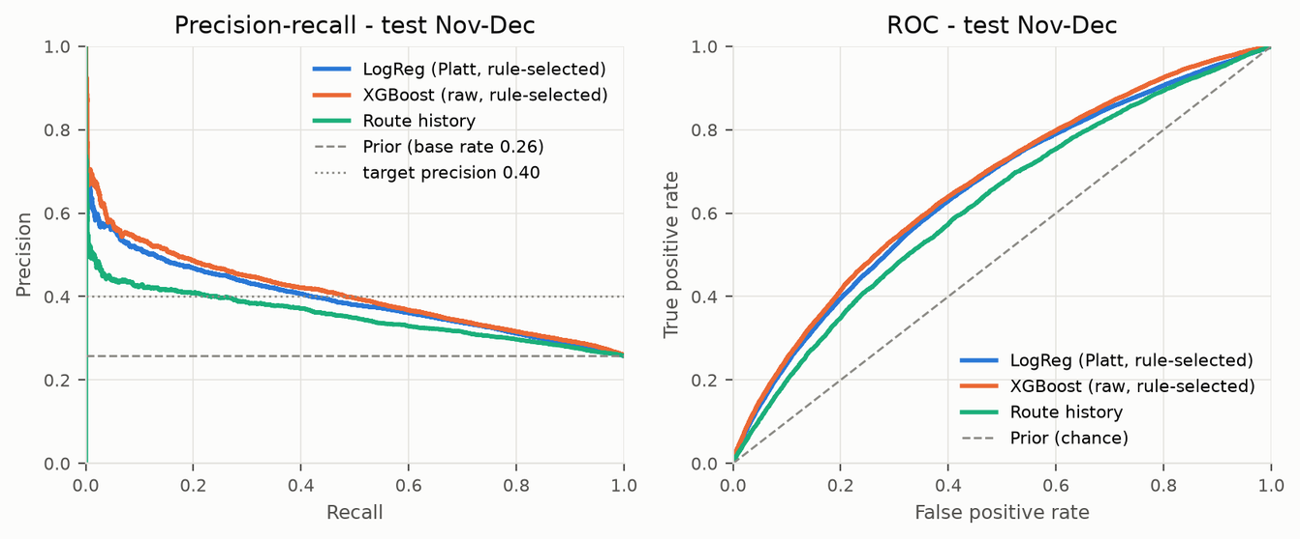
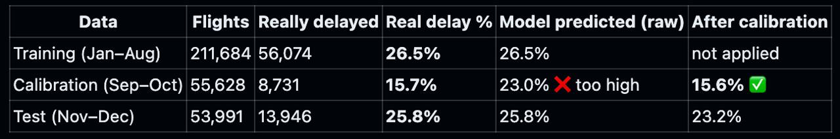
What We Found
Both models beat the baselines
Their curves sit above route history and the base rate across the PR and ROC plots.
LogReg and XGBoost almost overlap
Their curves are nearly the same, which is why the test set gives no clear winner.
Useful for daily planning
Reviewing the top 10% riskiest flights each day: 44.8% are truly late

Slide 11
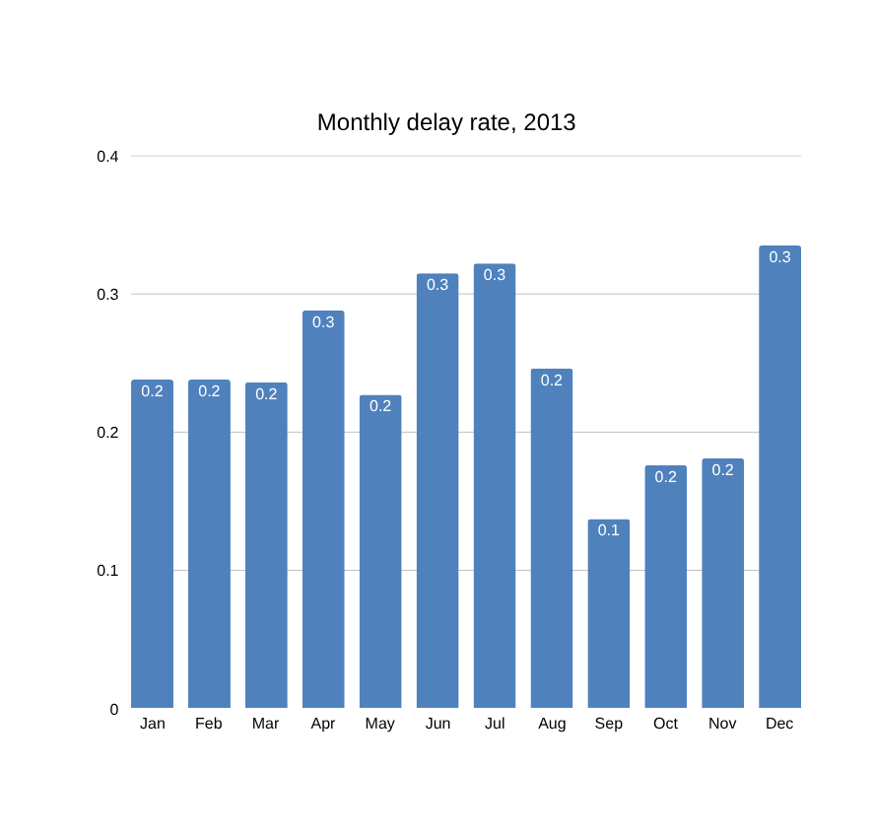
Limitations
Narrow scope
One year (2013) and three NYC airports (EWR, JFK, LGA): cross-year and cross-airport generalisation is not shown.
Changing delay rates
13.7% in September vs 33.5% in December. The static calibrator fails in December (ECE 0.143).
Evaluation limits
Only 4 CV folds and one 2-month test window. No weather and no aircraft-rotation features.

Slide 12
Conclusion & Future Work
Conclusion
We can flag risky flights a day ahead using only schedules and past outcomes, with no leakage. Logistic Regression is our final model: as good as XGBoost here, and simpler to explain.
References
[1] S. Kaufman, S. Rosset, C. Perlich, O. Stitelman, “Leakage in Data Mining: Formulation, Detection, and Avoidance,” ACM Trans. Knowledge Discovery from Data, vol. 6, no. 4, 2012.
https://doi.org/10.1145/2382577.2382579
[2] C. Guo, G. Pleiss, Y. Sun, K. Q. Weinberger, “On Calibration of Modern Neural Networks,” Proc. 34th ICML, pp. 1321–1330, 2017.
https://proceedings.mlr.press/v70/guo17a.html
[3] Kaggle Flights dataset (derived from the nycflights13 R package).
https://www.kaggle.com/datasets/mahoora00135/flights
[4] Team T49, AeroCast-AI code, notebooks and results.
https://github.com/nipun1803/AeroCast-AI
Future work
Deep learning: an MLP with embeddings
Phase 2 DL model: learn airline, origin and destination embeddings to capture interactions our hand-made features miss.
1
What-if rescheduling simulation
Try feasible alternative schedules for high-risk flights and estimate how much delay they would save.
2

