Slide 1
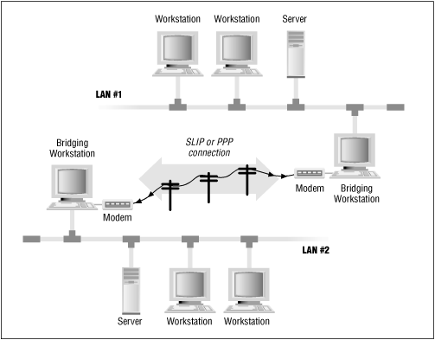
Topology 1
Router 2
Router 1
Topology 2
LANCOM can be used to configure multiple networks as networks get added
Scalability

