Slide 1

\
Backend
Server
Webserver
Production
Container
Request+ Response
Backend
Process
Proxy
Duplicator
Clone Manager
Webserver
Request
Test
Container
Backend
Process

Slide 2
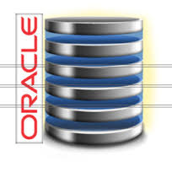
Mid-Tier Application
Production
Container
Proxy
Duplicator
Live Cloning
Proxy
Aggregator
webserver
Backend
Test
Container
Clone Manager

Slide 3
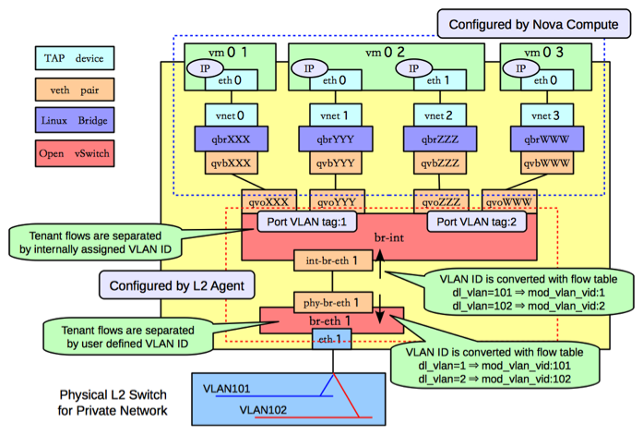

Slide 4
VM 01
VM 02
VM 03
eth0
eth1
eth2
vnet0
vnet1
vnet2
qbrXXX
qbrYYY
qbrZZZ
qvbXXX
qvbYYY
qvbZZZ
qvoXXX
qvoYYY
qvoZZZ
br-int
int-br-eth1
phy-br-eth1
br-eth1
eth1
VLAN 1
VLAN 2

Slide 5
External Mode
Internal Mode
Clone Manager
Clone Manager
Agent
Agent
Agent
P1
T1
IP namespace 1
IP namespace 2
P1
T1
NAT
NAT
To/From Duplicator
To/From Duplicator

Slide 6
2: Connection Manager
3: TCP Connector
4
6: TCP Connector
7
1
5: Buffer Manager

Slide 7
Production
3
1
4
Client
Proxy
2
5
6
Test

Slide 8
Mid-Tier Production
1
2
3
Proxy
Aggergator
Backend-Server
4
5
6
Mid-Tier Clone

Slide 9
RQ2
RQ1
RQ2
RQ1
Proxy Aggregator
RQ2
RQ1
RQ2
RQ1
RQ2
RQ1
RQ2
RQ1
Proxy Aggregator
RQ2
RQ1
RQ1
RQ2

Slide 10










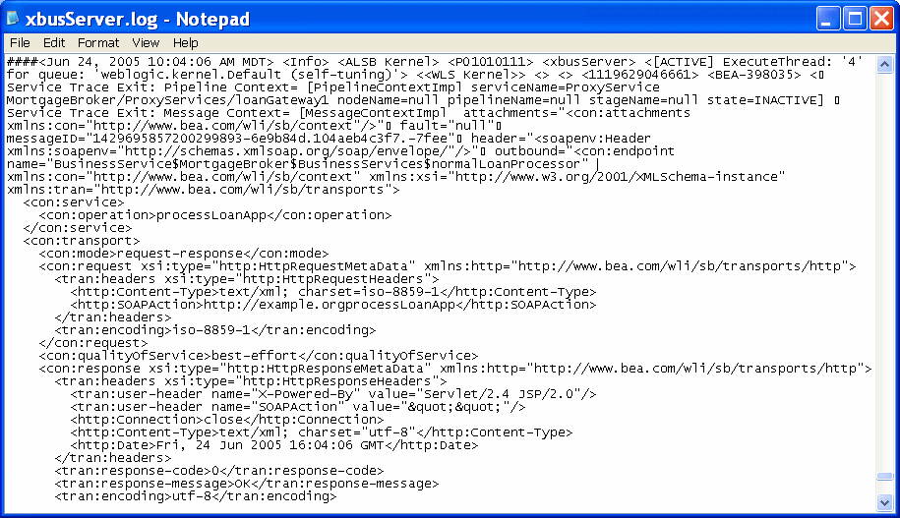
Tier 1
Tier 2
Tier 3
Tier 4
Tier 5
Tiers n
Live
production system
PARIKSHAN
“sandbox
cloned debug system”
Live debugging
Same system state
User input available
Less resources used
Fast time to debug
User observes error & creates sandbox clones
Cloned test containers &
network duplication
Debug
output

Slide 11
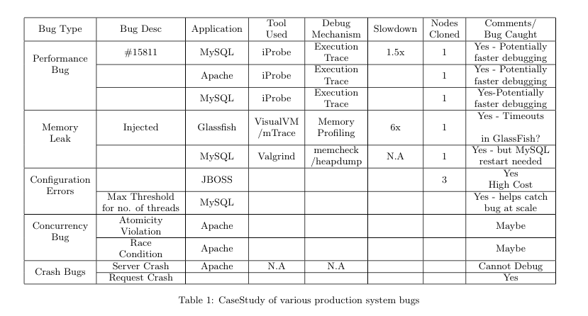

Slide 12



Live Debugging
Same system state
User input available
User Input
Bug Symptoms?
Configuration?
System State
Scale?
Webserver
Backend-Server
Webserver
Backend-Server
Test container
View traces/test-cases
(i). Without Parikshan - Offline Testing
(ii). With Parikshan - Online Testing

Slide 13
Production
3
1
4
Client
Proxy
2
5
6
Test
Mid-Tier
Production
Aggergator
Backend
Mid-Tier
Clone

Slide 14
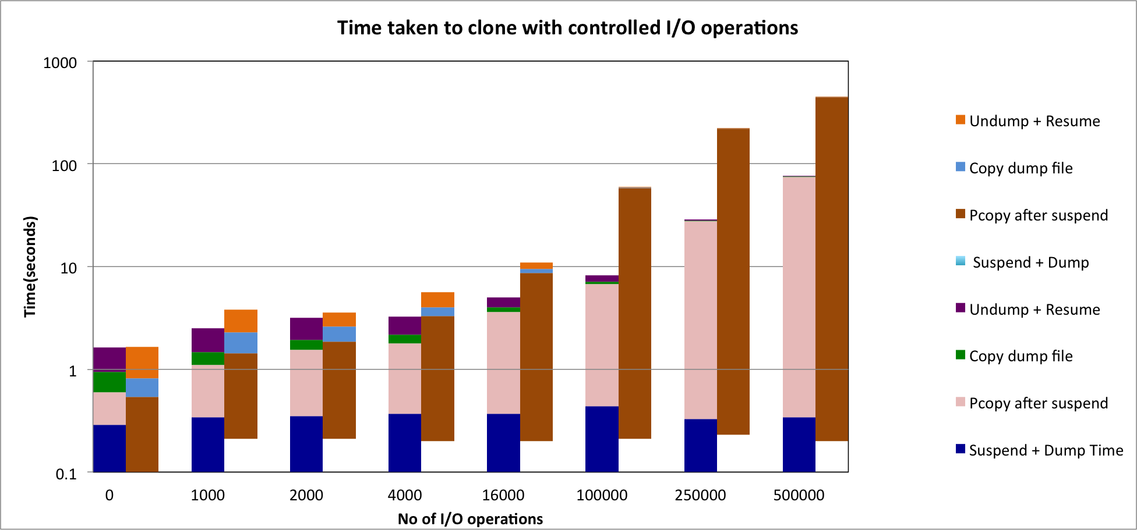
External
Internal

