Slide 1
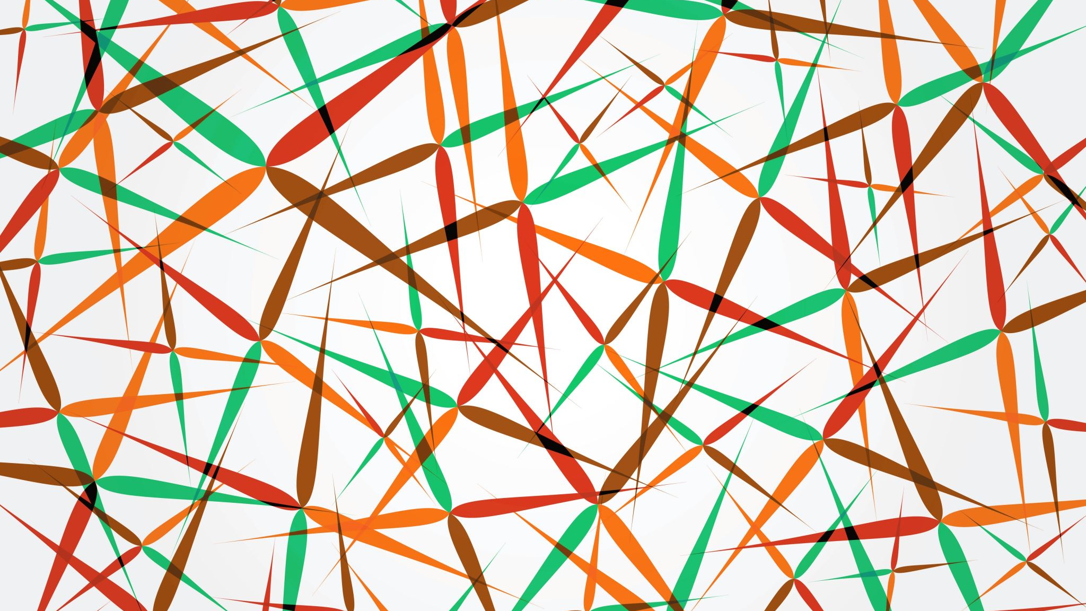
Detection of Breast Cancer using SVM and comparative study with other in-built models
Team no 15
Team Members:
Arjun Menon - BL.EN.U4AIE200003
Gaurang Choudhary- BL.EN.U4AIE200014
Nipun B Nair - BL.EN.U4AIE200044

Slide 2
Literature Survey I
" A hybrid algorithm for lung cancer classification using SVM and Neural Networks" by Pankaj Nanglia,Sumit Kumar, and Aparna Mahajan in ICT Express Volume 7 Issue 3, September 2021, Pages 335-341
The present research article focused on the factual findings of the potential usage of the combinational Feed-Forward Back Propagation Neural Network as a judgment making for lung cancer. In this context, Support Vector Machine is integrated with Feed-Forward Back Propagation Neural Network to create a hybrid algorithm that further helps in reducing the computation complexity of the classification. A set of 500 images are utilized in which 75% of data is used for the training purpose and the rest 25% is used to achieve the classification. In the view of forgoing, a three-block mechanism is proposed for the classification in which the first block pre-processes the dataset, the second block extracts the features via the SURF technique followed by the optimization using Genetic Algorithm and the terminal block is for the classification via FFBPNN. The hybrid classification algorithm is named as Kernel Attribute Selected classifier and the overall classification accuracy foregoing of the proposed algorithm is 98.08%. Herein, the objective of the study is to enhance the classification accuracy by applying a hybrid classification algorithm.

Slide 3
Literature Survey II
"Breast Cancer Image Classification based on CNN and Bit-Plane slicing" by Guoming Chen, Yongchang Chen and Zeduo Yuan in 2019 International Conference on Medical Imaging Physics and Engineering (ICMIPE)
In this paper we propose a CNN classifier base on image bit-plane slicing. The purpose is to improve recognition accuracy when we apply it to breast cancer images classification. Each texture image is decomposed into eight bit-plane images. Different bit-planes provide different levels and detail of image texture feature. At the same time, we have also tested feature classification performance by each bit-plane respectively and the fusion of all bit-planes. CNN classifier is used for classification and recognition. The simulation results on the breast cancer image datasets show that the proposed method on some bit-plane can greatly improve recognition rate and promote classification performance.

Slide 4
Literature Survey III
"Breast Cancer Detection Using Decision Tree, Naïve Bayes, KNN and SVM Classifiers: A Comparative Study" by Maheswar, Gautam Kumar in Second International Conference on Smart Systems and Inventive Technology (ICSSIT 2019)
The breast cancer remains as the major cause for the fatality in the women. To predict and classify breast cancer at early stage, researchers have used various machine learning procedures. Various classification algorithms like decision tree, SVM, KNN have been used on breast cancer dataset to categorize a cancer stage as either nonthreatening or threatening. In this paper, the four basic models of classification i.e. decision tree, Naïve Bayes, KNN, SVM have been used to classify the cancer stage. Then, a comparative study is done on these classifier using different accuracy measures like precision, recall and f1-score. This study shows that decision tree classifiers are best among all classifiers in terms of accuracy.

Slide 5
What is Breast Cancer?
Breast cancer is a type of cancer that starts in the breast. It can start in one or both breasts.
Cancer starts when cells begin to grow out of control.
Breast cancers can start from different parts of the breast. The breast is an organ that sits on top of the upper ribs and chest muscles. There is a left and right breast and each one has mainly glands, ducts, and fatty tissue. In women, the breast makes and delivers milk to feed newborns and infants. The amount of fatty tissue in the breast determines the size of each breast.

Slide 6
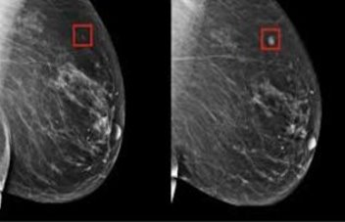
Why breast cancer occurs?
Breast cancer can spread when the cancer cells get into the blood or lymph system and then are carried to other parts of the body.
The lymph (or lymphatic) system is a part of your body's immune system. It is a network of lymph nodes (small, bean-sized glands), ducts or vessels, and organs that work together to collect and carry clear lymph fluid through the body tissues to the blood. The clear lymph fluid inside the lymph vessels contains tissue by-products and waste material, as well as immune system cells.
The lymph vessels carry lymph fluid away from the breast. In the case of breast cancer, cancer cells can enter those lymph vessels and start to grow in lymph nodes.

Slide 7

Symptoms of breast cancer
New lump in the breast or underarm (armpit).
Thickening or swelling of part of the breast.
Irritation or dimpling of breast skin.
Redness or flaky skin in the nipple area or the breast.
Pulling in of the nipple or pain in the nipple area.

Slide 8
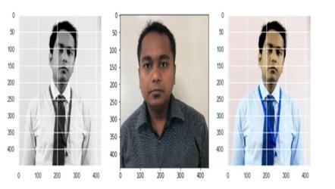
Image Processing
Image processing is a method to perform some operations on an image, in order to get an enhanced image or to extract some useful information from it. It is a type of signal processing in which input is an image and output may be image or characteristics/features associated with that image.
Many advanced Image Processing methods leverage Machine Learning Models like Deep Neural Networks to transform images on a variety of tasks, like applying artistic filters, tuning an image for optimal quality, or enhancing specific image details to maximize quality for computer vision tasks.
Examples of image processing
Rescaling Image (Digital Zoom)
Correcting Illumination.
Detecting Edges.
Mathematical Morphology.
Evaluation and Ranking of Segmentation Algorithms.

Slide 9
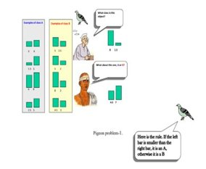
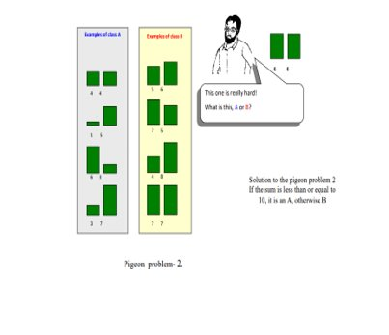
Image Classification
Image classification is the process of segmenting images into different categories based on their features.
A feature could be the edges in an image, the pixel intensity, the change in pixel values, and many more.
The three images belong to the same individual however varies when compared across features like the colour of the image, position of the face, the background colour, colour of the shirt, and many more. The biggest challenge when working with images is the uncertainty of these features. To the human eye, it looks all the same, however, when converted to data you may not find a specific pattern across these images easily.
An image consists of the smallest indivisible segments called pixels and every pixel has a strength often known as the pixel intensity.
Whenever we study a digital image, it usually comes with three color channels, i.e. the Red-Green-Blue channels, popularly known as the “RGB” values.
It has been seen that a combination of these three can produce all possible color pallets. Whenever we work with a color image, the image is made up of multiple pixels with every pixel consisting of three different values for the RGB channels. Let’s code and understand what we are talking about.

Slide 10
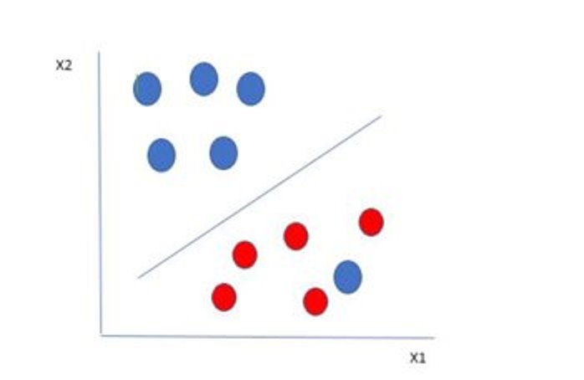
SVM-Support Vector Machine
Support Vector Machine(SVM) is a supervised machine learning algorithm used for both classification and regression.
The objective of SVM algorithm is to find a hyperplane in an N-dimensional space that distinctly classifies the data points. The dimension of the hyperplane depends upon the number of features. If the number of input features is two, then the hyperplane is just a line. If the number of input features is three, then the hyperplane becomes a 2-D plane. It becomes difficult to imagine when the number of features exceeds three.

Slide 11
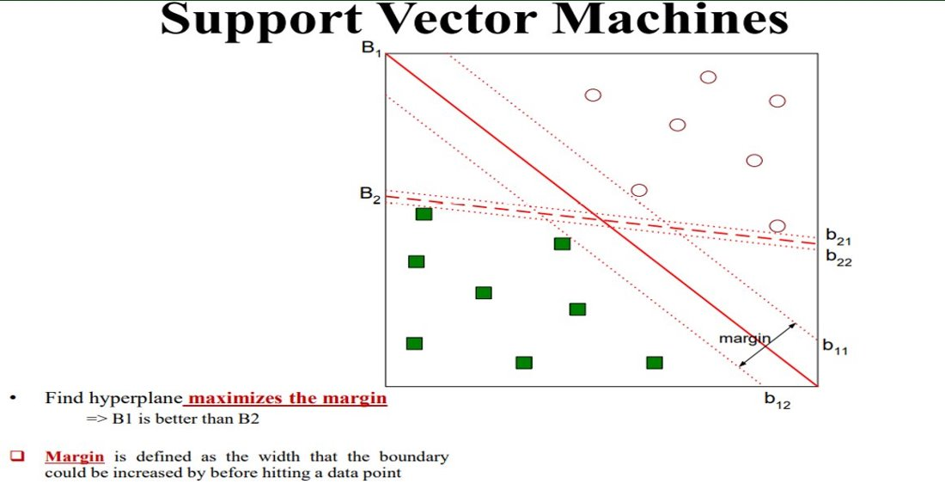

Slide 12
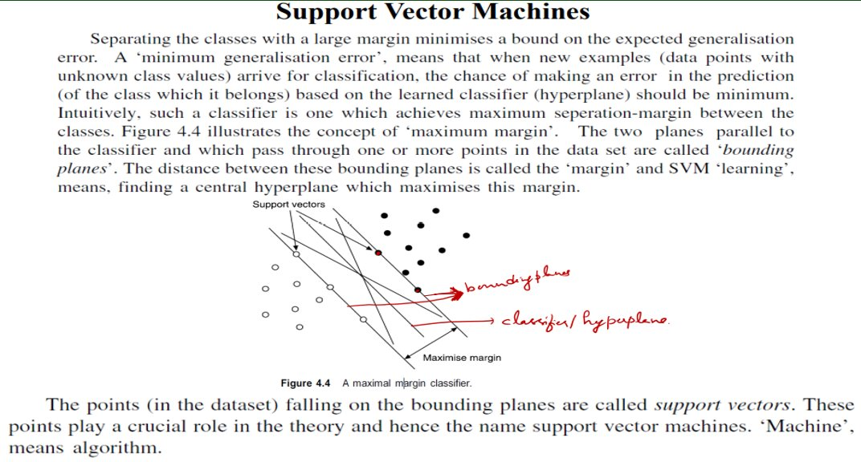

Slide 13
Convolution Neural Network
Neural networks are a subset of machine learning, and they are at the heart of deep learning algorithms.
They are comprised of node layers, containing an input layer, one or more hidden layers, and an output layer. Each node connects to another and has an associated weight and threshold. If the output of any individual node is above the specified threshold value, that node is activated, sending data to the next layer of the network. Otherwise, no data is passed along to the next layer of the network.
Convolutional neural networks now provide a more scalable approach to image classification and object recognition tasks, leveraging principles from linear algebra, specifically matrix multiplication, to identify patterns within an image. That said, they can be computationally demanding, requiring graphical processing units (GPUs) to train models.

Slide 14
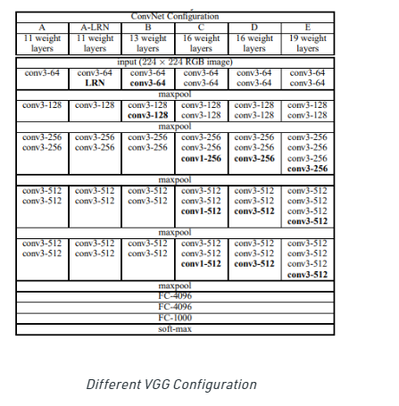
Vgg-16 model
VGG-16 is a convolutional neural network that is 16 layers deep.
You can load a pretrained version of the network trained on more than a million images from the ImageNet database. The pretrained network can classify images into 1000 object categories, such as keyboard, mouse, pencil, and many animals.
As a result, the network has learned rich feature representations for a wide range of images.
The network has an image input size of 224-by-224.
It is very slow to train (the original VGG model was trained on Nvidia Titan GPU for 2-3 weeks).
The size of VGG-16 trained ImageNet weights is 528 MB. So, it takes quite a lot of disk space and bandwidth that makes it inefficient.

Slide 15
Resnet-50
ResNet-50 is a convolutional neural network that is 50 layers deep. You can load a pretrained version of the network trained on more than a million images from the ImageNet database .
The pretrained network can classify images into 1000 object categories, such as keyboard, mouse, pencil, and many animals.
Although ResNet50 has proven powerful in many applications, one major drawback is that deeper network usually requires weeks for training, making it infeasible in real-world applications.

Slide 16
Inception-v3
Inception v3 is a convolutional neural network for assisting in image analysis and object detection, and got its start as a module for Google net.
Inception helps classification of objects in the world of computer vision. The Inceptionv3 architecture has been reused in many different applications, often used "pre-trained" from ImageNet.
The Inception architecture was designed to perform well even under strict constraints on memory and computational budget. The computational cost of Inception is also much lower than VGGNet or its higher performing successors.
This has made it feasible to utilize Inception networks in big-data scenarios where huge amount of data needed to be processed at reasonable cost or scenarios where memory or computational capacity is inherently limited, for example in mobile vision settings.
This makes it much harder to adapt it to new use-cases while maintaining its efficiency.
This is enabled by the generous use of dimensional reduction and parallel structures of the Inception modules which allows for mitigating the impact of structural changes on nearby components.

Slide 17
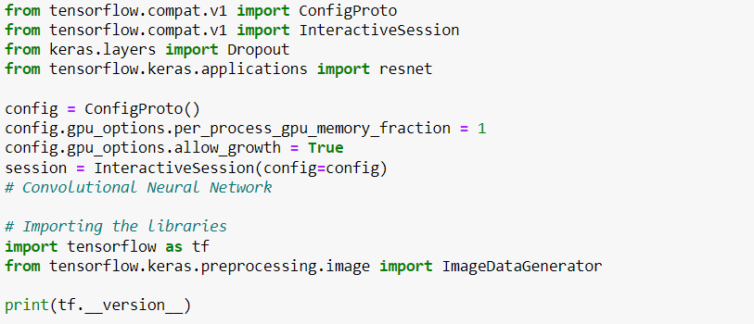
Code explanation

Slide 19
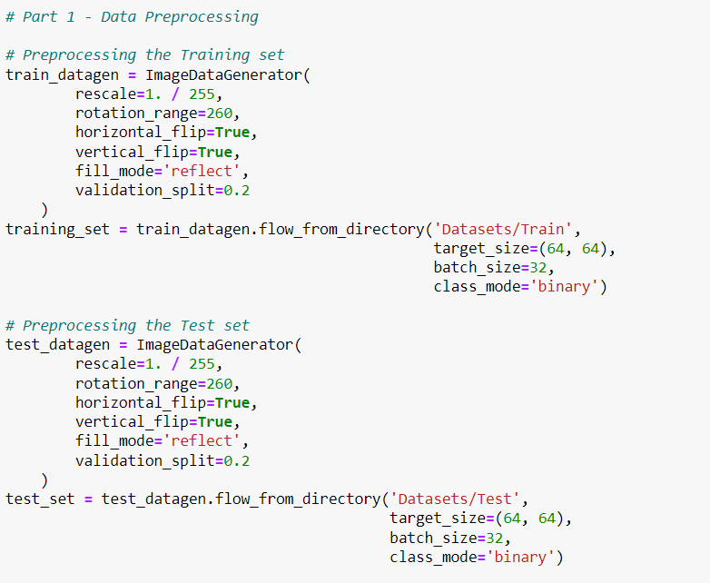
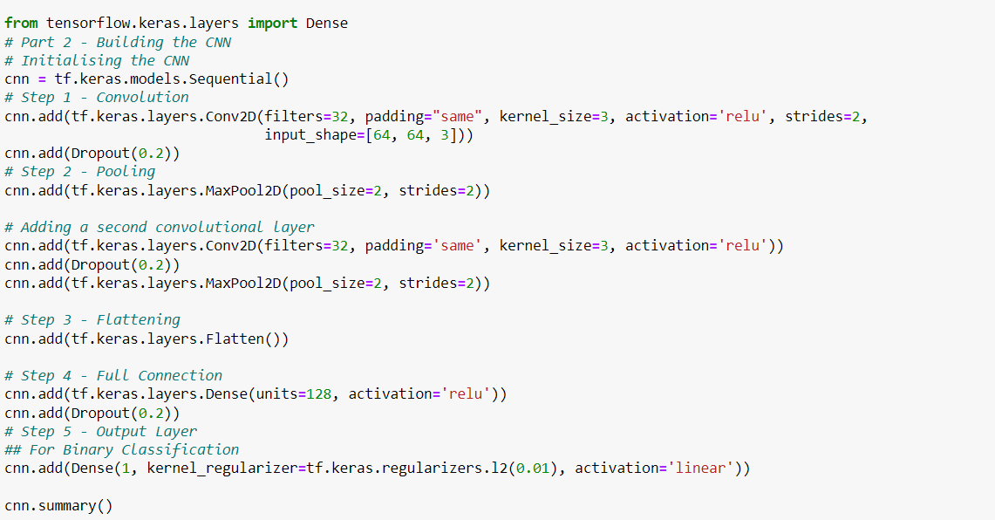

Slide 20
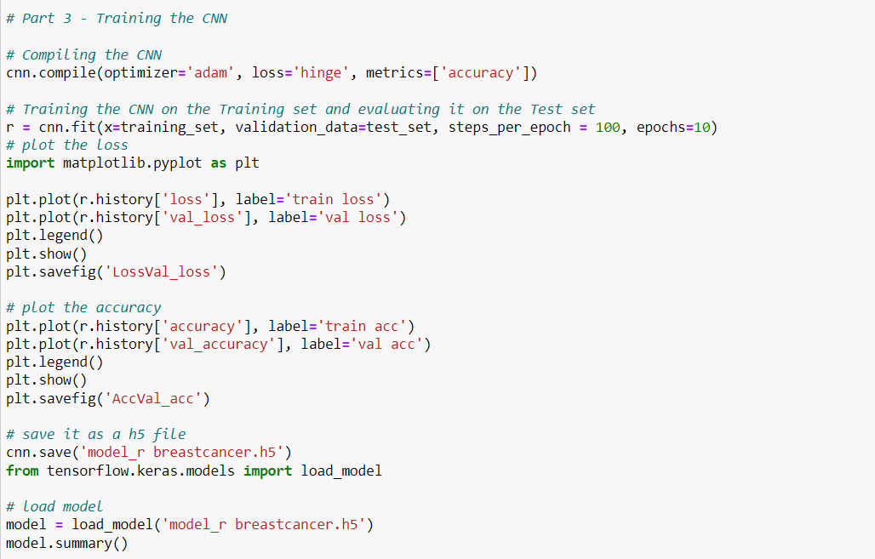
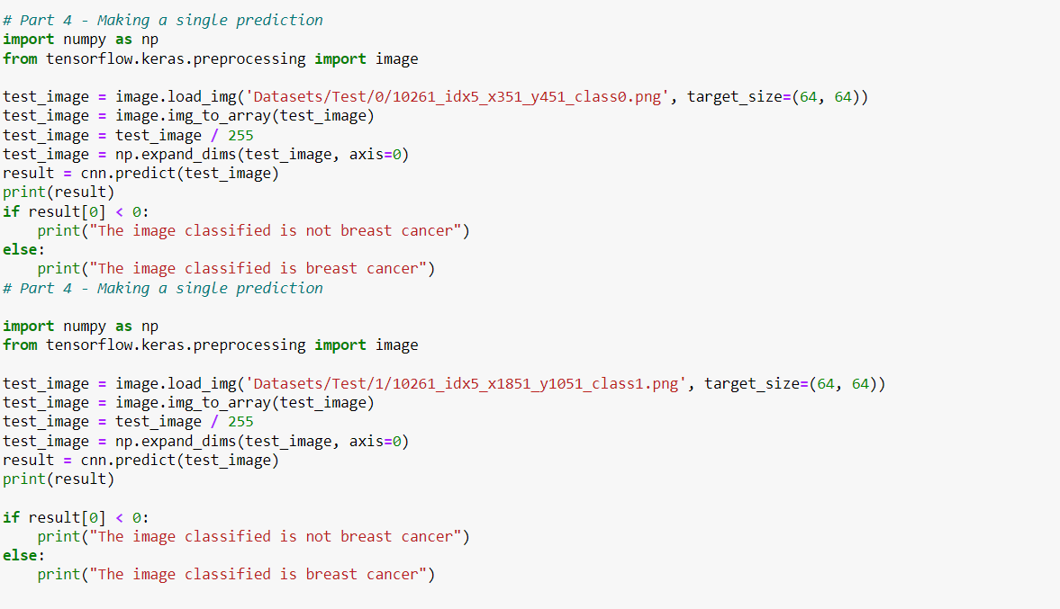

Slide 21
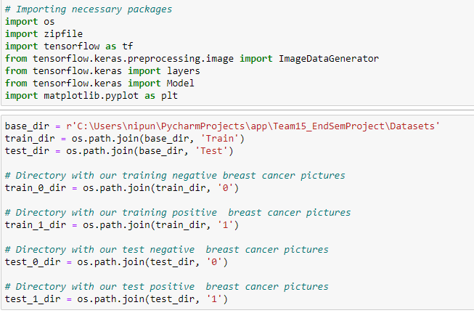
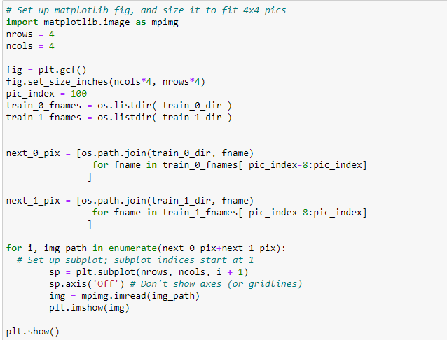
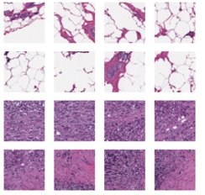

Slide 22
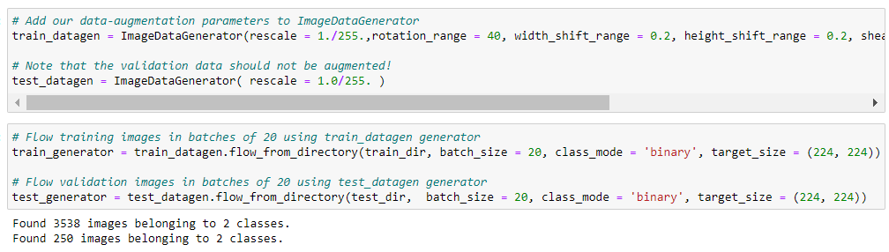
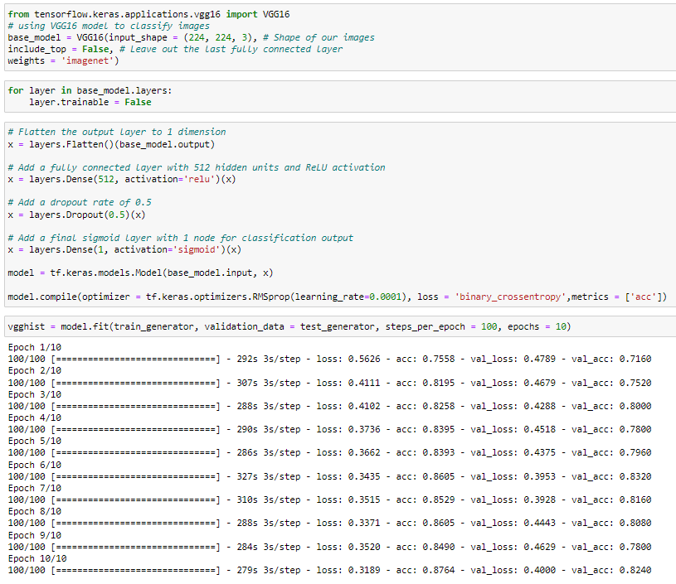
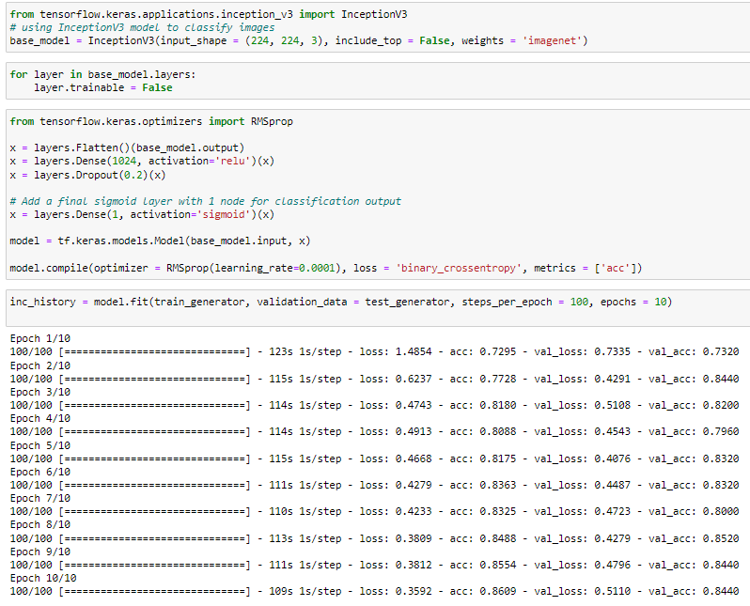
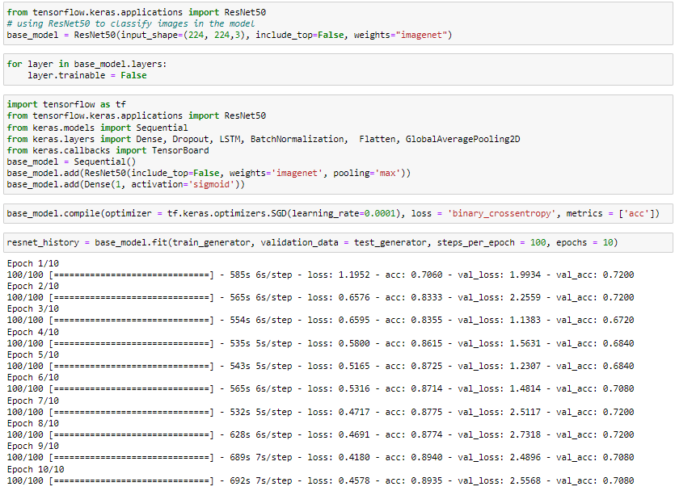

Slide 23
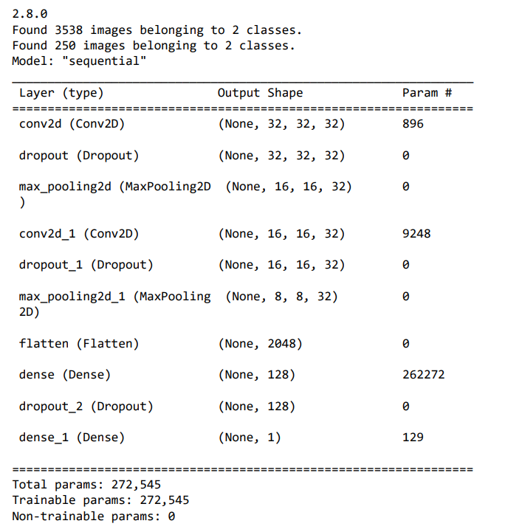
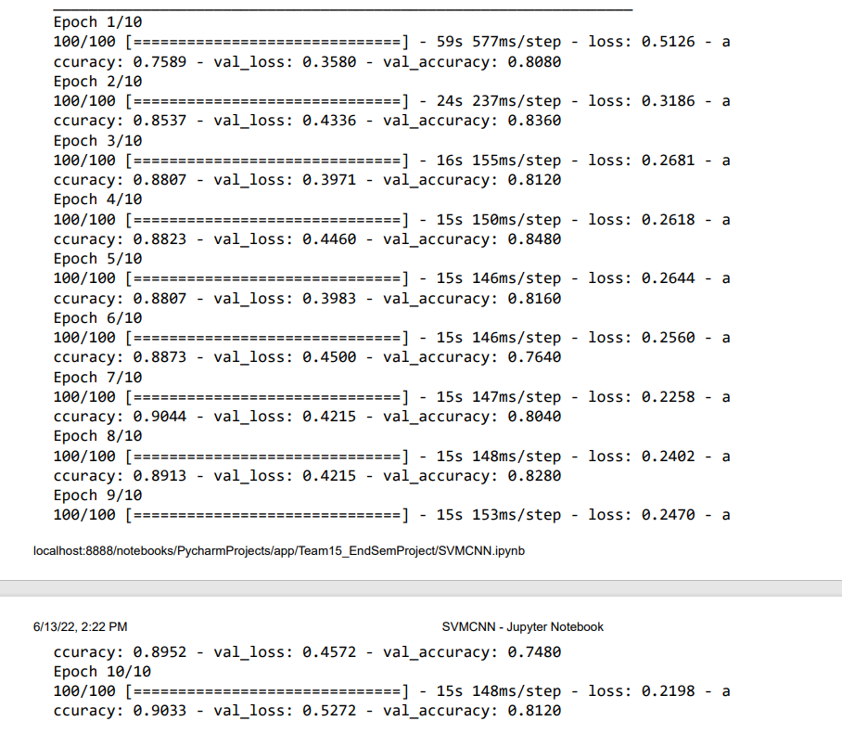
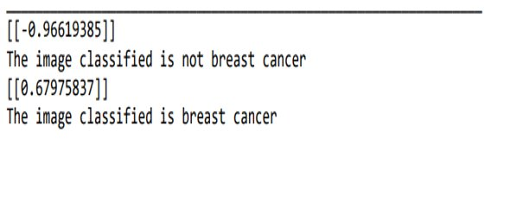
Output of svn-cnn

Slide 24
References
" A hybrid algorithm for lung cancer classification using SVM and Neural Networks" by Pankaj Nanglia,Sumit Kumar, and Aparna Mahajan in ICT Express Volume 7 Issue 3, September 2021, Pages 335-341
"Breast Cancer Image Classification based on CNN and Bit-Plane slicing"by Guoming Chen, Yongchang Chen and Zeduo Yuan in 2019 International Conference on Medical Imaging Physics and Engineering (ICMIPE)
"Breast Cancer Detection Using Decision Tree, Naïve Bayes, KNN and SVM Classifiers: A Comparative Study" by Maheswar, Gautam Kumar in Second International Conference on Smart Systems and Inventive Technology (ICSSIT 2019)
“Analysis of Image Classification using SVM”,by Sai Surya Teja Gontumukkala, Yogeshwara Sai Varun Godavarthi, Bhanu Rama Ravi Teja Gonugunta, Subramani R, K Murali
"VERY DEEP CONVOLUTIONAL NETWORKS FOR LARGE-SCALE IMAGE RECOGNITION"by Karen Simonyan ∗ & Andrew Zisserman
"Deep Residual Learning for Image Recognition" by Kaiming He Xiangyu Zhang Shaoqing Ren Jian Sun
"A Hybrid CNN and RBF-Based SVM Approach for Breast Cancer Classification in Mammograms" by Mohammad Alkhaleefah Chao-Cheng Wu
"An Architecture Combining Convolutional Neural Network (CNN) and Support Vector Machine (SVM) for Image Classification " by Abien Fred M. Agarap
"Rethinking the Inception Architecture for Computer Vision" by Zbigniew Wojna

Slide 25
Thank you

