Slide 1

Bank Customer Churn Prediction
Project by - Nipun Chauhan
Course - Applied Machine Learning by Shaojie Tang

Slide 2
Table of Contents
Objective
Data Exploration
Data Preprocessing
Base accuracy
Evaluation of Artificial Neural Network for Churn Prediction
Multivariable Logistic regression model Evaluation
Decision Trees model Evaluation
Comparison of models and Conclusion

Slide 3
Objective
RowNumber
CustomerId
Surname
CreditScore
Geography
Gender
Age
Tenure
Balance
NumOfProducts
HasCrCard
IsActiveMember
EstimatedSalary
Exited
In this project, the 'churn_modeling' dataset from Kaggle has been used. The dataset includes a variety of variables that have been incorporated as the independent variables in our analysis. The objective is to predict the dependent variable 'Existed', which represents the outcome of customer churn.
4/22/24
3

Slide 4
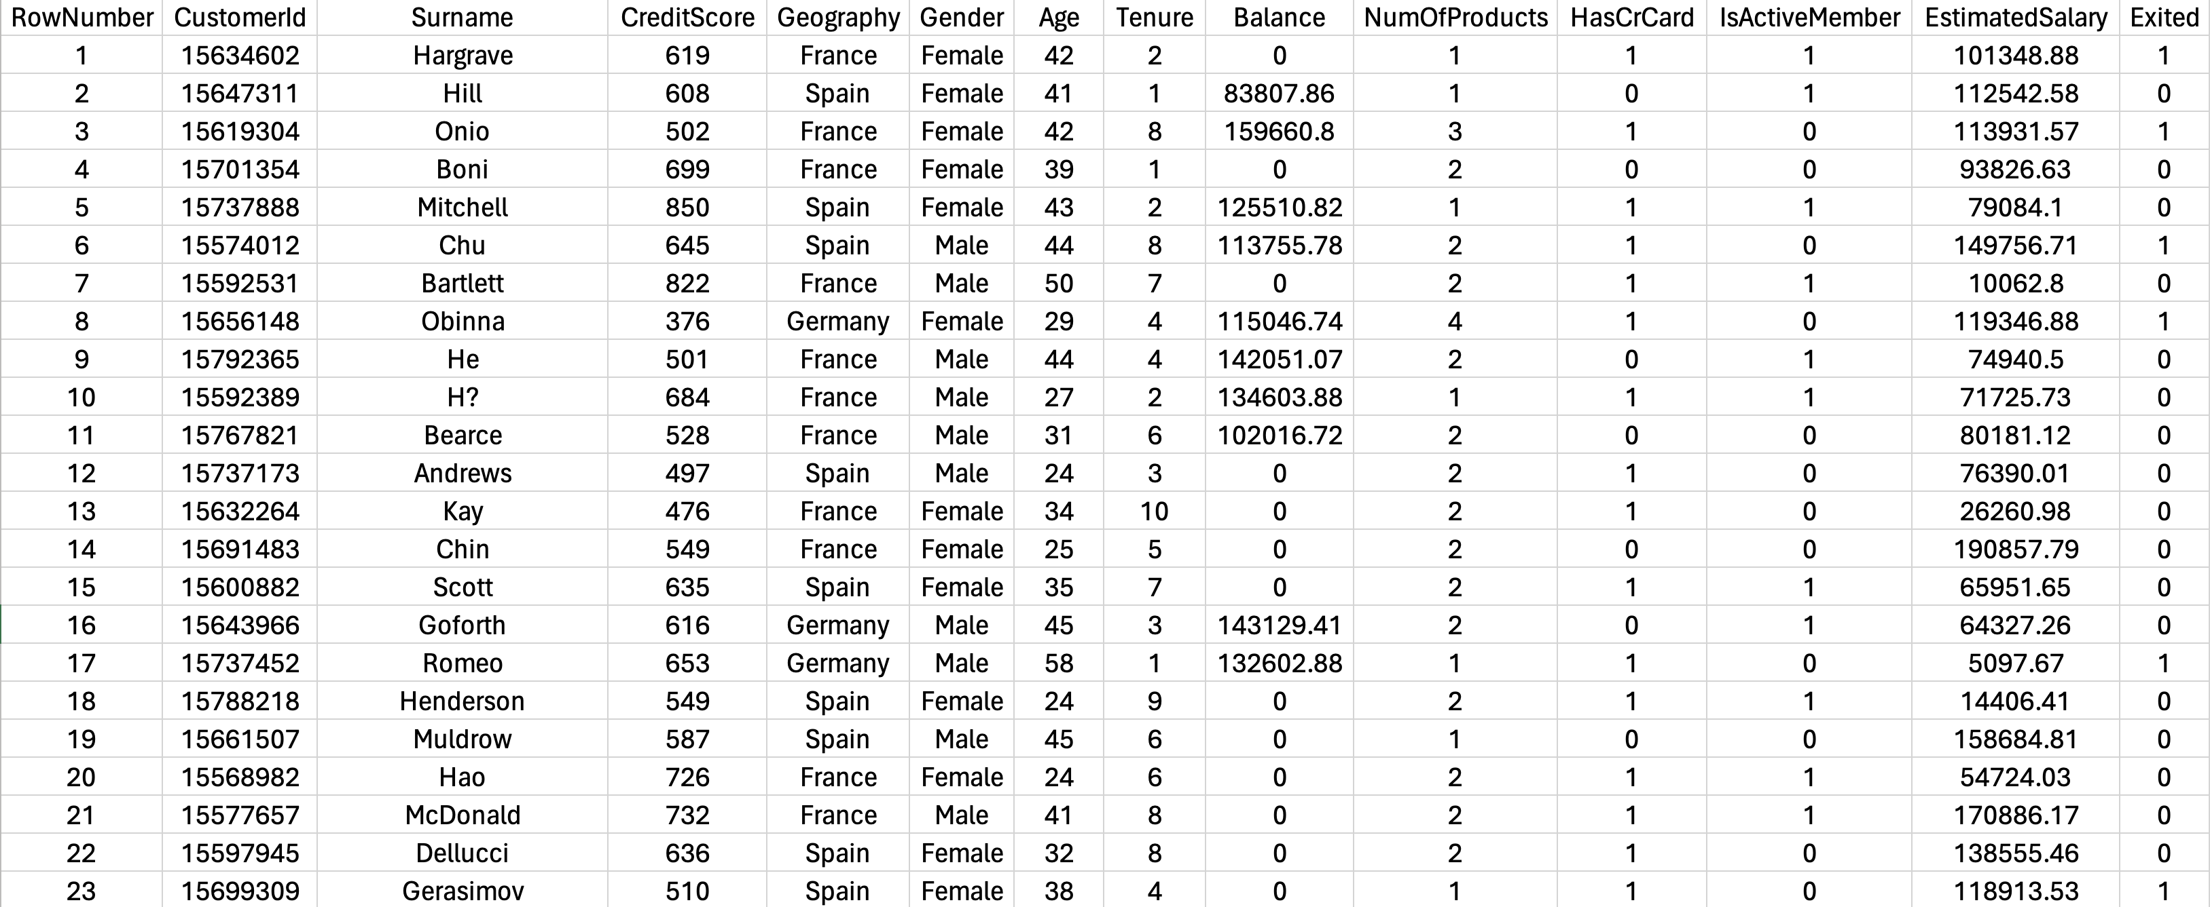
Below, I have presented a snapshot to showcase what the dataset looks like, providing you with a clear view of the data I have worked with.

Slide 5
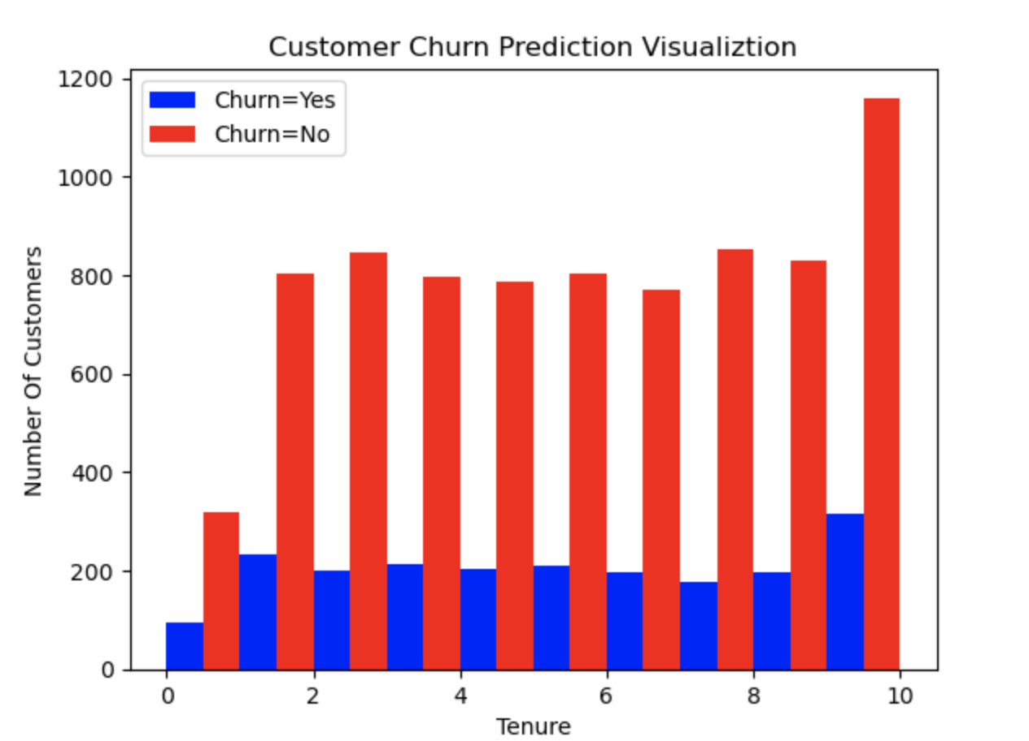
Data Exploration
For enhanced model performance and to avoid overfitting, the unique identifiers 'RowNumber', 'CustomerId', and 'Surname' were removed from our dataset, as they do not contribute to churn prediction. This ensures our model focuses on meaningful patterns that reflect genuine customer behavior.
The histogram reveals churn across varying tenures, peaking in the 10th year, which indicates the criticality of this period for retention efforts, despite also having the highest non-churn rates in the same year.

Slide 6
Data Preprocessing
Gender Transformation: The string labels in the 'Gender' column have been replaced with numerical codes, with 'Female' being assigned 1 and 'Male' assigned 0. This binary representation simplifies the inclusion of gender as a feature for the models.
Geography Encoding: One-hot encoding has been applied to the 'Geography' column. This technique creates new columns for each unique value in the original column and assigns binary codes. For instance, if 'Geography' contained 'France', 'Germany', and 'Spain', one-hot encoding would result in three new columns – 'Geography_France', 'Geography_Germany', and 'Geography_Spain'. In each row, a '1' is assigned to the column corresponding to the customer's country, with the rest set to '0'.
Boolean to Integer Conversion: Following one-hot encoding, the new geography columns, which are binary in nature, have been converted from boolean to integers. This conversion ensures that 'True' is represented as 1 and 'False' as 0, particularly for the 'Geography_France', 'Geography_Germany', and 'Geography_Spain' columns, making them ready for use as inputs in machine learning models.

Slide 7
Feature Scaling: The numerical variables 'CreditScore', 'Age', 'Tenure', 'Balance', 'NumOfProducts', and 'EstimatedSalary' have been standardized using MinMaxScaler. This scaler transforms each feature to a given range, usually 0 to 1, which prevents features with larger ranges from overpowering those with smaller ranges and ensures that each feature contributes equally to the model's prediction.
Data Cleaning: All rows containing null entries have been identified and dropped to ensure the integrity of the dataset. Upon examination, it was found that there were no rows with null entries, indicating that the dataset is complete and no further cleaning of missing values is necessary.

Slide 8
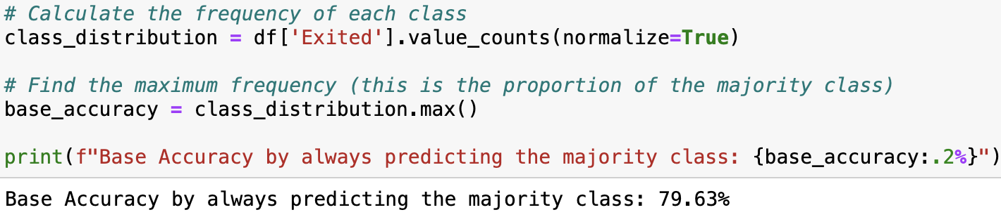
Base accuracy
This indicates that a naive prediction model, which predicts the majority class for every instance, would correctly predict the outcome 79.63% of the time without any further analysis.

Slide 9
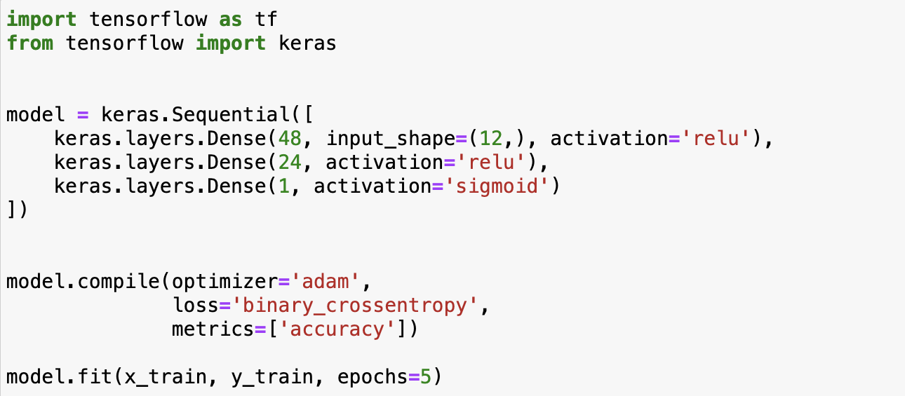
Evaluation of Artificial Neural Network for Churn Prediction

Slide 10
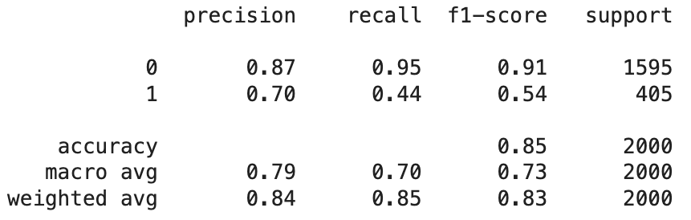
The model's accuracy improved from 82.96% at 5 epochs to over 88% at 100 epochs, showing more epochs significantly enhance performance. However, altering the network architecture, like the number of hidden layers, had minimal impact compared to increasing epochs.

Slide 11
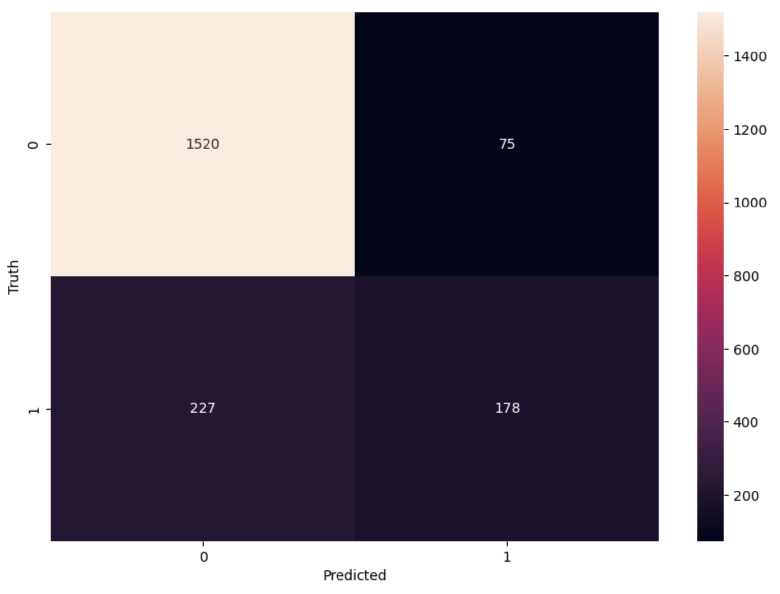

Slide 12
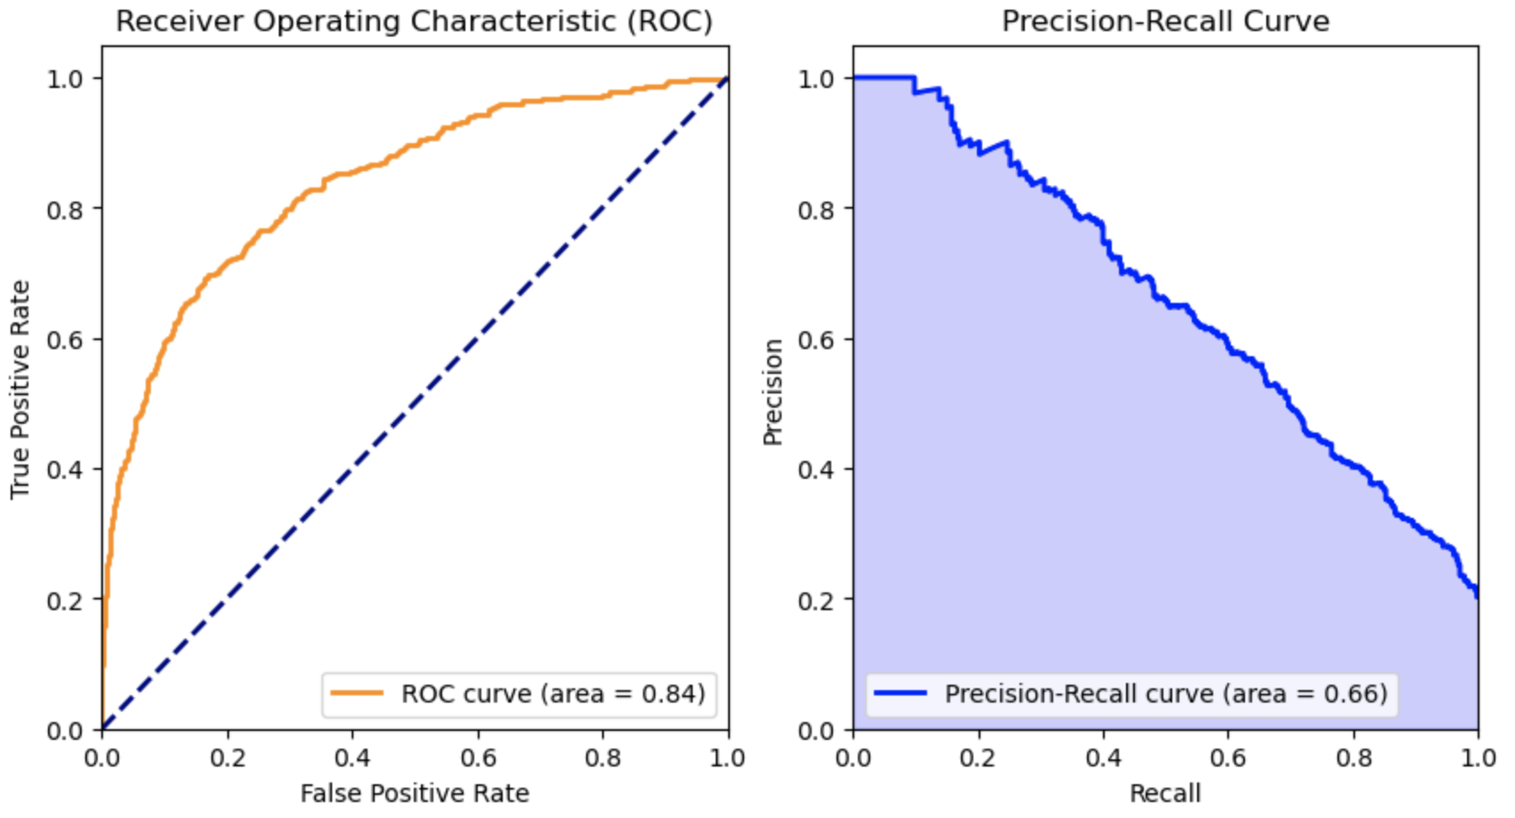

Slide 13
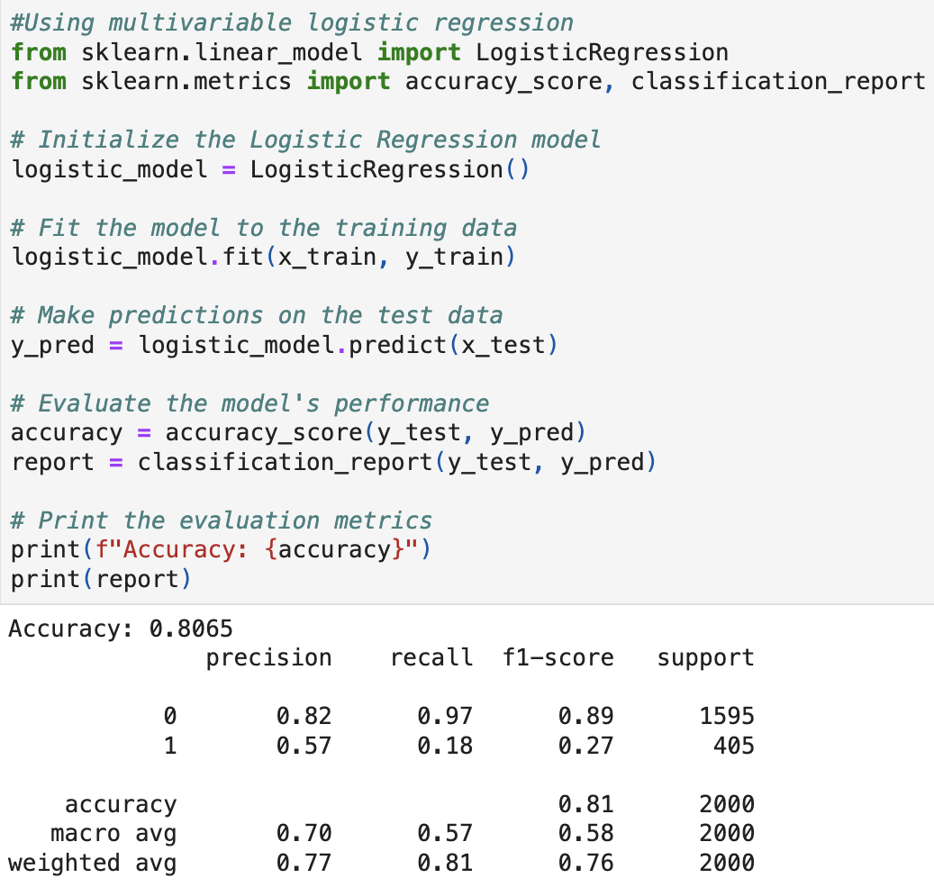
Multivariable Logistic regression model Evaluation

Slide 14
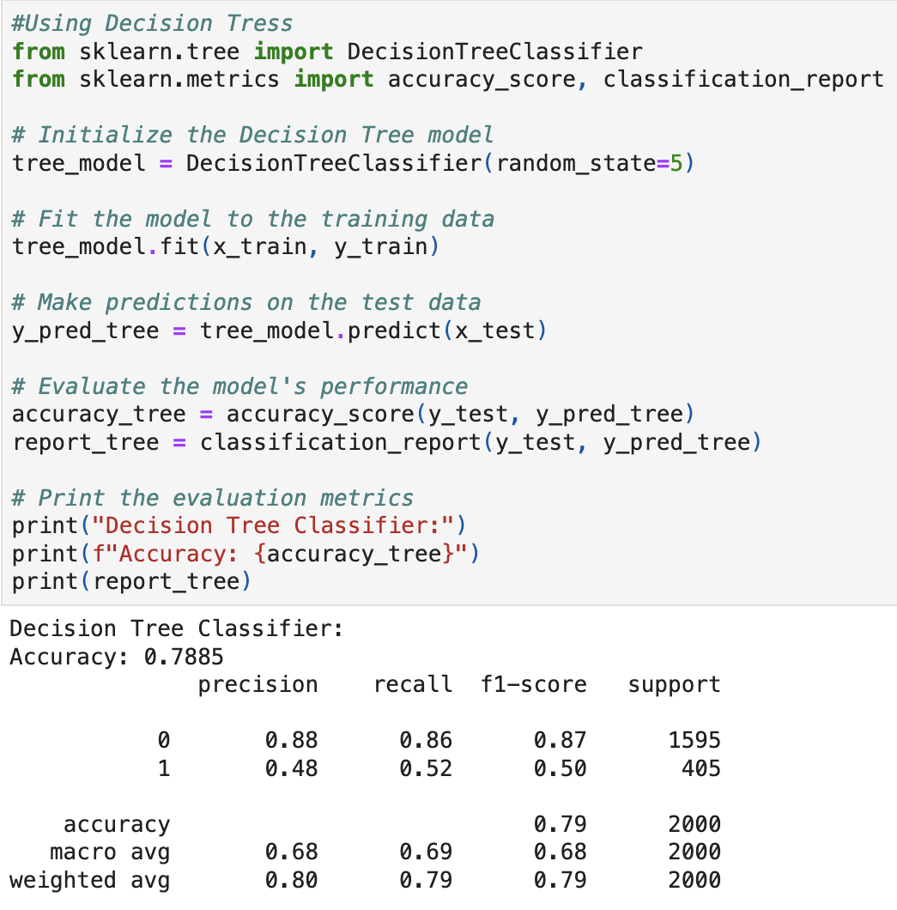
Decision Trees model Evaluation

Slide 15
Comparison of models and Conclusion
Accuracy Comparison:
"ANN Model: 85% - Highest"
"Logistic Regression: 80.65%"
"Decision Tree: 78.85%"
Precision Analysis (Class 0 'No Churn' / Class 1 'Churn'):
"Decision Tree: 0.88 / 0.48"
"ANN: 0.87 / 0.70 - Highest"
"Logistic Regression: 0.82 / 0.57"
Recall Analysis (Class 0 'No Churn' / Class 1 'Churn'):
"Logistic Regression: 0.97 / 0.18"
"ANN: 0.95 / 0.44"
"Decision Tree: 0.86 / 0.52 - Highest"
Conclusion:
The ANN offers a balanced approach, suitable for robust churn prediction. The Logistic Regression is biased towards the majority class, while the Decision Tree balances churn detection against a slightly lower accuracy.

Slide 16

THANK YOU

