Slide 1
Semantic Structure Identification using Image Detection and Unsupervised Learning

Slide 2
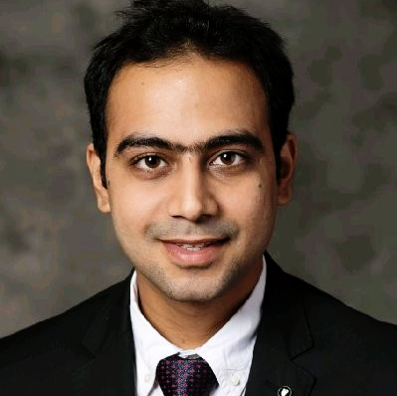
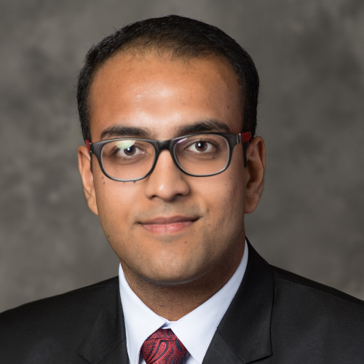

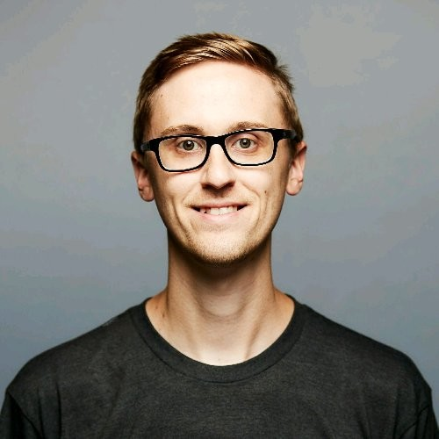
THE PURDUE TEAM:
Nipun Diwan
Udaiveer Singh Chauhan
Ananth Nath
Prof. Daniel Whitenack

Slide 3
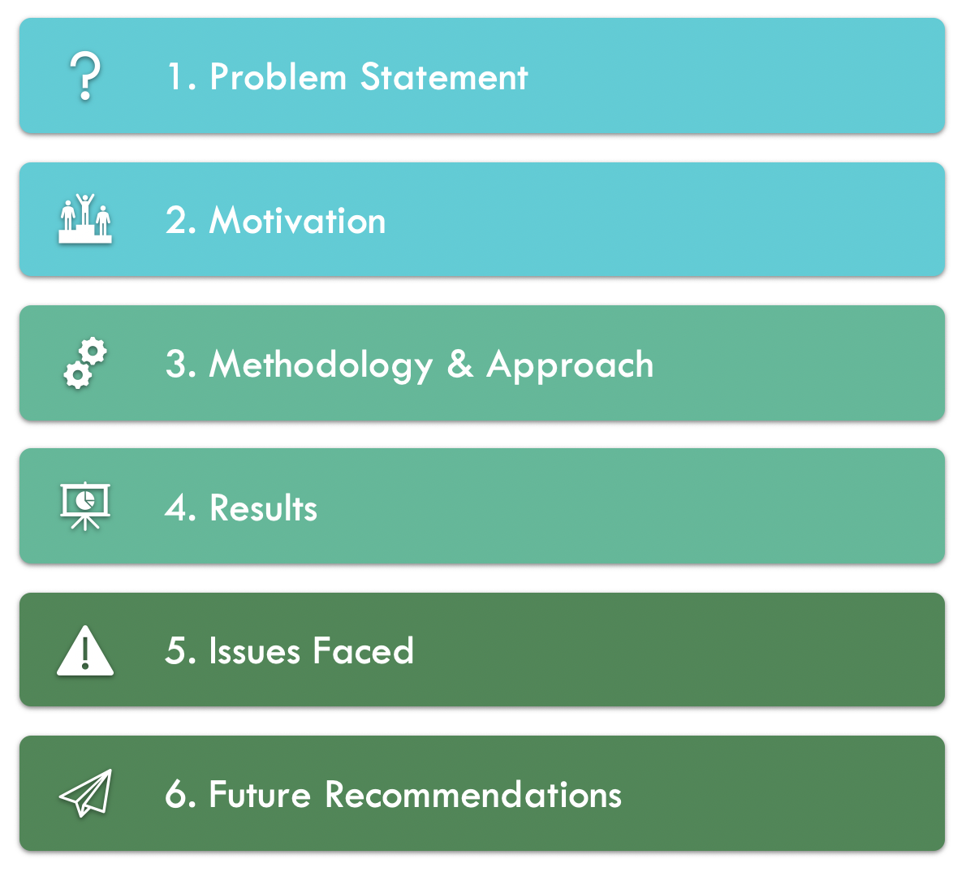
AGENDA

Slide 4
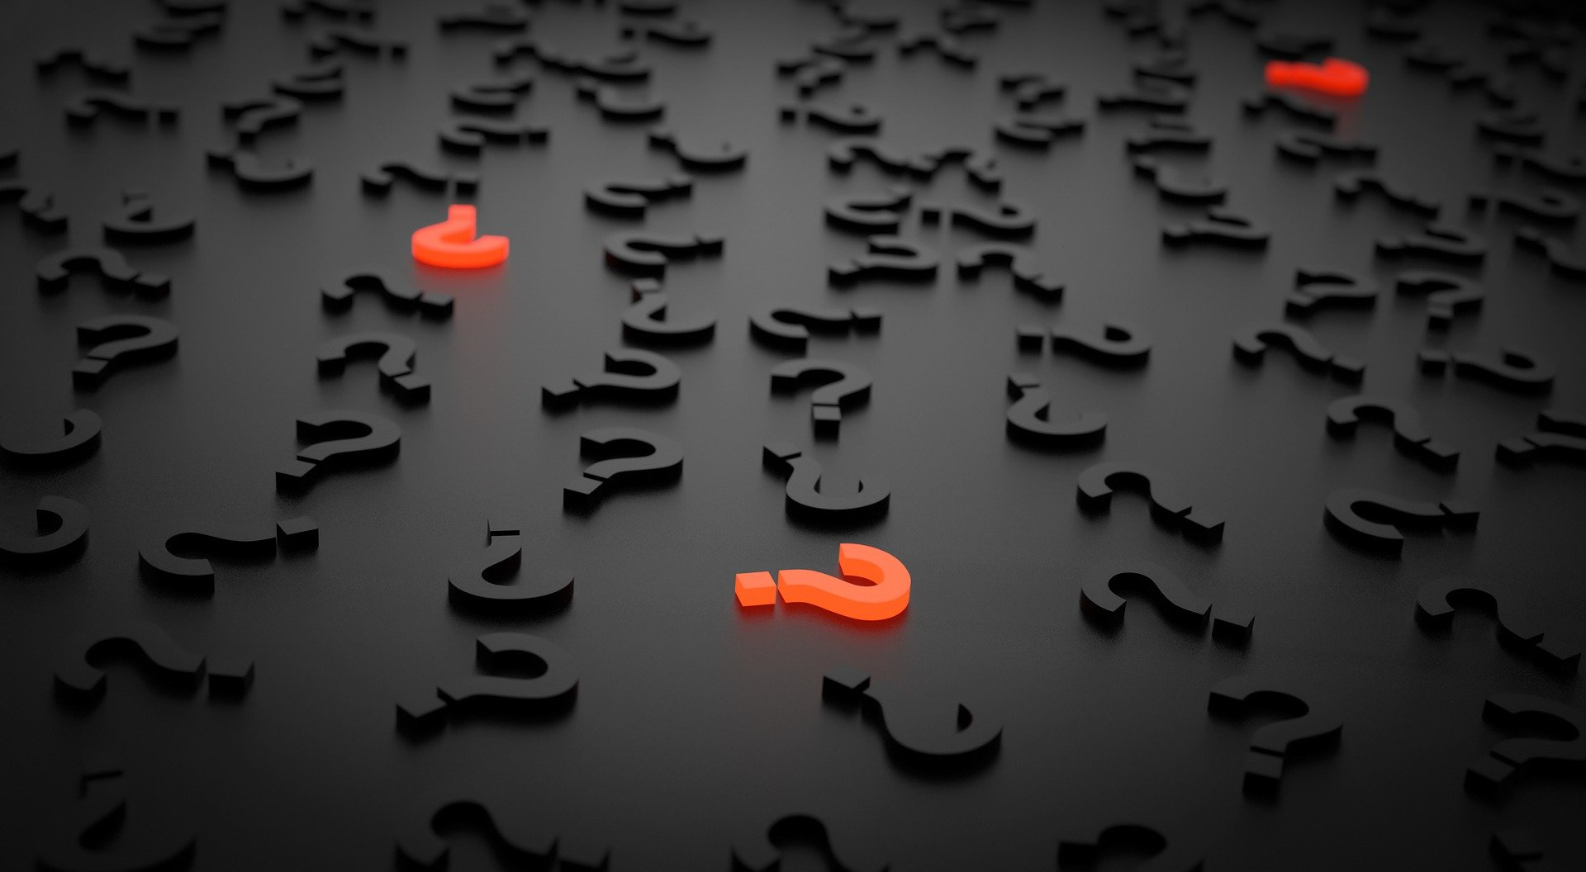
1.
PROBLEM STATEMENT

Slide 5
PROBLEMS IN EXTRACTING DATA
Data in multitudes of formats
Data-Wrangling a cumbersome task
Manual extraction of information
Time-consuming and error-prone
Hence, there is a need to make this process faster and efficient

Slide 6

2. THE REQUIREMENT

Slide 7

AUTOMATION
The key to handle data-extraction tasks efficiently

Slide 8

3. PREVIOUS RESEARCH

Slide 9
LET’S REVIEW SOME LITERATURE
2009
PDF-TREX: Approach for recognizing and extracting tables from PDF docs
(Ermelinda Oro, Massimo Ruffolo)
2012
Table-Header detection and classification
(Jing Fang, Prasenjit Mitra, Zhi Tang, C. Lee Giles)
2014
Comparison of two unsupervised table-recognition methods
(Stefan Klampfl, Kris Jack, Roman Kern)
2016
TensorFlow: A System for Large-Scale Machine Learning
(Martín Abadi, Paul Barham, Jianmin Chen, Zhifeng Chen, Andy Davis)
2016
TAO: System for Table Detection and Extraction from PDF Documents
(Martha O. Perez-Arriaga, Trilce Estrada, and Soraya Abad-Mota)
2017
Real-Time License Plate Detection Using OpenCV and Tesseract
(Rahul Palekar, Sushant Parab, Dhrumil Parikh)

Slide 10
First meeting with UQ team
Jan 10th
Data provided by UQ team
Jan 12th
Agreement on data annotation tool
Jan 23rd
Automation of annotation
Feb 13th
Table detection model working
Feb 26th
Initial run of the K-Means algorithm
Feb 28th
Final Presentation
May 5th

Slide 11
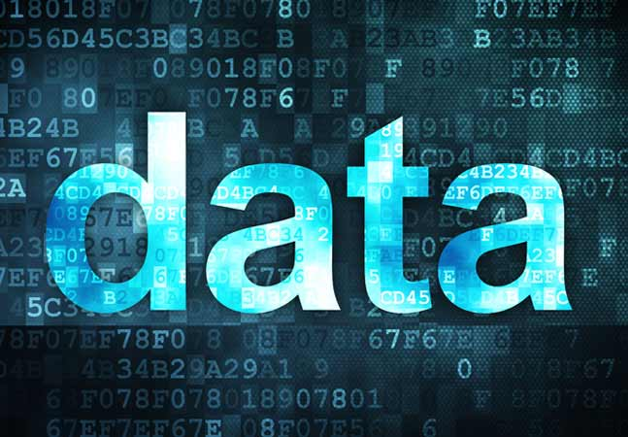
4. DATA

Slide 12
AVAILABLE DATA
413 PDF Files containing
Tables
Text
Images

Slide 13

5. METHODOLOGY

Slide 14
THREE-STEP APPROACH
Table Detection
Table Identification
Clustering

Slide 15
APPROACH IN DETAIL
Table Detection: Convert all PDF files to JPEG format and label data
Table Identification: Use TensorFlow and PyTesseract to identify table cells
Clustering: Unsupervised learning to form clusters of cells in identified tables
Document Conversion
Generate Word Bounding Boxes
Unsupervised Approach for Table Cell Detection

Slide 16
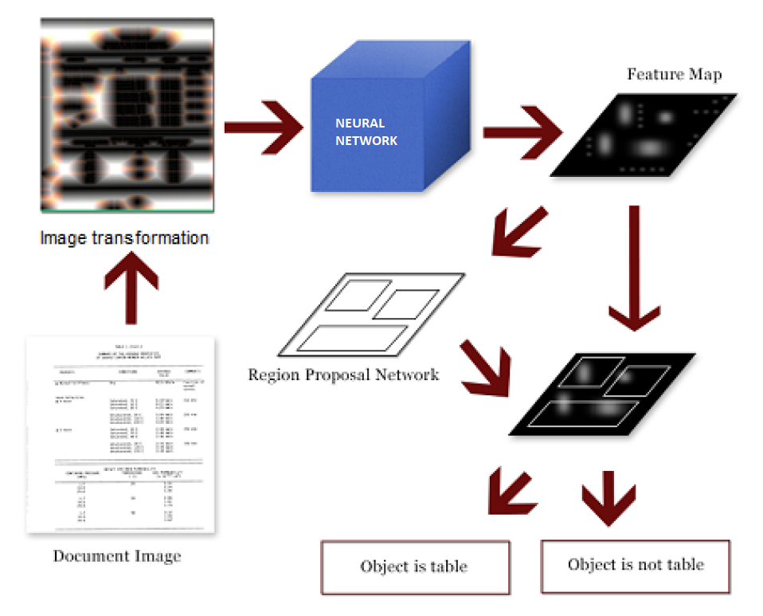
TABLE DETECTION

Slide 17
TABLE IDENTIFICATION
Step 1: TensorFlow trained to identify tables
Preprocessed Images
Step 2: Model predicts table coordinates
Bounding boxes drawn using OpenCV
Step 3: PyTesseract helps identify words & blocks of text

Slide 18
CLUSTERING
1. Row-level aggregation
2. K-Means Clustering on x coordinate
3. Cell-dentification using clusters

Slide 19

6. RESULTS

Slide 20
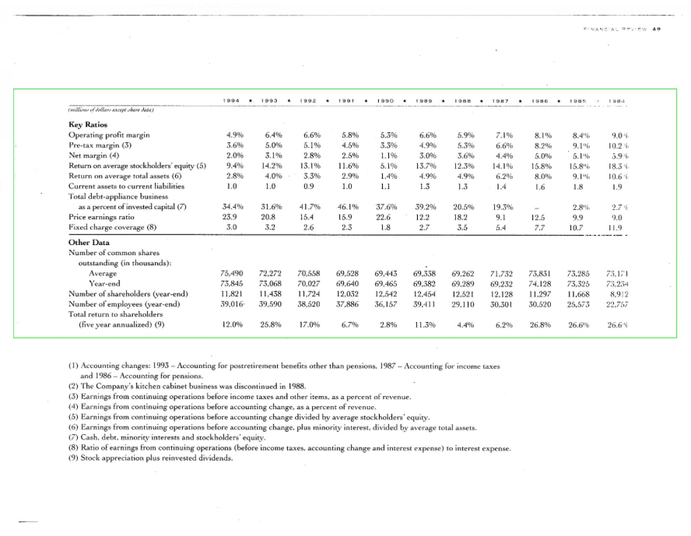

Slide 21
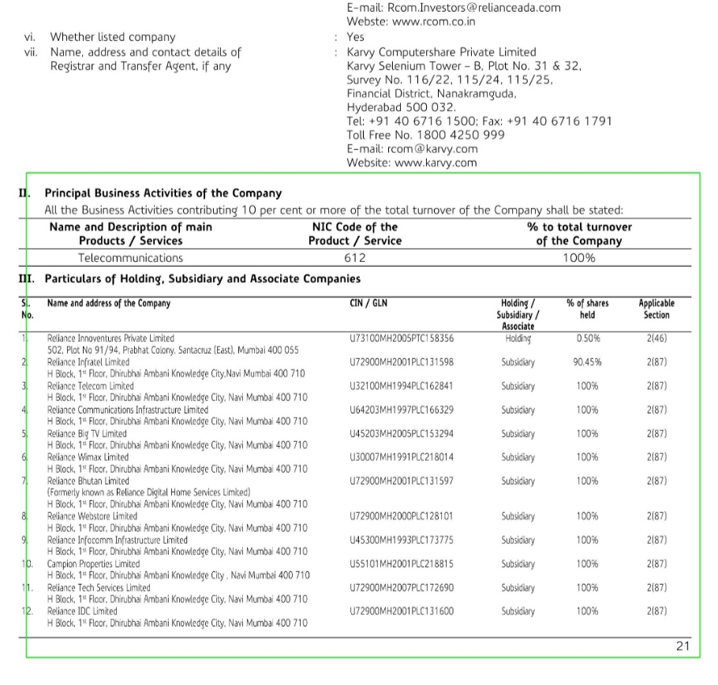

Slide 22
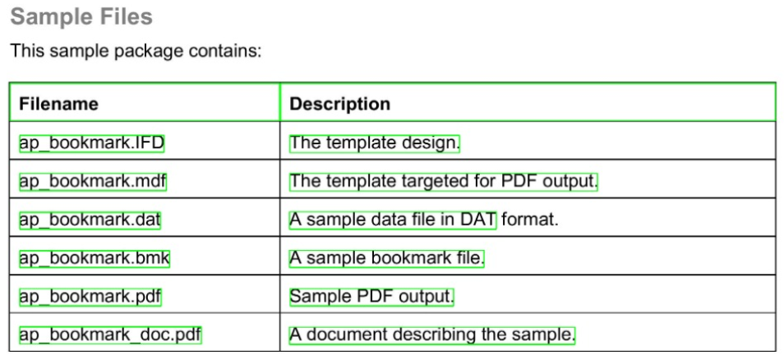
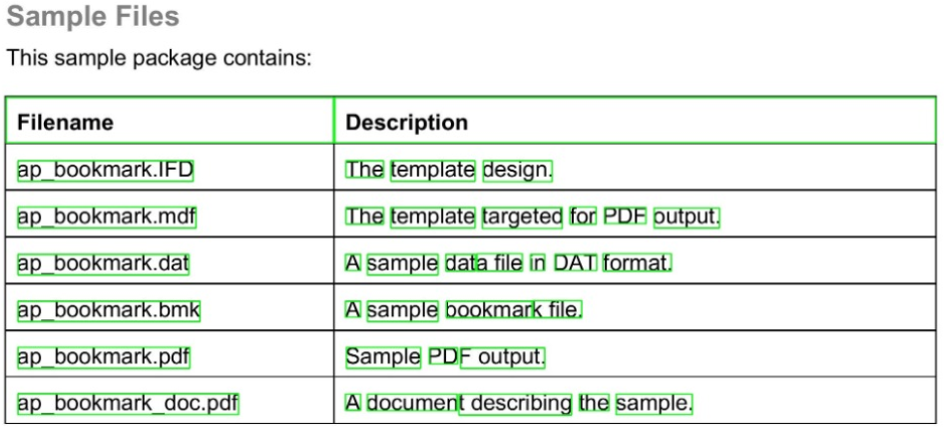
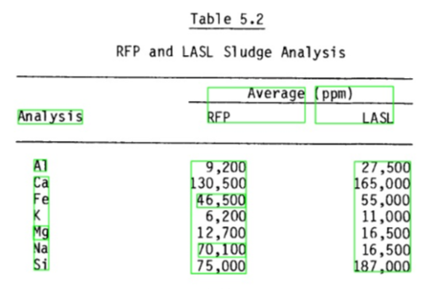
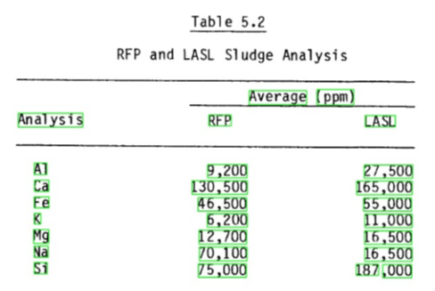
MODEL AND IDEAL OUTPUTS
Model Output (1)
Ideal Output (1)
Ideal Output (1)
Model Output (2)
Ideal Output (2)
Model Output (2)
Ideal Output (2)

Slide 23
PERFORMANCE METRICS
 | Table Detection | Word identification | Clustering
Accuracy | 60% | 90% | 70%
Partial Identification | 15% | 5% | 30%
Failed cases | 25% | 5% | 0%

Slide 24

7. ISSUES FACED

Slide 25
ISSUES FACED
Lack of labelled data
Special character recognition
Achieving semantic continuity in tables with multi line rows
Algorithm is clustering cells on a column level for certain tables

Slide 26

8. FUTURE SCOPE

Slide 27
IMPROVEMENTS & RECOMMENDATIONS
Increase number of training images for Table Detection Algorithm
Current approach uses 3 channel merge, conversion to grayscale can be tried
Modify features passed to the Clustering Algorithm

Slide 28
THANKS!

