Slide 1


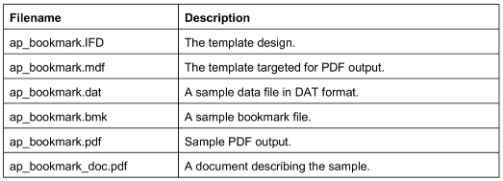
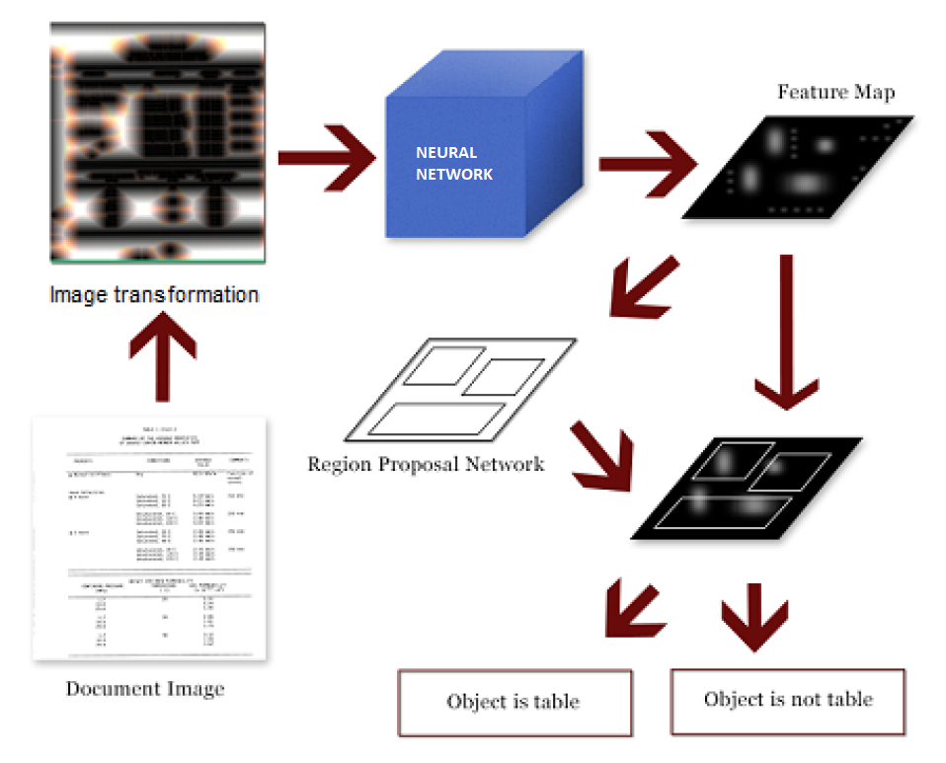
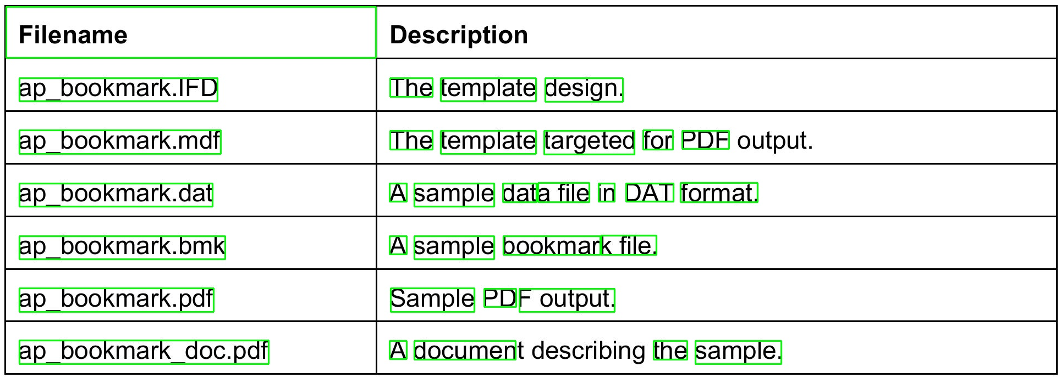
Semantic Structure Identification using Image Detection Algorithms
Udaiveer Singh Chauhan, Nipun Diwan, Ananth Nath, Daniel Lee Whitenack
Purdue University Krannert School of Management
uchauhan@purdue.edu; ndiwan@purdue.edu; natha@purdue.edu; dwhitena@purdue.edu
Abstract
Methodology
Results
In this project, we aim to develop a tool capable of identifying useful semantic structures from various file formats such as PDFs, images, etc. The tool attempts to identify cells of semantic continuity within files using Image recognition and Natural Language Processing. The tool will first convert each page of the document to an image in order to detect these cells. The second stage will detect semantic structures and linkages within the data (such as data originating in tables).
Methodology/Approach
Step 1: Data Preparation
We have a total of 418 documents in PDF format with approximately 50 pages in each. Each document is a combination of text in the forms of paragraphs & tables, and images, which might further consist of useful data.
PDF Files are converted into images
Blocks of text identified and bounding boxes drawn using OpenCV
Step 2: Table Identification
Images are transformed to bring uniformity and make it easier to train the tensor and predict whether an image contains a table
Step 3: Unsupervised Approach for Table Cell Detection
PyTesseract is used to label the words within the coordinates predicted by the deep learning model
K-Means Clustering is done in two steps:
Row wise Clustering: All words within the same row are clustered based on the X co-ordinates and horizontal distance between them
Column wise Clustering: All words within the same column are clustered based on their Y co-ordinates and their vertical distance
The model designed will be able to detect tables in the pdfs and provide the end coordinates of the principal diagonal
Step 1
The Table Detection algorithm was based on this paper “Table Detection using Deep Learning Azka Gilani, Shah Rukh Qasim, Imran Malik and Faisal Shafait”. We have used this approach for the initial phase of our project. The accuracy measures in the paper were around 60%.
Step 2
Using the output coordinates obtained from the previous step we were able to draw bounding boxes for each word within the table. For eg as seen in below figure
Step 3
From the above image, we can observe that the coordinates can be obtained for each word within the table.
Using these coordinates we tried to cluster the words based on their coordinates using DBSCAN. This approach failed as it could not deal with single word clusters
We then tried using Kmeans with the midpoint of the bounding boxes of each word. In this approach, the clusters failed as the distance between words of separate rows was also considered.
We are now working on another approach where we generate clusters based on rows and then on columns and obtain unique cells by using an intersection of the two sets.
Model Evaluation
To evaluate the performance of the model, we will be using the following metrics:
Sensitivity: identify number of correct instances of table cells predicted
Specificity: Identify number of cases where table cells were not predicted
Table Detection
Generate Word Bounding Boxes
Unsupervised Approach for Table Cell Detection
Step 1
Step 2
Step 3
Introduction
Figure 2. Three step methodology
Organizations operating in sectors such as financial, risk & compliance, consulting, or research are often challenged with data wrangling tasks
On average, employees spend two and a half hours every day seeking data
Key Data measures are usually not directly stored in companies' databases
Data is usually found in a variety of formats such as PDF, DOC, JPEG, etc.
Common data include accounting tables, price indices, investment details, records of credit history, etc.
Extraction process is manual, error-prone and time-consuming.
Figure 1. Screenshot from a PDF file containing a sample table
Goal
The main aim and motivation for this project is to:
Identify Tables in PDFs and other documents
Obtaining Word Clusters to get Semantically linked text in both Tables and Paragraphs of text
Challenges in sight
To achieve semantic continuity* in the text extracted from documents
To increase accuracy of the model in order to achieve a completely error prone tool that can solve problems for organizations
*The establishment of meaning and continuity in a model dealing with semantics
"file": "data/val/9541_023.png", "objects": [{"bbox": [26, 900, 2451, 2184], "label": "table", "prob": 0.8744}, {"bbox": [133, 544, 2390, 1476], "label": "table", "prob": 0.536}]
Literature Review
Figure 3. Preprocessing flow to differentiate tables from text
Literature Title | Motivation for Research | Takeaway from Research
Real Time License Plate Detection Using OpenCV and Tesseract (Palekar & Parab, 2017) | Implementation of image to text conversion has been tricky due to shortcomings of previous image processing applications. | Used the CV2 OpenCV library in Python language for image processing and Tessaract for text extraction from the processed image. Bounding boxes around the textual data are also created using the OpenCV library.
Table Detection in Document Images using Foreground and Background Features (Arif & Shafait, 2018) | Due to a variety of table layouts, it is difficult to design encoding techniques for extracting tables without any defined borders. | Proposed a deep learning based Faster R-CNN model for detection of tabular regions from document images based on the fact that tables usually contain more numerical data..
Table Recognition and Understanding from PDF Files (Hassan, 2007) | Presents a flexible method for detecting tables in PDF files not reliant upon one particular feature being present. | Defined a search method based on the principle of rectangular containment. Found a number of useful pre-processing steps useful in analyzing PDF files.
A Case Study on TensorFlow and Artificial Neural Networks (Vivekanandan, 2017) | TensorFlow performs very well on recognition problems, and the performance can be further improved by having more iterations. | Run our CNN models in TensorFlow and train them with hundreds of iterations.
Conclusions
With the digitization of most resources in the current business world, data is being stored and shared in multiple formats. This is why Table detection algorithms are important as they reduce the time required to parse through them and obtain the relevant information
Step 1
The model was able to predict tables. The performance can be improved by using more data points to train the model. Ideally the sample set should include over thousand images but we use only 400.
Step 2
We were able to generate word boxes perfectly using PyTesseract
Step 3
Identified that the best approach would be Kmeans as Dbscan required specification of minimum number of words per clusters. Currently working on this to improve accuracy and performance
First, all the words are bounded in boxes in Green
Second, sentence, line, and paragraph level aggregations are achieved
Acknowledgements
We thank Professor Daniel Lee Whitenack for his constant guidance on this project.

