Slide 1


Project
On
“Pneumonia Chest X-Ray Detection Model”
Guided By:
Ms. Anju Rajput
Assistant Professor
Presented By:
Ojasvi Sharma (20EJCCS187)
Nitin Malav (20EJCCS185)
Nipun Jain (20EJCCS181)

Slide 2
VISION AND MISSION OF INSTITUTE
Vision of the Institute
To become a renowned centre of higher learning, and work towards academic, professional, cultural and social enrichment of the lives of individuals and communities.
Mission of the Institute
To Focus on research and spirit of innovation that will drive academic orientation and pursuit at JECRC Foundation.
To Identify, based on informed perception of Indian, regional and global needs, areas of focus and specialization on which the College can concentrate.
To Undertake collaborative projects that offer opportunities for long-term interaction between academia and industry.
To Develop human potential to its fullest extent so that intellectually capable and imaginatively gifted leaders can emerge in a range of professions.

Slide 3
VISION AND MISSION OF DEPARTMENT
Vision of the Department
To become renowned Centre of excellence in computer science and engineering and make competent engineers & professionals with high ethical values prepared for lifelong learning.
Mission of the Department
M1- To impart outcome based education for emerging technologies in the field of computer science and engineering.
M2 - To provide opportunities for interaction between academia and industry.
M3 - To provide platform for lifelong learning by accepting the change in technologies
M4 - To develop aptitude of fulfilling social responsibilities.

Slide 4
COURSE OUTCOMES (COs)
CO1: Generate the report based on the Projects carried out for demonstrating the ability to apply the knowledge of engineering field during training
CO2: Demonstrate Competency in relevant engineering fields through problem identification, formulation and solution

Slide 5
CONTENTS
Problem – Pneumonia Medical Condition
Solution – Chest X-Ray Detection
Research and Data collection
Data Preprocessing
Model Development
Model Training and Validation Accuracy
Model Result
Conclusion
References

Slide 6
Pneumonia Infection
Pneumonia infection is a serious disease of the lungs with a range of possible causes.
Causes of Pneumonia : Virus, Bacteria and Fungus.
Prevalence of Pneumonia : Under-developed and Developing Countries
Affect of Pneumonia :Pneumonia infection is ranked as the eighth leading cause of death in the US. Also, it causes death in children younger than five years of age worldwide.

Slide 7
Effect of COVID-19
COVID-19 is caused by the novel coronavirus SARS-CoV-2, which primarily affects the respiratory system.
The impact of COVID-19 on pneumonia cases has been significant due to several factors:
Increased Pneumonia Cases
Overwhelming Healthcare Systems:
Changes in Pneumonia Diagnosis and Reporting
Impact of Preventive Measures

Slide 8
Chest X-Ray Detection
Chest X-rays are the commonly used radiological examination method to detect the Pneumonia infection and locate the infected area in the lungs.
Finding radiological examiners in remote places for analysis for more number of Chest X-rays is an extremely challenging task.
In recent times, artificial intelligence approaches are used to solve the challenges in several of medical diagnosis processes. Mainly, the deep learning and computer vision techniques are supports to the diagnosis of various cancer and diseases

Slide 9
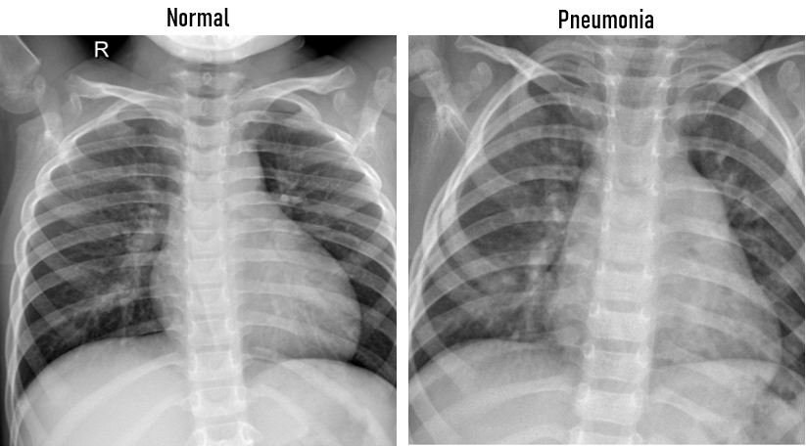
Research and Data Collection
The Chest X-ray dataset was downloaded from the open data repository for diagnosing pneumonia from chest images.
The Content-based visual information retrieval technique was used to retrieve the input images from the large database with minimum time conception.

Slide 10
Number of Images in Proposed Dataset
Class ID | Class Name | No of Training images | No of Testing images
0 | No Finding | 5950 | 150
1 | Pneumonia | 5950 | 150
Total Training Images |  | 11,900 | 300

Slide 11
Data Preprocessing
Data preprocessing is an important step in the data mining process. It refers to the cleaning, transforming, and integrating of data in order to make it ready for analysis. The goal of data preprocessing is to improve the quality of the data and to make it more suitable for the specific data mining task. Some Techniques are:-
Image Normalization
Data Augmentation
Noise Reduction

Slide 12
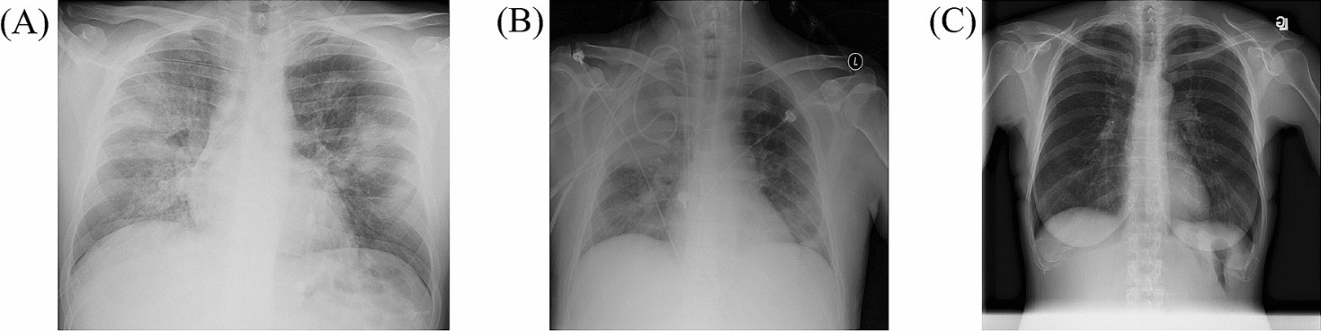
Data Augmentation
Data augmentation is a technique of artificially increasing the training set by creating modified copies of a dataset using existing data. It includes making minor changes to the dataset or using deep learning to generate new data points.
In pneumonia chest X-ray detection models, data augmentation is a game-changer to combat limited datasets. It artificially expands the training data by generating variations of existing X-rays (flips, rotations, brightness adjustments) to mimic real-world variations. This exposes the model to a wider range of features, reducing overfitting and ultimately leading to a more robust and accurate pneumonia detection system.

Slide 13
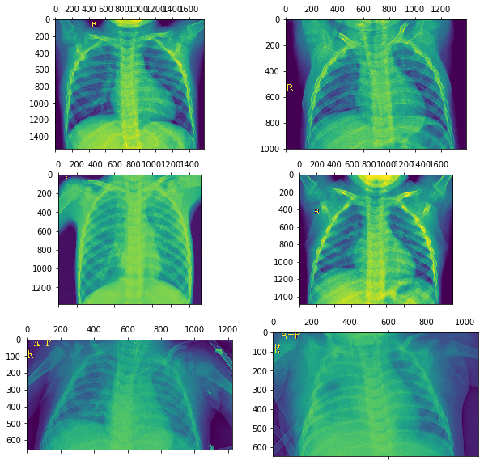
Steps Taken in Data Preprocessing
Rescaling of the images is done
by dividing each image by 255.
Image are resized to 128 by
128 pixels
Rotation of images performed
by 20 degrees horizontal rotation.
Width and height shifted by 0.2
fractions of total width and with
the input flipped horizontally.
Fig. Result

Slide 14
Model Development
The working model of Pneumonia detection by chest X-Ray is designed by using various tools and technologies such as:-
Numpy
Pandas
Matplotlib
TensorFlow
Keras

Slide 15

Keras
Keras acts as the user-friendly interface in your pneumonia X-ray model. Built on top of TensorFlow, it allows you to easily build and train your convolutional neural network (CNN) with minimal coding.

Slide 16

TensorFlow
TensorFlow is the workhorse behind your pneumonia X-ray model. It handles the complex math (convolutions etc.) to analyze the images, leverages powerful GPUs for faster training, and allows you to scale the model for even better results in the future.

Slide 17
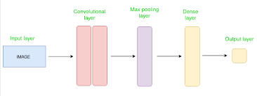
Convolutional Neural Network
This model leverages a Convolutional Neural Network (CNN) architecture, which is particularly well-suited for image analysis tasks like chest X-ray classification.
CNNs can automatically extract image features, eliminating the need for manual feature engineering and enabling the model to learn directly from the data.

Slide 18
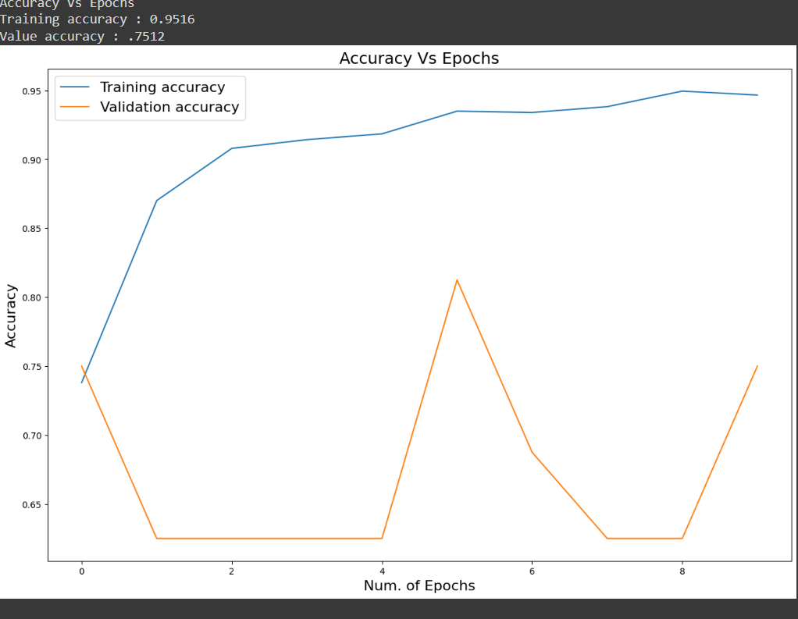
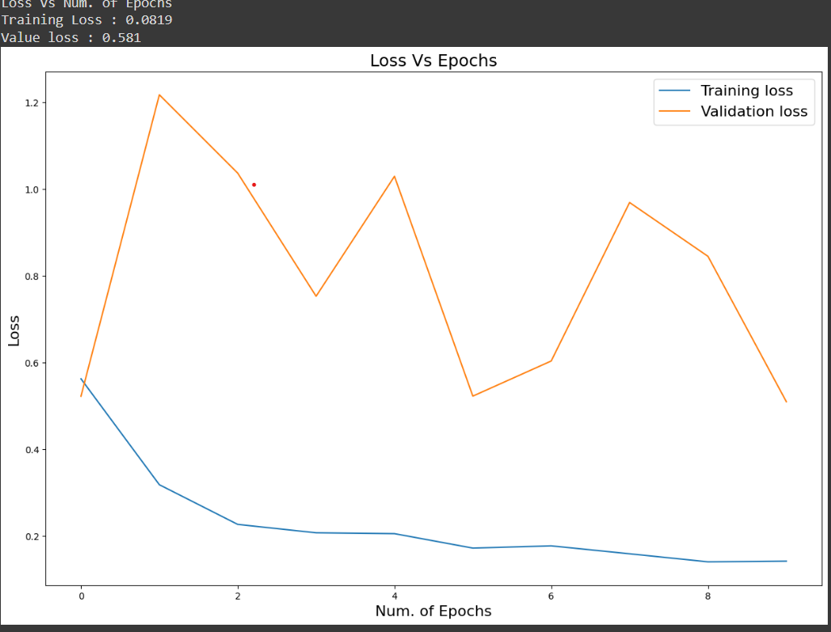
Model Training & Validation Accuracy
Training Accuracy = 95%
Validation accuracy = 85%

Slide 19
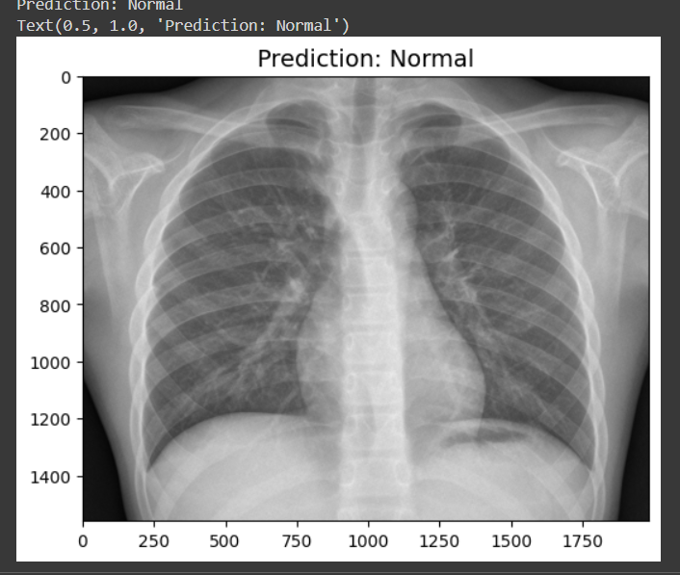
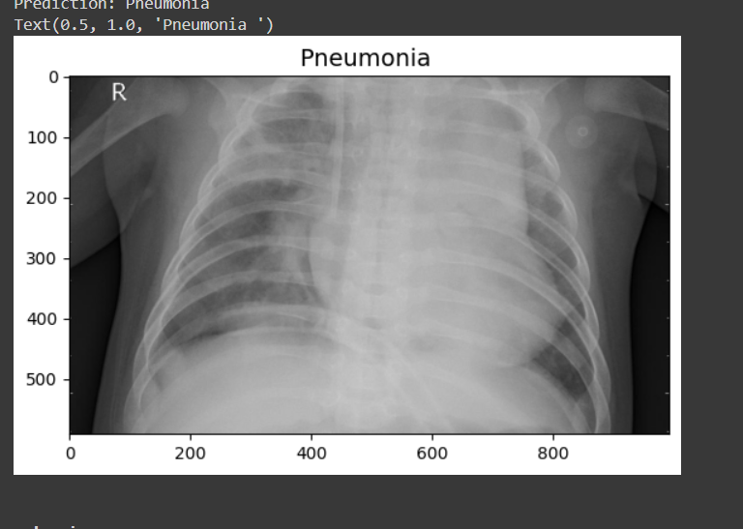
Model Result
Our model effectively distinguishes between healthy and pneumonia-infected lungs. As you can see (point to normal image), a healthy chest X-ray is correctly classified. In contrast, the model identifies the pneumonia case (point to pneumonia image) with a high confidence of 93.4%.

Slide 20
Conclusions
This research proposes a new model for automating pneumonia detection using chest X-ray data.
The data, collected from various patients, was meticulously reviewed and categorized by medical experts. The model was trained on a large dataset of chest X-ray images using advanced computational techniques. The training process involved numerous iterations to optimize its performance. To evaluate the model's effectiveness, unseen chest X-ray images were used for testing. The model achieved an impressive average accuracy of 94% in identifying pneumonia from these unseen images. These results suggest that this new approach holds significant promise for improving the efficiency and consistency of pneumonia detection from chest X-rays.

Slide 21
References
Jyothi et al. (2023) [ICRASET]. Used X-ray images and fake X-ray detection for Covid-19 detection.
Jindal et al. (2023) [GCAT]. Proposed federated learning and CNNs for pneumonia classification.
Warrier et al. (2023) [ICCCNT]. Presented an optimal deep ensemble model for pneumonia classification from chest X-rays.
Shourie et al. (2023) [CONIT]. Developed an efficient CNN framework for radiologist-level pneumonia detection using chest X-ray images.
Mazumdar et al. (2023) [ICICCS]. Implemented a CNN algorithm for pneumonia detection using chest X-ray images.

