Slide 1
Coursera Capstone Project
Deciding Where To Open A New Venue in London
A Presentation

Slide 2
Introduction
London is a great city. It is diverse, multicultural and full of opportunities. But there is also another side to its popularity and appeal. London is an expensive place to live and thrive. Many businesses want to open a venue here and many pay top price to have their window on Piccadilly or Oxford Street. But what about those, who want to start their own business and cannot really afford to open in the City yet? Where is it best to open a new place? Where will it be cheapest and will have enough people living around to be popular? Where the competition is not too overwhelming?

Slide 3
If we consider all of these questions, it might be a good idea to turn to data on the outer London, to look into the numbers with a bit more scrutiny, I have turned to the following sources:
1. Wikipedia list of London Boroughs with coordinates.
2. Foresquare data on the most popular venues in the respective boroughs
3. Online based data on rent in London boroughs

Slide 4
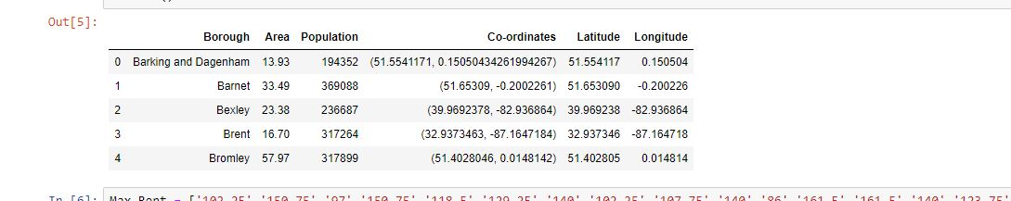
Methodology
First a brief look of the locality we are exploring -

Slide 5
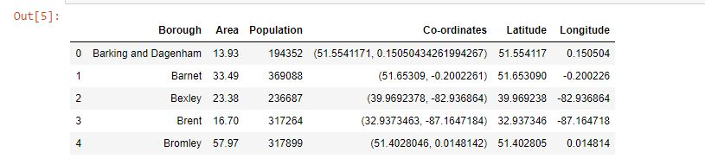
And follows –

Slide 6
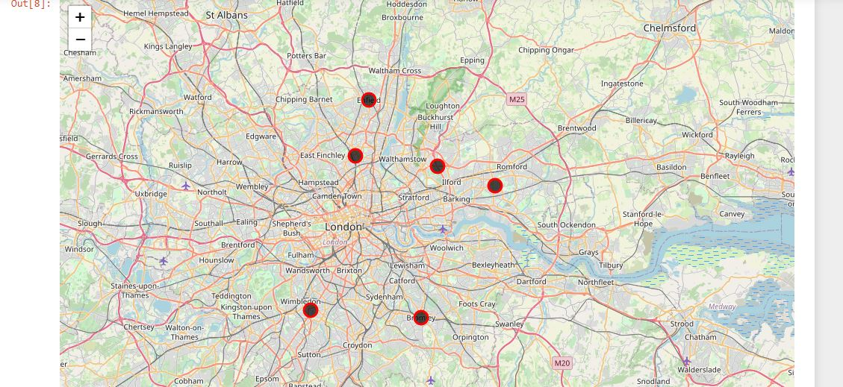
Now a representation of our locality on folium map -

Slide 7
First thing that comes to mind is how far apart they are, except maybe the top right corner ones. Due to the different size boroughs, quite a drastic difference in cultural and ethnic diversity in each borough, it will be more than interesting clashing them against each other!
To get a feel for what is the most and least favored venues for the people who live in the boroughs in question, we will use Foursquare data for venue exploration around the borough coordinates. Since in London you have everything pretty much everywhere, we will need to limit the amount of reviewed venues. For that, we will need to filter each borough`s preferences for their top 5 places of interest in the format below.

Slide 8
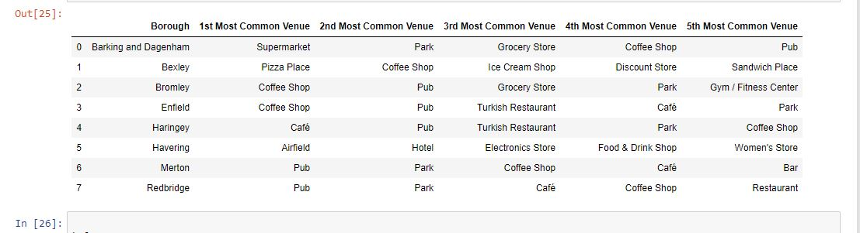
Something like this –

Slide 9
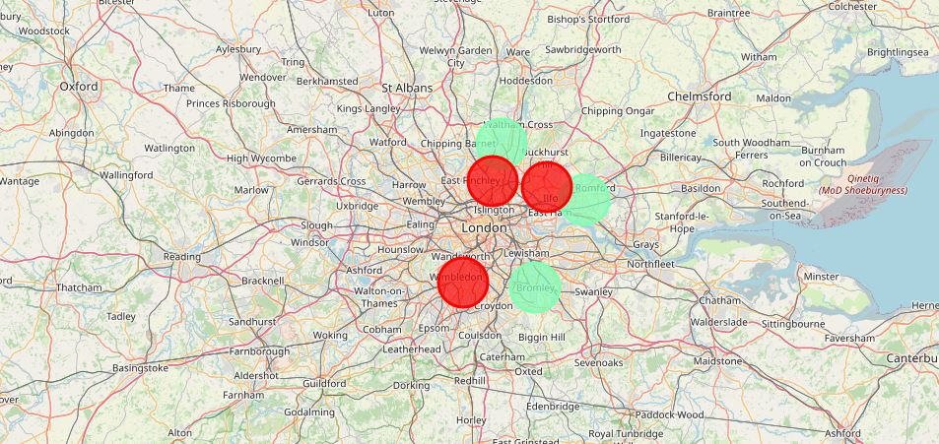
Now we identify distinct clusters –

Slide 10
The first pattern and a very British picture: Pub as a most popular venue, and for those, who don`t feel like a visit to a pub can enjoy the nature. This cluster is hardly of interest, because it will be problematic to open a new Pub. Not to mention a Park... Amongst the most popular venues are also restaurants, which can be of interest to foodies and the chefs living close by.
Second cluster, and the most controversial. Enfield is one of the bigger outer London boroughs, and the data, that we get can differ massively within the same borough: those living closer to M25 in the suburban houses tend to stay indoors and spend more time with their families and cook at home. On the other hand, those living closer to the inner borough limits may be more outgoing, and because of this contribute the most to our dataset. Regardless, with not too high rent, big and a very diverse population, Enfield is definitely worth considering

Slide 11
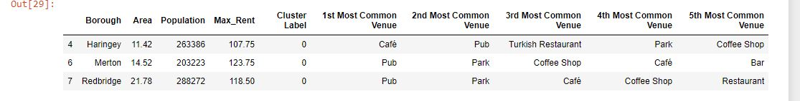

Slide 12
Results
Results of the above analysis and clustering cam be summarized:
1. The most popular social venues, outside of Inner London boroughs are Pubs and Coffee shops
2. Northern boroughs are more prone to visiting pubs, whereas southern boroughs are most likely to shop and have the social life from home
3. Within top 5 places of interest in every borough is an ethnic restaurant
4. Rent price is not so much a factor for going out - the demand is not affected by difference in costs

Slide 13
Findings
Looking at the data, Bromley and Enfield are the best places outside of Central London where a new venue is worth opening. However, a lot of information is not taken into account, and cannot be obtained from Foursquare Developer:
1. Higher ethnic presence in a given borough can and will influence the popularity of a given cuisine.
2. Closer proximity to Inner boroughs and better transport links allows people to travel to the neighboring borough and impact the measurements
3. Many small venues are not registered in Foursquare and are marketed via word-of-mouth, and are not taken into account
Regardless, the analysis provided an insight into what people like and opt for, when it comes to going out in their own neighborhoods.

Slide 14
Conclusion
Finally to conclude this project, I had a great trial run at solving a real-life problem, using available data to find a business solution - choosing to open a venue in London. I have made use of some frequently used python libraries to manipulate data, use Foursquare API to explore the information on the Boroughs I looked into and managed to make a map of results, that allowed me to illustrate my point graphically and quite clearly to someone, not familiar with data manipulation and who only wants to know one thing - where can I setup my new business?

