Slide 1
ECE 18-649Final Project Report
December 12, 2012
Group # 2
Jacob Olson
Nicholas Mazurek
Nipunn Koorapati
Benet Clark
Benet Clark - Group 2

Slide 2
OVERVIEW
Project Statistics
DriveControl design
  Time Triggered Requirements
  State Chart
  Connections to other modules
  Code
  Testing
Lessons learned
Open issues
Benet Clark - Group 2

Slide 3
STATISTICS
Midsemester | Final
14 scenarios and sequence diagrams 117 total SD arcs | 16 scenarios and sequence diagrams 131 total SD arcs
46 lines of requirements | 63 lines of requirements
7 state charts 19 states 28 arcs | 7 state charts 24 states 37 arcs
1882 lines of non-comment code | 3094 lines of non-comment code
7 unit tests | 11 unit tests
16 integration tests | 16 integration tests
53 revisions | 100 revisions
58 peer reviews 87 defects found. All fixed | 105 peer reviews 125 defects found. All fixed
12 defects found via test. All fixed | 22 defects found via test
Benet Clark - Group 2

Slide 4
TIME TRIGGERED REQUIREMENTS
State Variables used:
CurrentDirection = {Up, Down, Stop}
  Holds the direction that Drive should be set to
Benet Clark – Group 2

Slide 5
TIME TRIGGERED REQUIREMENTS
Macros used (shorthand notation):
CurrentFloor
  Value of f for whichever mAtFloor[f, b] is true
LevelingDirection = {Up, Down, Stop}
  If exactly one Level[d] is false, it is set to d, otherwise Stop.
DesiredFloorDirection = {Up, Down, Stop}
  Relative direction of mDesiredFloor.f from CurrentFloor
CommitPoint = {Reached, NotReached}
Safe = {True, False}
  Evaluates to true if mEmergencyBrake is off
Obese = {True, False}
  Evaluates to true if mCarWeight > MaxCarCapacity
ApproachingFloor = {True, False}
  Detects whether or not the car is decelerating to a floor
Benet Clark – Group 2

Slide 6
TIME TRIGGERED REQUIREMENTS
6.6: If Safe equals False, then Drive shall be set to (Stop, Stop)
6.7: If DriveSpeed equals (s,d), mDriveSpeed shall be set to (s,d)
6.8: If exactly one mLevel[d] is False, and either mDesiredFloor.f equals CurrentFloor or any mDoorClosed[b,r] are False, then
    6.8.1: Drive.s shall be set to Level
    6.8.2: CurrentDirection shall be set to Stop
6.9: If all mLevel[d] are True, and either mDesiredFloor.f equals CurrentFloor or any mDoorClosed[b,r] are False, then
    6.9.1: Drive.s shall be set to Stop.
    6.9.2: CurrentDirection shall be set to Stop.
    6.9.3: ApproachingFloor shall be set to false
*Updated for Fast Speed Feature
Benet Clark - Group 2

Slide 7
TIME TRIGGERED REQUIREMENTS
6.10: If mDesiredFloor.f is valid and does not equal CurrentFloor, and all mDoorClosed[b,r] are True, then
    6.10.1: Drive.s shall be set to Slow.
    6.10.2: CurrentDirection shall be set to DesiredFloorDirection.
6.11: If ApproachingFloor is false, and DriveSpeed is Slow, then Drive.s shall be set to Fast.
6.12: If CommitPoint is Reached, then:
  6.12.1: Drive.s shall be set to Slow
  6.12.2: ApproachingFloor shall be set to True
6.13: mDrive shall always be set to Drive.
6.14: Drive.d shall always be set to CurrentDirection.
*Updated for Fast Speed Feature
Benet Clark – Group 2

Slide 8
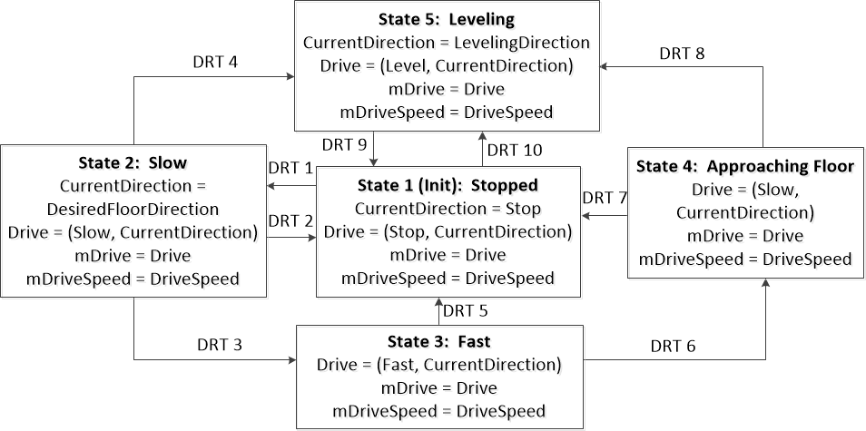
STATE CHART
Nick Mazurek – Group 2

Slide 9
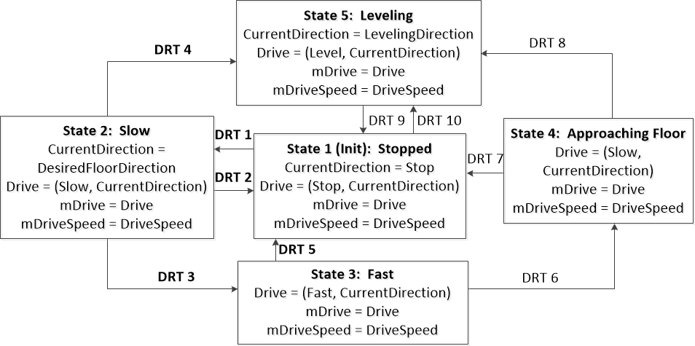
STATE CHART
DRT1 | mDesiredFloor!=CurrentFloor && mDesiredFloor.f is valid && mDoorClosed[*,*] == True && Safe && !Obese
DRT2 | mLevel[*]==True || Safe==False
DRT3 | CommitPoint is not reached && DriveSpeed >= SlowSpeed && Safe && !Obese
DRT4 | mDesiredFloor==CurrentFloor && DriveSpeed<=SlowSpeed && Safe && !Obese
DRT5 | Not Safe || Obese
Nick Mazurek – Group 2

Slide 10
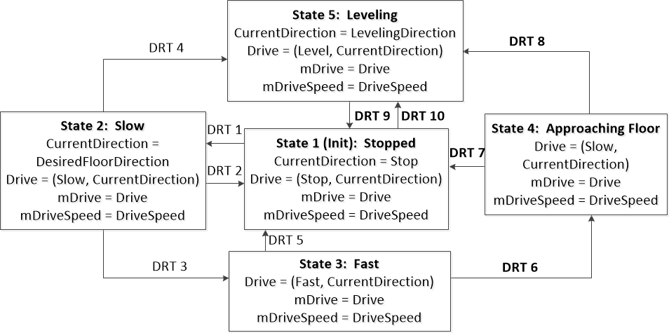
STATE CHART
DRT6 | CommitPoint is reached && Safe && !Obese
DRT7 | Not Safe or Obese
DRT8 | mDesiredFloor==CurrentFloor && DriveSpeed<=SlowSpeed && Safe && !Obese
DRT9 | mLevel[*]==True || not Safe
DRT10 | Car is not level && Safe && (mDesiredFloor==CurrentFloor || !(mDoorClosed[*]==True))
Nick Mazurek – Group 2

Slide 11
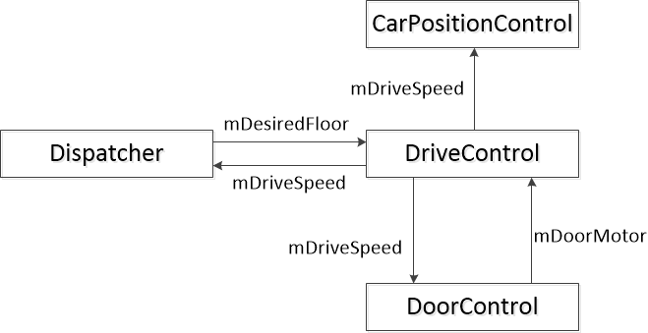
Interaction with Other Modules
Jacob Olson – Group 2

Slide 12
CODE
Followed directly from the state chart
Basic format is as follows
switch (currentState) {
case STOPPED:
set variables
determine nextState
break;
etc…
}
currentState = nextState;
Macros implemented as helper methods
Jacob Olson – Group 2

Slide 13
TESTING
Updated unit tests/integration tests for new design with fast speed
One major bug found via Acceptance Test
  Elevator must Level when passengers enter
  Even when obese. Our elevator refused to move when obese
  Acceptance test uncovered issue
We found several more bugs in the dispatcher that manifested themselves in the Drive. DriveControl blindly follows mDesiredFloor.f
Ran again with -fs 5.0
  We had to adjust the CommitPoint slack to be relative to speed
  Otherwise we missed floors
  Now we are robust to changing fast speed levels
Jacob Olson – Group 2

Slide 14
LESSONS LEARNED
What worked well:
  Peer Reviews found most silly errors
    And some high-level requirement violations
    And some non-bugs too, but that's okay sometimes
  Acceptance tests found major failure conditions
    Like not leveling when obese
    Or missing a floor due to not-enough-slack
  Github
    Used it to share/view changes to design and code
    Pull-requests used to signify ready-for-review
What didn’t work well
  Unit Tests / Integration Tests rarely found bugs in design.
  When they failed, the majority of the time it was due to a bug in the test itself. Often timing of messages.
  Github went down on Friday (a due date)
    We used an AFS git server as a backup upstream
Nipunn Koorapati – Group 2

Slide 15
OPEN ISSUES
Runtime Monitor has bugs which creates false positives
  Hall Calls turn off a bit before the RTM check
  Delay between Doors Open -> Lantern on due to slow period. RTM is unhappy.
We're not sure if we're violating HLR yet since our Runtime Monitor has so many false positives.
  We might be okay. We might not
Nipunn Koorapati – Group 2

Slide 16
Suggestions
Advice on Unit/Integration tests
  Goal: make sure code matches state chart
  Non-Goal: Using minimum timing for message propagation
  We spent more time debugging the timing on our tests than actually finding bugs in code
  Keep it simple. Spread out timing.
    Make sure it works. Don't waste tons of time.
    +500ms between each message.
      Overkill? Maybe. Works? Yes.
Nipunn Koorapati – Group 2

