Slide 1
Seizure Detection
BM4151 – Biosignal Processing
23/05/2017
K. C. M. Madarasingha
W. N. D. Perera

Slide 2
Progress Thus Far
Familiarization with literature
Reading seizure data to MATLAB
Preprocessing data by Low Pass Filtering
Extraction of energy from 0 – 16Hz and 16 – 25Hz bands
Creating SVM model

Slide 3
Things To Do
Feature extraction using PCA
Trying other types of classifiers
Selecting several other features to improve accuracy

Slide 4
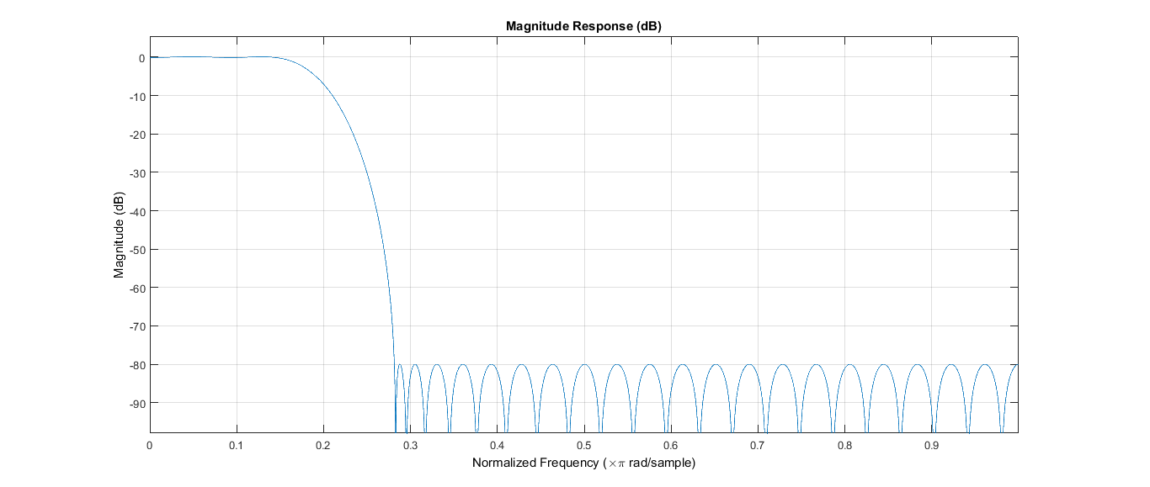
Low Pass FIR Filter Response

