Slide 1
Problem Statement
In today's digital age, safeguarding user password keys stored on disk is critical. Unauthorized access to these stored passwords can lead to severe security breaches and data theft.

Slide 2
Unique Idea Brief (Solution)
Our approach employs a multi-faceted security strategy, integrating hardware-based security modules, sophisticated encryption methods, and rate-limiting protocols to secure user password keys at rest.
By utilizing Trusted Platform Modules (TPMs) and Titan security chips, we anchor decryption keys to specific devices, significantly mitigating the risk of brute force attacks.

Slide 3
Features Offered
1. Enhanced security with TPMs and Titan chips.
2. Rate-limiting protocols to prevent unauthorized access attempts.
3. Robust AES-GCM encryption for password keys.
4. Personalized salt and key derivation functions for enhanced security.

Slide 4
Process flow
1. The user enters their password.
2. The password is hashed with a unique user-specific salt.
3. A key derivation function generates the input for hardware-backed security steps.
4. Rate-limiting ensures controlled decryption attempts.
5. The decryption key unlocks the encrypted data.

Slide 5
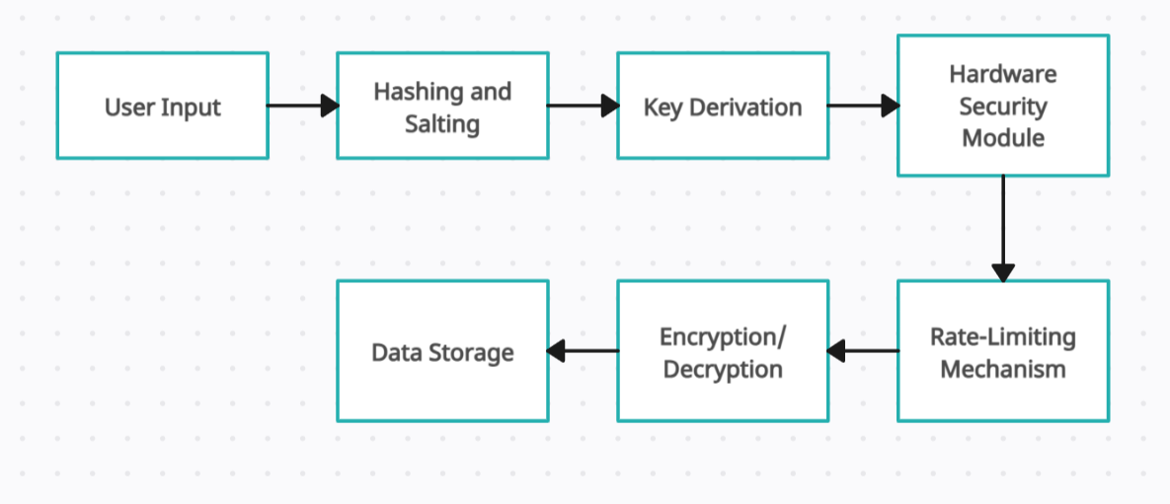
Architecture Diagram
A visual representation of the process flow, detailing the interactions between user input, hashing, key derivation, hardware security, and data decryption.

Slide 6
Technologies used
1. Trusted Platform Modules (TPMs)
2. Titan security chips
3. AES-GCM encryption
4. Scrypt key derivation function

Slide 7
Team members and contribution
Nipun Ramteke - Project Lead

Slide 8
Conclusion
Securing user password keys at rest is paramount to protecting sensitive information. Our solution leverages advanced hardware and encryption technologies, providing a comprehensive defense against sophisticated attacks.

