Slide 1

M. Tech. Thesis
Device Analysis and Simulation of Vertical Schottky Barrier Diode
Presented by – Nipun Sharma

Slide 2

Vertical Schottky Diode Simulation Problem
Generic Metal
Schottky Junction
Schottky Barrier Height : q$φ_{B_{n}}=$0.7 eV
(i) Simulate the Forward & Reverse I $\sim$V characteristics of the diode. Extract cut-in voltage & Reverse Saturation Current.
(ii) Simulate the C $\sim$V characteristics of the diode & extract built – in potential.
(iii) Plot Energy Band Diagram for:
V_{anode} = 0.1 V
V_{anode} = 0.2 V
V_{anode} = 0.3 V
V_{anode} = 0.4 V
1 $μm$
2 $μm$
$$n −Si$$
N_{D} $≈$ 10¹⁶ cm⁻³
Ohmic Contact
1 16 – March – 2026

Slide 3
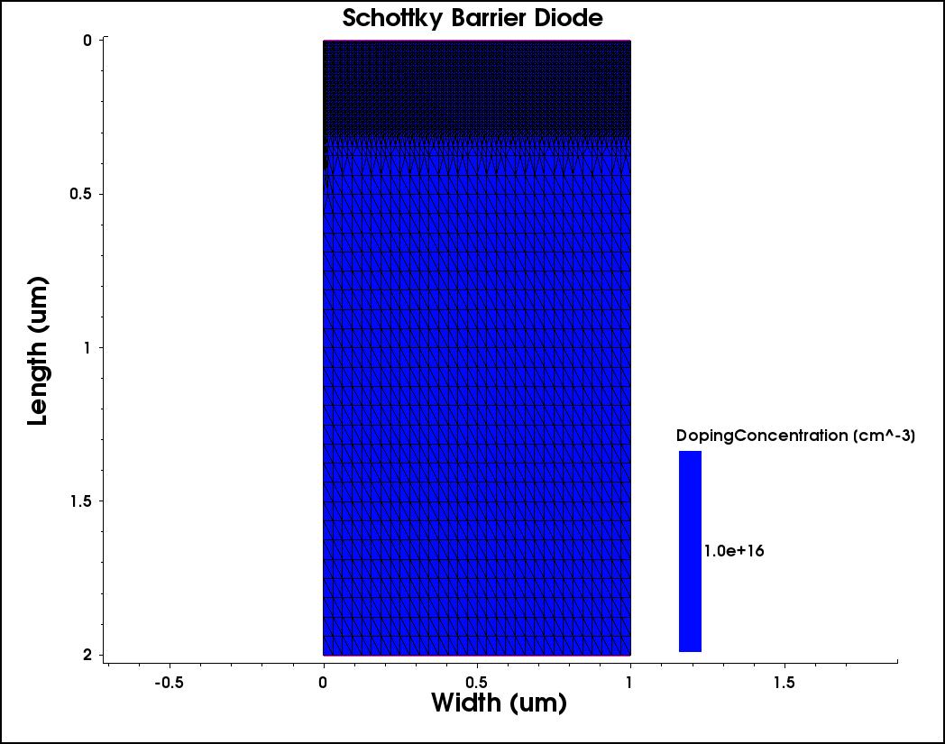
Vertical Schottky Diode Numerical Structure
Width = 1 $μ$m
Length = 2 $μ$m
Doping Concentration(N_{D}) = 10¹⁶ cm⁻³
Max Length_{Global Meshing} = 40 nm
Min Length_{Global Meshing} = 10 nm
Max Length_{Interface} = 10 nm
Min Length_{Interface} = 2 nm
Mesh Elements = 12318
Mesh Points = 6227
2 16 – March - 2026

Slide 4
Vertical Schottky Diode I – V Characteristics (Forward Bias)
3 16 – March - 2026

Slide 5
Cut – in Voltage extraction using $\frac{d^{2}I}{dV^{2}}$ Method
Cut-in Voltage V$γ=$0.170 V
4 16 – March - 2026

Slide 6
Vertical Schottky Diode I – V Characteristics (Reverse Bias)
Reverse Saturation Current
|J| = 8.141 x 10 ⁻⁶ A/cm²
5 16 – March - 2026

Slide 7
Schottky Barrier Diode C – V Characteristics
Built-in Potential
V_{bi} = 0.457 V
Frequency = 1MHZ
Interval = 500
6 16 – March - 2026

Slide 8
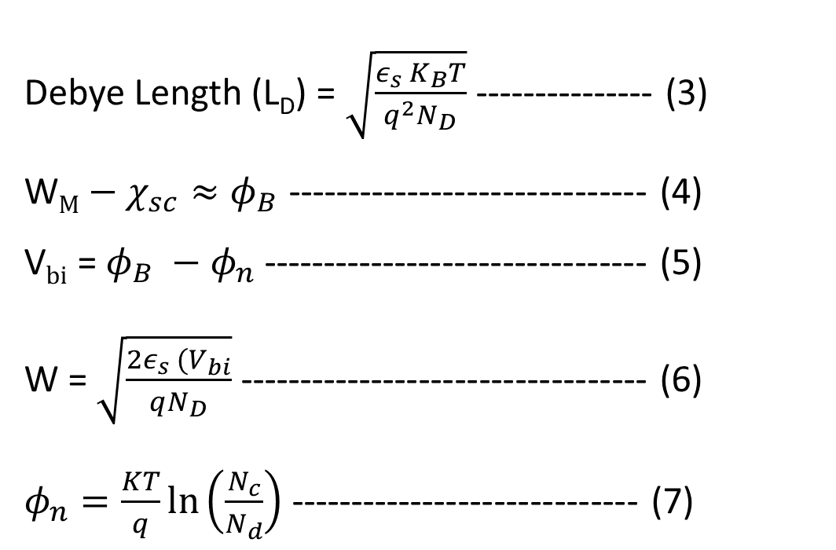
Vertical Silicon Schottky Diode Characteristic Parameters
Debye Length (L_{D}) = $\sqrt{\frac{ε_{s} K_{B}T}{q^{2}N_{D}}}$ --------------- (3)
W$M−χ_{sc}≈φ_{B}$ ------------------------------ (4)
V$bi$ = $φ_{B} −φ_{n}$ -------------------------------- (5)
W = $\sqrt{\frac{{2ε}_{s} (V_{bi}}{qN_{D}}}$ ---------------------------------- (6) $φ_{n}=\frac{KT}{q}\ln\left(\frac{N_{c}}{N_{d}}\right)$ ----------------------------- (7)
Parameters | Values
Cut – in Voltage (V$γ$) | 0.170 V
Built – in Potential (V_{bi}) | 0.457 V
Schottky Barrier Height ($φ_{B0}$) (given) | 0.7 V
Depletion Width (W) | 257 nm
Debye Length (L_{D}) | 12.9 nm
7 16 – March - 2026

Slide 9
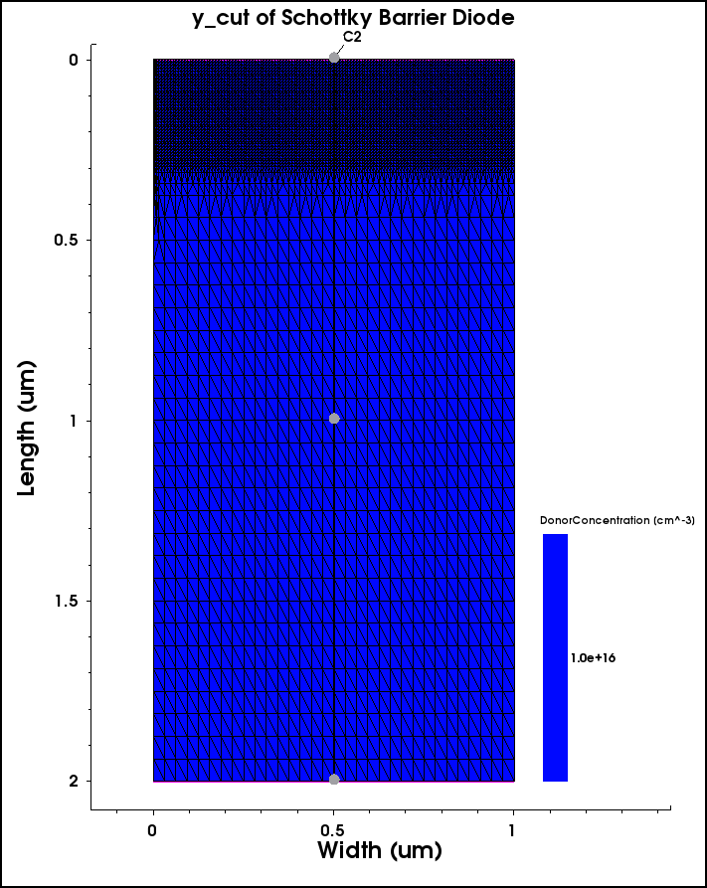
y-cut Energy Band Diagram
8 16 – March - 2026

Slide 10
Energy Band Diagram
V_{anode} = 0.1 V
9 16 – March - 2026

Slide 11
Energy Band Diagram
V_{anode} = 0.2 V
10 16 – March - 2026

Slide 12
Energy Band Diagram
V_{anode} = 0.3 V
11 16 – March - 2026

Slide 13
Energy Band Diagram
V_{anode} = 0.4 V
12 16 – March - 2026

Slide 14
Energy Band Diagram
V_{anode} = 0.4 V
13 16 – March - 2026

Slide 15
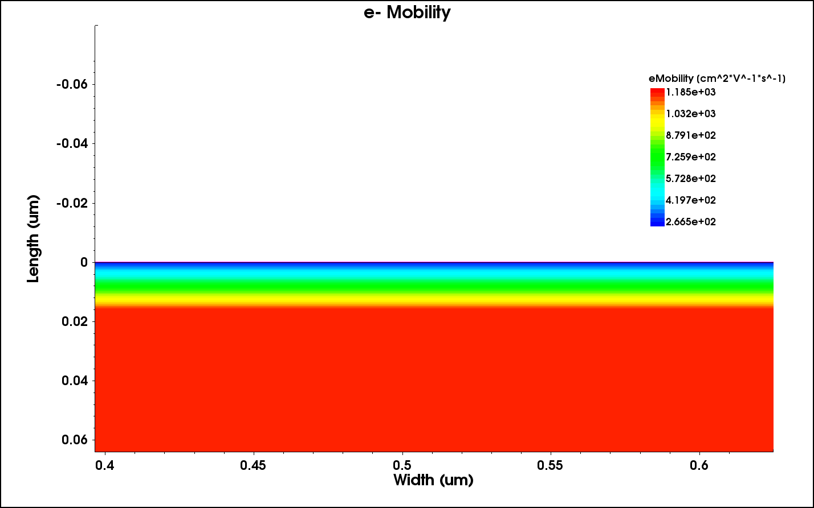
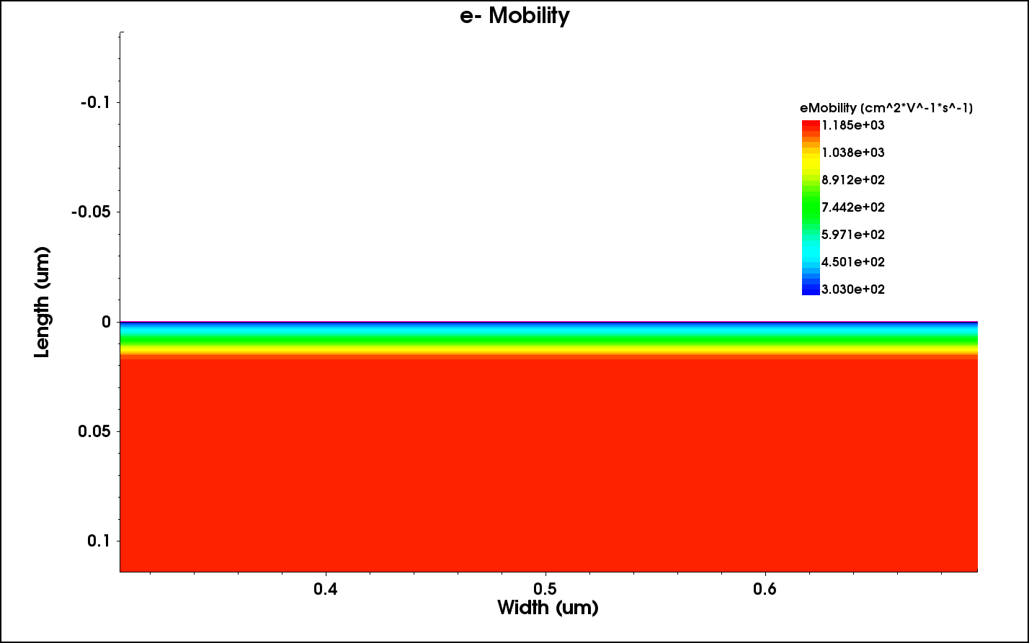
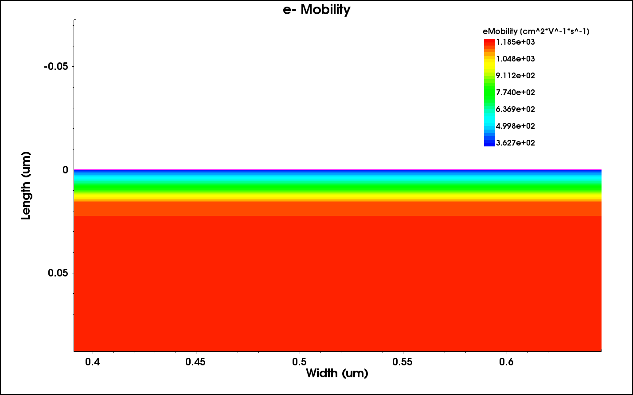
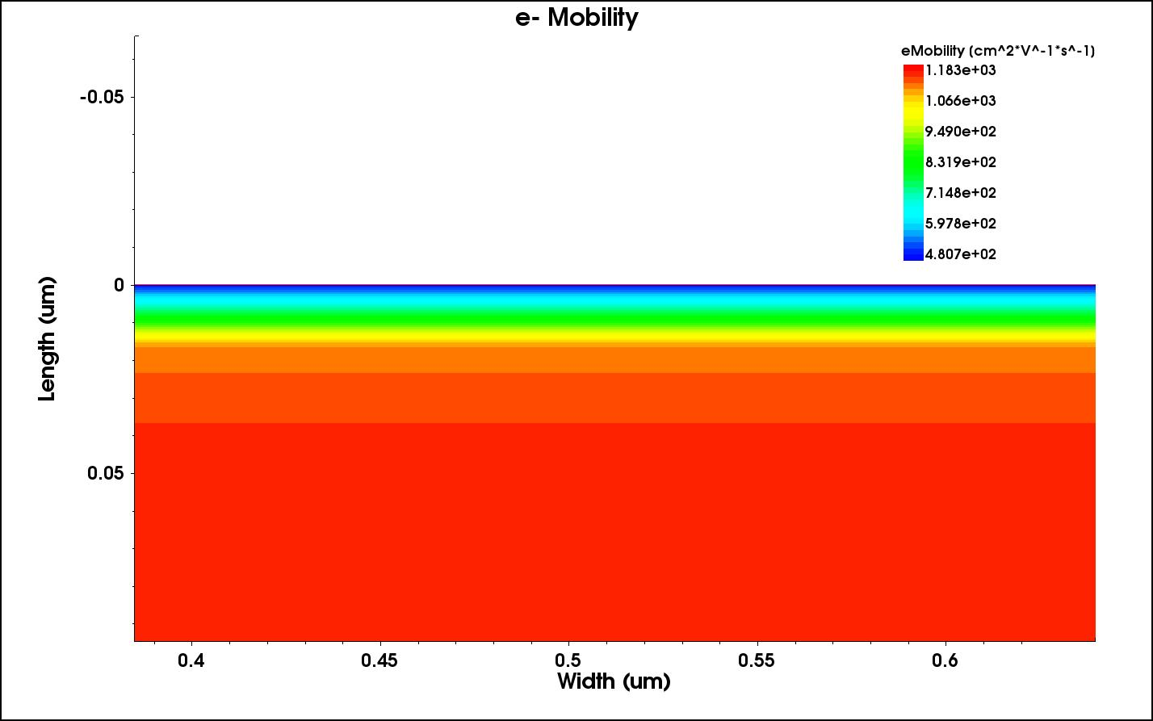
Variation of e⁻ Mobility w.r.t. Anode Voltage
V_{anode} = 0.1 V
V_{anode} = 0.2 V
V_{anode} = 0.3 V
V_{anode} = 0.4 V
14 16 – March - 2026

Slide 16
Variation of e⁻ Mobility w.r.t. Anode Voltage
15 16 – March - 2026

Slide 17
Variation of e⁻ Mobility w.r.t. Anode Voltage
16 16 – March - 2026

Slide 18
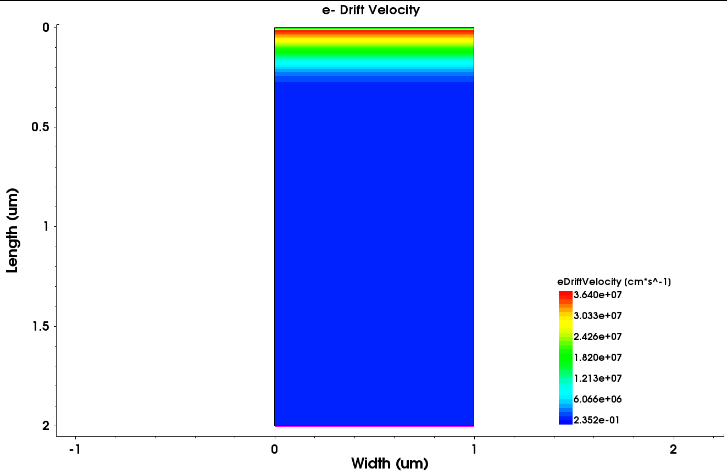
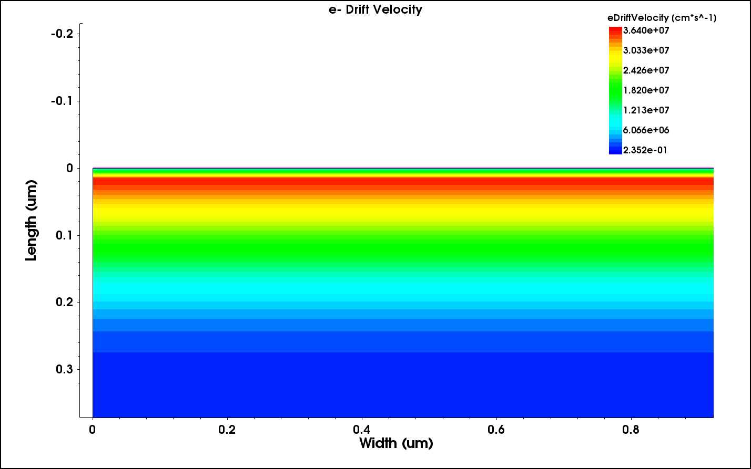
Variation of e⁻ Drift Velocity w.r.t. Anode Voltage
17 16 – March - 2026

Slide 19
Variation of e⁻ Drift Velocity w.r.t. Anode Voltage
18 16 – March - 2026

Slide 20
DEVICE ELECTRICAL
BREAKDOWN

Slide 21
Electrical Breakdown Methods
Breakdown Methods
1. Approximate Breakdown Analysis
2. Ionization Integrals with Carriers analysis
3. External resistor method
4. Voltage – to – current boundary condition (BC) switching method
5. Continuation Method
6. Transient Method
19 16 – March - 2026

Slide 22
Approximate Breakdown Analysis
ADVANTAGES: Fast; it does not consume much memory since it requires only the Poisson analysis. Qualitatively produces reasonable results.
LIMITATIONS: Can be applied only to off-state breakdown problematics, where currents are still negligibly small. Quantitatively not very precise; usually underestimates a breakdown.
To activate breakdown analysis, Sentaurus Device provides the driving force ElectricField, which can be computed even for constant quasi-Fermi levels.
Specifying ComputeIonizationIntegrals in the Math section switches on computation of the ionization integrals.
For example: Math
{ ...
ComputeIonizationIntegrals ()
}
U-2022.12/Sentaurus_Training/sd/sd_11.html, Sentaurus™ Device User Guide
20 16 – March - 2026

Slide 23
Ionization Integrals with carriers analysis
ADVANTAGES: Similar to approximate breakdown analysis in terms of ionization integrals computation. This method solves the entire carrier transport task, having the avalanche term deactivated in the right-hand side of the continuity equation, but computed in a postprocessing step.
LIMITATIONS: Requires educated guess from user to decide when to stop a simulation.
U-2022.12/Sentaurus_Training/sd/sd_11.html , Sentaurus™ Device User Guide
21 16 – March - 2026

Slide 24
Extraction of Breakdown Voltage
Breakdown Voltage, BV_{PP} = 49.458 V
22 16 – March - 2026

Slide 25
Approximate Breakdown Analysis
Reverse Saturation Current = -8.243 x 10⁻⁵ A/cm²
23 16 – March - 2026

Slide 26
Extraction of Breakdown Voltage
DOPING(cm⁻³) | BV_{PP} (V)
1e16 | 49.45
5e16 | 18.93
1e17 | 12.60
5e17 | 5.76
1e18 | 4.45
Where,
BV_{PP1} -> 1e16 cm⁻³
BV_{PP2} -> 5e16 cm⁻³
BV_{PP3} -> 1e17 cm⁻³
BV_{PP4} -> 5e17 cm⁻³
BV_{PP5} -> 1e18 cm⁻³
24 16 – March - 2026

Slide 27
Reverse Saturation Characteristics of a Schottky Barrier Rectifier
Reverse Saturation Current = -8.243 x 10⁻⁵ A/cm²
Where,
BV_{PP1} -> 1e16 cm⁻³
BV_{PP2} -> 5e16 cm⁻³
BV_{PP3} -> 1e17 cm⁻³
BV_{PP4} -> 5e17 cm⁻³
BV_{PP5} -> 1e18 cm⁻³
25 16 – March - 2026

Slide 28
Extraction of Breakdown Voltage
Where,
BV_{PP1} -> 1e16 cm⁻³
BV_{PP2} -> 5e16 cm⁻³
BV_{PP3} -> 1e17 cm⁻³
BV_{PP4} -> 5e17 cm⁻³
BV_{PP5} -> 1e18 cm⁻³
26 16 – March - 2026

Slide 29
Breakdown Voltage v/s Doping
27 16 – March - 2026

Slide 30
Reverse Saturation Characteristics of a Schottky Barrier Rectifier
Reverse Saturation Current = -8.243 x 10⁻⁵ A/cm²
Where,
BV_{PP1} -> 1e16 cm⁻³
BV_{PP2} -> 5e16 cm⁻³
BV_{PP3} -> 1e17 cm⁻³
BV_{PP4} -> 5e17 cm⁻³
BV_{PP5} -> 1e18 cm⁻³
Avalanche generation models used:
For electrons: Okuto–Crowell Model
For holes: van Overstraeten – de Man Model
28 16 – March - 2026

Slide 31
Reverse Saturation Characteristics (Van Overstraeten – de Man Model only)
Reverse Saturation Current = - 7.062 x 10⁻⁶ A/cm²
Where,
BV_{PP1} -> 1e16 cm⁻³
BV_{PP2} -> 5e16 cm⁻³
BV_{PP3} -> 1e17 cm⁻³
BV_{PP4} -> 5e17 cm⁻³
BV_{PP5} -> 1e18 cm⁻³
Avalanche generation models used:
For electrons and holes: van Overstraeten – de Man Model
29 16 – March - 2026

Slide 32
Reverse Saturation Characteristics (Van Overstraeten – de Man Model only)
Where,
BV_{PP1} -> 1e16 cm⁻³
BV_{PP2} -> 5e16 cm⁻³
BV_{PP3} -> 1e17 cm⁻³
BV_{PP4} -> 5e17 cm⁻³
BV_{PP5} -> 1e18 cm⁻³
Avalanche generation models used:
For electrons and holes: van Overstraeten – de Man Model
30 16 – March - 2026

Slide 33
Avalanche Breakdown Characteristics of Si Vertical Schottky Diode
DOPING (cm ⁻³) | BV (V)
1e16 | - 49.01
5e16 | -20.14
1e17 | -14.19
5e17 | -7.45
1e18 | -6.23
Where,
BV = Avalanche Breakdown
Voltage
31 16 – March - 2026

Slide 34
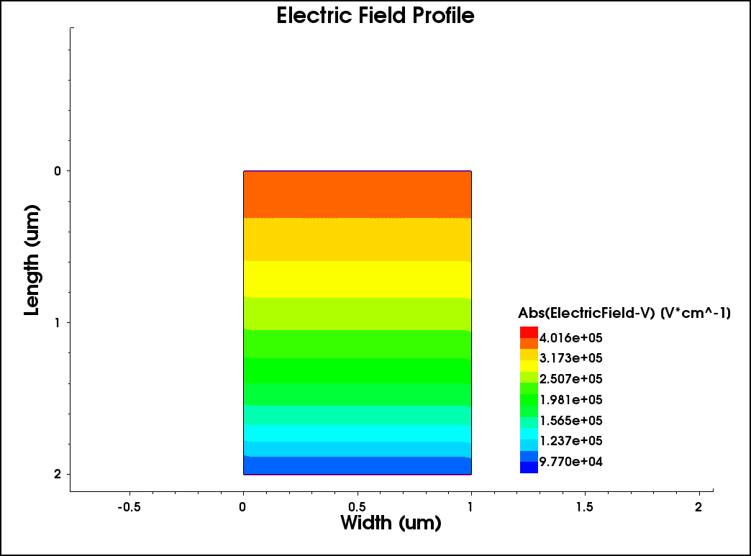
E - Field Profile at Breakdown Voltage regime
32 16 – March - 2026

Slide 35
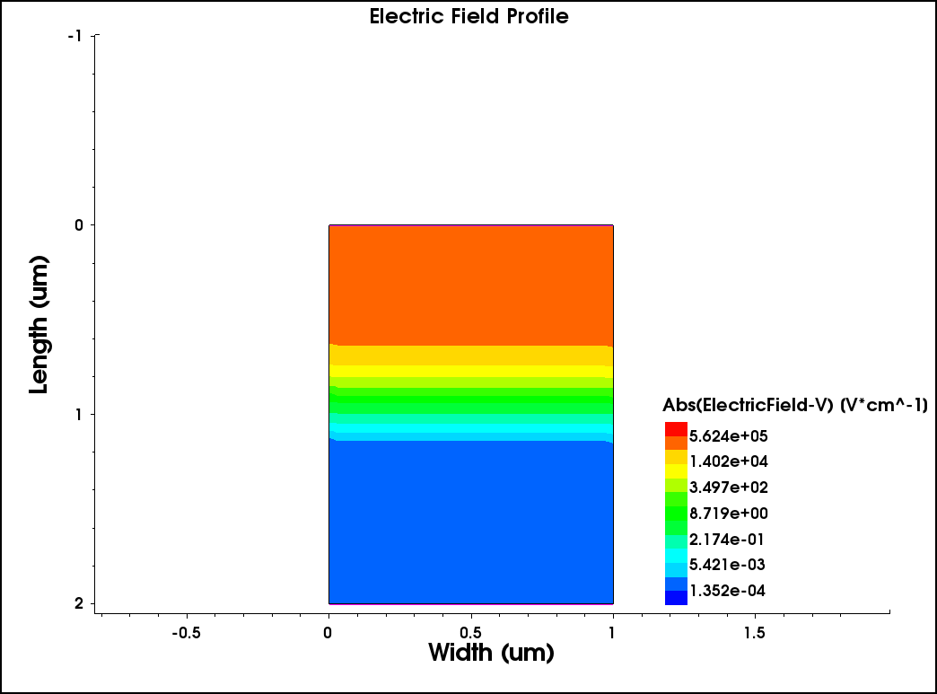
E - Field Profile at Breakdown Voltage regime
33 16 – March - 2026

Slide 36
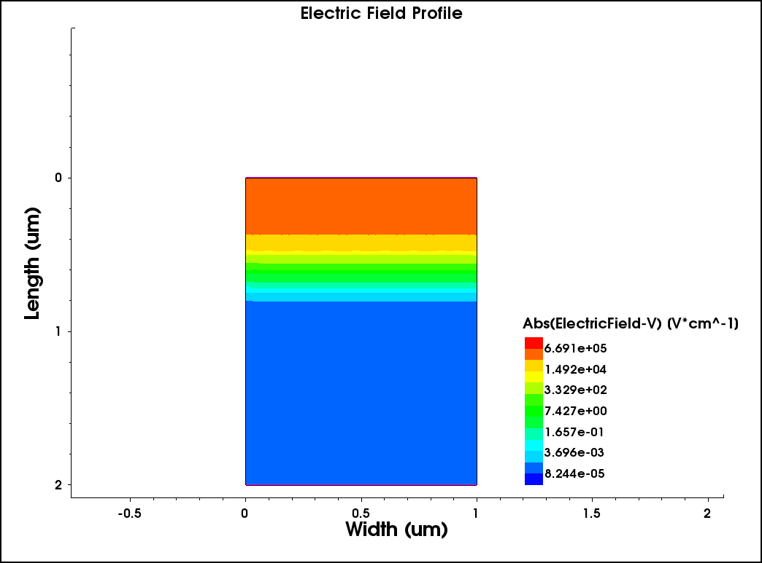
E - Field Profile at Breakdown Voltage regime
34 16 – March - 2026

Slide 37
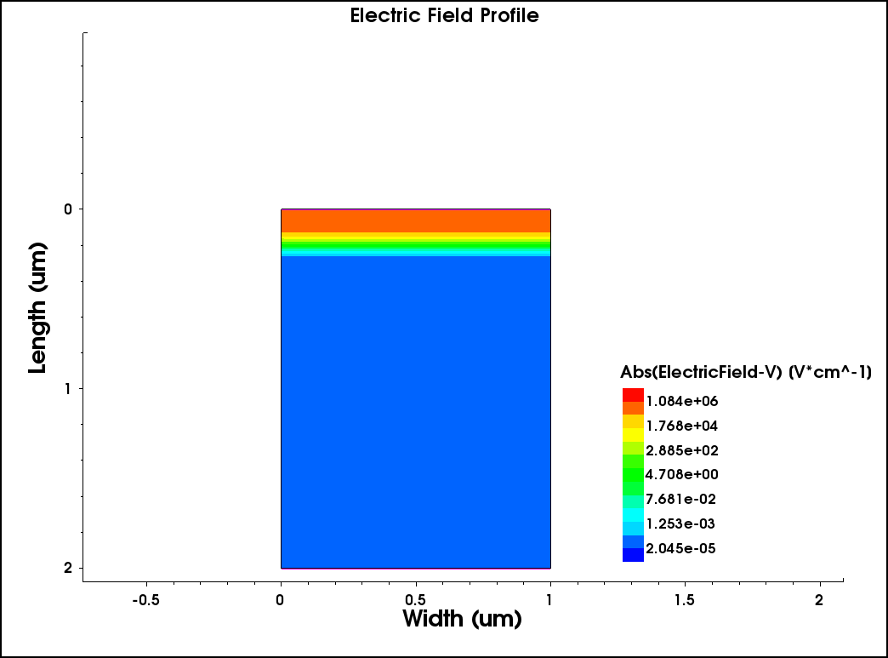
E - Field Profile at Breakdown Voltage regime
35 16 – March - 2026

Slide 38
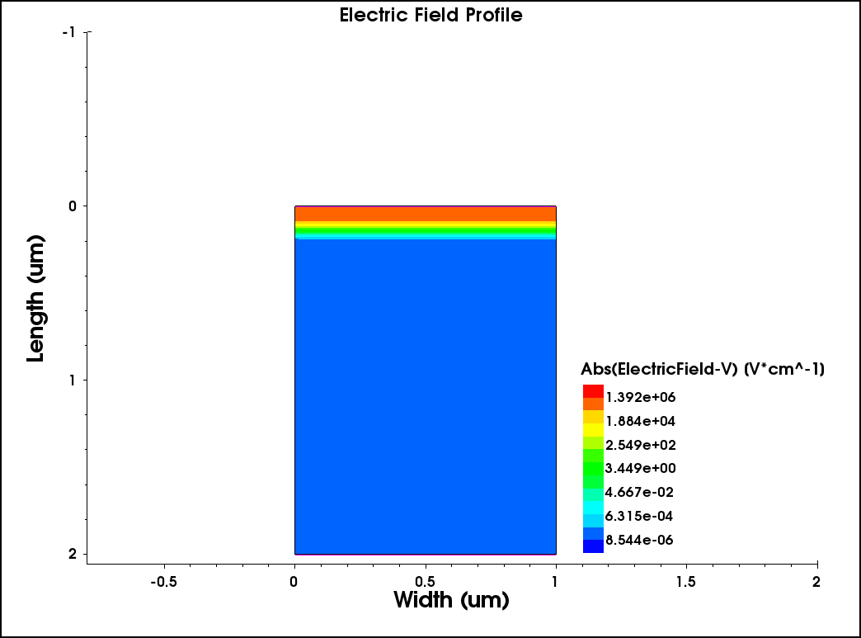
E - Field Profile at Breakdown Voltage regime
36 16 – March - 2026

Slide 39
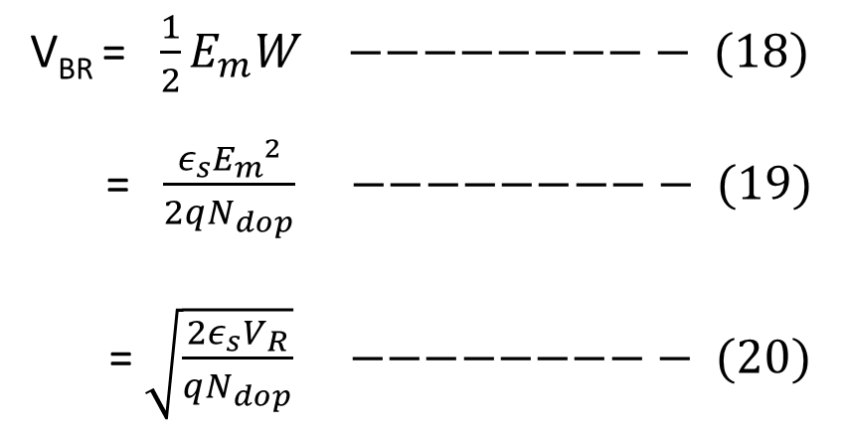
E - Field Profile at Breakdown Voltage regime
Doping Conc. (cm ⁻³ ) | Breakdown Voltage (V) | Max Electric Field (E_{m}) [V/cm]
1e16 | -49.01 | 4.0146 x 10⁵
5e16 | -20.14 | 5.6210 x 10⁵
1e17 | -14.19 | 6.6739 x 10⁵
5e17 | -7.45 | 1.0770 x 10⁶
1e18 | -6.23 | 1.3789 x 10⁶
V_{BR} = $\frac{1}{2}E_{m}W −−−−−−−−− (18)$
= $\frac{ε_{s}E_{m}^{ 2}}{2qN_{dop}}$ $−−−−−−−−− (19)$
= $\sqrt{\frac{2ε_{s}V_{R}}{qN_{dop}}}$ $−−−−−−−−− (20)$
37 16 – March - 2026

Slide 40
Energy Band Diagram
38 16 – March - 2026

Slide 41
Energy Band Diagram
39 16 – March - 2026

Slide 42
Energy Band Diagram
40 16 – March - 2026

Slide 43
THANK
YOU

