Slide 1

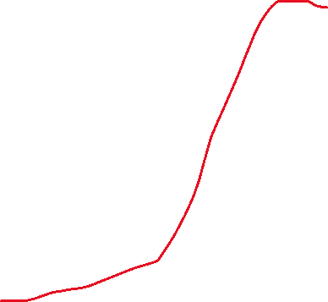

potato
---------------------------
potato_id pk
potato_name u
potato_type
colour
introduction_year
agents
-------------------
agent_id pk
agent_name u
foundation_year
breeder
------------------
breeder_id pk
breeder_name u
country
agent_id fk
breeds
--------------------------
breeder_id pk fk
potato_id pk fk
tonnes_per_year

