Slide 1
Credit EDA Case Study DS C17
Application Data
Previous Application

Slide 2
Problem statement
• To study and analyse the patterns of given data set of a finance
company which specializes in lending various types of loans to urban
customers and help to minimize the risk of losing company money
while lending to customers.
Solution Approach.
- Analyse the application Data set.
- Identify the key metrics/variable
- Perform univariate analysis on each of the identified key metrics.
- Perform Bivariate analysis to understand patterns
- Perform above analysis on target variable (defaulters or repayers)
- Analyse the Previous application data set
- Identify the key metrics/variable
- Divide the previous application set based on status(Approved/rejected)
- Merge each of these sets with the each of the target data set
- Again perform Uni/Bi variate analysis on the merged data.
- Find correlation of key variables

Slide 3
Application data
• Key Metrics
• Categorical
- Gender, Occupation type, family status , Income type, Loan type
• Quantitative
- Annual income, loan amount, Annuity amt, Age, Work exp.

Slide 4
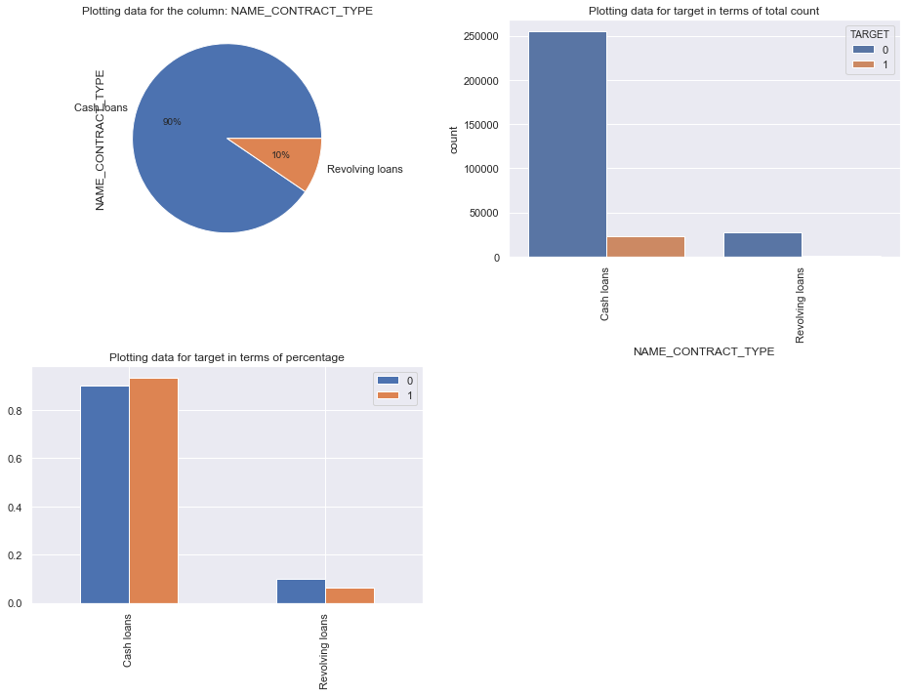
NAME_CONTRACT_TYPE
Identification if loan is cash or revolving- As identified from the plots that Cash Loan default rate is less

Slide 5
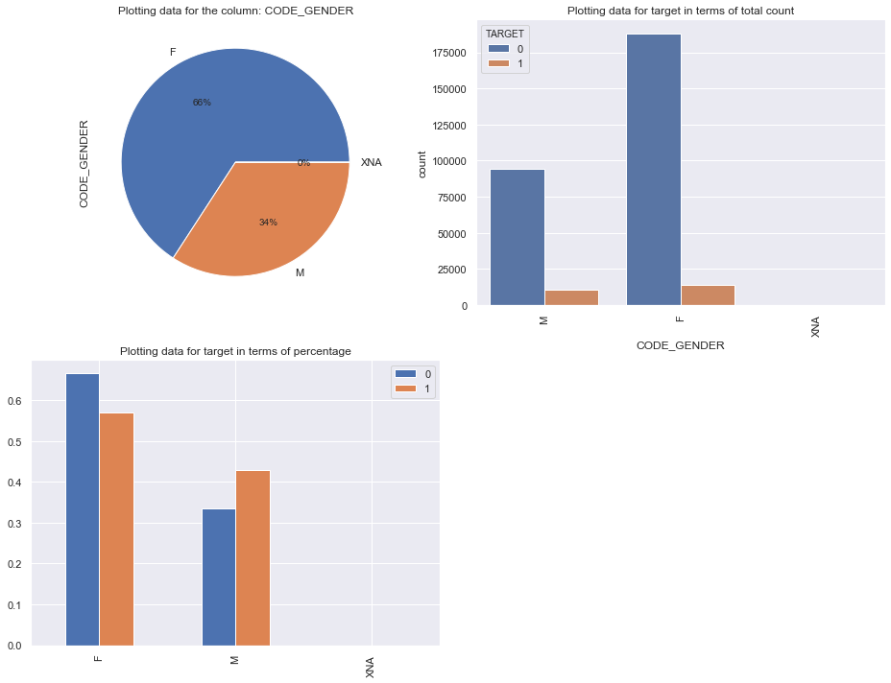
CODE_GENDER
Gender of the client- Less number of males(hist plot) take loan but the defaulters are higher in case of males(dist plot).

Slide 6
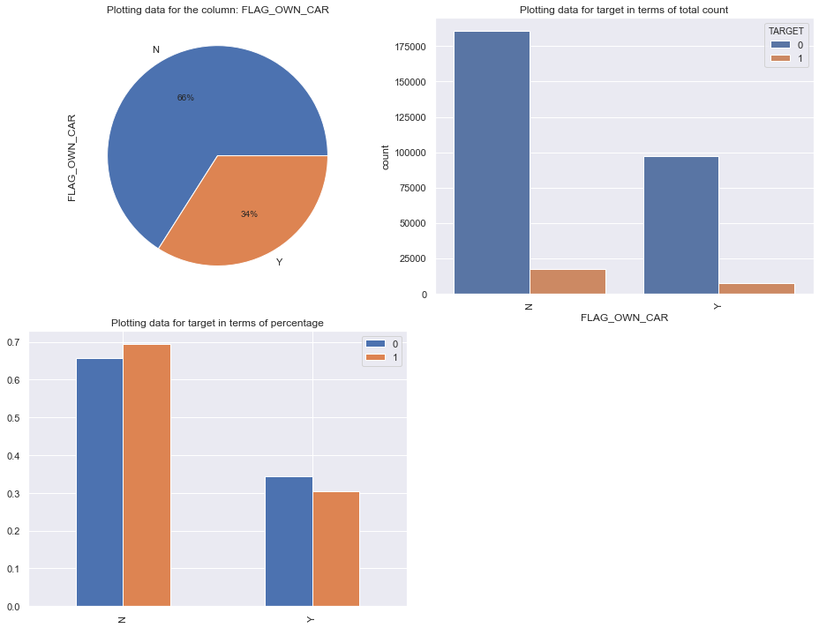
FLAG_OWN_CAR
Flag if the client owns a car- As identified from the plots that the car owners defaulter rate higher then who are not a car owner.

Slide 7
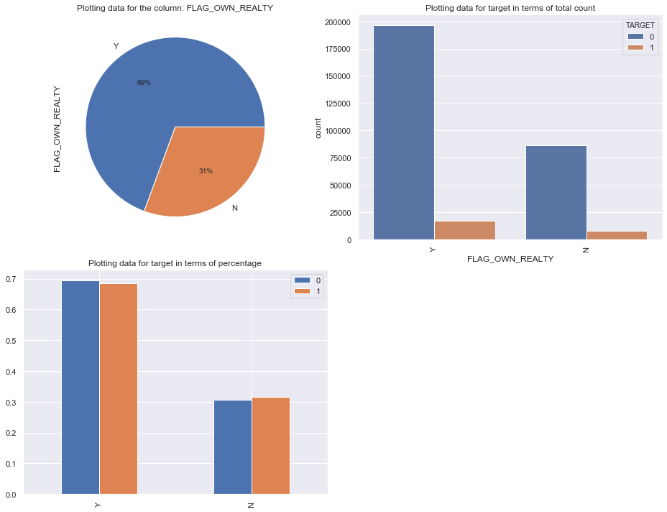
FLAG_OWN_REALTY
Flag if client owns a house or flat- As identified from the plots that the flat owners defaulter rate higher then who are not a flat owner.

Slide 8
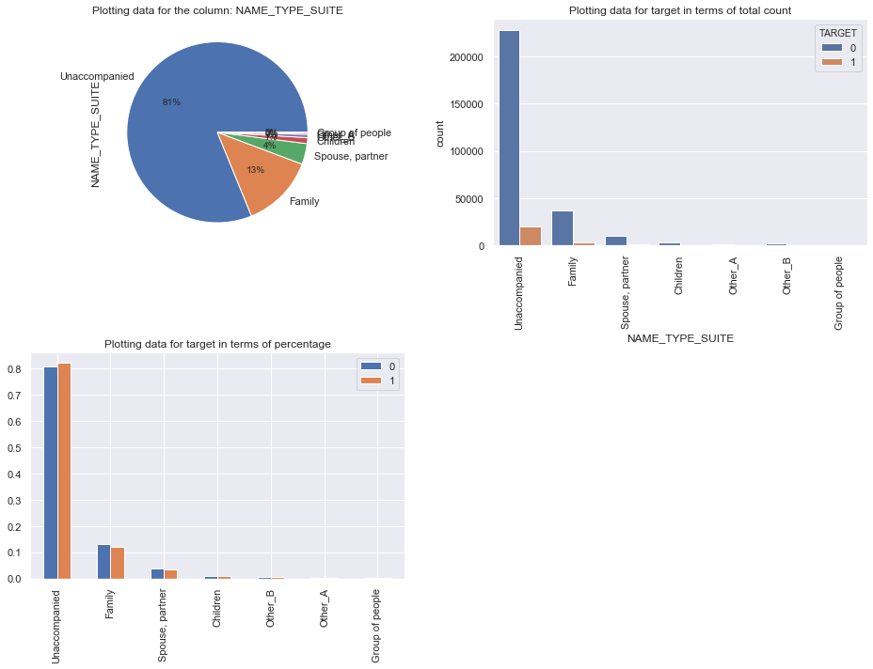
NAME_TYPE_SUITE
Who was accompanying client when he was applying for the loan- As identified from the plots that the those who unaccompanied has higher defaulter rate.

Slide 9
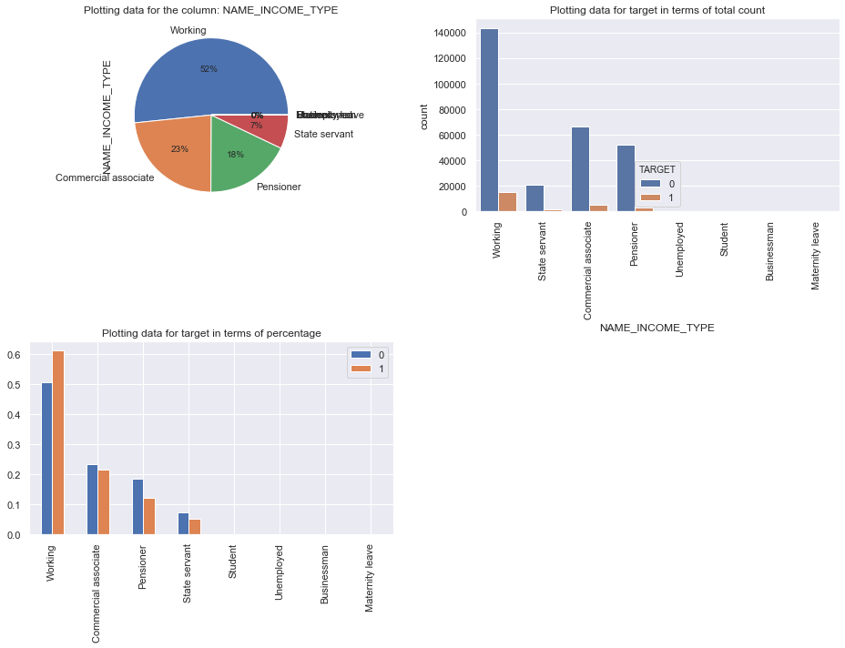
NAME_INCOME_TYPE
Clients income type (businessman, working, maternity leave,…)- As identified from the plots that the those who are working has higher defaulter rate.
Pensioner defaulter is lower than non-defaulter.

Slide 10
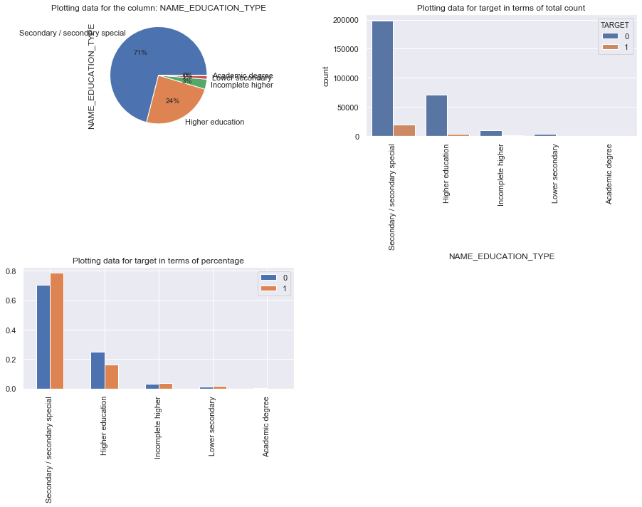
NAME_EDUCATION_TYPE
Level of highest education the client achieved- As identified from the plots that Most client take loan for secondary education followed by higher education. But the default rate in secondary education is much high and for higher education is much low.

Slide 11
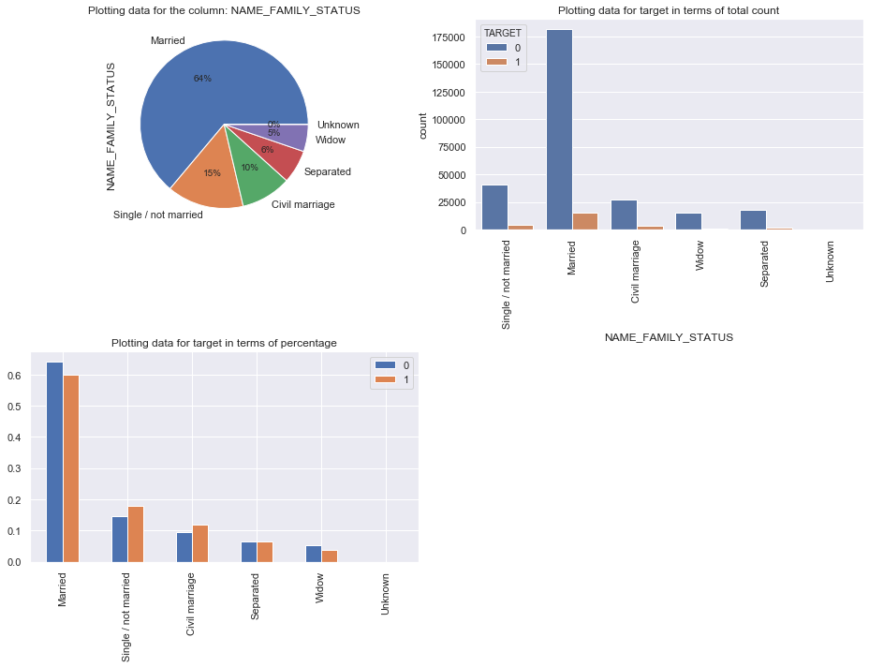
NAME_FAMILY_STATUS
Family status of the client- As identified from the plots that Most married people apply for loan, and mostly they are not defaulters. Single and civil marriage turns out to be more defaulter.

Slide 12
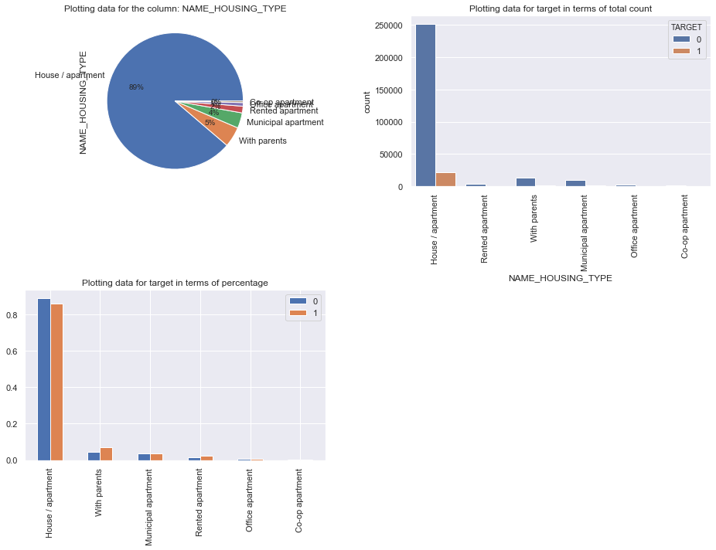
NAME_HOUSING_TYPE
What is the housing situation of the client (renting, living with parents, ...)- As identified from the plots that those who live in House or Apartment has higher default rate.

Slide 13
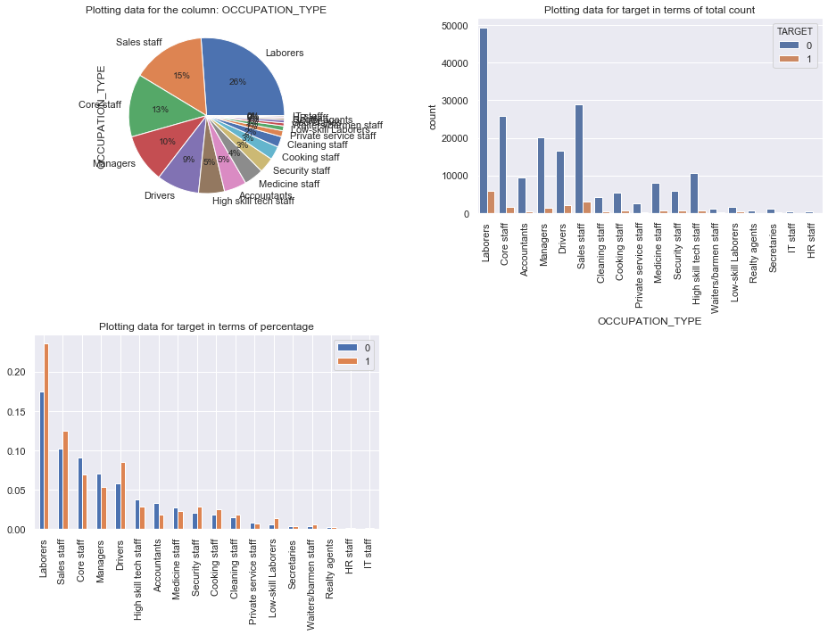
OCCUPATION_TYPE
What kind of occupation does the client have- As identified from the plots that Laborers and different categories of staffs mostly take the loan, but the managers and the high skilled tech staffs are most reliable

Slide 14
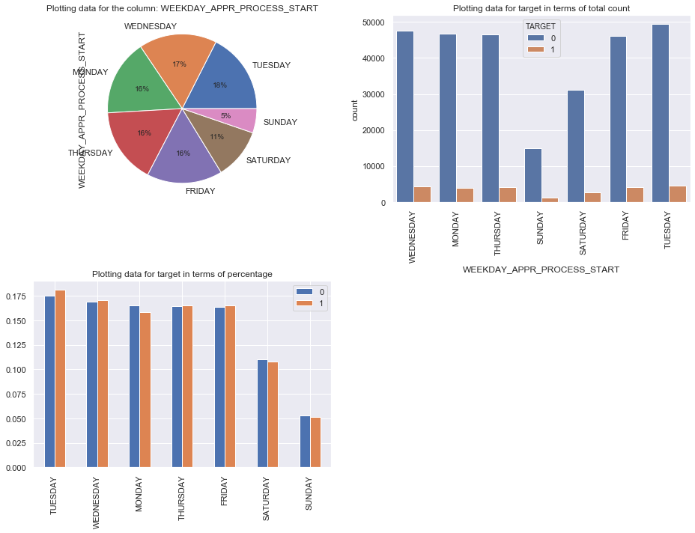
WEEKDAY_APPR_PROCESS_START
On which day of the week did the client apply for the loan- As identified from the plots that Interestingly the Tuesday applied loan has highest default percentage.

Slide 15
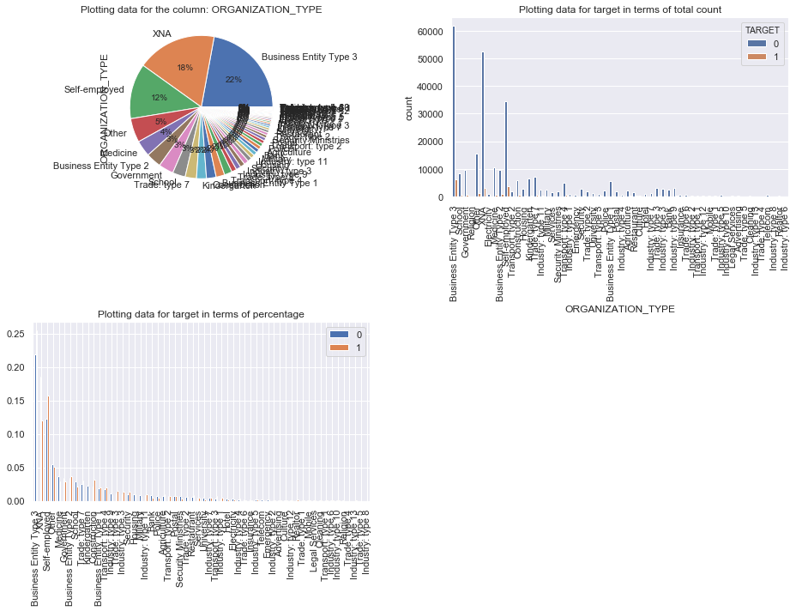
ORGANIZATION_TYPE
Type of organization where client works- As identified from the plots that the self-employed people has highest default percentage.

Slide 16
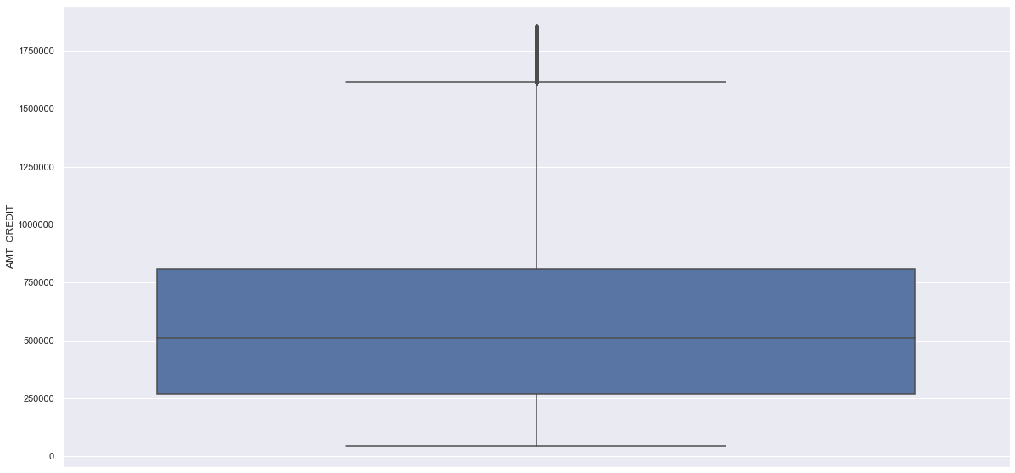
AMT_CREDIT
count 3.044340e+05 mean 5.834403e+05 std 3.723969e+05 min 4.500000e+04 25% 2.700000e+05 50% 5.084955e+05 75% 8.086500e+05 max 1.852808e+06
Credit amount of the loan- As identified from the plots that the Loan amount is distributed between 270000 to 800000.

Slide 17
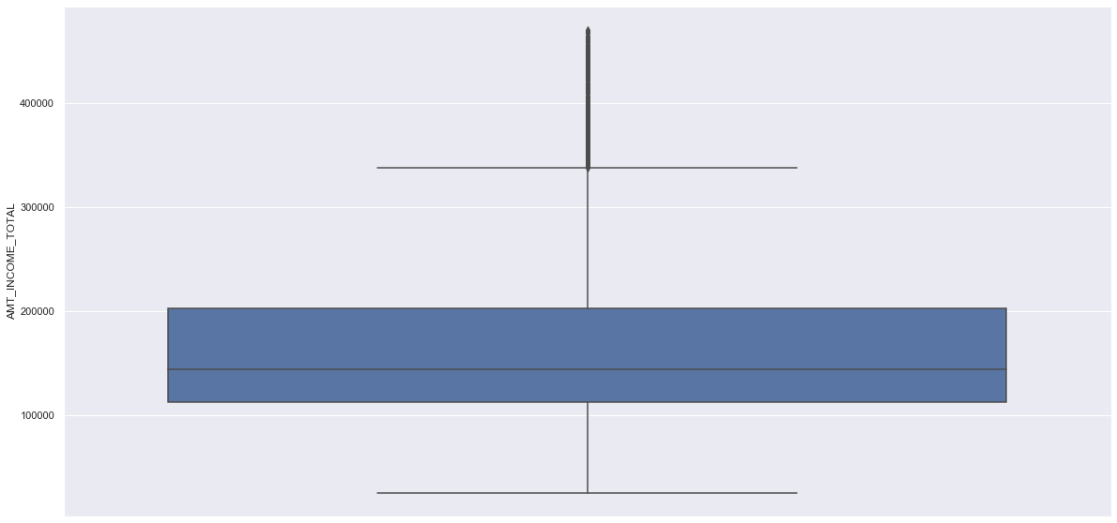
AMT_INCOME_TOTAL
count 304417.000000 mean 162911.014841 std 77494.004409 min 25650.000000 25% 112500.000000 50% 144000.000000 75% 202500.000000 max 469800.000000
Income of the client- As identified from the plots that the Income amount is distributed between 112500 to 202500.

Slide 18
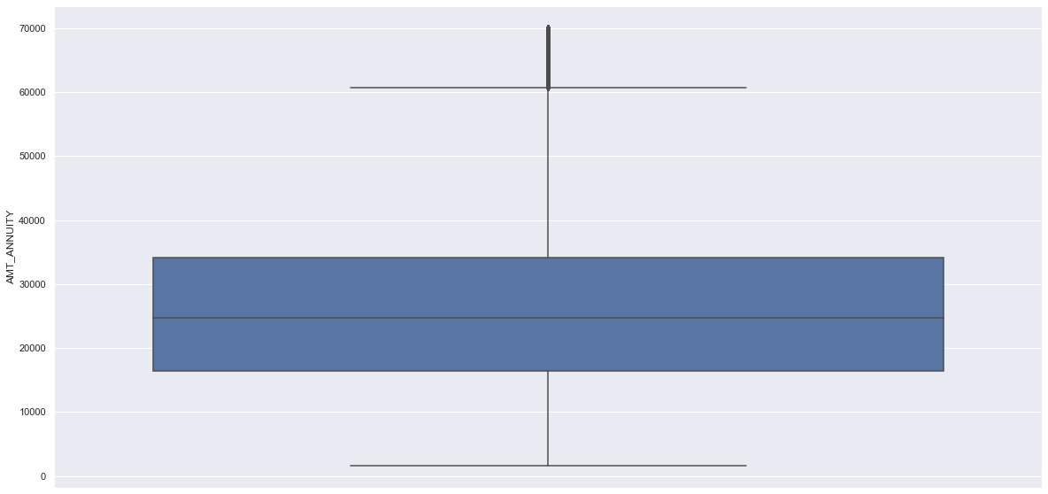
AMT_ANNUITY
count 304418.000000 mean 26498.619144 std 13032.387753 min 1615.500000 25% 16456.500000 50% 24745.500000 75% 34182.000000 max 69988.500000
Loan annuity- As identified from the plots that the Annuity amount is distributed between 16000 to 35000.

Slide 19
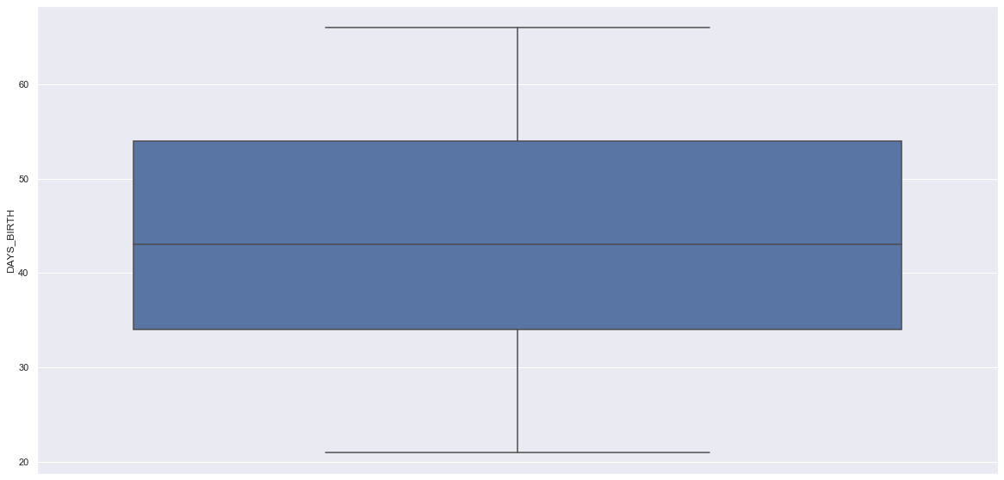
DAYS_BIRTH
count 303709.000000 mean 43.642437 std 11.740048 min 21.000000 25% 34.000000 50% 43.000000 75% 54.000000 max 66.000000
Client's age in days at the time of application- As identified from the plots that the Applicants age is distributed b/w 33 to 55 yrs

Slide 20
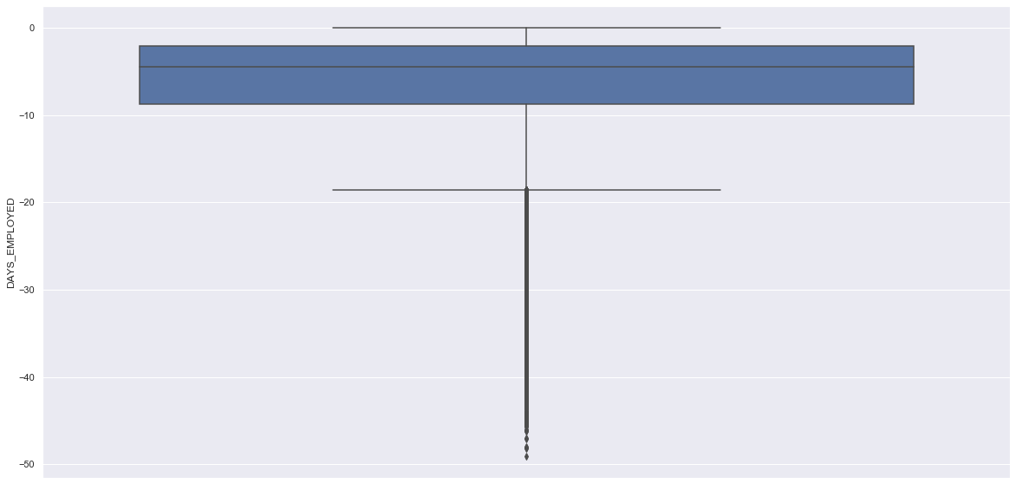
DAYS_EMPLOYED
count 252137.000000 mean -6.531971 std 6.406466 min -49.073973 25% -8.698630 50% -4.515068 75% -2.101370 max 0.000000
How many days before the application the person started current employment- As identified from the plots that Applicants are at least have 2 to 8yrs work experience before applying loan.

Slide 21
Analysis Using the Previous Application Data

Slide 22
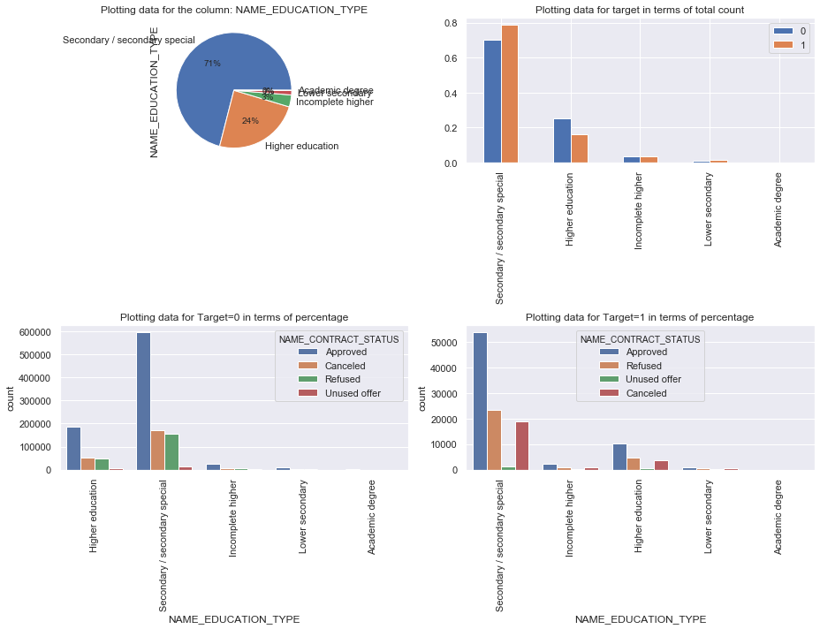
Column Reference- NAME_EDUCATION_TYPE & NAME_CONTRACT_STATUS
People tend to make more loan for 'Secondary special' and their loan is also approved.

Slide 23
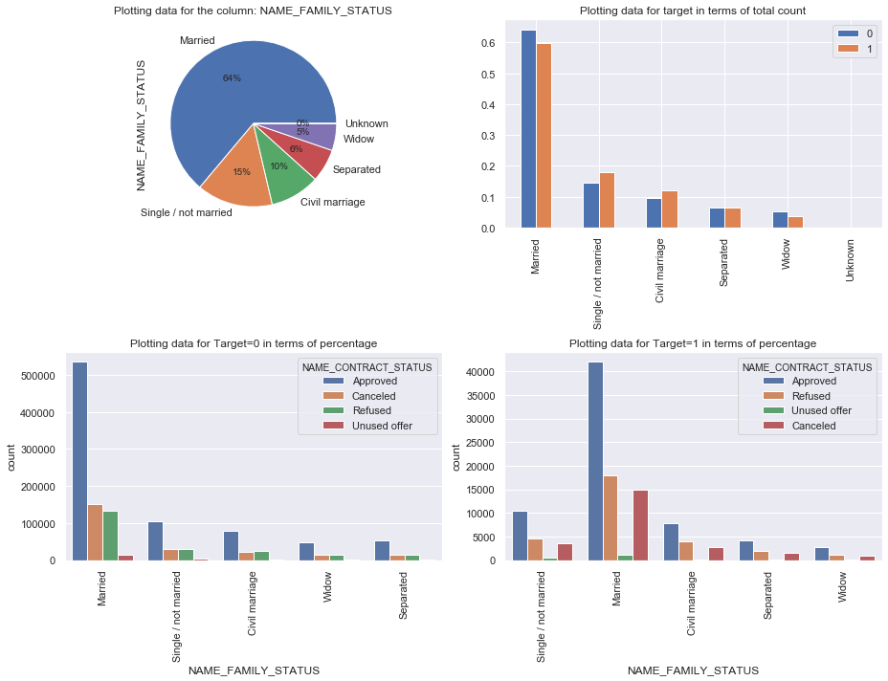
Column Reference- Name_FAMILY_STATUS & NAME_CONTRACT_STATUS
There is a clear difference for the categories for "Approved, Refused, Unused and Cancelled" for the category: Married. Married people tends to pay loan on time than Singles.

Slide 24
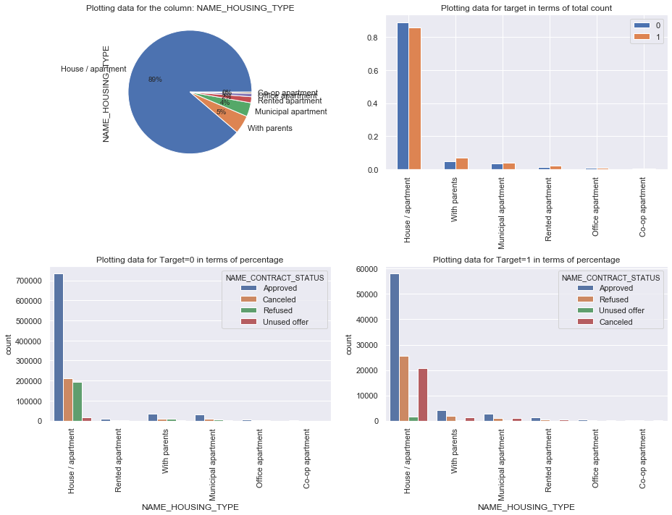
Column Reference- Name_HOUSING_TYPE & NAME_CONTRACT_STATUS
There is a clear difference for the categories for "Approved, Refused, Unused and Cancelled" for the category: House/apartment.

Slide 25
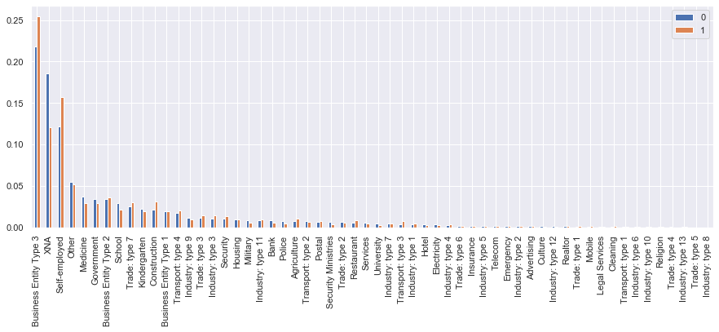
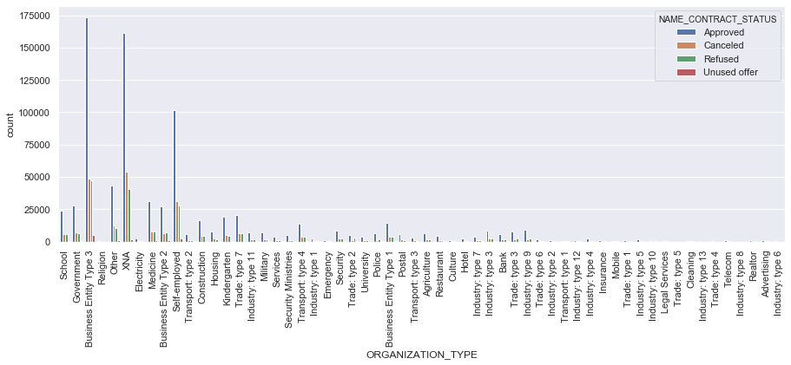
Column Reference- ORGANIZATION_TYPE & NAME_CONTRACT_STATUS
Its clear that Business Entry Type-3 has maximum default rate
Business Entry Type 3 has maximum Approve Rate from non Defaulter list

Slide 26
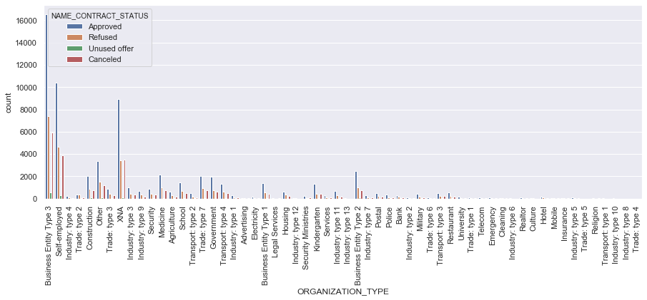
Column Reference- ORGANIZATION_TYPE & NAME_CONTRACT_STATUS
Business Entry Type 3 has maximum Approve Rate from Defaulter list

Slide 27
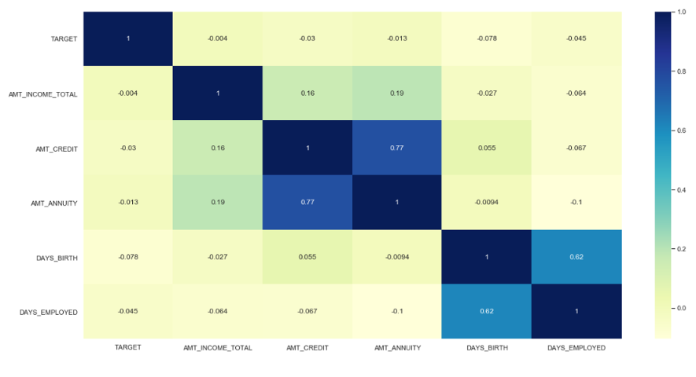
Correlation :
Correlation for entire set :

Slide 28
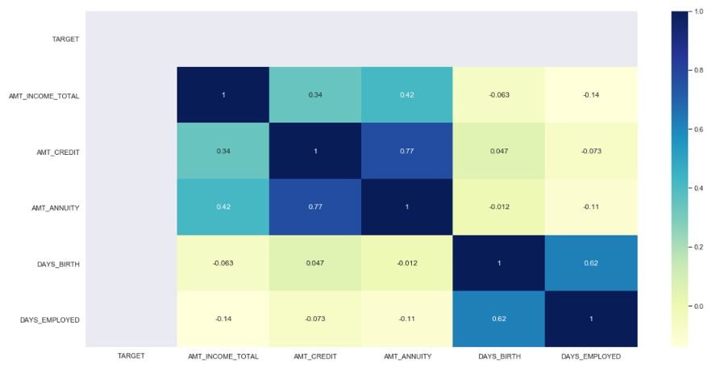
Correlation for data set Target = 0

Slide 29
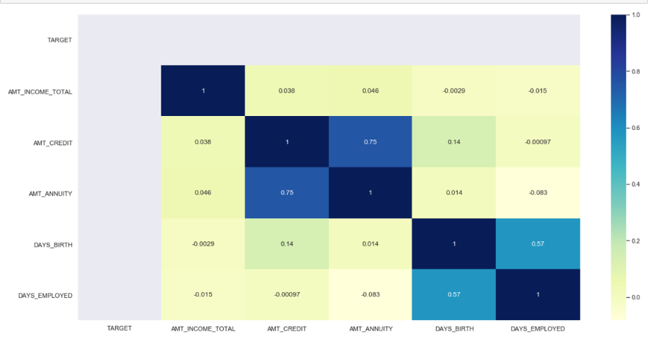
Correlation for data set for target =1

Slide 30
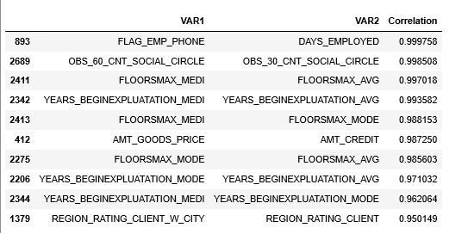
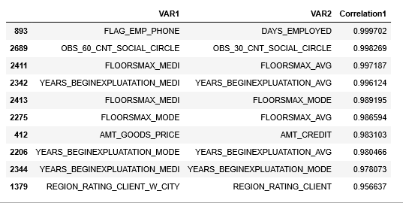
For Target 1 correlation matrix
For Target 0 correlation matrix
Observations :
FLAG_EMP_PHONE & DAYS_EMPLOYED 0.999758,
OBS_60_CNT_SOCIAL_CIRCLE & OBS_30_CNT_SOCIAL_CIRCLE 0.998508
FLOORSMAX_MEDI & FLOORSMAX_AVG 0.997018
YEARS_BEGINEXPLUATATION_MEDI & YEARS_BEGINEXPLUATATION_AVG 0.993582
FLOORSMAX_MEDI & FLOORSMAX_MODE 0.988153
AMT_GOODS_PRICE & AMT_CREDIT 0.987250
FLOORSMAX_MODE & FLOORSMAX_AVG 0.985603
YEARS_BEGINEXPLUATATION_MODE & YEARS_BEGINEXPLUATATION_AVG 0.971032
YEARS_BEGINEXPLUATATION_MEDI &YEARS_BEGINEXPLUATATION_MODE 0.962064
REGION_RATING_CLIENT_W_CITY & REGION_RATING_CLIENT 0.950149
It can be inferred from the top 10 co-related columns that that Target 0 & Target 1 dataset following the same pattern.

Slide 31
Thank You!!!

