Slide 1
Visualizing Our Global World Comprehensive Insights on Global News Imagery
Authorship:
Samvat Rastogi
Nirad Ranjan Parhi
Sneha Lakshmi Nyayapati
Sreya Chakrabarti
Niketh Shetty
Notes:
https://github.com/samvat/ivmooc-gdelt-project/blob/master/The%20GDELT%20Project%20-%20Final%20Report.pdf

Slide 2
GDELT and VGKG
The Global Database of Events, Language and Tone is an open database collection of news articles from across the globe from the year 1979. GDELT has three datasets :
Events Database
GKG
VGKG
The Visual Global Knowledge Graph is an enhancement on top of the GKG, which uses the Google Cloud Vision API to extract meaningful information from a stream of visuals that are part of the world’s news
Notes:
https://github.com/samvat/ivmooc-gdelt-project/blob/master/The%20GDELT%20Project%20-%20Final%20Report.pdf

Slide 3
Details of the Dataset
We are accessing the data from Google BigQuery . The name of the table accessed is gdelt-bq:gdeltv2.cloudvision
The table has 248,841,467 rows of data ranging from around 31st Dec 2015 to the present. It has a size of 2.12 TB
There are 12 columns in the table, out of which 5 are useful to this project
The envisioned depictions are based on the relevance and meaning that each column has.
Notes:
https://github.com/samvat/ivmooc-gdelt-project/blob/master/The%20GDELT%20Project%20-%20Final%20Report.pdf

Slide 4
Schema of the Cloud Vision dataset
DATE
DOCUMENTIDENTIFIER
IMAGEURL
LABELS
GEOLANDMARKS
LOGOS
SAFESEARCH
FACES
OCR
LANGHINTS
WIDTHHEIGHT
RAWJSON
Notes:
https://github.com/samvat/ivmooc-gdelt-project/blob/master/The%20GDELT%20Project%20-%20Final%20Report.pdf

Slide 5
Column specific information
DATE – The date on which that specific image was monitored and recorded by GDELT. This field is used in our timeline based visualizations
LABELS – This column gives information about the contents/objects present in the image. This field can be extensively used to cover various use-cases on a wide variety of topics
GEOLANDMARKS – The attributes ‘Latitude’ and ‘Longitude’ of this entity are being used to plot specific information over the world map
SAFESEARCH – This column provides us information about the content being offensive or non-offensive. The four attributes (Violence , Medical , Spoof , Adult) will be used to locate the kind of information
FACES – This field will be used extensively to extract information related to the emotions depicted in an image
Notes:
https://github.com/samvat/ivmooc-gdelt-project/blob/master/The%20GDELT%20Project%20-%20Final%20Report.pdf

Slide 6

EXAMPLE
Sample Query:
select Labels, GeoLandmarks, DocumentIdentifier, SafeSearch, Faces FROM [gdelt-bq:gdeltv2.cloudvision] where ImageURL = "http://www.wafa.ps/http://www.wafa.ps/userfiles/image/multimedia/samah.jpg";
Notes:
https://github.com/samvat/ivmooc-gdelt-project/blob/master/The%20GDELT%20Project%20-%20Final%20Report.pdf

Slide 7
Example Continued
Labels : graduation<FIELD>0.98690468<FIELD>/m/016c3c<RECORD>academic dress<FIELD>0.92389059<FIELD>/m/01xqvb<RECORD>event<FIELD>0.55467749<FIELD>/m/081pkj<RECORD>costume<FIELD>0.55138981<FIELD>/m/0250x
GeoLandmarks : null
DocumentIdentifier : http://www.wafa.ps/ar_page.aspx?id=RcYwVMa695154680682aRcYwVM
SafeSearch : -1<FIELD>0<FIELD>0<FIELD>0
Faces : 0.99955839<FIELD>12.286129<FIELD>30.525574<FIELD>-7.1071544<FIELD>0.5889504<FIELD>78,87;132,87;132,141;78,141<FIELD>0<FIELD>0<FIELD>0<FIELD>2<FIELD>0<FIELD>0<FIELD>0<RECORD>0.50865442<FIELD>6.1033735<FIELD>-5.2280416<FIELD>6.324564<FIELD>0.63740838<FIELD>146,69;196,69;196,119;146,119<FIELD>0<FIELD>0<FIELD>0<FIELD>2<FIELD>0<FIELD>0<FIELD>0
Notes:
https://github.com/samvat/ivmooc-gdelt-project/blob/master/The%20GDELT%20Project%20-%20Final%20Report.pdf

Slide 8
About the visualizations
There are four Visualizations in this project:
Burst Analysis on Labels
Quantified Relationship between Emotions and Associated Labels
Geographical distribution of SafeSearch trends
Top Labels based on SafeSearch category
Notes:
https://github.com/samvat/ivmooc-gdelt-project/blob/master/The%20GDELT%20Project%20-%20Final%20Report.pdf

Slide 9
Burst Analysis on Labels
This Visualization intends to highlight the variation of interests in major news topics over time.
The topics of interests from various news articles are shown with partitions of monthly time slices for the time period - January 2016 to March 2017.
Each label is represented by a bubble.
The size of the bubble denotes the frequency of appearance of a label number in the news articles for the period in question.
We captured 15 such subsets of data from BigQuery for the entire time range.
Notes:
https://github.com/samvat/ivmooc-gdelt-project/blob/master/The%20GDELT%20Project%20-%20Final%20Report.pdf

Slide 10
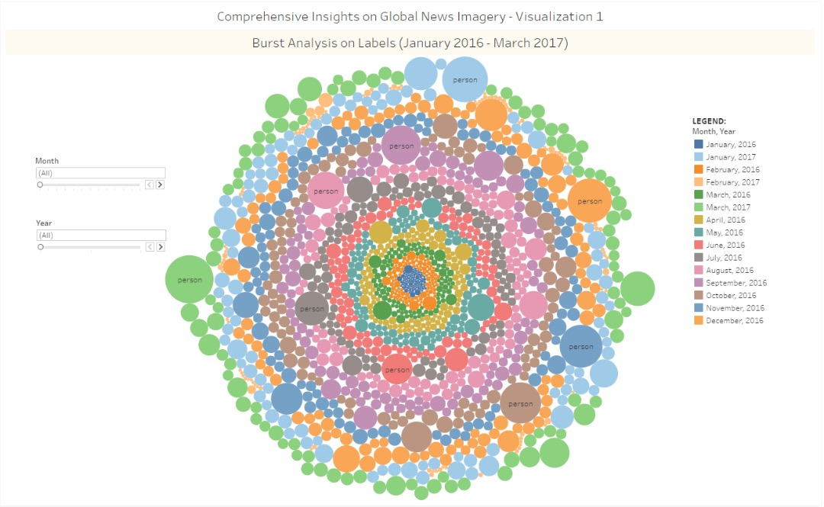
https://public.tableau.com/profile/samvat.rastogi#!/vizhome/ComprehensiveInsightsonGlobalNewsImagery-Visualization1/Dashboard1
Notes:
https://github.com/samvat/ivmooc-gdelt-project/blob/master/The%20GDELT%20Project%20-%20Final%20Report.pdf

Slide 11
Insights gained
The label person is most frequently occurring in all the news articles over the time range
Other frequently occurring labels are - people, profession, vehicle, athlete, sports
We can conclude that the labels relating people like vehicle, sports are occurring most frequently as the day-to-day news articles are dominated by such content.
Notes:
https://github.com/samvat/ivmooc-gdelt-project/blob/master/The%20GDELT%20Project%20-%20Final%20Report.pdf

Slide 12
Quantified Relationship between Emotions and Associated Labels
This is a network visualization that helps fetch insights about the co-occurence of emotions like joy, sorrow, anger and surprise by analyzing the likelihood of each emotion in the images tagged to the corresponding labels in the dataset
We have determined the top 10 labels associated with all the four emotions
It gives the quantified relationship between emotions and their associated labels
Notes:
https://github.com/samvat/ivmooc-gdelt-project/blob/master/The%20GDELT%20Project%20-%20Final%20Report.pdf

Slide 13
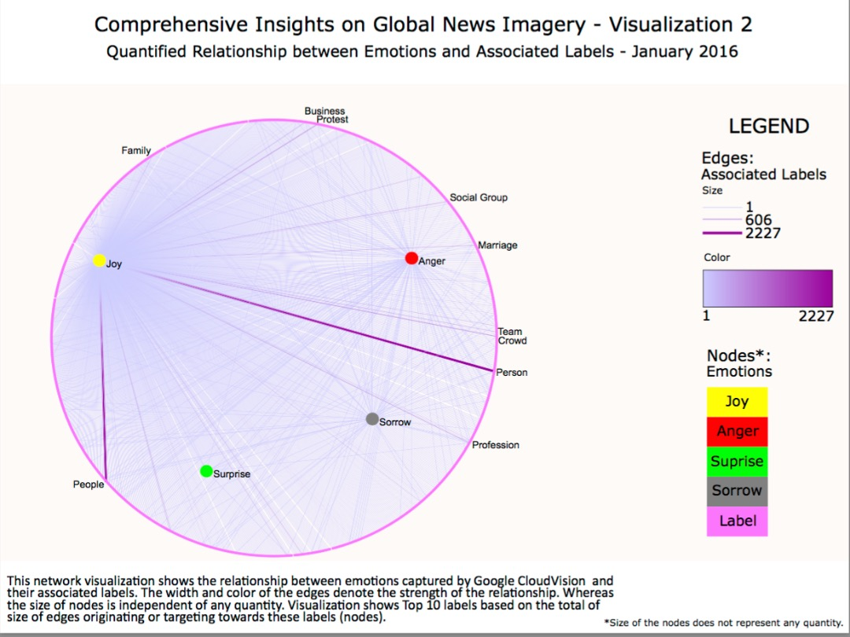
https://samvat.github.io/ivmooc-gdelt-project/Visualization2.pdf
Notes:
https://github.com/samvat/ivmooc-gdelt-project/blob/master/The%20GDELT%20Project%20-%20Final%20Report.pdf

Slide 14
Insights gained
Out of the four categories of emotions i.e. "Joy", "Sorrow", "Surprise" and "Anger" , the emotion "Joy" is most frequently occuring.
The top labels associated with all the 4 emotions are - Person, People, Protest, Crowd, Business,Social Group, Marriage etc.
The labels occurring most frequently with "Joy“ are Family, Person, People, Profession etc.
Similarly, we can see other frequently occurring labels with emotions.
Notes:
https://github.com/samvat/ivmooc-gdelt-project/blob/master/The%20GDELT%20Project%20-%20Final%20Report.pdf

Slide 15
Geographical distribution of SafeSearch trends
This visualization depicts the sources of news articles categorized as Medical, Violent, Adult and Spoof by the Google SafeSearch algorithm on a two dimensional map of the Earth.
The Geolocations are marked with the number of articles in each category originating from the location in question.
For this visualization, the two fields in use are GeoLandmarks and SafeSearch.
Notes:
https://github.com/samvat/ivmooc-gdelt-project/blob/master/The%20GDELT%20Project%20-%20Final%20Report.pdf

Slide 16
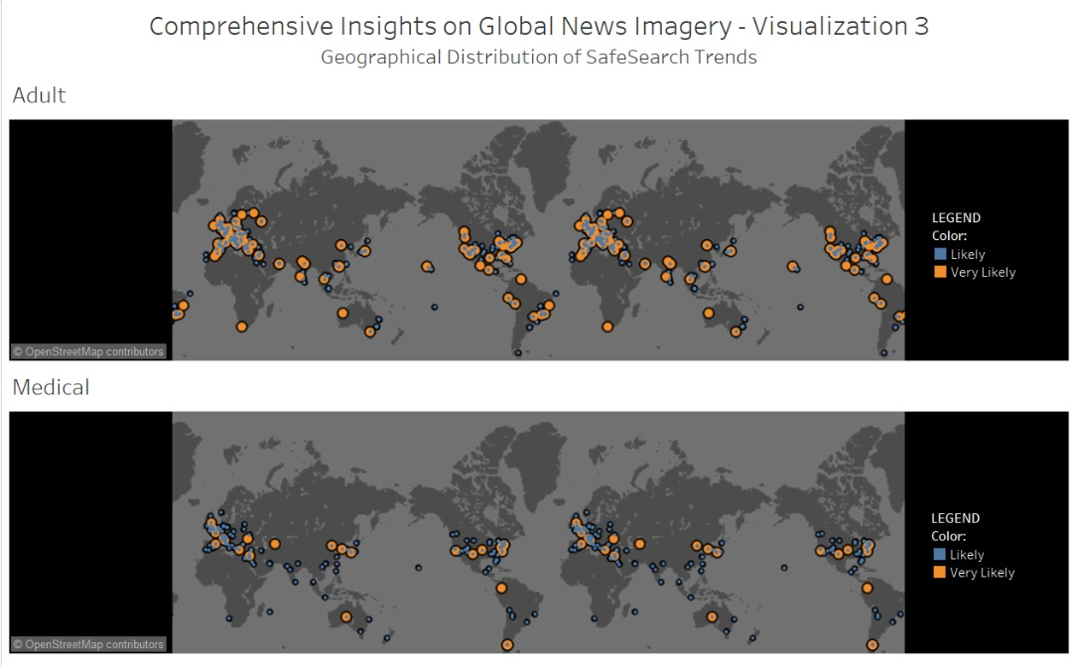
https://public.tableau.com/profile/samvat.rastogi#!/vizhome/ComprehensiveInsightsonGlobalNewsImagery-Visualization3/Dashboard1
Notes:
https://github.com/samvat/ivmooc-gdelt-project/blob/master/The%20GDELT%20Project%20-%20Final%20Report.pdf

Slide 17
Insights gained
Adult content in the news articles are majorly generated from North America and Europe Regions
In case of medical content, Europe region dominates the news. The U.S. , South Africa and Australia are other significant contributors.
News articles coming under spoof category is generated in almost equal proportion from the developed countries
News articles containing violent images are more predominantly generated from Europe, Russia, India and U.S.
Notes:
https://github.com/samvat/ivmooc-gdelt-project/blob/master/The%20GDELT%20Project%20-%20Final%20Report.pdf

Slide 18
Top Labels based on SafeSearch Category
This visualization is a TreeMap portraying the top 20 labels for each category of the Safe Search field.
Through this visualization we are trying to find the most common labels or objects present in an image that are linked to the type of search.
There are four categories of search that can be represented here – Violent , Medical , Spoof and Adult.
Notes:
https://github.com/samvat/ivmooc-gdelt-project/blob/master/The%20GDELT%20Project%20-%20Final%20Report.pdf

Slide 19
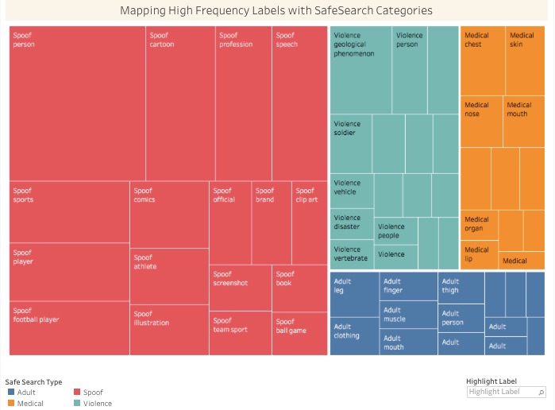
https://public.tableau.com/profile/samvat.rastogi#!/vizhome/ComprehensiveInsightsonGlobalNewsImagery-Visualization4/Dashboard1
Notes:
https://github.com/samvat/ivmooc-gdelt-project/blob/master/The%20GDELT%20Project%20-%20Final%20Report.pdf

Slide 20
InsightS Gained
The top labels which generally trigger the Spoof category of Cloud Vision API are Person, Cartoon, profession, speech, sports etc.
For violence SafeSearch category, the top labels are - geological phenomenon, soldier, vehicle, disaster etc.
Similarly, for the category "Medical", top labels are - chest, skin, nose, mouth, human body.
Notes:
https://github.com/samvat/ivmooc-gdelt-project/blob/master/The%20GDELT%20Project%20-%20Final%20Report.pdf

Slide 21
Related Work
The blog New GDELT Daily Trend Reports[3] discussed daily trends of conflict across the globe by correlating specific news items related to conflicts
Work done by Kaleev Letaru to find geographical details from news articles and geocodes those articles to specific locations[4]
Project undertaken by Kaleev Letaru to portray the positive or negative tone of the news articles based on the geo location using GKG dataset[5]
Notes:
https://github.com/samvat/ivmooc-gdelt-project/blob/master/The%20GDELT%20Project%20-%20Final%20Report.pdf

Slide 22
Challenges
Only around 1.5% of the dataset has geographic information
Data is sparse in most columns of the dataset
Huge size of the dataset
The CloudVision API parses the images and marks images as common nouns and does not give details such as name of a person etc.
Data ranges only from 2016 – 2017 , posing a limitation on temporal analysis
Notes:
https://github.com/samvat/ivmooc-gdelt-project/blob/master/The%20GDELT%20Project%20-%20Final%20Report.pdf

Slide 23
References
1] Börner, K. 2015. Atlas of Knowledge: Anyone Can Map. Cambridge, Massachusetts: The MIT Press.
[2] http://blog.gdeltproject.org/announcing-the-new-gdelt-visual-global-knowledge-graph-vgkg
[3] http://blog.gdeltproject.org/gdelt-daily-trend-reports/
[4] https://www.forbes.com/sites/kalevleetaru/2017/02/21/visual-geocoding-a-quarter-billion-global-news-photographs-using-googles-deep-learning-api/#68bf7a1217fa
[5] https://www.forbes.com/sites/kalevleetaru/2017/02/22/mapping-global-happiness-in-2016-through-a-quarter-billion-news-articles/#4141a7642692
[6] http://analysis.gdeltproject.org/module-gkg-wordcloud.html
Notes:
https://github.com/samvat/ivmooc-gdelt-project/blob/master/The%20GDELT%20Project%20-%20Final%20Report.pdf

Slide 24
Questions ?
Notes:
https://github.com/samvat/ivmooc-gdelt-project/blob/master/The%20GDELT%20Project%20-%20Final%20Report.pdf

