Slide 1
CAT2 PRACTICAL ASSESSMENT · PYTHON AND FUNDAMENTALS OF AI · ITLPA701
Student Performance
Prediction System
A Machine-Learning Decision-Support Tool for Academic Early Warning
Rwanda Polytechnic — Ngoma College
Department of ICT · Trade: IT · RTQF Level VI, Year 3
Module Trainer: Eng. UWAMAHORO Leopord

Slide 2
01
Problem Statement & Objectives
Why an early-warning model, and what this project set out to do
The Problem
Main Objective
Teachers usually discover a struggling student only once final grades are published — too late to intervene. Can we predict, from information available earlier in the term, whether a student will pass or fail?
Design, build, evaluate and deploy a machine-learning system that predicts PASS / FAIL outcomes from real student data, packaged as an explainable, interactive web application.
Acquire & clean a real dataset
Explore data to justify choices
Engineer non-leaking features
1
2
3
Compare & tune ML models
Evaluate with proper metrics
Deploy a Streamlit web app
4
5
6
Student Performance Prediction System | CAT2 Practical — ITLPA701
2

Slide 3
02
The Dataset
A real, peer-reviewed dataset — not synthetic data
395
33
0
0
students
raw attributes
missing values
duplicate rows
UCI Student Performance Data Set
Class Balance
Source: UCI Machine Learning Repository
Citation: Cortez & Silva (2008), Proceedings of 5th FUBUTEC, Porto, Portugal
Subjects: Two Portuguese secondary schools (Math course)
Target: Final grade G3 (0–20) → binary PASS/FAIL (PASS if G3 ≥ 10)
Student Performance Prediction System | CAT2 Practical — ITLPA701
3

Slide 4
03
System Architecture
One shared pipeline guarantees training and prediction never drift apart
TRAINING PIPELINE
Raw CSV
→
Cleaning
→
EDA
→
Feature
Engineering
→
Train/Test
Split
→
Preprocess
(Pipeline)
→
Train &
Tune
→
Evaluate
→
Save Model
(joblib)
PREDICTION PIPELINE
User Input
(Streamlit)
→
Validation
→
Feature
Engineering
→
Preprocess
(same Pipeline)
→
Trained
Model
→
Prediction +
Confidence
Key design decision: a single fitted scikit-learn Pipeline (preprocessing + model) is saved once with joblib and reused, unchanged, for every live prediction — eliminating any train/serve mismatch.
Student Performance Prediction System | CAT2 Practical — ITLPA701
4

Slide 5
04
Feature Engineering
Six derived features — none of them uses G3, so none leaks the target
average_prior_grade
grade_trend
total_study_support
(G1 + G2) / 2
G2 − G1
count of support flags
A single, less-noisy summary of prior performance.
Captures whether a student is improving or declining.
Combines schoolsup, famsup & paid classes into one score.
parental_education
social_alcohol_index
attendance_risk
(Medu + Fedu) / 2
Dalc + Walc
absences > 10
Merges two correlated home-environment indicators.
Reduces noise from two correlated weekday/weekend columns.
A robust flag for a highly skewed raw variable.
Student Performance Prediction System | CAT2 Practical — ITLPA701
5

Slide 6
05
Model Selection & Tuning
Three algorithms compared with 5-fold cross-validation, then tuned
Model | CV Accuracy | CV F1-score | CV Precision | CV Recall
Gradient Boosting ★ selected | 92.7% | 94.6% | 94.4% | 94.8%
Random Forest | 92.7% | 94.5% | 96.2% | 92.9%
Logistic Regression | 91.8% | 93.9% | 93.9% | 93.9%
Why Gradient Boosting?
Highest cross-validated F1-score among the three candidates
Builds trees sequentially, each correcting the last — strong on small tabular datasets
Captures non-linear relationships without heavy manual engineering
Margin over Random Forest is small — evidence-based, not decisive
GridSearchCV — Best Hyperparameters
n_estimators = 100
max_depth = 2 (shallow trees — limits overfitting on a small dataset)
learning_rate = 0.1
Best cross-validated F1-score: 0.958
Student Performance Prediction System | CAT2 Practical — ITLPA701
6

Slide 7
06
Results — Final Tuned Model
Evaluated once on 79 held-out students the model never saw during training
89.9%
95.9%
88.7%
92.2%
94.3%
Accuracy
Precision
Recall
F1-score
ROC-AUC
Tuning Made a Real, Measured Improvement
Interpretation
Precision 95.9%:
when the model predicts PASS, it is right 96% of the time.
Recall 88.7%:
correctly identifies 89% of students who actually pass.
Student Performance Prediction System | CAT2 Practical — ITLPA701
7

Slide 8
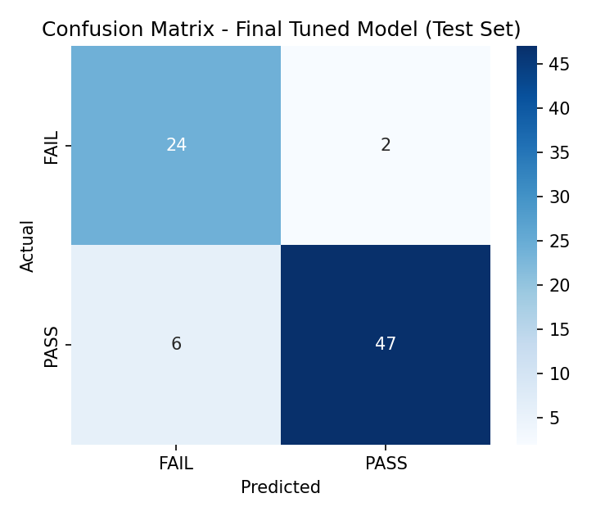
07
Confusion Matrix & Error Analysis
79 test students — which errors matter most for a student-welfare tool?
24
Actual FAIL → Predicted FAIL
Correct
2
Actual FAIL → Predicted PASS
At-risk student missed — the costliest error
6
Actual PASS → Predicted FAIL
Flagged unnecessarily — lower-cost error
47
Actual PASS → Predicted PASS
Correct
Student Performance Prediction System | CAT2 Practical — ITLPA701
8

Slide 9
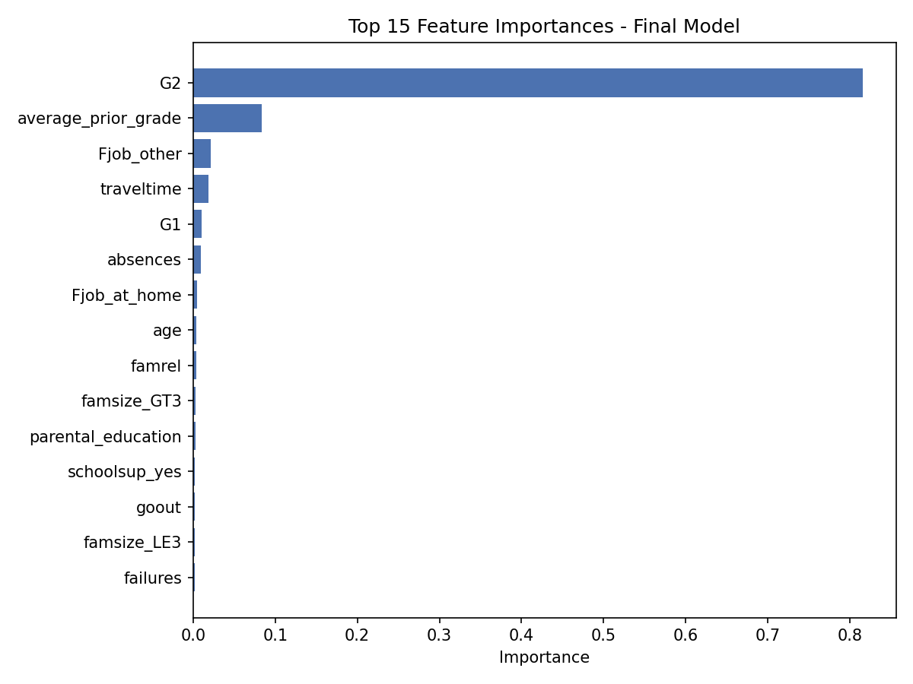
08
An Honest Trade-off: Predicting Earlier
What happens if prior grades G1/G2 aren’t available yet?
G2 alone drives ~82% of the model’s decisions
A version retrained WITHOUT G1/G2 shows how much accuracy depends on already having those grades.
Metric | With G1/G2 | Without
Accuracy | 89.9% | 67.1%
F1-score | 92.2% | 78.7%
ROC-AUC | 94.3% | 64.8%
Takeaway: early prediction is possible, but noticeably less reliable — the dashboard reports both numbers transparently.
Student Performance Prediction System | CAT2 Practical — ITLPA701
9

Slide 10
09
The Streamlit Application
Four pages — from overview to live, explainable predictions
Page 1
Page 2
Page 3
Page 4
Home
Predict Performance
Model Dashboard
Responsible Use
Project overview, purpose, how the system works, and a clear disclaimer.
Data-entry form → PASS/FAIL prediction with confidence & interpretation.
Dataset stats, metrics, confusion matrix, feature importance, limitations.
Risk & mitigation for bias, privacy, security, over-reliance and fairness.
Run it yourself: pip install -r requirements.txt → streamlit run app.py
The exact same fitted preprocessing + model pipeline used in training powers every live prediction — no train/serve mismatch.
Student Performance Prediction System | CAT2 Practical — ITLPA701
10

Slide 11
10
Responsible AI & Limitations
A decision-support tool — never a decision-maker
!
!
!
!
Bias
Privacy
Over-reliance
Fairness
Data reflects two schools, one era
Records include sensitive data
Staff may trust output blindly
Accuracy may vary across groups
Retrain on local data; report as probabilities
In-memory only; follow data-protection policy
Prominent disclaimers; one input among several
Audit metrics per subgroup before deployment
This system must NOT be used as the sole basis for decisions about a student’s grading, placement, discipline, or future opportunities.
Known technical limitations: small & dated dataset (395 students, 2008) · heavy reliance on G1/G2 for best accuracy · moderate class imbalance (67% / 33%).
Student Performance Prediction System | CAT2 Practical — ITLPA701
11

Slide 12
Conclusion
A complete, reproducible ML workflow — from real data to a deployed, explainable web app.
Real UCI dataset · leakage-safe preprocessing pipeline
6 documented engineered features, no target leakage
3 models compared, best tuned with GridSearchCV
89.9% accuracy, 92.2% F1 on unseen test students
Honest early-warning trade-off openly reported
Deployed as a 4-page Streamlit decision-support app
Thank you — questions welcome
Full source, report & demo guide in the project repository

