Slide 1

DPR400210 · DATABASE PROGRAMMING WITH ORACLE DATABASE
Farmer Produce & Market
Supply Chain Management System
Phase VIII — Documentation & Final Presentation
Student: Valentin Student ID: 31383/2025
Database: 31383_2025_Valentin_Farm_DB

Slide 2



01 · OVERVIEW
Introduction
DPR400210
What This Project Is
Why It Matters
A complete Oracle database solution for a regional agricultural cooperative, covering the full journey of produce — from farmer registration and harvest logging, through sales to buyers, to payment and audit — with an Oracle APEX front end for day-to-day use.
Smallholder farmers currently rely on paper records or memory to track harvests, sales, and payments. Digitizing this process gives the cooperative accurate data, faster payments, and a transparent audit trail for governance.
5 core actors: Farmer, Clerk, Buyer, System, Admin
9 database tables, fully normalized to 3NF
PL/SQL package, triggers, and an APEX dashboard
Farmer Produce & Market Supply Chain Management System | 2 / 10

Slide 3
02 · PROBLEM STATEMENT
The Problem
DPR400210
Consequences of the Gap
Problem Definition
Payment disputes with no record to verify who was paid what
Smallholder farmers lack a reliable system to track farms, harvests, and sales to buyers. Records are kept on paper or not at all, making it hard to track payments, yields, or which buyer offers the best price. Cooperative managers have no easy way to audit produce movement or sales compliance.
No visibility into which crops or buyers are most profitable
No audit trail for cooperative governance or compliance
Context of Use
Manual, error-prone tracking of harvests and inventory
A regional cooperative office where staff register farmers, log harvests, record sales, and track payments under admin oversight.
Farmer Produce & Market Supply Chain Management System | 3 / 10

Slide 4
03 · APPROACH
Methodology
DPR400210
An eight-phase capstone workflow, from problem definition to a working APEX application.
1
2
3
4
5
6
7
8
Problem Statement
Business Process
Modeling (MIS)
ERD & 3NF
Normalization
Database
Creation
Table
Implementation
PL/SQL
Programming
Triggers,
Audit & Security
APEX &
Documentation
Each phase builds directly on the last: the ERD (Phase 3) is enforced by the DDL (Phase 5), which is operated on by PL/SQL (Phase 6), governed by triggers (Phase 7), and finally exposed through the APEX UI (Phase 8).
Design principle: start from real business rules (weekday/holiday sales restriction, audit obligations) and let those rules drive the schema, PL/SQL, and trigger design — not the other way around.
Farmer Produce & Market Supply Chain Management System | 4 / 10

Slide 5
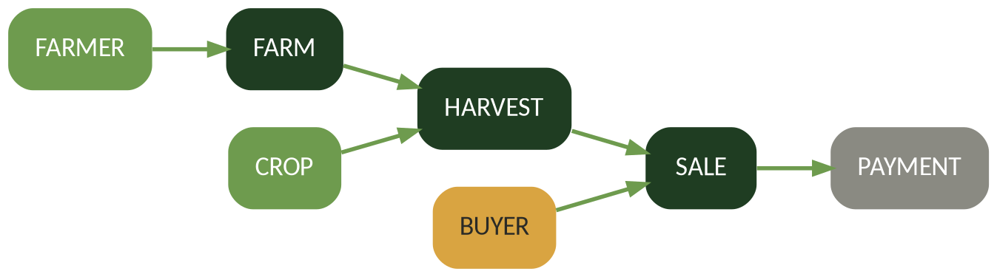
04 · ERD OVERVIEW
Database Design
DPR400210
9 entities in total — core chain shown above, plus PUBLIC_HOLIDAY (trigger reference) and AUDIT_LOG (system-wide change log).
1NF: atomic attributes, no repeating groups
2NF: surrogate PKs eliminate partial dependency
3NF: no transitive dependencies across entities
Farmer Produce & Market Supply Chain Management System | 5 / 10

Slide 6
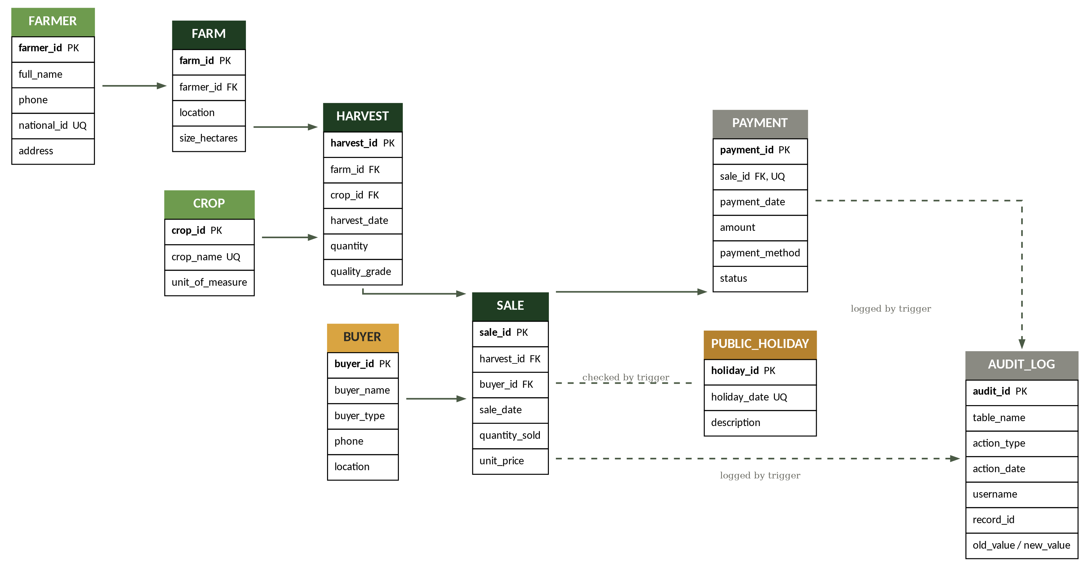
DATABASE DESIGN · 9 TABLES
Entity-Relationship Diagram
DPR400210
Farmer Produce & Market Supply Chain Management System | 2 / 3

Slide 7
LEGEND · NORMALIZATION
Reading the ERD
DPR400210
Legend
Normalization (3NF)
PK
Primary Key — uniquely identifies the row
1NF
All attributes are atomic — no repeating groups or multi-valued fields
FK
Foreign Key — references another table's PK
UQ
Unique constraint — no duplicate values allowed
2NF
Every table uses a single-column surrogate PK, so partial dependency cannot occur
→ (solid)
Foreign key relationship (one-to-many)
3NF
No transitive dependencies — crop and buyer details live only in CROP/BUYER, never duplicated in HARVEST or SALE
→ (dashed)
Referenced by trigger logic, not a formal FK
9 tables total: 7 core transactional entities (Farmer through Payment) plus 2 supporting tables (Public Holiday, Audit Log) that exist to enforce business rules and accountability rather than to model the sale chain itself.
Farmer Produce & Market Supply Chain Management System | 3 / 3

Slide 8
05 · SCHEMA & PL/SQL
Implementation
DPR400210
Schema Layer
PL/SQL Layer
9 tables with PK / FK / UNIQUE / CHECK / NOT NULL constraints
farm_pkg package: register_harvest, record_sale, process_payment
9 sequences driving surrogate primary keys
Function calc_sale_total() and get_farmer_revenue()
Referential integrity enforced across the full sale chain
Explicit cursor listing all unpaid sales
Custom exception e_insufficient_qty + system exception handling
Sample constraint
CONSTRAINT chk_sale_qty CHECK (quantity_sold > 0)
Farmer Produce & Market Supply Chain Management System | 6 / 10

Slide 9

06 · TRIGGERS & SECURITY
Implementation
DPR400210
Role-Based Security
Business Rule Trigger
role_clerk
trg_sale_business_rule blocks any SALE insert, update, or delete on weekdays and on dates listed in PUBLIC_HOLIDAY — enforced at the database level, not just the application.
Insert/update on operational tables; no DELETE on sales
role_buyer_viewer
Audit Triggers
Read-only access to crops, harvests, and sales
trg_audit_sale and trg_audit_payment log every INSERT / UPDATE / DELETE to AUDIT_LOG with old and new values, timestamp, and username — a tamper-evident history of every transaction.
role_admin
Full CRUD except audit_log, which stays read-only
Farmer Produce & Market Supply Chain Management System | 7 / 10

Slide 10


07 · ORACLE APEX APPLICATION
Results
DPR400210
Farmers & Farms
Harvest Logging
Sales & Payments
Admin Dashboard
Interactive Grid CRUD
Form calling farm_pkg
Validated against triggers
Charts + audit log, role-gated
Screenshots of each running APEX page are included in the full project report.
Farmer Produce & Market Supply Chain Management System | 8 / 10

Slide 11
07 · OUTCOMES ACHIEVED
Results
DPR400210
9
2
3
8
Database tables
Triggers
User roles
APEX pages
fully normalized to 3NF
business rule + audit logging
clerk, buyer-viewer, admin
end-to-end workflow coverage
What the System Now Makes Possible
Every harvest, sale, and payment is traceable end-to-end
Sales outside approved trading windows are blocked automatically
Admins get real-time visibility into revenue and unpaid sales
Every data change is logged with who did it and when
Farmer Produce & Market Supply Chain Management System | 9 / 10

Slide 12
CONCLUSION
A Single Source of Truth,
From Farm to Sale
This capstone project delivers a complete Oracle database solution for managing farmer produce sales — from registration through harvest logging, sales, payments, and auditing. Referential integrity, business rules, and accountability are enforced at the database level, with an Oracle APEX front end providing role-based access for clerks, buyers, and administrators.
Thank you — questions welcome.
Valentin · 31383/2025 · 31383_2025_Valentin_Farm_DB

