Slide 1
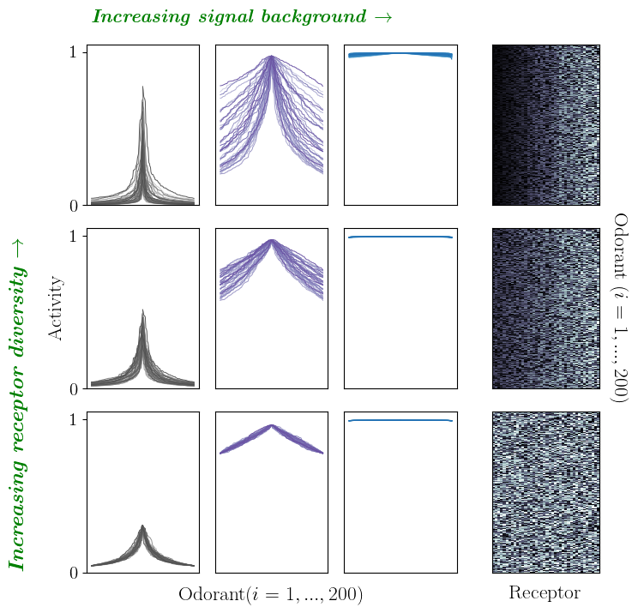
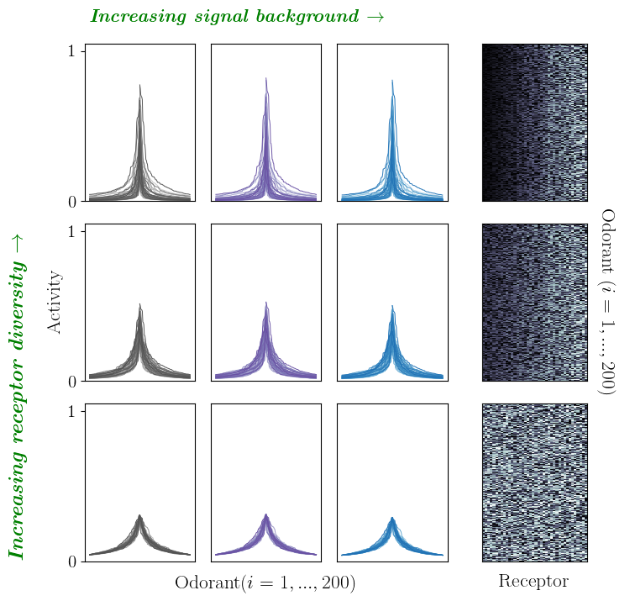
A B
Figure 1. Weber-Law adaptation preserves response tuning across a range of stimulus backgrounds. A Simulated tuning curves for increasing stimulus backgrounds (column-wise; s = 1e-2, 1e0, 1e2 from left to right) and increasing diversity in activation free energies ε_{ρ} (row-wise), without adaptation. Activation free energies for each receptor, ε_{ρ}, are plotted in the final column. Tuning curve shapes are sensitive to (and saturate with) increasing stimulus, irrespective of ε_{ρ} diversity. B With Weber Law adaptation (ε_{ρ} ~ ln(s_{i}) + c), tuning curves are invariant over several magnitudes of stimulus backgrounds.

Slide 2



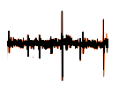
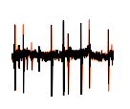

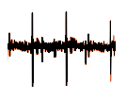
Figure 2. TODO
Odor signal in high-D space
Receptor response
Inferred odor identity
unadapted adapted

Slide 3
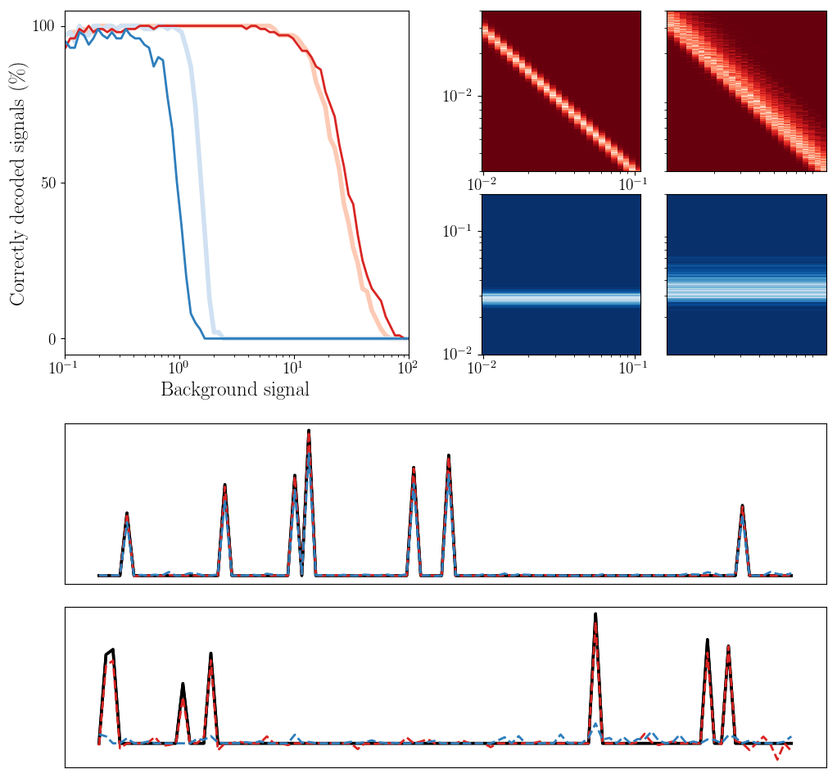
A B
C
Figure 3. Weber-law adaptation in a combinatorial code preserves the accuracy of odor recognition across a range of stimulus backgrounds. A Percentage of 100 randomly-generated sparse odor signals that are correctly estimated by the linearized compressed sensing scheme, as a function of signal background, with and without Weber-Law adaptation (red and blue plots, respectively). Signal background is the average value of the signal’s nonzero components. Varying levels of receptor diversity are considered; lighter plots represent more uniform tuning curves. B Histogram heat maps of the linearized gain for distinct background levels, with and without Weber-Law adaptation (upper red and lower blue plots, respectively), for increasing receptor diversity (left to right). With adaptation, the full distribution of the receptor gain scales as 1/s. C Indicative odor estimation at low stimulus (top) and high stimulus (bottom).

Slide 4
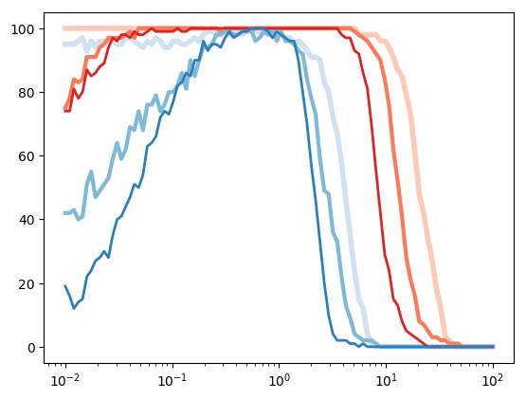
Red: adapted
Blue: unadapted
Light to dark: # of background components: 1, 2, 4, with 7 total nonzero odorants
Correctly decoded signals
Latent odor mean signal (signal 1)
Figure 4. Discrimination: todo

Slide 5
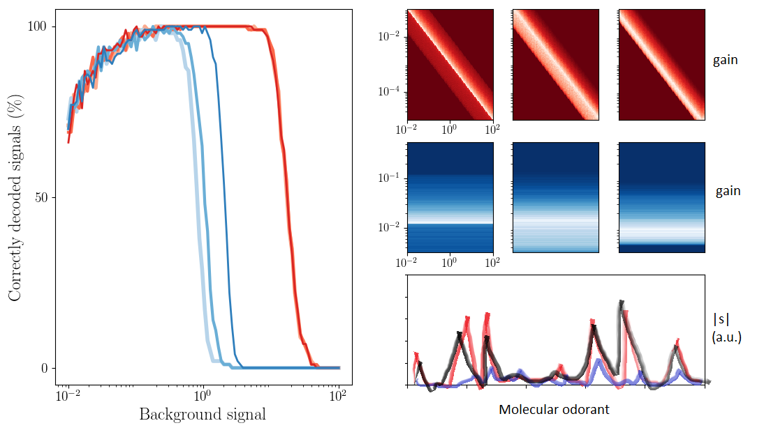
A B
C
Figure 3. Weber-law adaptation in a combinatorial code preserves the accuracy of odor recognition across a range of stimulus backgrounds. A Percentage of 100 randomly-generated sparse odor signals that are correctly estimated by the linearized compressed sensing scheme, as a function of signal background, with and without Weber-Law adaptation (red and blue plots, respectively). Signal background is the average value of the signal’s nonzero components. Varying levels of receptor diversity are considered; lighter plots represent more uniform tuning curves. B Histogram heat maps of the lineareized gain for distinct background levels, with and without Weber-Law adaptation (upper red and lower blue plots, respectively), for increasing receptor diversity (left to right). With adaptation, the full distribution of the receptor gain scales as 1/s. C Indicative odor estimation

Slide 6
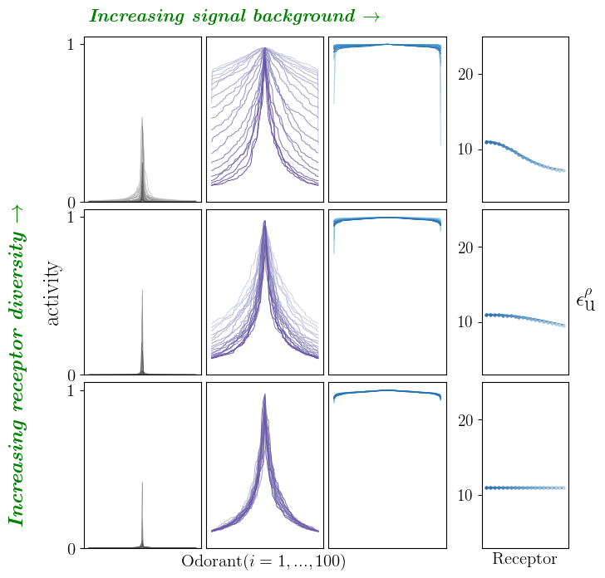
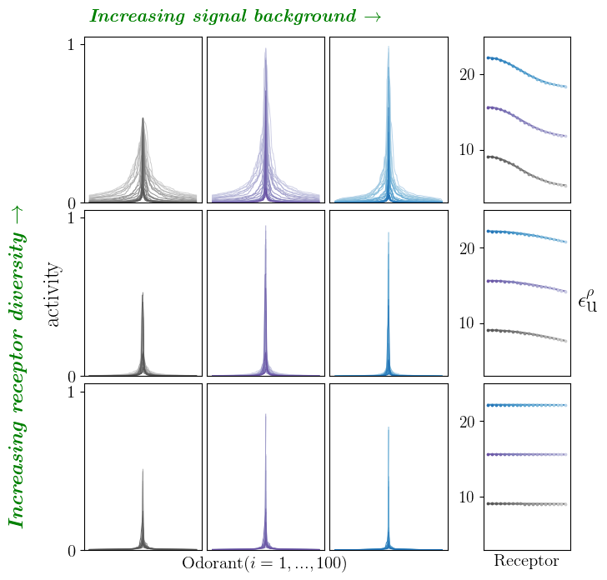
A B
Figure 1. Weber-Law adaptation preserves response tuning across a range of stimulus backgrounds. A Simulated tuning curves for increasing stimulus backgrounds (column-wise; s = 1e-2, 1e0, 1e2 from left to right) and increasing diversity in activation free energies ε_{ρ} (row-wise), without adaptation. Activation free energies for each receptor, ε_{ρ}, are plotted in the final column. Tuning curve shapes are sensitive to (and saturate with) increasing stimulus, irrespective of ε_{ρ} diversity. B With Weber Law adaptation (ε_{ρ} ~ ln(s_{i}) + c), tuning curves are invariant over several magnitudes of stimulus backgrounds.

Slide 7
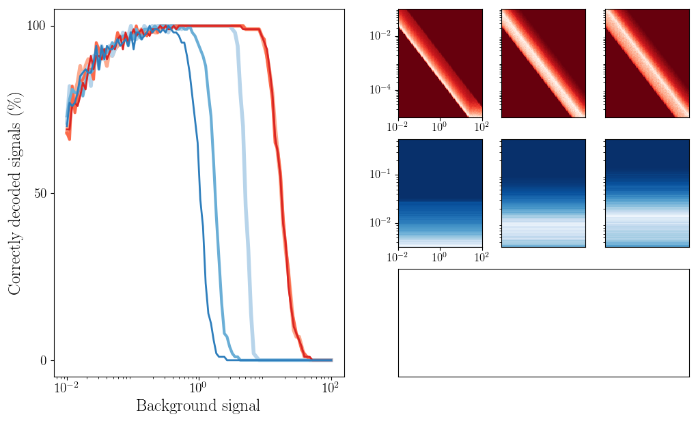
A B
C
Figure 2. Weber-law adaptation in a combinatorial code preserves the accuracy of odor recognition across a range of stimulus backgrounds. A Percentage of 100 randomly-generated sparse odor signals that are correctly estimated by the linearized compressed sensing scheme, as a function of signal background, with and without Weber-Law adaptation (red and blue plots, respectively). Signal background is the average value of the signal’s nonzero components. Varying levels of receptor diversity are considered; lighter plots represent more uniform tuning curves. B Histogram heat maps of the lineareized gain for distinct background levels, with and without Weber-Law adaptation (upper red and lower blue plots, respectively), for increasing receptor diversity (left to right). With adaptation, the full distribution of the receptor gain scales as 1/s. C Indicative odor estimation

Slide 8
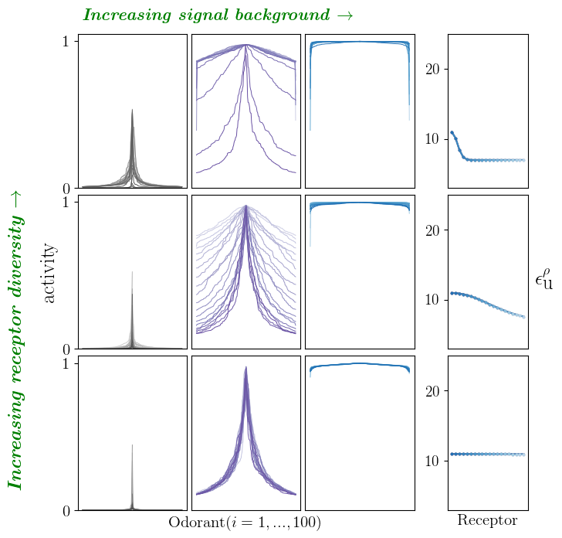
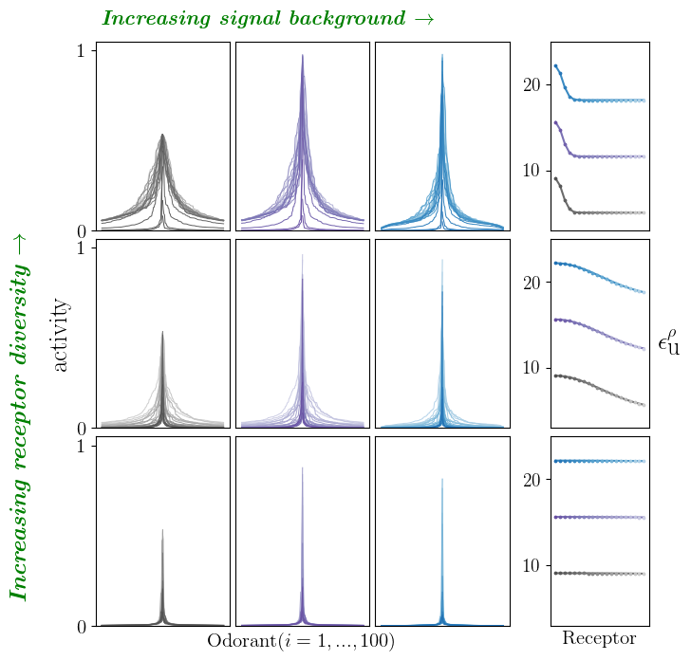
A B
Figure 1. Weber-Law adaptation preserves response tuning across a range of stimulus backgrounds. A Simulated tuning curves for increasing stimulus backgrounds (column-wise; s = 1e-2, 1e0, 1e2 from left to right) and increasing diversity in activation free energies ε_{ρ} (row-wise), without adaptation. Activation free energies for each receptor, ε_{ρ}, are plotted in the final column. Tuning curve shapes are sensitive to (and saturate with) increasing stimulus, irrespective of ε_{ρ} diversity. B With Weber Law adaptation (ε_{ρ} ~ ln(s_{i}) + c), tuning curves are invariant over several magnitudes of stimulus backgrounds.

