Slide 1
COMPILER DESIGN

Slide 2
Compiler design is design of a software that translates the source code written in a high-level programming language (Like C, C++, Java or Python) into the low level language like Machine code, Assembly code or Byte code. It comprises a number of phases where the code is pre-processed, and parsed, its semantics or meaning are checked, and optimized, and then the final executable code is generated.

Slide 3
INTRODUCTION TO COMPILERS

Slide 4
LANGUAGE PROCESSING SYSTEM
We tend to write programs in high level language , that is much less complicated for us to understand and maintain in thoughts . These programs go through a series of transformation so that they can readily be used in machines.

Slide 5
LANGUAGE PROCESSING SYSTEM
In a language processing system, the source code is first preprocessed.
The modified source program is processed by the compiler to form the target assembly program which is then translated by the assembler to create relocatable object codes that are processed by linker and loader to create the target program.

Slide 6
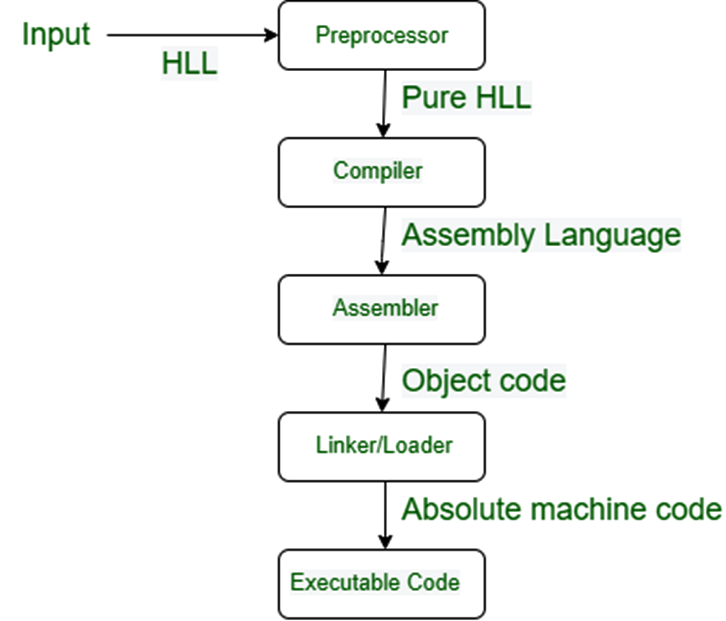
STEPS IN A LANGUAGE PROCESSING SYSTEM

Slide 7
High-Level Language: If a program contains pre-processor directives such as #include or #define it is called HLL. They are closer to humans but far from machines. These (#) tags are called preprocessor directives. They direct the pre-processor about what to do.

Slide 8
Pre-Processor: The pre-processor removes all the #include directives by including the files called file inclusion .
All the # define directives using macro expansion.(define pi).
It performs
file inclusion(Include header files in program)
macro expansions.
short hand operations(a+=1) etc.
Pure HLL − It means that the program will not contain any # tags. These # tags are also known as preprocessor directives.

Slide 9
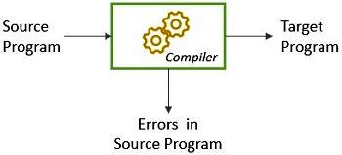
Compiler: A compiler is a computer program that translates computer code written in one programming language(source language) into another language(target language).
It converts pure HLL into assembly language.
The compiler is primarily used for programs that translate source code from a high level programming language to a lower level language(assembly language)

Slide 10
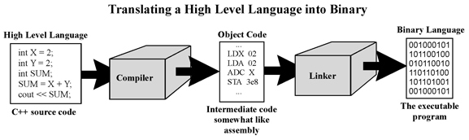

Slide 11
Assembly language: It’s neither in binary form nor high level. It is an intermediate state that is a combination of machine instructions and some other useful data needed for execution.
Assembler: For every platform (Hardware + OS) we will have an assembler. They are not universal since for each platform we have one. The output of the assembler is called an object file. Its translates assembly language to machine code.
Relocatable Machine Code: It can be loaded at any point and can be run. The address within the program will be in such a way that it will cooperate with the program movement.

Slide 12
Loader/Linker: Linker converts the relocatable code into absolute code and tries to run the program resulting in a running program or an error message (or sometimes both can happen). Linker loads a variety of object files into a single file to make it executable. Then loader loads it in memory and executes it.
Linker: The basic work of a linker is to merge object codes (that have not even been connected), produced by the compiler, assembler, standard library function, and operating system resources.
Loader: The codes generated by the compiler, assembler, and linker are generally re-located by their nature, which means to say, the starting location of these codes is not determined, which means they can be anywhere in the computer memory. Thus the basic task of loaders to find/calculate the exact address of these memory locations.

Slide 13
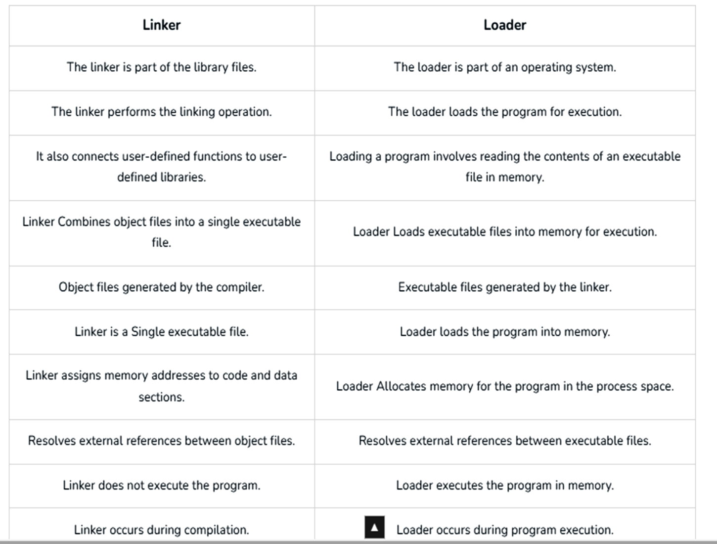

Slide 14
HISTORY
The first practical compiler was written by Corrado Böhm in 1951 for his PhD thesis.
The first implemented compiler was written by Grace Hopper, who also coined the term "compiler",^{[6][7]} referring to her A-0 system which functioned as a loader or linker, not the modern notion of a compiler.
The first Autocode and compiler in the modern sense were developed by Alick Glennie in 1952 at the University of Manchester for the Mark 1 computer.The FORTRAN team led by John W. Backus at IBM introduced the first commercially available compiler, in 1957, which took 18 person-years to create.

Slide 15
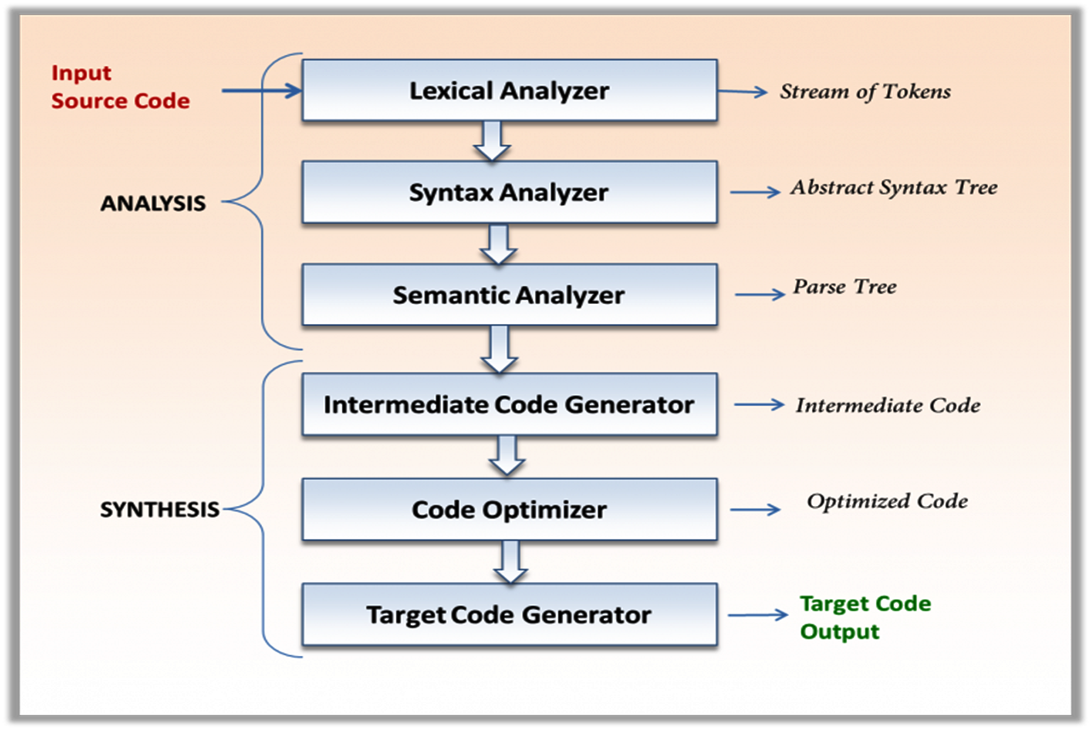
STRUCTURE/ PHASES of a Compiler

Slide 16
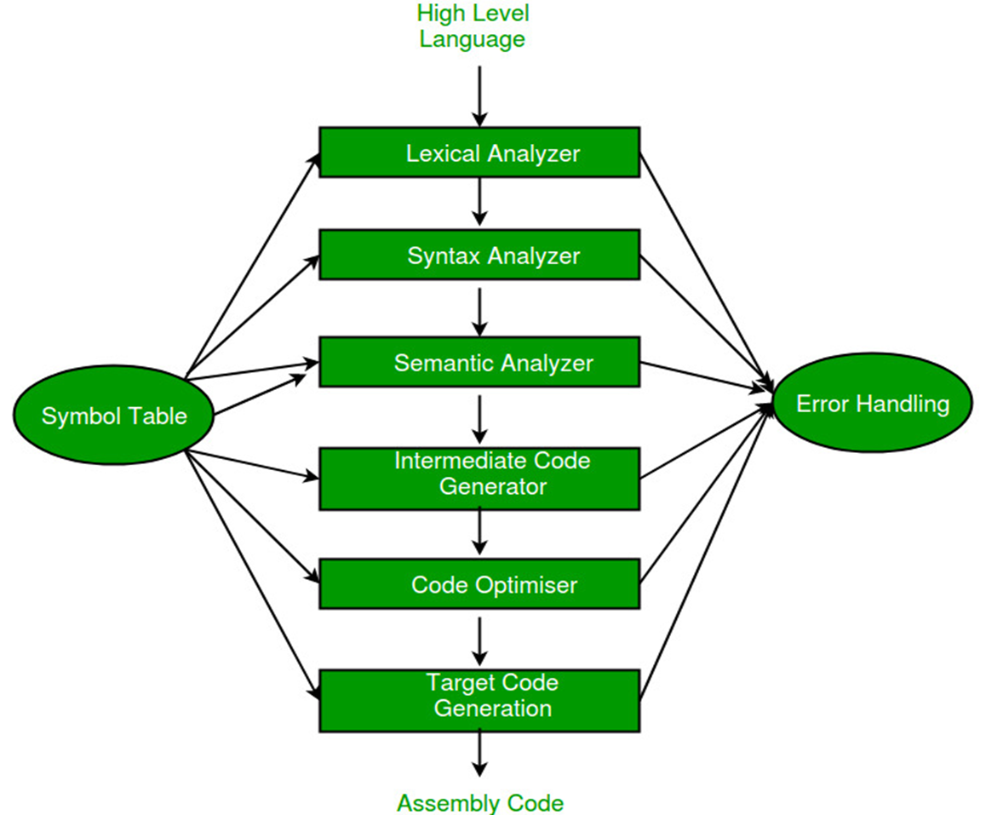

Slide 17
STRUCTURE/ PHASES of a Compiler
Synthesis Phase
Analysis Phase
An intermediate representation is created from the given source code :
Lexical Analyzer
Syntax Analyzer
Semantic Analyzer
Intermediate Code Generator
An equivalent target program is created from the intermediate representation. It has two parts :
Code Optimizer
Code Generator

Slide 18
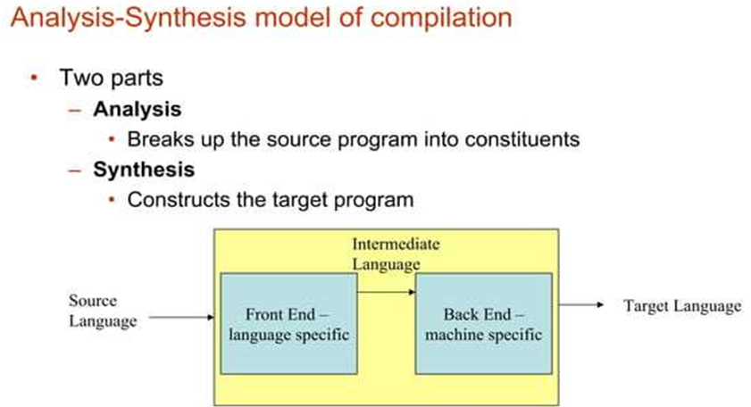

Slide 19
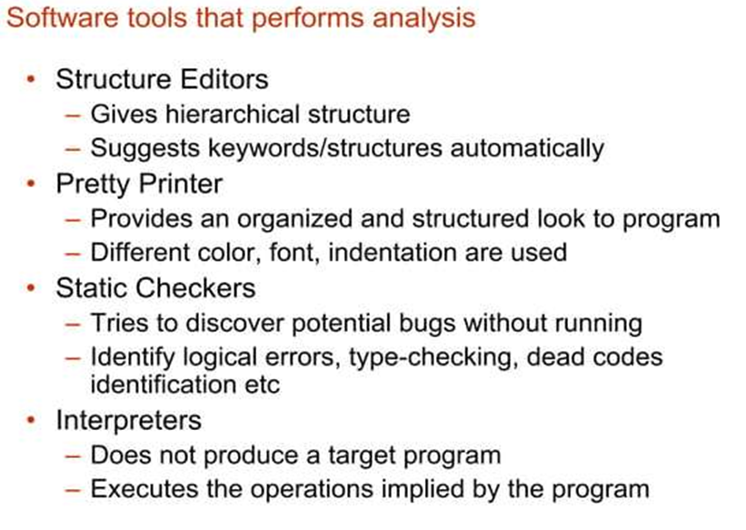

Slide 20
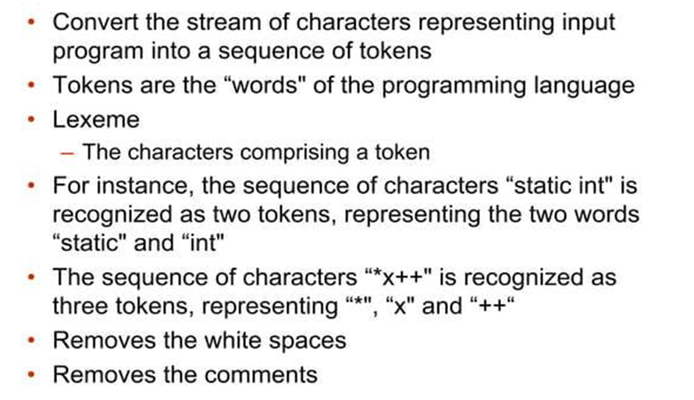
LEXICAL ANALYZER

Slide 21

For example
In lexical analysis the characters in the assignment statement position: = initial + rate * 60
would be grouped in to the following tokens
1. The identifier position
2. The assignment symbol: =
3. The identifier initial
4. The plus sign
5. The identifier rate
6. The multiplication sign
7. The number 60

Slide 22
SYNTAX ANALYZER
The second phase of a compiler is syntax analyzer, also known as parser.
It use productions of CFG to construct parse tree.
Its primary goal is to verify the syntactical correctness of the source code.
It takes the tokens generated by the lexical analyzer and attempts to build a Parse Tree or Abstract Syntax Tree (AST).
It reads all the tokens one by one.

Slide 23
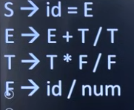
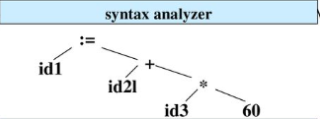
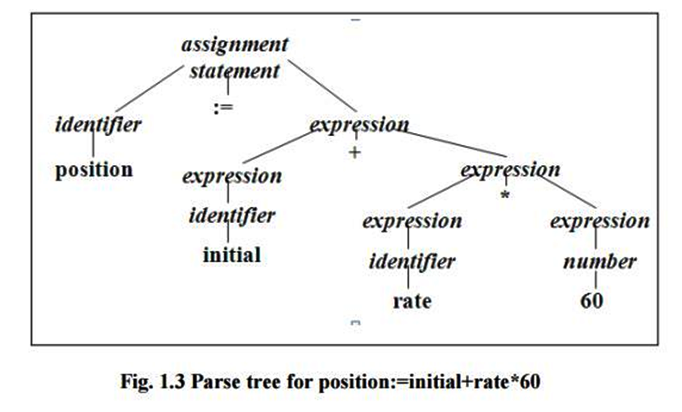
EXAMPLE

Slide 24
SEMANTIC ANALYSIS
This phase checks whether the code is semantically correct.
In this stage, the compiler checks the meaning of the source code to ensure that it makes sense.
The compiler performs type checking,(Shows error when try to add a string to an integer) which ensures that variables are used correctly and that operations are performed on compatible data types. The compiler also checks for other semantic errors, such as undeclared variables and incorrect function calls.

Slide 25
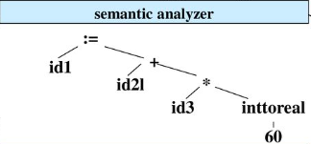
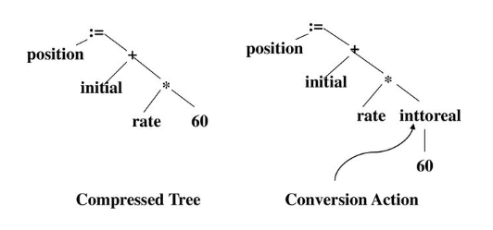

Slide 26
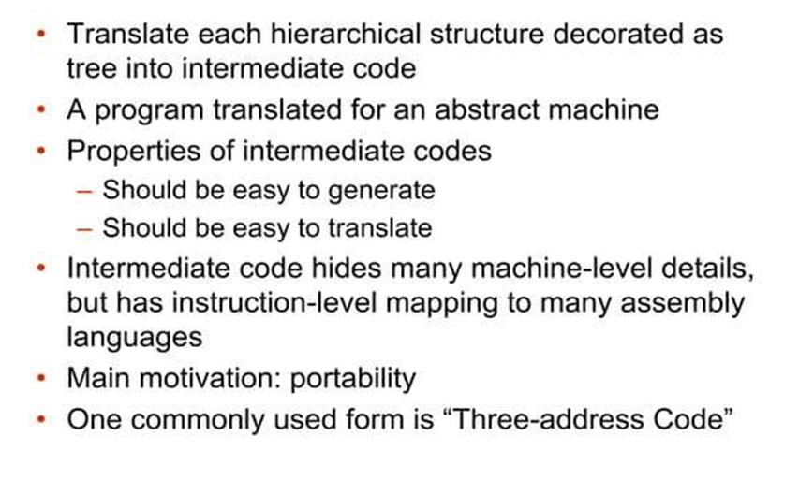
Intermediate Code Generator
It generates intermediate code , that is a form which can be readily understood by machine.

Slide 28

Optimization
The fifth phase of a compiler is optimization. This phase applies various optimization techniques to the intermediate code to improve the performance of the generated machine code.

Slide 29
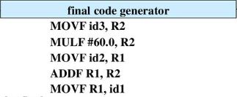
Code Generation
The final phase of a compiler is code generation. This phase takes the optimized intermediate code and generates the actual machine code that can be executed by the target hardware.

Slide 30
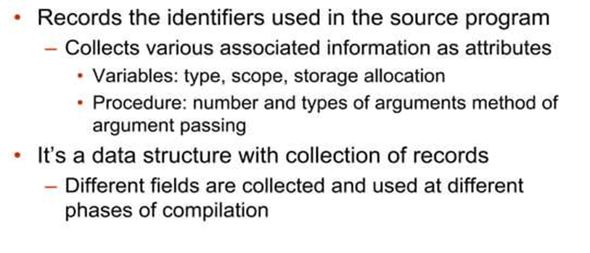
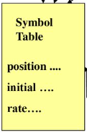
Symbol Table
It helps the compiler to function smoothly by finding the identifiers quickly.

Slide 31
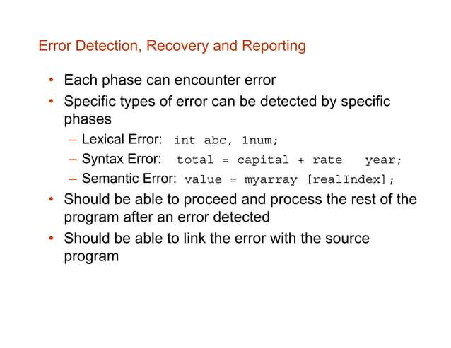

Slide 32
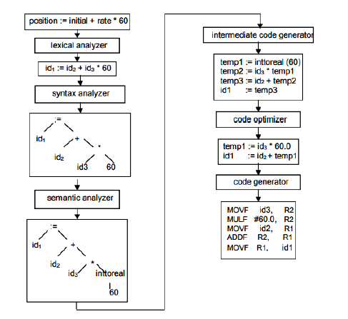

Slide 33
GROUPING OF PHASES
Generally, phases are divided into two parts:
1. Front End phases
2. Back End phases

Slide 34
1. Front End phases: The front end consists of those phases or parts of phases that are source language-dependent and target machine, independents. These generally consist of lexical analysis, semantic analysis, syntactic analysis, symbol table creation, and intermediate code generation. A little part of code optimization can also be included in the front-end part. The front-end part also includes the error handling that goes along with each of the phases.

Slide 35
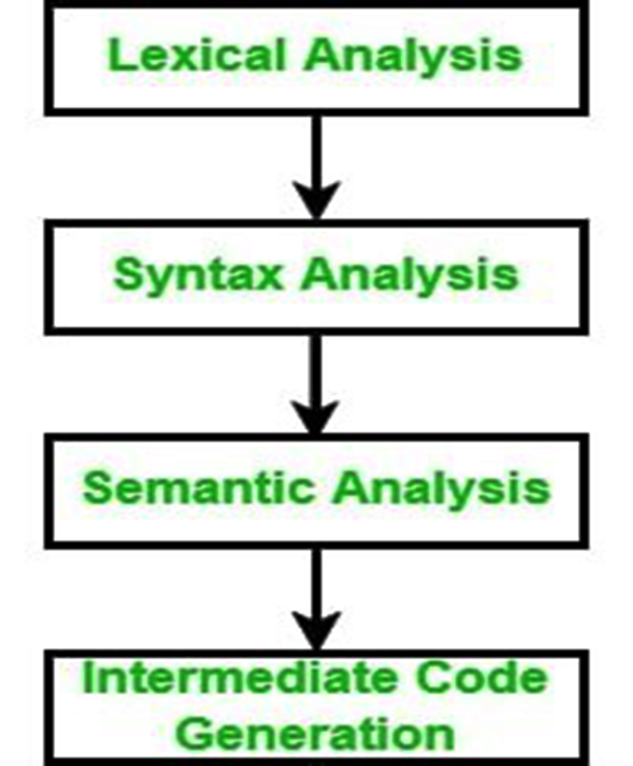
Front End phases

Slide 36
2. Back End phases: The portions of compilers that depend on the target machine and do not depend on the source language are included in the back end. In the back end, code generation and necessary features of code optimization phases, along with error handling and symbol table operations are also included.

Slide 37
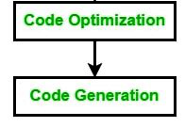
Back End phases

Slide 38
Passes in Compiler:
A pass is a component where parts of one or more phases of the compiler are combined when a compiler is implemented. A pass reads or scans the instructions of the source program or the output produced by the previous pass, which makes necessary transformation specified by its phases.
There are generally two types of passes
One-pass
Two-pass

Slide 39
Several phases are grouped together to a pass so that it can read the input file and write an output file.
One-Pass – In One-pass all the phases are grouped into one phase. The six phases are included here in one pass.
Two-Pass – In Two-pass the phases are divided into two parts
i.e. Analysis or Front End part of the compiler and the synthesis part or back end part of the compiler.

Slide 40
Compiler construction tools
The compiler writer can use some specialized tools that help in implementing various phases of a compiler. These tools assist in the creation of an entire compiler or its parts. Some commonly used compiler construction tools include:
Parser Generator
Scanner Generator
Syntax directed translation engines
Automatic code generators
Data-flow analysis engines

Slide 41
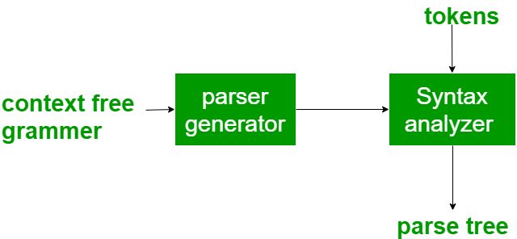
Parser Generator – It produces syntax analyzers (parsers) from the input that is based on a grammatical description of programming language or on a context-free grammar. It is useful as the syntax analysis phase is highly complex and consumes more manual and compilation time. Example: PIC, EQM

Slide 42
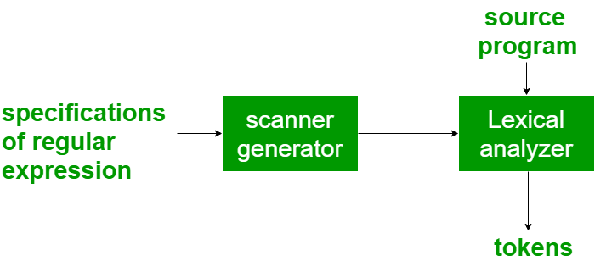
Scanner Generator – It generates lexical analyzers from the input that consists of regular expression description based on tokens of a language. It generates a finite automaton to recognize the regular expression. Example: Lex

Slide 43
Syntax directed translation engines – It generates intermediate code with three address format from the input that consists of a parse tree. These engines have routines to traverse the parse tree and then produces the intermediate code. In this, each node of the parse tree is associated with one or more translations.

Slide 44
Automatic code generators – It generates the machine language for a target machine. Each operation of the intermediate language is translated using a collection of rules and then is taken as an input by the code generator. A template matching process is used. An intermediate language statement is replaced by its equivalent machine language statement using templates.

Slide 45
Data-flow analysis engines – It is used in code optimization.Data flow analysis is a key part of the code optimization that gathers the information, that is the values that flow from one part of a program to another.

Slide 46
LEXICAL ANALYSIS
Lexical analysis is the process of breaking down the source code of the program into smaller parts, called tokens, such that a computer can easily understand.

Slide 47
ROLE OF LEXICAL ANALYZER
The main task of the lexical analyzer is to read the input characters of the source program, group them into lexemes, and produce as output tokens.
This stream of tokens is sent to the parser for syntax analysis. It is common for the lexical analyzer to interact with the symbol table as well

Slide 48
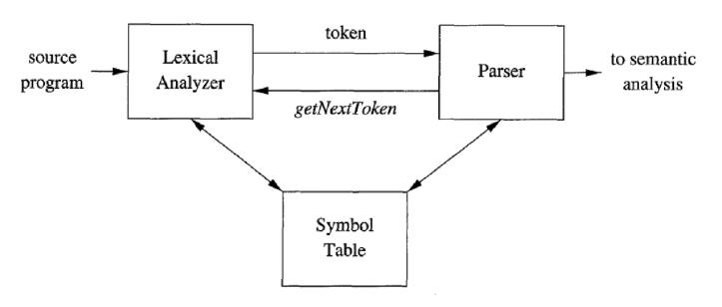
LEXICAL ANALYZER

Slide 49
When lexical analyzer identifies the first token it will send it to the parser, the parser receives the token and calls the lexical analyzer to send next token by issuing the getNextToken() command.
The lexical analyzer will neglect or discard the white spaces and comment lines.

Slide 50
TOKENS, PATTERNS AND LEXEMES
A token is the smallest unit of meaningful data.
It may be an identifier, keyword, operator, or symbol.
A token represents a series or sequence of characters that cannot be decomposed further.

Slide 51
Some examples of tokens would include:
Keywords : Those reserved words in C like ` int `, ` char `, ` float `, ` const `, ` goto `, etc.
Identifiers: Names of variables and user-defined functions.
Operators : ` + `, ` – `, ` * `, ` / `, etc.
Delimiters /Punctuators: Symbols used such as commas ” , ” semicolons ” ; ” braces ` {} `.

Slide 52
Tokens may be divided into three categories:
Terminal Symbols (TRM) : Keywords and operators.
Literals (LIT) : Values like numbers and strings.
Identifiers (IDN) : Names defined by the user.

Slide 53
Example 1:
int a = 10; //Input Source code Tokens int (keyword), a(identifier), =(operator), 10(constant) and ;(punctuation-semicolon)
Total number of tokens = 5

Slide 54
Example 2:
int main() { // printf() sends the string inside quotation to // the standard output (the display) printf("Welcome to GeeksforGeeks!"); return 0; } Tokens 'int‘ , 'main‘ , '(‘ , ')‘ , '{‘ , 'printf‘ , '(‘ , "Welcome to GeeksforGeeks!" , ')’ , ';’ , 'return', '0', ';’ , '}‘
Total number of tokens = 14

Slide 55
PATTERN
A pattern is a rule or syntax that designates how tokens are identified in a programming language.
It is supposed to specify the sequences of characters or symbols that make up valid tokens, and provide guidelines as to how to identify them correctly to the scanner.

Slide 56
Example of Programming Language (C, C++)
For a keyword to be identified as a valid token, the pattern is the sequence of characters that make the keyword.
For identifier to be identified as a valid token, the pattern is the predefined rules that it must start with alphabet, followed by alphabet or a digit.

Slide 57
LEXEME
A lexeme is a sequence of characters in the source program that matches the pattern for a token and is identified by the lexical analyzer as an instance of that token.
Example: In the following C language statement ,
printf ("Total = %d\n‖, score) ;
both printf and score are lexemes matching the pattern for token id, and "Total = %d\n‖ is a lexeme matching literal [or string].

Slide 58
INPUT BUFFERING
Input buffering is a technique that allows the compiler to read input in larger chunks, which can improve performance and reduce overhead.(amount of system capacity spent)
Lexical Analysis has to access secondary memory each time to identify tokens. It is time-consuming and costly. So, the input strings are stored into a buffer and then scanned by Lexical Analysis.
Lexical Analysis scans input string from left to right one character at a time to identify tokens.

Slide 59
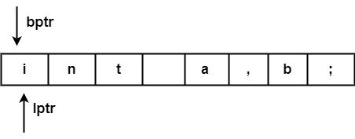
It uses two pointers to scan tokens −
Begin Pointer (bptr) − It points to the beginning of the string to be read.
Look Ahead Pointer (lptr) − It moves ahead to search for the end of the token.
Example − For statement int a, b;
Both pointers start at the beginning of the string, which is stored in the buffer.

Slide 60
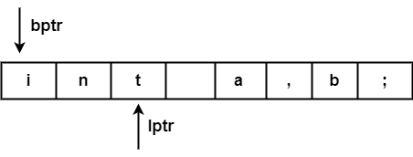
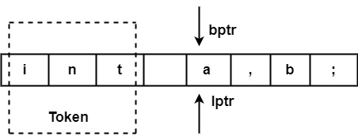
Look Ahead Pointer scans buffer until the token is found.
After processing token ("int") both pointers will set to the next token ('a'), & this process will be repeated for the whole program.

Slide 61
The input character is thus read from secondary storage, but reading in this way from secondary storage is costly. hence buffering technique is used.
A block of data is first read into a buffer, and then second by lexical analyzer.
There are two methods used in this context: One Buffer Scheme, and Two Buffer Scheme.

Slide 62
1.One Buffer Scheme: In this scheme, only one buffer is used to store the input string but the problem with this scheme is that if lexeme is very long then it crosses the buffer boundary, to scan rest of the lexeme the buffer has to be refilled, that makes overwriting the first of lexeme.

Slide 63
2. Two Buffer Scheme: To overcome the problem of one buffer scheme, in this method two buffers are used to store the input string. the first buffer and second buffer are scanned alternately. when end of current buffer is reached the other buffer is filled.
The only problem with this method is that if length of the lexeme is longer than length of the buffer then scanning input cannot be scanned completely.

Slide 64
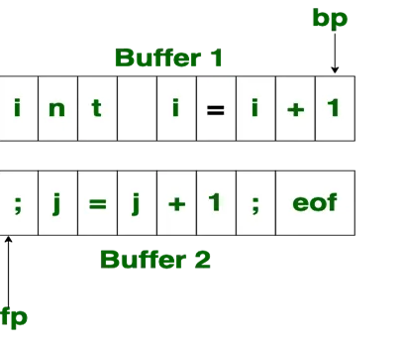

Slide 65
Initially both the bp and fp are pointing to the first character of first buffer. Then the fp moves towards right in search of end of lexeme, as soon as blank character is recognized, the string between bp and fp is identified as corresponding token. to identify, the boundary of first buffer end of buffer character should be placed at the end first buffer.

Slide 66
Similarly end of second buffer is also recognized by the end of buffer mark present at the end of second buffer. when fp encounters first eof, then one can recognize end of first buffer and hence filling up second buffer is started. in the same way when second eof is obtained then it indicates of second buffer.

Slide 67
Alternatively both the buffers can be filled up until end of the input program and stream of tokens is identified. This eof character introduced at the end is calling Sentinel which is used to identify the end of buffer.

Slide 68
Specification of Tokens
Specification of tokens depends on the pattern of the lexeme. Here we will be using regular expressions to specify the different types of patterns that can actually form tokens.

Slide 69
There are 3 specifications of tokens:
String
Language
Regular Expression

Slide 70
1. String
An alphabet or character class is a finite set of symbols.
A string over an alphabet is a finite sequence of symbols drawn from that alphabet.
In language theory, the term "word" is often used as synonyms for "string".
The length of a string s, usually written |s|, is the number of occurrences of symbols in s. For example, "banana" is a string of length six.
The empty string, denoted ε, is the string of length zero.

Slide 71
Operations on String:
1. Prefix of String
The prefix of the string is the preceding symbols present in the string and the string(s) itself.
For Example: s = abcd
The prefix of the string abcd: ∈, a, ab, abc, abcd

Slide 72
2. Suffix of String
Suffix of the string is the ending symbols of the string and the string(s) itself.
For Example: s = abcd
Suffix of the string abcd: ∈, d, cd, bcd, abcd

Slide 73
3. Proper Prefix of String
The proper prefix of the string includes all the prefixes of the string excluding ∈ and the string(s) itself.
Proper Prefix of the string abcd: a, ab, abc

Slide 74
4. Proper Suffix of String The proper suffix of the string includes all the suffixes excluding ∈ and the string(s) itself. Proper Suffix of the string abcd: d, cd, bcd

Slide 75
5. Substring of String
The substring of a string s is obtained by deleting any prefix or suffix from the string. Substring of the string abcd: ∈, abcd, bcd, abc, …

Slide 76
6. Proper Substring of String The proper substring of a string s includes all the substrings of s excluding ∈ and the string(s) itself. Proper Substring of the string abcd: bcd, abc, cd, ab…

Slide 77
7. Subsequence of String The subsequence of the string is obtained by eliminating zero or more (not necessarily consecutive) symbols from the string. A subsequence of the string abcd: abd, bcd, bd, …

Slide 78
8. Concatenation of String If s and t are two strings, then st denotes concatenation. s = abc t = def Concatenation of string s and t i.e. st = abcdef

Slide 79
2. Language
A language is any countable set of strings over some fixed alphabet.
Operation on Language
As we have learnt language is a set of strings that are constructed over some fixed alphabets. Now the operation that can be performed on languages are:

Slide 80
1. Union Union is the most common set operation. Consider the two languages L and M. Then the union of these two languages is denoted by:
L ∪ M = { s | s is in L or s is in M}
That means the string s from the union of two languages can either be from language L or from language M. If L = {a, b} and M = {c, d} Then L ∪ M = {a, b, c, d}

Slide 81
2. Concatenation Concatenation links the string from one language to the string of another language in a series in all possible ways. The concatenation of two different languages is denoted by: L ⋅ M = {st | s is in L and t is in M} If L = {a, b} and M = {c, d} Then L ⋅ M = {ac, ad, bc, bd}

Slide 82
3. Kleene Closure Kleene closure of a language L provides you with a set of strings. This set of strings is obtained by concatenating L zero or more time. The Kleene closure of the language L is denoted by: If L = {a, b} then L* = {∈, a, b, aa, bb, aaa, bbb, …}

Slide 83
4. Positive Closure L+ denotes the Positive closure of a language L and provides a set of all the strings that can be obtained by concatenating L one or more times.
If L = {a, b}
then L+ = {a, b, aa, bb, aaa, bbb, …}

Slide 84
3. Regular Expression
Regular expressions are strings of characters that define a searching pattern with the help of which we can form a language, and each regular expression represents a language.
A regular expression r can denote a language L(r) which can be built recursively over the smaller regular expression by following some rules.

Slide 85
Writing Regular Expressions
Following symbols are used very frequently to write regular expressions .
Repeaters ( *, +, and { } )
These symbols act as repeaters and tell the computer that the preceding character is to be used for more than just one time.

Slide 86
The asterisk symbol ( * ): It tells the computer to match the preceding character (or set of characters) for 0 or more times (upto infinite).
Example : The regular expression ab*c gives the following string-
ac, abc, abbc, abbbc, abbbbbc.. and so on.
The Plus symbol ( + )
It tells the computer to repeat the preceding character (or set of characters) at atleast one or more times(up to infinite).
Example : The regular expression ab+c will give abc, abbc, abbbc, … and so on.

Slide 87
The curly braces { … }
It tells the computer to repeat the preceding character (or set of characters) for as many times as the value inside this bracket.
Example : {2} means that the preceding character is to be repeated 2 times, {min,} means the preceding character is matches min or more times. {min,max} means that the preceding character is repeated at least min & at most max times.

Slide 88
Wildcard ( . )
The dot symbol can take the place of any other symbol, that is why it is called the wildcard character.
Example : The Regular expression .* will tell the computer that any character can be used any number of times.

Slide 89
Optional character ( ? )
This symbol tells the computer that the preceding character may or may not be present in the string to be matched.
Example : We may write the format for document file as – “docx?” The ‘?’ tells the computer that x may or may not be present in the name of file format.

Slide 90
Character Classes
A character class matches any one of a set of characters. It is used to match the most basic element of a language like a letter, a digit, a space, a symbol, etc.
\s: matches any whitespace characters such as space and tab. \S: matches any non-whitespace characters. \d: matches any digit character. \D: matches any non-digit characters. \w : matches any word character (basically alpha-numeric) \W: matches any non-word character. \b: matches any word boundary (this would include spaces, dashes, commas, semi-colons, etc. [set_of_characters]: Matches any single character in set_of_characters. By default, the match is case-sensitive.

Slide 91
[^set_of_characters] Negation:
Matches any single character that is not in set_of_characters. By default, the match is case-sensitive.
Example : [^abc] will match any character except a,b,c .

Slide 92
[first-last] Character range:
Matches any single character in the range from first to last.
Example : [a-zA-z] will match any character from a to z or A to Z.
Vertical Bar ( | )
Matches any one element separated by the vertical bar (|) character.
Example : th(e|is|at) will match words - the, this and that.

Slide 93
The following rules are used to define a regular expression r over some alphabet Σ and the languages denoted by these regular expressions.

Slide 94
If ε is a regular expression that denotes a language L(ε). The language L(ε) has a set of strings {ε} which means that this language has a single string which is the empty String.

Slide 95
If there is a symbol 'a' in Σ, then 'a' is a regular expression that denotes a language L(a). The language L(a) = {a}, i.e., the language has only one String of length, and the String holds 'a' in the first position.

Slide 96
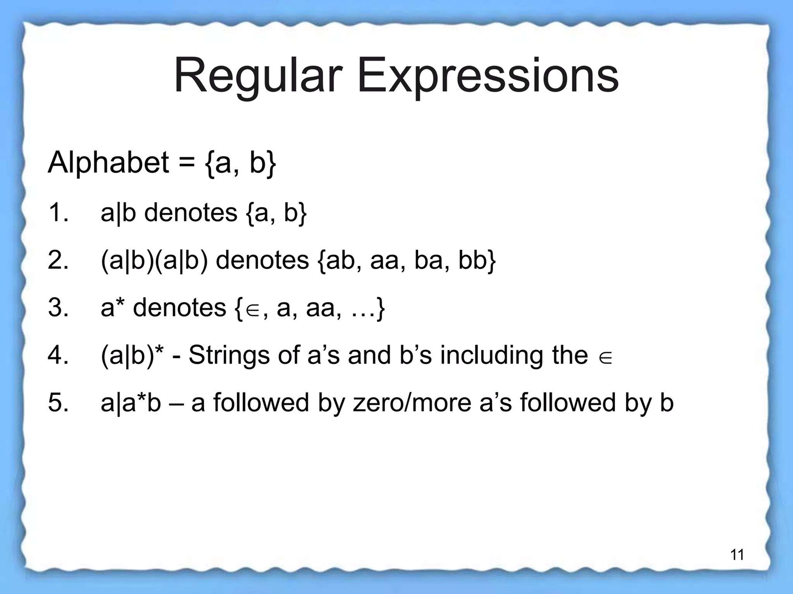

Slide 97
Consider the two regular expressions r and s then:
r|s denotes the language L(r) ∪ L(s).
(r) (s) denotes the language L(r) ⋅ L(s).
(r)* denotes the language (L(r))*.
(r)+ denotes the language L(r)

Slide 98
RECOGNITION OF TOKENS
Tokens obtained during lexical analysis are recognized by Finite Automata.
Finite Automata (FA) is a simple idealized machine that can be used to recognize patterns within input taken from a character set or alphabet (denoted as C). The primary task of an FA is to accept or reject an input based on whether the defined pattern occurs within the input.
There are two notations for representing Finite Automata. They are:
Transition Table
Transition Diagram

Slide 99

1. Transition Table
It is a tabular representation that lists all possible transitions for each state and input symbol combination.
EXAMPLE Assume the following grammar fragment to generate a specific language.

Slide 100
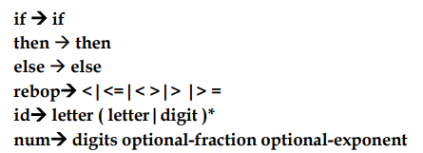
where the terminals if, then, else, relop, id and num generates sets of strings given by following regular definitions.

Slide 101
where letter and digits are defined as - (letter → [A-Z a-z] & digit → [0-9])
For this language, the lexical analyzer will recognize the keywords if, then, and else, as well as lexemes that match the patterns for relop, id, and number.
To simplify matters, we make the common assumption that keywords are also reserved words: that is they cannot be used as identifiers.

Slide 102

The num represents the unsigned integer and real numbers of Pascal.
In addition, we assume lexemes are separated by white space, consisting of nonnull sequences of blanks, tabs, and newlines.
Our lexical analyzer will strip out white space. It will do so by comparing a string against the regular definition ws, below.

Slide 103
2. Transition Diagram
It is a directed labeled graph consisting of nodes and edges. Nodes represent states, while edges represent state transitions.

Slide 104


Components of Transition Diagram
One state is labelled the Start State. It is the initial state of transition diagram where control resides when we begin to recognize a token.
Position is a transition diagram are drawn as circles and are called states.

Slide 105
The states are connected by Arrows called edges. Labels on edges are indicating the input characters.
Zero or more final states or Accepting states are represented by double circle in which the tokens has been found.

Slide 106
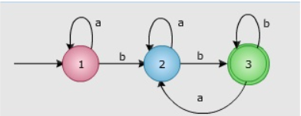
Example:

Slide 107
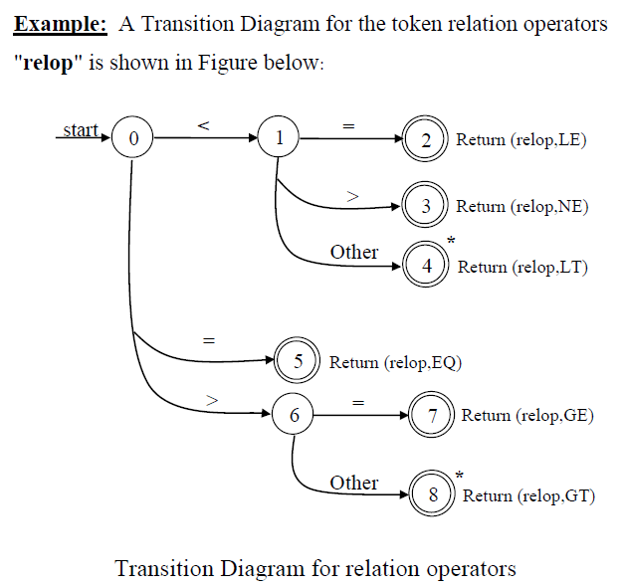

Slide 108
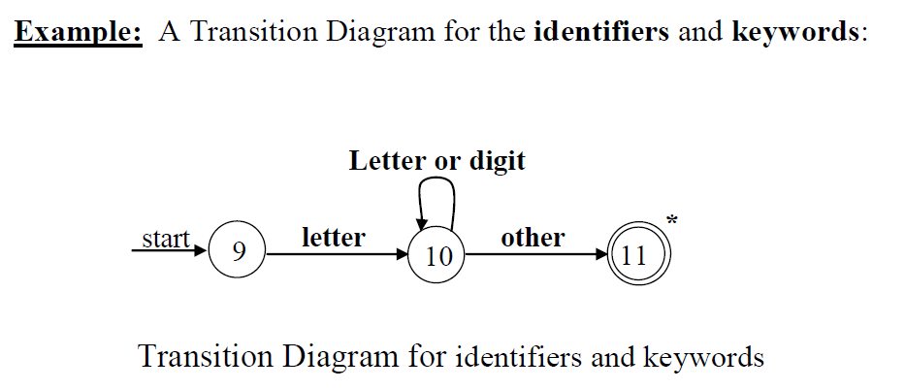

Slide 111
What is LEX in Compiler Design?
Lex is a tool or program that creates a lexical analyzer and helps us perform the task of lexical analysis (It converts characters stream into tokens).
The Lex tool is a compiler itself. The Lex compiler transforms the input into input patterns.
It is commonly used with YACC(Yet Another Compiler Compiler).

Slide 112
Function of Lex
Lexical Analyzer Creation: The process begins by creating a program called lex.l using Lex's language. This program defines the rules and patterns for recognizing tokens in the source code
Lex Compiler Execution: The lex.l program is then executed using the Lex compiler. This step generates a C program named lex.yy.c
C Compiler Execution: The C compiler is then used to compile the generated lex.yy.c program. The result is an object program referred to as a.out
Lexical Analysis: The a.out object program is essentially a lexical analyzer. When this program is run, it takes an input stream of source code and transforms it into a sequence of tokens based on the rules defined in the original lex.l program

Slide 113
lex.yy.c: It is a C program.
File.l: It is a Lex source program
a.out: It is a Lexical analyzer

Slide 114
LEX Source Program
A LEX source program is a collection of instructions and patterns.
These instructions and patterns are written in the LEX programming language.
LEX is a tool used for generating lexical analyzers. It tokenizes input source code into meaningful units called tokens.

Slide 115
The LEX source program defines how these tokens are recognized and processed.
It consists of regular expressions that describe the patterns of tokens and corresponding actions to be taken when those patterns are encountered in the source code.
This program serves as a set of rules that instructs LEX on how to break down a stream of characters from the input source code into tokens.
There are two main components of this Lex source program:

Slide 116
1)Auxilary Definitions: These are often located in the "Definitions Section" of the LEX source program. These are user-defined macros or variables that simplify the expression of regular expressions .
2) Translation Rules: These are commonly found in the "Rules Section" of the LEX source program. They establish the mapping between patterns and actions. Each translation rule consists of a regular expression pattern followed by the action to be executed when that pattern is matched in the input source code

Slide 117
Working of Lex
Firstly we create a file that describes the generation of the lex analyzer. This file is written in Lex language and has a .l extension.
The lex compiler converts this program into a C file called lex.yy.c.
The C compiler then runs this C file, and it is compiled into a.out file.
This a.out file is our working Lexical Analyzer which will produce the stream of tokens based on the input text.

Slide 118
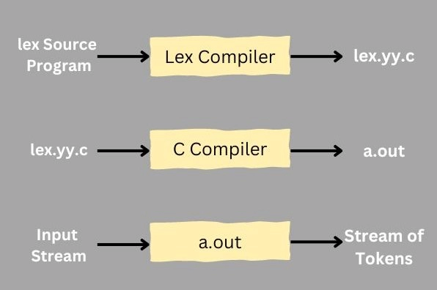

Slide 119
Lex File Format
Any lex file consists of the following three parts-
Definitions/Declarations: This section of lex files contains declarations of constant, variable, and regular definitions.
Translation Rules: This section of the lex files defines the rules in the form of the regular expressions and corresponding actions that the lexer should take to identify tokens in the input stream. Each rule consists of a regular expression followed by a code block that specifies the action to take when the regular expression matches.
User Subroutines: This section contains the user-defined functions that can be used by the action code block in the rules section of the lex file.

Slide 120
The formal lex file has the following format- (separated by % delimiters)
{ definitions }
%%
{ rules }
%%
{ user subroutines }

Slide 121
declaration number[0-9] %% translation if {return (IF);} %% auxiliary function int numberSum()

Slide 122
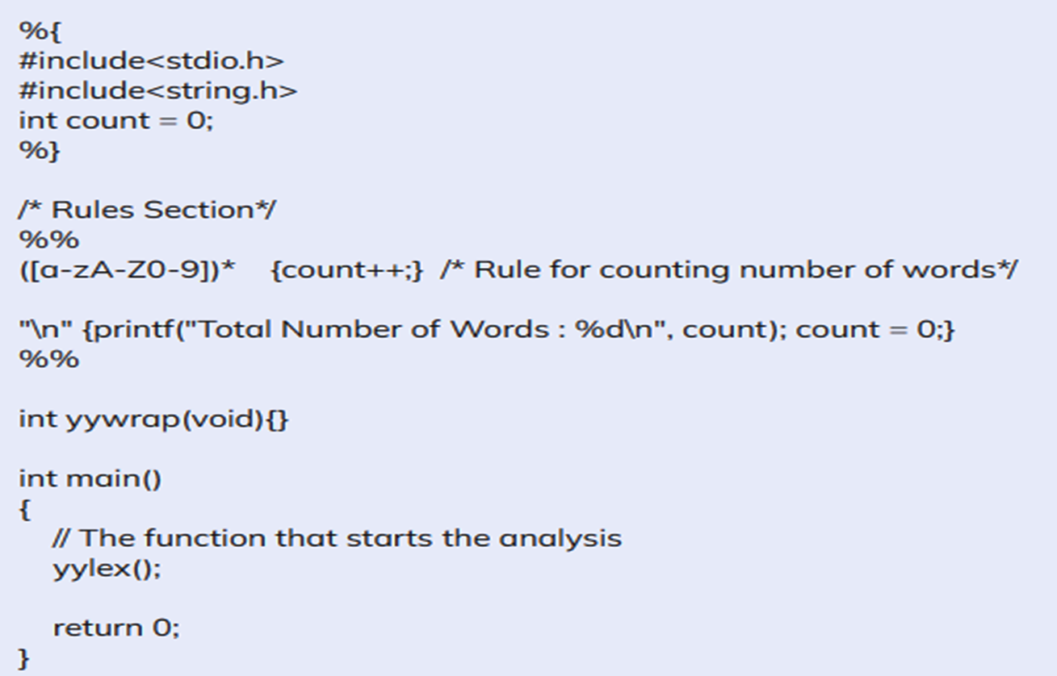
An example implementation of a Lexical Analyser using Lex
The following Lex Program counts the number of words-

Slide 123
DFA(Deterministic finite automaton )
A DFA is a finite-state machine that accepts or rejects a given string of symbols by running through a state sequence that is uniquely determined by the string.
For each input symbol, the state to which the machine will move can be determined using DFA.
It's called as a Deterministic Automaton as a result of this. As it contains a finite number of states, the machine is called a Deterministic Finite Machine or Deterministic Finite Automaton.

Slide 124
Representation of DFA
It is represented as 5 tuples (Q, ∑, δ, q0, F) where:
Q represents the finite states
∑ represents the is a finite set of symbols, also called the alphabet
δ represents the transition function
where δ: Q × ∑ → Q
q0 represents the initial state from where any input is processed
F represents the set of final state of Q.

Slide 125
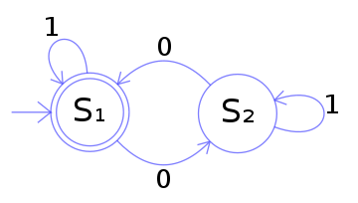
Example:
The following is an example of a DFA M with a binary alphabet that accepts an even number of 0s in the input.
M = (Q, Σ, δ, q₀, F) where
Q = {S₁, S₂}
q₀ = S₁
Σ = {0, 1}
F = {S₁}
δ is represented by the following table.
From | Next State from input 0 | Next State from input 1
s1 | s2 | s1
s2 | s1 | s2

Slide 126
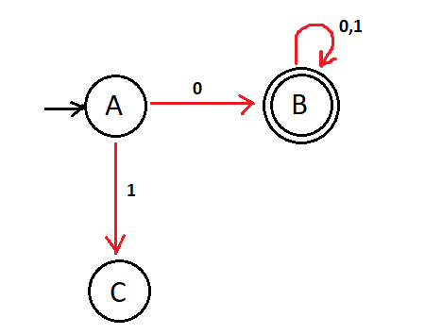
Dead state in DFA
If the machine has successfully progressed to the final string accepting state, we can say that the string has been accepted by the DFA.
However, if we arrive at a point where the machine can no longer progress to its final state, we have arrived at a dead state. A Dummy state is another name for a dead state.

Slide 127
Need of Deterministic Finite Automata
DFAs are useful in the functionality of applications such as
Vending Machines
Traffic Lights
Video Games
Text Parsing
Regular Expression Matching
CPU Controllers
Protocol Analysis
Natural Language Processing
Speech Recognition

Slide 128
How Can I Use Deterministic Finite Automata?
DFA can be effectively utilized:
1) Pattern Matching: DFA can be employed to search for specific patterns within strings or texts efficiently.
2) Lexical Analysis: DFA are extensively used in compilers and interpreters for lexical analysis, also known as tokenization.
3) String Validation: DFA can verify whether a given string adheres to a specified format or syntax.

Slide 129
4) Finite State Machines (FSM): DFA serve as the fundamental building blocks for designing more complex finite state machines. FSMs are widely used in control systems, protocol design, circuit design, and modeling sequential logic.
5) Regular Expression Matching: DFA can be implemented as part of engines that process regular expressions. Regular expressions define patterns that describe sets of strings, and DFA can recognize these patterns efficiently.

Slide 130
Non-Deterministic Finite Automata
NFA means where the transition from a state can be multiple next states for each input symbol. We can define the non-deterministic finite automaton as a finite automaton variant with two characteristics:
ε-transition: state transition can be made without reading a symbol; and
Nondeterminism: state transition can have zero or more than one possible value.

Slide 131
Formal definition of Non-Deterministic Finite Automata
The formal definition of NFA, like that of DFA, is: (Q, 𝚺, δ, q0, F), where
Q is a finite set of states.
𝚺 is a finite set of all alphabet symbols.
δ: Q x 𝚺 → Q is the transition function from state to state.
q0 ∈ Q is the starting state, and the starting state must be in the set Q
F ⊆ Q is the set of accepted states, all of which must be in the set Q.
NFA requires to include the empty string (ε) in the delta function along with the other symbols.

Slide 132
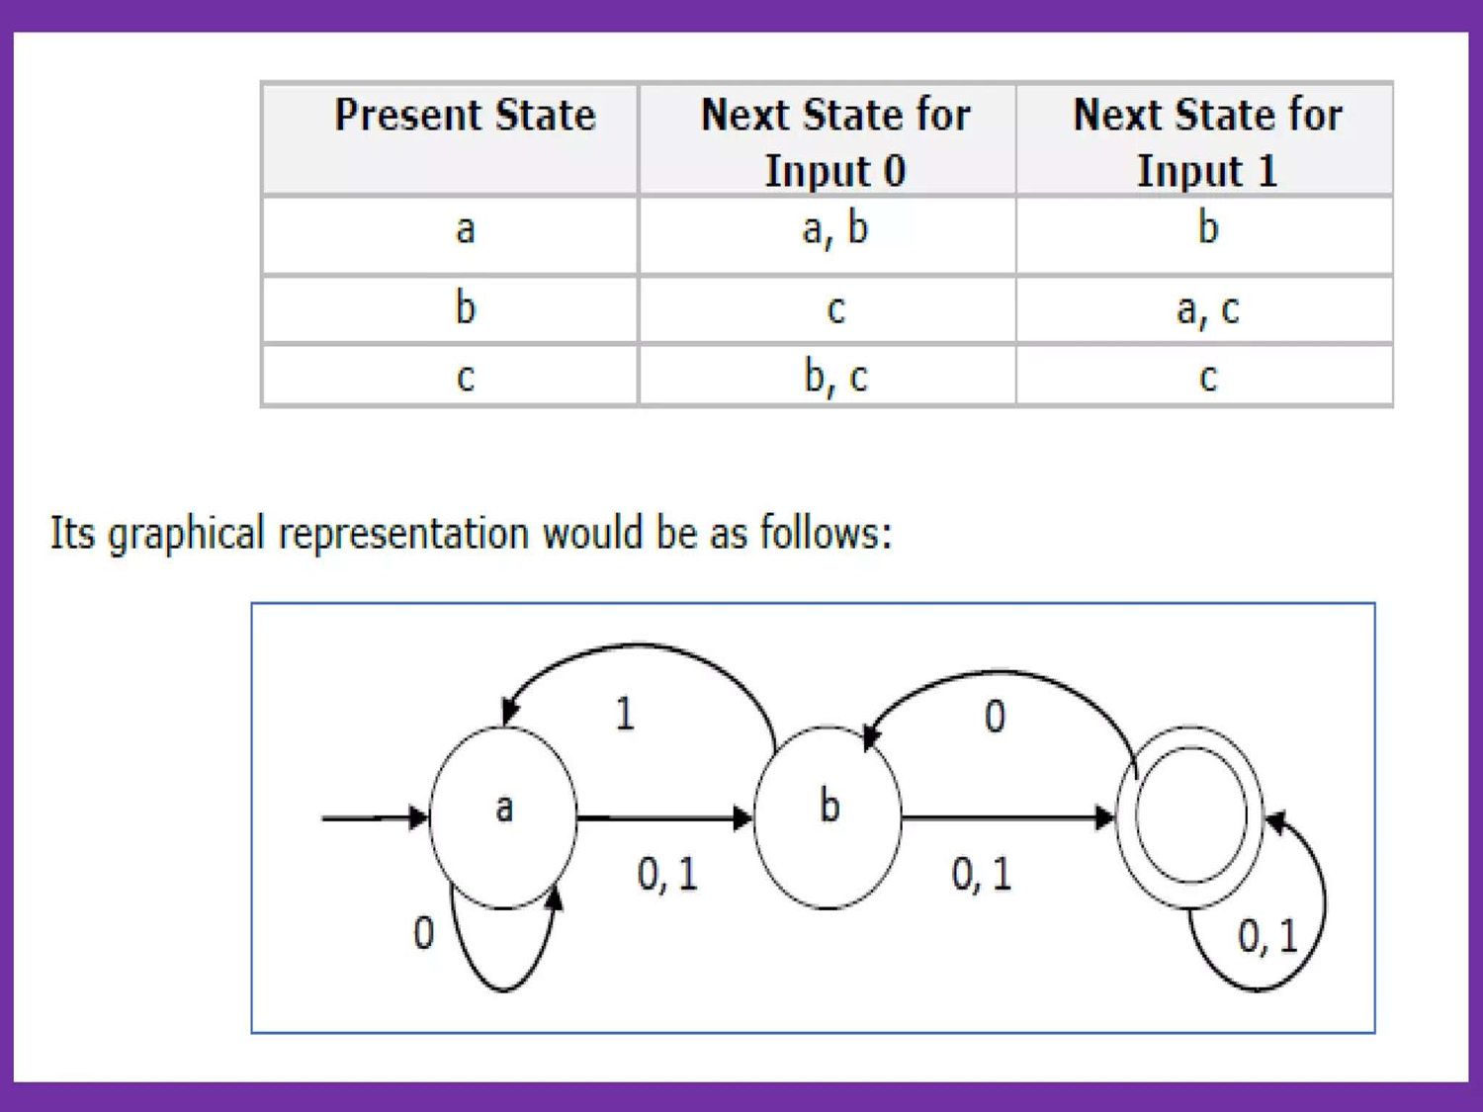
Example

Slide 133
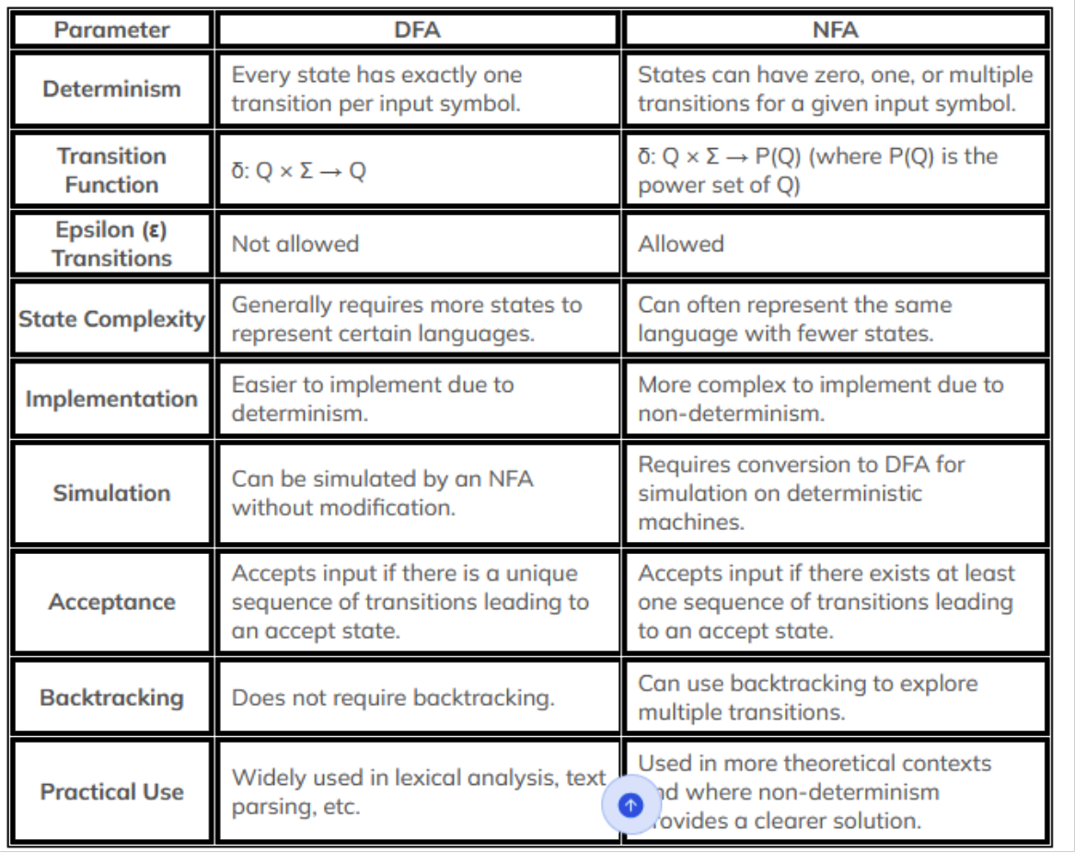
DFA VS NFA

Slide 134
Conversion Of Regular Expressions to Finite Automata
Steps To Convert Regular Expressions To Finite Automata(The method that is popularly used is known as the Subset method)
Step 1: Make a transition diagram for a given regular expression, using NFA with ε moves.
Step 2: Then, Convert this NFA with ε to NFA without ε.
Step 3: Finally, Convert the obtained NFA to equivalent DFA.

Slide 135
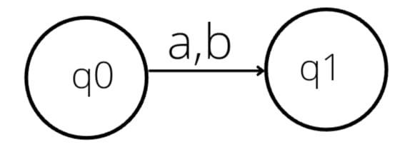
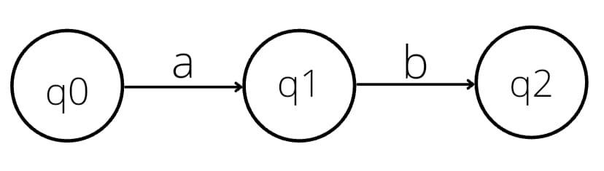
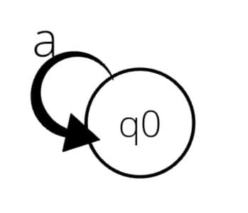
Some standard rules help in the conversion of RE to NFA are:-
1.) If RE is in the form a+b, it can be represented as:
2.) If RE is in the form ab, it can be represented as:
3.) If RE is in the form of a*, it can be represented as:

Slide 136
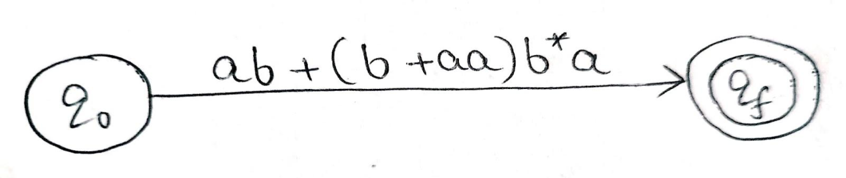
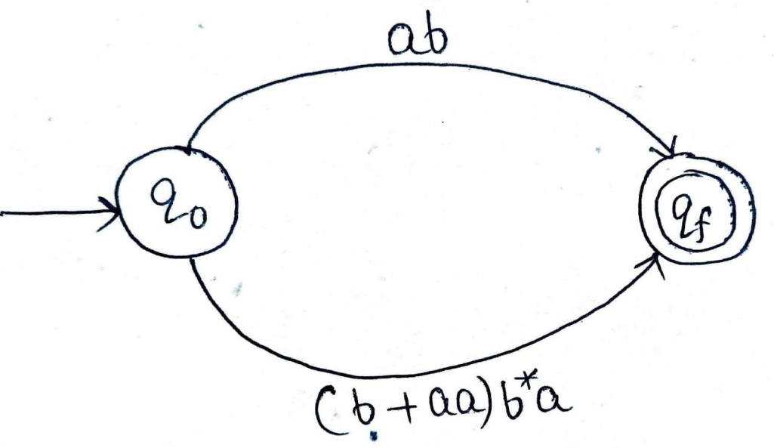
Example 1: Design a Finite Automata from the given RE [ ab + (b + aa)b* a ].
Solution. At first, we will design the Transition diagram for the given expression.
STEP 1
STEP 2

Slide 137
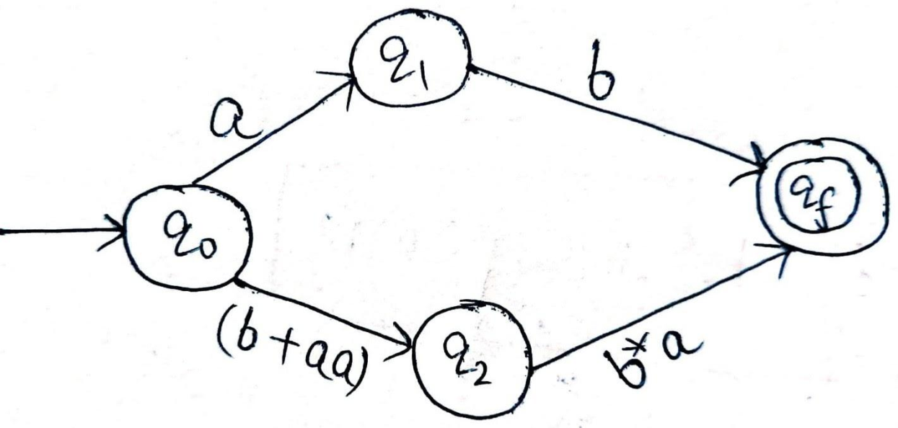
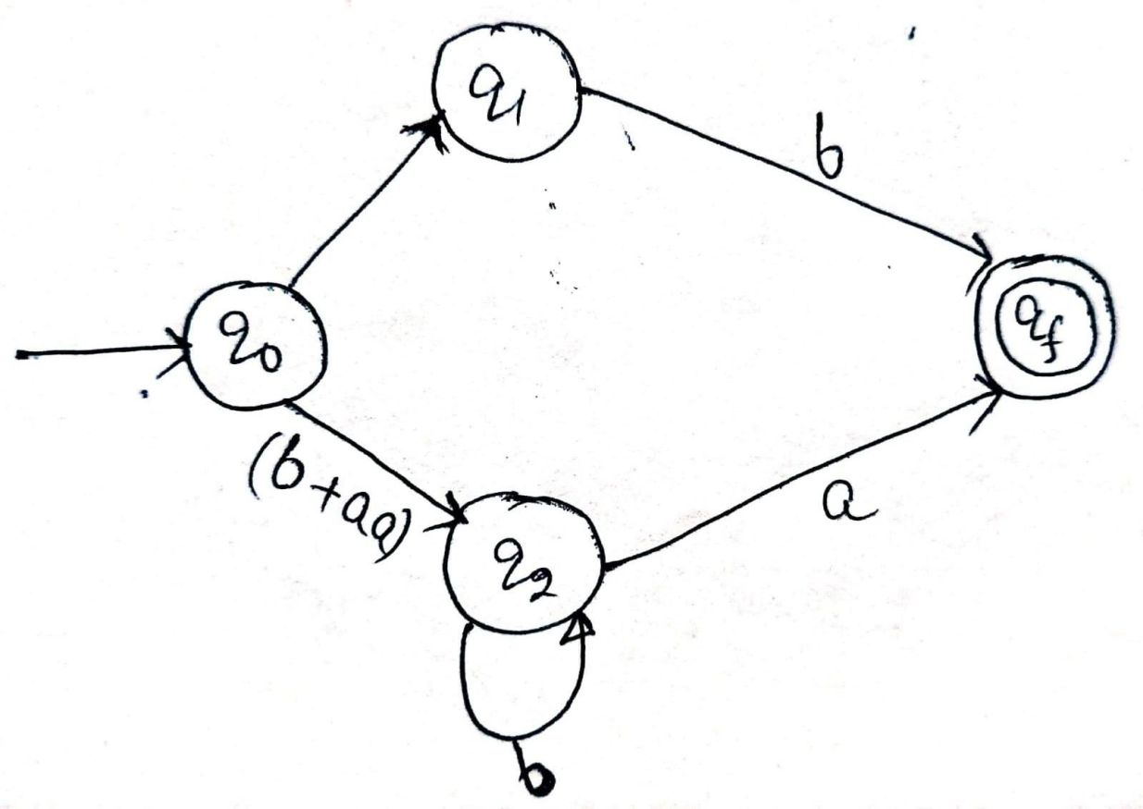
STEP 3
STEP 4

Slide 138
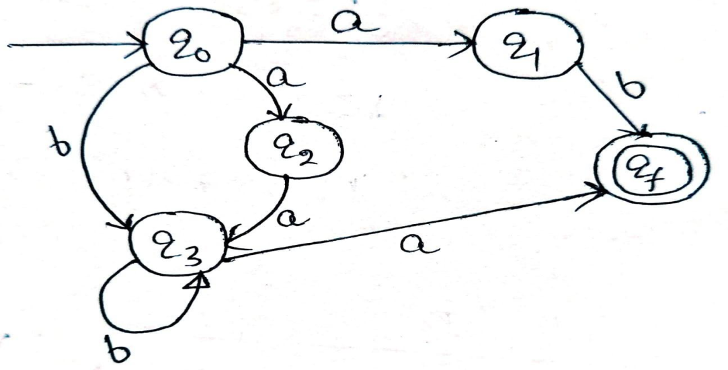
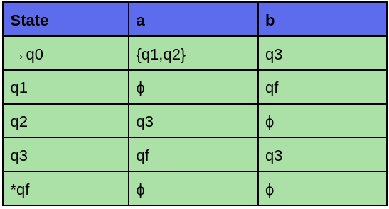
STEP 5
we have got NFA without ε.
Transition Table For NFA:

Slide 139
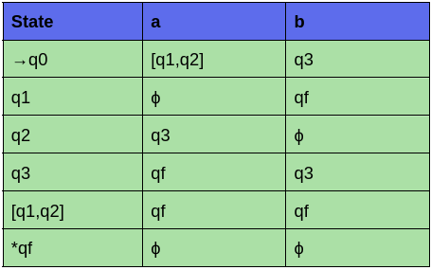
The Corresponding transition table for DFA is:

Slide 140



Example 2: Design an NFA from the given RE [ a (a* ba* ba*)* ].
STEP 1
STEP 2
STEP 3

Slide 141
Minimization of DFA
The process of reducing a given DFA to its minimal form is called as minimization of DFA.
It contains the minimum number of states.
The DFA in its minimal form is called as a Minimal DFA.

Slide 142

How To Minimize DFA?
The two popular methods for minimizing a DFA are-

Slide 143
Minimization of DFA Using Equivalence Theorem-
Step-01:
Eliminate all the dead states and inaccessible states from the given DFA (if any).
Dead State
All those non-final states which transit to itself for all input symbols in ∑ are called as dead states.
Inaccessible State
All those states which can never be reached from the initial state are called as inaccessible states.

Slide 144
Step-02:
Draw a state transition table for the given DFA.
Transition table shows the transition of all states on all input symbols in Σ.
Step-03:
Now, start applying equivalence theorem.
Take a counter variable k and initialize it with value 0.
Divide Q (set of states) into two sets such that one set contains all the non-final states and other set contains all the final states.
This partition is called P₀.

Slide 145
Step-04:
Increment k by 1.
Find P_{k} by partitioning the different sets of
P_{k-1} .
In each set of P_{k-1} , consider all the possible pair of states within each set and if the two states are distinguishable, partition the set into different sets in P_{k}
Two states q₁ and q₂ are distinguishable in partition P_{k} for any input symbol ‘a’,if δ (q₁, a) and δ (q₂, a) are in different sets in partition P_{k-1}

Slide 146
Step-05:
Repeat step-04 until no change in partition occurs.
In other words, when you find P_{k} = P_{k-1}, stop.
Step-06:
All those states which belong to the same set are equivalent.
The equivalent states are merged to form a single state in the minimal DFA.
Number of states in Minimal DFA= Number of sets in P_{k}

Slide 147

Problem-01:
Minimize the given DFA-

Slide 148
Solution-
Step-01:
The given DFA contains no dead states and inaccessible states.
Step-02:
Draw a state transition table-
 | a | b
→q0 | q1 | q2
q1 | q1 | q3
q2 | q1 | q2
q3 | q1 | *q4
*q4 | q1 | q2

Slide 149
Step-03:
Now using Equivalence Theorem, we have-
P₀ = { q₀ , q₁ , q₂ , q₃ } { q₄ }
P₁ = { q₀ , q₁ , q₂ } { q₃ } { q₄ }
P₂ = { q₀ , q₂ } { q₁ } { q₃ } { q₄ }
P₃ = { q₀ , q₂ } { q₁ } { q₃ } { q₄ }
Since P₃ = P₂, so we stop.
From P₃, we infer that states q₀ and q₂ are equivalent and can be merged together.

Slide 150

So, minimal DFA is-

Slide 151

Problem-02:
Minimize the given DFA-

Slide 152

Solution-
Step-01:
State q₃ is inaccessible from the initial state.
So, we eliminate it and its associated edges from the DFA.
The resulting DFA is-

Slide 153
Step-02:
Draw a state transition table-
 | a | b
→q0 | *q1 | q0
*q1 | *q2 | *q1
*q2 | *q1 | *q2

Slide 154
Step-03:
Now using Equivalence Theorem, we have-
P₀ = { q₀ } { q₁ , q₂ }
P₁ = { q₀ } { q₁ , q₂ }
Since P₁ = P₀, so we stop.
From P₁, we infer that states q₁ and q₂ are equivalent and can be merged together.

Slide 155

So minimal DFA is-

Slide 156

Problem-03:
Minimize the given DFA-

Slide 157
Solution-
Step-01 The given DFA contains no dead states and inaccessible states.
Step-02: Draw a state transition table-
 | 0 | 1
→q0 | q1 | q3
q1 | q2 | *q4
q2 | q1 | *q4
q3 | q2 | *q4
*q4 | *q4 | *q4

Slide 158
Step-03:
Now using Equivalence Theorem, we have-
P₀ = { q₀ , q₁ , q₂ , q₃ } { q₄ }
P₁ = { q₀ } { q₁ , q₂ , q₃ } { q₄ }
P₂ = { q₀ } { q₁ , q₂ , q₃ } { q₄ }
Since P₂ = P₁, so we stop.
From P₂, we infer that states q₁ , q₂ and q₃ are equivalent and can be merged together.

Slide 159

So, minimal DFA is-

