Slide 1
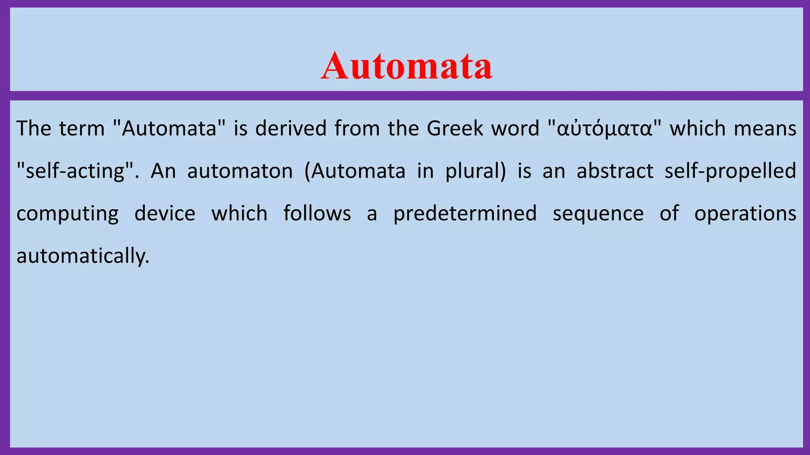

Slide 2
Introduction of Finite Automata
Finite automata are abstract machines used to recognize patterns in input sequences, forming the basis for understanding regular languages in computer science.
They consist of states, transitions, and input symbols, processing each symbol step-by-step.
If the machine ends in an accepting state after processing the input, it is accepted; otherwise, it is rejected.

Slide 3
Features of Finite Automata
Input: Set of symbols or characters provided to the machine.
Output: Accept or reject based on the input pattern.
States of Automata: The conditions or configurations of the machine.
State Relation: The transitions between states.
Output Relation: Based on the final state, the output decision is made.

Slide 4
Types of Finite Automata There are two types of finite automata: Deterministic Finite Automata (DFA) Non-Deterministic Finite Automata (NFA)

Slide 5
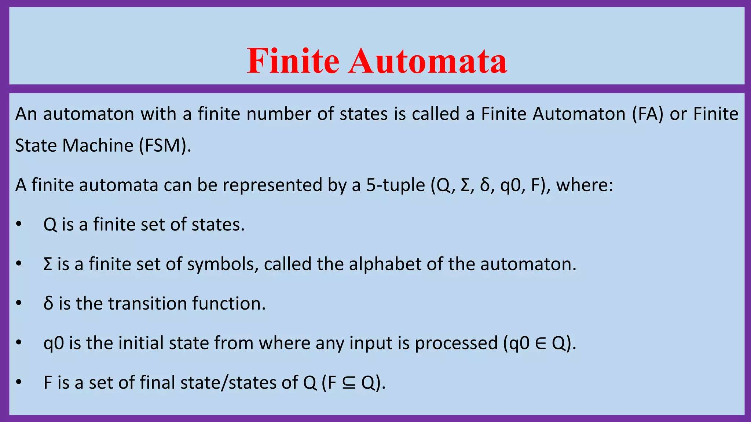

Slide 6
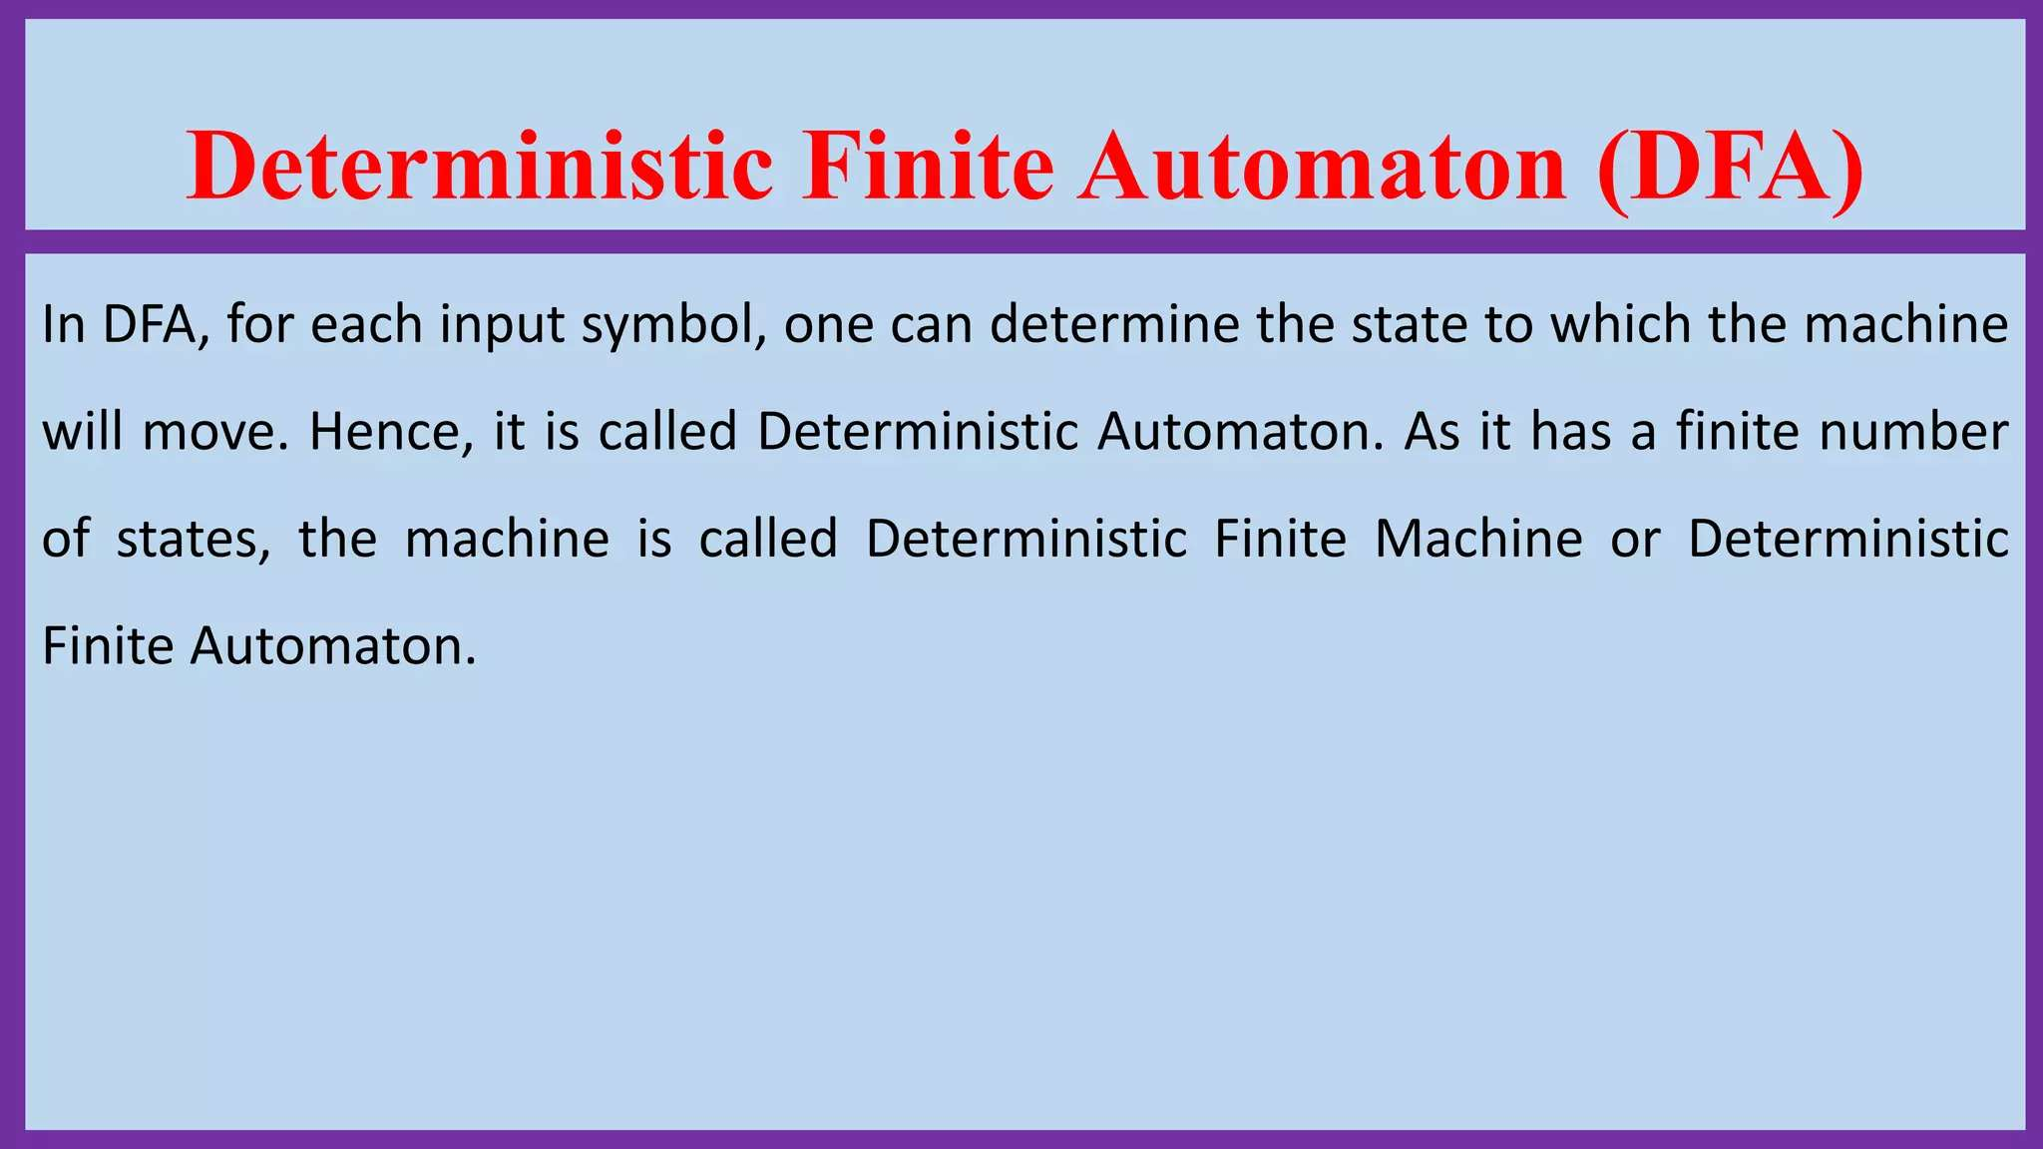

Slide 7
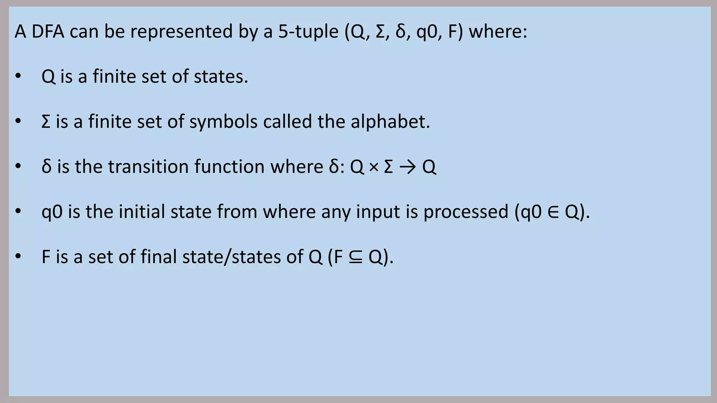

Slide 8
The machine transitions to one and only one state.
DFA does not allow any null transitions, meaning every state must have a transition defined for every input symbol.

Slide 9
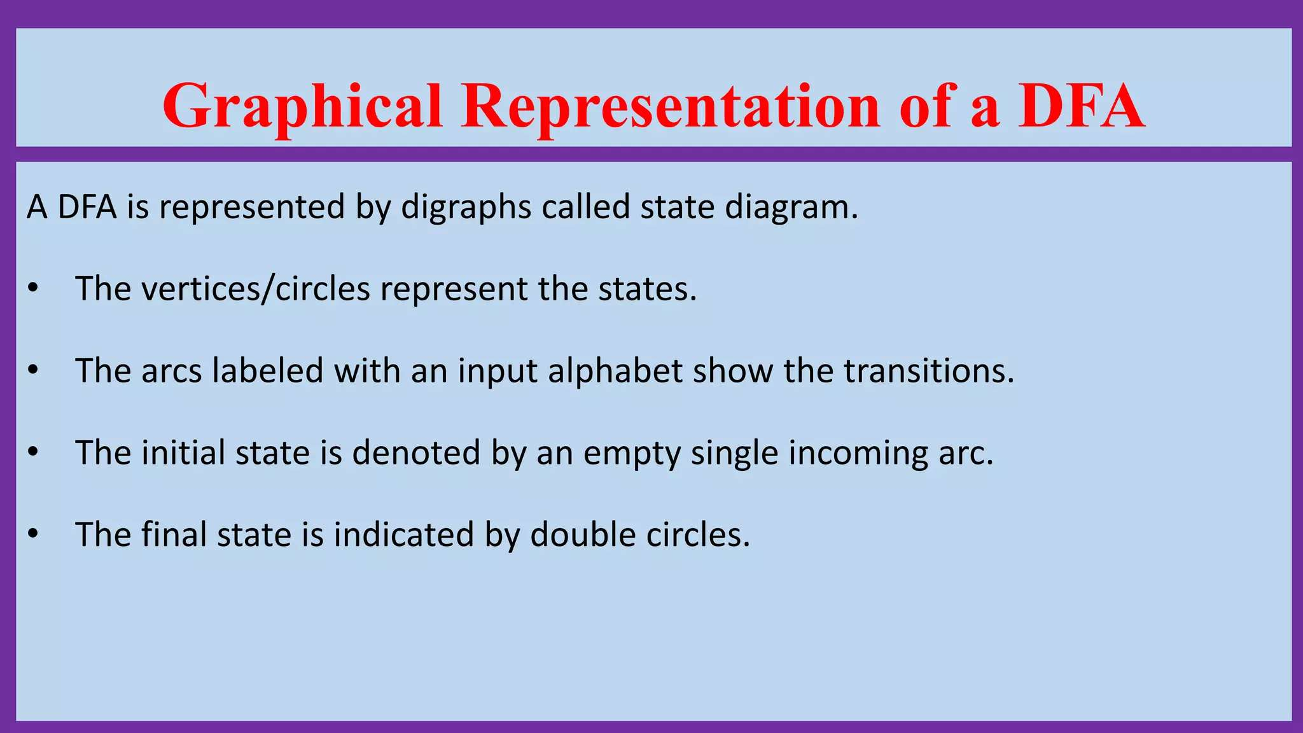

Slide 10
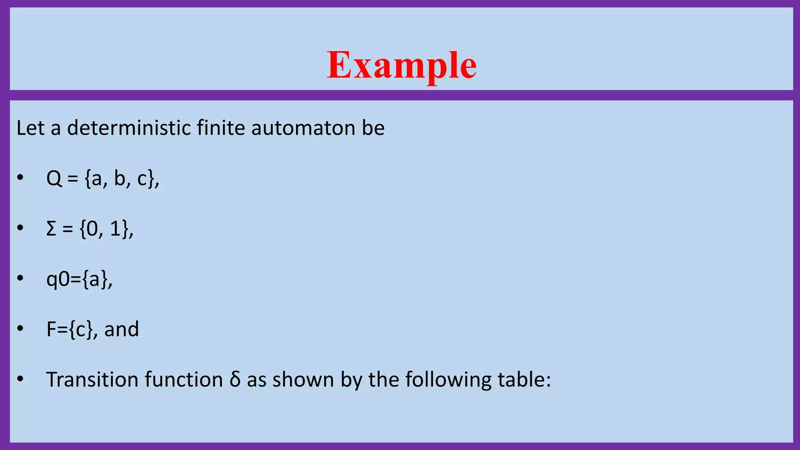

Slide 11
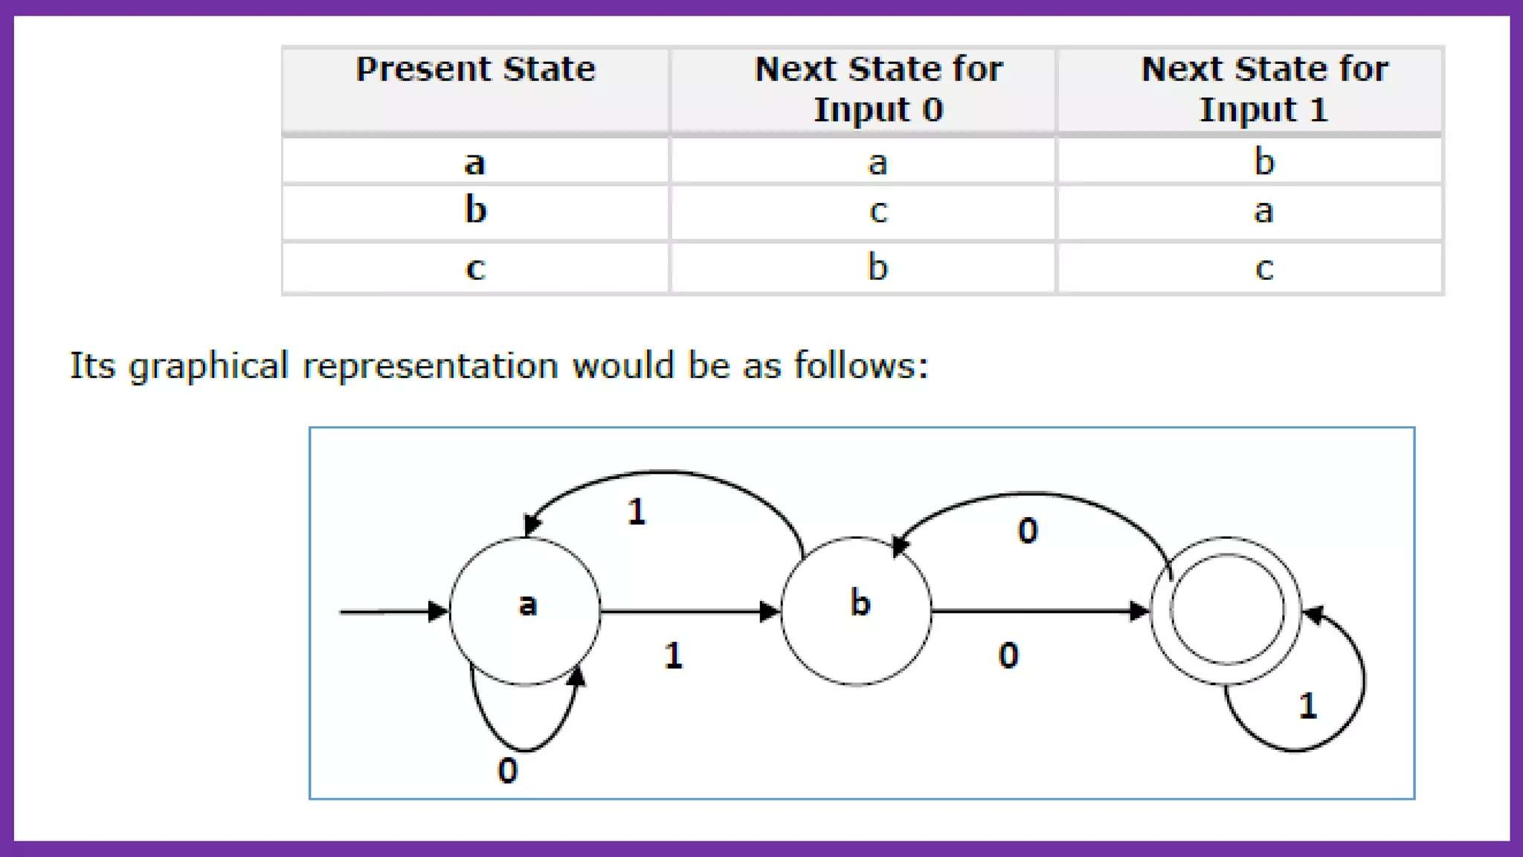

Slide 12
Example:
Construct a DFA that accepts all strings ending with ‘a’.
Given:
Σ = {a, b},
Q = {q0, q1},
F = {q1}

Slide 13
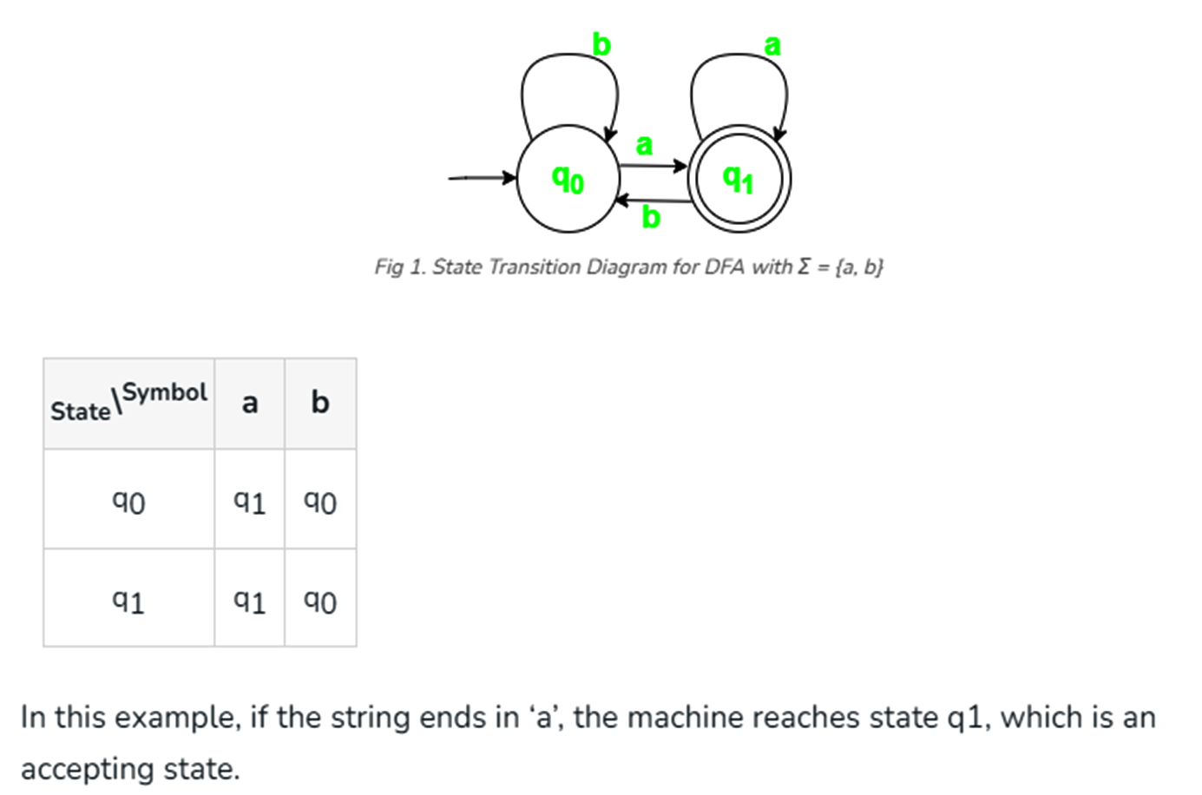

Slide 14
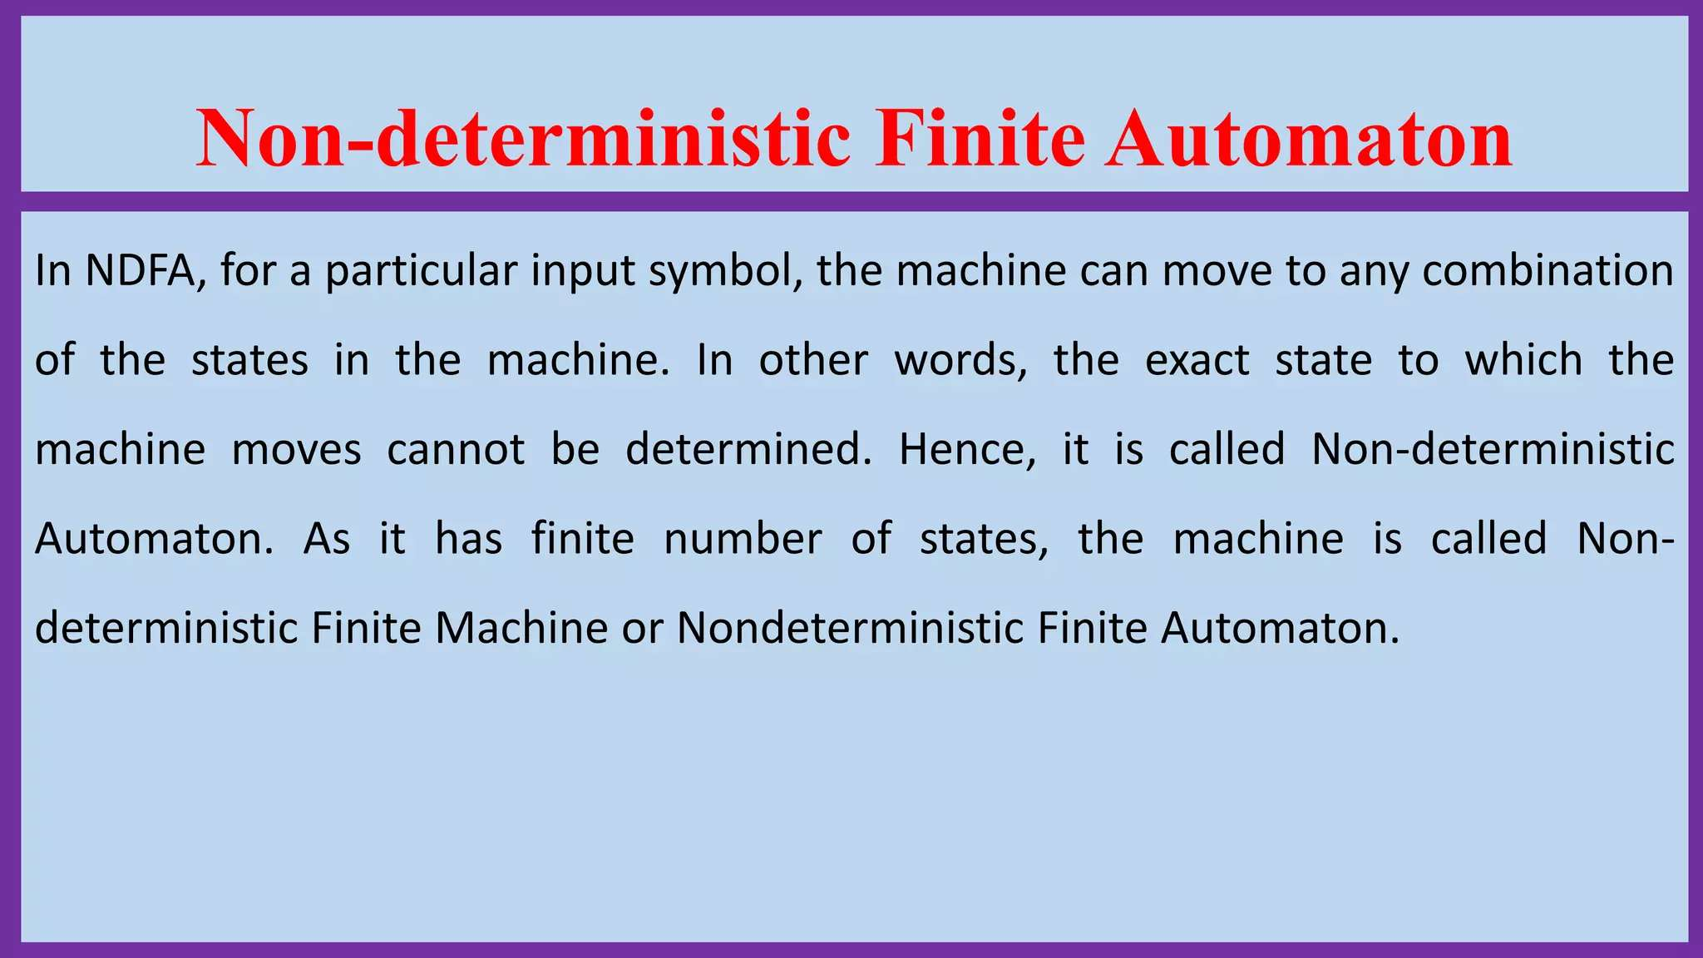

Slide 15
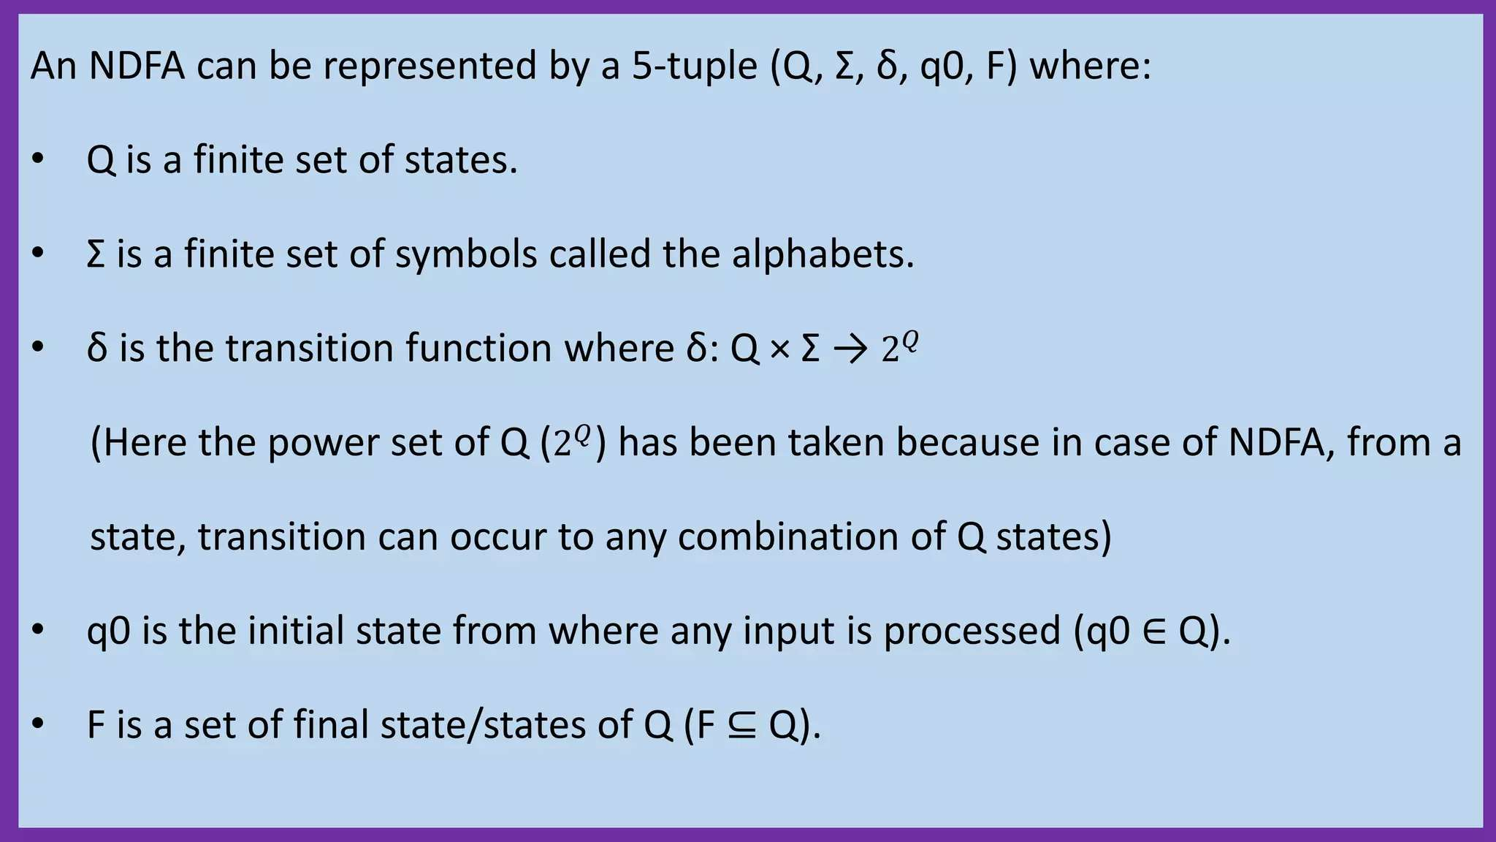

Slide 16
NFA is similar to DFA but includes the following features:
*It can transition to multiple states for the same input.
*It allows null (ϵ) moves, where the machine can change states without consuming any input.

Slide 17
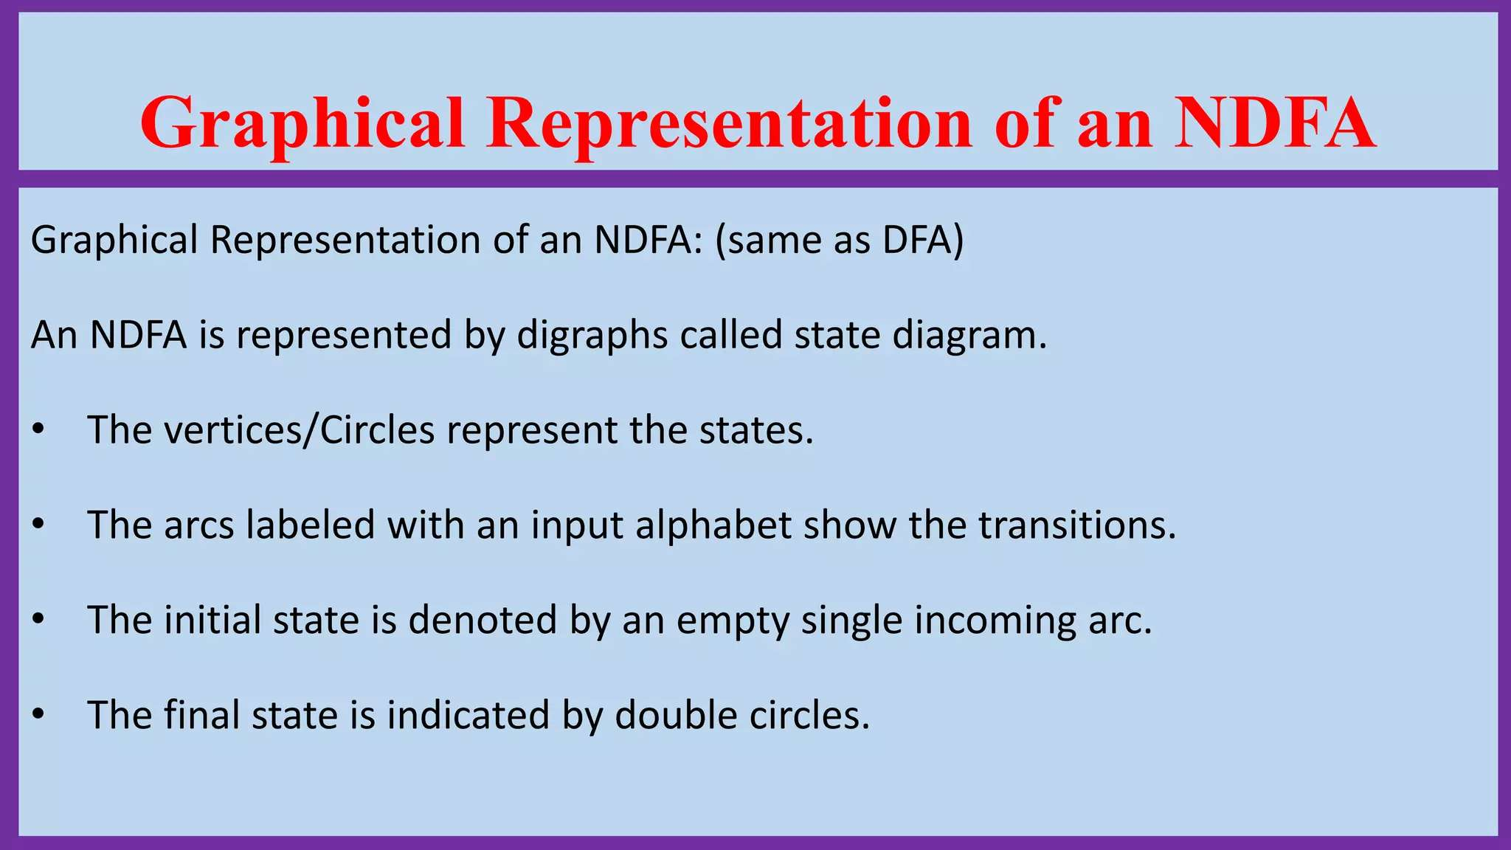

Slide 18
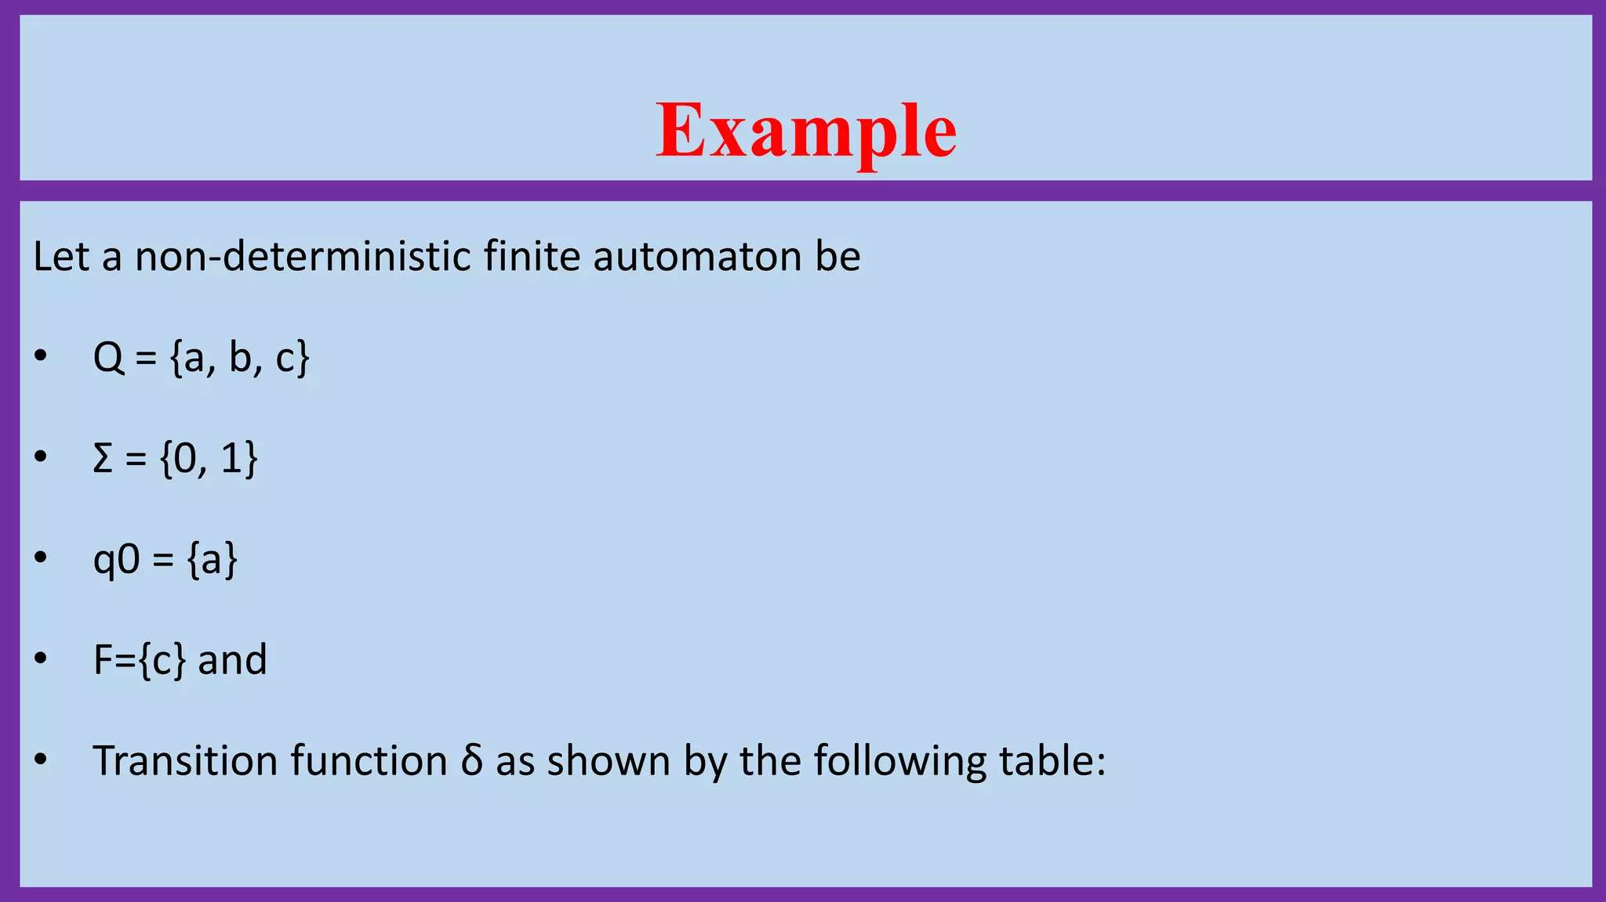

Slide 19
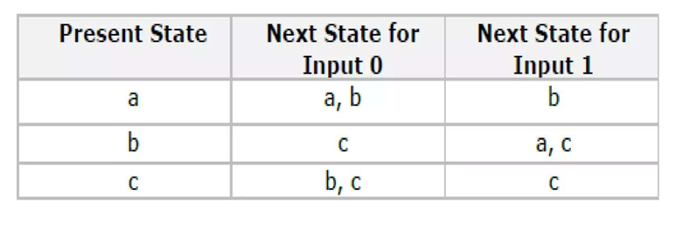
Transition Table

Slide 20
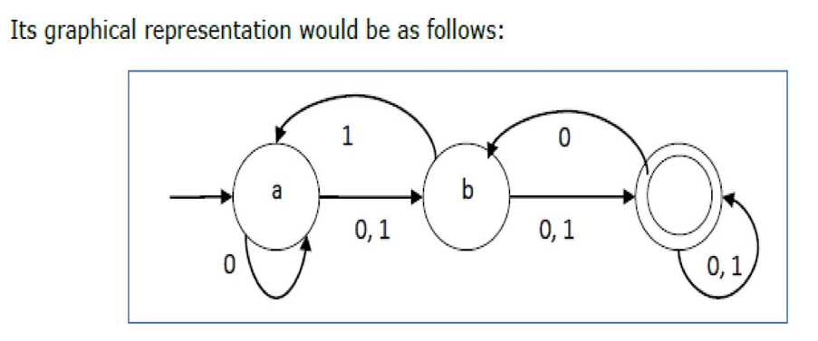

Slide 21
Example:
Construct an NFA that accepts strings ending in ‘a’.
Given:
Σ = {a, b},
Q = {q0, q1},
F = {q1}

Slide 22
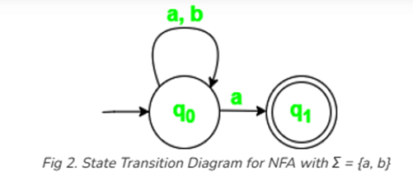

Slide 23
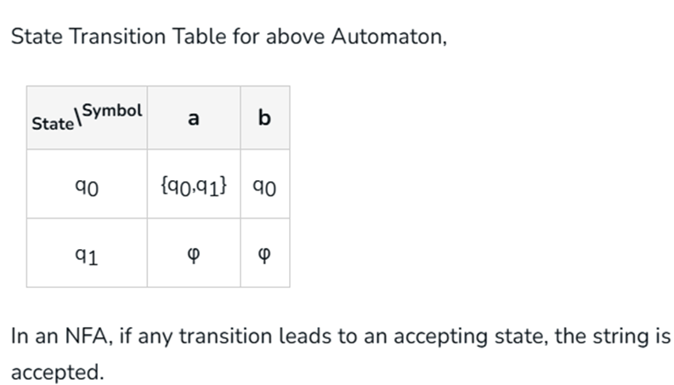

Slide 24
Comparison of DFA and NFA
Although NFAs appear more flexible, they do not have more computational power than DFAs. Every NFA can be converted to an equivalent DFA, although the resulting DFA may have more states.
DFA: Single transition for each input symbol, no null moves.
NFA: Multiple transitions and null moves allowed.
Power: Both DFA and NFA recognize the same set of regular languages.

Slide 25
Example 1: Design an NFA over the alphabet Σ = {a, b} that accepts only the strings that start with “b”
Solution
The language generated by this example will include all strings that start with b
L = {b, ba, bb, bab, baa……..}
The following NFA machine accepts all strings that start with “b”

Slide 26
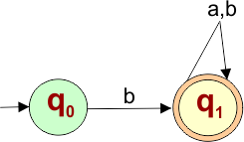
5 Tuples of the above NFA are given below,
{q0, q1, q2, q3} refers to the set of states
{a,b} refers to the set of input alphabets
δ refers to the transition function
δ (q0, a) =ϕ δ (q0, b) = q1 δ (q1, a) = q2 δ (q1, b) =q2
q0 refers to the initial state
{q1} refers to the set of final states

Slide 27
The transition table for the above NFA is given below
States | a | b
q0 | ϕ | q1
q1 | q1 | q1

Slide 28
Example: 2 Design an NFA over the alphabet Σ = {a, b} that accepts only the strings that start with “bab”
Solution
The language generated by this example will include all strings that start with “bab”
L = {bab, baba, babb, babab, babba……..}

Slide 29
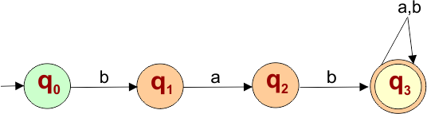
The following NFA automaton machine accepts all strings that start with “bab”

Slide 30
{q0, q1, q2, q3} refers to the set of states
{a,b} refers to the set of input alphabets
δ refers to the transition function
δ (q0, a) =ϕ
δ (q0, b) = q1
δ (q1, a) = q2
δ (q1, b) =ϕ
δ (q2, a) = ϕ
δ (q2, b) = q3
δ (q3, a) = q3
δ (q3, b) = q3
q0 refers to the initial state
{q3} refers to the set of final states

Slide 31
Transition Table for the above Non-Deterministic Finite Automata is-
States | a | b
q0 | ϕ | q1
q1 | q2 | ϕ
q2 | ϕ | q3
q3 | q3 | q3

Slide 32
NFA Example: 3 Design an NFA over the alphabet Σ = {a, b} that accepts only the strings that start with “aa” or “bb”
Solution
The language generated by this example will include all strings that start with “aa” or “bb”
L = { aa, bb, aaa, bbb, aaab, aaba,……..}

Slide 33
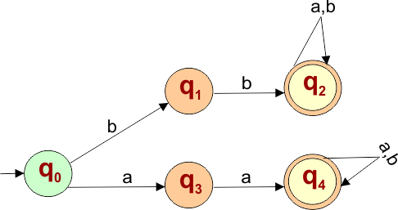
The following NFA automaton machine accepts all strings that start with “bab”

Slide 34
{q0, q1, q2, q3, q4} refers to the set of states
{a,b} refers to the set of input alphabets
δ refers to the transition function
δ (q0, a) =q3
δ (q0, b) = q1
δ (q1, a) =ϕ
δ (q1, b) = q2
δ (q2, a) = q2
δ (q2, b) = q2
δ (q3, a) = q4
δ (q3, b) =ϕ
δ (q4, a) = q4
δ (q4, b) = q4
q0 refers to the initial state
{q2,q4} refers to the set of final states

Slide 35
Transition Table for the above Non-Deterministic Finite Automata is-
States | a | b
q0 | q3 | q1
q1 | ϕ | q2
q2 | q2 | q2
q3 | q4 | ϕ
q4 | q4 | q4

Slide 36
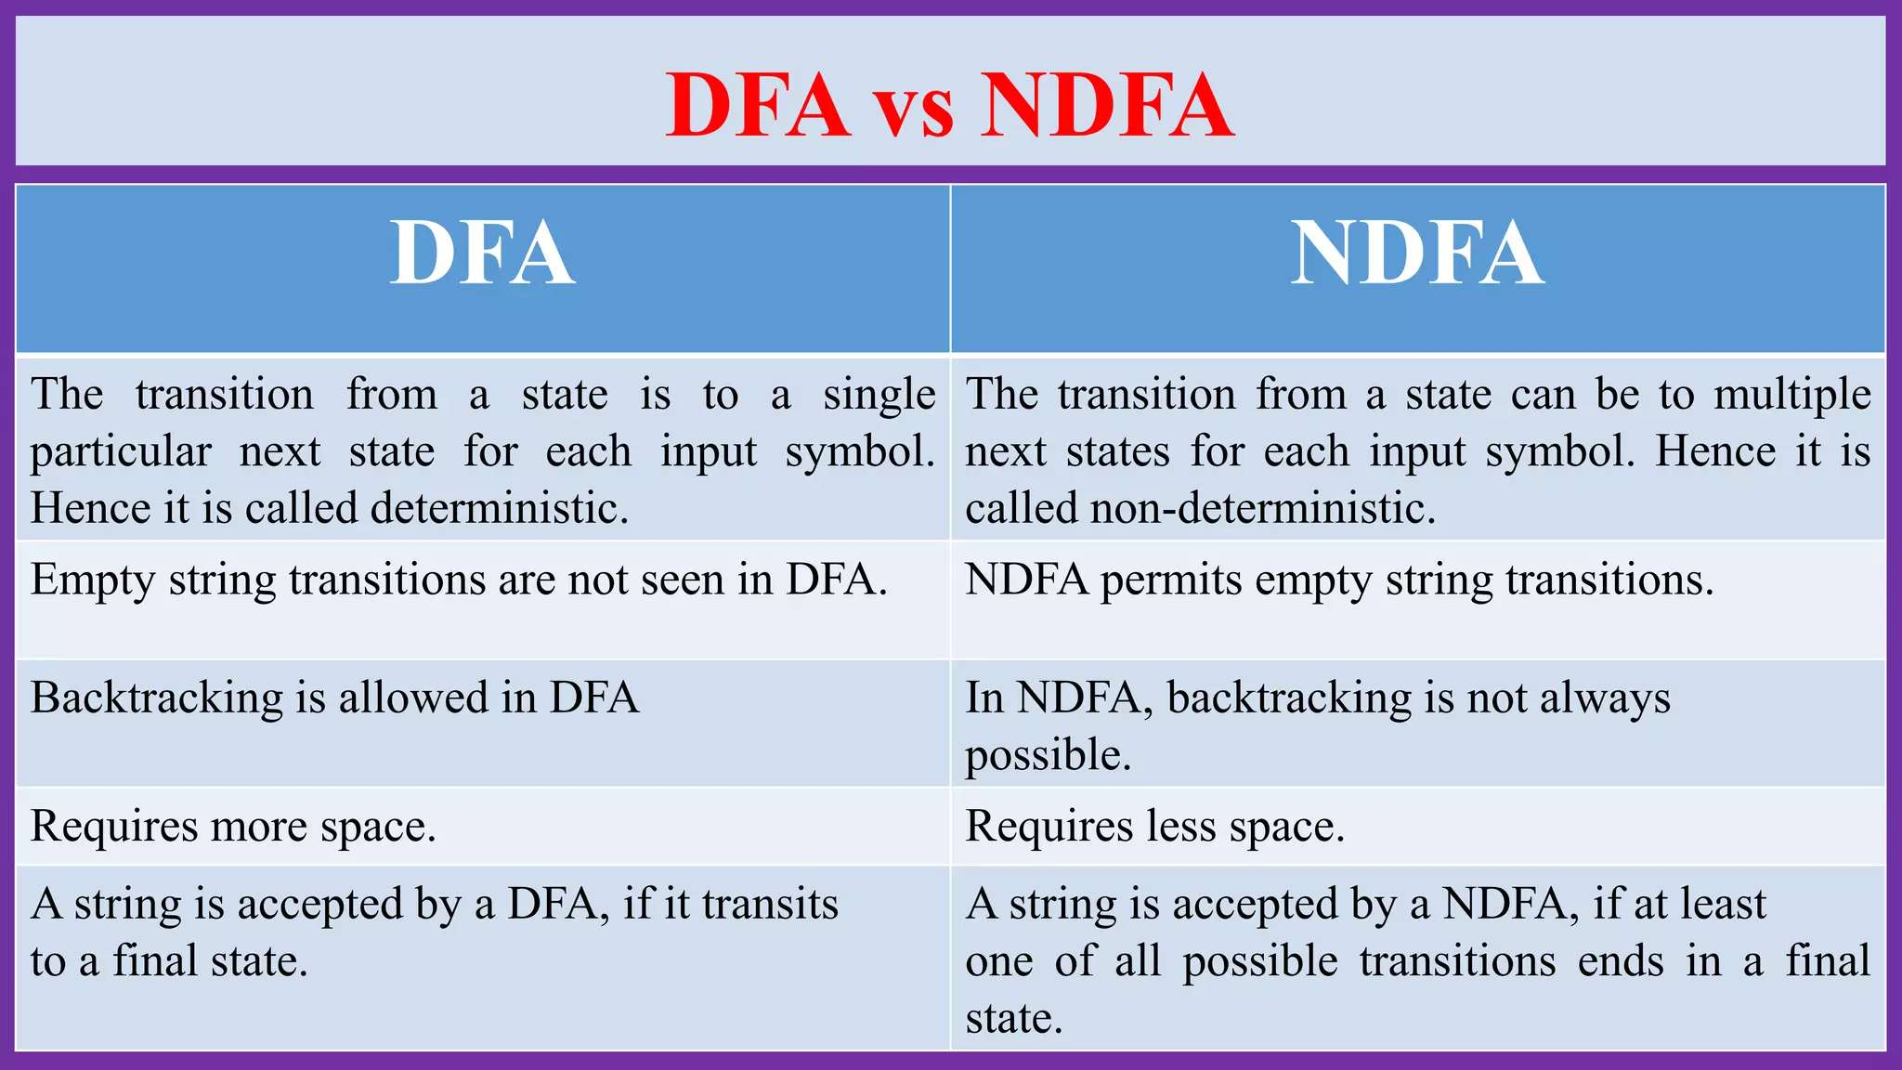

Slide 37
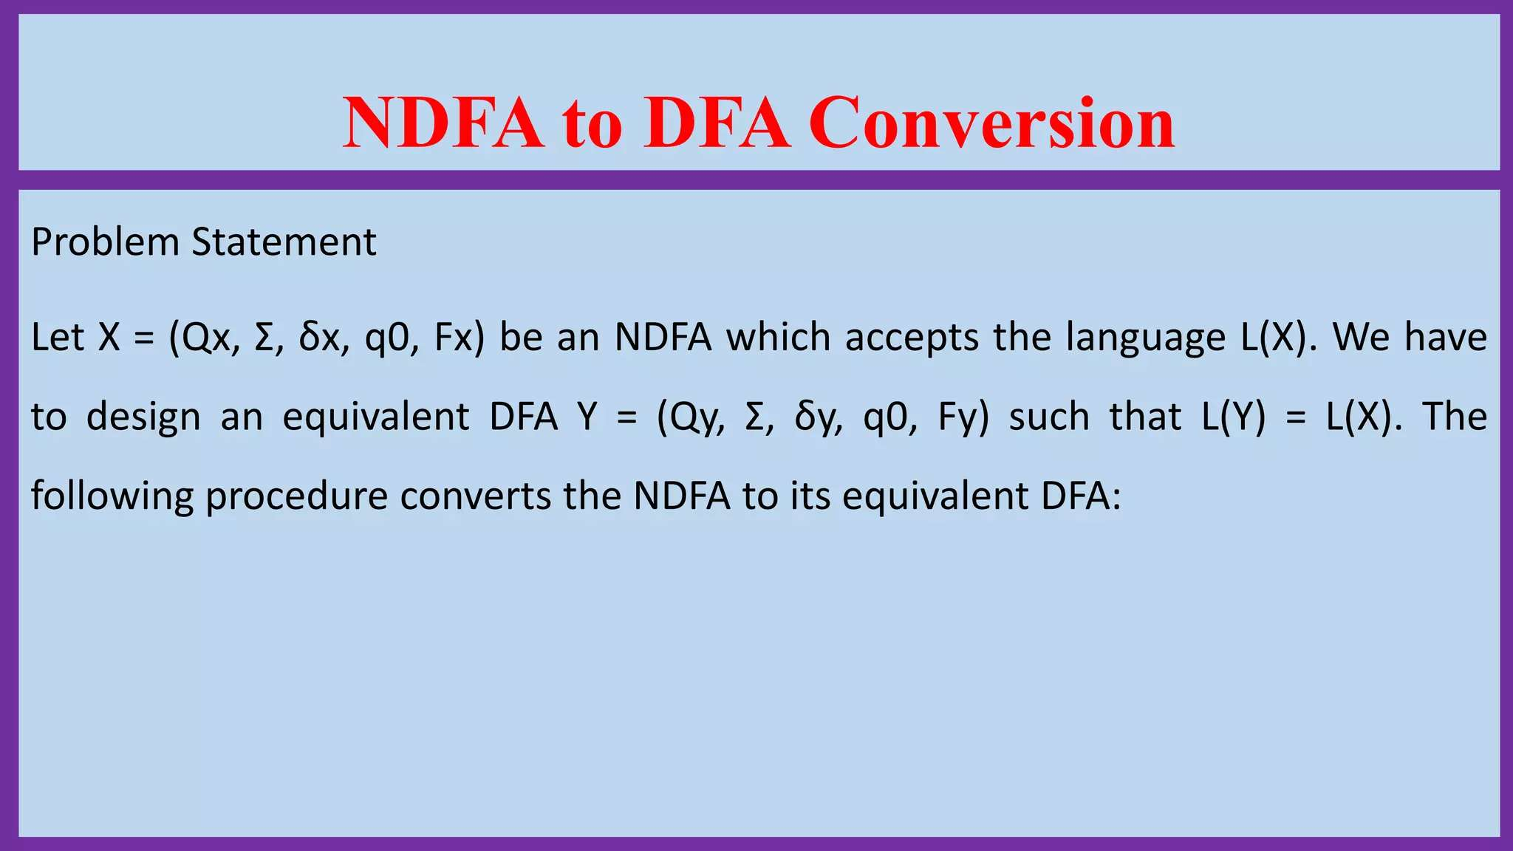

Slide 38
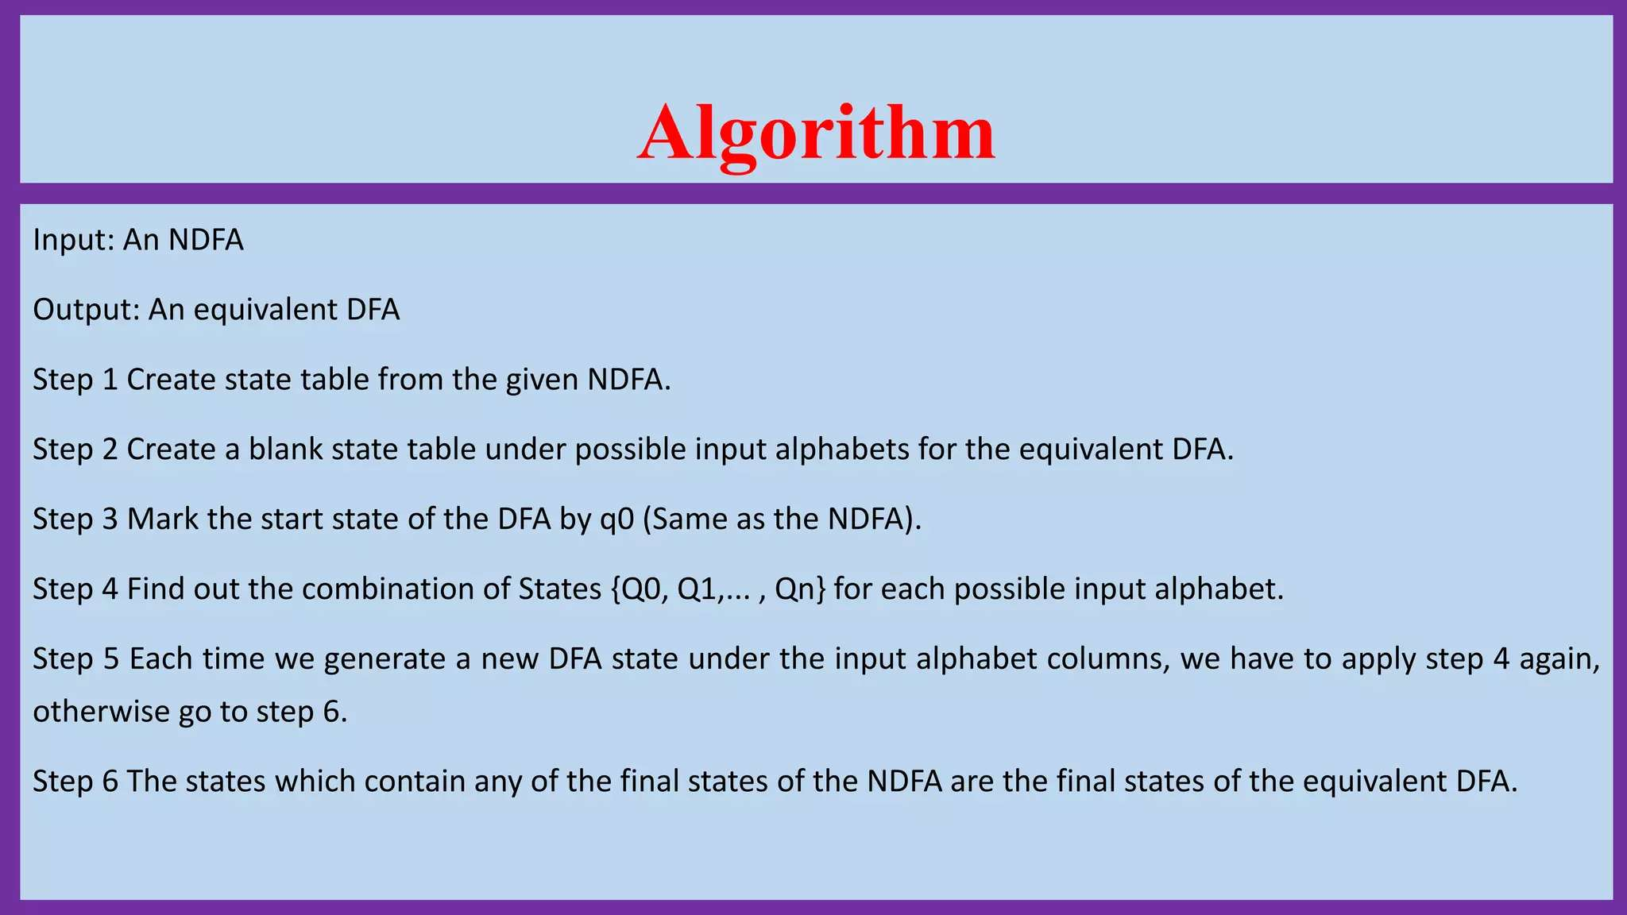

Slide 39
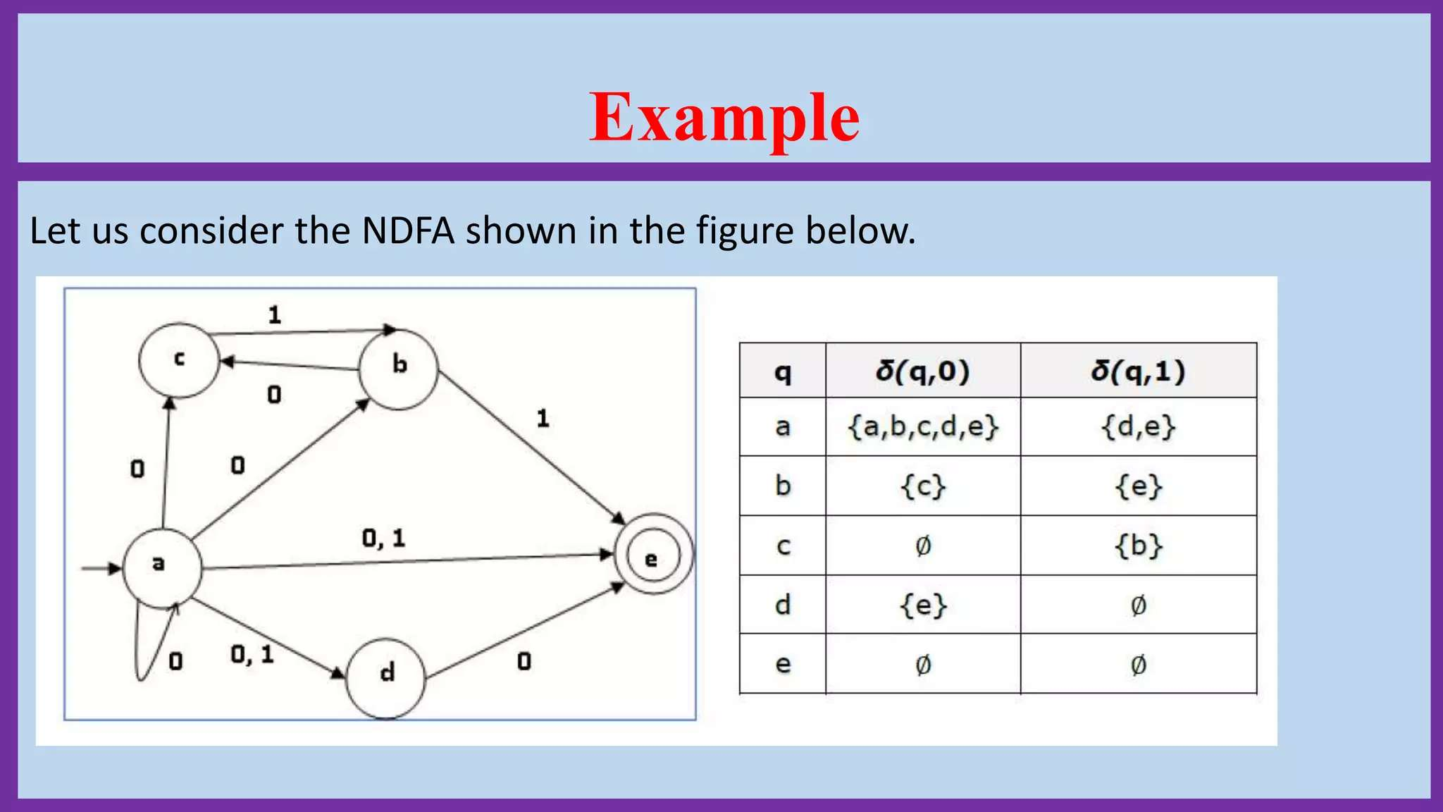

Slide 40
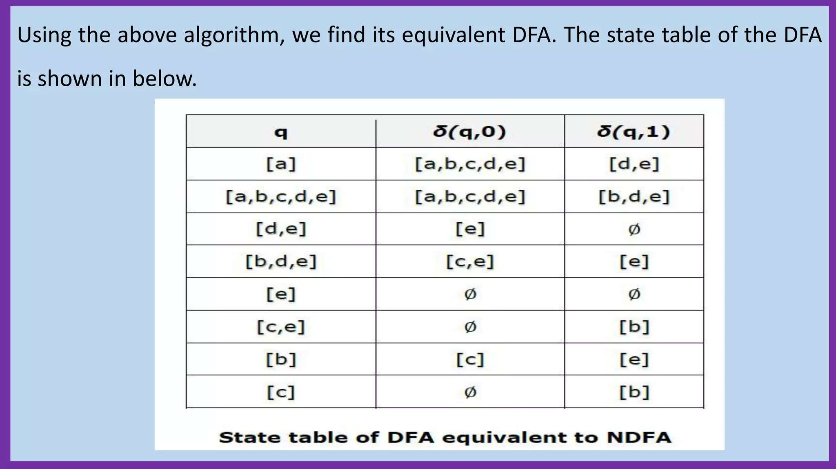

Slide 41
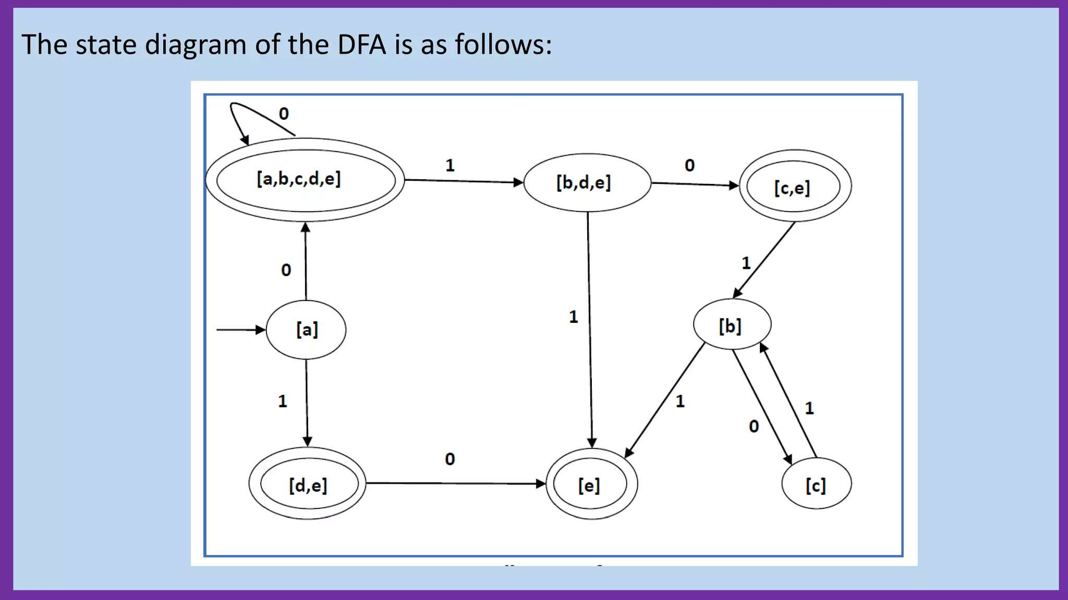

Slide 42
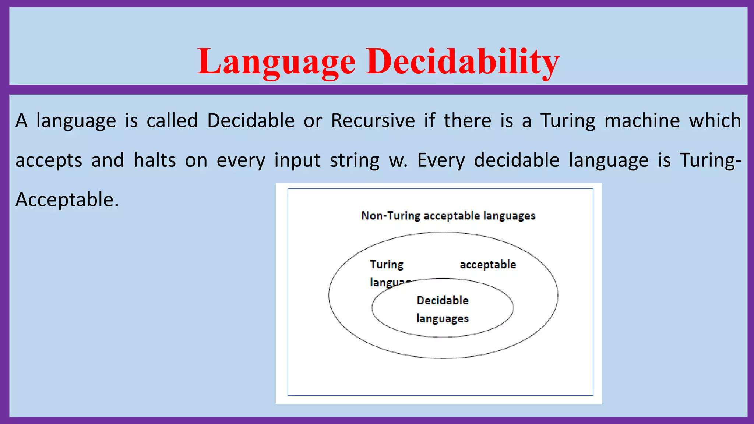

Slide 43
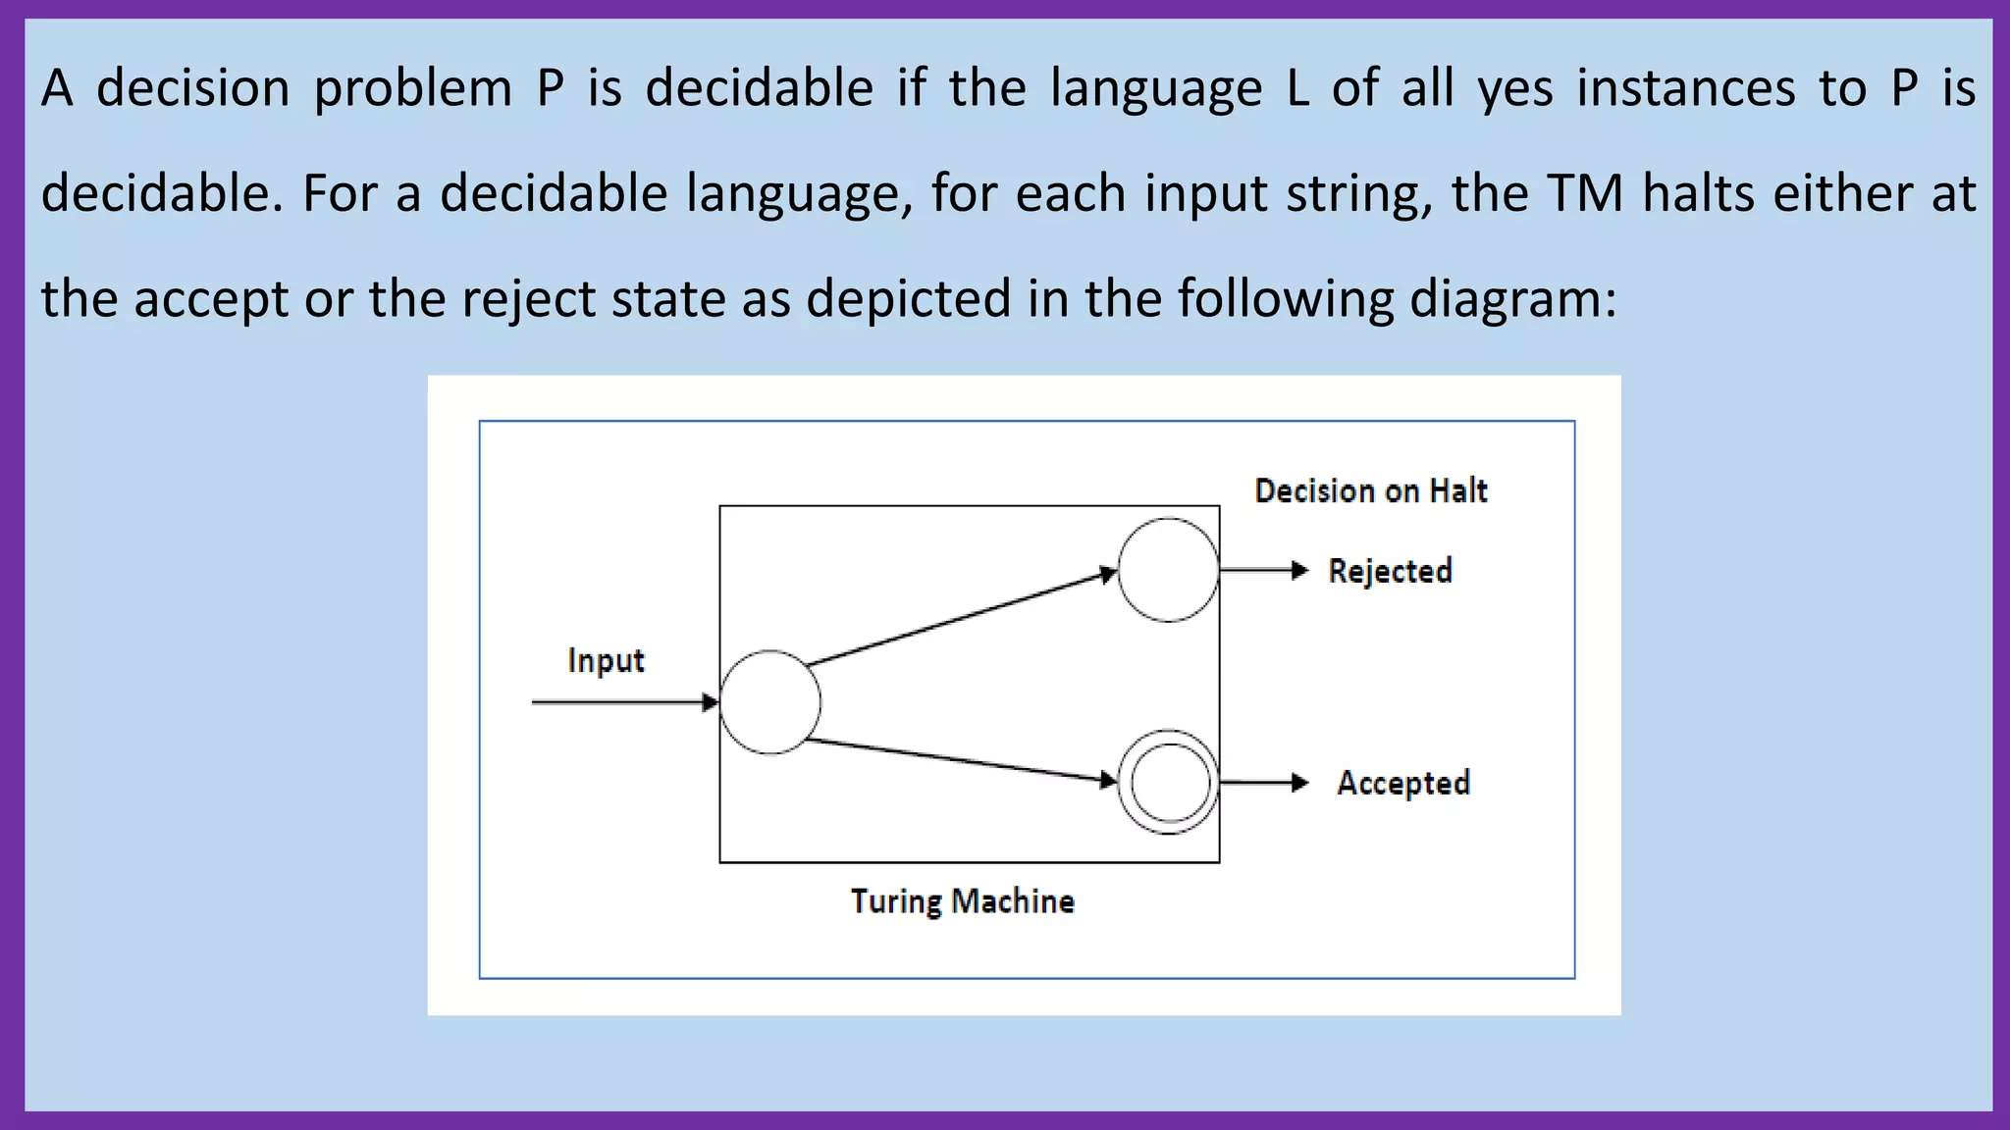

Slide 44
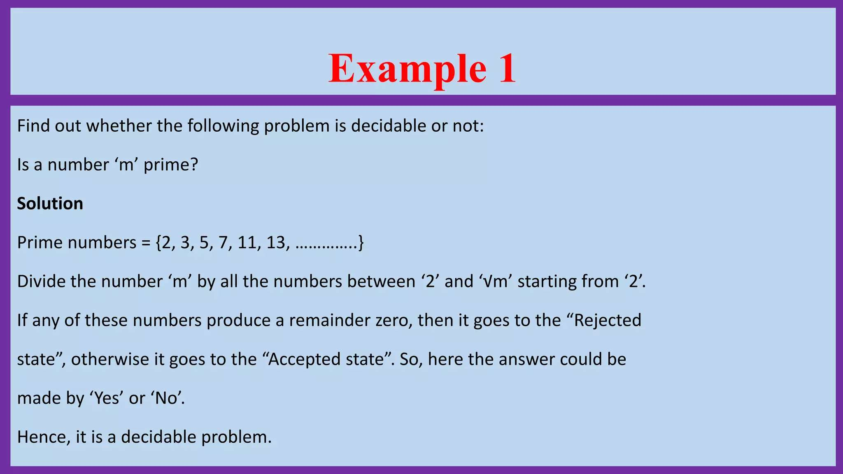

Slide 45
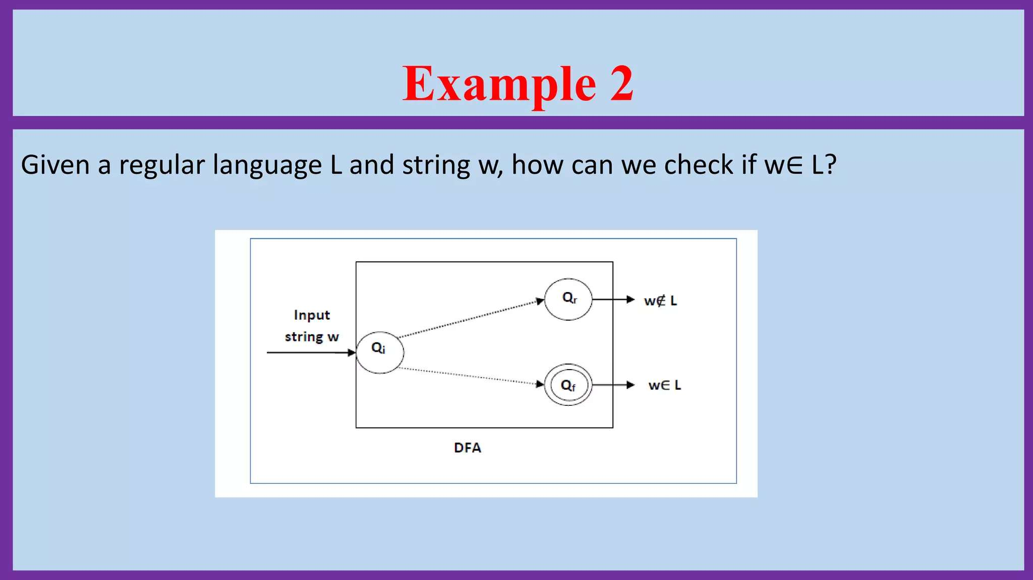

Slide 46
Draw DFA which accepts the string starting with ‘ab’.
Problem
Draw the state transition diagram over an alphabet Σ={a,b} that accepts the string starting with ‘ab’.
Solution
The formal definition of Deterministic Finite Automata (DFA) is as follows −
A DFA is a collection of 5-tuples as shown below −
M=(Q, Σ, δ,q0,F)

Slide 47
Where, Q: Finite set called states. Σ: Finite set called alphabets. δ: Q × Σ → Q is the transition function. q0 ∈ Q is the initial state. The language is generated as given below − L={ab,aba,abab,…….} The transition diagram is as follows −

Slide 48
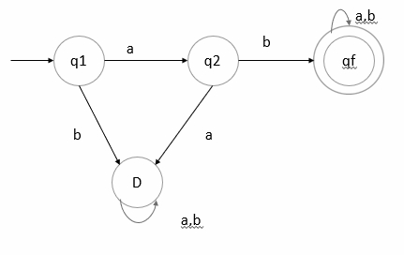

Slide 49
Here, D is a dead state. D is a transition state, which it can never escape. Such a state is called a trap state. It is called the dead state. ab − q1 on’ a’ goes to q2 and q2 on ‘b’ goes to qf to reach final state. So, ab is accepted. baa − q1 on ‘b’ goes to D state, which is dead state. There is no way to reach the final state. So, baa is not accepted.

Slide 50
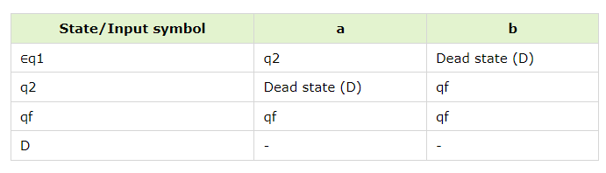
Transition table The transition table is as follows −

Slide 51
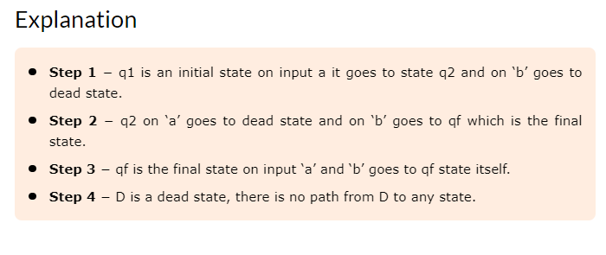

Slide 52
Example 2 Design a DFA which accepts a language over the alphabets Σ = {a, b} such that L is the set of all strings starting with ‘aba’. All strings start with the substring “aba”. Therefore, length of substring = 3. Minimum number of states in the DFA = 3 + 2 = 5. The language L= {aba,abaa,abaab,abaaba}

Slide 53
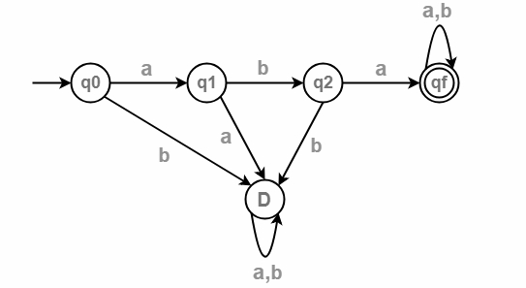
The transition diagram is as follows −

Slide 54
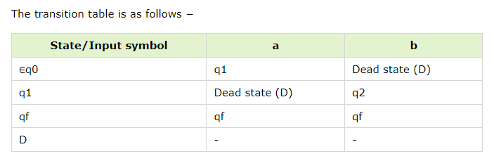
Transition table

Slide 55
Construct DFA with Σ= {0,1} accepts all strings with 0.
A Deterministic Finite automata (DFA) is a collection of defined as a 5-tuples and is as follows −
M=(Q, Σ, δ,q0,F)
Where,
Q: Finite set called states.
Σ: Finite set called alphabets.
δ: Q × Σ → Q is the transition function.
q0 ∈ Q is the start or initial state.
F: Final or accept state.

Slide 56
Example 1 The DFA accepts all strings starting with 0 The language L= {0,01,001,010,0010,000101,…} In this language, all strings start with zero.

Slide 57
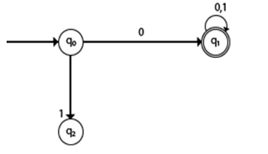
Transition diagram The transition diagram is as follows −

Slide 58
Explanation
Step 1 − q0 is the initial state on input ‘0’ it goes to q1, which is the final state, and ‘0’ string is accepted.
Step 2 − q0 on ‘1’ goes to q2 which is dead state because for q2 there is no path to reach to the final state.
Step 3 − q1 on input ‘0’ and ‘1’ goes to q1 itself which is the final state.

Slide 59
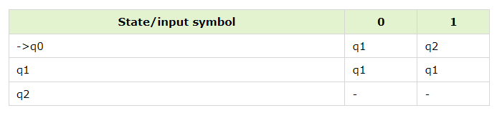
Transition table The transition table is as follows −

Slide 60
Example 2 Construct DFA for the language accepting strings starting with ‘101’
All strings start with substring “101”.
Then the length of the substring = 3.
Therefore, Minimum number of states in the DFA = 3 + 2 = 5.
The minimized DFA has five states.
The language L= {101,1011,10110,101101,.........}

Slide 61
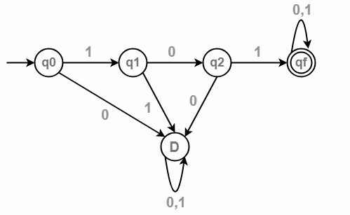
The transition diagram is as follows −

Slide 62
Explanation Step 1 − q0 is an initial state on input ‘1’ goes to q1 and on input ‘0’ leads to a dead state. Step 2 − q1 on input ‘0’ goes to q2 and on ‘1’ goes to dead state. Step 3 − q2 on input ‘1’ goes to qf which is the final state, and on ‘0’ goes to dead state. Step 4 − qf is the final state, on input ‘1’ and ‘0’ it goes to qf itself.

Slide 63
Construct a DFA, accepting all strings ending with 'ab' over ∑={a,b}
SOLUTION:
∑={a,b}
L = {ab, aab, bab, abab, aaab,……… }
So DFA can be Q={ q₀ , q₁ , q₂},
∑={a,b},
q₀={ q₀},
F={q₂} and δ is given by the table

Slide 64
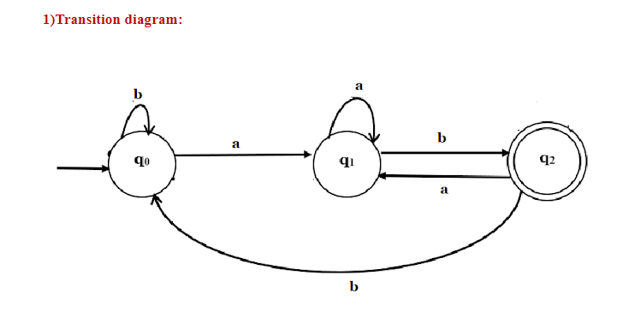

Slide 65
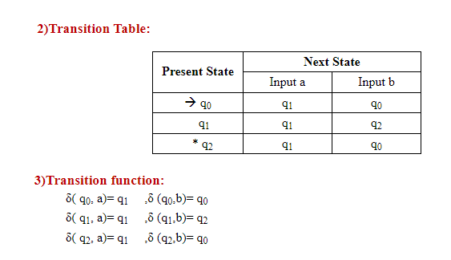

Slide 66
DFA accepting all strings over w ∈(a,b)* which contains “aba” as a substring Below is the designed DFA Machine for the given problem. Construct a transition table for DFA states and analyze the transitions between each state. Below are the steps –

Slide 67
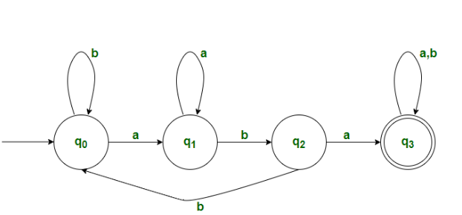

Slide 68
Desired Language: L = {aba, baba, abab, aababbb.....}
Explanation:
Firstly, there will be 4states.(say q₀, q₁, q₂, q₃) , with q₀ being initial state and q₃ being final state.
Initially we will be in q₀ state, now we start reading the given string.
When we read ‘b’, we will remain in the same state
If we read ‘a’, then it transits to state q₁.
3. Assuming that now we are in q₁ state.
When we read ‘a’, we will remain in the same state.
If we read ‘b’, we will transits to state q₂.
4. Assuming that now we are in q₂ state.
If we read ‘a’, it transits to state q₃.
If we read ‘b’, it transits to state q_{0.}
5. Assuming we are in final state(q₃)
We remain in the same state, when we read ‘a’ or ‘b’.
6. All strings which are accepted by this DFA will have “aba” as its substring.

Slide 69
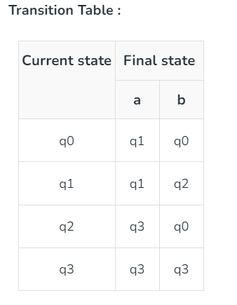

Slide 70
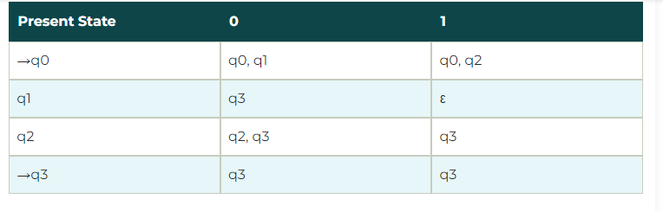
Examples of NFA Example 1: Design a NFA for the transition table as given below:

Slide 71
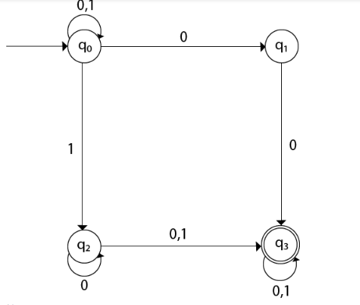
Solution: The transition diagram can be drawn by using the mapping function as given in the table.

Slide 72
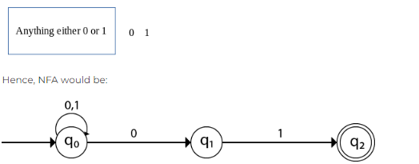
Design an NFA with ∑ = {0, 1} accepts all string ending with 01.
Solution:

Slide 73
Construction of a minimal NFA accepting a set of strings over {a, b} in which each string of the language starts with ‘ab’.
Explanation: The desired language will be like:
L1 = {ab, abba, abaa, ...........}

Slide 74
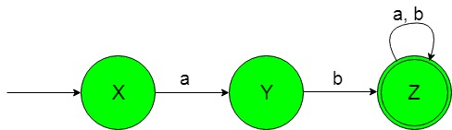
The state transition diagram of the desired language will be like below:

Slide 75
In the above NFA, the initial state ‘X’ on getting ‘a’ as the input it transits to a state ‘Y’.
The state ‘Y’ on getting ‘b’ as the input it transits to a final state ‘Z’.
The final state ‘Z’ on getting either ‘a’ or ‘b’ as the input it remains in the state of itself.

Slide 76
Construction of a minimal NFA accepting a set of strings over {a, b} in which each string of the language contain ‘a’ as the substring.
Explanation: The desired language will be like:
L1 = {ab, abba, abaa, ...........}

Slide 77
But the below language is not accepted by this NFA because some of the string of below language does not contain ‘a’ as the substring. L2 = {bb, b, bbbb, .............}

Slide 78
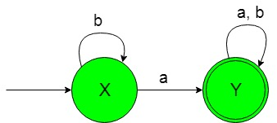
The state transition diagram of the desired language will be like below:

Slide 79
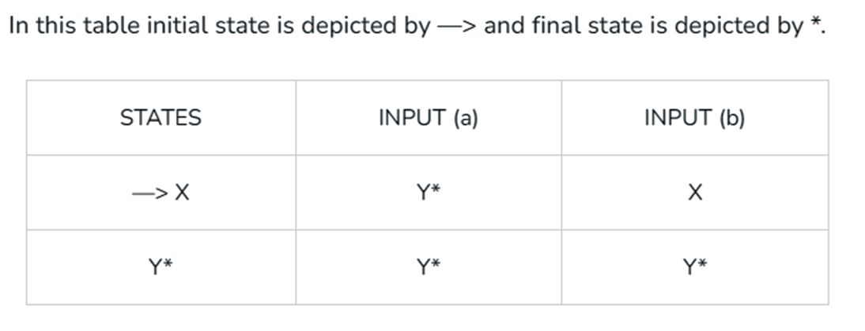

Slide 80
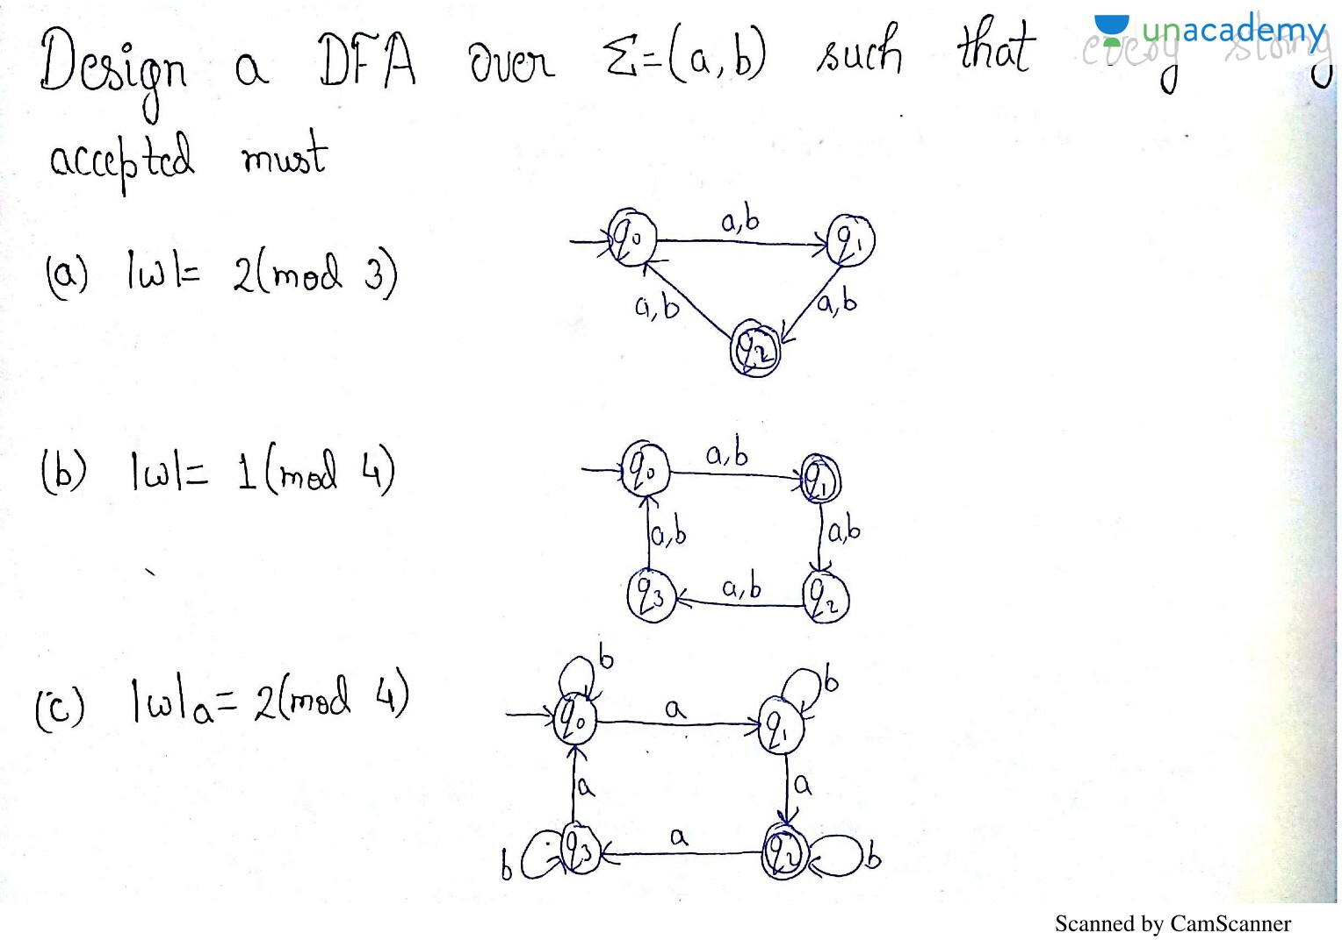

Slide 81
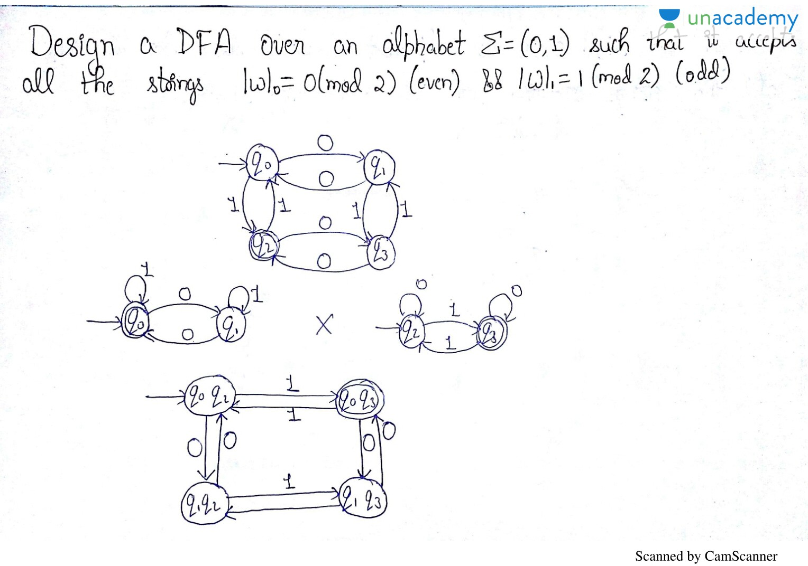

Slide 82
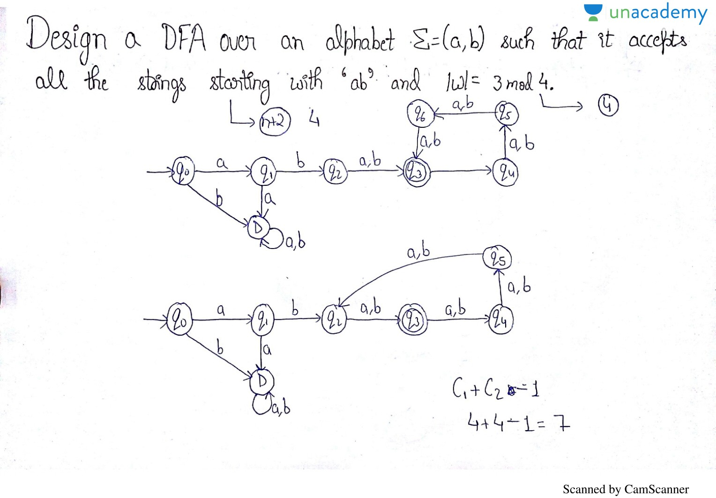

Slide 83


Slide 84


Slide 85
Minimization of Finite Automata
Minimization of Finite Automata is the process of reducing the number of states in a finite automaton without changing the language it recognizes.
This process is crucial for optimizing the performance
and efficiency of the automaton.

Slide 86
Types of States
Productive
Non Productive
Productive-Presence or absence of these states changes the language accepting capability of machine.
Non Productive- Presence or absence of these states do not changes the language accepting capability.
3 Types- Dead States , Unreachable states , Equal States.

Slide 87
Unreachable states are the states that are not reachable from the initial state of the DFA, for any input string. These states can be removed.
Dead states are the states from which no final state is reachable. These states can be removed unless the automaton is required to be complete.
Non distinguishable states are those that cannot be distinguished from one another for any input string. These states can be merged.

Slide 88


Slide 89
What is a Finite Automaton?
A finite automaton is a theoretical machine used in computer science to model computation.
It consists of a finite number of states, transitions between those states, and an initial state.
There are two main types of finite automata:
Deterministic Finite Automaton (DFA): Each state has exactly one transition for each input symbol.
Nondeterministic Finite Automaton (NFA): States can have zero, one, or multiple transitions for each input symbol.

Slide 90
Why Minimize Finite Automata?
Minimizing a finite automaton has several advantages:
Efficiency: Fewer states mean less memory usage and faster execution, which is crucial for real-time applications.
Simplicity: A minimized automaton is easier to understand and analyze.
Optimization: Reducing redundancy in states leads to more optimized and streamlined models.

Slide 91
Steps in Minimizing a DFA Minimizing a DFA involves several steps, which we will outline below:
1. Remove Unreachable States
*An unreachable state is a state that cannot be reached from the initial state for any input string.
*These states do not affect the language recognized by the automaton and can be removed. The steps to remove unreachable states are:
*Start from the initial state and mark it as reachable.
*Recursively mark all states that can be reached from any reachable state using any input symbol.
*Remove all states that are not marked as reachable.

Slide 92
2) Identify Equivalent States
Two states are equivalent if, for every input string, they either both reach an accepting state or both reach a non-accepting state. Identifying equivalent states involves:
*Creating a table to record distinguishable pairs of states.
*Initially, mark pairs consisting of one accepting and one non-accepting state as distinguishable.
*Recursively mark pairs as distinguishable if, for some input symbol, their transitions lead to a distinguishable pair of states.

Slide 93
3. Merge Equivalent States
Once all equivalent states are identified, merge them into a single state. The steps include:
Group all equivalent states.
Create a new state for each group of equivalent states.
Redirect transitions to point to the new merged states.

Slide 94


Slide 95
Minimization of DFA Using Equivalence Theorem-
Step-01:Eliminate all the dead states and inaccessible states from the given DFA (if any)
Step-02:
Draw a state transition table for the given DFA.
Transition table shows the transition of all states on all input symbols in Σ.

Slide 96
Step-03:
Now, start applying equivalence theorem.
Take a counter variable k and initialize it with value 0.
Divide Q (set of states) into two sets such that one set contains all the non-final states and other set contains all the final states.
This partition is called P₀.

Slide 97
Step-04:
Increment k by 1.
Find P_{k} by partitioning the different sets of P_{k-1} .
In each set of P_{k-1} , consider all the possible pair of states within each set and if the two states are distinguishable, partition the set into different sets in P_{k}.
Two states q₁ and q₂ are distinguishable in partition P_{k} for any input symbol ‘a’,
if δ (q₁, a) and δ (q₂, a) are in different sets in partition P_{k-1}.

Slide 98
Step-05:
Repeat step-04 until no change in partition occurs.
In other words, when you find P_{k} = P_{k-1}, stop.
Step-06:
All those states which belong to the same set are equivalent.
The equivalent states are merged to form a single state in the minimal DFA
Number of states in Minimal DFA
= Number of sets in P_{k}

Slide 99

Problem-01:
Minimize the given DFA-

Slide 100
Solution-
Step-01:The given DFA contains no dead states and inaccessible states.
Step-02:Draw a state transition table-
 | a | b
→q0 | q1 | q2
q1 | q1 | q3
q2 | q1 | q2
q3 | q1 | *q4

Slide 101
Step-03:
Now using Equivalence Theorem, we have-
P₀ = { q₀ , q₁ , q₂ , q₃ } { q₄ }
P₁ = { q₀ , q₁ , q₂ } { q₃ } { q₄ }
P₂ = { q₀ , q₂ } { q₁ } { q₃ } { q₄ }
P₃ = { q₀ , q₂ } { q₁ } { q₃ } { q₄ }
Since P₃ = P₂, so we stop.
From P₃, we infer that states q₀ and q₂ are equivalent and can be merged together.

Slide 102

So, Our minimal DFA is-

Slide 103

Problem-02:
Minimize the given DFA-

Slide 104

Solution- Step-01:
State q₃ is inaccessible from the initial state.
So, we eliminate it and its associated edges from the DFA.
The resulting DFA is-

Slide 105
Step-02:
Draw a state transition table-
 | a | b
→q0 | *q1 | q0
*q1 | *q2 | *q1
*q2 | *q1 | *q2

Slide 106
Step-03:
Now using Equivalence Theorem, we have-
P₀ = { q₀ } { q₁ , q₂ }
P₁ = { q₀ } { q₁ , q₂ }
Since P₁ = P₀, so we stop.
From P₁, we infer that states q₁ and q₂ are equivalent and can be merged together.

Slide 107

So, Our minimal DFA is-

Slide 108
Myhill-Nerode Theorem (Table Filling Method)
This theorem states that a language L is regular if and only if L~ has a finite number of equivalence classes. Furthermore, if this finite number of equivalence classes is N, then N is the number of states in minimal DFA (Deterministic Finite Automaton) recognizing L

Slide 109
Algorithm
1) Create a table with all possible pairs of states from the given DFA. Each cell in the table will represent a pair of states, like (A, B), (C, D), etc.
2) Mark all pairs where P belongs to the final state, and Q does not belong to the final state. This means that for each pair of states in the table, check whether one state is a final state, and the other is not.
3) After marking the pairs in the second step, we move on to the unmarked pairs. For each unmarked pair (P, Q), check their transitions on every input symbol (X). If both P and Q transition to a pair that is already marked in the table, then mark the pair (P, Q).
4) Repeat step 3 until you cannot make any new markings in the table. This means we have exhausted all possible combinations and identified all the distinguishable pairs of states.
5) At the end combine all the unmarked pairs and make them a single state in the minimized DFA.

Slide 110

Example1 of Myhill-Nerode Theorem
Consider we have a DFA like below −
Here,
States: {A, B, C, D, E, F}
Input Symbols: {0, 1}
Start State: A
Final States: {C, D, E}

Slide 111
The state transition table will be like the shown here −
State | 0 | 1
A | B | C
B | A | D
C | E | A
D | E | F
E | E | F

Slide 112


To make the table for the theorem we need 6 × 6 table, but the upper triangle is not needed, so we can remove them.
After the first step, we jump to the second step to fill the table ↑

Slide 113
For a pair (B, A), check −
δ(B, 0) = A and δ(A, 0) = B, since the new pair (B, A) is not marked, nothing will be marked now.
δ(B, 1) = D and δ(A, 1) = C, since the new pair (C, D) is not marked, nothing will be marked now.
For a pair (D, C), check −
δ(D, 0) = E and δ(C, 0) = E, since the new pair (E, E) is not in the table, nothing will be marked now.
δ(D, 1) = F and δ(C, 1) = F, since the new pair (F, F) is not in the table, nothing will be marked now.
For a pair (E, C), check −
δ(E, 0) = E and δ(C, 0) = E, since the new pair (E, E) is not in the table, nothing will be marked now.
δ(E, 1) = F and δ(C, 1) = F, since the new pair (F, F) is not in the table, nothing will be marked now.

Slide 114
For a pair (E, D), check −
δ(E, 0) = E and δ(D, 0) = E, since the new pair (E, E) is not in the table, nothing will be marked now.
δ(E, 1) = F and δ(D, 1) = F, since the new pair (F, F) is not in the table, nothing will be marked now.
For a pair (F, A), check −
δ(F, 0) = F and δ(A, 0) = B, since the new pair (F, B) is not marked, nothing will be marked now.
δ(F, 1) = F and δ(A, 1) = C, since the new pair (F, C) is marked, then we have to mark the current pair (F, A) also.
For a pair (F, B), check −
δ(F, 0) = F and δ(B, 0) = A, since the new pair (F, A) is marked in the previous step, we have to mark (F, B).
δ(F, 1) = F and δ(B, 1) = C, since the new pair (F, C) is marked, then we have to mark the current pair (F, A) also.

Slide 115

Now let us see the updated table once −
In step 4, it states repeat step 3 until there is no other marks. You can check, but here we do not have any new marking in the next iteration. So go to the next step.
The unmarked pairs are (B, A), (D, C), (E, C), (E, D)
Now let us draw the minimized DFA −
(D, C), (E, C), (E, D) contains the common elements so these are merged. And we are getting the minimized DFA

Slide 116

Example 2
Minimize the following DFA using Table Filling Method.

Slide 117
Steps:
Draw a table for all pairs of states (P, Q)
Mark all pairs where Pϵ F and Q∉F
If there are any Unmarked pairs (P, Q) such that [δ(P, x),δ(Q, x)] is marked, then mark [P, Q] where ‘x’ is an input symbol. Repeat this until no more marking can be made.
Combine all the unmarked pairs and make them a single state in the minimized DFA.

Slide 118

Step 1: Draw a table for all pairs of states (P, Q)

Slide 119

Step 2: Mark all pairs where Pϵ F and Q∉F

Slide 120

Step 3: If there are any Unmarked pairs (P, Q) such that [δ(P, x),δ(Q, x)] is marked, then mark [P, Q] where ‘x’ is an input symbol. Repeat this until no more marking can be made.

Slide 121

Step 4 :(A, C), B, D, E

Slide 122


Example 1 NFA to DFA Conversion
NFA DFA
State / Alphabet | a | b
→q0 | q0 | {q0, q1}
{q0, q1} | q0 | *{q0, q1, q2}
*{q0, q1, q2} | q0 | *{q0, q1, q2}
State / Alphabet | a | b
→q0 | q0 | q0, q1
q1 | – | *q2
*q2 | – | –

Slide 123


Example 2 NFA to DFA conversion
NFA DFA
State / Alphabet | 0 | 1
→q0 | q0 | *{q1, q2}
*{q1, q2} | *{q0, q1, q2} | *{q1, q2}
*{q0, q1, q2} | *{q0, q1, q2} | *{q1, q2}
State / Alphabet | 0 | 1
→q0 | q0 | q1, *q2
q1 | q1, *q2 | *q2
*q2 | q0, q1 | q1

Slide 124
NFA_{ε} - NFA - DFA equivalence

Slide 125

What is an Epsilon NFA (∈-NFA) NFA_{ε}
An NFA_{ε} is an NFA that might have ε-moves. In an ε-move we can transport from one state to the other without having any symbols.
An NFA is by definition an NFA_{ε} (but with no ε-moves).

Slide 126
NFA computation
An NFA illustrates a machine that can have choices (just like our brains). If there are two arrows under a specific symbol it can choose either of them and follow it.
So it works more or less like you. Suppose that you want to do something and that you can think of several methods to do it. Some of them can possibly fail but it suffices to find one that succeeds.
An NFA accepts a string if there exists a path following arrows under the symbols of the string consecutively that takes us to an accept state.

Slide 127
Example
1
0
This automaton accepts the string 1110 because there is a path under 1110 that takes us to an accept state (the path q₀ , q₀ , q₀ , q₁), beside the fact that there are paths under 1110 that fail (for example the path q₀ , q₀ , q₁, q₀).
However it doesn’t accept the string 00 because there are no paths under 00 that can take us to q₁.
q₀
q₁
0,1

Slide 128
NFA – DFA equivalence
The language that an NFA recognizes is the set of strings which the NFA accepts.
To see if a string is accepted it suffices to find the set of the possible states in which I can be with this string as input and see if a final state is contained in this set.

Slide 129
NFA – DFA eqivalence
Whenever an arrow is followed, there is a set of possible following states that the NFA can be. This set of states is a subset of Q.
For example with 0010 I have the following sequence of set of states:
0
1
0
q₀
0,1
q₁
q₂

Slide 130
NFA – DFA equivalence
So only want to keep information about these subsets of states that can be reached from the initial state after following arrows.
Since all the subsets of Q are 2^{|Q|} in total, this should be a finite (<= 2^{|Q|}) number of subsets.
consider each subset of states of the NFA as a state of the DFA and every subset of states containing a final state as a final state of the DFA.

Slide 131
NFA – DFA equivalence
Suppose that you want to find an equivalent DFA for an NFA . The algorithm is the following:
Start from the start state and see where 0 or 1 takes you.
For every new subset you find, see where 0 or 1 takes you.
Repeat until no new subsets are found.

Slide 132
NFA – DFA equivalence (example)
To find an equivalent DFA with the NFA of the figure, complete the following table:
 | 0 | 1
q₀ | {q₁} | {q₀, q₁}
{q₁} | {q₀, q₂}
{q₀, q₁} | {q₀, q₁, q₂} | {q₀, q₁}
{q₀, q₂} | {q₁} | {q₀, q₁}
{q₀, q₁, q₂} | {q₀, q₁, q₂} | {q₀, q₁}
0
1
0
q₀
0,1
q₁
q₂

Slide 133
NFA – DFA equivalence (example)
0,1
So the DFA is:
0
1
q₀
0
q₁
q₀₂
 | 0 | 1
q₀ | {q₁} | {q₀, q₁}
{q₁} | {q₀, q₂}
{q₀, q₁} | {q₀, q₁, q₂} | {q₀, q₁}
{q₀, q₂} | {q₁} | {q₀, q₁}
{q₀, q₁, q₂} | {q₀, q₁, q₂} | {q₀, q₁}
0
1
1
1
q₀₁
0
1
0
q₀₁₂

Slide 134
NFA_{ε} – NFA equivalence
An NFAε is an NFA in which I can have ε-moves.
I want to get rid of ε-moves.

Slide 135
NFA_{ε} – NFA equivalence
Suppose that I have an ε-move like in the figure. Since an ε-move is like teleporting from q₁ to q₂ I can remove the arrow with the ε and add several arrows from q₁ to every neighbor of q₂.
0
q₃
0
0
q₃
q₁
0
q₄
0
q₂
q₁
ε
q₂
0
q₄
q₅
q₅
1
1
1

Slide 136
NFA_{ε} – NFA equivalence
If from q₁ an ε-move takes me to q2 which is accept state then, when I remove the ε-move I should convert q1 to accept state.
q₁
q₂
0
q₄
q₁
ε
q₂
0
q₄
0

Slide 137


Slide 138


Slide 139


Slide 140


Slide 141


Slide 142


Slide 143


Slide 144


Slide 145


Slide 146


Slide 147


Slide 148


Slide 149
Conversion from NFA to DFA
*In NFA, when a specific input is given to the current state, the machine goes to multiple states.
*It can have zero, one or more than one move on a given input symbol.
On the other hand, in DFA, when a specific input is given to the current state, the machine goes to only one state.
* DFA has only one move on a given input symbol.

Slide 150
Let, M = (Q, ∑, δ, q0, F) is an NFA which accepts the language L(M). There should be equivalent DFA denoted by M' = (Q', ∑', q0', δ', F') such that L(M) = L(M').

Slide 151
Steps for converting NFA to DFA: Step 1: Initially Q' = ϕ Step 2: Add q0 of NFA to Q'. Then find the transitions from this start state. Step 3: In Q', find the possible set of states for each input symbol. If this set of states is not in Q', then add it to Q'. Step 4: In DFA, the final state will be all the states which contain F(final states of NFA)

Slide 152

Example 1: Convert the given NFA to DFA.

Slide 153

Solution: For the given transition diagram we will first construct the transition table

Slide 154
Now we will obtain δ' transition for state q0.
δ'([q0], 0) = [q0]
δ'([q0], 1) = [q1]
The δ' transition for state q1 is obtained as:
δ'([q1], 0) = [q1, q2] (new state generated)
δ'([q1], 1) = [q1]
The δ' transition for state q2 is obtained as:
δ'([q2], 0) = [q2]
δ'([q2], 1) = [q1, q2]

Slide 155
Now we will obtain δ' transition on [q1, q2].
δ'([q1, q2], 0) = δ(q1, 0) ∪ δ(q2, 0)
= {q1, q2} ∪ {q2}
= [q1, q2]
δ'([q1, q2], 1) = δ(q1, 1) ∪ δ(q2, 1)
= {q1} ∪ {q1, q2}
= {q1, q2}
= [q1, q2]

Slide 156

The state [q1, q2] is the final state as well because it contains a final state q2. The transition table for the constructed DFA will be:

Slide 157


Slide 158

Example 2: Convert the given NFA to DFA.

Slide 159


Slide 160


Slide 161


Slide 162


Slide 163

EXAMPLE 3: Draw an NFA that accepts all the strings ending with “1” over Σ {0,1} and convert this NFA to its corresponding DFA.
SOL:
Step 01: Draw NFA Graph
The following is the NFA graph for conversion into DFA.

Slide 164

Step 02: Draw the NFA transition Table. The NFA transition table of the above NFA is given below
Don’t confuse: dash (“-“) symbol represents the empty symbol (ϕ).

Slide 165

Step 03: Conversion of NFA to DFA Transition Table
DFA Transition Table Start

Slide 166
Transition calculations for state “q0q1”
For input “0”
δ([q0q1], 0) = δ(q0, 0) ∪ δ(q1, 0)
= {q0} ∪ {ϕ}
= {q0}
For input “1”
δ([q0q1], 1) = δ(q0, 1) ∪ δ(q1, 1)
= {q0q1} ∪ {ϕ}
= {q0q1}

Slide 167

DFA Transition Table
State “q1” was the final state in the NFA Table. That’s why all those states will be the final states where “q1” is present in the DFA state column. Simply mark with “*” to represent the final state.

Slide 168


Slide 169

Step 4: Draw DFA

Slide 170
What is an Epsilon NFA (∈-NFA) NFA_{ε}
An NFA_{ε} is an NFA that might have ε-moves. In an ε-move we can transport from one state to the other without having any symbols.
An NFA is by definition an NFA_{ε} (but with no ε-moves).
Epsilon NFA (∈-NFA) is also called a null NFA or an NFA lambda.

Slide 171
Epsilon (ε) - closure Epsilon closure for a given state X is a set of states which can be reached from the states X with only (null) or E moves including the state X itself. In other words, £-closure for a state can be obtained by union operation of the £-closure of the states which can be reached from X with a single E move in a recursive manner.

Slide 172


Example Consider the following figure of NFA with ε move −

Slide 173
For the above example, ε closure are as follows −
E closure( A) : {A, B,C}
E closure( B) :{B,C}
E closure( C) : {C}

Slide 174

Epsilon NFA To NFA Conversion Algorithm
If the epsilon exists between any two states in an automata, then the removal of epsilon through some rules is called the elimination of epsilon from the epsilon-NFA.
Suppose there are two vertices / states, V1 and V2; the epsilon between them is below.

Slide 175
Look at the following steps for the elimination of epsilon from epsilon NFA
Step 1: First, find the epsilon location. Label the vertices as V1 (start of epsilon edge) and V2 (end of edge) where epsilon exists.
Step 2: Find all edges starting from V2. Simply, duplicate V2 edges to V1 with the same labels. Now, remove the epsilon
Step 3: If V1 is the initial state, make V2 initial. If V2 is the final state, make V1 final. Remove all unreachable states (if they exist).
Step 4: Check if there are any more epsilons. Repeat steps 1 to 3 until no epsilons remain.

Slide 176

Example 01: Convert Epsilon NFA to NFA
Step 01: Find Epsilon Location
Epsilon exists between q0 and q2. So, q0 becomes V1 and q2 becomes V2. Now apply the steps of epsilon removal.

Slide 177

Step 02: Find starting edges from V2, duplicate it to V1, Remove Epsilon
Two edges are starting from V2 (q2)
First Edge: Goes to q3 for input “0”.
Second Edge: Goes to q4 for input “1”.
Simply, duplicate these edges (starting from V2) to V1 and remove the epsilon edge.

Slide 178

Step 03: Check Initial, Final, and Unreachable State Conditions
Initial state condition: As V1 (q0) is the initial state. So V2(q2) becomes initial as well.

Slide 179

Final state condition: As V2 (q2) is a final state. So V1(q0) also becomes the final state.
Unreachable state condition: There is no unreachable state. So we cannot remove any state from the above NFA

Slide 180
Step 04: Check for any more Epsilon
Only the single epsilon was given in the example, which had already been removed. So, the final NFA is given below

Slide 181

Example 02: Convert Epsilon NFA to NFA
Step 01: Find Epsilon Location
In the above epsilon NFA, there are two epsilons.
First, Epsilon exists between q0 and q1.
Second Epsilon exists between q1 and q4.
First, we remove the second epsilon, because it is far away from the initial state.

Slide 182

Step 02: Find starting edges from V2, duplicate it to V1, Remove Epsilon
Only single edges start from V2 (q4) and go to q5 for input “0”. Simply duplicate this edge V1 (q0) and remove the epsilon edge with its label. we get the following

Slide 183
Step 03: Check Initial, Final, and Unreachable State Conditions
Initial state condition: As V1 (q1) is not an initial state. So V2(q4) cannot be an initial state; NFA remains unchanged.
Final state condition: As V2 (q4) is not a final state. So V1(q1) cannot be a final state. NFA remains unchanged.
Unreachable state condition: A constructed NFA has one unreachable state, which is q4. Simply remove this state along with its outgoing edges.

Slide 184

Step 04: Check for any more Epsilon
Yes, still there exists one more epsilon edge between “q0” and “q1”. So, repeat the first 3 steps to remove the remaining epsilons.
Again, step 1: Find Epsilon Location
Epsilon exists between q0 and q1. So, q0 becomes V1 and q1 becomes V2. Now apply the steps of epsilon removal.

Slide 185

Again, step 02: Find starting edges from V2, duplicate it to V1, and Remove Epsilon
Only single edges start from V2 (q1) and go to q3 for input “0”. Simply, duplicate this edge with its label to V1 (q0) and remove the epsilon edge.

Slide 186

Again, Step 03: Check Initial, Final, and Unreachable State Conditions
Initial state condition: As V1 (q0) is an initial state. So V2(q1) becomes initial as well. As given below
Final state condition: As V2 (q1) is not a final state. So V1(q0) cannot be a final. NFA remains unchanged
Unreachable state condition: There is no unreachable state. So we cannot remove any state from the above NFA

Slide 187
Again, step 04: Check for any more Epsilon
As there were two epsilons given initially in the example, both are removed. No more epsilon exists.
Final Result:
So the final NFA, after removing all epsilons from the given epsilon NFA, is given below

Slide 188
Properties of Regular Languages
General Discussion of “Properties”
Closure properties
Decision properties
The Pumping Lemma

Slide 189
There are different closure properties for regular languages. They are as follows − Union Intersection concatenation Kleene closure Complement

Slide 190
Union If L1 and If L2 are two regular languages, their union L1 U L2 will also be regular.
Example
L1 = {aⁿ n > O} and L2 = {bⁿ | n > O}
L3 = L1 U L2 = {aⁿ U bⁿ | n > O} is also regular.

Slide 191
Intersection
If L1 and If L2 are two regular languages, their intersection L1 ∩ L2 will also be regular.
Example
L1= {a^{m} b^{n} | n > 0 and m > O} and
L2= {a^{m} b^{n} U b^{n} a^{m} | n > 0 and m > O}
L3 = L1 ∩ L2 = {a^{m} b^{n} | n > 0 and m > O} are also regular.

Slide 192
Concatenation
If L1 and If L2 are two regular languages, their concatenation L1.L2 will also be regular.
Example
L1 = {a^{m} | m > 0} and L2 = {b^{n} | n > O}
L3 = L1.L2 = {a^{m} . b^{n} | m > 0 and n > O} is also regular.

Slide 193
Kleene Closure
If L1 is a regular language, its Kleene closure L1* will also be regular.
Example
L1 = (a U b )
L1* = (a U b)*

Slide 194
Complement
If L(G) is a regular language, its complement L'(G) will also be regular. Complement of a language can be found by subtracting strings which are in L(G) from all possible strings.
Example
L(G) = {a^{n} | n > 3} L'(G) = {a^{n} | n <= 3}

Slide 195


Slide 196


Slide 197


Slide 198


Slide 199


Slide 200


Slide 201


Slide 202


Slide 203


Slide 204


Slide 205


Slide 206


Slide 207


Slide 208
What is the pumping lemma for regular language?
There are two Pumping Lemmas (PL), which are defined for Regular Languages and Context - Free Languages.

Slide 209
Pumping lemma for Regular languages
It gives a method for pumping (generating) many substrings from a given string.
In other words, we say it provides means to break a given long input string into several substrings.
It gives necessary condition(s) to prove a set of strings is not regular.

Slide 210
Theorem
For any regular language L, there exists an integer P, such that for all w in L
|w|>=P
We can break w into three strings, w=xyz such that.
(1)lxyl < P
(2)lyl > 1
(3)for all k>= 0: the string xy^{k}z is also in L

Slide 211
Application of pumping lemma Pumping lemma is to be applied to show that certain languages are not regular. It should never be used to show a language is regular. If L is regular, it satisfies the Pumping lemma. If L does not satisfy the Pumping Lemma, it is not regular.

Slide 212


Slide 213


Slide 214


Slide 215


Slide 216


Slide 217


Slide 218


Slide 219


Slide 220


Slide 221


Slide 222


Slide 223


Slide 224


Slide 225
REGULAR EXPRESSION
Regular Expression is a powerful mathematical tool used to define regular languages, which are recognized by Finite Automata. They are similar to arithmetic, logic, and Boolean expressions in representation but different in their operation and purpose.
Regular expressions generate sets of strings (finite or infinite in number) that always represent a unique and specific regular language.
Each of these regular languages can be recognized and accepted by a finite automata.

Slide 226


Slide 227
The main uses of regular expressions are
Pattern Recognition: Represent patterns that can be recognized by finite automata (DFA and NFA).
Compiler Design: Used in lexical analysis to tokenize input strings during compilation.
Automata Conversion: Enable conversion between regular expressions and finite automata for language recognition.
Theoretical Analysis: Help analyze and prove properties of languages within formal language theory.

Slide 228

Category 1: Basic Regular Expressions

Slide 229


Slide 230

Example 1.1: Regular Expression = a

Slide 231

Example 1.2: Regular Expression = ab

Slide 232

Example 1.3: Regular Expression = (a+b)

Slide 233

Example 1.4: Regular Expression = (a)*

Slide 234

Example 1.5: Regular Expression = (ab)*

Slide 235

Example 1.6: Regular Expression = (a+b)*

Slide 236
Category 2: Start with Regular Expressions

Slide 237


Slide 238

Example 2.1: Regular Expression = a(a+b)*
The following figure shows all possible strings that can be derived from RE = a(a+b)*

Slide 239


Slide 240

Example 2.2: Regular Expression = 101*(0+1)*

Slide 241


Slide 242

Example 2.3: Regular Expression = bab(a+b)*

Slide 243


Slide 244

Category 3: End with Regular Expressions

Slide 245

Example 3.1: Regular Expression = (a+b+c+d)*ab

Slide 246


Slide 247

Example 3.2: Regular Expression = (aaa+bbb)*ba

Slide 248


Slide 249

Example 3.3: Regular Expression = (a+b+c)*abc

Slide 250


Slide 251
Category 4: Start and End with Regular Expressions

Slide 252

Example 4.1: Regular Expression = 1(1+0)*1 + 0(1+0)*0

Slide 253


Slide 254

Example 4.2: Regular Expression = 11(0+1)(00)

Slide 255


Slide 256
Types of Regular Expressions in TOC
Finite Regular Expressions
II. Infinite Regular Expressions

Slide 257
Examples of Finite Regular Expression
Example 01: Write the regular expression for the language which has no string.
Solution: Language for the given example is given below
L = { } //empty string
Regular expression for the above language is given below
L(R) = Φ
Example 02: Write the regular expression for the language with a string with zero length.
Solution: Language for the given example is given below
L = { ε } //single string
Regular expression for the above language is given below
L(R) = ε

Slide 258
Example 03: Write the regular expression for the language with a string with a single length over ∑ = {a, b}.
Solution: Language for the given example is given below
L = { a,b } //string with single length
A regular expression for the above language is given below
L(R) = (a+b)
Example 04: Write the regular expression for the language with a string with the length of two over ∑ = {a, b}.
Solution: Language for the given example is given below
L = (a,b).(a,b) = { aa,ab,ba,bb } //string with length of two
A regular expression for the above language is given below
L(R) = (aa+ab+ba+bb)

Slide 259
Examples of Infinite Regular Expression
Example 01: Write the regular expression for the language that accepts all the strings having all combinations of a’s over ∑ = {a}.
Solution: Language for the given example is given below
L = { ε, a, aa, aaa, aaaa, aaaaa, ……….. }
A regular expression for the above language is given below
L(R) = a*
Example 02: Write the regular expression for the language that accepts all the strings having all combinations of a’s except the null string over ∑ = {a}.
Solution: Language for the given example is given below
L = {a, aa, aaa, aaaa, aaaaa, ……….. }
A regular expression for the above language is given below
L(R) = a⁺

Slide 260
Example 03: Write the regular expression for the language that accepts all the strings, which has any number of a’s and b’s over ∑ = {a, b}.
Solution: Language for the given example is given below
L = {a, b, ab, ba, aab, aba, aaba ……….. }
Regular expression for the above language is given below
L(R) = (a+b)*
Example 04: Write the regular expression for the language that accepts all the strings, having only one “b” and any numbers of “a” over ∑ = {a, b}.
Solution: Language for the given example is given below
L = {b, ab, aba, abaa, abaaaa, aaaaabaaaaaaa……….. } // all strings having only one “b”
Regular expression for the above language is given below
L(R) = a*ba*

Slide 261
Operations on Regular Languages in Automata
1. If regular expression (R) is equal to Epsilon (ε), then the language of Regular expression (R) will represent the epsilon set, i.e. { ε}. A mathematical equation is given below,
2. If regular expression (R) is equal to Φ, then the language of Regular expression (R) will represent the empty set, i.e. { }. The mathematical equation is given below,

Slide 262
3. If regular expression (R) is equal to an input symbol “a,” which belongs to sigma, then the language of Regular expression (R) will represent the set which has “a” alphabet, i.e. {a}. A mathematical equation is given below,

Slide 263

4. The union of two Two Regular Expressions will always produce a regular language. Suppose R1 and R2 are two regular expressions. IF R1= a, R2=b then R1 U R2 =a+b So L(R1 U R2) = {a,b}, still string “a,b” is a regular language.

Slide 264

5. Concatenation of two Two Regular Expressions will always produce a regular language. IF R1= a, R2=b then R1.R2 =a.b So L(R1.R2) = {ab}, still string “ab” is a regular language

Slide 265
6. Kleene closure of Regular Expression (RE) is also a regular language
If R1 = x and (R1)* is still a regular language
In a regular expression, x* means zero or more occurrences of x. It can generate { ε, x, xx, xxx, xxxx, …..}
In a regular expression, x⁺means one or more occurrence of x. It can generate {x, xx, xxx, xxxx, …..}
7. If R is regular, (R) is also a regular language

