Slide 1



UNIT I
Introduction to Data Science and Python
DSC 481 · BCSIT · 3 hours
Notes:
Welcome. Unit I has two parts: what data science is, and how to get Python running. Full text is on the Unit I page of the notes.

Slide 2




What You Will Learn
Data science
The workflow
Why Python
Setup
What it is, where it is used
From question to result
The tools we use
Run your first cell
Notes:
Four goals for this unit. Matches the learning objectives on the page.

Slide 3


What Is Data Science?
Data
Patterns
Decisions
Marks in a register
Weak in English
Extra English class
Notes:
Data is a record of facts. Data science uses data to answer questions and make better decisions. Example: the teacher with 40 students' marks.

Slide 4

Question
Your phone counts the data you use.
What question can it answer?
Notes:
Ask the class. Your phone records data use every day. What question could that record answer? Real numbers: first 7 days of mobile_data.csv.

Slide 5






Where It Is Used
Weather
Shop
Bank
Will it rain tomorrow?
How much rice to stock?
Is this payment strange?
Hospital
Tourism
College
Which days are busiest?
When do visitors come?
Which subject has most fails?
Notes:
Each row starts with a question, uses data that already exists, and ends with a better decision.

Slide 6
The Workflow
1
2
3
4
5
6
Ask
Collect
Clean
Explore
Model
Share
question
data
data
data
predict
results
New question, start again
Notes:
Six steps, and the cycle starts again because every answer raises a new question. Units VII to X follow these steps.

Slide 7
Example: A Shop in Butwal
1
Ask
4
Explore
Top 3 items each week?
Totals, averages, charts
2
Collect
5
Model
Sales book, spreadsheet
Predict next week's sales
3
Clean
6
Share
Fix missing, repeated rows
A chart for the owner
Notes:
Follow one example through the six steps. The owner wants to know what to stock.

Slide 8

Real Data Is Messy
marks = [78, 64, "absent", 92]
print(sum(marks))
TypeError
unsupported operand type(s) for +: 'int' and 'str'
Clean the data first
Missing · repeated · mistyped
Notes:
One mark was typed as the word absent. Adding the marks fails. This is why the cleaning step exists.

Slide 9





Why Python?
Easy to read
Free
Many libraries
Big community
Runs everywhere
Like plain English
No cost
Ready-made code
Help everywhere
Windows, macOS, Linux
Notes:
Python is a programming language, a way of giving instructions to a computer. Five reasons it suits beginners and professionals.

Slide 10
Libraries We Use
pandas
numpy
matplotlib
Tables of data
Fast number work
Charts
Units VII–VIII
Unit VIII
Units VIII, X
seaborn
scikit-learn
plotly + dash
Statistical charts
Machine learning
Dashboards
Units VIII, X
Unit IX
Unit X
Notes:
A library is a ready-made toolbox of code written by other people. These are the ones this course uses.

Slide 11
A First Look at Python
Variable
Data type
Operator
name = "Asha"
marks = 78
print(name, marks)
print(type(78))
print(type("Asha"))
avg = (78+64+85)/3
print(round(avg, 2))
OUTPUT
OUTPUT
OUTPUT
Asha 78
<class 'int'>
<class 'str'>
75.67
Notes:
Only a taste. Unit II teaches each idea in detail. Notice how plain the code looks.

Slide 12



Where Do I Write Python?
Anaconda
Miniconda
Plain Python
Google Colab
Everything ready
Small start
Smallest, no conda
In the browser
About 9.7 GB
About 900 MB
venv + pip
Nothing to install
Then write code in Jupyter Notebook (browser) or VS Code (editor)
Notes:
Four ways to get Python. Anaconda and Miniconda need conda. Plain Python does not. Colab needs nothing installed. Disk sizes are from Anaconda's documentation.

Slide 13
Which One Should I Use?
Anaconda
Everything ready
Can you install software?
What suits you?
Yes
Miniconda
Smaller, uses conda
No
Plain Python
Smallest, no conda
Google Colab
Then write code in:
Jupyter
browser
VS Code
editor
Notes:
Same decision diagram as the Setting Up Python page. VS Code is an editor you add after choosing how to get Python.

Slide 14
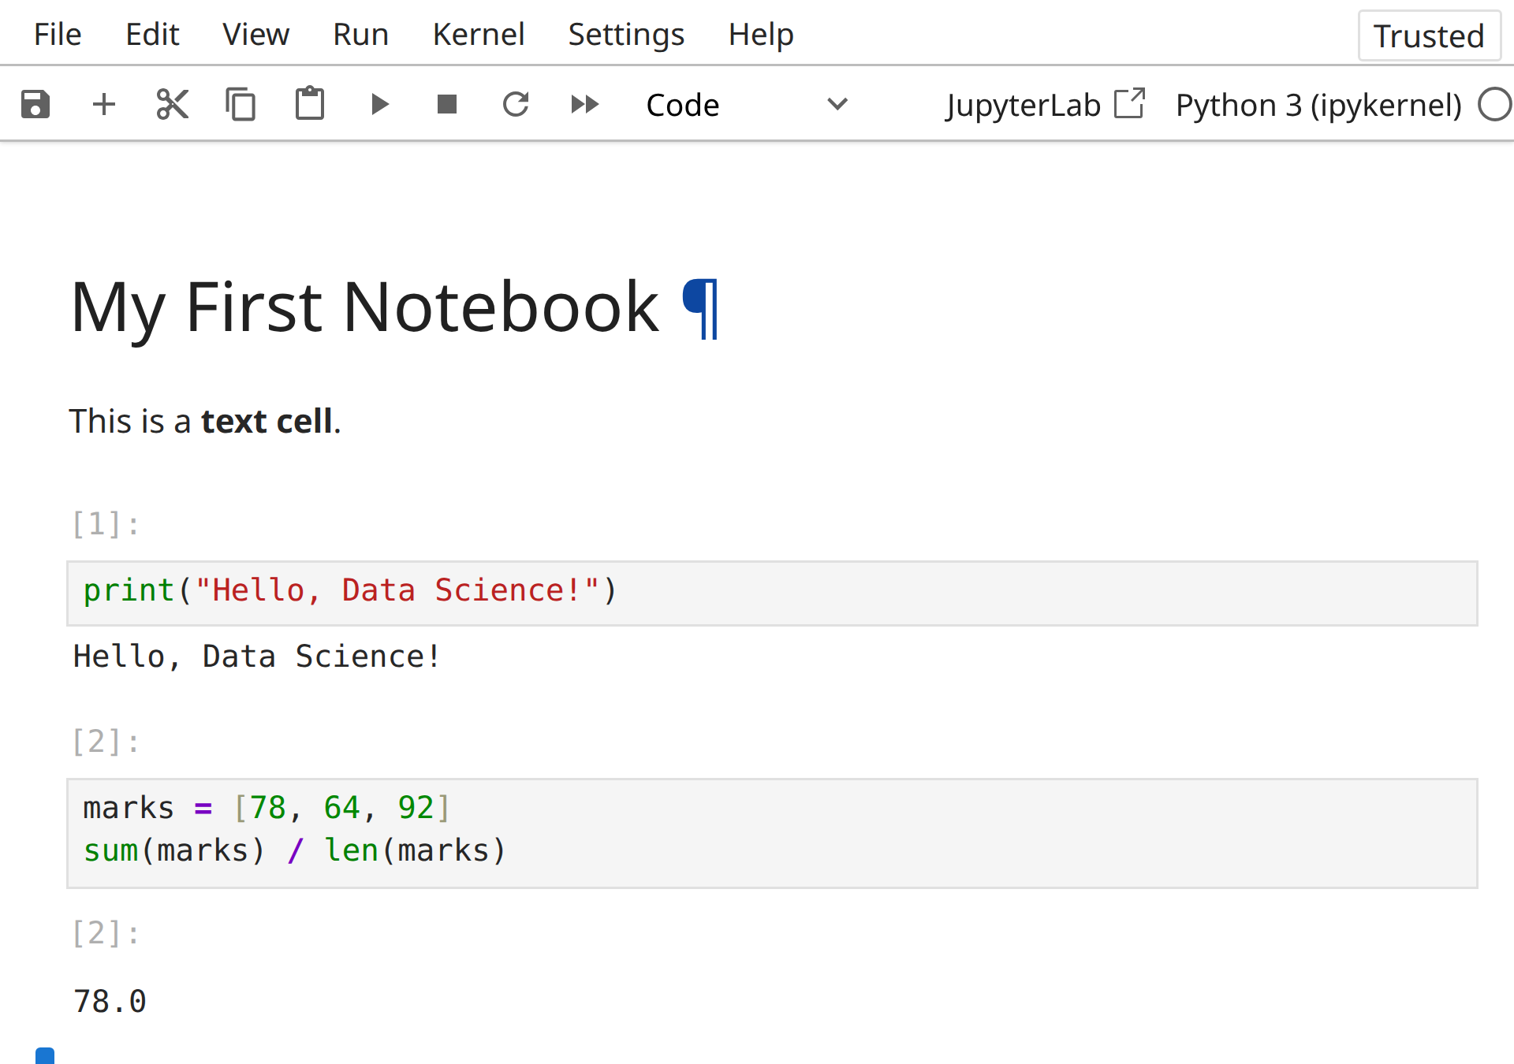
A Jupyter Notebook
1
Text cell
Notes for people
1
2
Code cell
2
You type Python
3
Result
Shown right below
3
Notes:
A notebook has text cells and code cells. Run a cell and the result appears right below it. This is a real screenshot from Jupyter Notebook.

Slide 15

Quick Recap
Data science turns data into decisions
Six steps, and the cycle repeats
Python: easy, free, many libraries
Pick one setup: Anaconda, Miniconda, plain Python or Colab
Write code in Jupyter or VS Code
Notes:
Five takeaways. Ask the class to say each one in their own words.

Slide 16

Next
Lab 1
Set up Python and run a first script
Then: Unit II, Python basics and operators
Notes:
Hand out Lab 1 from the Lab Sheets page. Unit II starts with variables, data types and operators.

