Slide 1
House price prediction by time series analysis
GROUP MEMBERS
MD OHIDUL ISLAM (250822)
MARVI HUSSIAN (250808)
NIRAJAN KARKI (246108)

Slide 2
WHY WE CHOSE THIS PROJECT?
Forecasting is an essential task in business
House price is an interesting topic for everyone in the society
Government, real estate developers and individuals
Range of house price is a great concern for both buyers and sellers
Prediction model can lessen bias problems with evaluators

Slide 3
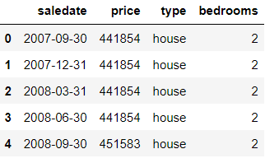
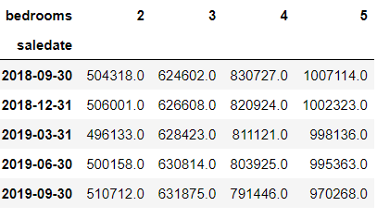
PROJECT BACKGROUND
Dataset taken from Kaggle
Contains sales data of house property from 2007-2019
Targeting number of bedrooms as mulit-variable
Converted number of bedrooms into each columns to fit into model

Slide 4
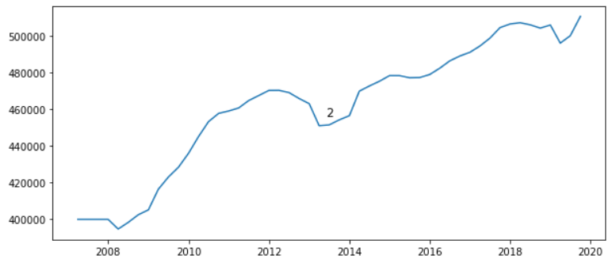
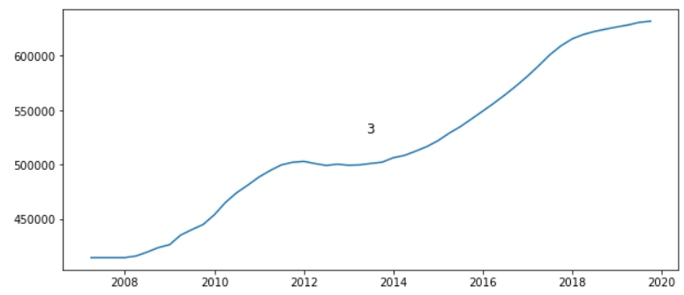
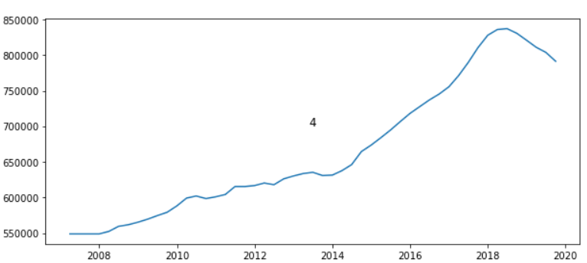
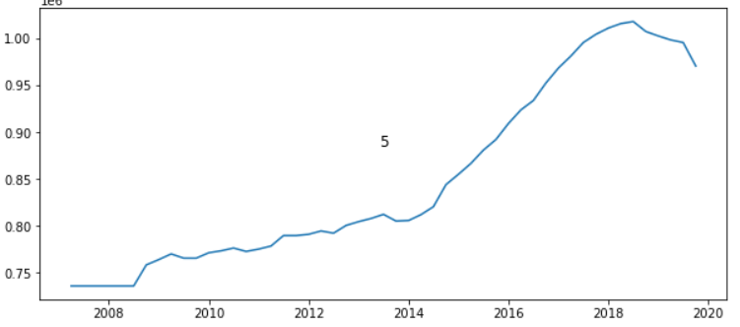
PLOTTING OF DATASET

Slide 5
PROBLEM STATEMENT & PROJECT OBJECTIVE
PROBLEM
Prediction of house price
OBJECTIVE
To make a standard time series model that can forecast house price.

Slide 6
ASSUMPTIONS
Assumption 1: Prediction depends only upon the past values of a variable
Univariate analysis
AutoARIMA model
Lags-4
Assumpiton 2: Each variable depends not only on its past values but also has some dependency on other variables.
Multivariate analysis
VAR model (Vector auto regression)
LSTM model (Long short-term memory)
Lags -4

Slide 7
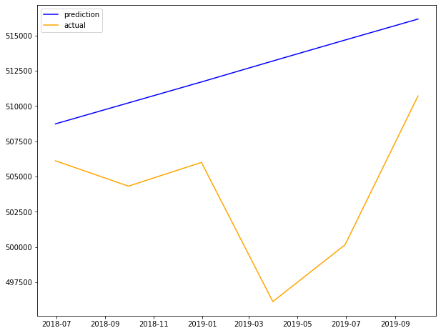
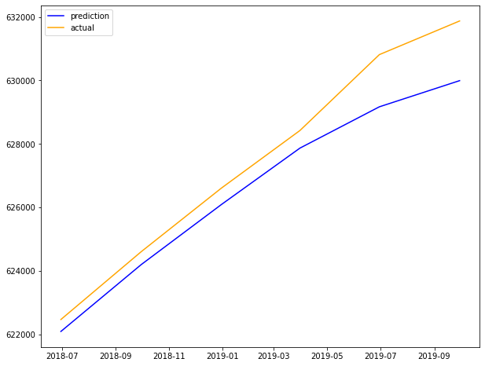
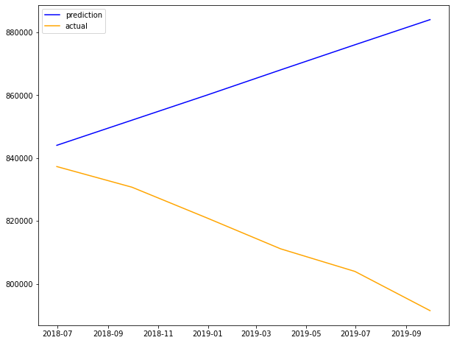
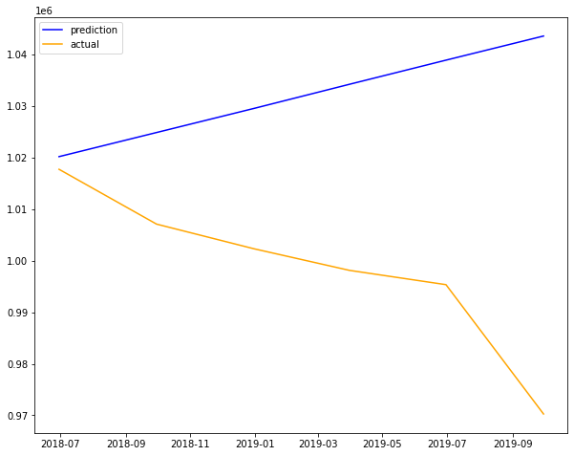
RESULTS OF AUTOARIMA MODEL
No. of bedrooms | MAPE | RMSE | Mean (Test data)
2 | 1.73 | 10048 | 503906
3 | 0.57 | 1089 | 627464
4 | 5.93 | 56343 | 815906
5 | 3.36 | 40098 | 998492

Slide 8
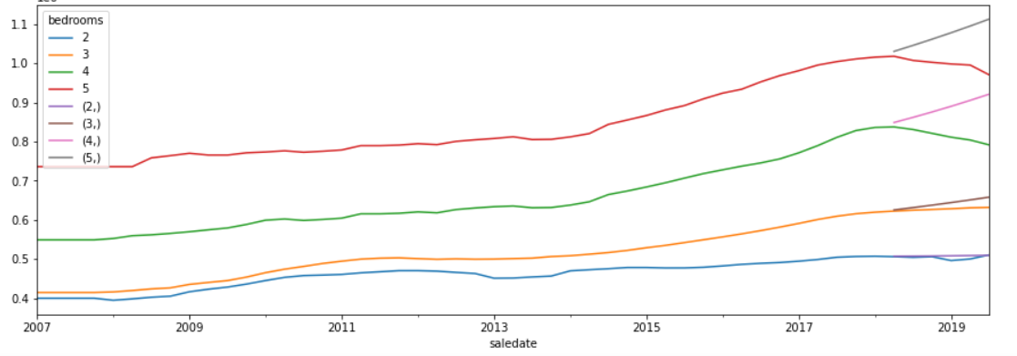
RESULT OF VAR MODEL
No. of bedrooms | MAPE | RMSE | Mean (test data)
2 | 1.02 | 6632 | 503906
3 | 2.35 | 15921 | 627464
4 | 8.34 | 78893 | 815906
5 | 7.22 | 83350 | 998492
No. of bedrooms | MAPE (VAR) | MAPE (LSTM) | RMSE (VAR) | RMSE (LSTM )
2 | 1.02 | 0.86 | 6632 | 6043
3 | 2.35 | 1.55 | 15921 | 10199
4 | 8.34 | 4.92 | 78893 | 46148
5 | 7.22 | 4.87 | 83350 | 52059

Slide 9
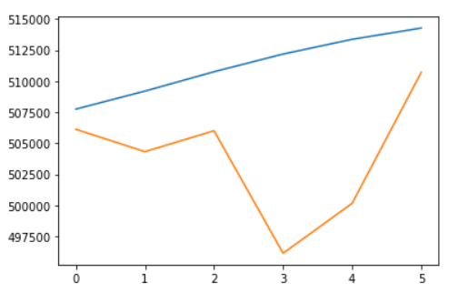
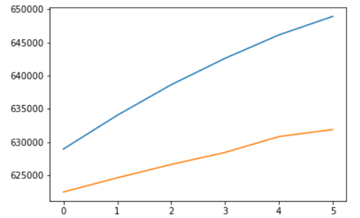
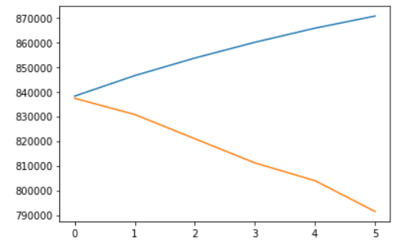
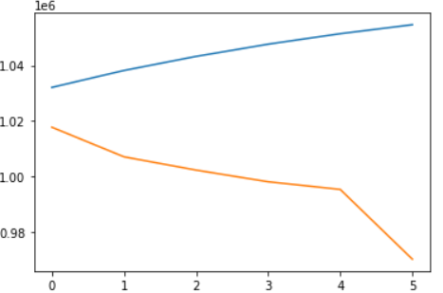
RESULT OF LSTM MODEL
No. of bedrooms | MAPE | RMSE | Mean (test data)
2 | 1.46 | 9070 | 503906
3 | 1.97 | 12916 | 627464
4 | 4.94 | 47932 | 815906
5 | 4.64 | 50914 | 998492

Slide 10
COMPARISION & DISCUSSION
VAR vs LSTM
No. of bedrooms | MAPE (VAR) | MAPE (LSTM) | RMSE (VAR) | RMSE (LSTM) | Mean (test data)
2 | 1.02 | 1.46 | 6632 | 9070 | 503906
3 | 2.35 | 1.97 | 15921 | 12916 | 627464
4 | 8.34 | 4.94 | 78893 | 47932 | 815906
5 | 7.22 | 4.64 | 83350 | 50914 | 998492
For 2-bedrooms house, VAR score is better than LSTM
But for 3,4,5-bedrooms, LSTM scores are better than VAR
So, overall LSTM outperforms VAR
No. of bedrooms | MAPE (AUTO ARIMA) | MAPE (VAR) | MAPE (LSTM) | RMSE (AUTO ARIMA) | RMSE (VAR) | RMSE (LSTM) | Mean (test data)
2 | 1.73 | 1.02 | 1.46 | 10048 | 6632 | 9070 | 503906
3 | 0.57 | 2.35 | 1.97 | 1089 | 15921 | 12916 | 627464
4 | 5.93 | 8.34 | 4.94 | 56343 | 78893 | 47932 | 815906
5 | 3.36 | 7.22 | 4.64 | 40098 | 83350 | 50914 | 998492
AUTOARIMA vs VAR vs LSTM
For 2-bedrooms house, VAR score is better than LSTM, AUTOARIMA
But for 3-bedrooms, AUTOARIMA scores are better than VAR,LSTM
overall AUTOARIMA and LSTM has nearly same score

Slide 11
CONCLUSION
Since both univariate and multivariate analysis models gave nearly same prediction result, we concluded that that there was negligible effect of one dependent variable to another variable in our dataset.
So, we concluded that our first assumption stating prediction of a house depends only upon its past price, was verified.
Therefore, we recommended univariate time series analysis using autoarima model for predicting house price with such type of datasets.

Slide 12
LIMITATIONS &FUTURE WORK
Our dataset lacks other important parameters which directly affects house price prediction, such as location, floor area, year built, last renovated,etc.
Prediction model using such realistic factors as multiple variables
Model deployment

Slide 13
REFERENCES
Wang, F., Zou, Y., Zhang, H., & Shi, H. (2019). House price prediction approach based on deep learning and ARIMA model. Paper presented at the 2019 IEEE 7th International Conference on Computer Science and Network Technology (ICCSNT).
Bontempi, G., Ben Taieb, S., & Borgne, Y.-A. L. (2012). Machine learning strategies for time series forecasting. Paper presented at the European business intelligence summer school.

Slide 14
QUESTIONS ?
THANK YOU !

