Slide 1

MCS Thesis Defence
Comparative Benchmarking of CatBoost, TabPFN and TabFM for Explainable Multi-Tier Hair Fall Risk Stratification
Krishna Gautam
Supervisor: Rabin Shrestha
Master of Computer Science (MCS)
Lincoln International College of Management & IT · Lincoln University College
Notes:
Good morning. My thesis compares three machine learning models for predicting hair fall risk in three levels, Low, Moderate and High, and explains their predictions with SHAP. One model is a tuned gradient-boosted tree, CatBoost; the other two, TabPFN and TabFM, are new tabular foundation models that need no training.

Slide 2
Outline
1
Background & problem
5
Results
2
Research questions & objectives
6
Explainability (SHAP)
3
Literature gap
7
Practical costs
4
Methodology & data
8
Conclusion & future work
Notes:
The talk follows the thesis chapters: problem, questions, related work, method, results, explanations, costs, and conclusions.

Slide 3




Why hair fall risk?
Many small factors add up — no single test predicts it
Nutrition
iron · protein · vitamin D · calcium
Today
Self-reported history, late clinical check
Subjective and hard to access
Data are tabular — ideal for machine learning
Stress & sleep
stress level · late sleep · disturbance
Health & heredity
liver enzyme ALT · anaemia · family history
Goal: an accurate and explainable risk tier — Low, Moderate or High
Lifestyle
chemical treatments · hard water
Notes:
Hair fall comes from many interacting factors: nutrition, stress and sleep, health and heredity, and lifestyle. Assessment today relies on self-report and late examination. These factors are recorded as tabular data, which is where machine learning works well.

Slide 4


Problem statement
Three gaps in existing work
Conflicting evidence
Foundation models untested
Black-box predictions
Ensembles best in one study, Random Forest beats CatBoost in another — no clear model choice.
TabPFN and TabFM predict without training, but were never tested on hair fall data.
Accurate models are hard to explain — clinicians cannot check the reason.
This study: a fair benchmark of CatBoost, TabPFN and TabFM on the same data — with SHAP for every model.
Notes:
First, earlier studies disagree on which model is best. Second, the new zero-shot tabular foundation models have not been tested on this problem. Third, accurate models are opaque, which limits their use in health.

Slide 5
Research questions → objectives
General objective: benchmark CatBoost, TabPFN and TabFM for explainable hair fall risk stratification
Question
Specific objective
Performance
Can zero-shot models match a tuned CatBoost?
Compare accuracy, macro-F1, ROC-AUC + McNemar test
1
Data efficiency
How does training size change results?
Retrain with 100, 500, 2,000 rows
2
Explainability
Which features drive predictions?
SHAP for all three models
3
Practicality
What do the models cost to run?
Runtime and implementation issues
4
Notes:
Four research questions, each with one specific objective: performance, data efficiency, explainability and practical cost.

Slide 6



What the literature says
32 sources reviewed
Tuned trees
Tabular foundation models
Gradient boosting (XGBoost, LightGBM, CatBoost) is still the strong baseline on tabular data.
TabPFN (2023, 2025) and TabFM (2026) predict in one forward pass — no tuning.
SHAP
Hair loss studies
Shapley values explain any model, so different models can be compared.
Classical models, conflicting results, few explanations.
Gap: no study compares two tabular foundation models with a tuned CatBoost on hair fall data, with SHAP for all.
Notes:
Tuned boosted trees are still the reference on tabular data. Tabular foundation models are the new alternative. SHAP lets us explain any model. Hair loss studies used classical models and disagree. The gap is a fair comparison with explanations.

Slide 7



Methodology
Quantitative, experimental benchmark — same data, split and metrics for every model
›
›
›
›
›
Data
Preprocess
Split
Models
Evaluate
Explain
21,606 records
20 features
drop IDs
encode gender
80 / 20 stratified
seed 42
CatBoost · TabPFN
· TabFM
metrics · McNemar
context sizes
SHAP
for all models
Tools: Python · scikit-learn · catboost · tabpfn · tabfm · shap · statsmodels | Kaggle & Google Colab, NVIDIA T4 GPU
Notes:
The data were split once into training and test sets. CatBoost was tuned; TabPFN and TabFM received the training rows as context. All models were evaluated on the same test set, compared with McNemar's test, retrained with smaller contexts, and explained with SHAP.

Slide 8
Dataset
Assembled from two public datasets (Kaggle, Mendeley) and adjusted with domain knowledge
21,606
Biomarkers
iron, protein, vitamin D, calcium, manganese, ALT, body water, stress score
records
20
Clinical & lifestyle flags
anaemia, chronic illness, stress, sleep, chemicals, hard water
predictors
3
Demographics
age, gender, family history
risk tiers
Notes:
21,606 records, 20 predictors, three tiers. The classes are unequal: 45% Low, 35% Moderate, 20% High, so macro-averaged metrics were used. Important: the dataset is constructed, not a clinical registry, so results are a benchmark of models, not a diagnostic tool.

Slide 9
Three models, two philosophies
Tuned training vs. zero-shot prediction
CatBoost
TabPFN
TabFM
Gradient-boosted trees
Pretrained transformer
Google, 2026 · row + column attention
Grid search: depth × learning rate
5-fold stratified CV
Best: depth 4, lr 0.1
17,284 training rows
No training, no tuning
Training rows given as context
One forward pass
17,284 context rows
No training, no tuning
Single ensemble member
Slow at large context
500 context rows
Notes:
CatBoost was tuned by grid search with cross-validation. TabPFN and TabFM were not tuned at all — that asymmetry is the point of the study. TabFM used 500 context rows because it became too slow with more.

Slide 10
Result 1 — performance is almost identical
Held-out test set: 4,322 records
CatBoost
TabPFN
TabFM
78.51%
78.57%
77.88%
Macro-F1 0.776 · AUC 0.919
Macro-F1 0.779 · AUC 0.923
Macro-F1 0.772 · AUC 0.918
McNemar test: no significant difference
p = 0.90 · 0.20 · 0.11 — TabPFN matched tuned CatBoost with zero tuning; TabFM used < 3% of the data.
Notes:
All three reach about 78% accuracy, far above the 45% of always predicting Low. McNemar's test found no significant difference for any pair. Careful wording: no difference was detected — that is not proof of equivalence.

Slide 11
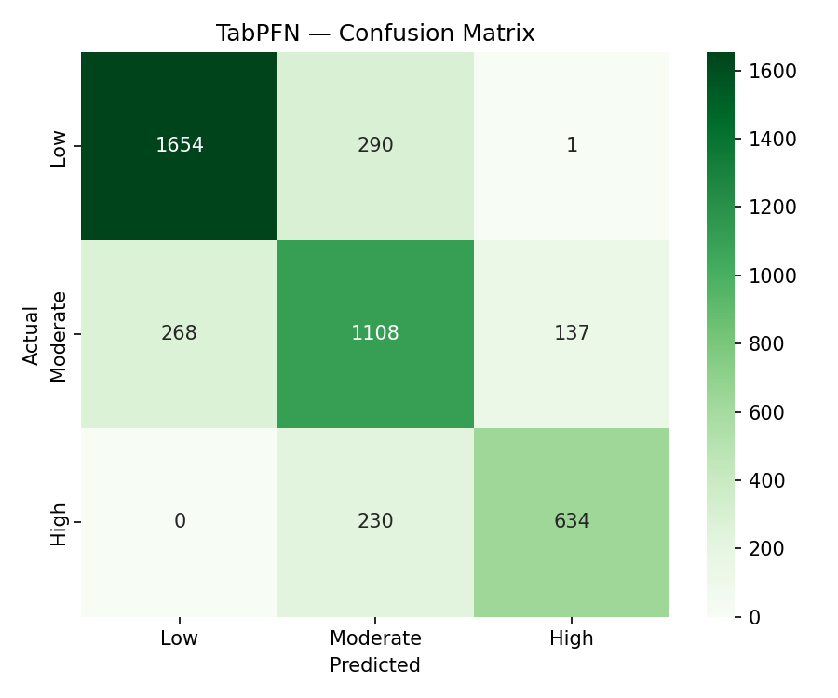


Where the models make mistakes
Errors stay between neighbouring tiers
Low ↔ High almost never
only 1–3 of ~930 errors
Moderate is hardest
F1 = 0.71 for every model
High often under-rated
27–31% of High predicted as Moderate
Ordinal agreement
Quadratic weighted kappa ≈ 0.81
TabPFN confusion matrix (others look the same)
Notes:
Almost every error is to a neighbouring tier. Moderate is hardest because it borders both others. High-risk records are often under-rated as Moderate, so a Moderate prediction should not exclude high risk.

Slide 12
Result 2 — foundation models need far less data
Accuracy (%) when models get only part of the training data
+11 to +14
points over CatBoost with only 100 rows
≥ 5× less data
to pass 70% accuracy; the gap closes at full data
* 2,000-row run tested on a 500-record subset. TabFM not run at full size.
Notes:
With 100 rows CatBoost reaches 61%, TabPFN 72% and TabFM 74%. The gap narrows as data grows and closes at full size. So the benefit of foundation models is greatest when labelled data is scarce. TabFM versus TabPFN ordering is not reliable.

Slide 13
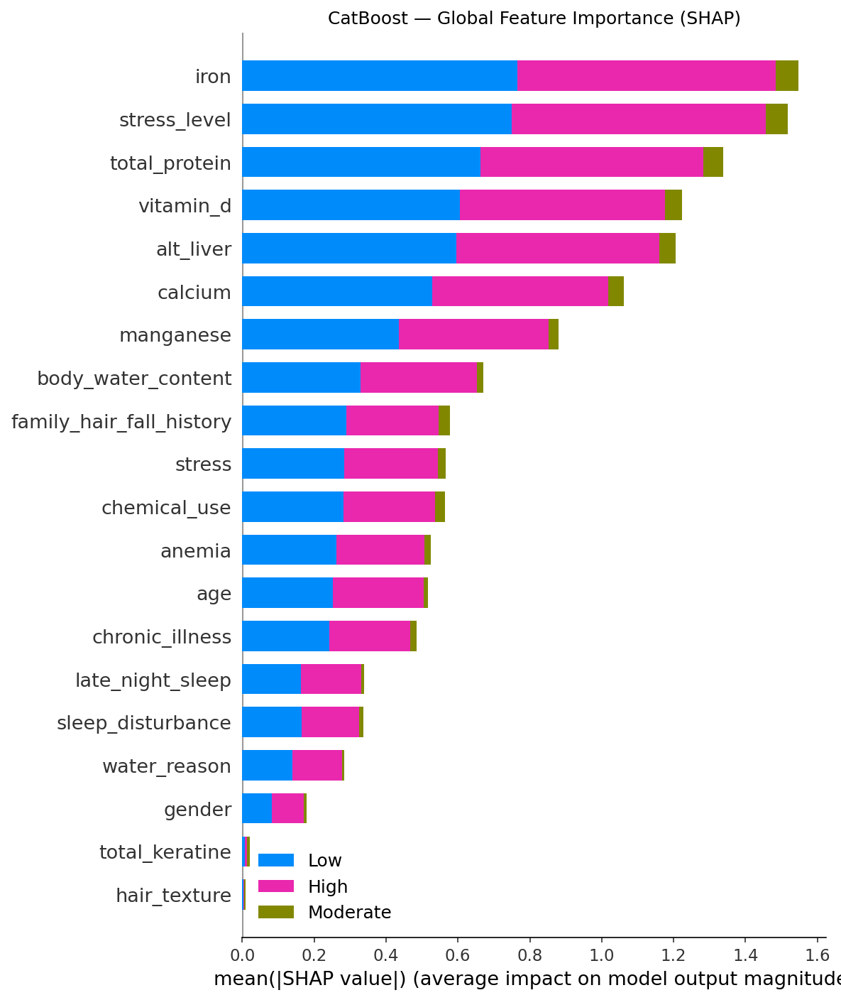
Result 3 — the same features drive every model
SHAP explanations agree across all three models
Top 7 in all three models
▲ Raise risk
Iron
high stress level, high ALT, every risk flag
Stress level
Total protein
Vitamin D
▼ Lower risk
ALT (liver)
high iron, protein, vitamin D, calcium, manganese
Calcium
Manganese
CatBoost global SHAP importance
Notes:
The same seven biomarkers lead in all models, and they are the ones most correlated with risk in the data. Directions agree too. Because the dataset was constructed, this shows the models recovered the built-in relationships — not a new clinical discovery. The foundation-model SHAP used only 20–30 records.

Slide 14

Result 4 — no tuning ≠ cheap to run
TabFM prediction time grows steeply with context size
Software problems solved
0.11 s
1.8 s
did not finish
SHAP Permutation → numba error; used KernelExplainer
per record
per record
500-row context
2,000-row context
17,284-row context
TabFM crashed on 1-row input; padded to 2 rows
4× more context → ~16× slower per record
TabPFN checkpoint load; patched torch.load
Choice depends on data size and number of predictions: CatBoost is cheap to run once trained; foundation models need no training but pay at every prediction.
Notes:
Zero tuning does not mean cheap. TabFM became about sixteen times slower per record when the context grew four times, and the full-context run did not finish. Three software problems needed workarounds, which I document for other users of these new packages.

Slide 15
Conclusion
RQ1 · Performance
RQ2 · Data efficiency
No significant difference: tuned CatBoost ≈ zero-shot TabPFN ≈ TabFM (~78%).
Foundation models far better with little data; gap closes at full size.
RQ3 · Explainability
RQ4 · Practicality
Same 7 biomarkers and directions in all models — SHAP works for all.
TabFM is slow at large context; new tools need testing before use.
When labelled data is scarce, start with a tabular foundation model — and always explain the predictions.
Notes:
Each research question is answered. The main message: foundation models match a tuned baseline without tuning and are much better with little data, and all three models can be explained.

Slide 16

Limitations & future work
Limitations
Future work
Constructed dataset — not clinical validation
TabFM used 500 rows, not full data
SHAP for foundation models on 20–30 records
One split, one seed; early stopping used test set
Validate on real clinical data
Full-context TabFM, several seeds and splits
Larger SHAP samples
Ordinal models for the Moderate tier
Ensembles and lightweight distilled models
Notes:
The main limitation is the constructed dataset, so this is a benchmark, not a clinical tool. Future work: real clinical data, full-context TabFM, repeated splits, larger SHAP samples and ordinal models.

Slide 17
Thank you
Questions & discussion
Krishna Gautam · Supervisor: Rabin Shrestha
Notes:
Thank you. I am happy to answer questions.

