Slide 1

Tribhuvan University, Institute of Science and Technology
Comparing CatBoost, TabPFN, and TabFM for Explainable Hair Fall Risk Prediction
Dissertation Proposal
Submitted by: Nirajan Shahi (Roll no. 49/079)
Supervised by: Asst. Prof. Jagadish Bhatta
Central Department of Computer Science and Information Technology, Kirtipur, Kathmandu
Notes:
Introduce the topic: we compare three models for predicting hair fall risk and explain each prediction.

Slide 2
Project at a glance
Problem | Hair fall risk is hard to judge, and most prediction models cannot explain their answers.
Objectives | 1. Benchmark CatBoost, TabPFN, and TabFM. 2. Explain every model with SHAP.
Research gap | Foundation models were never tested on hair fall data; CatBoost was never tuned; no side-by-side explanations.
Data | 21,606 records, 20 features (blood and body measurements, lifestyle, clinical), 3 risk tiers: Low, Moderate, High.
Method | Same split for all models; CatBoost tuned, TabPFN and TabFM without tuning; SHAP; accuracy, macro-F1, ROC-AUC, McNemar's test.
Expected outcome | A fair comparison, a strong tuned baseline, TabFM limits recorded, and explanations checked against known biology.
Time | 4 months: proposal work (Months 1 and 2) and final work (Months 3 and 4).
Comparing CatBoost, TabPFN, and TabFM for Explainable Hair Fall Risk Prediction
2 / 14
Notes:
One-slide summary. Problem, aim, data, method, expected result and time. Each point is explained on the next slides.

Slide 3
Problem statement
• Hair loss risk is hard to judge: hormones, nutrition, stress, illness, and habits act together.
• Assessment often relies on self-reporting or late clinical checks, which are subjective and hard to reach in rural areas.
• Earlier prediction studies used classical algorithms and report very different accuracies (about 50% to 100%).
• Newer tabular foundation models (TabPFN, TabFM) have not been tested on hair fall data.
• Both gradient boosting and foundation models are hard to explain.
Comparing CatBoost, TabPFN, and TabFM for Explainable Hair Fall Risk Prediction
3 / 14
Notes:
Hair loss has many causes that act together, so one test cannot predict it. Doctors rely on history and self-reports. ML can help but is a black box, which is a problem in health care.

Slide 4
Objectives
1. To implement and benchmark CatBoost, TabPFN, and TabFM for predicting multi-tier hair fall risk from structured clinical and lifestyle data.
2. To provide transparent, feature-level decision-support insights for every model through SHAP-based explainability, so that each predicted risk tier can be traced to specific indicators.
Comparing CatBoost, TabPFN, and TabFM for Explainable Hair Fall Risk Prediction
4 / 14
Notes:
Two objectives: compare the three models, and explain them. Everything in the project serves one of these two.

Slide 5
Background: what causes hair loss
Factor | What it does | Source
Hormones and heredity | Inherited sensitivity to androgens; family history is a key indicator | Agaoglu et al. (2021)
Nutrition and iron | Shortage of iron, zinc, and vitamins weakens follicles | Guo & Katta (2017); Lin et al. (2023)
Thyroid function | Thyroid hormones regulate the hair cycle | Hussein et al. (2023)
Psychological stress | Pushes follicles into the resting phase early | Bai et al. (2026)
Illness and infection | Can trigger heavy shedding (telogen effluvium) | Cline et al. (2021)
Trend: hair loss is reported more often and at a younger age, and it affects self-confidence and quality of life.
Comparing CatBoost, TabPFN, and TabFM for Explainable Hair Fall Risk Prediction
5 / 14
Notes:
Hair grows in cycles. Anything that pushes follicles out of the growth phase early causes shedding. These factors overlap, which is why a model that combines many indicators is useful.

Slide 6
Literature: what others did
Study | Data | Models | Main result
Khatun et al. (2022) | Survey, 610 people | SVM, KNN, LR, RF, XGBoost | XGBoost 92.62%
Sai et al. (2023) | Hair fall data | SVM, KNN, DT, RF, LR, ensemble | Ensemble best
Kumar et al. (2025) | 2,000 records | RF, XGBoost, CatBoost, LightGBM | RF 100%, CatBoost 49.5%
Siami & Azis (2025) | Multi-factor data | LR, DT, RF, GB, XGBoost, voting | About 50% at best
Leema et al. (2025) | Survey, 750 people | LSTM, RF, TFT, ARIMAX | TFT 97.5%
Shakeel et al. (2021); Sayyad et al. (2022) | Hair images | SVM, KNN, VGG with SVM | 91.4% and 98.31%
LR = Logistic Regression, DT = Decision Tree, RF = Random Forest, GB = Gradient Boosting
Comparing CatBoost, TabPFN, and TabFM for Explainable Hair Fall Risk Prediction
6 / 14
Notes:
These are the closest studies. Most use classical models on survey data, or images. Results differ a lot between studies, and explanations were not compared.

Slide 7
Literature: the three model families
• CatBoost (Prokhorenkova et al., 2018): gradient boosted trees with ordered encoding of categorical answers.
• TabPFN (Hollmann et al., 2025): transformer pretrained on synthetic tables; predicts in one forward pass; best on small tables.
• TabFM (Kong et al., 2026): 400-million-parameter foundation model; first among default foundation models on 51 TabArena datasets.
• An independent check of TabFM reported software defects and memory limits on larger tables (Pandey, 2026).
• SHAP (Lundberg & Lee, 2017): explains any model by the contribution of each feature.
Comparing CatBoost, TabPFN, and TabFM for Explainable Hair Fall Risk Prediction
7 / 14
Notes:
CatBoost is a strong boosted-tree model for categorical data. TabPFN and TabFM are new foundation models: pretrained once, then they predict in one pass without training.

Slide 8
Research gap
• Hair loss prediction studies used only classical algorithms, and accuracies differ widely.
• CatBoost was compared only once, and it was not tuned.
• TabPFN and TabFM have not been tested on hair loss data.
• TabFM has only one independent check, which reported defects and memory limits.
• No study explains a boosted-tree model and foundation models side by side.
Comparing CatBoost, TabPFN, and TabFM for Explainable Hair Fall Risk Prediction
8 / 14
Notes:
This is what we found missing in the literature. It is why the project compares these three models and explains them.

Slide 9
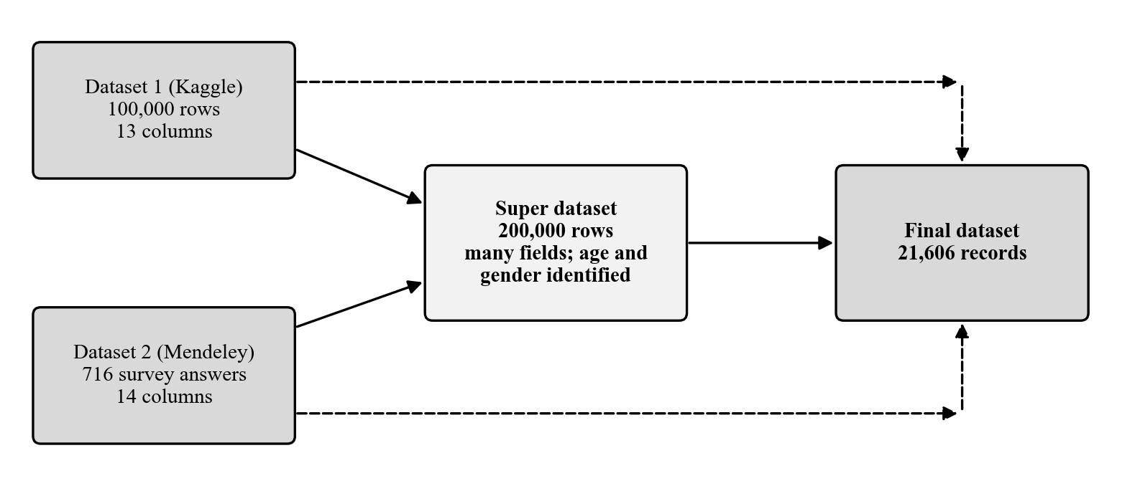
Data
• Dataset 1 (Kaggle): 100,000 records, 13 columns of measurements and hair fall (0 to 5).
• Dataset 2 (Mendeley): survey of 716 people, 14 columns.
• Super dataset: 200,000 records with all fields of both and extra fields.
• Final dataset: 21,606 records, 20 features, target Low 45%, Moderate 35%, High 20%.
Comparing CatBoost, TabPFN, and TabFM for Explainable Hair Fall Risk Prediction
9 / 14
Notes:
Two public datasets are the sources. A super dataset of 200,000 records holds all their fields plus extra fields. Age and gender are identified in it. Comparing it with the two datasets gives the final dataset of 21,606 records used for modelling.

Slide 10
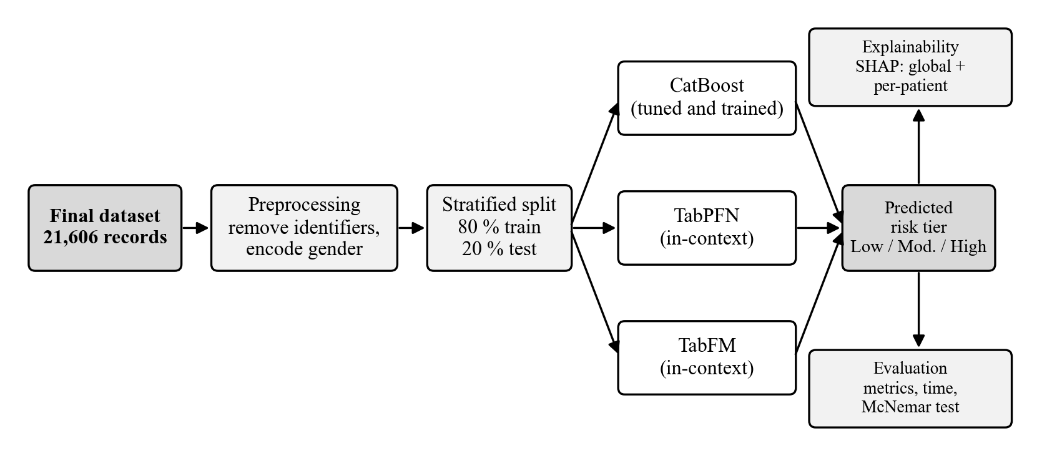
Research framework
Same split and seed for all models. Training sizes: 500, 2,000, and all 17,284 records.
Comparing CatBoost, TabPFN, and TabFM for Explainable Hair Fall Risk Prediction
10 / 14
Notes:
One pipeline: clean and split the data once, give the same rows to the three models, evaluate them the same way, and explain each with SHAP. The 500 and 2,000 record sets show behaviour with little data.

Slide 11
Models
Model | How it works | Training and tuning
CatBoost | Many small symmetric decision trees, each correcting the previous ones | Trained and tuned: grid search with 5-fold cross-validation
TabPFN | Transformer reads training rows and the patient, predicts in one pass | None; weights are fixed
TabFM | Transformer with column and row attention, about 400 million parameters | None; weights are fixed
TabPFN and TabFM will run on a Kaggle GPU; CatBoost and the statistics on a Mac.
Comparing CatBoost, TabPFN, and TabFM for Explainable Hair Fall Risk Prediction
11 / 14
Notes:
Three different ways to predict. CatBoost needs training and tuning. TabPFN and TabFM only read the training rows as context and predict, so they need no tuning.

Slide 12
Explainability and evaluation
SHAP for all three models:
TreeExplainer for CatBoost
KernelExplainer for TabPFN and TabFM
Global ranking and per-patient explanations
Evaluation on the same test set:
Accuracy, macro-precision, macro-recall, macro-F1
ROC-AUC (one-versus-rest)
Confusion matrix
McNemar's test and Wilson 95% intervals
Comparing CatBoost, TabPFN, and TabFM for Explainable Hair Fall Risk Prediction
12 / 14
Notes:
SHAP shows which features push each prediction up or down. Metrics are macro averages because the tiers are not equal in size. McNemar's test tells us if differences are real.

Slide 13
Expected outcomes
• A fair comparison of three model families on the same hair fall data.
• A properly tuned CatBoost as a strong baseline.
• TabPFN and TabFM competitive without tuning, especially with small training sets (to be tested).
• The practical limits of TabFM recorded on a real health dataset.
• SHAP explanations that agree with known causes: iron, stress, family history.
Comparing CatBoost, TabPFN, and TabFM for Explainable Hair Fall Risk Prediction
13 / 14
Notes:
These are expectations to test, not results. The study can also show the opposite, and a difference counts only if McNemar's test supports it.

Slide 14
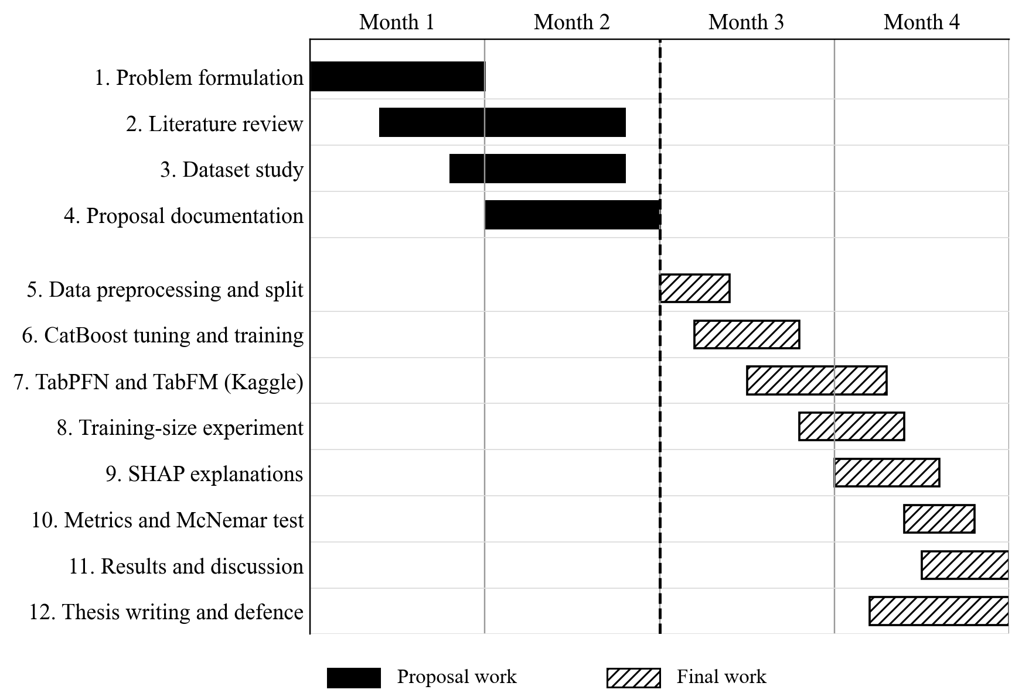
Schedule: 4 months
Comparing CatBoost, TabPFN, and TabFM for Explainable Hair Fall Risk Prediction
14 / 14
Notes:
Months 1 and 2 are the proposal work. Months 3 and 4 are the final work after approval, in the order of the methodology. Thank you; questions are welcome.

