Slide 1
A project on HOSPITAL MANAGEMENT
Prepared By:
Nirajan Shrestha
ACE077BCT051
PUJAN SHRESTHA
ACE077BCT061

Slide 2
In this project, we used different programming language like
Java Script
CSS
HTML
Basically, we used javascript for the coding section.
And for the designing portion HTML and CSS was used.
As mentioned earlier, we need to use any portion of data structure and algorithms(DSA) in this project.
So as per the mention, here we used
Linked List

Slide 3
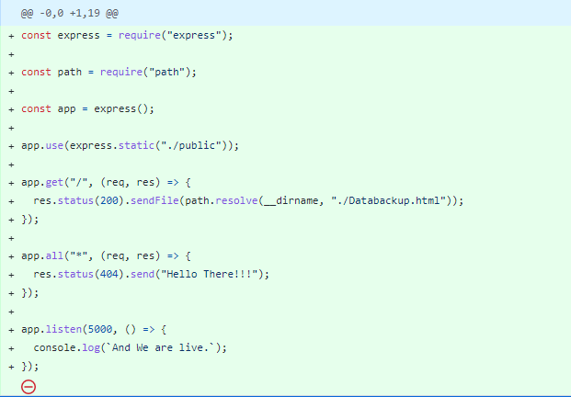
Using Javascript:

Slide 4
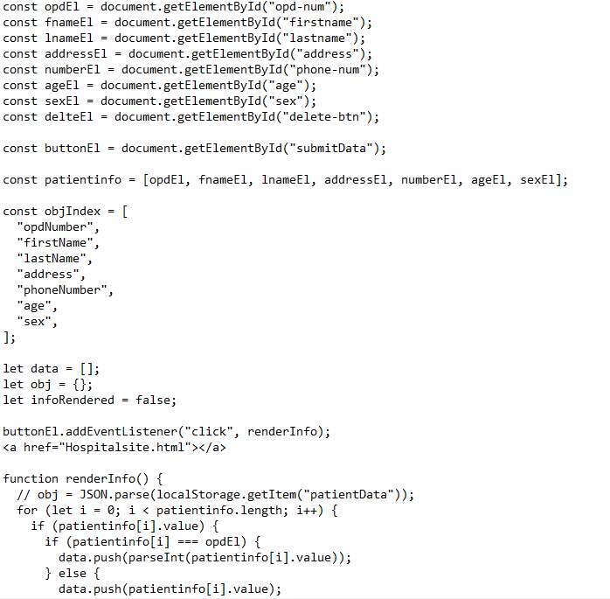

Slide 5
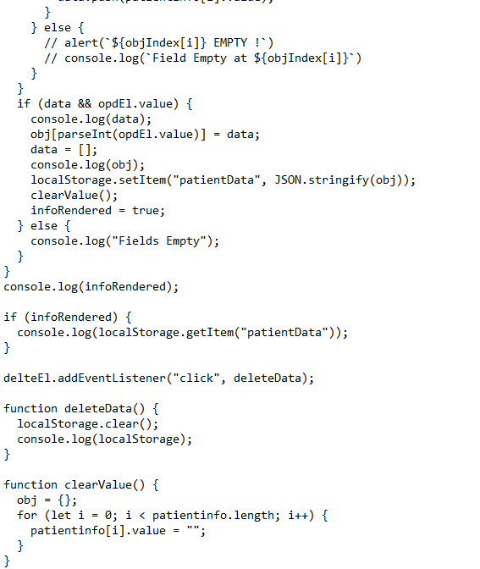

Slide 6
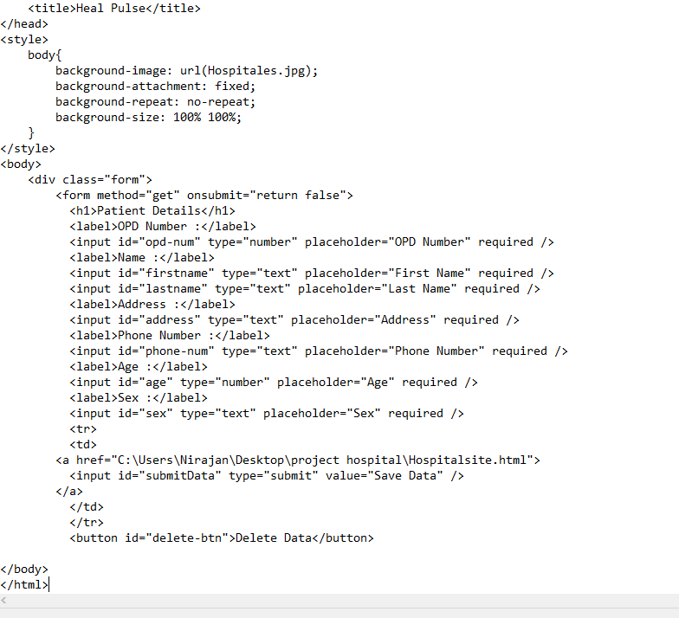
Using html :

Slide 7
LINKED LIST
A linked list is a data structure used for storing and organizing a sequence of elements, where each element is represented by a node that contains both a value and a pointer to the next node in the sequence. In other words, a linked list is a collection of nodes that are linked together by pointers.
The first node in a linked list is called the head node, and the last node is called the tail node. The tail node points to a null value, indicating the end of the list.
Advantages of Linked Lists:
Dynamic Size: Linked lists can grow or shrink during runtime, which means that they can be resized easily without having to allocate or deallocate memory in large blocks.
Easy Insertion and Deletion: Adding or removing elements in a linked list is relatively easy compared to other data structures like arrays.
Efficient Memory Usage: Linked lists use memory more efficiently than arrays because they only allocate memory as needed.
Flexibility: Linked lists can be used in a variety of ways, such as implementing stacks, queues, and graphs, and for dynamic memory allocation.

Slide 8
Disadvantages of Linked Lists: Slower Access: Accessing a specific element in a linked list can be slower than in an array because elements in a linked list are not stored in contiguous memory locations. Extra Memory: Linked lists require extra memory to store the pointers that link the nodes together. Reverse Traversal is Difficult: Traversing a linked list in reverse order can be difficult with a singly-linked list, as you need to traverse the list from the beginning to reach the desired node. Here is the demo of our project where linked list is used.

Slide 9

THANK YOU!!!

