Slide 1
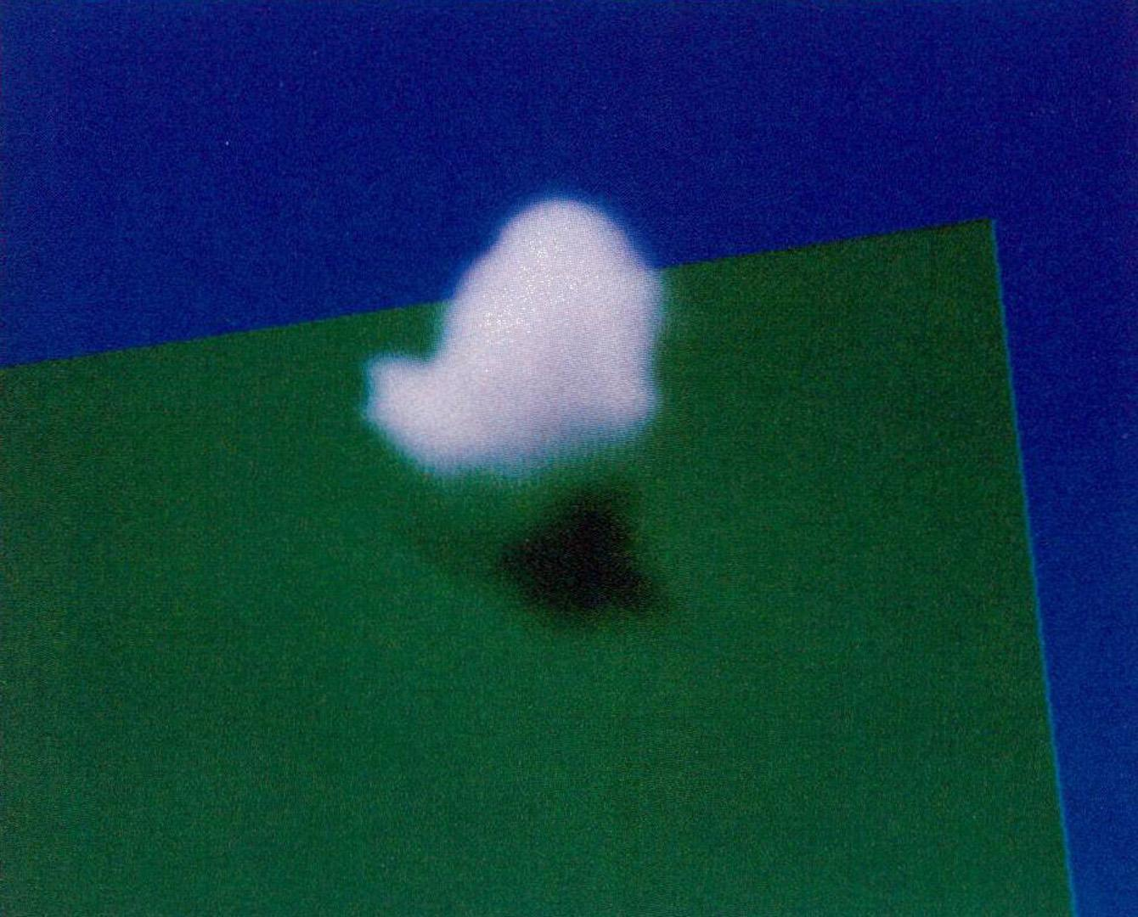
Kajiya & von Herzen Volume Rendering
1984

Slide 2
A Step Forward in Volumetric Rendering
Being interested in the rendering of fog in games, I decided to explore technical papers that advanced volumetric effects in computer graphics. Prior to the work of Kajiya and von Herzen, fog and atmospheric effects were often approximated using simple depth-based models that did not physically account for how light interacts with space. Their paper introduced volume rendering by treating non-surface media such as fog and clouds as participating media, allowing light to be absorbed, emitted, and scattered throughout a volume rather than only interacting with surfaces. While earlier researchers had explored aspects of volumetric effects, this work significantly improved upon prior models by enabling self-shadowing within clouds and more realistic light transport. Compared to earlier approaches such as the Blinn scattering model, their method better handled complex volumetric phenomena and could be extended to effects like fire and cloud formations. The images produced were computationally expensive for the time, often requiring hours of CPU rendering, highlighting both the novelty and cost of the technique, this specific image took 2 hours to render.

Slide 3
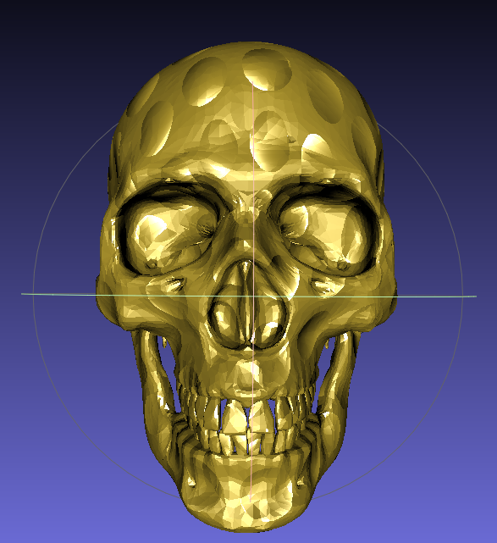
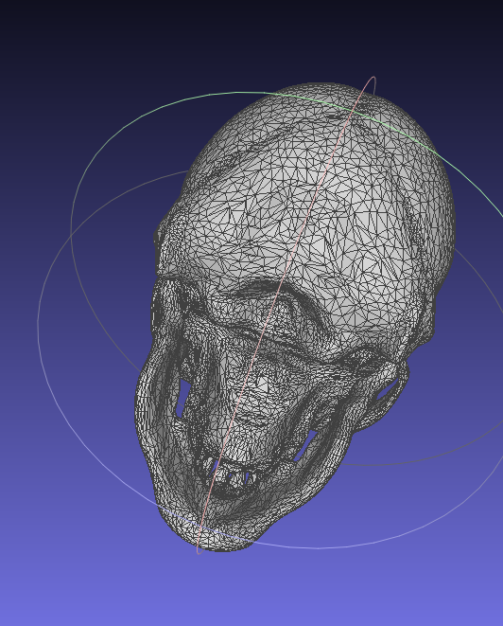
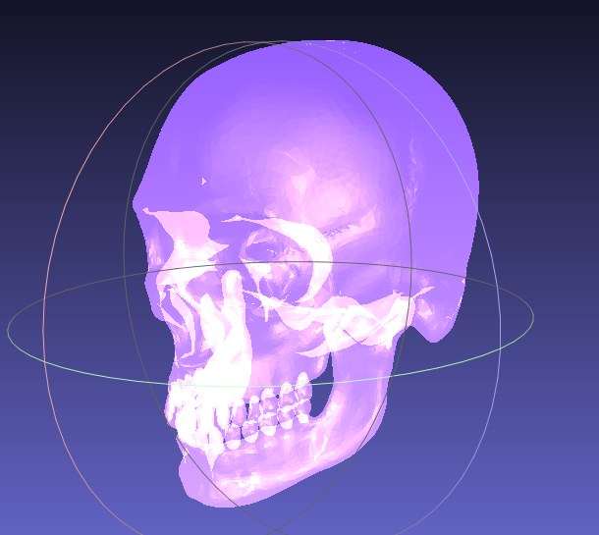
Skull Mesh in Meshlab

