Slide 1
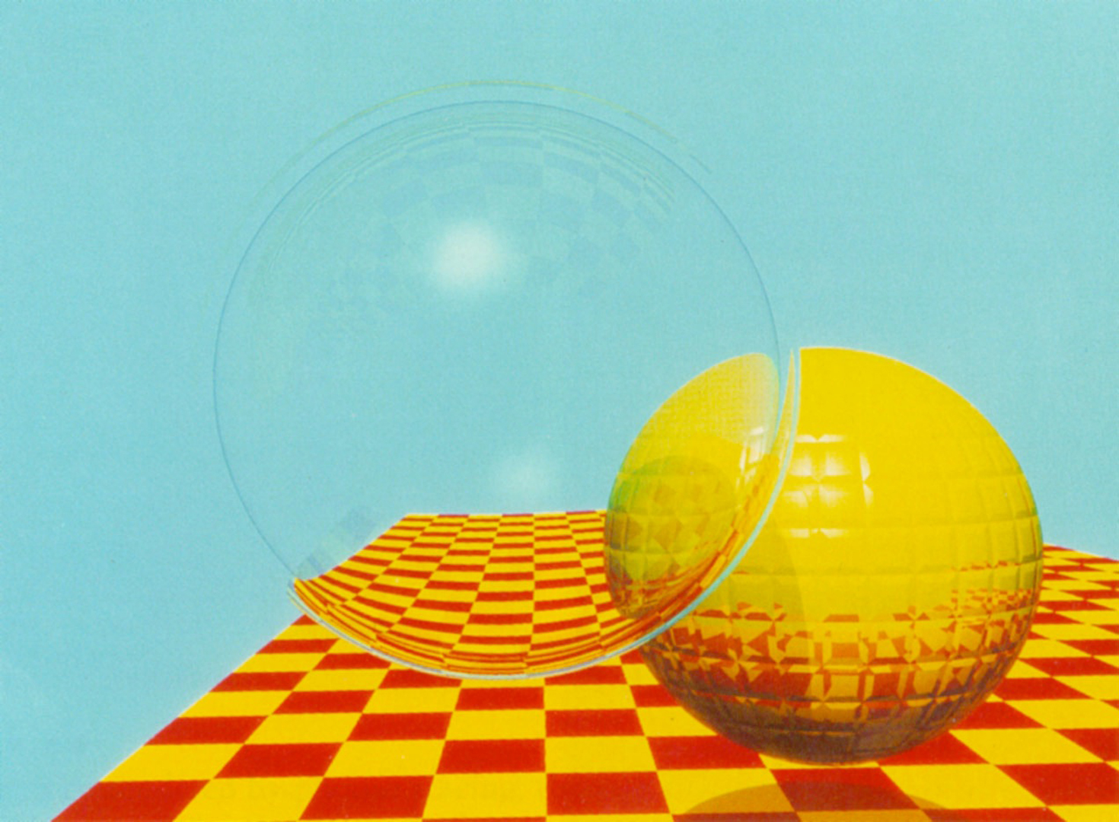
Representative image
"The Whitted Spheres" (often titled Inter-reflecting Spheres), created by Turner Whitted for his seminal 1980 paper, "An Improved Illumination Model for Shaded Display."
This image is widely considered a milestone in computer graphics because it was the first to demonstrate the power of recursive ray tracing. The image depicts two spheres floating above a red and yellow checkerboard grid: one sphere is a perfect mirror, reflecting the other sphere and the floor, while the second sphere is transparent (glass), distorting the background through refraction. Before this image, rendering techniques like Phong shading could only calculate local illumination—how light hits a single surface directly. Whitted’s groundbreaking algorithm traced light rays backwards from the viewer's eye into the scene, allowing them to bounce off surfaces to simulate global effects like true reflection, refraction (transparency), and accurate shadows. This technique shifted the paradigm of rendering from simply coloring polygons to simulating the physics of light transport, laying the foundation for the photorealistic graphics seen in modern movies and video games today.

Slide 2
