Slide 1
Assignment 0
Ray Tracing in One Semester
Vikrant Deo

Slide 2
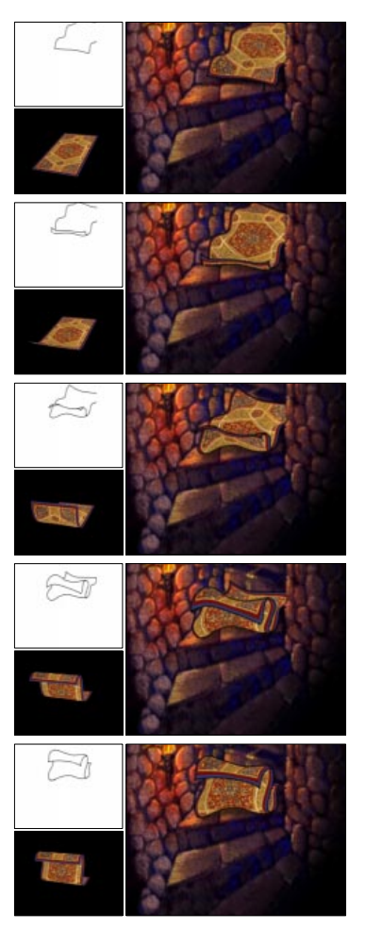
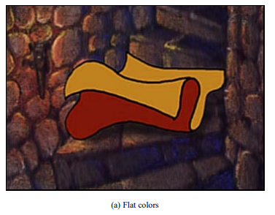
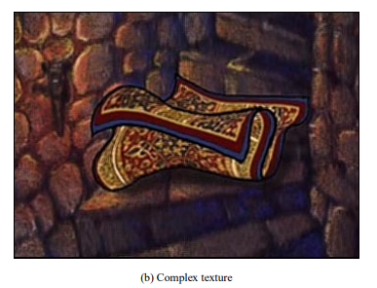
History of Rendering Image
Texture Mapping for Cel Animation (SIGGRAPH 1998):
Corrêa, Jensen, Thayer, Finkelstein
https://dl.acm.org/doi/10.1145/280814.280949
Description
I chose this image because it represents an important moment where computer graphics techniques were used to enhance traditional hand-drawn animation rather than replace it. Before this work, animated characters were typically colored with flat shades because applying detailed textures frame-by-frame caused visual instability, often called “boiling” or “swimming.” This paper introduced a hybrid 2D/3D approach that uses a simple 3D model underneath hand-drawn artwork to keep textures stable while preserving the expressive quality of traditional cel animation. The technique was groundbreaking because it allowed complex textures to move consistently, respect depth and occlusion, and integrate seamlessly with hand-drawn characters, influencing later work in non-photorealistic rendering and hybrid animation pipelines.

Slide 3
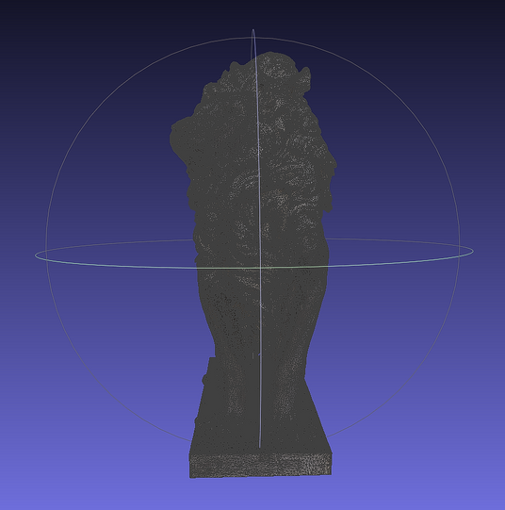
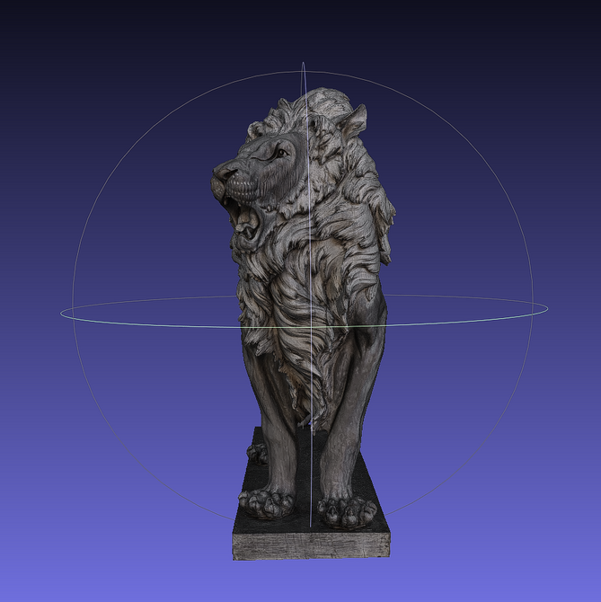
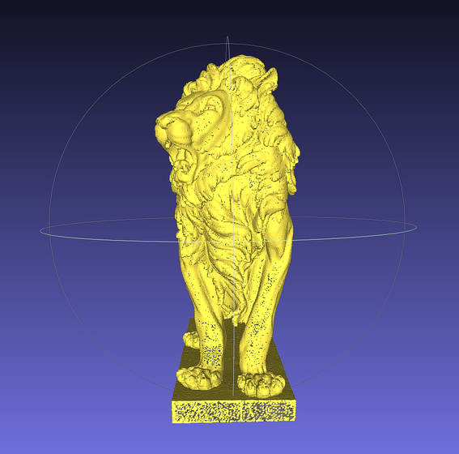
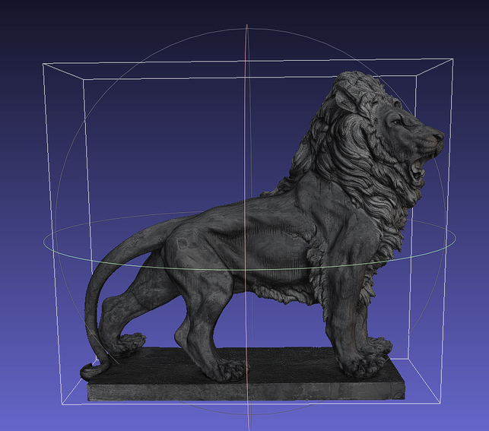
Mesh Visualization: Roaring Lion Sculpture (METAStadt, Vienna)
For the mesh visualization portion of this assignment, I used a 3D model of a roaring lion sculpture located at the METAStadt site, a former industrial complex in Vienna’s 22nd district that is now used for concerts, events, and flea markets. The sculpture is part of the collection provided by Antik-Möbel-Hesz. Using MeshLab, I examined the lion mesh from multiple viewpoints to better understand its geometric structure, surface detail, and overall form. Rotating the mesh highlights how complex shapes, such as facial features and the mane, are represented using polygonal geometry. This exercise helped illustrate how real-world objects can be captured as digital meshes and how viewing angle and lighting influence the perception of 3D models in rendering workflows.
Wireframe view:
The wireframe visualization reveals the underlying polygonal structure of the lion mesh, showing how its complex form is constructed from interconnected triangles.
Front (face) view:
The front view focuses on the facial geometry, demonstrating how expressive features like the open mouth and contours are captured through polygonal detail.
Points view:
The points view displays the individual vertices of the mesh, illustrating the density and distribution of sampled geometry across detailed regions such as the face and mane.
Side view:
The side view highlights the overall silhouette and proportions of the lion, emphasizing how depth and volume are represented in the mesh.

Slide 4
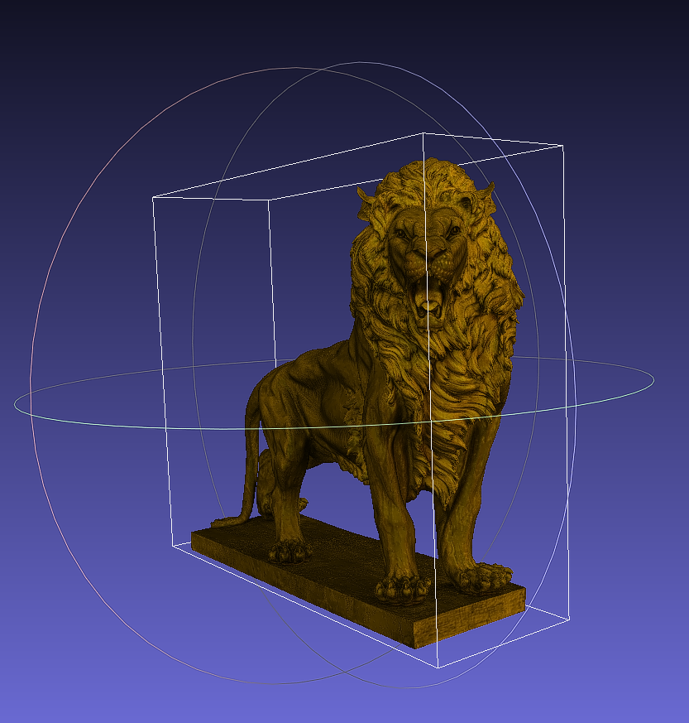
Custom color:
A custom color was applied to the mesh to improve visual contrast and make the geometry easier to distinguish during visualization.

