Slide 1
SELENIUM WEBDRIVER

Slide 2
Why automate testing?
Test automation has specific advantages for improving the long-term efficiency of a software team’s testing processes. Test automation supports:
0 Frequent regression testing
0 Rapid feedback to developers
0 Virtually unlimited iterations of test case execution
0 Support for Agile and extreme development methodologies
0 Disciplined documentation of test cases
0 Customized defect reporting
0 Finding defects missed by manual testing

Slide 3
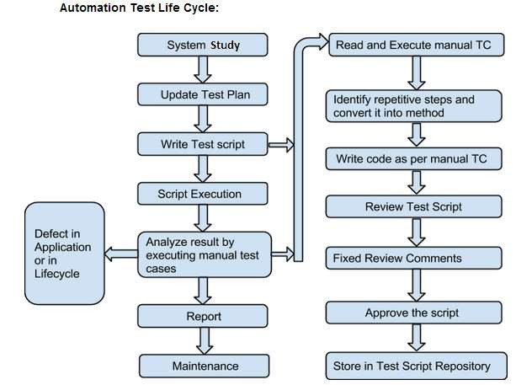
Automation Test Life Cycle

Slide 4
Selenium History
0 2004 - at ThoughtWorks in Chicago, Jason Huggins built the Core mode as "JavaScriptTestRunner" for the testing of an internal Time and Expenses application (Python, Plone).
0 2006 - at Google, Simon Stewart started work on a project he called WebDriver. Google had long been a heavy user of Selenium, but testers had to work around the limitations of the product. The WebDriver project began with the aim to
solve the Selenium’ pain-points.
0 2008 - merging of Selenium and WebDriver. Selenium had massive community and commercial support, but WebDriver was clearly the tool of the future. The joining of the two tools provided a common set of features for all users and brought some of the brightest minds in test automation under one roof.
0 Shinya Kasatani in Japan became interested in Selenium, he
0 Wrapped the core code into an IDE module into the Firefox browser
0 Added the ability to record tests as well as play them back in the same plugin.
0 This tool, turned out an eye opener in more ways that was originally thought as it is
not bound to the same origin policy.
0 See http://docs.seleniumhq.org/about/history.jsp for more interesting details
0 http://docs.seleniumhq.org/about/contributors.jsp

Slide 5

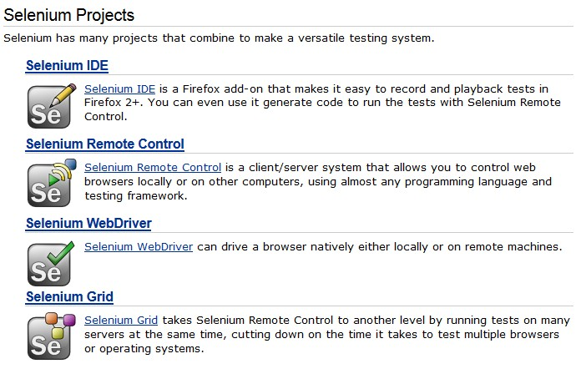
Selenium World

Slide 6

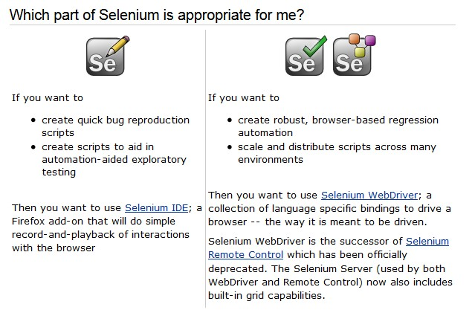
Which tool to use?

Slide 7
Selenium IDE – Limitations/Drawbacks
0 Firefox only
0 Can not Specify any condition Statement.
0 Can not Specify any Looping Statement.
0 Can not take external text data from External Resources such as XLS,XML or Database.
0 Handing Exceptions is not in scope.
0 Note:- To overcome the limitation of Selenium IDE we go for Selenium WebDriver.

Slide 8
Selenium Web Driver – Browser Support
Selenium-WebDriver supports the following browsers along with the operating systems these browsers are compatible with.
0 Google Chrome
0 Internet Explorer
0 Firefox
0 Opera 11.5+
0 HtmlUnit
0 Android – 2.3+ for phones and tablets (devices & emulators)
0 iOS 3+ for phones (devices & emulators) and 3.2+ for tablets (devices & emulators)

Slide 9
WebDriver is a tool for automating testing web applications.
It is popularly known as Selenium 2.0. WebDriver uses a different underlying framework, while Selenium RC uses JavaScript Selenium-Core embedded within the browser which has got some limitations.
WebDriver interacts directly with the browser without any intermediary, unlike Selenium RC that depends on a server.
It is used in the following context −
Multi-browser testing including improved functionality for browsers which is not well-supported by Selenium RC (Selenium 1.0).
Handling multiple frames, multiple browser windows, popups, and alerts.
Complex page navigation.
Advanced user navigation such as drag-and-drop.
AJAX-based UI elements.

Slide 10
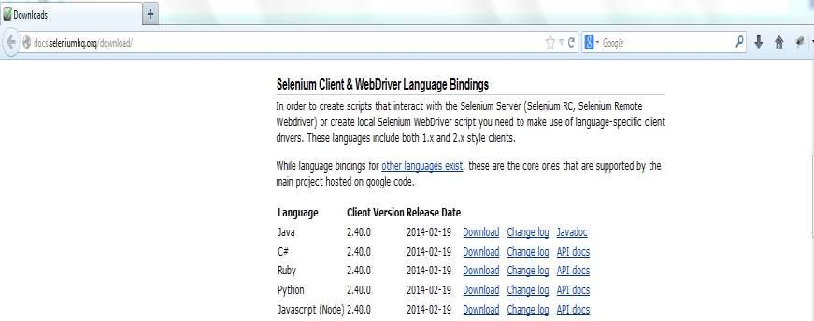
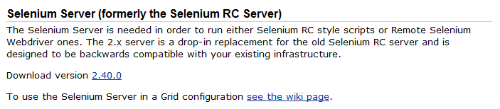
Install/Configure Webdriver with Eclipse.

Slide 11
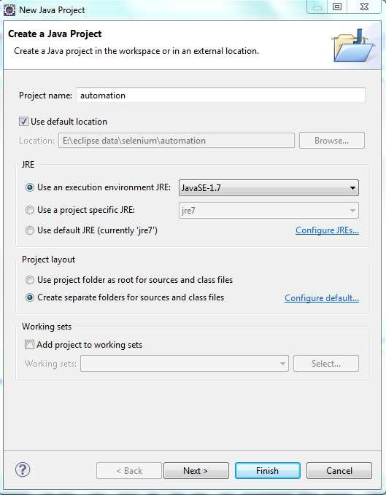
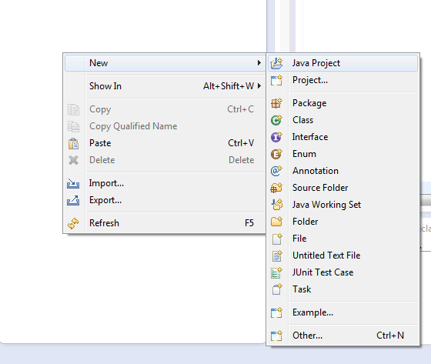
Creating Project

Slide 12
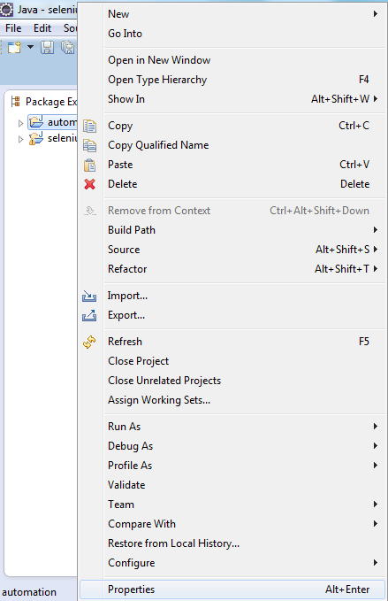

Slide 13
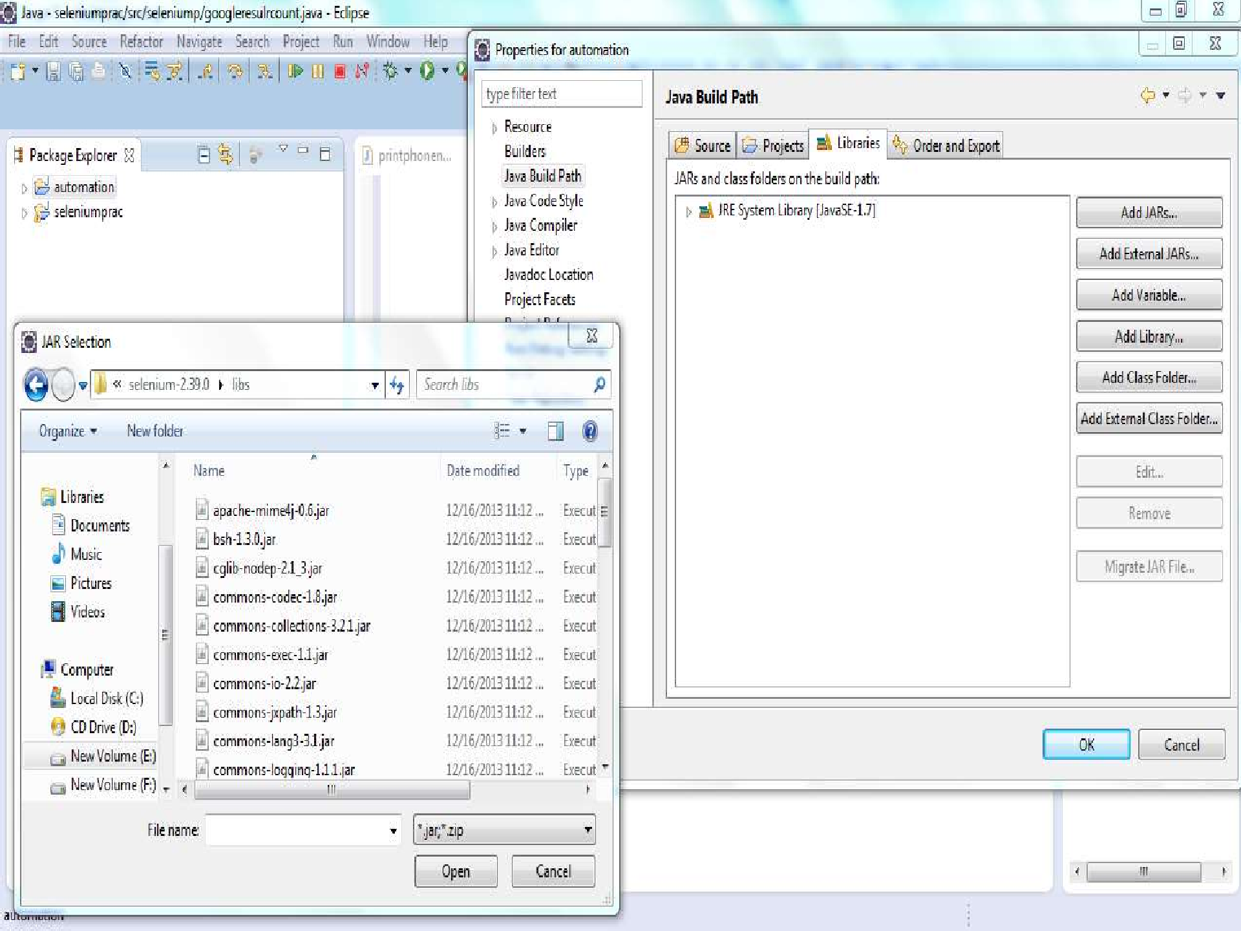

Slide 14
Simple Architecture of WebDriver
Interface
WEBDRIVER(i)
Protected class
Remote Webdriver
Firefox Driver
Chrome Driver
Internet Explorer Driver

Slide 15
Methods:- “ findElement” is a POPULAR method of webdriver interface which is Use to identify required element in the application. This method takes an Object as an argument of type “By”. Find Element command returns the web element that matches the first most element within the web page. Find Elements command returns a list of web elements that match the criteria.

Slide 16
Driver.get() : It's used to go to the particular website , But it doesn't maintain the browser History and cookies so , we can't use forward and backward button , if we click on that , page will not get schedule
driver.navigate() : it's used to go to the particular website , but it maintains the browser history and cookies, so we can use forward and backward button to navigate between the pages during the coding of Testcase.

Slide 17
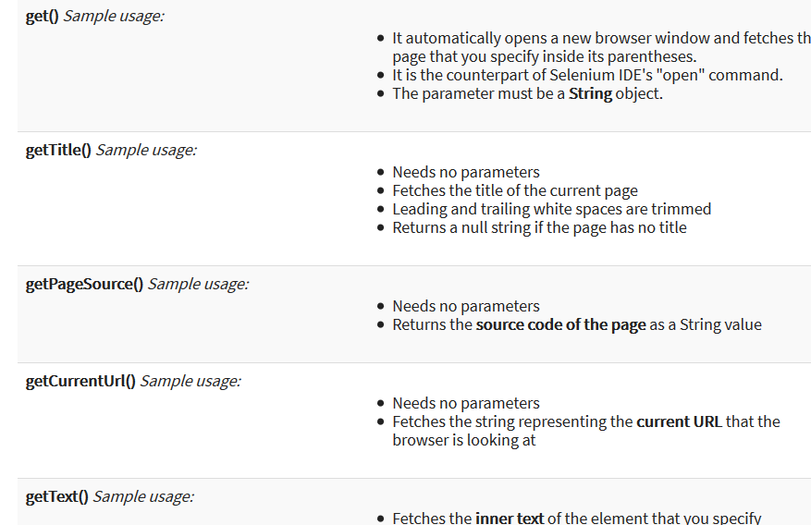

Slide 18
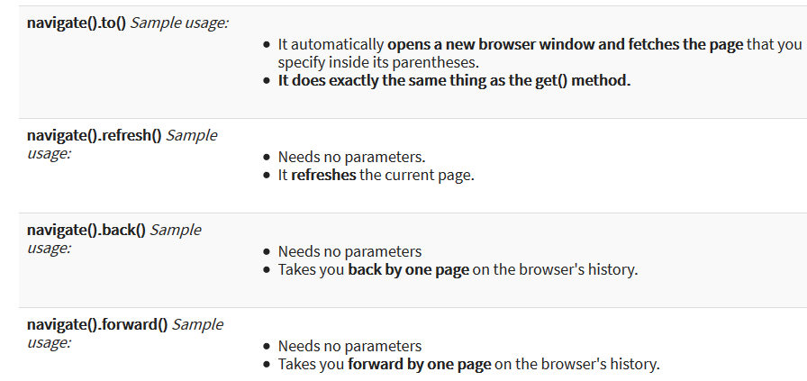
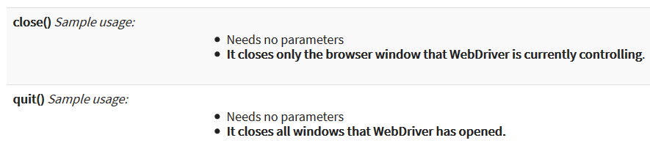

Slide 19
The switchTo().frame() and switchTo().alert() methods are used to direct WebDriver's focus onto a frame or alert, respectively.
Implicit waits are used to set the waiting time throughout the program, while explicit waits are used only on specific portions.
You can use the isEnabled(), isDisplayed(),isSelected(), and a combination of WebDriverWait and ExpectedConditions methods when verifying the state of an element.
However, they do not verify if the element exists. When isEnabled(), isDisplayed(),or isSelected() was called while the element was not existing, WebDriver will throw a NoSuchElementException.
When WebDriverWait and ExpectedConditions methods were called while the element was not existing, WebDriver would throw a TimeoutException.

Slide 20
Locators:- Webdriver supports 8 types of locators to identify the Elements and all the locators will return the object of the type Webelements.
Types of Locators:-
By.id(arg)
By.name(String)
By.xpath(String xpathExpression)
By.cssSelector(String Selector)
By.linkText(String linkText)
By.partialLinkText(String linkText)
By.className(String className)
By.tagName(String Name)

Slide 21
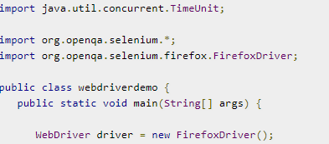


Slide 22




Slide 23
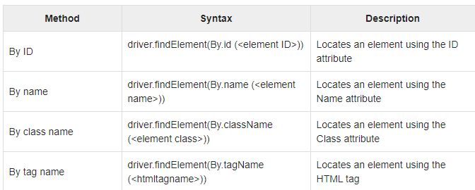
Locator is a command that tells Selenium IDE which GUI elements ( say Text Box, Buttons, Check Boxes etc) its needs to operate on. Identification of correct GUI elements is a prerequisite to creating an automation script.

Slide 24

By Class Name
Here an object is accessed with the help of Class Names. In this case, it is the Class name of the WebElement. The Value can be accessed with the help of the gettext method.
By Tag Name
The DOM Tag Name of an element can be used to locate that particular element in the WebDriver. It is very easy to handle tables with the help of this method.

Slide 25
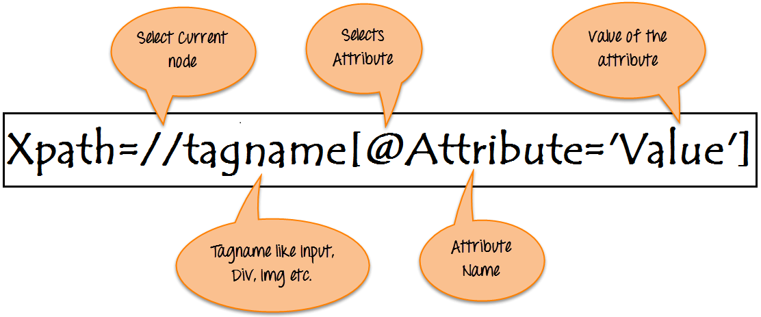
Syntax for XPath:
XPath contains the path of the element situated at the web page. Standard syntax for creating XPath is.
Xpath=//tagname[@attribute='value']

Slide 26
XPath is required to find an element on the web page as to do an operation on that particular element.
There are two types of XPath:
Absolute XPath
Relative XPath
XPath Axes are the methods used to find dynamic elements, which otherwise not possible to find by normal XPath method
XPath expression select nodes or list of nodes on the basis of attributes like ID , Name, Classname, etc. from the XML document .

Slide 27
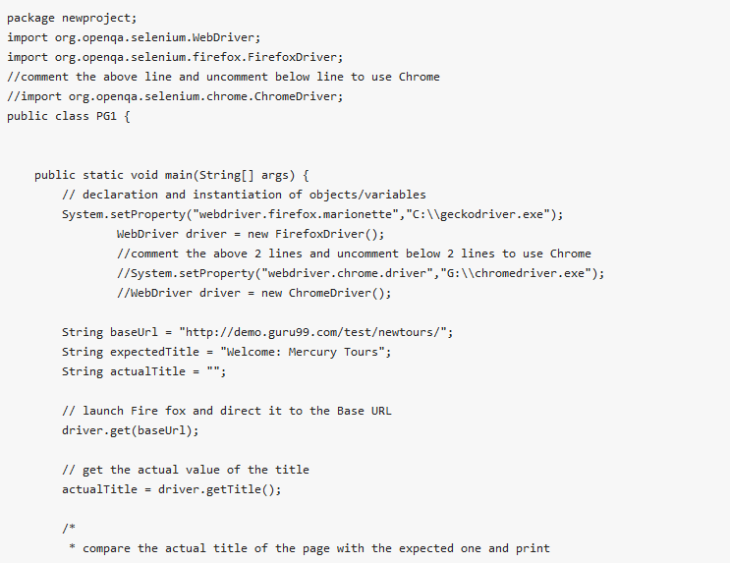
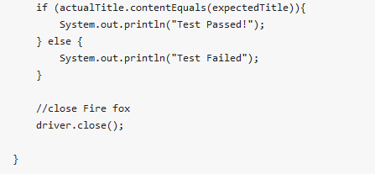

Slide 28
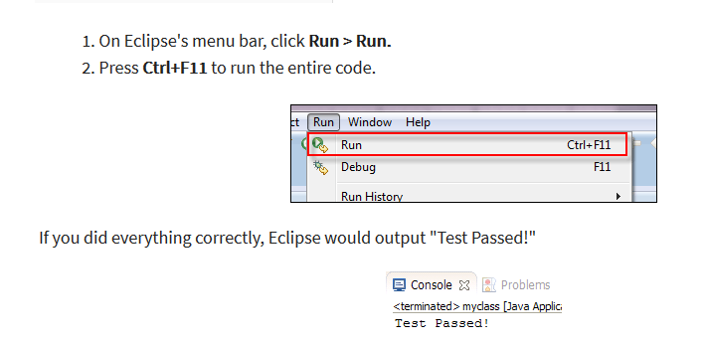

Slide 29
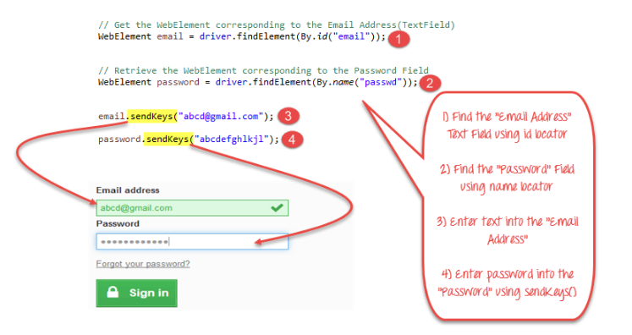
Text Box

Slide 30
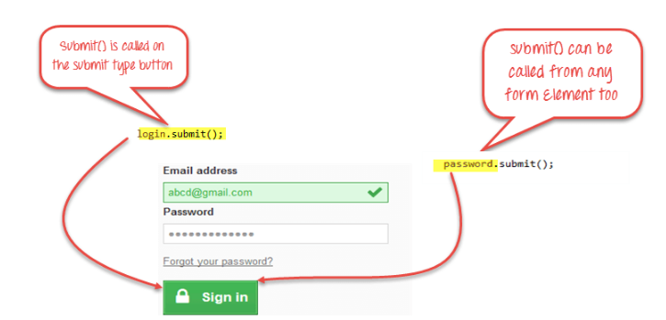
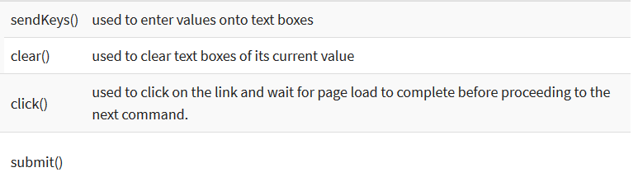

Slide 31
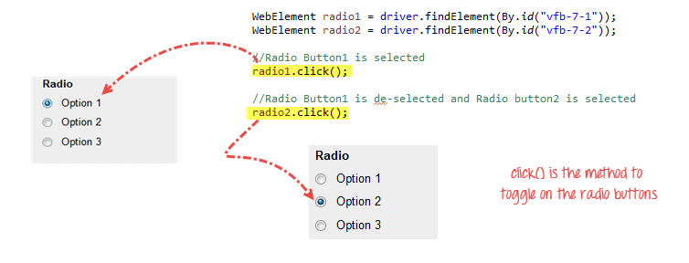
Radio Buttons too can be toggled on by using the click() method.

Slide 32
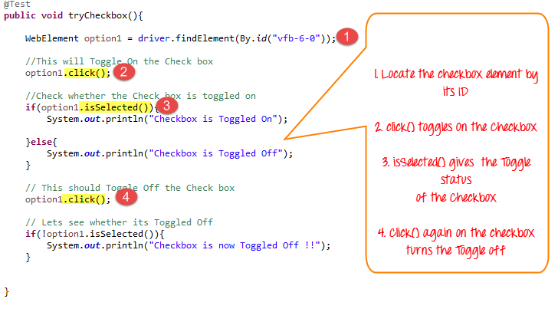
IsSelected() method is used to know whether the Checkbox is toggled on or off.

Slide 33

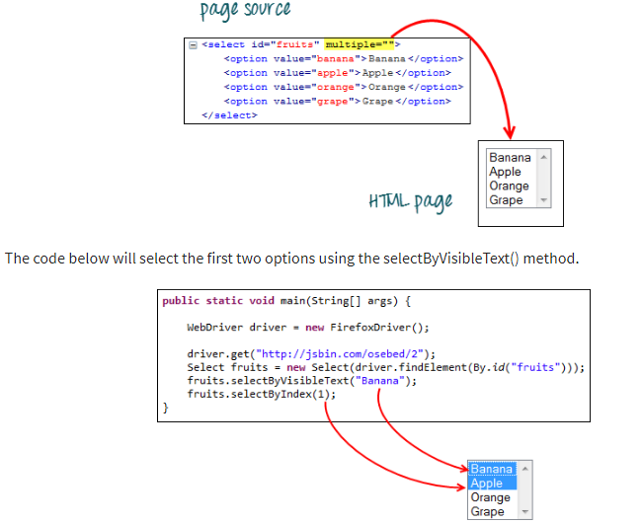
Drop down

Slide 34
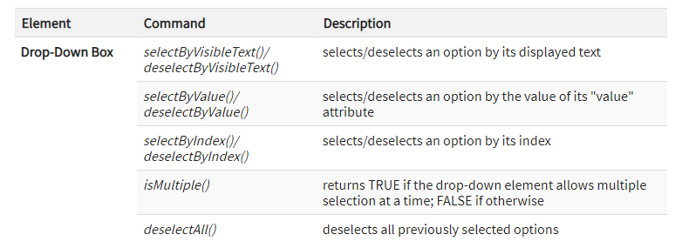

Slide 35


Handling Keyboard & Mouse Events
Handling special keyboard and mouse events are done using the Advanced User Interactions API. It contains the Actions and the Action classes that are needed when executing these events.

Slide 36
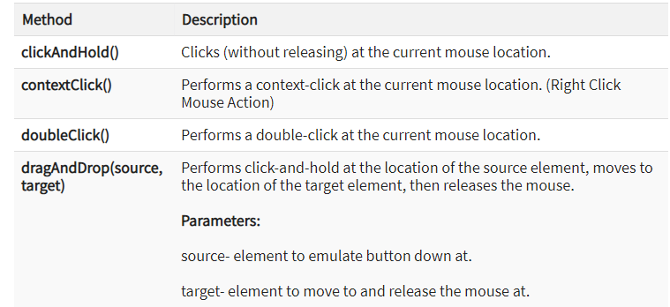
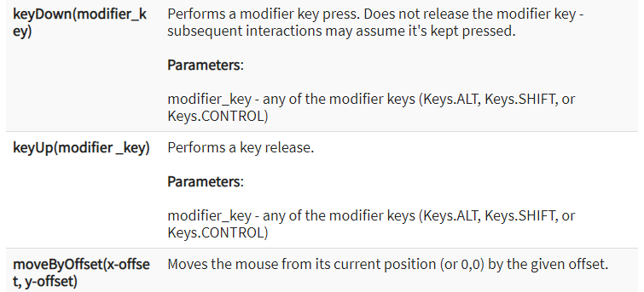

Slide 37
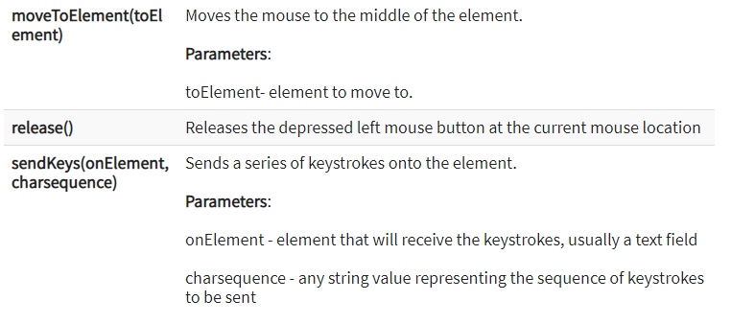

Slide 38
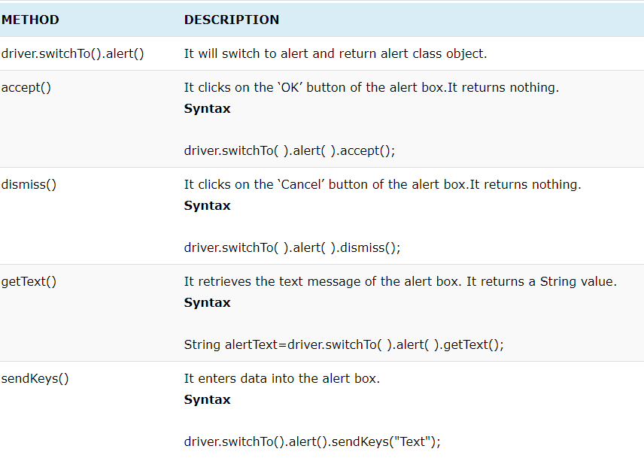
alerts and PopUps while interacting with web applications.

Slide 39
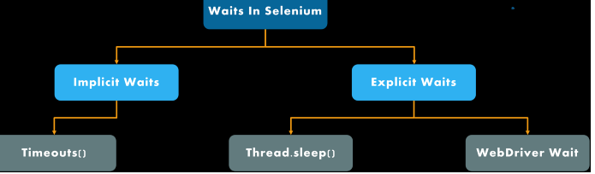

Slide 40
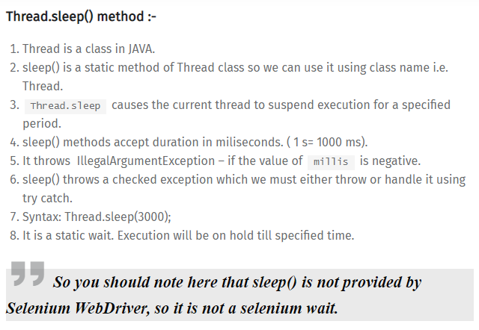

Slide 41
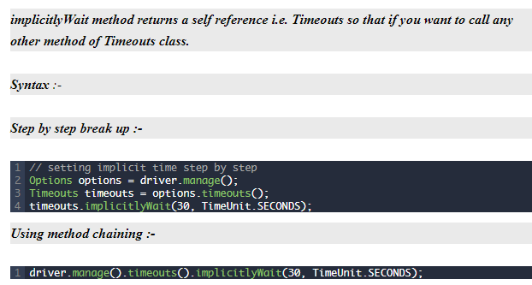

Slide 42
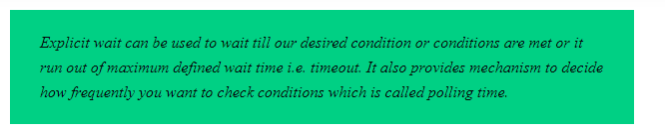
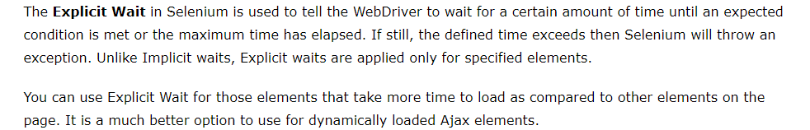
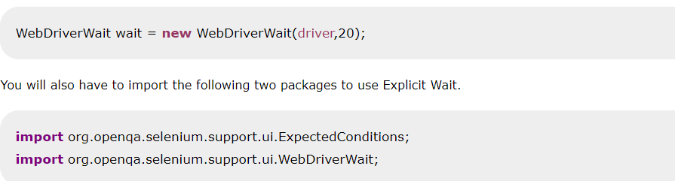

Slide 43
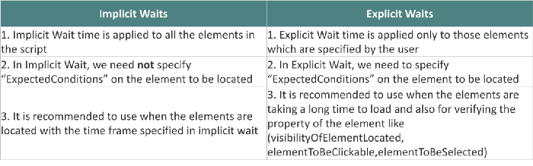

Slide 44
