Slide 1

120 Years of Olympic
Data Analysis
Presented by:
Niraj Kumar

Slide 2

Introduction
The Olympic Games, a hallmark of global sportsmanship and competitive excellence, have a rich history spanning over a century. Since their inception in 1896, the Olympics have grown exponentially in terms of participation, events, and global influence. This research project dives into 120 years of Olympic data, analyzing trends, patterns, and unique insights using SQL queries. With a dataset encompassing 39,748 records from various Olympic Games, this analysis aims to uncover stories and statistics that highlight the evolution of the Games and the athletes who participate in them.

Slide 3
Objectives
Historical Trends:
Examine the growth in athlete participation, the introduction of new sports, and the evolution of athlete demographics over time.
Performance Analysis:
Identify top-performing countries and athletes, understand patterns in medal distribution, and highlight exceptional achievements.
Demographic Insights:
Explore the characteristics of athletes, including age, height, weight, and gender, and how these have changed across different eras and sports.
Comparative Analysis:
Compare various aspects of the Summer and Winter Olympics, and evaluate the impact of geographical, temporal, and social factors on the Games.s

Slide 4
Methodology
Data Source:
The data for this project comes from a comprehensive Olympic dataset containing records from 1896 to 2016.
Tools:
SQL is utilized to query and analyze the data, while Excel is used to visualize the findings through charts and graphs.
Approach:
20 SQL queries are designed to address specific questions about the Olympic Games, each followed by a visualization of the results and an interpretation of the insights gained.

Slide 5
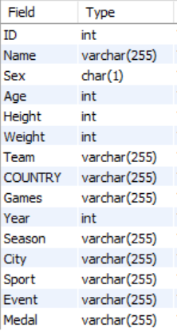
1
Introduction to The Dataset
Dataset credit- mavenanalytics.io
The Dataset comprise of one table- The Olympic table
The columns present and their data type are mentioned below

Slide 6
1
Introduction to The Dataset
ID (int): Unique identifier for each record.
Name (varchar(255)): Name of the athlete.
Sex (char(1)): Gender of the athlete ('M' for male, 'F' for female).
Age (int): Age of the athlete at the time of the event.
Height (int): Height of the athlete in centimeters.
Weight (int): Weight of the athlete in kilograms.
Team (varchar(255)): Name of the team the athlete represents.
Country (varchar(255)): Country of the athlete.
Games (varchar(255)): Specific edition of the Olympic Games (e.g., "Athens 1896").
Year (int): Year in which the Olympic Games took place.
Season (varchar(255)): Season of the Games ('Summer' or 'Winter').
City (varchar(255)): Host city of the Olympic Games.
Sport (varchar(255)): Sport in which the athlete competed.
Event (varchar(255)): Specific event within the sport (e.g., "100m freestyle").
Medal (varchar(255)): Medal won by the athlete ('Gold', 'Silver’, or 'Bronze').

Slide 7
ANALYSIS OF DATA

Slide 8
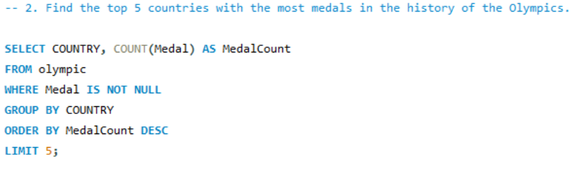
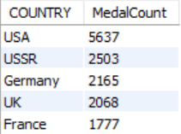
Countries With The Most Medal
Here Are The Top 5 Country That Have Highest Medal:

Slide 9
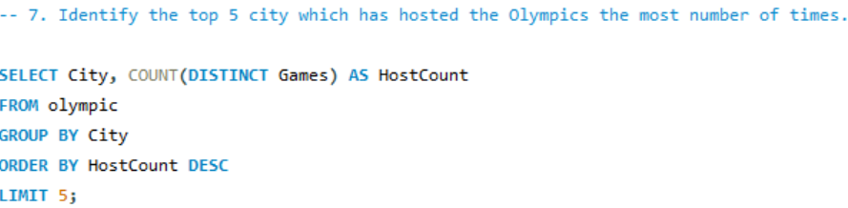
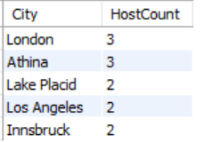
Top 5 City Which Has Hosted The Olympics
Here Are The Top 5 Country That Have Hosted The Olympic Most No. of Times:

Slide 10
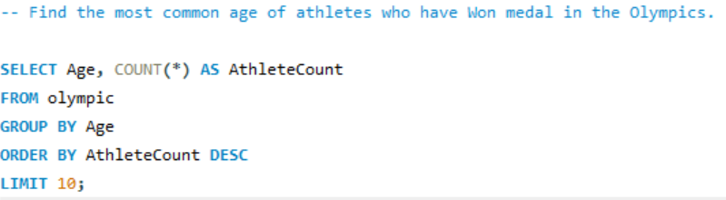
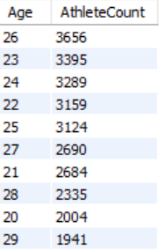
Most Common Age of Athletes
Here Are The Most Common Age of Athletes who have Won medal in the Olympics.

Slide 11
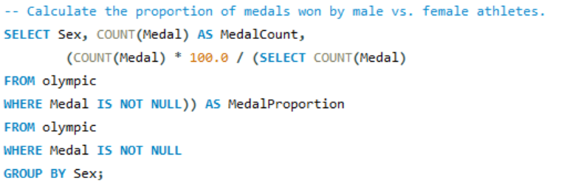

Proportion of Medal Won
Here Are The Proportion of Medal Won by male vs. female athletes.

Slide 12
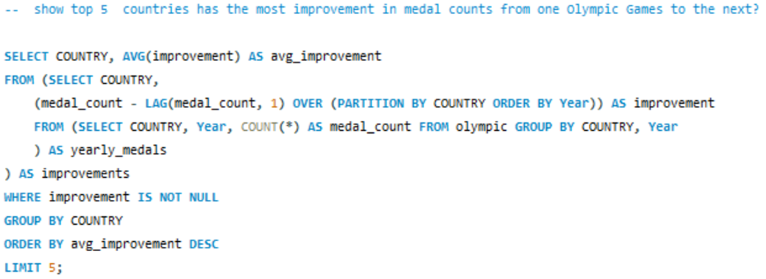
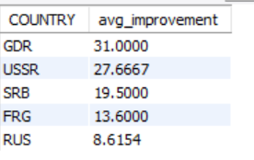
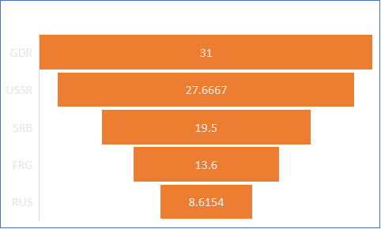
Top 5 Countries Has The Most Improvement In Medal
Here Are The top 5 countries has the most improvement in medal counts from one Olympic Games to the next

Slide 13
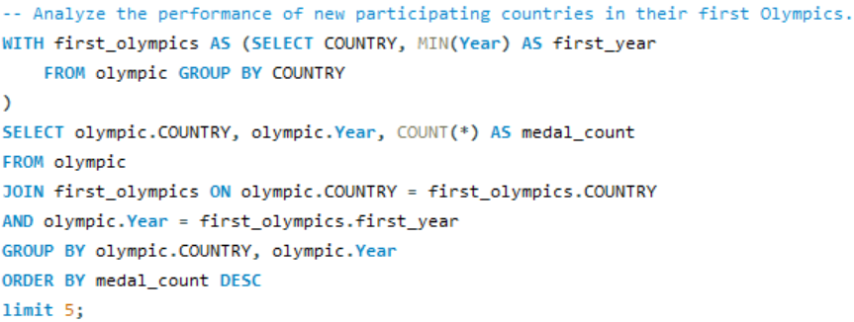
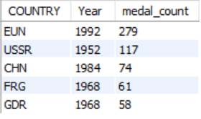
The Performance of New Participating
The performance of new participating countries in their first Olympics.

Slide 14
Findings From This Analysis
USA, Soviet Union, Germany, Great Britain, and France are top medal winners.
Rhythmic Gymnastics, Softball, and Synchronized Swimming are female-only sports.
Average age of gold medalists has varied over the decades, with a slight increase in recent years (e.g., from 24.5 years in the 1980s to 26.2 years in the 2010s), suggesting possible shifts in training and athlete longevity.
Athletes like Clara Hughes and Eddie Eagan have won medals in multiple sports.

Slide 15
Findings From This Analysis
Host countries often see a spike in medal counts, likely due to home advantage and increased investment in athletes (e.g., China in 2008, Great Britain in 2012).
Fluctuations in participation and performance during periods of global conflict or political boycotts, such as the 1980 and 1984 Olympics.
East Africa dominates distance running, while Eastern Europe excels in weightlifting and gymnastics, reflecting regional specialization and training emphasis.
Breakdown of medal distribution shows athletes aged 20-30 winning the majority of medals, indicating peak performance periods in athletes' careers.

Slide 16

Conclusion
Our analysis of 120 years of Olympic data reveals a dynamic evolution marked by increased global participation, improved athlete performance, and strides towards gender equality. Host countries shape the Games, while challenges like doping persist. Despite this, the Olympics inspire unity, celebrate diversity, and drive positive societal change. As a symbol of hope and excellence, the Games continue to innovate, introducing new sports and sustainability measures. Through sport, the Olympics foster camaraderie among nations, transcending borders to unite people in the pursuit of athletic excellence and mutual respect on a global stage.

Slide 17
Thank you!

