Slide 1

Pizza Sales Analysis
Presented by:
Niraj Kumar

Slide 2
Introduction to Pizza Sales Analysis
Pizza sales analysis is crucial for understanding customer preferences and optimizing sales strategies. By analyzing various factors such as popular toppings, size trends, and seasonal variations, we can make informed decisions to enhance profitability and customer satisfaction.

Slide 3
Market Overview and Trends
Online Ordering
Health-Conscious Choices
Increased demand for online pizza orders and deliveries.
Rise in demand for healthier pizza options, including gluten-free crusts.
Plant-Based Options
Artisanal Pizza Trends
Growing interest in plant-based pizza toppings and meat alternatives.
Emergence of artisanal pizza makers
using high quality, unique ingredients.

Slide 4
Sales Data and Statistics
$8,17,860
Total Sales
$16.821
Avg Bill/Person
1.019
Avg Order/Person
Classic Deluxe (L)
Best-Selling Pizza

Slide 5
Sales Data and Statistics
Weekdays Sales Figures
Mondays have the most sales, while Wednesdays have the least.
Knowing this helps us plan better for busy and slow days, like scheduling more staff on Mondays and adjusting marketing efforts to boost sales on Wednesdays.

Slide 6
1
Quarterly Sales Data and Statistics
Quarterly Sales Figures
The sales data shows consistent growth over the past year, with an increase in pizza sales every quarter.
Insights:
Quarter 2 stands out with the highest sales volume, indicating a peak in business activity during this period.
Conversely, Quarter 4 records the lowest sales, suggesting a potential slowdown in customer demand towards the end of the year.

Slide 7
Monthly Sales Data and Statistics
Monthly Sales Figures
The sales data shows consistent growth over the past year, with an increase in pizza sales every month.
Insights:
July stands out with the highest sales volume, indicating a peak in business activity during this month.
Conversely, oct records the lowest sales, suggesting a potential slowdown in customer demand towards the end of the year.

Slide 8
Hourly Sales Data and Statistics
Sales Trend Throughout the Day:
Peak Sales: 12:00 PM
Shop Hours: 9:00 AM - 11:00 PM
Insights:
High sales observed during lunch hours.
Shop operates from 9:00 AM to 11:00 PM, covering peak sales periods.

Slide 9
1
Best-Selling Pizzas
Top 5 Best-Selling Pizzas
Top Pizza: The Classic Deluxe Pizza
Insights:
These 5 pizzas are the top-selling item, reflecting strong customer demand.
Identifying top-selling pizzas enables targeted efforts to optimize production and marketing strategies.

Slide 10
1
Pizza Preference Analysis
Understanding Customer Preferences
Veg Pizza Consumption: 78%
Non-veg Pizza Consumption: 22%
Insights:
78% of customers prefer veg pizzas, indicating a strong preference for vegetarian options.
Non-veg pizzas account for 22% of sales, suggesting a significant but smaller market segment for meat-based options.

Slide 11
1
Pizza Size Preference Analysis
Understanding Customer Preferences
Most Selling Size: L (38%)
Least Selling Size: XXL (0.006%)
Insights:
The large size (L) pizza dominates sales, accounting for 38% of total sales.
The extra-extra-large (XXL) size is the least popular, making up only 0.006% of total sales.

Slide 12
1
Analysis of Pizza Size Preference
Understanding Customer Preferences
Most Selling Size: L (veg - 14024 Quantity)
Least Selling Size: XXL(Non-veg) (0)
Insights:
The large size (L) in veg is the most popular choice for veg pizzas, with 14,024 units sold.
Interestingly, the extra-extra-large (XXL) size does not register any sales for non-veg pizzas.

Slide 13
Analysis of popular pizza toppings
Pepperoni
Margherita
A classic favorite, pepperoni provides a savory and slightly spicy flavor that appeals to a wide range of pizza lovers.
This simple but delicious combination of tomatoes, mozzarella, and basil is a timeless choice for those who love traditional flavors.
Mushrooms
Barbecue Chicken
With their earthy and rich taste, mushrooms are a popular topping choice that complements a variety of pizza styles and sauces.
A fusion of smoky barbecue sauce, tender chicken, and melted cheese, this topping has gained popularity for its unique and flavorful profile.

Slide 14
Month wise in pizza preferences
1
January
In January, customers tend to favor classic toppings like pepperoni and cheese.
2
June
During the summer months, preferences shift towards lighter toppings such as vegetables and mushrooms.
3
November
In the colder months, there is a rise in demand for heartier toppings like sausage and bacon.

Slide 15



Factors influencing pizza sales
Product quality
1
Fresh ingredients and unique flavors
Marketing efforts
2
Effective advertising and promotional campaigns
Customer experience
3
Convenient ordering and exceptional service

Slide 16
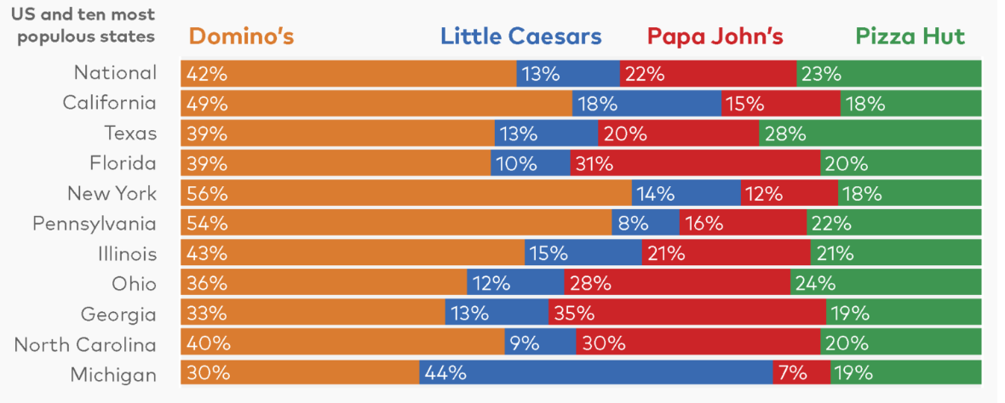
Competitive Landscape and Market Share
Company Name
Market Share (%)
Pizza Hut
24%
Dominos
36%
Papa John's
28%
Little Caesars
12%
The competitive landscape in the pizza industry is dominated by major players such as Pizza Hut, Dominos, Papa John's, and Little Caesars. Dominos currently holds the largest market share at 36%, closely followed by Pizza Hut at 24%. Understanding the market share of each company is crucial for strategic decision-making and market positioning.

Slide 17
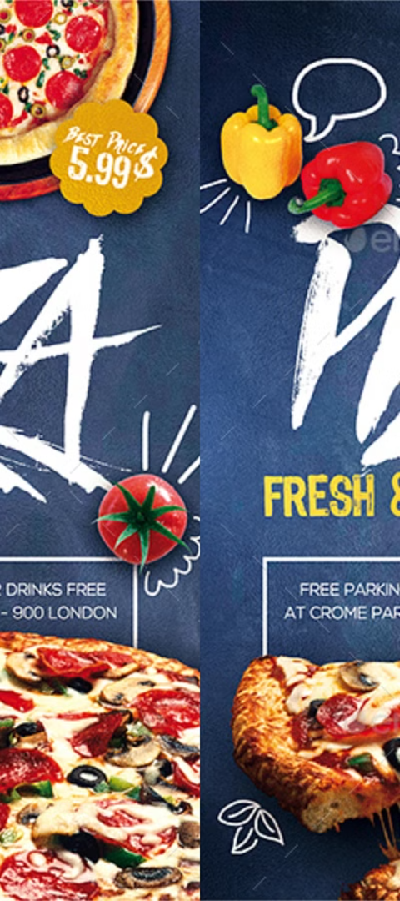



Strategies for increasing pizza sales
Online Ordering Optimization
Streamline the online ordering process for a user-friendly experience.
Special Promotions and Deals
Introduce attractive deals and promotions to attract new customers.
Community Engagement Events
Host community events to build brand recognition and loyalty.

Slide 18

Question & Answer Session
Q1. What was the total revenue generated from pizza sales in 2023?
Ans- The total revenue generated from pizza sales in 2023 was $8,17,860.05.
Q2. Which pizza size recorded the highest sales volume?
Ans- The large (L) size pizza recorded the highest sales volume among all sizes.
Q3. Which pizza category recorded the highest sales volume?
Ans- The "Classic Deluxe" pizza category emerged as the top-selling category in terms of sales volume.
Q4. Which month witnessed the highest number of pizza orders?
Ans- July recorded the highest number of pizza orders in 2023.
Q5. How many distinct pizza ingredients were used across all pizza variations?
Ans- There were a total of 15 distinct pizza ingredients used across all pizza variations.

Slide 19
Question & Answer Session
Q6. What were the key insights gained from the analysis of pizza sales data?
Ans- The analysis revealed several key insights, including the top-selling pizzas, peak sales hours, popular pizza sizes, customer preferences for veg and non-veg options, and quarterly sales trends.
Q7. Were there any notable trends or patterns observed in customer ordering behavior?
Ans- Yes, we observed trends such as higher sales during certain times of the day (e.g., lunch hours), preference for larger pizza sizes among certain customer segments, and a clear preference for vegetarian pizzas among the majority of customers.
Q8. How do we plan to address the low sales of certain pizza sizes or categories?
Ans- Strategies may include adjusting pricing for less popular items, introducing new menu offerings to diversify options, and conducting customer surveys to understand preferences better and tailor offerings accordingly.
Q9. How did the sales performance vary across different pizza categories?
Ans- Certain pizza categories, such as "Classic" and "Supreme," performed better than others, indicating higher customer demand for specific flavor combinations and toppings.

Slide 20
Question & Answer Session
Q10. What are the next steps or recommendations based on the analysis findings?
Ans- The next steps involve taking practical actions based on our analysis findings.
Refine menu offerings based on popular items and customer preferences.
Optimize pricing strategies to attract more customers while maintaining profitability.
Enhance marketing efforts to reach a wider audience and increase sales.
Invest in staff training to improve customer service and satisfaction.

Slide 21
Conclusion and key takeaways
Consumer behavior: Analyze trends in consumer preferences and behavior to tailor pizza offerings.
Market share: Evaluate competitive landscape and target areas for increasing market share.
Strategic initiatives: Implement marketing strategies and promotions based on sales analysis.

Slide 22
Thank you for your attention!

