Slide 1
Location Controlled Brain Tumour Image Synthesis
Abhinav Kumar (180050003) Niraj Mahajan (180050069)

Slide 2
Aim
To explore various models and methods of training for location controlled abnormality insertion in normal medical Images
Incorporate Image inpainting for generating the training data, ie, normal brain MRI images corresponding to the tumour images.

Slide 3
The dataset used
We have used the BRATS dataset, which contains the tumour + segmentation information.
The data is already processed, ie, the skull is cropped off.
Since the MRI is 3D, with the z coordinate varying from [0,~150], we have used 26 images per MRI in the range [70-95]

Slide 4
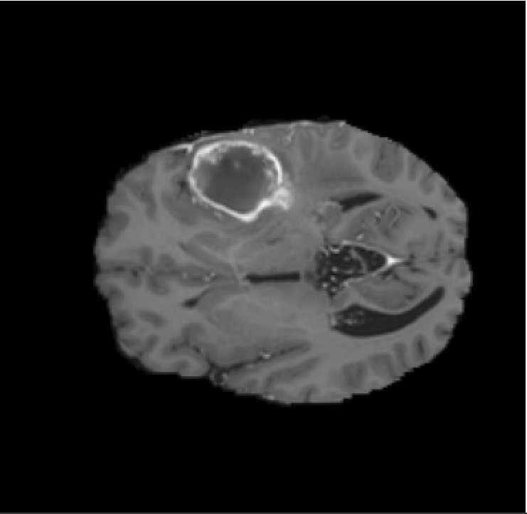
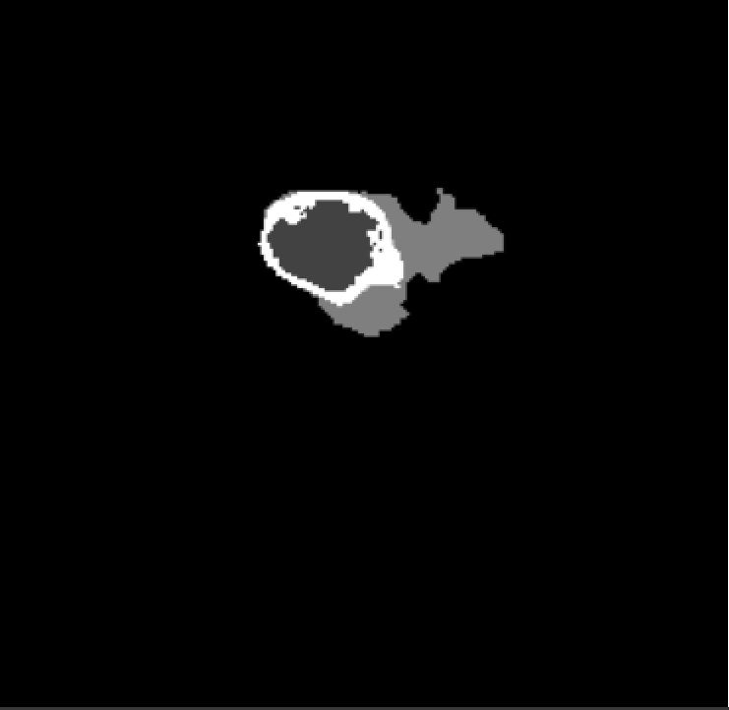
Sample Images from the dataset

Slide 5
Image Generation Pipeline
Tumour Image
Rectifier
Rectified Image
Rectified Image
Bounding Box
Abnormality Inserter
Abnormality Inserter
Bounding Box
Tumour Image
Pix2Pix Training
Testing Pipeline

Slide 6
Section 1: Rectifier

Slide 7
Idea
Normal Brain images are not readily available as it involves interaction with magnetic waves so healthy brain images are scarce
Given a MRI image with a tumour, the corresponding healthy brain image is sparser.
To deal with above, we came up with a rectifier network which performs image inpainting on a brain image with tumour part cropped out generates the complete healthy image.
Above network is trained as a separate network from the main network for location controlled tumour generation from normal brain image

Slide 8
Experiments
We tried two methods for image inpainting - Context Encoders and Pix2Pix GANS.
We got good results from the Pix2Pix network, but the context encoder gave suboptimal results.

Slide 9
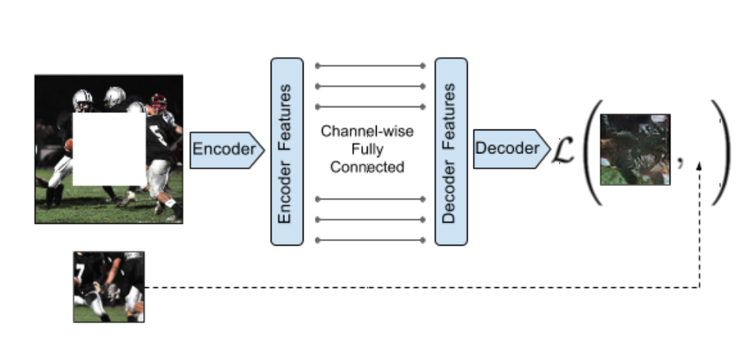
Context Encoder

Slide 10
<ctd>
We trained our model by adding an adversarial loss to the latent space of the encoder-decoder pipeline.
The key idea is to treat the tumour as a outlier in the image. That is, if we consider a bounding box at some location, then the event of this bounding box to have a tumour is an outlier.
We exploit this property of Neural Networks to develop a rectifier

Slide 11
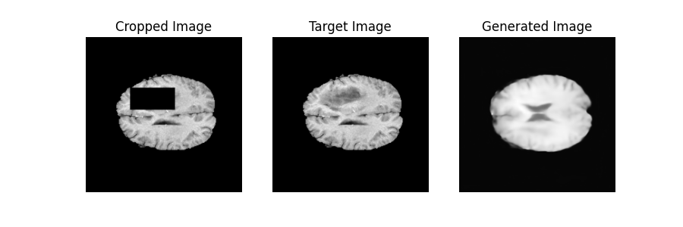
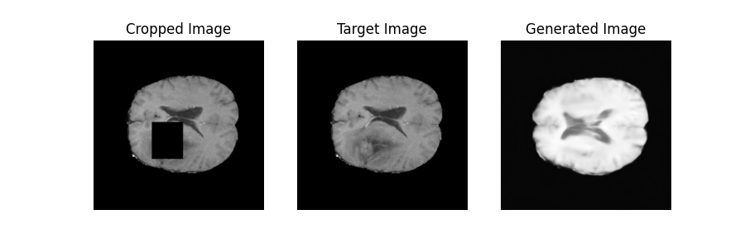

Slide 12
Key Insights/ Takeaways
The idea to consider the tumour as an outlier clearly works, as none of the generated images show the presence of a tumour.
The parameters need to be fine tuned because the research paper shows promising results for inpainting on more complicated datasets.

Slide 13
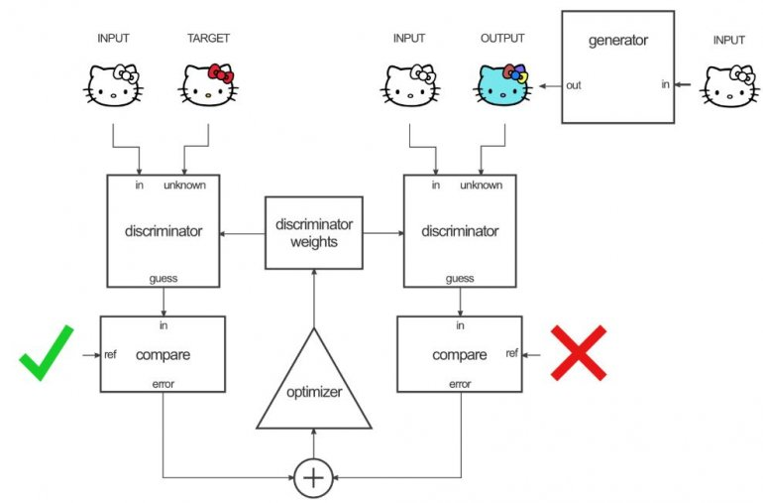
Pix2Pix Architecture

Slide 14
<ctd>
Again relying on the principle that the tumour part is an outlier, we train a Pix2Pix Network for generating the healthy images.
The generator uses a similarity loss on the generated image with the “target” complete brain image to ensure that the generated image does not deviate a lot from the original structure, since the idea is to simply add a tumour to the given location, without changing the brain structure.
We tried two different losses for this similarity measure - L1 loss and L2 Loss

Slide 15

L1 loss vs L2 loss
We know that the Median minimises the sum of the absolute deviations (aka L1 loss), while the mean minimises the sum of euclidean distances from points (aka L2 loss). X_{median} = |s_{i} - x| X_{mean} = (s_{i} - x)²

Slide 16
<ctd>
Since the median is robust to outliers, and our method relies on the assumption that the tumour regions are outliers and will be ignored.
Thus, the method with L1 loss gives a marginally better result when visually compared with the results obtained from L2 loss

Slide 17
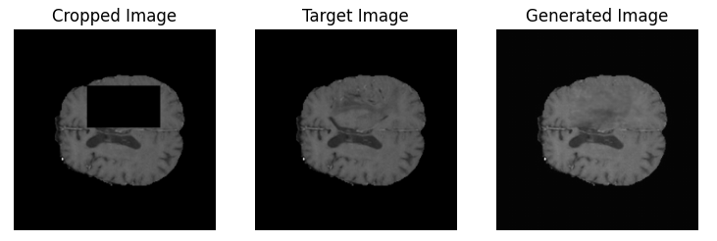
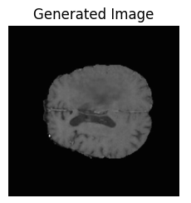
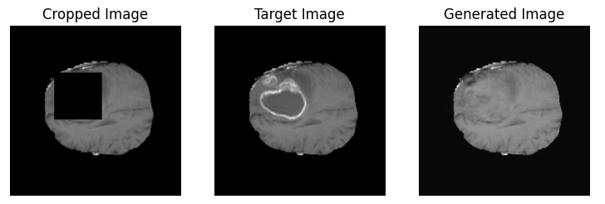

L1
L2
L1
L2

Slide 18
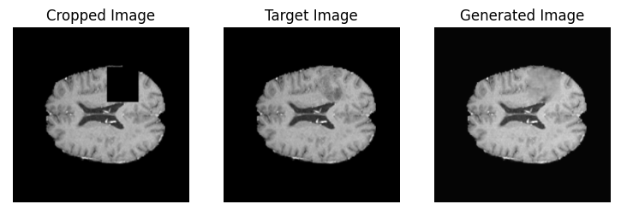

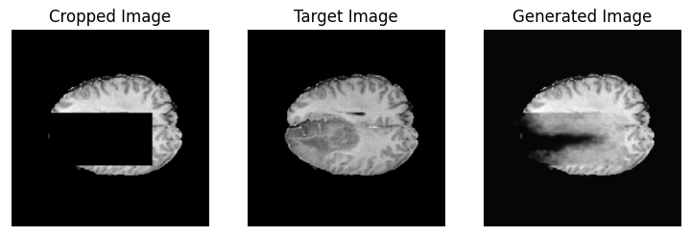

L1
L2
L1
L2

Slide 19
Section 2: Tumour Inserter

Slide 20
Idea
For this section, we will assume that we have tumour images, and the corresponding healthy image (given we have the rectifier).
Given a healthy image and a custom bounding box, we need to insert a tumour at the specified location.
The idea is to establish a general method that can be applied for location controlled abnormality insertion for any medical imaging application.

Slide 21
Loss Functions
For the Adversarial Loss, we have trained both lsGAN as well as vanilla GAN. Both of the training processes give comparable results
We induce a similarity measure similar to the rectifier case. We tried 3 variations here
L1 loss
L1 loss for the tumour part, MSE loss for the rest (1:1 ratio weight)
L1 loss for the tumour part, MSE loss for the rest (1:100 ratio weight)
We have shown and compared the results for all 4 methods for the same healthy image, with different bounding boxes.

Slide 22
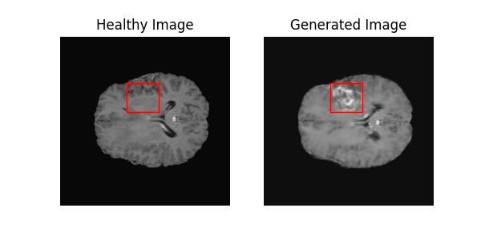
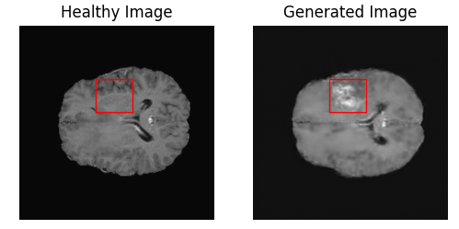
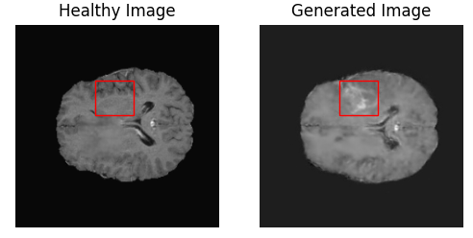
Vanilla | L1
LSGAN | L1
LSGAN | L1 + MSE
LSGAN | L1 + MSE weighted

Slide 23
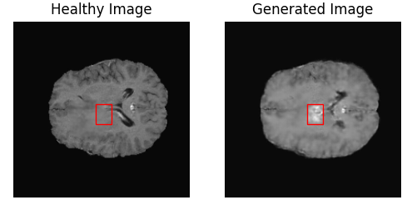
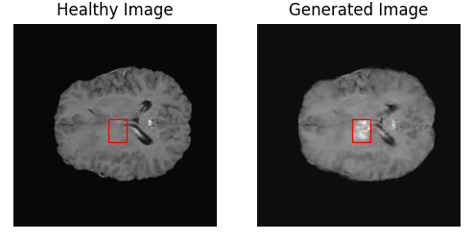
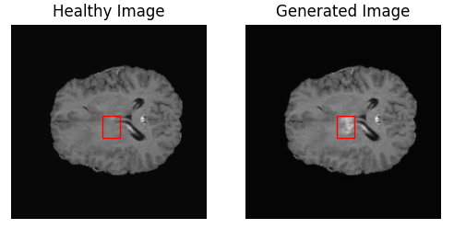
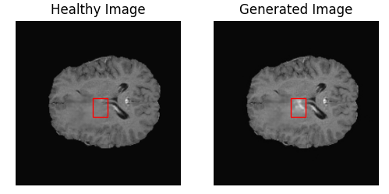
Vanilla | L1
LSGAN | L1
LSGAN | L1 + MSE
LSGAN | L1 + MSE weighted

Slide 24
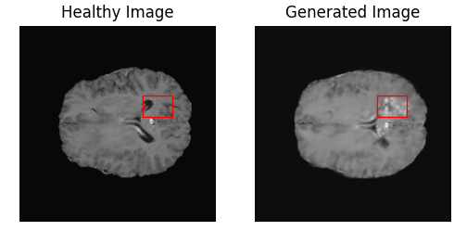
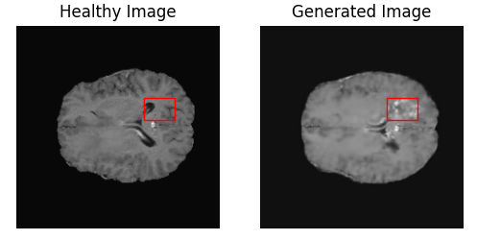
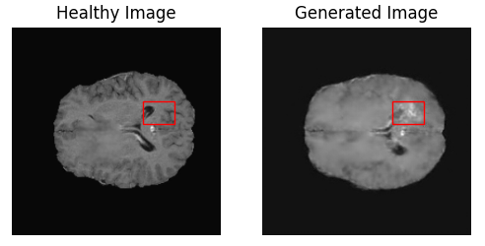
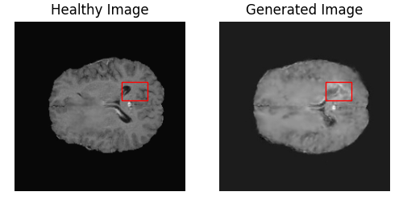
Vanilla | L1
LSGAN | L1
LSGAN | L1 + MSE
LSGAN | L1 + MSE weighted

Slide 25
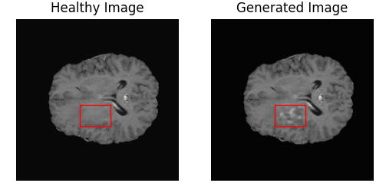



Vanilla | L1
LSGAN | L1
LSGAN | L1 + MSE
LSGAN | L1 + MSE weighted

Slide 26
Why a rectifier?
One may argue that we can directly train a location controlled abnormality generator by simply giving the segmentation mask. (The loss can be the L2 difference between the tumour image and the output)
So the reason we use a rectifier is because we want the corresponding abnormal, healthy image pair while training. This is useful because
Having the healthy image ensures that our model will preserve all the features outside the bounding box, and this will be very useful when we combine such abnormality generators - or simply when we want complete control over the image outside the target area.
Having the surrounding image information given as input, the training will be significantly easy and faster.

Slide 27
Future Experiments/Applications
While training the rectifier, we used the tumour image as a target. We showed that this was treated as an outlier by the model. But instead of the tumour image, what if we use an image with the tumour region blurred (say by a gaussian filter), or completely blackened out?
Of course this is only for datasets that do not have healthy images - for those having healthy images, we can simply use a random crop operation for training the rectifier.
This method can be further augmented for generating complicated textures/objects in images. We can have a separate “abnormality generator” and have an end to end training with such a generator incorporated.

Slide 28
<ctd>
This method can also be used for conditional location controlled abnormality generator, in cases where the abnormality has grades.
We could see the output of the pix2pix network was a bit blurred out - the region outside the target region has some loss in the edges. To counter this, we can add skip connections in the pix2pix architecture so that on down sampling, such high-detail data is not lost, thus helping us preserve the resolution of the image.

Slide 29
Conclusion
In this project, we have proposed a method of generating location controlled abnormality images, which can be generalised for Medical Imaging Applications like fractures, retinopathy, pneumonia, etc.
We proposed a rectifier based pipeline that helps preserve the other features in the image, while easing the training process of the abnormality generator.

Slide 30
References
Context Encoders: Feature Learning by Inpainting

Slide 31
Thank you for your time!

