Slide 1
Sentiment Analysis Assignment
By [Your Name]
Course: [Your Course]
Date: [Today's Date]

Slide 2
Introduction
• Sentiment analysis uses Natural Language Processing (NLP) to determine the sentiment of text.
• This project analyzes movie reviews from the IMDb dataset.
• Objective: Identify positive, negative, and neutral sentiments.

Slide 3

Dataset Description
Source: IMDb Dataset of 50K Movie Reviews (Kaggle).
Contains 50,000 movie reviews with sentiment labels (positive/negative).
Structure: Two columns – 'review' and 'sentiment'.
Example: 'The movie was fantastic!' - Positive sentiment.

Slide 4
Implementation
• Libraries Used: TextBlob, pandas, matplotlib.
• Steps:
Load IMDb dataset.
Perform sentiment analysis using TextBlob.
Save results to 'imdb_sentiment_results.csv'.
Output: Sentiment score and label for each review.

Slide 5
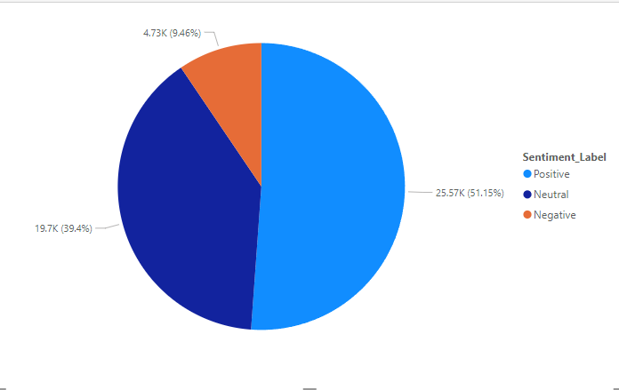
Visualization

Slide 6

Challenges and Solutions
Challenges:
Dataset preprocessing.
Assigning sentiment scores to text data.
Solutions:
Used TextBlob for efficient sentiment scoring.
Processed data to handle missing or ambiguous reviews.

Slide 7
Conclusion
Key Insights:
Majority of reviews were positive.
Sentiment analysis can provide actionable insights for businesses.
• Future Scope:
Explore advanced NLP models (e.g., BERT).

Slide 8

References
Lakshmi, A. (2020). IMDb dataset of 50K movie reviews. Kaggle. https://www.kaggle.com/datasets/lakshmi25npathi/imdb-dataset-of-50k-movie-reviews
Loria, S. (2020). TextBlob: Simplified text processing. https://textblob.readthedocs.io
Microsoft. (n.d.). Power BI. Microsoft. https://powerbi.microsoft.com
The Pandas Development Team. (n.d.). Pandas documentation. Pandas. https://pandas.pydata.org/docs/reference/index.html
Hunter, J. D. (2007). Matplotlib: A 2D graphics environment. Computing in Science & Engineering, 9(3), 90-95. https://doi.org/10.1109/MCSE.2007.55
Loria, S. (2020). TextBlob. https://textblob.readthedocs.io

Slide 9

THANK YOU

