Slide 1
Covid-19 Detection Using Deep Learning
Mentor : Dr Santosh Kumar Bharti
submitted by: NIRAJ PATEL (20MDS003)

Slide 2
Outline
Introduction
Objective
Dataset
Process Flow
Model Used
Accuracy
Future Research

Slide 3
Introduction
The COVID-19 that was first identified in China in December 2019 has spread across the globe rapidly infecting over ten million people. The World Health Organization (WHO) declared it as a pandemic on March 11, 2020.
What makes it even more critical is the lack of testing facility available in many country to control the disease, although many medical laboratories are trying their best to detect virus using blood sample, RT-PCR etc and many companies working toward developing effective solutions to battle this life-threatening disease.
X-ray images scanning is one of the most encouraging exploration zones; it can help in finding and providing early diagnosis to diseases and gives both quick and precise outcomes.

Slide 4
Objective
Detect Covid-19 using X-Ray Image with the help of CNN
Blood test take time to conduct result approx. 5 hour per patients so with the help of x-ray images our model will predict whether a person have covid-19 or not.

Slide 5
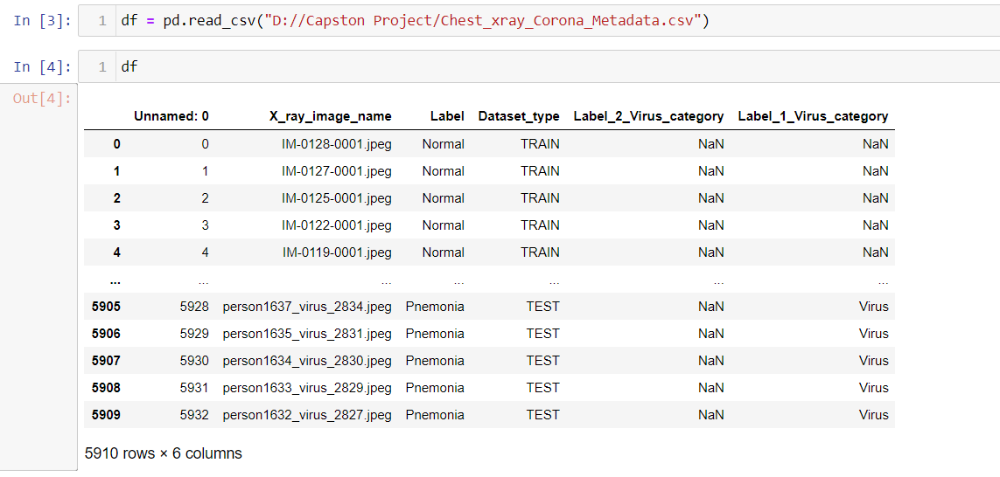
Dataset
https://www.kaggle.com/praveengovi/coronahack-chest-xraydataset

Slide 6
Process Flow
Data collection
Data Preprocessing
Analysis of Data
Model Building
Model Evaluation

Slide 7
Model Used
Convolution Neural Network: A basic CNN was used as a baseline model to achieve a benchmark accuracy for the classification problem. CNN, this type of Neural Network deals with images with the convolution formula and that diminish the number of parameters to train, this can speed up the process of training and may result in better performance as it is optimized to be used.
Resnet50: ResNet-50 is a convolutional neural network that is 50 layers deep. The reason ResNet-50 has been used is because it solves the vanishing gradient problem by using Identity shortcut connection or skip connections that skip one or more layers. It is pretrained model from the Keras Applications has the advantage of allow you to use weights that are already calibrated to make predictions. In this case, we use the weights from Imagenet and the network is a ResNet50

Slide 8
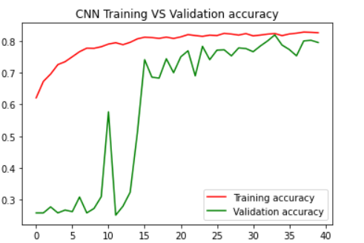
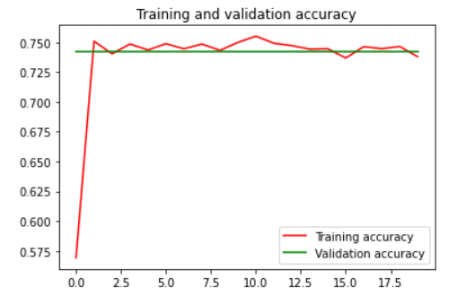
Accuracy
Base CNN
0.7950
ResNet50
0.7422

Slide 9
Future Research
More images for Covid19 as well as Non Covid19 would lead to much better results
Along with Results (Covid19 and NonCovid19), probabilities would be given
New State of the art models can be used for better results

Slide 10
Thank You
Any Question?

