Slide 1
Geographical Sentiment Analysis for Pfizer Vaccine Tweets
Submitted by: Niraj Patel

Slide 2
Problem Statement
Study the subjects of recent tweets about the vaccine made in collaboration by Pfizer and BioNTech, perform various NLP tasks on this data source.
One have to analyze tweets Geographically weather their feelings towards vaccine is positive, negative or neutral.

Slide 3
What is Sentiment Analysis?
Sentiment analysis is a technique through which you can analyze a piece of text to determine the sentiment behind it. It combines machine learning and natural language processing (NLP) to achieve this.
Using basic Sentiment analysis, a program can understand whether the sentiment behind a piece of text is positive, negative, or neutral.
For example, you can use sentiment analysis to analyze customer feedback. After collecting that feedback through various mediums like Twitter and Facebook, you can run sentiment analysis algorithms on those text snippets to understand your customers' attitude towards your product.

Slide 4
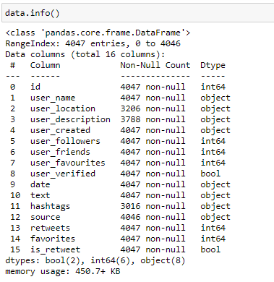
Dataset
Dataset : https://www.kaggle.com/gpreda/pfizer-vaccine-tweets?select=vaccination_tweets.csv

Slide 5
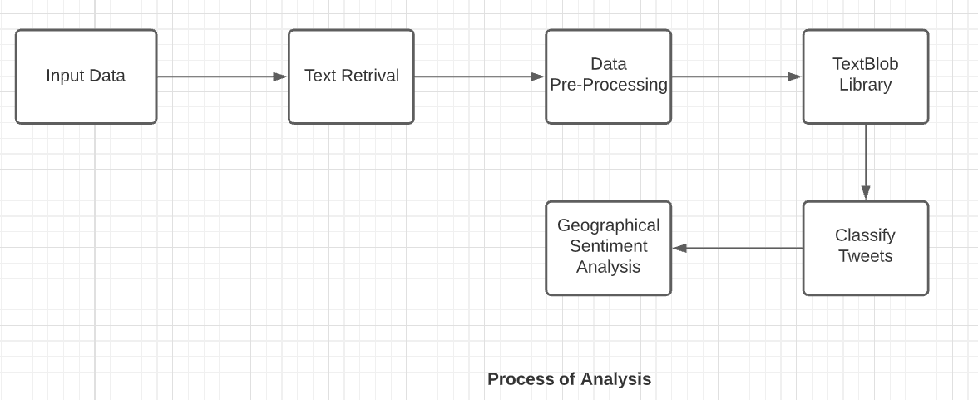
Process of Analysis

Slide 6
What is Textblob?
TextBlob is a Python (2 and 3) library for processing textual data.
It provides a simple API for diving into common natural language processing (NLP) tasks such as,
sentiment analysis,
Classification,
Tokenization, and more.

Slide 7
Polarity and Subjectivity
Based on the polarity and subjectivity, you determine whether it is a positive text or negative or neutral.
For TextBlog, if the polarity > 0, it is considered positive, polarity < 0 -is considered negative and polarity = 0 is considered neutral.
Whereas, a subjectivity/objectivity identification task reports a float within the range [0.0, 1.0] where 0.0 is a very objective sentence and 1.0 is very subjective.

Slide 8
Deliverable Expected
To implement an algorithm for automatic classification of text into positive, negative or neutral.
Sentiment Analysis to determine the attitude of user is positive, negative or neutral towards the Pfizer Vaccine.
Sentiment analysis on Pfizer vaccine tweets will be done for user location.

Slide 9
Thank you

