Slide 1
http://www.vidyanidhi.com/
ketkiacharya.net@gmail.com
Ketki Acharya
From: SM VITA ATC of CDAC
9769201036
ketkiacharya.net@gmail.com

Slide 2
Function
Since javascript is dynamically typed programming language function can return any type of data and it need not mention the type.
<script>
"use strict";
function go()
{
document.write("hello");
}
go(); //function call
var r=go(); undefined
console.log(r);//Undefine
document.write(typeof(go)); //function
document.write("<hr/>");
document.write(go); //function defination
</script>
In the above example observe no datatype before function. In the above example r will get value “Undefined” . By default function will return undefined.
Function definition
function go()
{
document.write("hello");
}

Slide 3
Passing parameter to function
<script>
"use strict";
function call(a,b)
{ var p;
p=a*b
return p;
}
var x , y;
x=5;
y=7;
var r=call(x,y);
document.write(r);
document.write(call(3,3));
</script>
Observe we do not have to write any type before a, b in function definition.
function call(a,b){ }
Every function has it’s own copy of variable.
We know function makes code reusable.
a
b
p
5
7
35
a
b
p
3
3
9
x
y
r
5
7
35
9

Slide 4
Passing insufficient parameter to function
<script>
"use strict";
function call(a,b)
{ var p;
p=a*b
return p;
}
var x , y;
x=5;
y=7;
var r=call(x);
document.write(r);
document.write(call(3,3));
</script>
In javascript if you pass only one parameter in function call and have two parameter in definition. It is not an error.
function call(a,b)
{ }
var r=call(x);
Observe we do not have to write any type before a, b in function definition.
function call(a,b){ }
Every function has it’s own copy of variable.
We know function makes code reusable.
a
b
p
5
undefined
NaN
a
b
p
3
3
9
x
y
r
5
7
NaN
9

Slide 5
Passing insufficient parameter to function and checking undefined
a
<script>
"use strict";
function call(a,b)
{ var p;
if(a!=undefined&&b!=undefined)
p=a*b
else if(a!=undefined)
p=a;
return p;
}
var x , y;
x=5;
y=7;
var r=call(x);
document.write(r);
document.write(call(3,3));
</script>
In javascript if you pass only one parameter in function call and have two parameter in definition. It is not an error.
function call(a,b)
{ }
var r=call(x);
We can avoid NaN by checking undefine before calculation.
5
b
p
undefined
5
a
b
p
3
3
9
x
y
r
5
7
5
9
if(a&&b)

Slide 6
Logically setting default value
<script>
"use strict";
function call(a,b)
{ var p;
b=b || 3;
p=a*b
return p;
}
var x , y;
x=5;
y=7;
var r=call(x);
document.write(r);
document.write(call(3,4));
</script>
What is false in java script
0
undefined

Slide 7
Default argument
a
<script>
"use strict";
function call(a,b=1)
{ var p;
p=a*b
return p;
}
var x , y;
x=5;
y=7;
var r=call(x);
document.write(r);
document.write(call(3,3));
</script>
In javascript if you pass only one parameter in function call and have two parameter in definition. It is not an error. You can set default value for second parameter.
If user pass second parameter then default value will be overridden.
function call(a,b)
{ }
var r=call(x);
We can avoid NaN by checking undefine before calculation.
Default parameter has to be last.
If you set default parameter in between you will get error
5
b
p
1
5
a
b
p
3
1 3
9
x
y
r
5
7
5
9

Slide 8
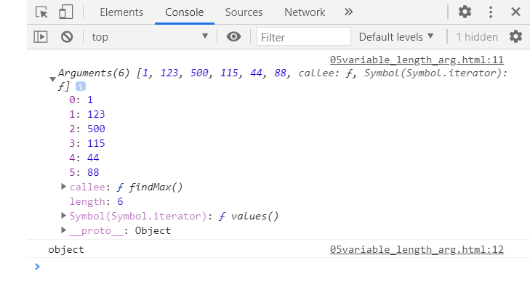
Variable length of argument
<script>
"use strict";
function findMax() {
var i, max = arguments[0];
for (i = 1; i < arguments.length; i++) {
if (arguments[i] > max) {
max = arguments[i];
}
console.log(arguments);
console.log(typeof arguments)//Object
}
return max;
}
var x = findMax(1, 123, 500, 115, 44, 88);
document.write(x);</script>
Arguments
arguments
Callee:
Symbole:
0 | 1 | 2 | 3 | 4 | 5
1 | 123 | 500 | 115 | 44 | 88
arguments object contains all arguments passed to the function;
the arguments object is not a real array
methods like sort, map, forEach or pop can not be applied on it directly;
the arguments object has additional functionality specific to itself (like the callee property).
You can call findMax() function with different number of parameter
Call findMax(2,9)
Call findMax(9,8,2)

Slide 9
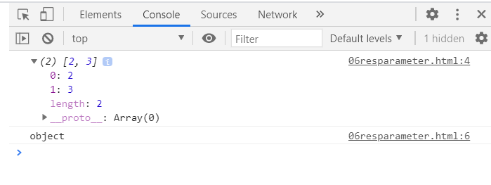
Rest parameter
function multiply( ...myarg) { }
In above line myarg is rest parameter observe 3 dots
<script>
"use strict";
function multiply(...myarg) {
console.log(myarg) //
console.log(typeof myarg)// object
console.log(myarg.constructor)// object
let sum=0;
for(let i=0;i<myarg.length;i++)
sum=sum+myarg[i];
return sum;
}
var arr = multiply( 2, 3);
document.write(arr);
arr = multiply( 2, 3,5,6,7);
</script>
myarg
2 | 3
2
3
arr
5

Slide 10
Rest parameter
Uncaught SyntaxError: Rest parameter must be last formal parameter
You will get above error if your rest parameter is not last parameter
function multiply( ...myarg, m) { }
In above line rest parameter is in the beginning
<script>
"use strict";
function multiply(m, ...myarg) {
console.log(myarg) //2.3
console.log(typeof myarg)// object
let sum=0;
for(let i=0;i<myarg.length;i++)
sum=sum+myarg[i];
return sum;
}
var arr = multiply( 1, 2, 3);
document.write(arr);
</script>
m
1
0 | 1
2 | 3
arr
5
1
2
3

Slide 11
Difference between rest parameters and the arguments object
There are three main differences between rest parameters and the arguments object:
rest parameters are only the ones that haven't been given a separate name, while the arguments object contains all arguments passed to the function;
the arguments object is not a real array, while rest parameters are Array instances, meaning methods like sort, map, forEach or pop can be applied on it directly;
the arguments object has additional functionality specific to itself (like the callee property).

Slide 12
spread
Closely related to rest parameters is the spread operator. While rest parameters allow you to specify that multiple independent arguments should be combined into an array, the spread operator allows you to specify an array that should be split and have its items passed in as separate arguments to a function
x
y
<script>
"use strict";
function myFunction(x, y, z)
{ return x+y+z;
}
var args = [0, 1, 2];
var r=myFunction(...args);
console.log(r);
</script>
Any argument in the argument list can use spread syntax and it can be used multiple times.
z
0
1
2
args
0 | 1 | 2
0 | 1 | 2

Slide 13
Spread parameter can be written any where in function call.
v
w
y
x
<script>
"use strict";
function myFunction(v, w, x, y, z) { }
var args = [0, 1];
myFunction(-1, ...args, 2)
<script>
-1
0
1
2
-1
0 | 1
2
args

Slide 14
“use strict” is good practice else see the problem
external memory block
<script>
//observe you have not used use strict
var x; //global variable
function call()
{
a=5; //global variable
var c=7; //local variable
document.write("welcome");
alert("hi");
x=9;
}
//document.write(a); //uninitialized variable as function call is not done yet
call();
document.write(a); //5 as it is define after function call
//document.write("with var"+c); //out of scope
document.write(x);
</script>
X
Undefined 9
a=5
c
7

