Slide 1
http://www.vidyanidhi.com/
ketkiacharya.net@gmail.com
Ketki Acharya
From: SM VITA ATC of CDAC
9769201036
ketkiacharya.net@gmail.com

Slide 2
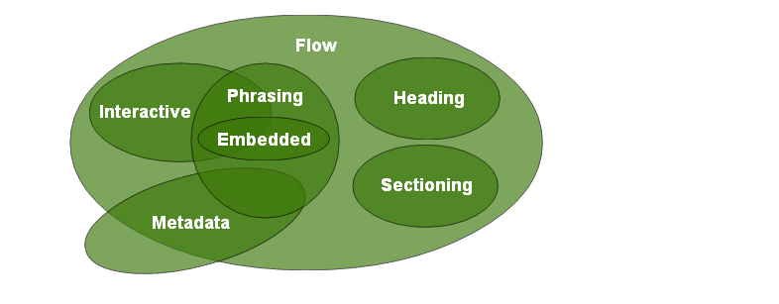
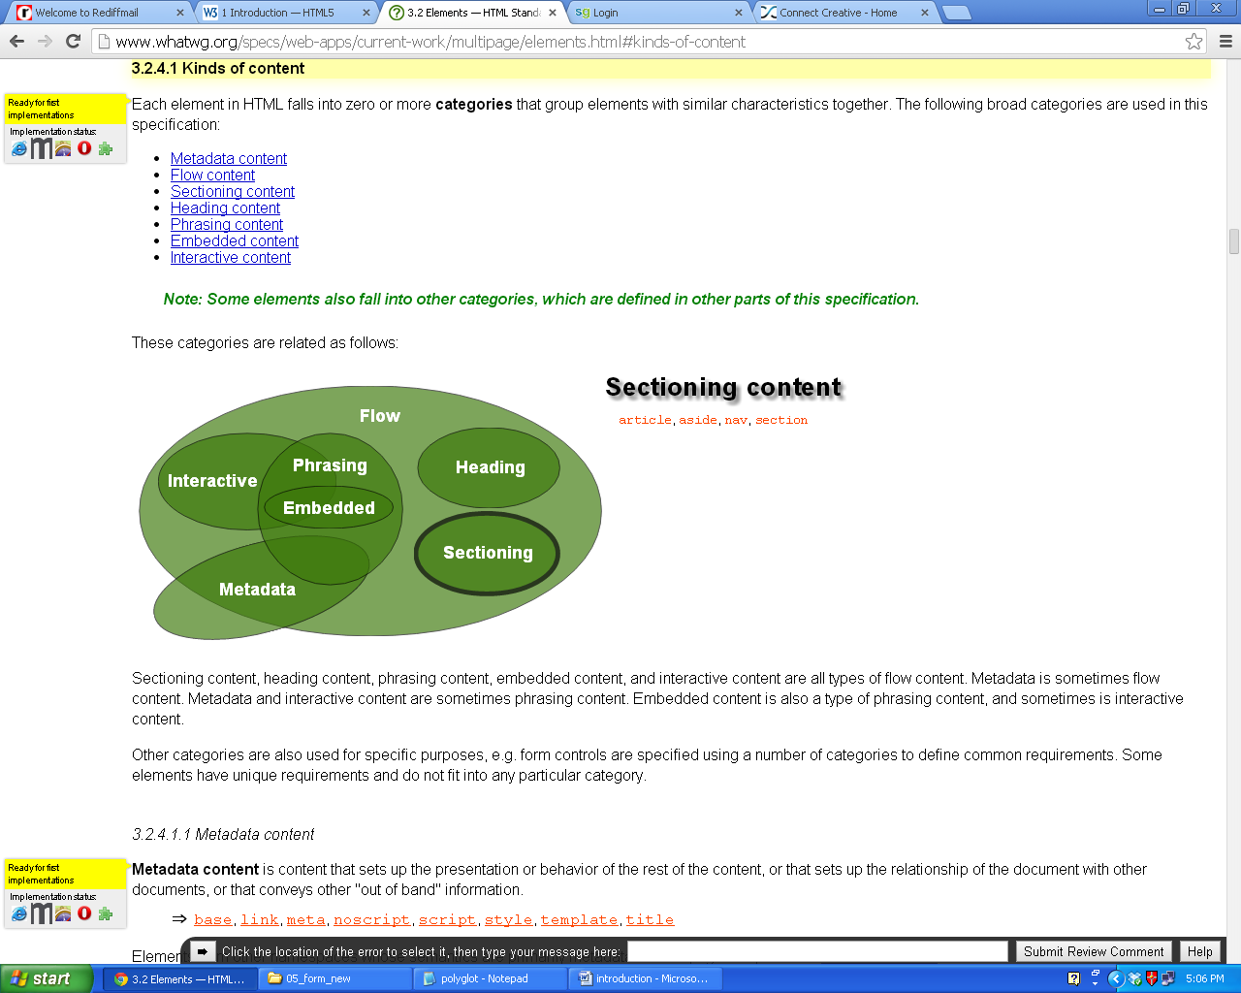

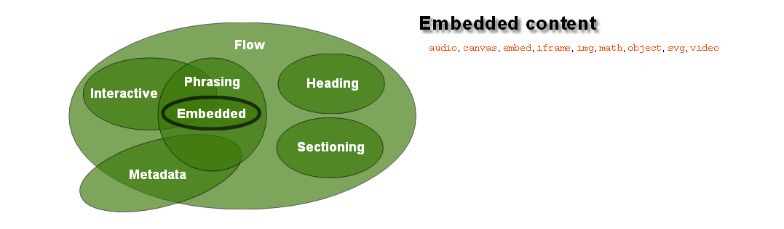

Slide 3
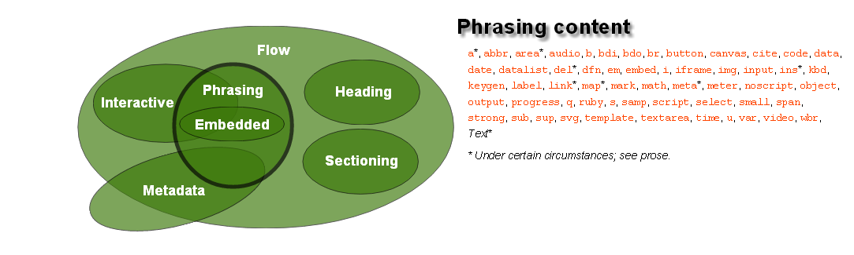
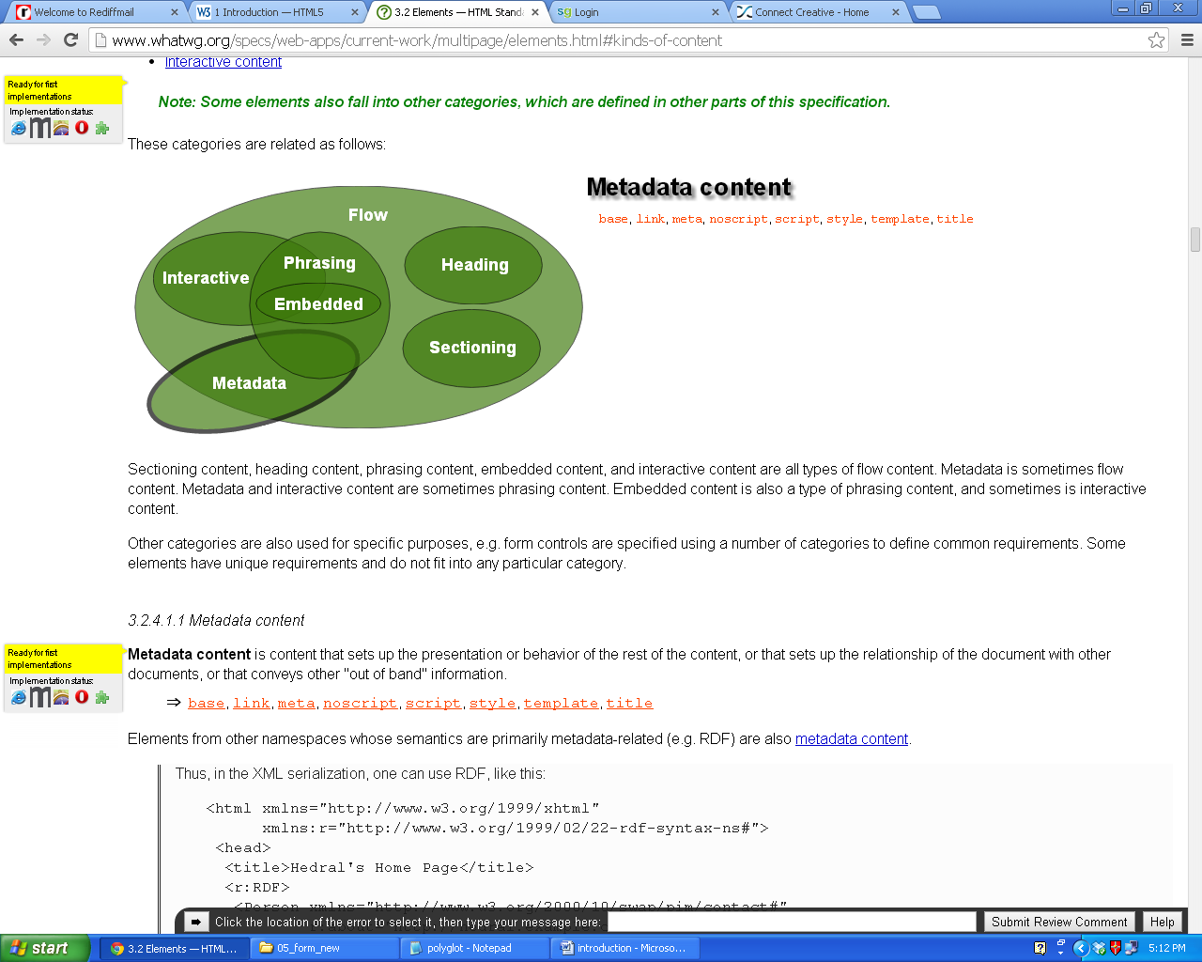
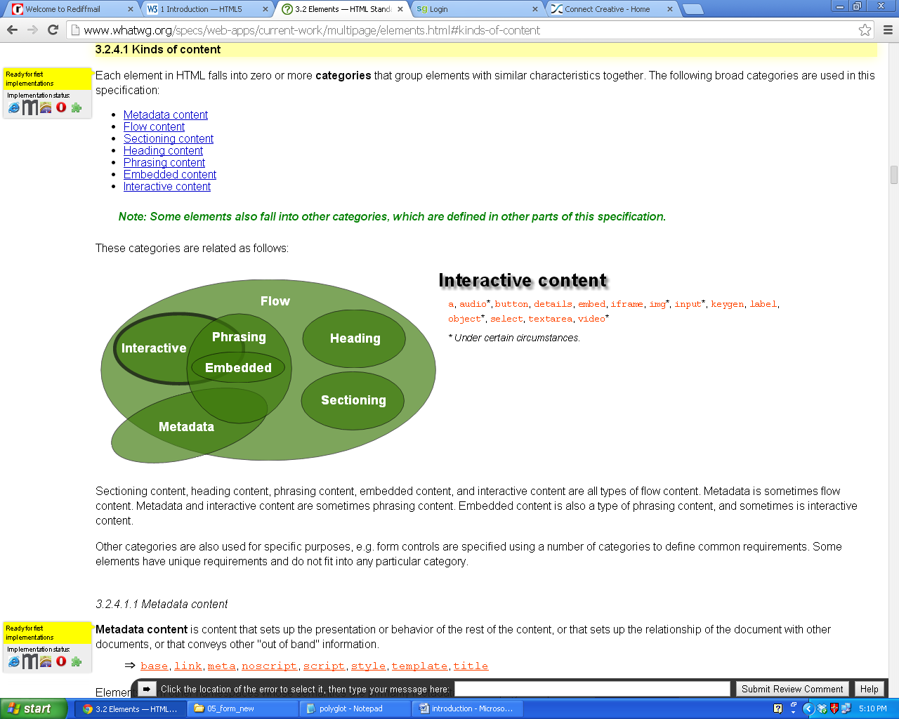

Slide 4
What is the WHATWG?
The Web Hypertext Application Technology Working Group (WHATWG) is a growing community of people interested in evolving the Web. It focuses primarily on the development of HTML and APIs needed for Web applications.
The WHATWG was founded by individuals of Apple, the Mozilla Foundation, and Opera Software in 2004, after a W3C workshop. Apple, Mozilla and Opera were becoming increasingly concerned about the W3C’s direction with XHTML, lack of interest in HTML and apparent disregard for the needs of real-world authors. So, in response, these organisations set out with a mission to address these concerns and the Web Hypertext Application Technology Working Group was born.
What is the WHATWG working on?
The WHATWG's main focus is the HTML standard, which also includes Web Workers, Web Storage, the Web Sockets API, and Server-Sent Events. Occasionally, specifications outside WHATWG space are discussed on the WHATWG mailing list; recent examples include a crypto API, HTML editing APIs, and the UndoManager specification.

Slide 5
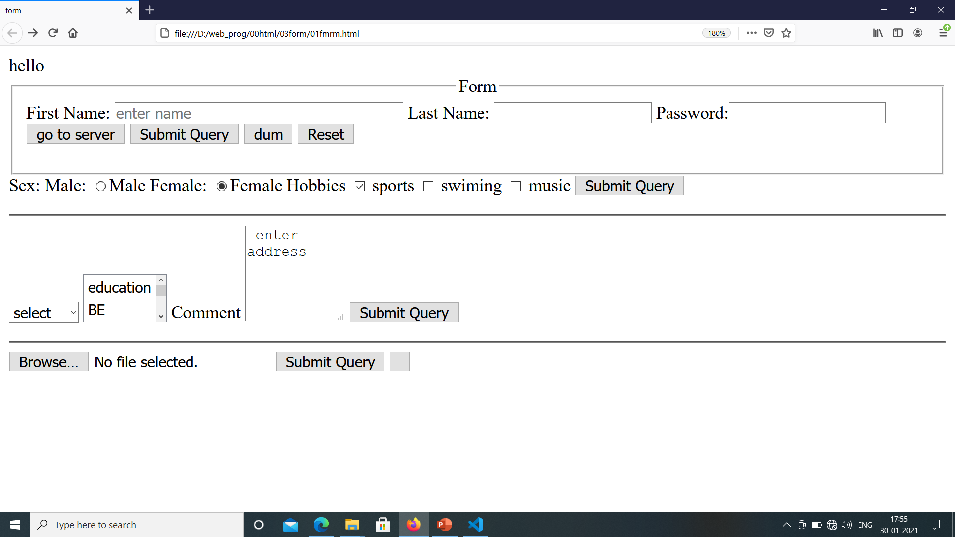
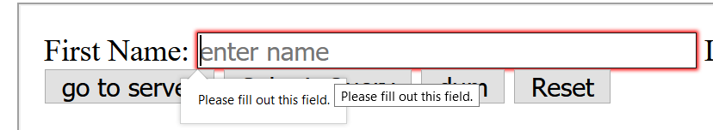
Form node has all from component
Putting data scattered is not a good practice so even First name we put in label tag.
For attribute is used for accessibility rule ie. jaws software a voice device speak: label for first name:
<input />
Above line is same as
<input type=“text"/>
If you keep firstname field empty and if you click submit it will give error.
<fieldset><legend align="center">Form</legend>
<form action="02frm_post.html" method= “GET” onsubmit="return true">
<label for="first name">First Name:</label>
<input name="fnm" size="40" placeholder="enter name" required/>
<input type="submit" />
<input type="button" value="dum"/>
<input type="reset"/>
</form>
</fieldset>

Slide 6
Input type submit reset button
Submit hit the server. It send data to server, if method is GET you can see data in url as key value pair. Key is nothing but name attribute of the component. If you forget to put name attribute it will not able to send data to server.
<input name="fnm“/>
If Method is POST data will go as FormData and it is not visible in URL.
Get method can send only 255kb where as POST method can send more data.
When you upload file we must use method POST
02frm_post.html?fnm=vita&lnm=vidyanidhi&lm=nod
FormData:
fnm=vita
When you click on submit button onsubmit event get fired which has default value onsubmit="return true“ ie. it will send control to <form action="02frm_post.php”> and it will send data to php file.
So we say submit listen to action. And
<form action="02frm_post.html" method= “GET” onsubmit="return true">
onsubmit is form level event as it will send entire form data to server.
TRY: onsubmit="return false“ in this case it will not listen to action and control stays in current form.
<form action="“> if you do not put action then bydefault page is submitted to it self
Reset:the job of reset is to clear form and when you click on reset onreset event get fired which is also form level event. <input type=“reset" value=“clear"/> what ever you assign to value attribute that value is visible on reset button.
Button: button is dum button it can’t do anything unless you add some javascript code. Ie.you have to write onclick=“dojob()” where dojob is name of function written in java script.
We can also use <Button> SUBMIT FORM</Button> pair tag. or
<Button type="submit"> SUBMIT FORM</Button>

Slide 7
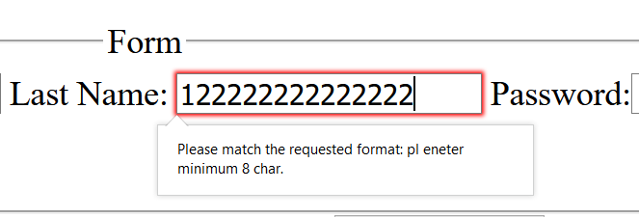

<html><head>
<title>form</title>
</head>
<body>
<fieldset>
<legend align="center">Form</legend>
<form action="02frm_post.html" onsubmit="return true">
<label for="enterfirst name">First Name:</label>
<input name="fnm" size="40" placeholder="enter name" required/>
<label>Last Name:</label>
<input name="lnm" maxlength="15" pattern='[a-zA-Z]{8,15}'
title="pl eneter minimum 8 char"/>
<label>Password:</label><input type="password" name="lm" maxlength="3"/>
<button>go to server</button>
<input type="submit" />
<input type="button" value="dum"/>
<input type="reset"/>
</form>
</fieldset>
x
pattern='[a-zA-Z]{8,15}’ this says user can only character minimum 8 and maximum 15 character.
pattern=‘[a-zA-Z0-9]{8,15}’ this says user can only enter digit char [small,cap] and it has to be minimum 8 and maximum 15.
pattern=‘[0-9]{10}’ this says user can only enter digit and it has to be exact 10 digit.
maxlength="3“ ie. maximum character allowed is 3 and it will not allow you to type further
Type password does not show character.

Slide 8
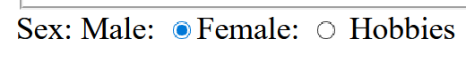
Radio button give choice to user and user can select only
One value. Eg.: Yes No or Male Female etc.
In radio button name has to be same
Other wise it will allow you to select both radio button.
<input type="radio" name="mf" value="M"/>Male
When user click on submit , value will go to server ie. it will send data mf= M to server
Checked key word set default value female as checked when you load a page.
<form action="">
<label>Sex:</label>
<label>Male:</label>
<input type="radio" name="mf" value="M"/>
<label>Female:</label>
<input type="radio" name="mf" value="F"
checked/>
</form >

Slide 9
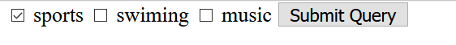
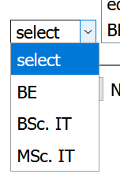
Check box allow you to select multiple option
Eg. Hobbies, buy product, add topping for pizza etc.
Checked key word set default value sports as checked when you load a page.
If method is GET
?mf=M&chk1=sports&chk2=swimings
You can see the data.
And concatenation in URL is &
If you do not use value attribute you will not able to send data to server.
<label>Hobbies</label>
<input type="checkbox" name="chk1" value="sports" checked="checked"/>
<label>sports</label>
<input type="checkbox" name="chk2" value="swimings"/>
<label>swiming</label>
<input type="checkbox" name="chk3" value="music"/>
<label>music</label>
Selected key word set default value MSc. IT
as selected when you load a page.
Dropdown help you to select one value.
If you want you to allow multiple option to be selected in that case add attribute multiple.
Observe dsp[] so it will go as array
<select name="sl">
<option value="-1">select</option>
<option value="1">BE</option>
<option value="2">BSc. IT</option>
<option value="3“ selected>MSc. IT</option>
</select>
<select name="dsp[]" multiple="multiple">

Slide 10


<label>Comment</label>
<textarea rows="5" cols="10" name="cmt"> enter address</textarea>
It is used to write comment or address
<form enctype="multipart/form-data" action="a.php" method="post">
<input type="file“ multiple name="f"/>
To upload file you have to set enctype="multipart/form-data" and method has to be POST.
<input type="hidden" name="raz" value="good customer"/>
Above line does not show any value on page but can send data
raz=good customer

Slide 11
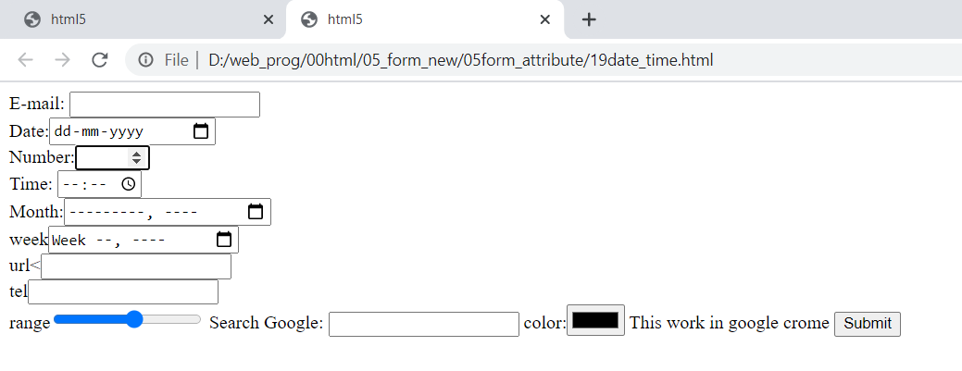
<form autocomplete="on">
First name: <input type="text" name="fname" placeholder="enter first name" autofocus autocomplete required minlength="3" maxlength="10" />
E-mail: <input type="email" name="email" autocomplete="off" /><br />
Date:<input type="date" name="dt" /><br />
Number:<input type="number" name="nm" min=5 max=50 step=3 autofocus="autofocus"/><br />
Time: <input type="time" name="time" /><br />
Month:<input type="month" name="mon" /><br />
week<input type="week" name="week" /><br />
url<<input type="url" name="path" /><br />
tel<input type="tel" name="tel" /><br />
range<input type="range" name="points" min="1" max="10">
Search Google: <input type="search" name="googlesearch">
color:<input type="color" name="col">
<input type="submit" formnovalidate="formnovalidate“ formaction="datalist.html“formmethod="post" formtarget="_blank“>

Slide 12
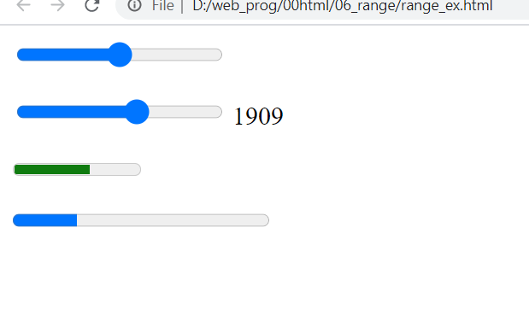
<form oninput="r.value=b.valueAsNumber">
<input type="range" name="b" min="300" max="3000">
<output name="r"></output>
</form>
<p><meter value="3" min="0" max="5">???</meter></p>
<p><progress value="5" min="0" max="5">???</progress></p>

Slide 13
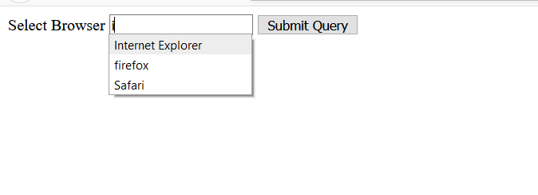
<!DOCTYPE html>
<html>
<body>
<form action="demo_form.asp" method="get">
<!-- value of list and id has to be same-->
Select Browser
<input list="brow" name="br"/>
<datalist id="brow">
<option value="Internet Explorer"/>
<option value="firefox"/>
<option value="chrome"/>
<option value="opera"/>
<option value="Safari"/>
<option value="netscape"/>
</datalist>
<input type="submit"/>
</form></body></html>

Slide 14
<a href="http://www.vita.com/html5" accesskey="h">HTML5 tutorial</a><br />
<a href="http://www.vita.com/css3" accesskey="c">CSS3 tutorial</a>
<p><b>Note:</b> Use Alt + <i>accessKey</i> (or Shift + Alt + <i>accessKey</i>)
to access the element with the specified access key.</p>
<menu type="toolbar">
<li><menu>home|image|contect</menu></li>
<li><menu>edit|copy</menu></li>
</menu><hr>
<menu>my data</menu>hjghj
<header>HTML 5</header>
<nav>Video <br />Audio<br/>drgdrop<br /></nav>
<hgroup style="color:red">
<h1>Welcome to my WWF</h1>
<h2>For a living planet</h2>
</hgroup>
<article> Learning about storage
<section> Web storage </section>
<section> Local storage </section>
</article>
<aside>some image or reference data</aside>
<footer>Done by VITA</footer>
<p>My favorite color is <del>blue</del> <ins>red</ins>!</p>
HTML5 Document:
The following tags have been introduced for better structure:
section: This tag represents a generic document or application section. It can be used together with h1-h6 to indicate the document structure.
article: This tag represents an independent piece of content of a document, such as a blog entry or newspaper article.
aside: This tag represents a piece of content that is only slightly related to the rest of the page.
header: This tag represents the header of a section.
footer: This tag represents a footer for a section and can contain information about the author, copyright information, et cetera.
nav: This tag represents a section of the document intended for navigation.
dialog: This tag can be used to mark up a conversation.
figure: This tag can be used to associate a caption together with some embedded content, such as a graphic or video.

Slide 15
Header |  | Aside
Article product Headphone | stereo
Footer

Slide 16
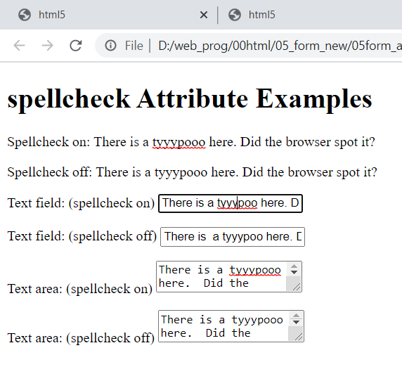
<!DOCTYPE html><html><head>
<meta http-equiv="Content-Type" content="text/html; charset=utf-8">
<title>HTML 5 spellcheck Attribute Examples</title></head>
<body>
<h1>spellcheck Attribute Examples</h1>
<p spellcheck="true" contenteditable="true">Spellcheck on: There is a tyyypooo here. Did the browser spot it?
</p>
<p spellcheck="false" >Spellcheck off: There is a tyyypooo here. Did the browser spot it?</p>
<form action="#" method="get">
<p>
<label>Text field: (spellcheck on)</label>
<input type="text" name="textfield" spellcheck="true" value="There is a tyyypoo here. Did the browser spot it?">
</p>
<p><label>Text field: (spellcheck off)</label>
<input type="text" name="textfield" spellcheck="false" value="There is a tyyypoo here. Did the browser spot it?">
</p>
<p><label>Text area: (spellcheck on)</label>
<textarea name="comments" spellcheck="true">There is a tyyypooo here. Did the browser spot it?</textarea>
</p>
<p><label>Text area: (spellcheck off)</label>
<textarea name="comments" spellcheck="false">There is a tyyypooo here. Did the browser spot it?</textarea>
</p>
</form></body></html>
spellcheck="true“
contenteditable="true“

Slide 17
Micro data –Figure and figcaption
<div itemscope>
My birthday is:
<time itemprop="birthday" datetime="1971-05-08">
Aug 5th 1971
</time>
</div>
<div itemscope>
<p>My name is <span itemprop="name">Zara</span>.</p>
</div>
<html>
<body>
<figure itemscope itemtype="http://n.whatwg.org/work">
<img itemprop="work" src="mypond.jpg">
<figcaption>
<p><cite itemprop="title">My Pond</cite></p>
<p><small>Licensed under the
<a itemprop="license" href="http://creativecommons.org/licenses/by-sa/3.0/us/">
Creative Commons Attribution-Share Alike 3.0 United States License</a>
and the
<a itemprop="license" href="http://www.opensource.org/licenses/mit-license.php"> MIT license</a>.
</small>
</p>
</figcaption>
</figure></body></html>

Slide 18
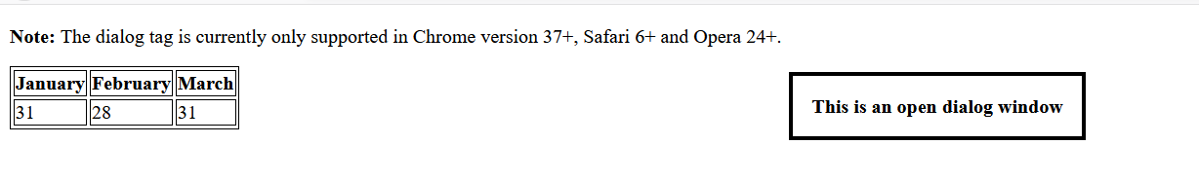
Video- audio
<audio controls>
<source src="song.ogv" type="audio/ogg" />
<source src="song.mp3" type="audio/mpeg" />
Your browser does not support the audio element.</audio>
<!DOCTYPE html>
<html><body>
<video width="520" height="540" muted autoplay loop controls
poster="a.bmp">
<source src="shuttle.ogv" type="video/ogv" />
<source src="shuttle.mp4" type="video/mp4" />
Your browser does not support the video tag.
</video>
<hr/>
<h3> autopaly attribute paly vedio on load</h3>
</body></html>
Autoplay will work only if video is muted
<!DOCTYPE html>
<html><head>
<style>
table, th, td { border: 1px solid black;
}
</style></head><body>
<p><b>Note:</b> The dialog tag is currently only supported in Chrome version 37+, Safari 6+ and Opera 24+.</p>
<table>
<tr>
<th>January <dialog open>This is an open dialog window
</dialog></th>
<th>February</th> <th>March</th>
</tr>
<tr>
<td>31</td> <td>28</td> <td>31</td>
</tr></table></body></html>

Slide 19
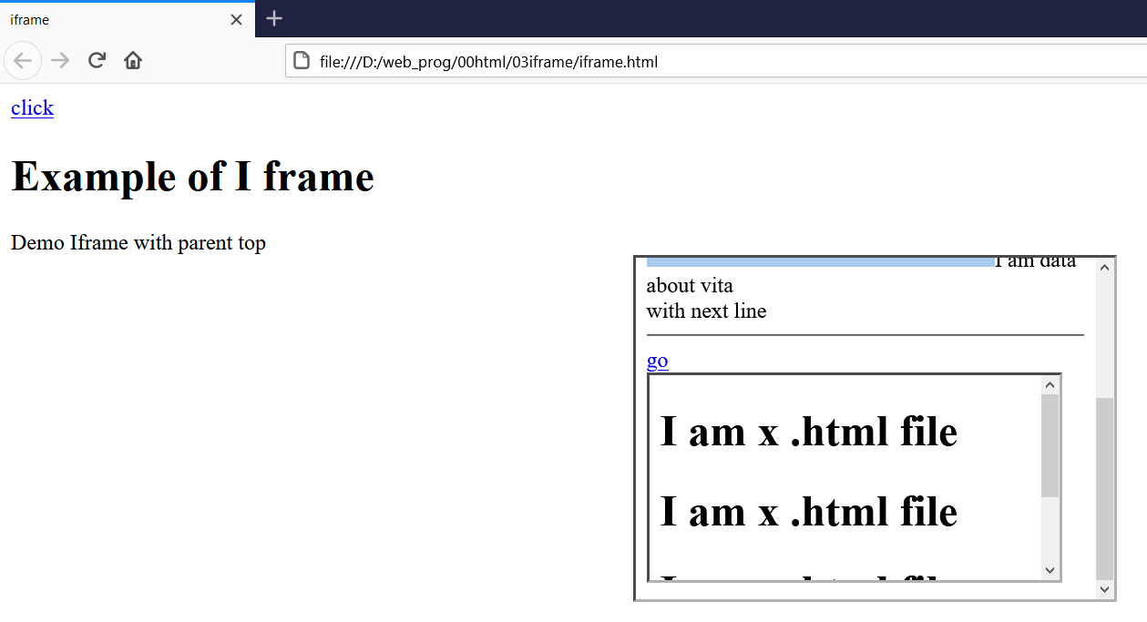
<!DOCTYPE html>
<html><head>
<title>iframe</title>
</head>
<body>
<a href="b.html" target="a"> click</a>
<h1> Example of I frame</h1>
Demo Iframe with parent top <center>
<iframe name="a" src="a.html"
height="250" width="350"/></center>
<hr/>
</body>
</html>
TOP
parent
child
_self
_top
_parent
_blank

Slide 20
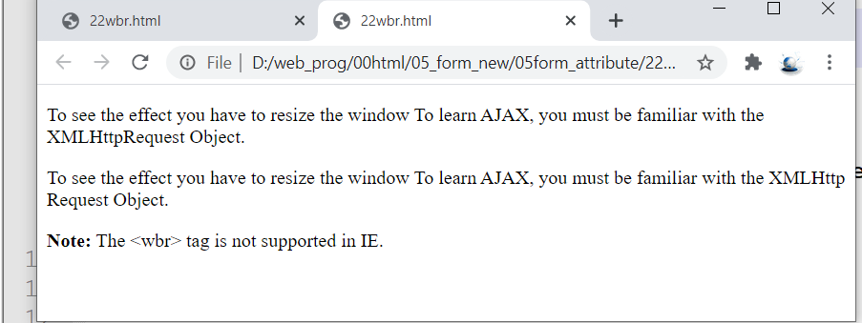
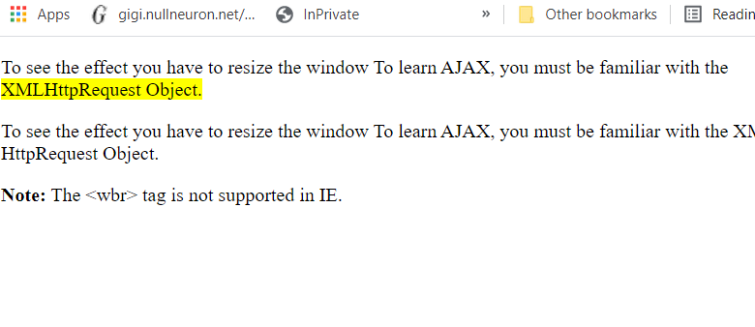
Wbr wordbreak
<!DOCTYPE html>
<html>
<body>
<p>Try to shrink the browser window,
to view how the word <mark> XMLHttpRequest <mark>in
the paragraph below will break:</p>
<p>To learn AJAX, you must be familiar with the
XML<wbr/>Http<wbr/>Request Object.</p>
<p><b>Note:</b> The &lt;wbr&gt; tag is not supported in IE.</p>
</body>
</html>

Slide 21
What are Semantic Elements?
A semantic element clearly describes its meaning to both the browser and the developer.
Examples of semantic elements: <form>, <table>, and <img> - Clearly defines its content.
Examples of non-semantic elements: <div> and <span> - Tells nothing about its content.

Slide 22
Create form with following detail all filled required
Name:➔min3 max=15
Password➔8, 16
Address➔min =5 max 25
Age➔number (18,99)
Email➔
DOB➔date
URL➔
Hobbies➔ dance music sports
Gender ➔Radio
Education➔ dropdown upload your resume ➔ submit (home.html) and reset
Display your image and write 5 line next to image➔ display video
Display mark sheet in table

