Slide 1
http://www.vidyanidhi.com/
ketkiacharya.net@gmail.com
Ketki Acharya
From: SM VITA ATC of CDAC
9769201036
ketkiacharya.net@gmail.com

Slide 2
DHTML
Dynamic HTML-HTML-CSS-Javascript

Slide 3
What is CSS?
CSS stands for Cascading Style Sheets
Styles define how to display HTML elements
Styles are normally stored in Style Sheets
Styles were added to HTML 4.0 to solve a problem
External Style Sheets can save you a lot of work
External Style Sheets are stored in CSS files
Multiple style definitions will cascade into one

Slide 4
Problems with HTML
Need to repeat a formatting of tag as many time as you are using that tag .
Eg. all heading in blue color
Client can see your source
Limitation about positioning of data
Limitation about font size
Cannot give separate background to diff area.

Slide 5
CSS was a breakthrough in Web design
it allowed developers to control the style and layout of multiple Web pages all at once.
As a Web developer you can define a style for each HTML element and apply it to as many Web pages as you want. To make a global change, simply change the style, and all elements in the Web are updated automatically.

Slide 6
Advantages of CSS
Write once use en number of time.
Client can not see your source
Provide consistency in your different page of a same web site, Enforce standards and uniformity.
Ability to make global changes to all documents from a single location

Slide 7
css syntext is made up of three parts:
a selector(tag),
a property(attribute)
and value:
Eg
H3 { color : red ;
background-color:pink }

Slide 8
How to begin
<head>
<style type=“text/css”>
P { color : red;
Margin-left:20px }
</style>
</head>
<body>
<p>this a paragraph</p>
</body>
</html>
This is internal style sheet
All p tag will have text color red and margin 20px

Slide 9
External style sheet
Save this file as ext.css in external css file we do not use style tag
h1 {background-color:pink;
color:blue;
text-align:center
}

Slide 10
How to use external style sheet
<html>
<head>
<link rel="stylesheet" href="ex2.css"/>
</head>
<body>
<h3> hello</h3>
</body>
</html>

Slide 11
Inline stylesheet
<html>
<head>
<body>
<h5 style="color:maroon; margin-left:20px">
this is inline style
</h5>
</body>
<html>

Slide 12
Group selector
<html><head><style>
H1,h2,h3,h5 { color : green }
</style>
</head>
</body>
<h1>this is heading one</h1>
<h5>heading 5</h1>
</body>
</html>

Slide 13
<html><head><style>
p.center { text-align : center }
p.right { text-align : right }
</style>
</head><body>
<p class=“center”>paragraph is in center</p>
<p class=“right”>paragraph is in right</p>
</body>
</html>
You can use class right and center only with p tag.

Slide 14
<html><head><style>
.center { text-align : center }
.right { text-align : right }
</style>
</head><body>
<p class=“center”>paragraph is in center</p>
<h1 class=“right”>paragraph is in right</p>
</body>
</html>
You can use this class with any tag

Slide 15
You are allowed to use multiple class in a tag
<html><head><style>
.center { text-align : center }
.col { text-align : right ;
color:green
}
</style>
</head><body>
<p class=“center”>paragraph is in center</p>
<h1 class=“col center” >paragraph is in right</p>
</body>
</html>

Slide 16
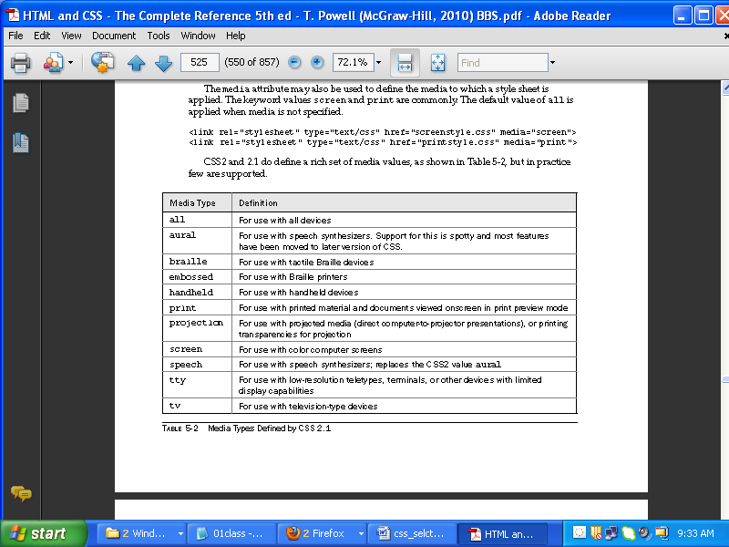

Slide 17
Imported Styles—@import
Within embedded <style> blocks, properties can be imported from an external file and
expanded in place, similar to a macro. Importing can be used to include multiple style
sheets. An imported style is defined within a <style> tag using @import followed
optionally by a type value and a URL for the style sheet:
<style type="text/css">
@import url(newstyle.css);
@import print url(printstyle.css);
</style>

Slide 18
The @import directive allows style sheets to be grouped and joined together, though
some might wonder what the value of this function is given what linked styles provide.
NOTE Some CSS developers use the @import directive to perform a weak form of browser
selection, because many older CSS implementations do not support the directive. The basic idea
of the trick is to put sophisticated style rules in an @import style sheet and leave basic styles in
the style block. This trick should be avoided, particularly given that some browsers, notably
versions of Internet Explorer, will cause a disturbing flash effect when loading imported styles.

Slide 19
Order of execution
Order of execution is top to bottom so in our example
Internal
External
If we have conflicting property ie.
In external :h1,h2,h3 {background-color:blue;}
And
Internal: h1,h2,h3{background-color:yellow;}
In such situation order of execution is top to bottom
<!DOCTYPE HTML><html><head>
<title> css</title>
<style>
h1,h2,h3{background-color:yellow;}
</style>
<link rel="stylesheet" type="text/css" href="a.css">
</style>
</head>
<body>
<h1 style="font-family:Tahoma;">data</h1>
<p> this is external color and internal background</p>
<h2>data</h2>
<p> this is external color and internal background</p>
<h3 style="background-color:pink;">data</h3>
<p> this is external color and inlineground</p>
</body>
<html>
<!DOCTYPE HTML>
<html><head>
<title> css</title>
<link rel="stylesheet" type="text/css" href="a.css">
</style>
<style>
h1,h2,h3{color:red;
}
</style>
</head>
<body>
<h1>data</h1>
<p> this is external color and internal background</p>
<h2>data</h2>
<p> this is external color and internal background</p>
<h3 style="color:pink;">data</h3>
<p> this is external color and internal background</p>
</body>
<html>
a.css
h1,h2,h3{background-color:blue;
text-align:center;
}

Slide 20
Id Class as selector
Id has preference over class in case of same property set in class and id.
You can not use two ID together.
But you can use ID and class to`igether
<html>
<head><style>
#iden{background-color:green;
color:white
}
#idenn{color:blue;
margin-left: -8px
}
.idcl{font-family:Arial Black;
margin-left:-8px
}
</style>
<head><body>
<h4 id="iden">This is heading with id iden-having color white with background-green</h4>
<p id="idenn">This is id with blue color and margin left</p>
<h3 id="iden idenn">combination of id not allowed</h3>
<hr>
<p id="iden" class="idcl">This is combination of Id and class</p>
</body>
</html>

