Slide 1
http://www.vidyanidhi.com/
ketkiacharya.net@gmail.com
Ketki Acharya
From: SM VITA ATC of CDAC
9769201036
ketkiacharya.net@gmail.com

Slide 3
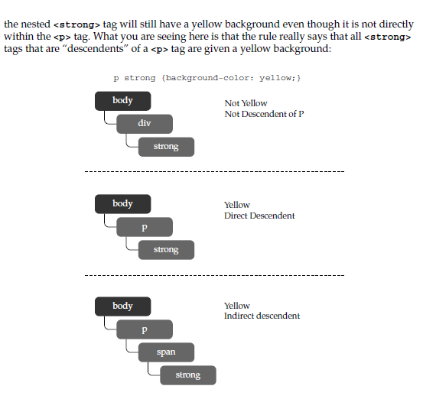
Descendent [Child and grand child]
p strong {background-color: yellow;}
all occurrences of the strong element within a p element have a yellow background. Other
occurrences of strong without a p ancestor element might not necessarily have the yellow
background.
TIP Be careful about the use of the space and comma in CSS selectors; it is easy to turn grouping
into contextual selection or vice versa with a simple typo.
Contextual selection does not require a direct parent-child relationship with elements.
For example, with the rule in the preceding example, you would find that given
<p>This <span>is not <strong>directly</strong>within</span>
the paragraph.</p>

Slide 4
<!DOCTYPE HTML>
<html><head><style>
p strong{color: red;} //space means child and grand child
</style></head>
<body>
This states that all paragraph elements that are directly after an h1 tag are red, as indicated by this markup:
<h1>I am a heading</h1>
<p>I am an
<strong>decendent paragraph</strong>
so I am red!</p>
<p>I am <i> italic<strong>indirectly decendent </strong>oh</i>so I am not red.</p>
<Blockquote>I am <strong> not descendent</strong> so I am not red</blockquote>
<p>data1</p>
<strong>strong</strong>
</body>
</html>

Slide 5
Direct child
<!DOCTYPE HTML>
<html>
<head>
<style>
h1 > strong {color: red;}
</style></head>
<body>
<h1>I am a heading
<strong>I am direct child I am red!</strong>
<em><strong>I am not red.</strong></em>good
</h1>
<h1>I am a heading</h1>
<strong>I am an adjacent paragraph ie sibling so I am not red!</strong>
<h1>I am a heading</h1>
<p>I am not child <strong>of h1</strong> so I am not red!</p>
<h1>I am <strong> a child</strong></h1>
</body></html>
h1 > strong {color: red;}
All strong tag inside h1 tag will have red color

Slide 6
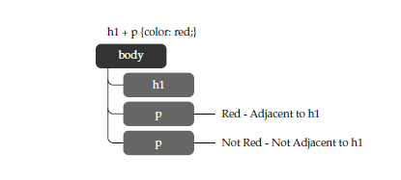
Adjacent Sibling Selectors
Adjacent-sibling selector is specified using the plus sign (+) and is
used to select elements that would be siblings of each other. For example, consider the
following rule:
h1 + p {color: red;}
This states that all paragraph elements that are directly after an <h1> are red, as indicated
by this markup:
<h1>I am a heading</h1>
<p>I am an adjacent paragraph so I am red!</p>
<p>I am not adjacent so I am not red.</p>
<!DOCTYPE HTML>
<html>
<head>
<style>
h1+p{color: red;}
</style></head>
<body>
This states that all paragraph elements that are directly after an h1 tag are red, as indicated
by this markup:
<p>I am above adjacent so I am not red.</p>
<h1>I am a heading</h1>
<p>I am an descendent paragraph so I am red!</p>
<p>I am not adjacent so I am not red.</p>
</body>
</html>

Slide 7
Preceding sibling ~
<!DOCTYPE HTML>
<html><head>
<style>
h1 ~ strong {color: red;}
</style>
</head>
<body>
This states that all strong elements that
are directly after an h1 tag are red, as indicated
by this markup:<hr/>
<strong>I am sibling of h1 but not descendent</strong><br/>
<strong>I am also sibling</strong>
<h1>I am a heading</h1>
<strong>I am adjacent sibling of h1!</strong><br/>
<strong>I am also sibling of h1 !</strong>
</body>
</html>
All strong tag will be of red colour provided it has h1 tag as preceding sibling
Here all strong tag after h1 will be of red color.

Slide 8
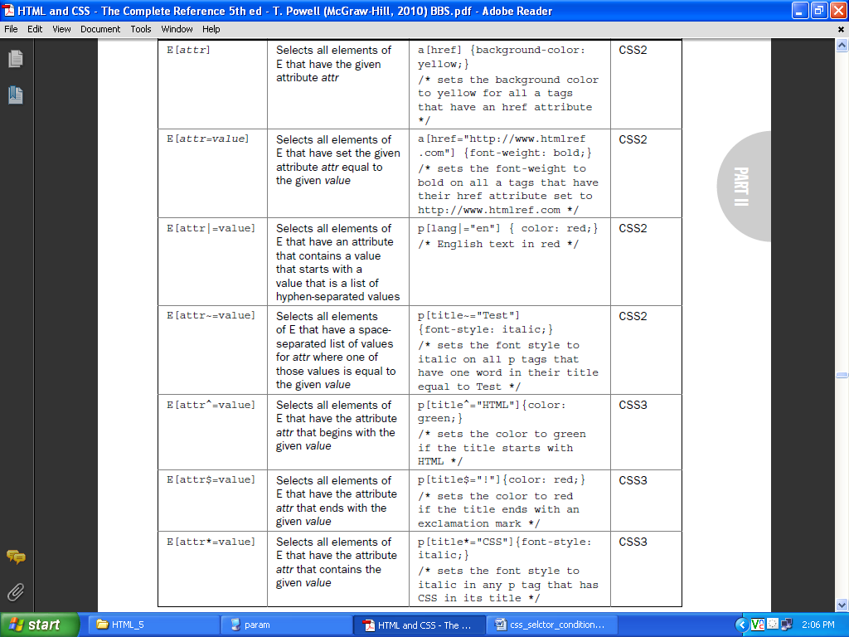

Slide 9
Hover
<!DOCTYPE html>
<html><head>
<meta http-equiv="Content-Type" content="text/html; charset=utf-8">
<title>Hover and Focus Pseudo-Class Example</title>
<style type="text/css" media="screen">
.annoy:hover {border-style: dashed; background-color: yellow;}
</style></head><body>
<p class="annoy">Roll over me.</p>
<p>Now <span class="annoy">roll over</span> that bit of text.</p>
</body>
</html>

