Slide 1



RETAIL DATA ANALYSIS
BY NIRAJ PAWAR
(PGA Thane)

Slide 2
1.PROBLEM STATEMENT:
In this project, you will analyze and predict the weekly sales of Retail company and see how the weekly sales are impacted by other variables. This will enable the Retail company to manage the effort required to win a deal to meet the growth targets.
OBJECTIVE 1: Predictive Analytics –
Build a ML model to predict the Weekly sales and enhance the growth of company
OBJECTIVE 2: Prescriptive Analytics –
Identify variables that are most likely to
help in increasing the weekly sales

Slide 3
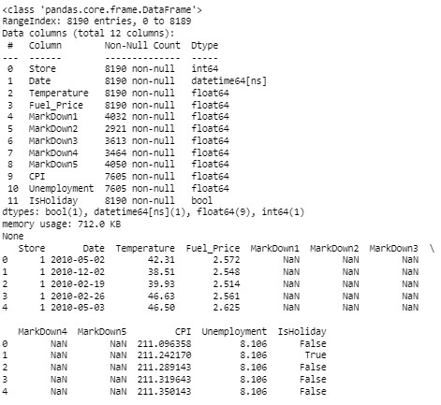
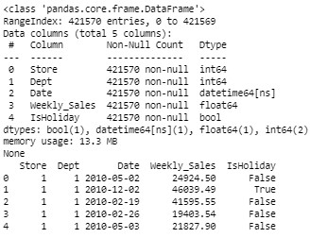
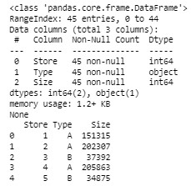
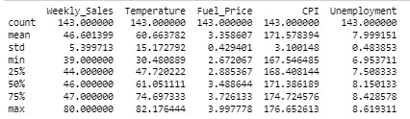
2.DATA UNDERSTANDING
Features data set
Sales Data Set
Stores Data Set Descriptive Statistics

Slide 4
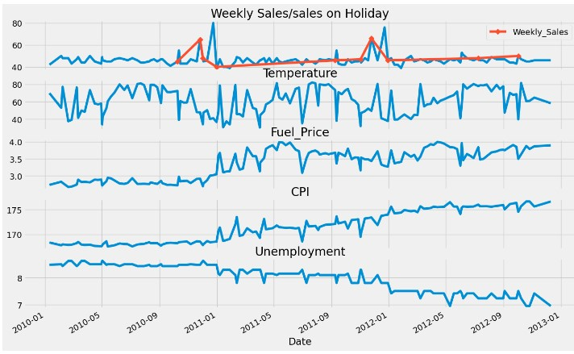
3.EDA (Exploratory Data Analysis)
Nov- Dec shows spike in Weekly Sales but over the year it is not increased.
Weeks nearby holiday shows peak
Fuel Price and Consumer Price Index shown growth over the year.
Unemployment decreased year after year.
Temperature is showing a random walk

Slide 5
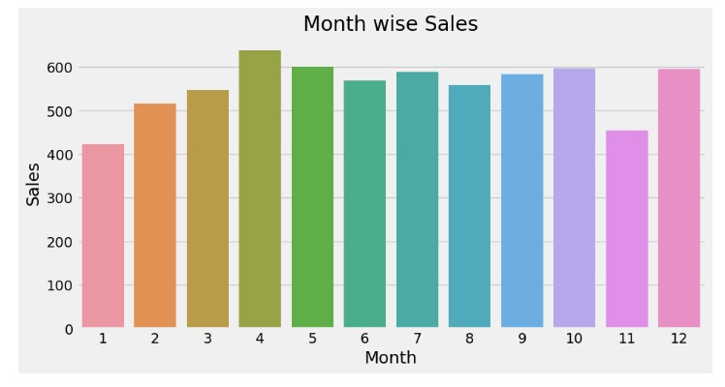
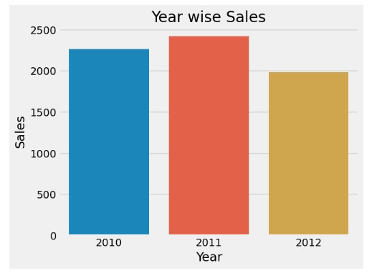

It could be as Enough buying during offer and holidays (Black friday Sales,Chrismas,New year) and later sales go down and then again gaining momentum in some months.
In Nov also people show less buying can be waiting period for upcoming sales.
Whole data for Dec-2013 I guess is not available so even after spike in Dec the sales are not gone very high.
2011 had a highest sales

Slide 6
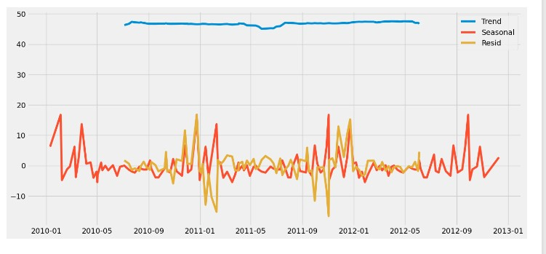
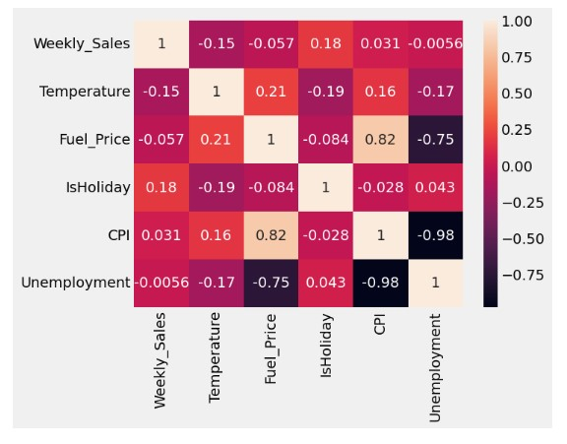
SEASONAL DECOMPOSE
It shows a sideway trend
HEAT MAP
Weekly sales doesnot show any high correlation with any other parameters.
CPI and Unemployment shows negative correlation on other hand Fuel Price show positive correlation
Unemployment and Fuel price are also negatively correlated

Slide 7
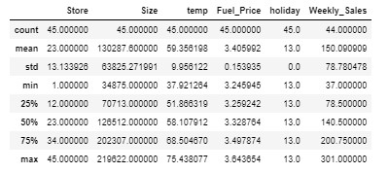
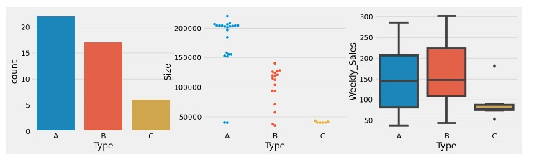
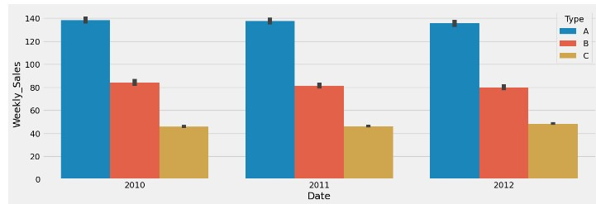
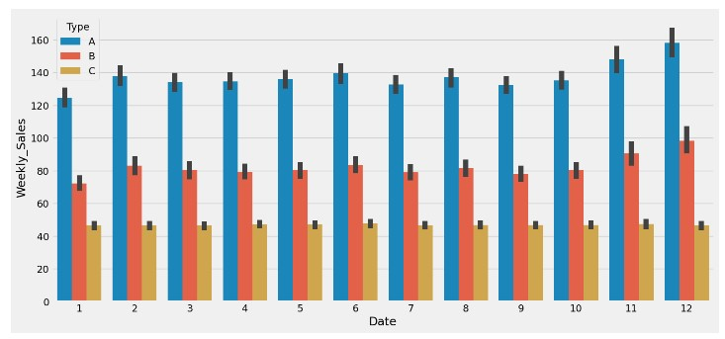
Descriptive Statistics for Sales Data Set
Countplot Swarmplot Boxplot
Store Count is in the order of A, B and least is C
Size wise A store as most no of Item followed by B and than C
Even After less Count of Store and lesser Size B has more Weekly Sales than A and C at the least.
Store Type A & B has shown slight decrease year on basis in sales.
Store C has shown a slight increase in sales.
Type A & B store show spike in Nov Dec mostly due to holiday whereas jan has shown decrease in sale.
Type C is consistent over every month and does not show much deviation.

Slide 8
4.DATA CLEANING AND DATA PREPARATION STEP
Reading the file in python
Importing libraries PANDAS AND NUMPY
To seek Data types , No of Data (rows and column),Null Data ,
few rows to understand the data
Checked Descriptive Statistics of the DATAFRAME
Generated EDA and got some insights
Replacing null values of CPI , Unemployment with there respective mean values same goes for mark down columns
Transformed date into 3 columns month , year, weeksofyear
Converted isholiday column into object and mapped it 0 and 1
Applied Iterativeimputer on Markdown Columns
To avoid multicollinearity remove dummy column from ["Type","Month","Year","WeekofYear"]
Splitted the data into Train and Test
Trained the Xtrain with various model
Evaluated with particular metrics
Got the optimum Model for the data set

Slide 9
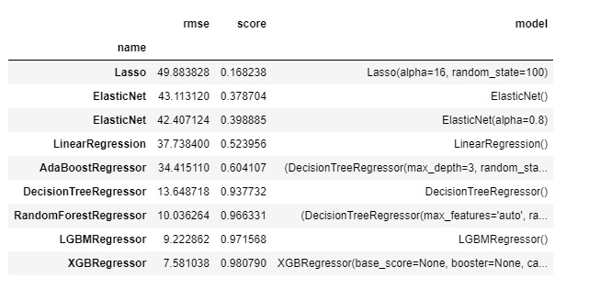
5.MODEL PERFORMANCE
XGB Regressor is the optimum model used for the given dataset
6.CONCLUSION
Optimum model used in the retail sale to increase weekly sales is XGB Regressor
Score for Optimum Model comes out to be 0.97
THANK YOU

