Slide 1

Google Play Store Rating Prediction
Group 5:
Sindhu Swaroop
Niraj Sai Prasad
Data Mining - IE 7275 (Spring 2023)
Prof. Xuemin

Slide 2
Problem Setting
Introduction:
Google Play Store, formerly known as the Android Market, has evolved significantly since its inception in 2008.
It offers over 3.5 million apps and a wide range of content, including books, movies, and games, making it the go-to digital distribution service for Android app developers and users.
Google Play has earned consumer trust through its robust security protocols.

Slide 3
Problem Setting
Marketing Apps on Google Play:
While Google Play provides easy app distribution for developers, marketing is crucial for increasing app reach and downloads.
Success of an app is not solely dependent on optimization, but also on user experience, ratings, and reviews.
Google Play has a star-based rating system with 5 stars being the highest, and ratings play a significant role in users' decision-making process.

Slide 4
Problem Setting
Ratings and reviews on Google Play are critical for users' decision-making process.
Users often make quick decisions based on the rating and the number of ratings an app has.
Positive ratings and reviews can significantly impact an app's visibility and attract more downloads.
User experience and ratings help potential consumers determine whether or not to install an app.
Importance of Ratings and Reviews:

Slide 5
Problem Definition
User ratings as an accurate representation of consumer impression on the application
Lower-rated applications' impact on search results, reach, and potential removal
Developer's aim to maximize app rating
Goal of the project: Predict overall app rating for gaining user confidence
Importance of higher-rated apps and apps with more ratings in search algorithm and user trust
Use of supervised machine learning, data mining, and visualization to gain insights into success factors for app installations and user ratings

Slide 6
Data Source
Kaggle
https://www.kaggle.com/code/taghredsalah199/google-playstore-regression-model/data
Type: CSV Format

Slide 7
Data Description
10,841 records, 13 columns
Columns are :
['App', 'Category', 'Rating’, 'Reviews’, 'Size', 'Installs’, 'Type', 'Price’, 'Content_Rating’,
'Genres', 'Last_Updated’, 'Current_Version’,
'Android_Version’]
Target Variable: Rating (1-5)

Slide 8
Data Cleaning and Mining Tasks
Removing nulls
Dropping duplicates
Data imputation and handling special texts
Converting columns to numeric/float as required
Removing special characters that to avoid confusion:
Replacing ‘$’ in price [‘$200’ to 200]
Replacing ‘M’ and ‘K’ in the app size and using appropriate multiplier [10M to 10000000]
Creating dummies for categorical variables
Finding correlation between columns

Slide 9
Dimensionality Reduction
Genres & Category : There are many unique categories (~10) and genres (>20). Making dummies and training the model with these features resulted in a very low difference of metrics. The training time was more, and cost was more. Hence, we did not use it as predictor
Features like 'Last_Updated’, 'Current_Version’ and 'Android_Version’ are not relevant to our analysis, hence we’ve removed these.
Type and Price convey the same information, hence we removed Type for our analysis.

Slide 10
Data Exploration and Visualization

Slide 11
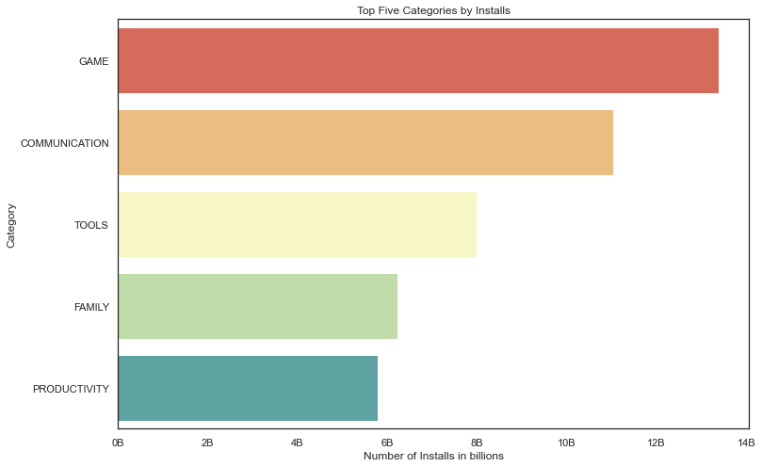
Top 5 app categories based on no. of installations

Slide 12
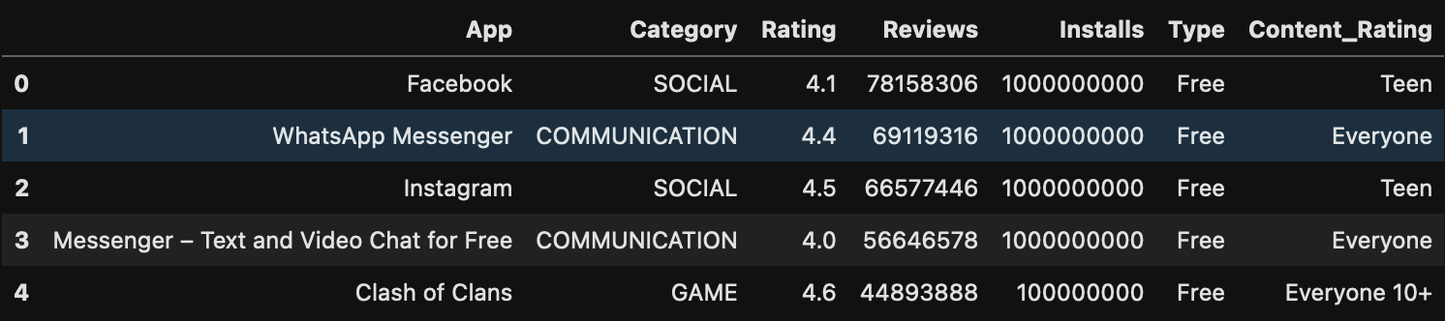
Top 5 Highest Rated Apps based on No. of Reviews

Slide 13
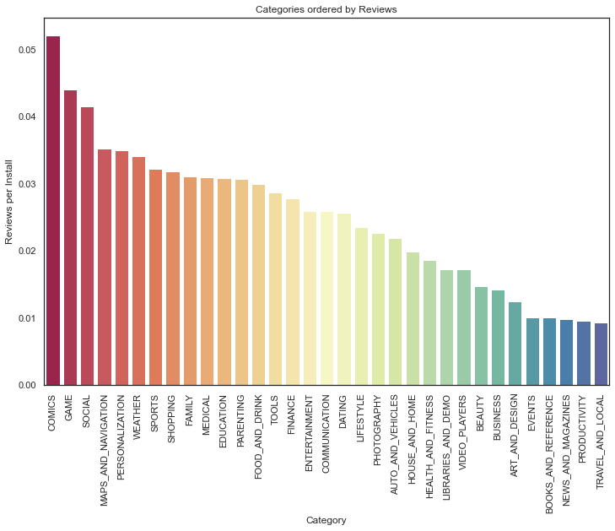
App Categories ordered by Number of Reviews

Slide 14
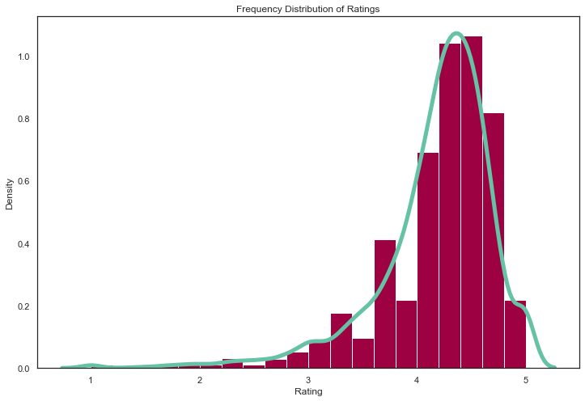
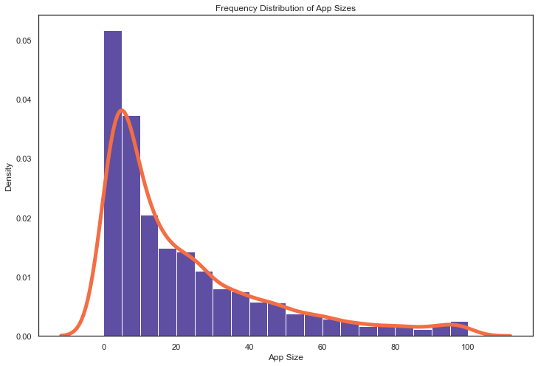
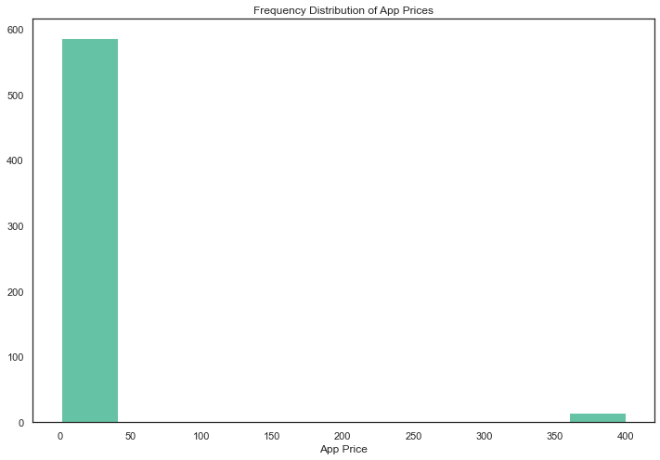
Frequency distribution of ratings, app sizes and app prices

Slide 15
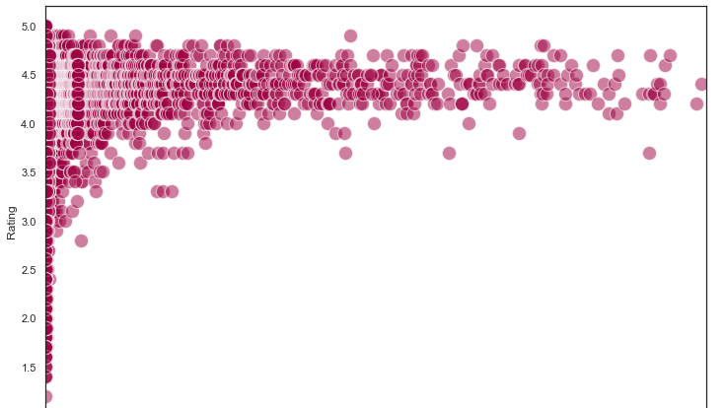
Ratings vs. Number of Reviews

Slide 16
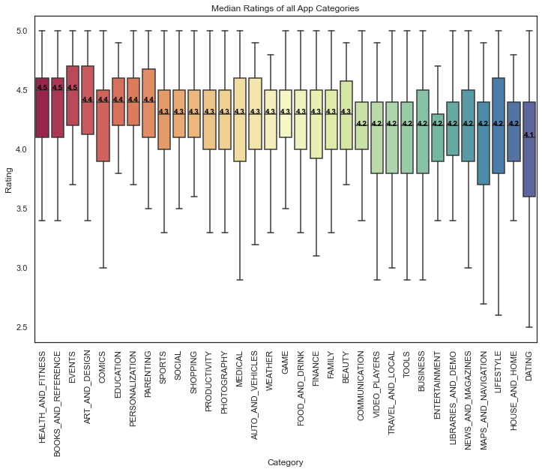
MEDIAN RATINGS OF ALL APP CATEGORIES

Slide 17
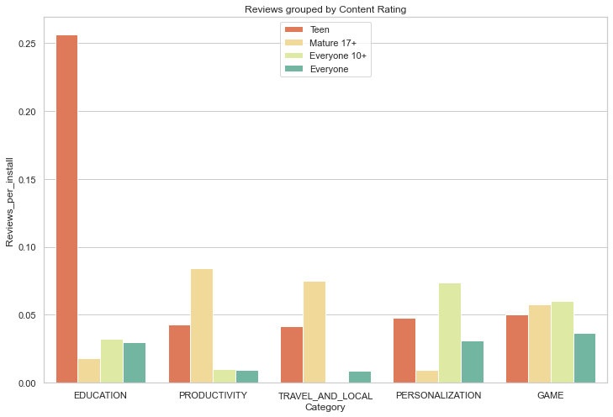
Top 5 Most Reviewed App Categories based on Content Rating

Slide 18
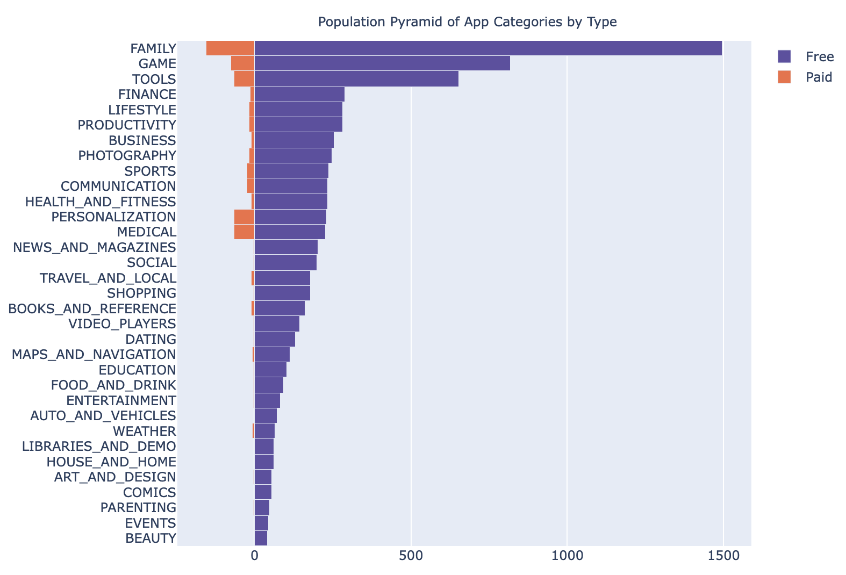
Population pyramid of App Categories by Type

Slide 19
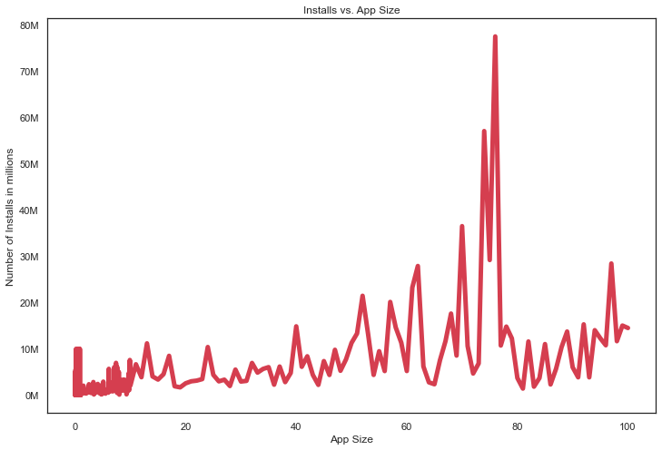
App Sizes vs. Installs

Slide 20
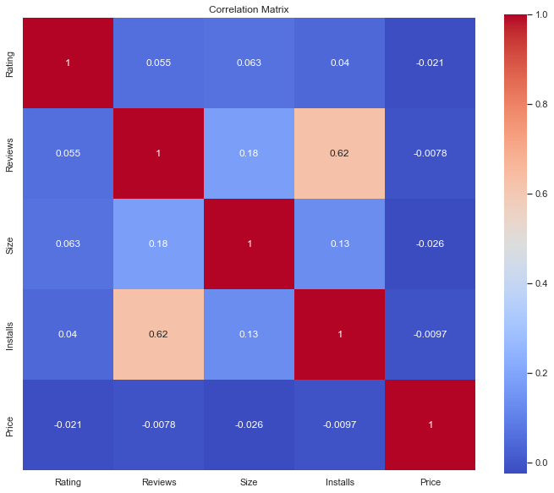
Correlation Matrix

Slide 21

Data Mining Models and Methods
Since this is a prediction problem, we have trained our data on the following models:
Baseline Linear Regression
KNN Regressor
SVM Regressor
Random Forest Regressor
Neural Nets MLP (Multi-layer Perceptron) Regressor

Slide 22
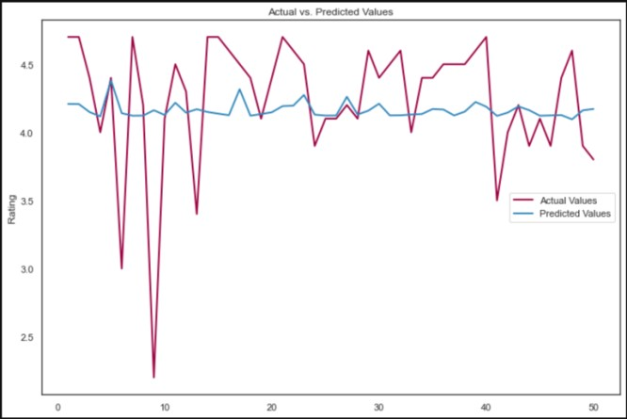
Linear Regression
Approach:
Parameters –
fit_intercept = True
normalize = False
copy_x = True
Results:
MSE – 0.28
RMSE – 0.53

Slide 23
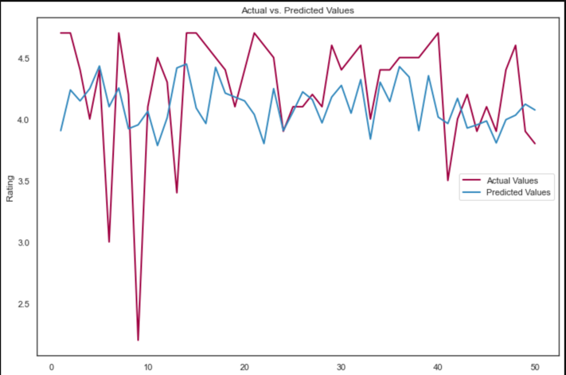
KNN Regressor
Approach:
Data Standardization Applied
Used GridSearchCV() to find best parametrs
No. of Neighbors: 19
Metric: Manhattan
Results:
MSE – 0.28
RMSE – 0.53

Slide 24
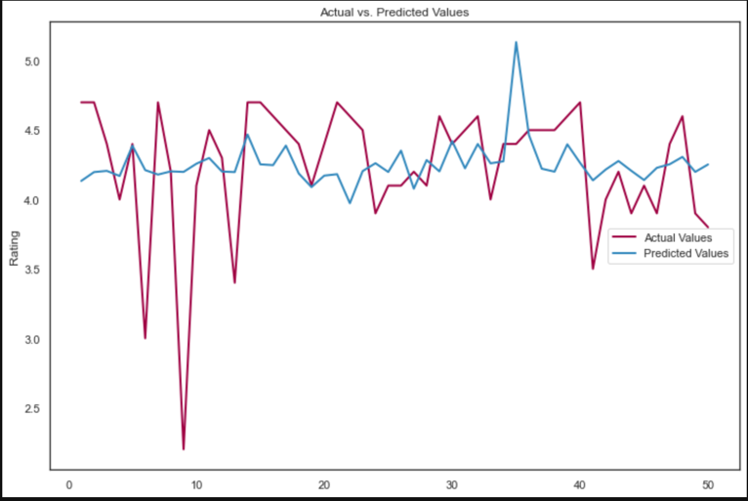
SVM Regressor
Approach:
Data Standardization Applied
Used GridSearchCV() to find best parametrs:
C = 10
gamma = 1
kernel = ‘rbf’
Results:
MSE – 0.28
RMSE – 0.53

Slide 25
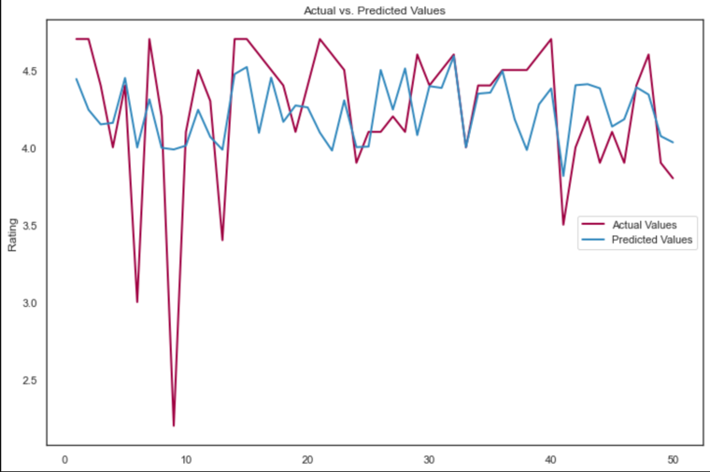
Random Forest Regressor
Approach:
Used GridSearchCV() to find best parametrs
n_estimators=44
max_features='auto’
max_depth=9
Random_state=300
Results:
MSE – 0.24
RMSE – 0.49

Slide 26

RF Model Accuracy Improvement
We performed gradient booster regression to try and improve the accuracy for RF, but the improvement was very slight in the order of ~ 10⁻⁴

Slide 27
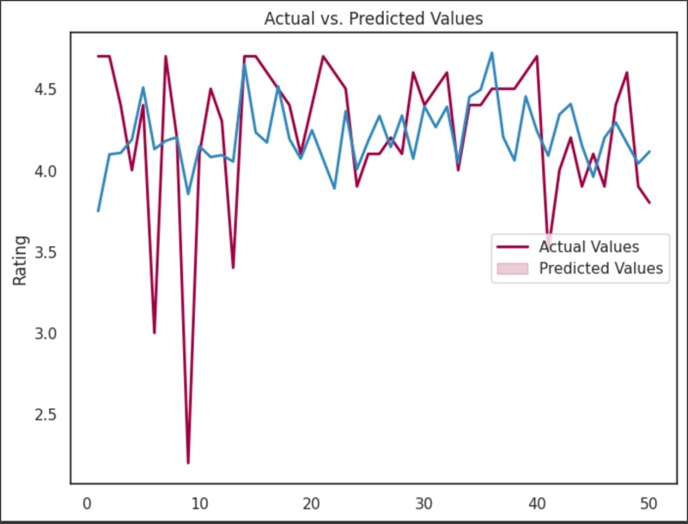
MLP Regressor (Neural Nets)
Approach:
Data Standardization Applied
Used GridSearchCV() to find best parametrs:
activation = tanh
hidden_layer_sizes = (50, 100, 50)
max_iter = 5000
n_iter_no_change = 200
Results:
MSE – 0.27
RMSE – 52

Slide 28
Performance Evaluation
Model | RMSE | MSE
Linear Regressor | 0.53 | 0.28
KNN Regressor | 0.53 | 0.28
SVM Regressor | 0.53 | 0.28
Random Forest Regressor | 0.49 | 0.24
Neural Networks MLP | 0.52 | 0.27

Slide 29
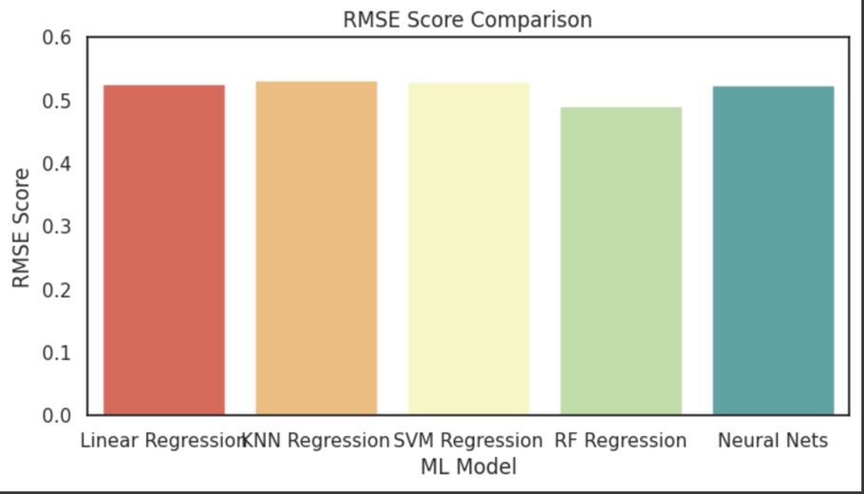
RMSE Score Comparison

Slide 30
Project Results
The objective of the project was to assess the rating of applications on the Google Play Store using various predictors such as Category, Price, Content Rating, etc.
Identifying the factors that influence app ratings is crucial for app developers to enhance incentives for highly rated apps and avoid penalties for low-rated apps.
This knowledge can help developers focus on improving user engagement and ratings, leading to better app performance in the market.
Among the models evaluated, the Random Forest Regressor exhibited the lowest RMSE (Root Mean Squared Error) compared to other models, indicating superior performance.
Therefore, the Random Forest Regressor is recommended as the ideal model for detecting the rating of applications on the Google Play Store.

Slide 31
Impact
App developers can utilize the findings of this project to optimize their app development strategies and improve the overall rating and performance of their apps on the Google Play Store.

Slide 32

THANK YOU!

