Slide 1
Workflow
DATA FACTORY

Slide 2
Data Source
Python Tweepy API Script
Fetches Data
Data Cleaning
Saves CSV and Json Files to Azure Blob Storage

Slide 3
Azure Data Factory
Step 1: Run Python Script
Azure Batch Account
Batch Pools and Nodes Pre-Installed with Python Libraries
Runs Script in Small VM Based on Node Availability
Azure Storage Container Blob Now has CSV Data

Slide 4
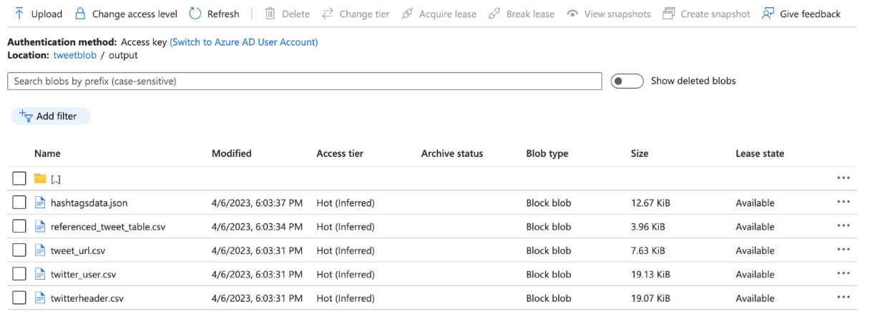

Slide 5
Azure Data Factory
Step 2: Data Refresh for All Tables
Fetch Source CSV File from Azure Blob Container
Run Stored Proc in Azure SQL Database to Archive and Clean Data in SQL/Cosmos
Push Data to Sink or Destination Tables
Cosmos and SQL Database Now has Refreshed Data

Slide 6
Azure Data Factory
Step 3: Data Cleaning
Fetch Source CSV File from Azure Blob Container
LOG ALL ACTIVITIES
Run Delete Scripts to Clean Up Source Blob Container
Storage Container Now Clean and Ready for Next Scheduled Run

Slide 7
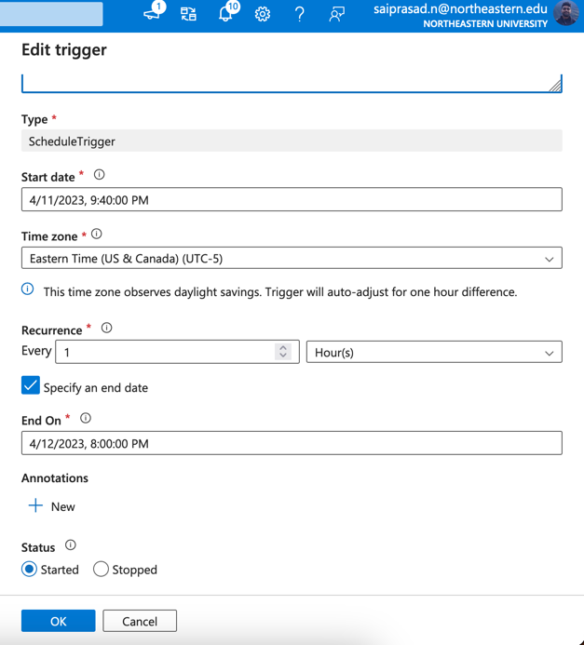
Azure Data Factory
Scheduling Pipeline Runs
Create Trigger
Schedule Trigger to Run Based on Intervals

Slide 8
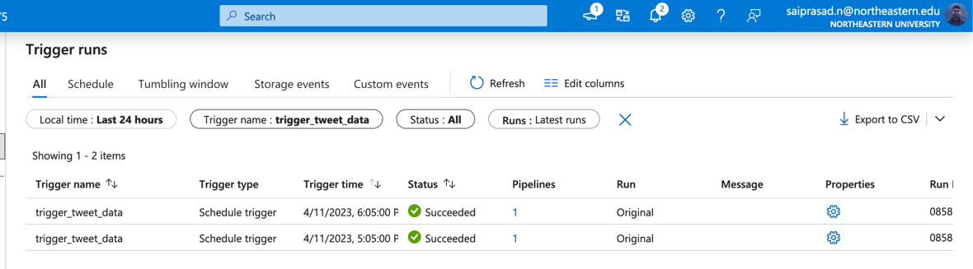
Azure Data Factory
Maintenance:
Monitor Trigger Runs
Monitor Pipeline Runs
Check Logs For Errors

Slide 9
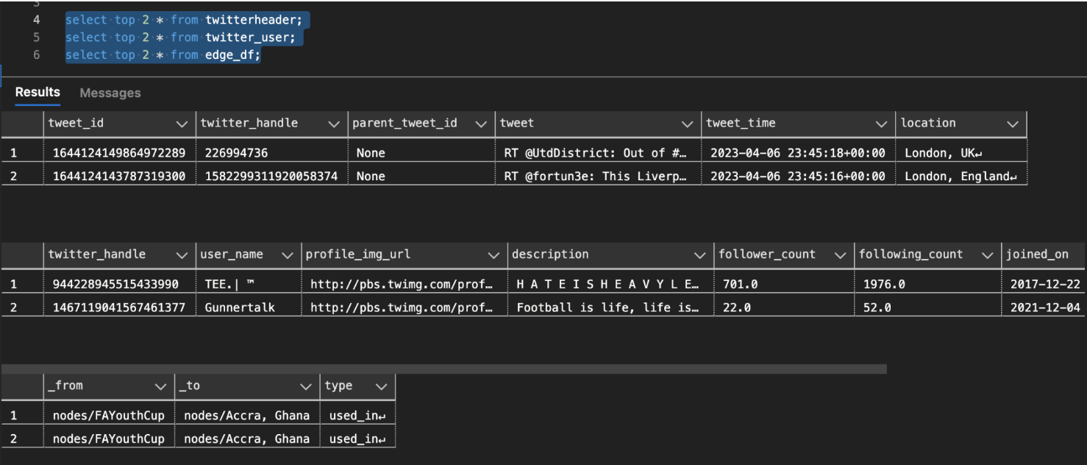
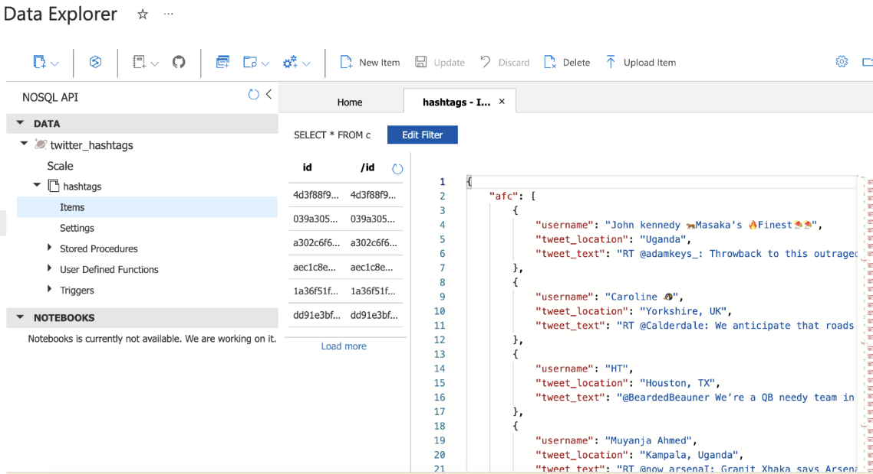
Data Destination
SQL Database:
Twitter Header
Twitter User
Twitter URL
Reference Tweet Table
Hashtag Nodes
Hashtag Edges
Cosmos Database:
Hashtags Data Json Items

Slide 10
PowerBI Visualization/ Analytics

