Slide 1

Soil Analysis and Crop Recommendations
Niraj Kumar
21/02/2026
AI/ML for Industry
Continuing Education Programme
Indian Institute of Technology Delhi

Slide 2
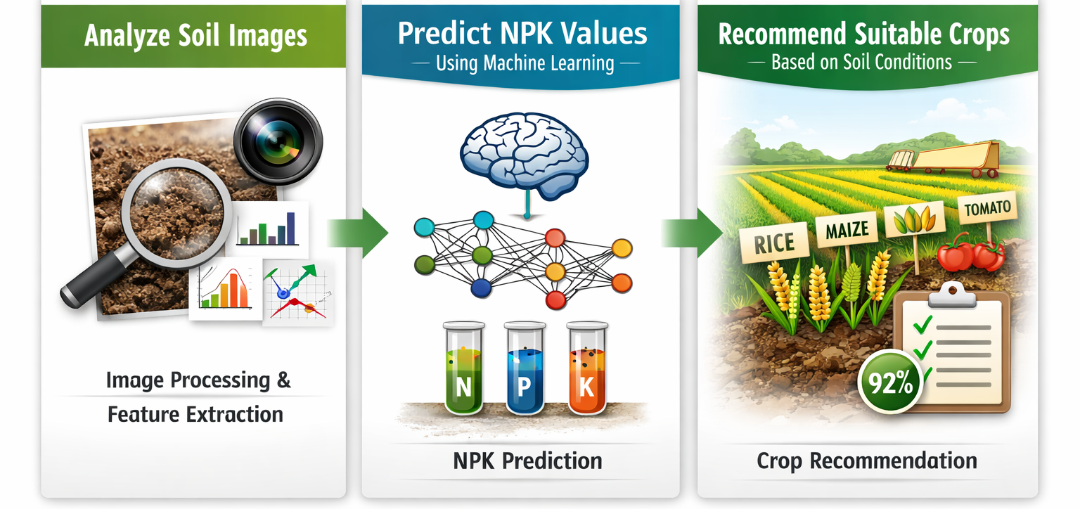
Background
Agriculture productivity depends heavily on soil nutrient content, especially Nitrogen, Phosphorus, and Potassium (NPK). Traditional soil testing methods are expensive and time-consuming. With advancements in AI, image processing and machine learning can be used to predict soil nutrient levels. Inspired by modern agricultural technologies used by organisations like ISRO and NASA, this project aims to analyse soil images, predict NPK values, and recommend suitable crops. A realistic synthetic dataset was created to train and test the prediction models.
Inspired by these technological advancements, this project aims to develop a smart system that can:
Analyse soil images
Predict NPK values using Machine Learning
Recommend suitable crops based on soil conditions
Return the human readable explanation using Deep Learning model
Due to limited availability of real-world agricultural soil datasets, a realistic synthetic (dummy) soil dataset was generated using standard agricultural nutrient ranges. The dataset was used to train predictive models capable of estimating soil nutrient levels from extracted image features.

Slide 3
Problem Statement
Agricultural decision-making depends on accurate soil nutrient analysis. However, laboratory-based soil testing is not scalable or accessible to all farmers. There is limited availability of real-time soil nutrient estimation tools. Therefore, a machine learning-based system capable of predicting NPK values from soil images and recommending suitable crops is required to enable precision agriculture.
Problem Statement
Soil testing is expensive and time-consuming
Many farmers lack access to lab facilities
Incorrect crop selection reduces yield
Overuse of fertilizers damages soil
Need for AI-based soil analysis and crop recommendation system
Why Did I Choose This Problem?
Agriculture is the backbone of India’s economy. Many farmers cannot afford frequent laboratory soil testing. By using image processing and machine learning, we aim to provide a faster and low-cost alternative solution.

Slide 4
Methodology, Datasets, and Tools used
The system first extracts color features from soil images. These features are scaled and reduced using PCA. A Random Forest model predicts NPK values. Based on these values and environmental factors, another ML model recommends suitable crops. Fertilizer suggestions are provided by comparing predicted nutrients with ideal crop requirements.
Tools & Technologies Used
Python
FastAPI (Backend API framework)
Scikit-learn (Machine Learning)
OpenCV (Image Processing)
Pandas & NumPy (Data Handling)
HTML, CSS, ReactJS (Frontend)
Datasets Used
Soil Dataset (soil_dataset.csv)
Crop Recommendation Dataset (Crop_recommendation.csv)
Fertilizer Dataset (fertilizer.csv)
Methodology Flow
Soil Image ↓ Feature Extraction (RGB + HSV) ↓ Scaling ↓ PCA ↓ NPK Prediction Model ↓ Crop Recommendation Model ↓ Fertilizer Suggestion
↓
DL transformer (Ollama Model with deepseak-llm)

Slide 5
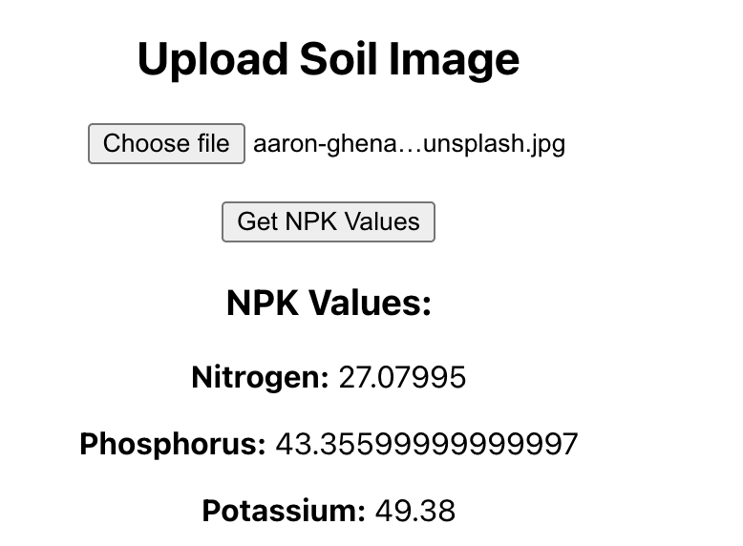
Results 1
NPK Prediction Results
Upload Sample soil image
Predicted NPK values

Slide 6
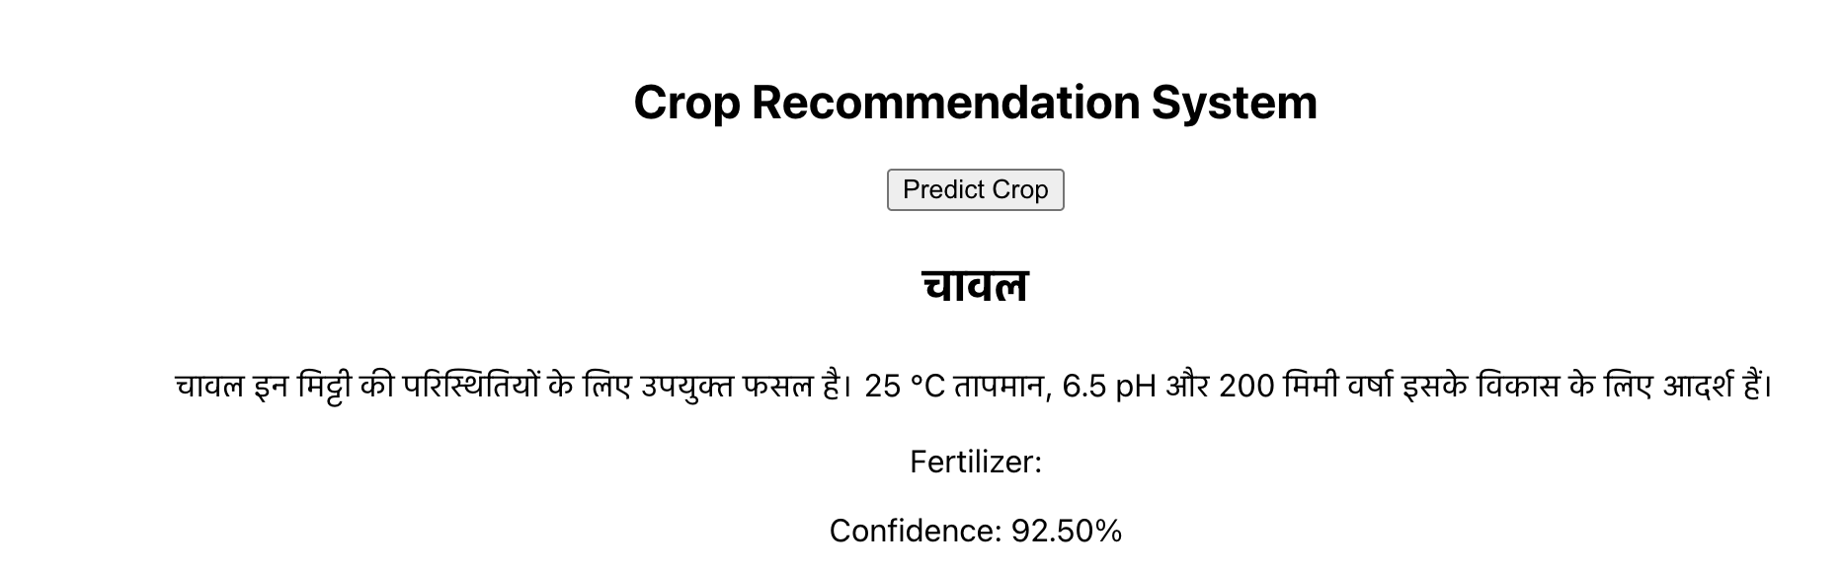
Results 2
Crop Recommendation Output
Example output:
Recommended Crop: Rice Confidence: 92.5%
Explain:
Based on predicted NPK
Based on soil pH
Based on temperature & rainfall
Fertilizer Recommendation
Example:
Nitrogen Deficient Recommended Fertilizer: Urea

Slide 7
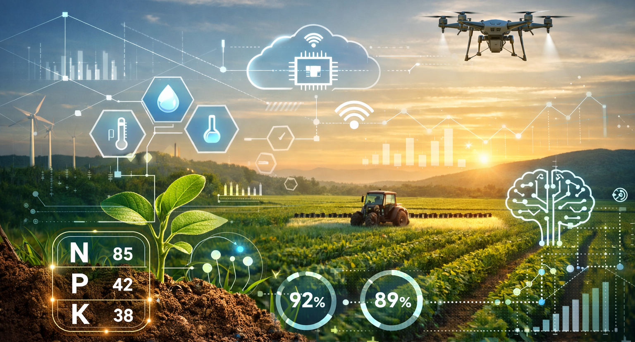
Conclusions
The proposed system successfully predicts soil nutrient values from images and recommends suitable crops using machine learning techniques. The integration of PCA, Random Forest models, and FastAPI ensures efficient and real-time prediction. The system demonstrates the potential of AI-driven precision agriculture solutions.
Caption

