Slide 1
Masked Emotion Detection
EE P 596 Computer Vision: Classic and Deep Methods
Niraj Suresh

Slide 2
Problem Statement
During the pandemic, people wear masks in public places
Being able to read facial expressions is fundamental to communication
Can a CNN be trained to recognize emotion from unmasked facial features?
Focused on categorizing as “happy” and “unhappy”

Slide 3
Dataset
Face expression recognition dataset, created by Kaggle-user Jonathan Oheix
~7000 images each of happy and unhappy (angry and sad)

Slide 4
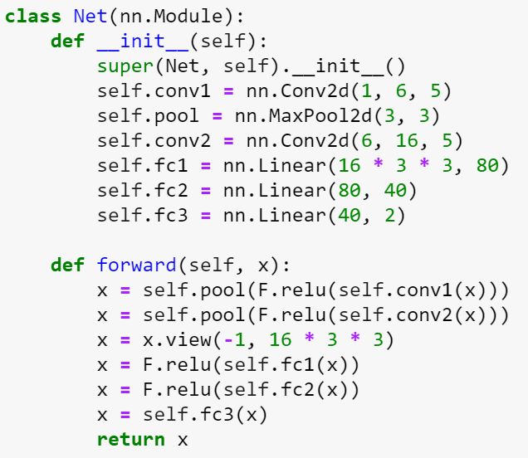
CNN Architecture

Slide 5

Baseline – Full Face Dataset
Batch size of 4, learning rate 0.001
Trained for 25 epochs
Achieved 88% training accuracy, 81% testing accuracy

Slide 6
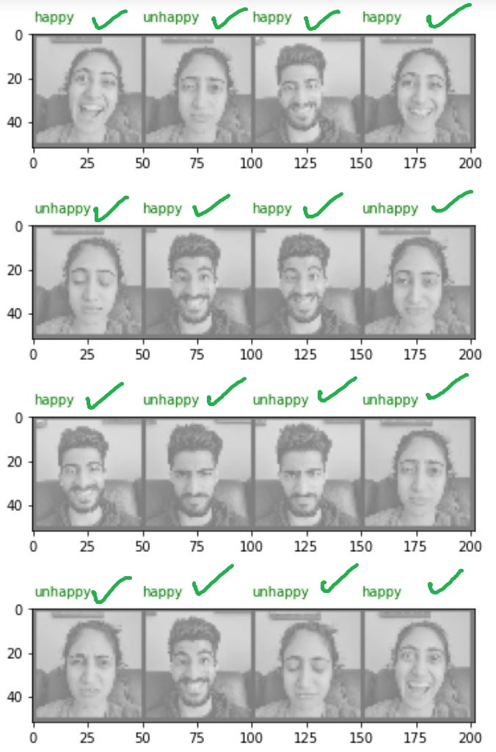
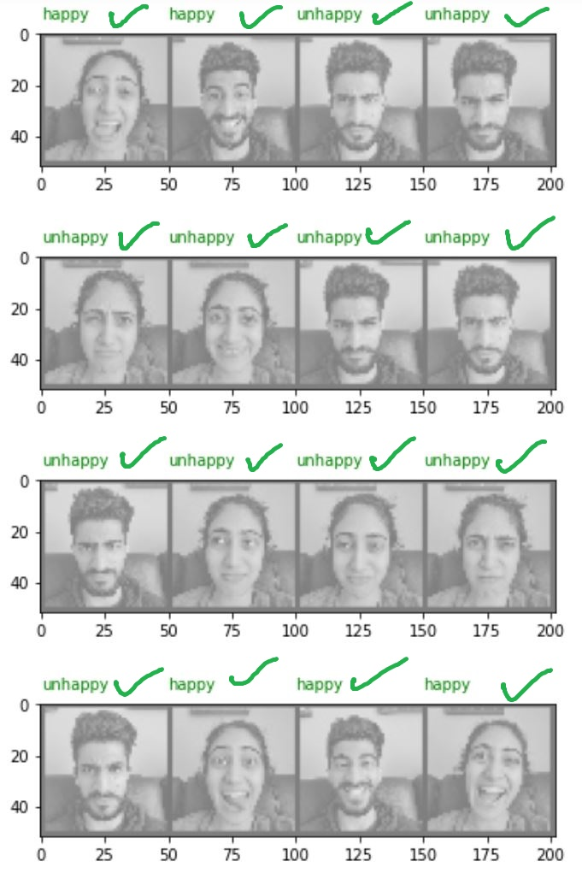
Full Face Model Test
Achieved 100% accuracy on real images (small sample size)

Slide 7

“Masking” Images
Modified dataset to mimic mask-wearing
Used face detection algorithm to identify tip of nose in each face
Zeroed out all pixels below this point

Slide 8

“Masked” Dataset
Dataset nearly halved (~3900 each)
Same CNN architecture, trained for 18 epochs
Proved to be optimal when applied to images of people wearing masks
Achieved 81% training accuracy and 74% testing accuracy

Slide 9
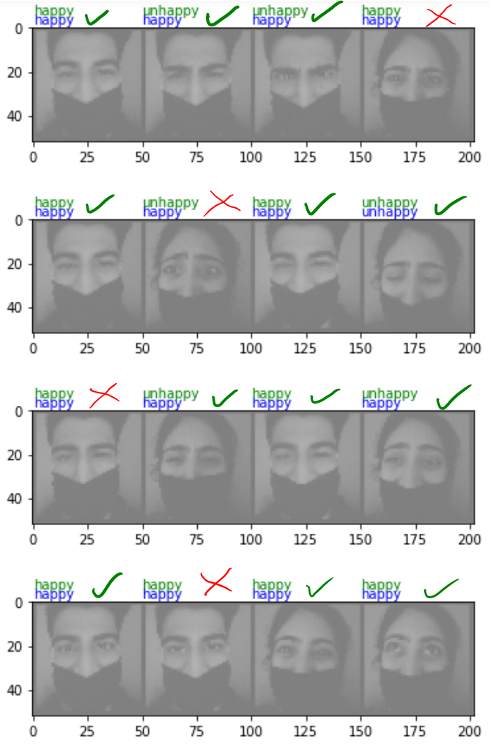
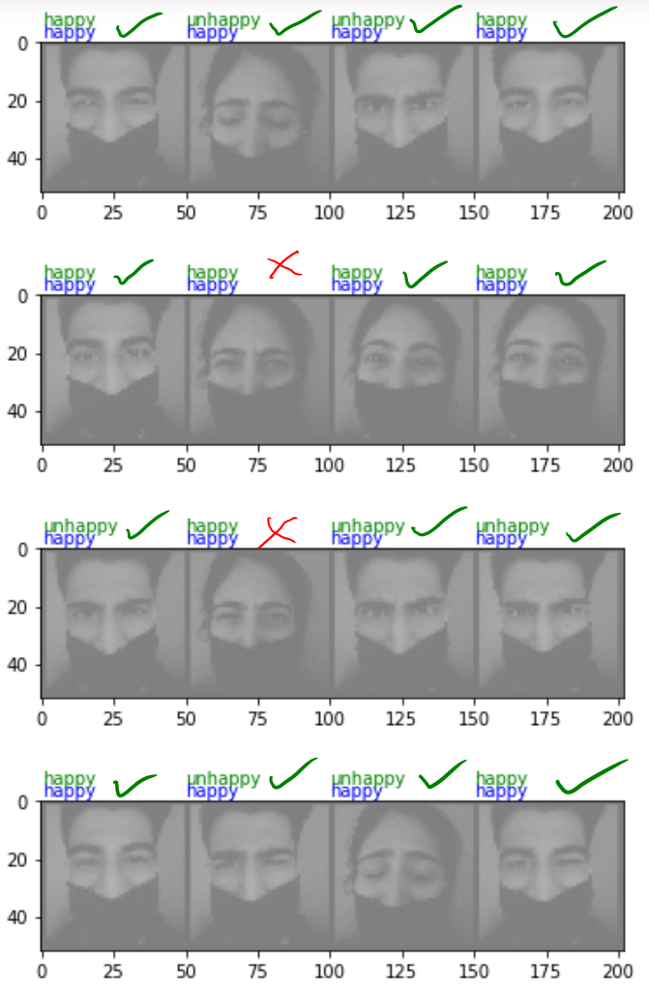
Mask Model Test
Achieved ~80% accuracy on real images (small sample size)

Slide 10
Potential Improvements
Better approach to identifying and zeroing mask area of face
Expand to identify other emotions
Dataset actually split into
Happy
Sad
Angry
Surprise
Disgust
Fear
Neutral

Slide 11
Questions?

