Slide 1


Final Year Project Work Final Defense
On
Chronic Kidney Disease Prediction Using Naive Bayes
Presented by
Binaya Khadka(20799/075)
Krijan Chakradhar(20805/075)
Niraj Uprety(20814/075)
B.Sc. CSIT VII (2075)
16th Baisakh 2080

Slide 2
Presentation Outline
About Project
System Analysis
System Design
System Implementation
Conclusions and Future Enhancement
Appendix

Slide 3
About Project
Project Introduction
The Chronic Kidney Disease Prediction system is a web-based tool that collects patient health data and uses data mining algorithms to make predictions about their kidney health.
Problem Statement
People with chronic diseases have a higher risk of health problems and unequal access to healthcare.
Lack of technology to monitor and track health care for these diseases makes it difficult and time-consuming.
Health measurements and records are often recorded on paper, which can lead to missing information.
Due to lack of early diagnosis people are facing major consequences.

Slide 4
About Project
Objectives
To focus on chronic kidney diseases by using Naive Bayes algorithms.
To Provide experimental results and analysis to measure accuracy of the system
Project Scope
Creating a web app for diagnosing chronic kidney disease with Naive Bayes algorithm
Utilizing machine learning and data mining for accurate predictions
Finding key attributes for early detection of chronic kidney disease

Slide 5
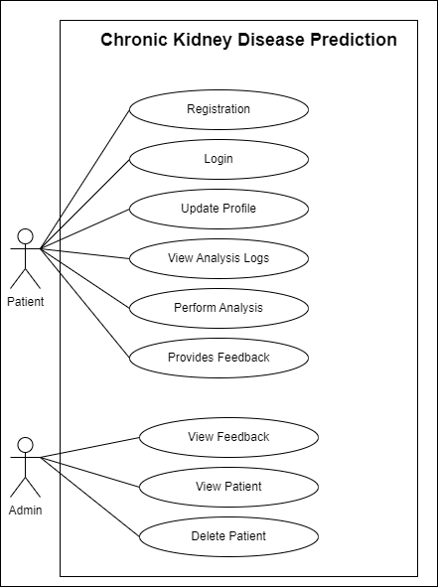
System Analysis
Functional Requirements (Use Case Diagram)
Data input
Prediction model
Data storage
User Interface
Accuracy
Privacy and security

Slide 6
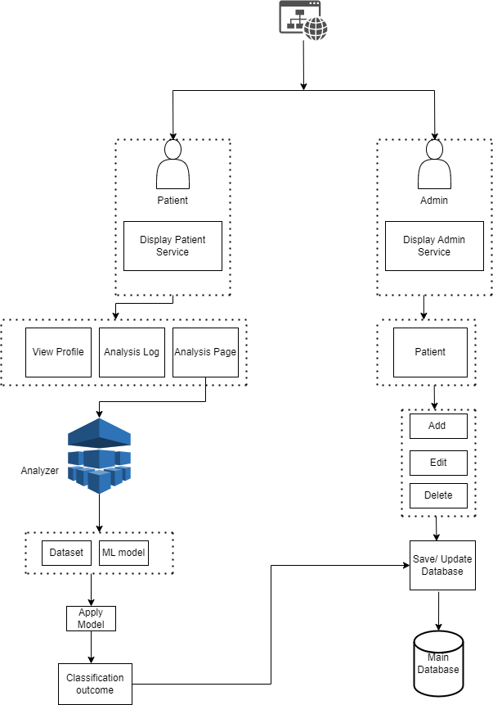
System Analysis
System Architecture

Slide 7
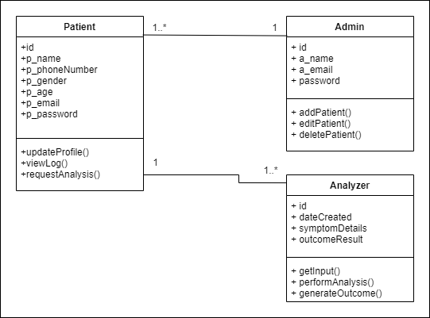
System Analysis
Class Diagram

Slide 8
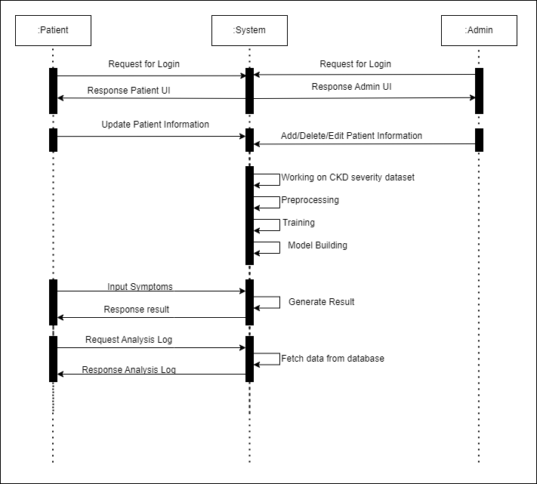
System Analysis
Sequence Diagram

Slide 9
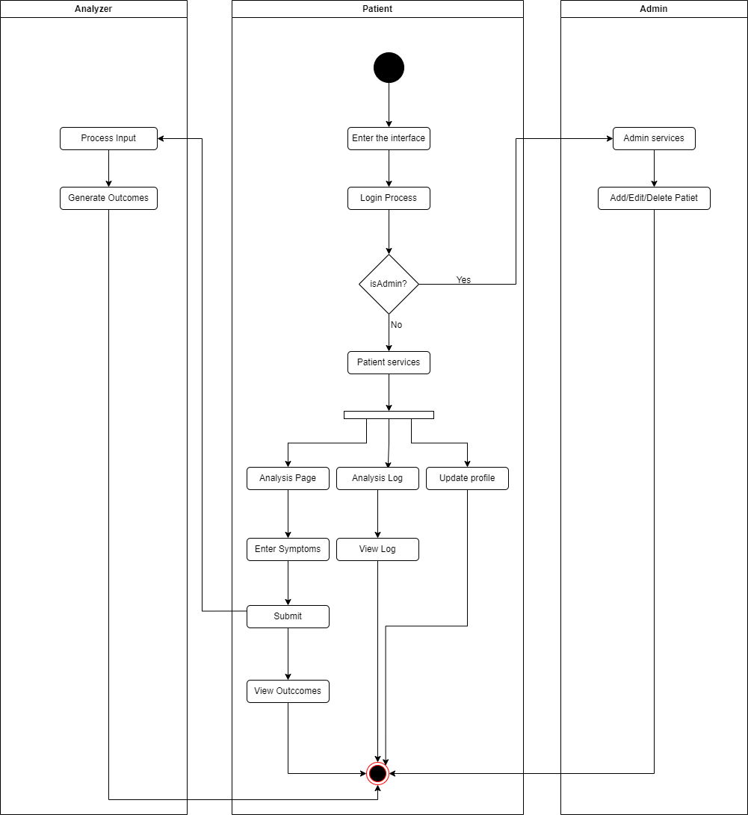
System Analysis
Activity Diagram

Slide 10
Algorithm
Implemented Naive Bayes classifier to predict CKD based on 24 input parameters. Achieved accurate classification and identified important parameters for prevention and treatment strategies
Bayes' theorem (alternatively Bayes' law or Bayes' rule), named after Thomas Bayes, describes the probability of an event, based on prior knowledge of conditions that might be related to the event.

Slide 11
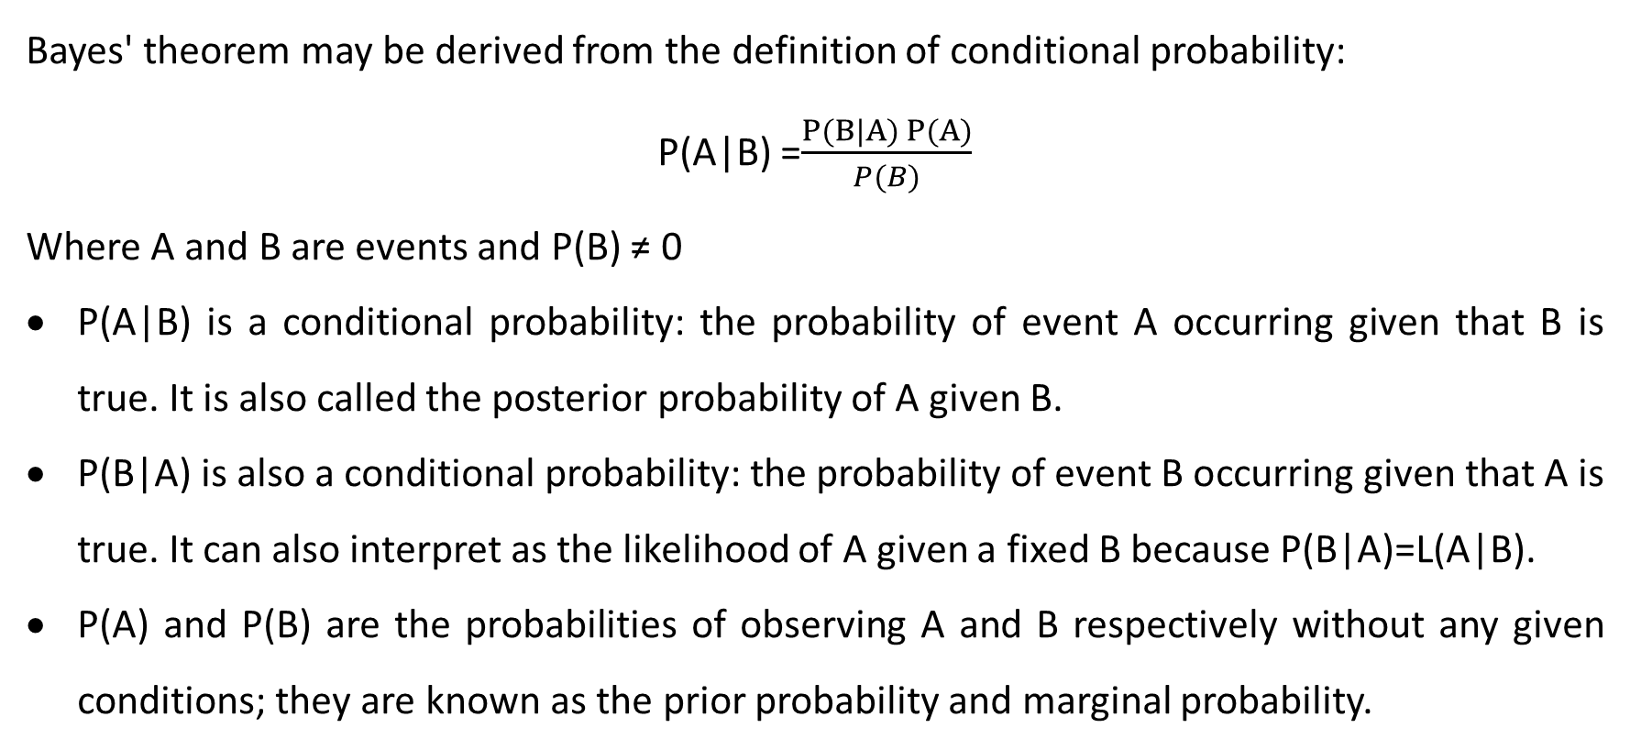
Algorithm
Bayes' theorem may be derived from the definition of conditional probability:
P(A|B) =$\frac{P(B|A) P(A)}{P(B)}$
Where A and B are events and P(B) ≠ 0
P(A|B) is a conditional probability: the probability of event A occurring given that B is true. It is also called the posterior probability of A given B.
P(B|A) is also a conditional probability: the probability of event B occurring given that A is true. It can also interpret as the likelihood of A given a fixed B because P(B|A)=L(A|B).
P(A) and P(B) are the probabilities of observing A and B respectively without any given conditions; they are known as the prior probability and marginal probability.

Slide 12
System Implementation
Tools used (Front end, Back end, Other resources etc)
Front end
HTML , CSS , Bootstrap, JavaScript
Back end
PHP, Laravel, MySQL, Python
Other Resources
Laptop, Electricity, Internet
Development Tools
Git, GitHub, Anaconda, Jupyter Notebook, VS code, Xammp, Browser, Ms Word, Ms Project, Ms PowerPoint

Slide 13
Testing
Testing (Unit Testing) with Test Cases and Test Results Tables
Registration

Slide 14
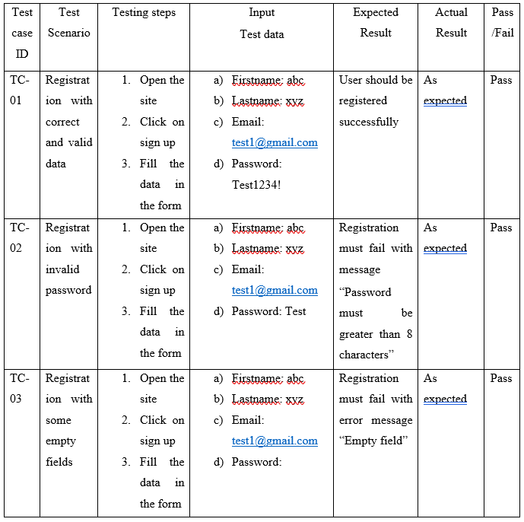

Slide 15
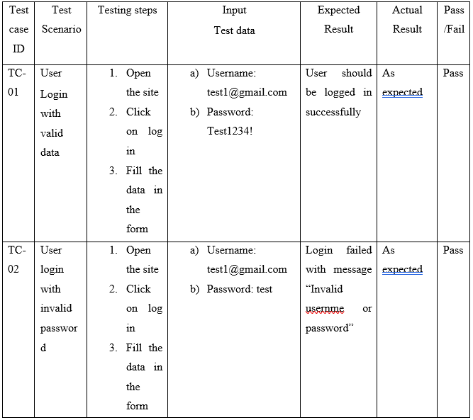

Slide 16
Testing
Testing (Integration Testing) with Test Cases and Test Results Tables

Slide 17
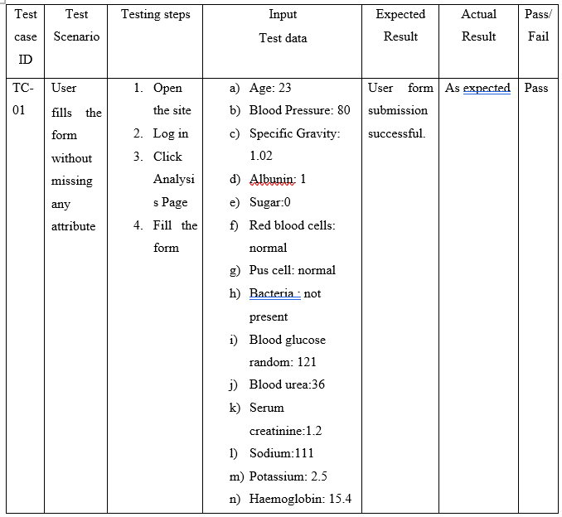

Slide 18
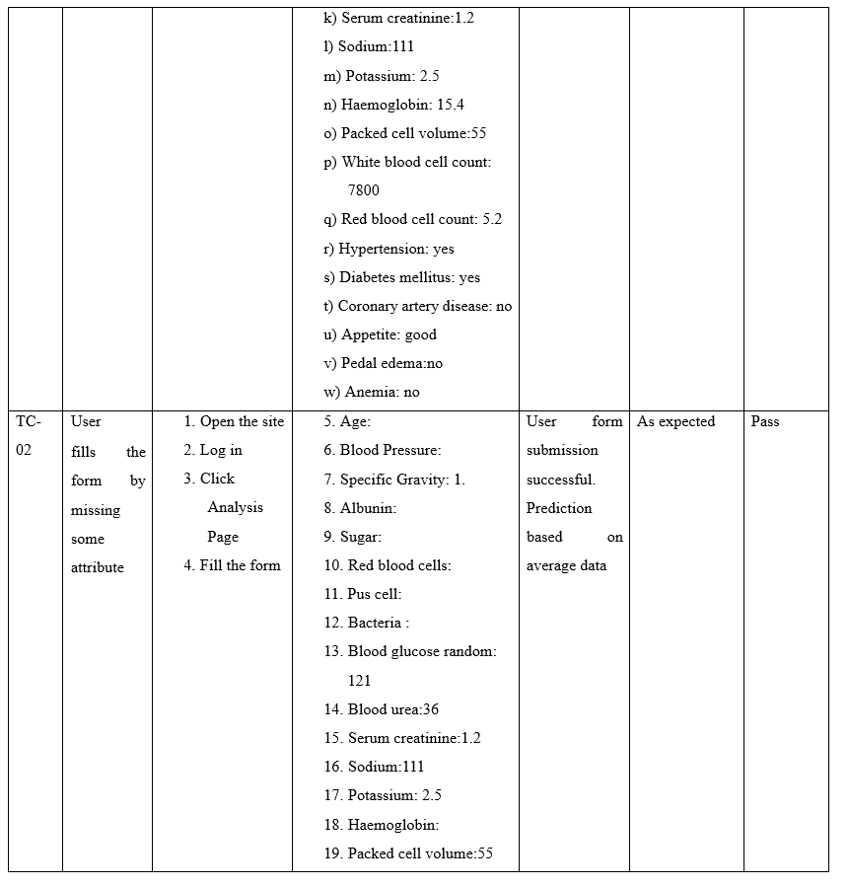

Slide 19


Slide 20
Testing
Testing (System Testing)
This CKD application underwent system testing to evaluate its overall functionality. This testing was done to ensure that the system worked as intended and met user requirements. All units of the application were integrated and tested to ensure proper input processing and accurate output. Usability, security, and performance were also tested. After several rounds of testing, the application passed the system test, indicating that it was ready for deployment.

Slide 21
Conclusion and Future Enhancement
Final Results/Outcomes
This CKD application has produced excellent results with high accuracy of around 91%. The user testing feedback has indicated that the application is very user-friendly, with easy-to-use interfaces and helpful features like real-time feedback and data visualization. As a result, this application can help patients and healthcare providers to manage CKD effectively, leading to better health outcomes and improved quality of life.
Limitations
The accuracy of the predictions may be limited by the quality and quantity of the data used
The algorithm may not take into account all relevant factors that can impact the disease
The application may not be accessible or usable for patients with limited internet access or technical skills.

Slide 22
Conclusion and Future Enhancement
Limitation
The application is based on statistical data and may not reflect the individual characteristics and conditions of each patient.
Future Enhancement
Assign a doctor to each patient based on their symptoms and results for personalized medical attention and treatment
Provide notes to patients based on their symptoms and results for better understanding and self-care management
Introduce an online video conference feature to connect patients with their doctors for remote medical advice and treatment
Use online video conferences to monitor patient progress and adjust treatment plans
Incorporate these innovative features into healthcare systems to improve access to care and patient outcomes.

Slide 23
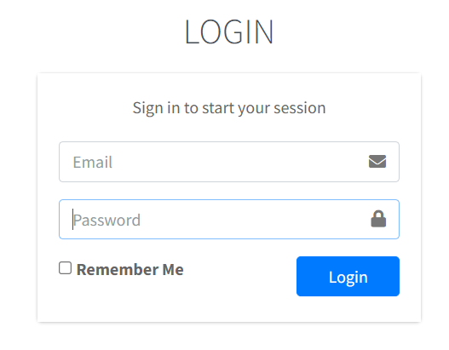
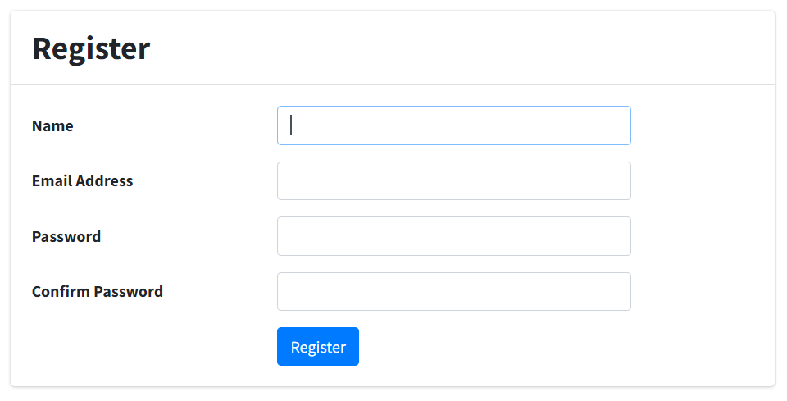
Appendix

Slide 24
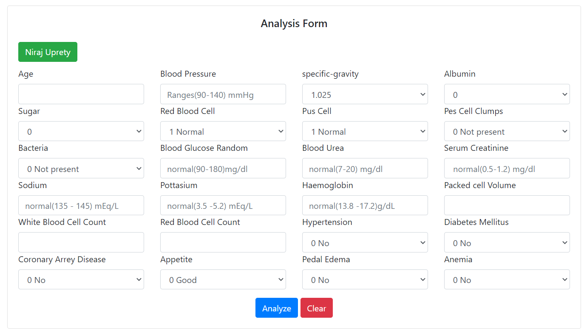
Appendix

Slide 25
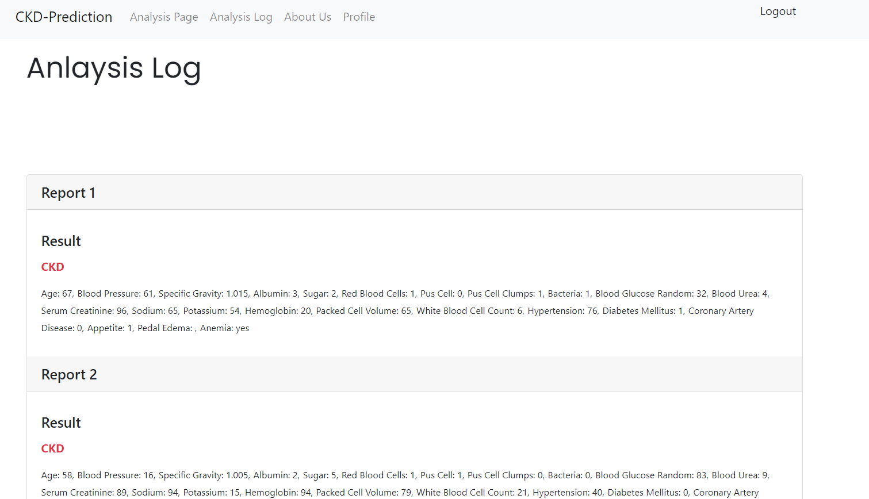
Appendix

Slide 26
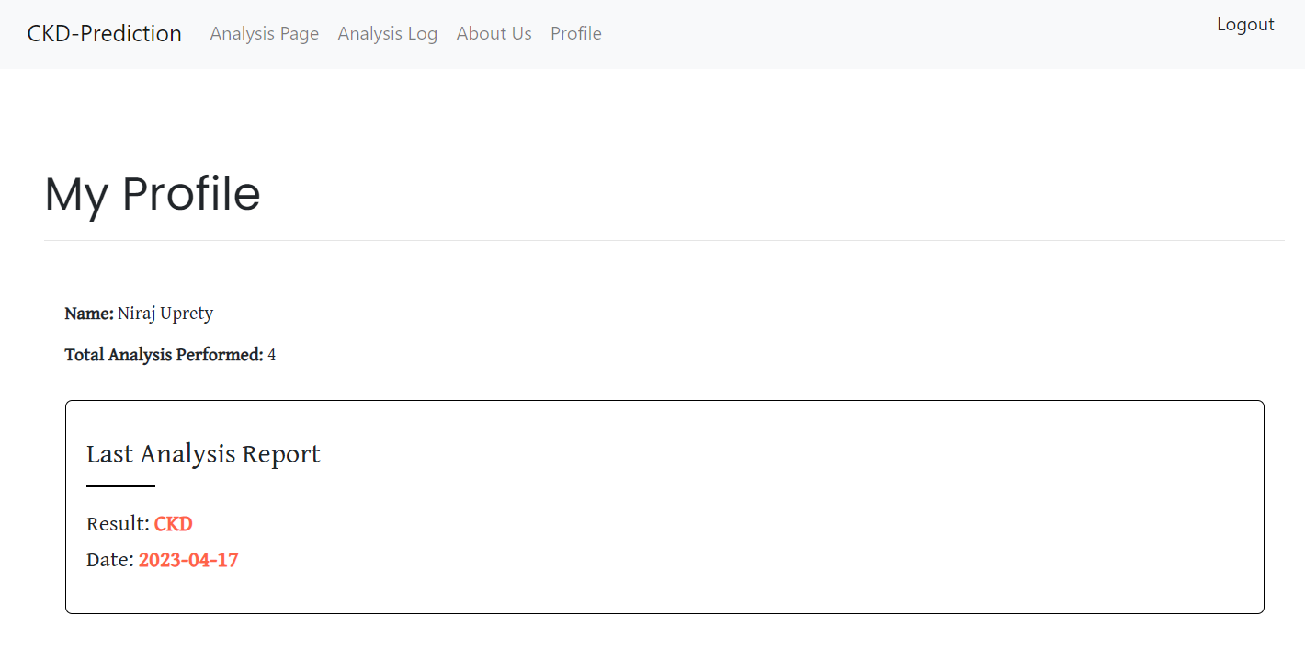
Appendix

Slide 27
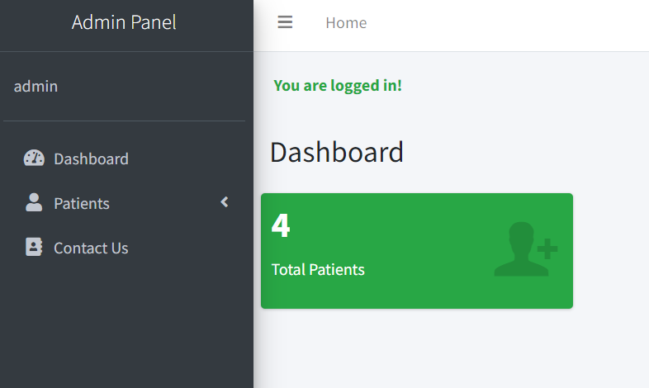
Appendix

Slide 28
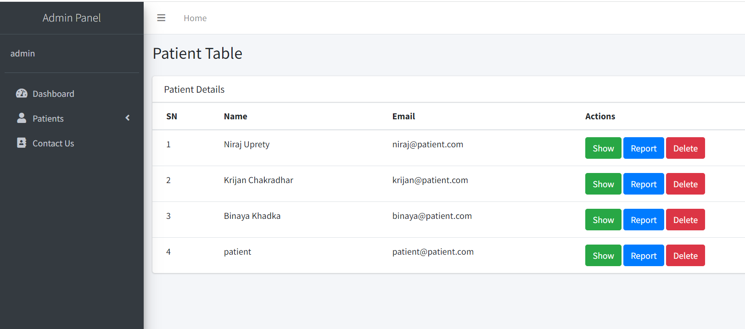
Appendix

Slide 29
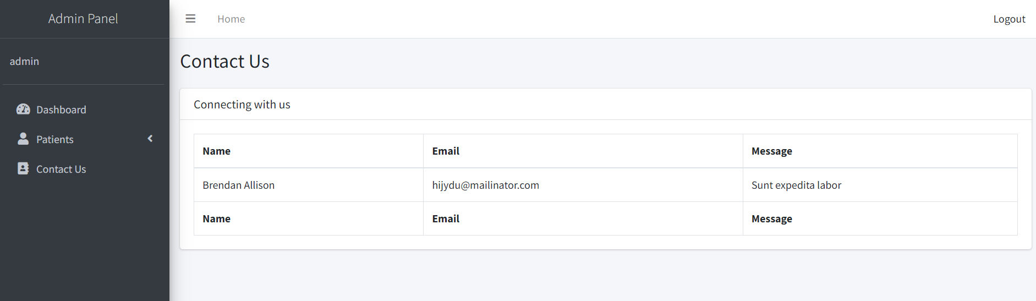
Appendix

Slide 30
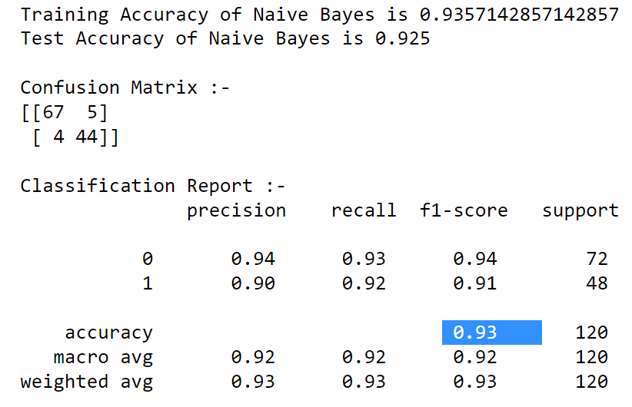
Appendix

Slide 31
Reference
[1] A. O. a. Q.-G. Wang, "XGBoost Model for Chronic Kidney Disease Diagnosis," [Online].
[2] T. F. T. N. W. C. S. S. N. N. Anusorn Charleonnan, "Predictive Analytics for Chronic Kidney Disease Using Machine Learning Techniques," [Online].
[3] a. T. T. Anandanadarajah Nishanth, "Identifying important attributes for early detection of Chronic Kidney Disease," [Online].
[4] S. V. A. V. S. Devika R, "Comparative Study of Classifier for Chronic Kidney Disease prediction using Naive Bayes, KNN and Random Fores," [Online].
[5] K. C. A. S. S. A. B. Veenita Kunwar, "CHRONIC KIDNEY DISEASE ANALYSIS USING DATA MINING CLASSIFICATION TECHNIQUES," [Online].
[6] A. S. Guneet Kaur, "Predict Chronic Kidney Disease Using Data Mining Algorithms In Hadoop," [Online].

Slide 32
Thank You !!!

