Slide 1
DB Project - IMDb
- Aadesh Randeria
Chetana Vyas
Nirali Merchant

Slide 2
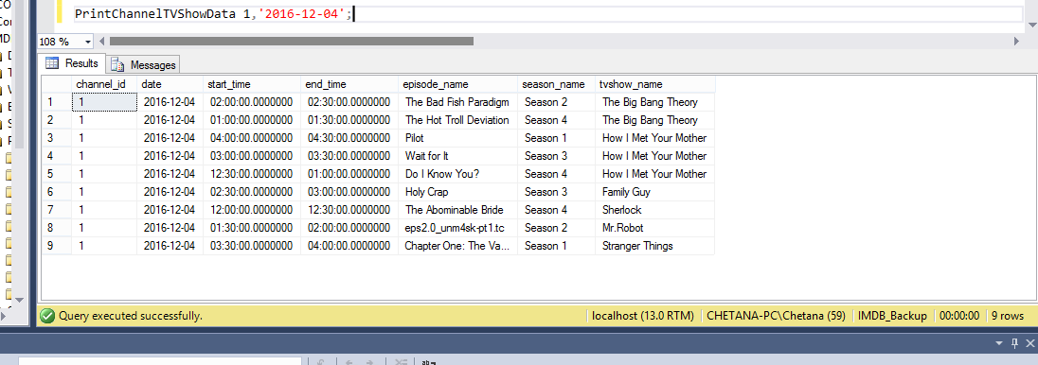
Displaying TV series telecasted on a particular channel
Tv show details for a channel – episode name, season no, tv show name telecasted on a particular channel on particular date

Slide 3
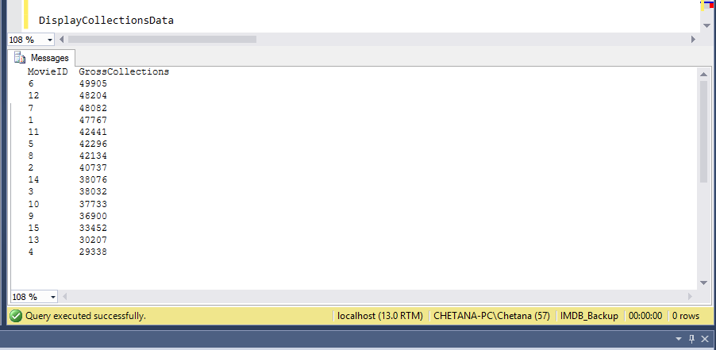
Procedure to displaying collections data as per movie

Slide 4
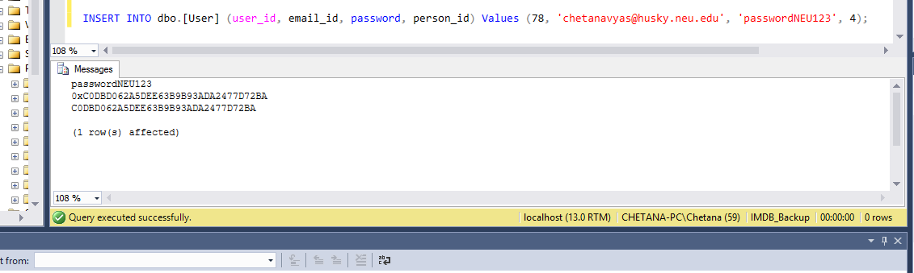
Trigger: User Login - ConvertHashPassword

Slide 5
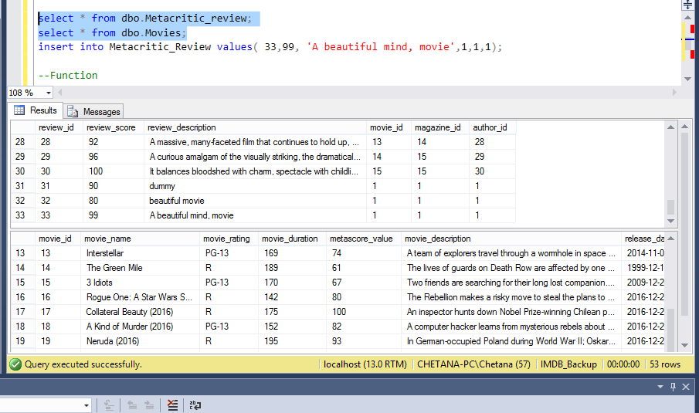
Before metacritic review score

Slide 6
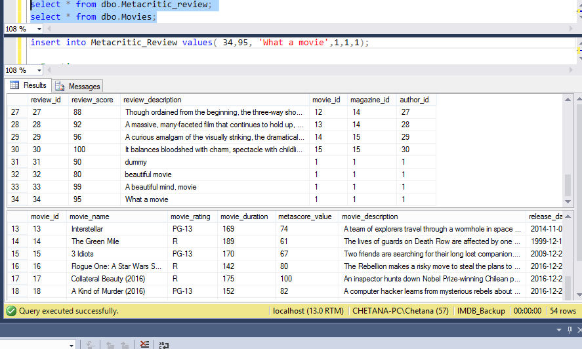
After metacritic review score update

Slide 7
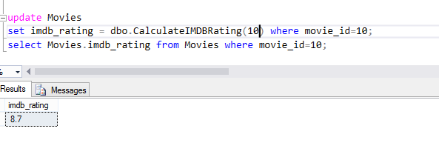
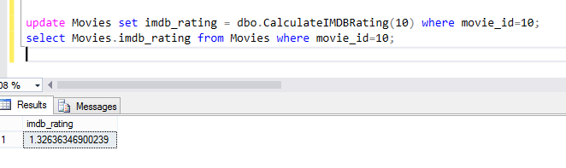
Calculate imdb rating

Slide 8
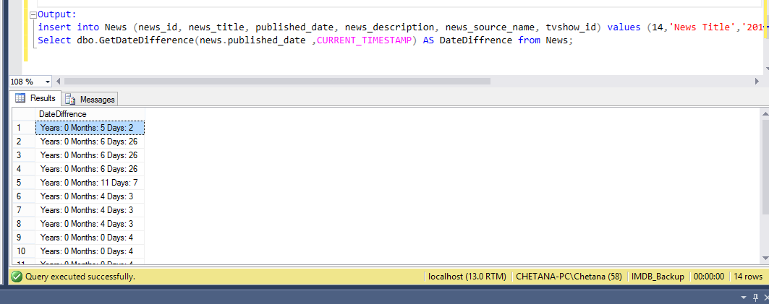
To determine how old a published news is

Slide 9
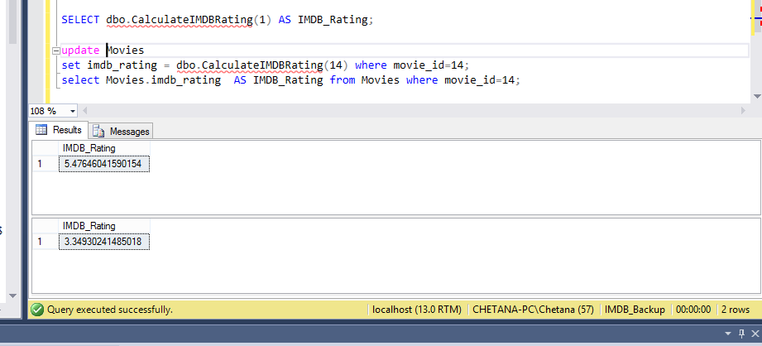
Function - IMDb rating calculation

Slide 10
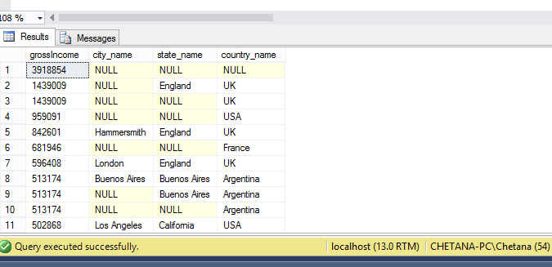
Queries - Location hierarchy collection analysis based on entertainment, revenue generated

Slide 11
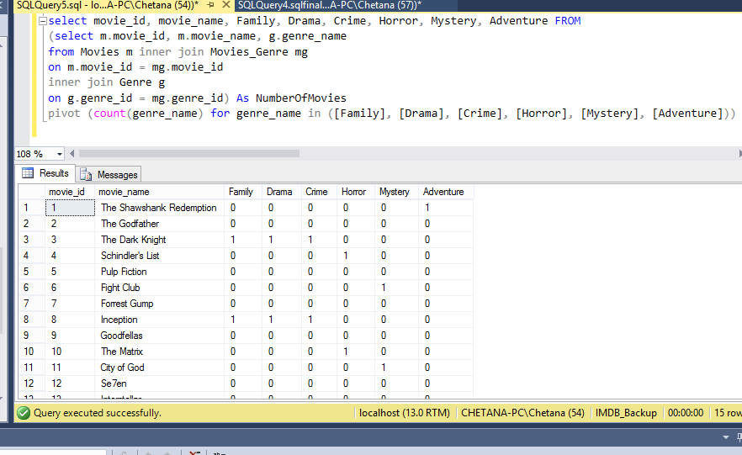
Analysing a movie’s genre type

Slide 12
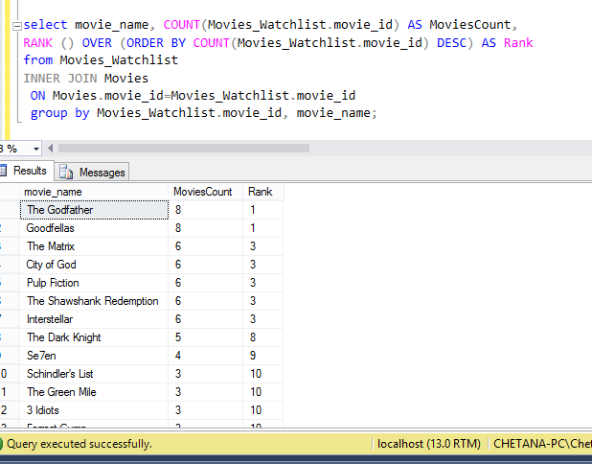
Query – To determine most preferred movie

Slide 13
Thank you

